Slide 1


Quantitative Analytical Model of the Formation Damage by Gel Particles
By
Dr. MAHMOUD ELSHARAFI
McCoy School of Engineering,
Midwestern State University, Wichita Falls, Texas
5th World Congress on
Petrochemistry and Chemical Engineering
December 05-07, 2016 Phoenix, Arizona, USA

Slide 2
Outlines
Introduction
Filtration Test Model
Quantitative Analytical Model
Conclusions
Acknowledgments
Notes:
Gel Treatment
Types of Gels
Previous work
Preformed Particle Gels (PPGs)
Problem Statement
Research Scope
Experimental Materials
Filtration Test Model
Load Pressure Model
Quantitative Analytical Model
Load Pressure Model
Back Pressure Model
PPG Compressibility

Slide 3
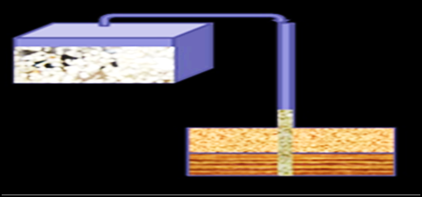
Introduction
Excess water production
Reservoir heterogeneity
Effect of Preformed
Particle Gels (PPGs)
Notes:
has become a major problem of oilfield operations as reservoirs mature (Bai, 2008, Seright, 2003).
is the single most important reason for both low oil recovery and early excess water production.
This research studied the effect of preformed particle gels (PPGs) on unswept, low-permeable zones/areas during conformance control treatments.

Slide 4
Gel Treatment
  Gel treatments are:
    A proven cost-effective method to improve sweep efficiency and reduce excess water production
    important methods to correct the reservoir heterogeneity
Notes:
(Seright & Liang, 1994; Liang et al. 1992).
in field applications to both
(Seright et al., 1994, 2003)
Used to improve oil recovery and suppress water production

Slide 5
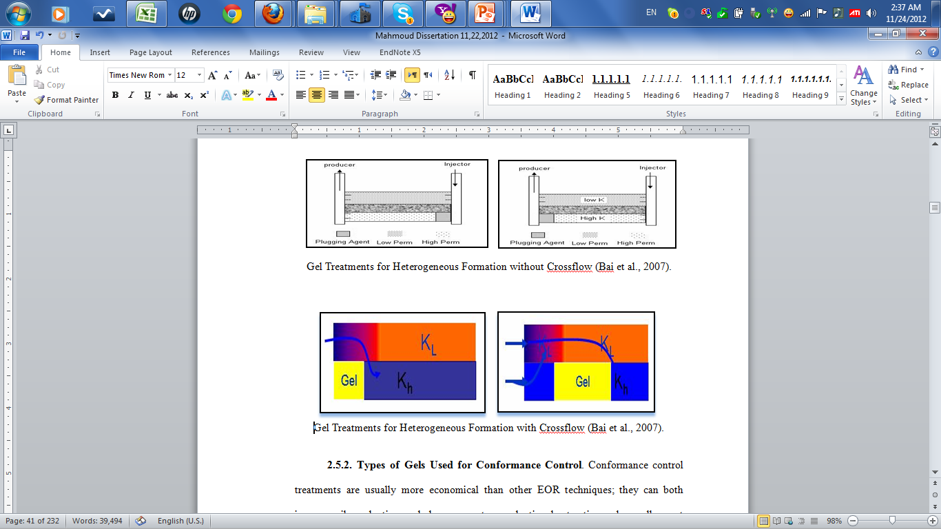
Gel Treatment to Block/Reduce Water Flow through High Permeability Zones/Streaks

Slide 6
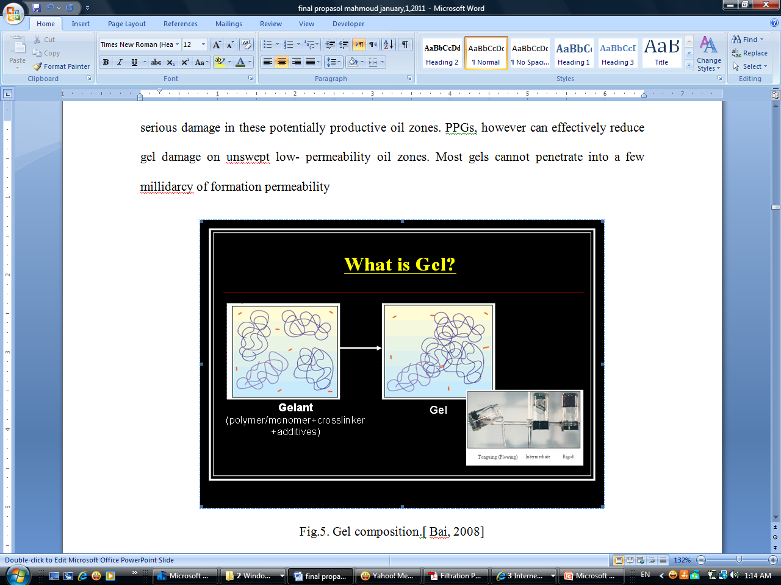
Types of Gels
1- In-Situ Gel:
  In-situ gels are crosslinked polymers.
  The liquid formulation of in-situ gel composition is called a gelant.
  The gelant is injected into the formation, and the gel forms under reservoir conditions.
  Gel strength can be controlled by gelant composition and surrounding conditions.
Gel composition (Sydansk, 2000)
Notes:
composed of several chemical materials including polymer, crosslinker.
In an in-situ system,
Under conditions such as either increasing temperature or changing pH, the gelant can crosslink to form a gel.
it can be weak, like a flowing gel, or very rigid, like rubber.

Slide 7
Types of Gels
2- Preformed Gels :
Various Gels Used in the Oil Industry
Preformed Gel | Related Studies
Performed Particle Gels ,PPG | Coste, 2000; Bai, 2004, 2007, and 2008.
Microgels | Chauveteau, 2000 & 2001; Rousseau, 2005; Zaitoun, 2007.
pH-sensitive Crosslinked Polymers | Al-Anazi, 2002; Huh, 2005; Beson, 2007; Choi & Shrman, 2009.
Bright Water^{R} | Pritchett, 2003; Frampton, 2004 Roussennac & Toschi 2010; Ghaddab 2010; Mustoni 2012.

Slide 8
Preformed Particle Gels (PPGs)
  PPGs are a dried crosslinked polyacrylamide powder.
  The gel forms in surface facilities before injecting into reservoirs.
  PPG particle size is adjustable from a scale of micrometers to millimeters.
  Particles have a swelling ratio of 10-200 times the original volume.
  PPGs are resistant to temperature up to 110 ºc.
  PPGs can overcome some drawbacks of in-situ gelation systems.
Notes:
In PPG systems,
no gelation occurs in the reservoir.
and they remain stable for more than a year below 110 ºc.
such as lack of gelation time control, uncertainness of gelling due to shear degradation, change of gelant compositions, and dilution by formation water.

Slide 9
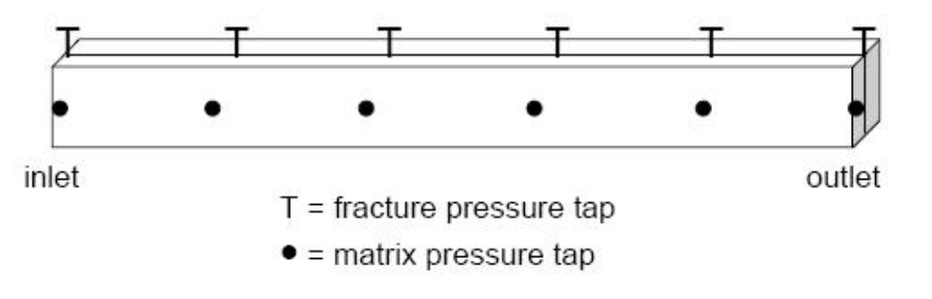
Previous work
1- Seright et al. (1999) studied the propagation of gel through open fractures.
  They used Berea sandstone core, fractured along the length of the core.
  Various gauges to measure pressures along the fracture.
  Their results can be used to identify the best gels for various fractures widths.
Schematic of a Fractured Core (Seright et al., 1999)

Slide 10
Previous work
2- Al-Anazi et al. ( 2002) studied pH-sensitive polymers solution propagation through Berea cores .
  The solution was easy to penetrate through a long 6 inch cores.
  The pH-sensitive polymer reduce the permeability of the cores.
3- Frampton et al. (2004) found Bright Water^{R} could be injected to packs or cores with permeability between 124 to 3400 mD and it has ability to reduce their permeability.
4- Rousseau et al. (2005) study the microgels stability while the propagation through the pores media.
Notes:
They used silicon carbide (SiC) particles packed porous models and sandstone cores to evaluate the in-depth propagation and adsorption of their microgels.

Slide 11
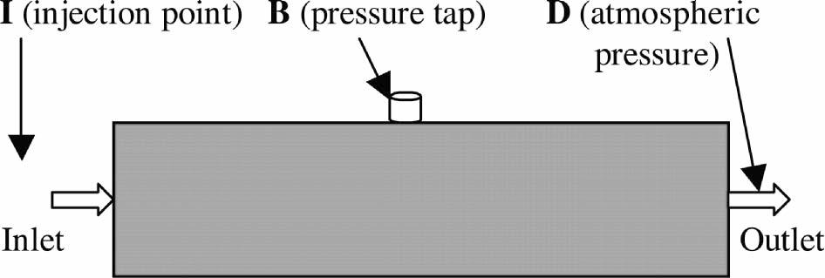
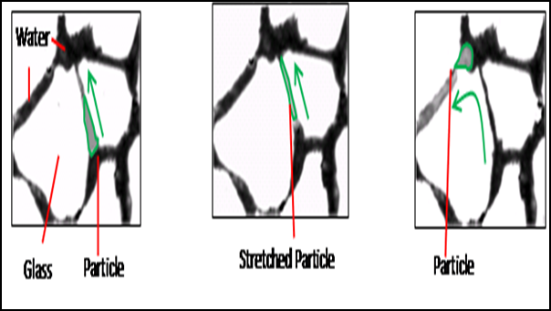
Previous work
5- Bai et al. (2004, 2007) used sandpack core to understand the PPG transport through high permeability porous media.
  Three types of flow patterns were identified pass, broken and pass, and plug.
Schematic of sandpack model
(a) Particle moving to a throat entrance.
(b) Stretched particle filling throat.
(c) Particle passing through throat and move to another throat.
(a) (b) (c)
Notes:
A process of particle moving through one throat when

Slide 12
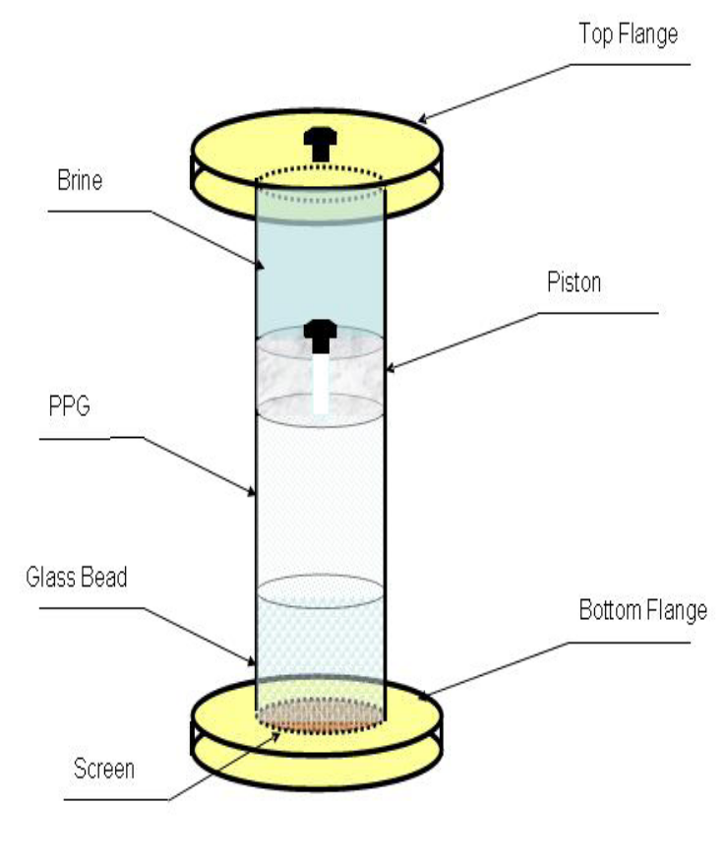
Previous work
6- Challa, R. (2010) in his MS thesis used screen model to study the flow behavior of the PPG through screens.
  A screen model is a long tube connected to pump.
  He found that the particles are deformed in shape after they pass through the screen.
Screen Model

Slide 13
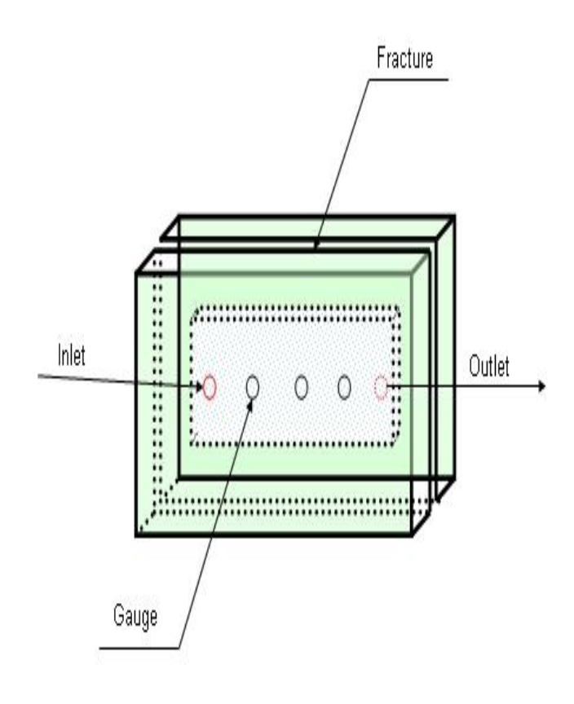
Previous work
7- Zhang and Bai (2010) used transparent fracture model to understand the PPG propagation through the open fractures and study the water flow through the PPG placed in fractures.
  The model was used to study the particle strength and size effect on the injectivity and visually observe particle movement in a fracture.
  They found PPG can reduce the permeability of fractures but could not completely block fractures.
Transparent Open Fracture Model
Notes:
Their model constitutes two parallel plates, between which there is a rubber O-ring. Bolts, nuts, and shims are used to fix the two parallel plates and control the fracture width.

Slide 14
Problem Statement
Damage caused by gels to unswept zones/areas.
Such damage occurs when gels invade or form a cake on low permeability zones/areas from the wellbore or, from the high permeability zone, if two layers are connected.
Notes:
has become one of the most serious problems with using a gel treatment in mature reservoirs.
Previous studies focused on both the propagation and the plugging efficiency of PPGs in both fractures (Zhang et al., 2010) and super high permeable formations (Bai et al., 2004 & 2007).
For a successful PPG treatment, PPG is expected to be easily injected into super high permeable channels/fractures and minimizing the penetration into non-swept zones/areas.

Slide 15
Research Objective
Identify methods that both minimize the damage of PPGs on unswept production zones/areas and improve PPG treatment efficiency.
The results of the filtration tests provided a basis for the development of an analytical model.
Notes:
identifying factors affecting the performance of PPG treatments in mature reservoirs.
Explains the mechanism responsible for the reduction of core permeability. This research results help determine whether or not PPGs damage unswept production zones/areas.
permitting the selection of gel strengths, gel types, brine concentrations, and particle sizes that produce the desired degree of permeability at reservoir pressures. This capability is important for successful gel treatment because the optimal gel treatment design must sufficiently reduce super-high permeability in a mature reservoir during gel treatments.

Slide 16
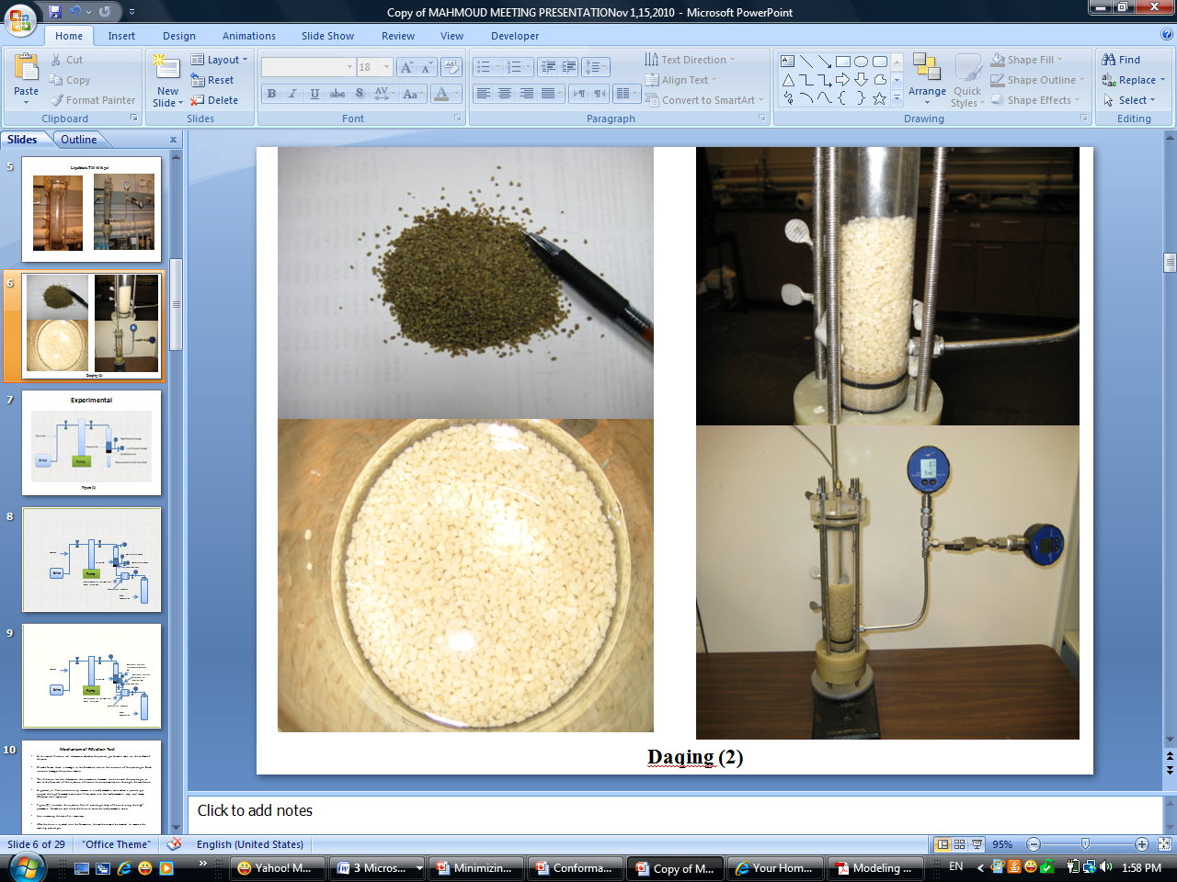
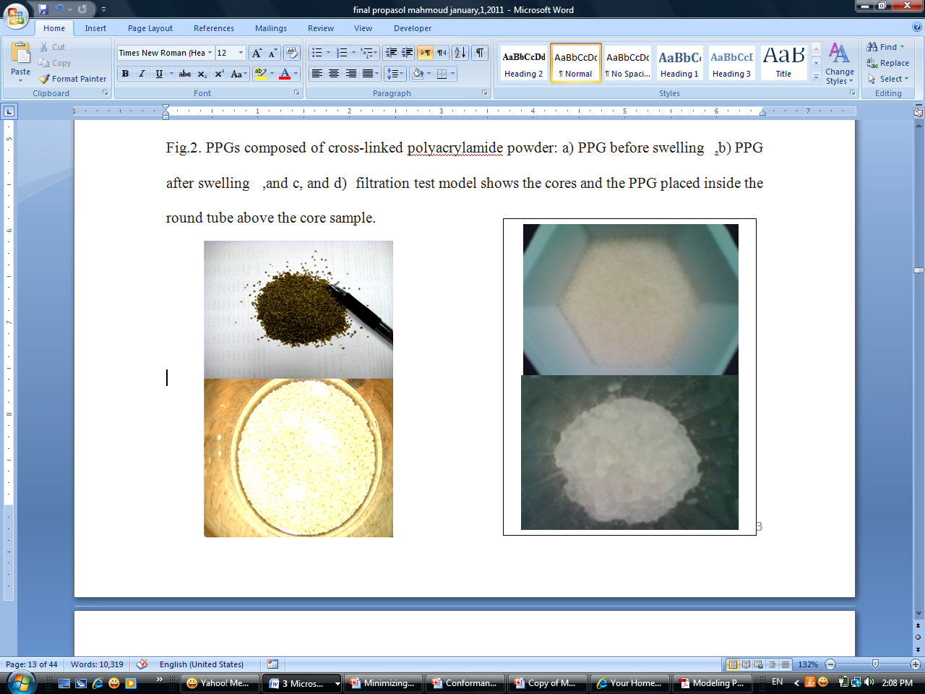
Experimental Materials
Preformed Particle Gels (PPGs)
LiquiblockTM 40K is a weak gel particle with an elastic module of ∼400 Pa at 0.05% of NaCl (wt %).
DQ is a strong gel particle with an elastic module of ~4100 Pa at 0.05% of NaCl (wt%)
The particle sizes for both gels were from 30 to 120 meshes.
(a)
(b)
PPGs before and after Swollen: a) Daqing Gel and b) LiquiBlockTM 40K Gel

Slide 17
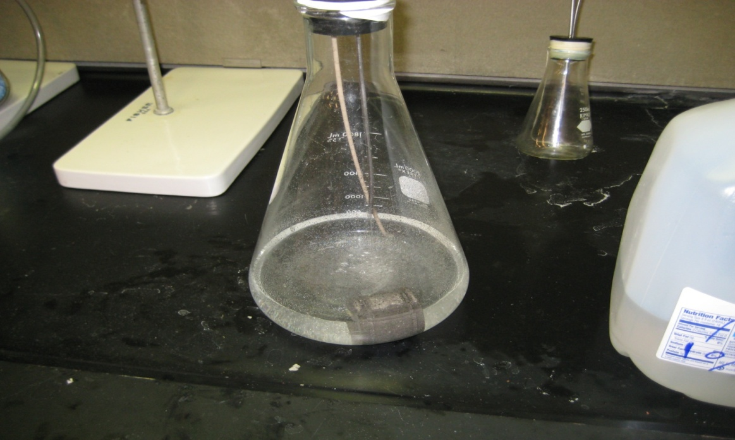
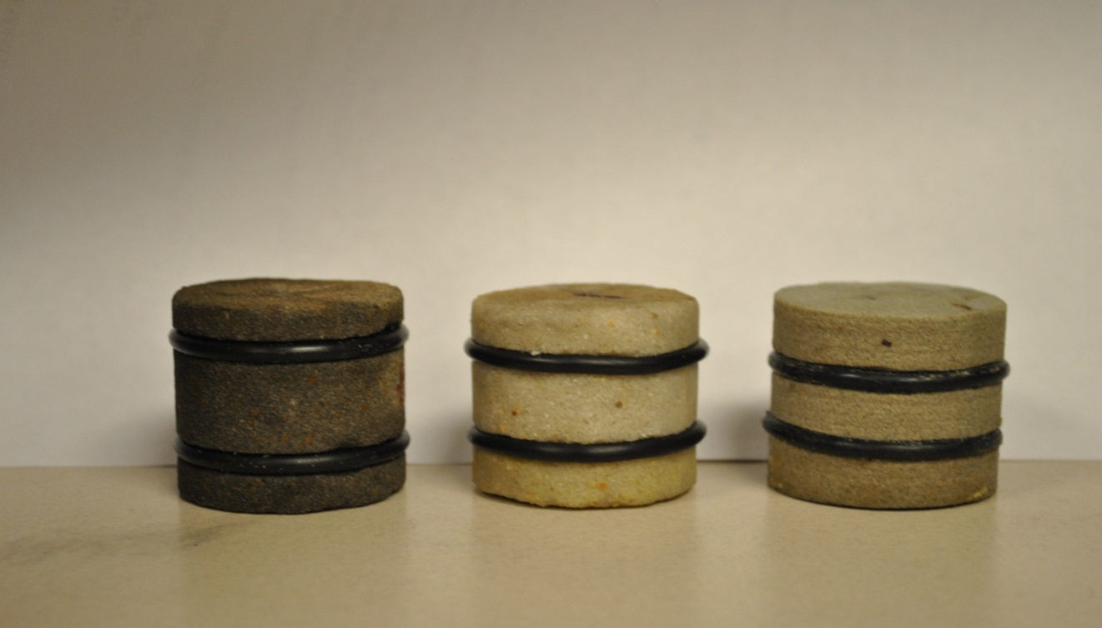
Experimental Materials
Brine. Sodium choloride (NaCl) was used to prepare all brines. Various brine concentrations (0.05, 0.25, 1, 10% NaCl) at room temperature were selected to prepare the swollen PPGs.
Sandstone Core Samples. Various sandstone cores were used with the permeability ranging from 3 to 320 mD.
Core Vacuumed and Saturated with Brine
Sandstone Cores Prepared for Experiments
Notes:
Brine concentration significantly affects the PPG swelling ratio and swollen particle strength.
High salinity brine results in a lower swelling ratio and higher swollen particle strength. The brine viscosity was about 1 cp.
These sandstone cores were collected from three different sources: Missouri, St James, and Berea sandstone. the characteristics of each core, such as porosity (Φ), permeability (k), and average pore throat diameter (d_{o}) was measured.

Slide 18
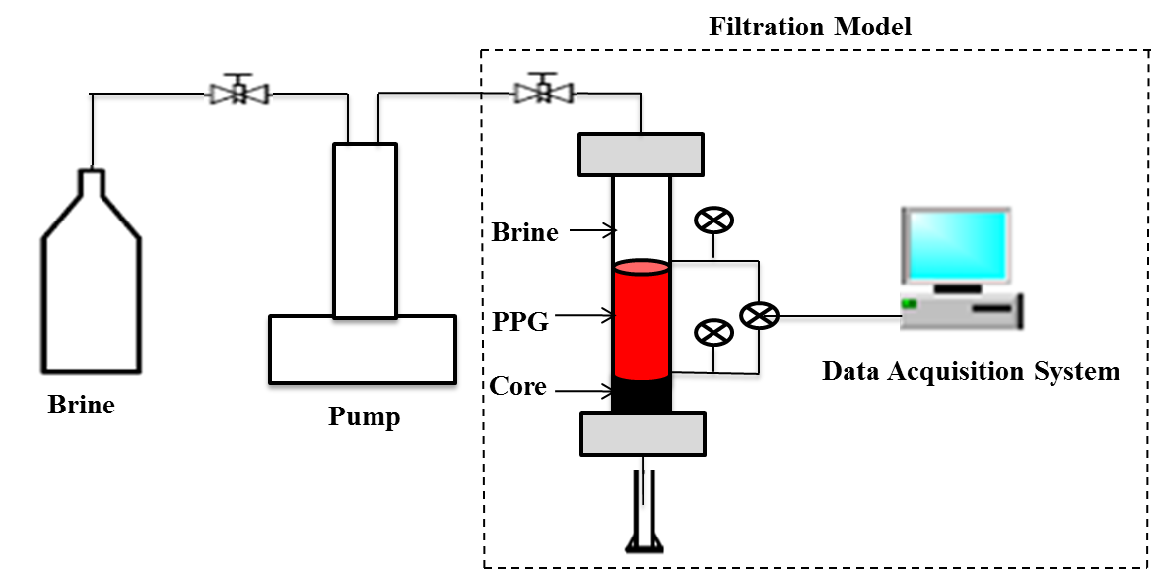
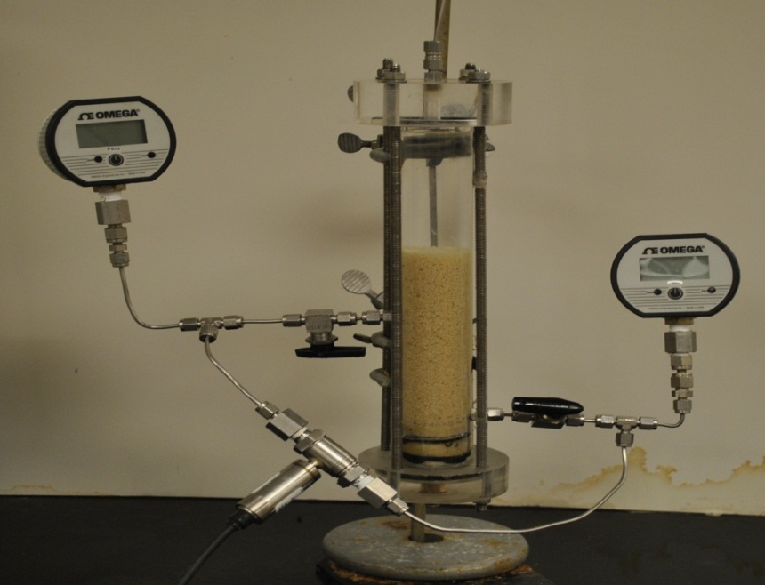
Filtration Test Model
Filtration Test Model Apparatus
Filtration Test Schematic

Slide 19
Filtration Test Results (Weak PPG).
Brine was injected at pressures of 10, 50, 10, 100, 10, 200, 10, 400, and 10 psi,
Filtration Test Results for LiquiblockTM 40K Gel at 30 mesh with1% brine
a) for all pressures and b) for each 10 psi
Notes:
Experimental procedure. The procedures for the filtration test experiments were briefly described as follows:
Core samples were vacuumed and saturated with brine, and porosity (ϕ) was obtained for each core.
The core sample was fitted on the bottom part of the transparent filtration model.
Brine was injected into the model to measure the rock permeability before gel treatment.
The completely swollen PPG was poured into the transparent tube, sitting on top of the core; the other space was filled with brine.
Brine was injected at pressures of 10, 50, 10, 100, 10, 200, 10, 400, and 10 psi, and each constant pressure was run either for 30 min, or until 500 mL brine (pump capacity limitation) was pumped through the core. The purpose for repeatedly using the 10 psi pressure was to determine whether the core was damaged further when the injection pressure increased. Accumulative effluent was recorded at 1, 2, 3, 4, 5, 7.5, 10, 15, 20, 25, and 30 min for the period of each pressure used.
PPG was poured out from the tube and brine was injected to measure rock permeability.
The above procedure was repeated for each experiment and the cumulative filtration volumes were plotted vs. time.

Slide 20
Filtration Test Results (Weak PPG).
Filtration Test Results for LiquiblockTM 40K Gel at 100-120 meshes with1% brine
a) for all pressures and b) for each 10 psi

Slide 21
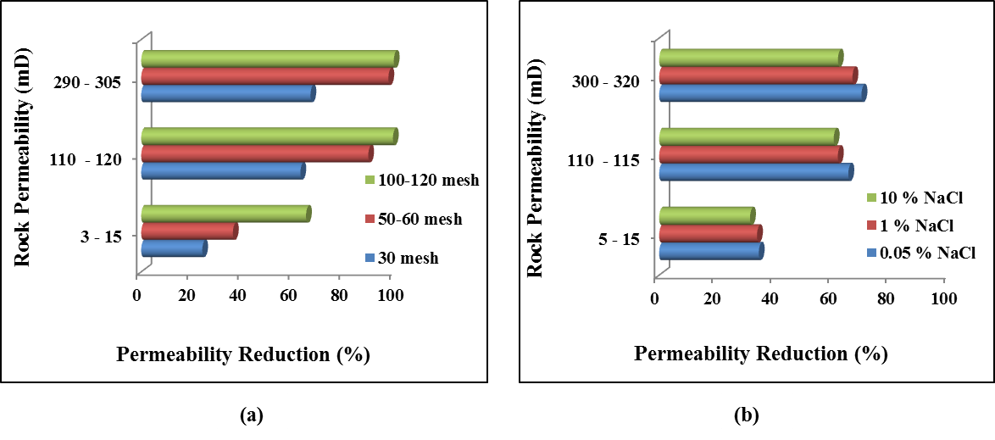
Filtration Test Results (Weak PPG).
Effect of the Rock Permeability
Effect of Rock Permeability on Filtration Test Results a) Different Particle Sizes b) Different Brine Concentrations

Slide 22
Filtration Test Results (Strong PPG).
(a)
(b)
Filtration test Results for strong PPG at 1% brine using 30 mesh
a) for all injection pressures b) for each 10 psi

Slide 23
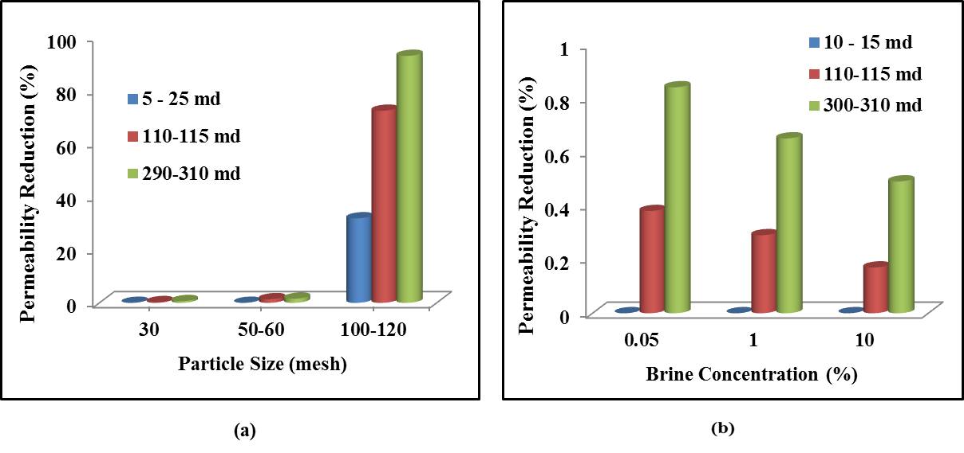
Filtration Test Results (Strong PPG).
Effect of rock permeability
Core Permeability Reduction of Various Cores: a) Different Particle Size b) Different Brine Concentration

Slide 24
Quantitative Analytical Model
Many researchers used square root of time, typically with
dynamic filtration tests, and long cylindrical core samples.
This study could not obtain a linear function for the square
root of time when cumulative volume versus square root
time was plotted for the experiments results.
This study used a linear analytical model relationship
between cumulative volumes versus filtration time with a
good fits result.
Notes:
These experiments were dealing with a short samples, small diameters, and single linear flow systems.
Semi-log plots couldn’t explain the core damage since the curves trend was upward with same shapes.
Poloymeteric equations was not explaining the experiments results.

Slide 25
Quantitative Analytical Model
Results analysis
When core damage occurred, the filtration volume curves required a few minutes to become a linear function of the time.
The cumulative filtration test volume is explained by the following equation:
V_{cf} = m t+ b
Slop m increases as the injection pressure increases.
If the intercept b > 2 the damage occurred because the gel particles invasion started to the core surface.
The shift of the volume vertically in the y-intercept was occurred even no core damage because the PPGs lose some water.
Notes:
PPGs lost some water (volume lost), water loss could explain the core damage.

Slide 26
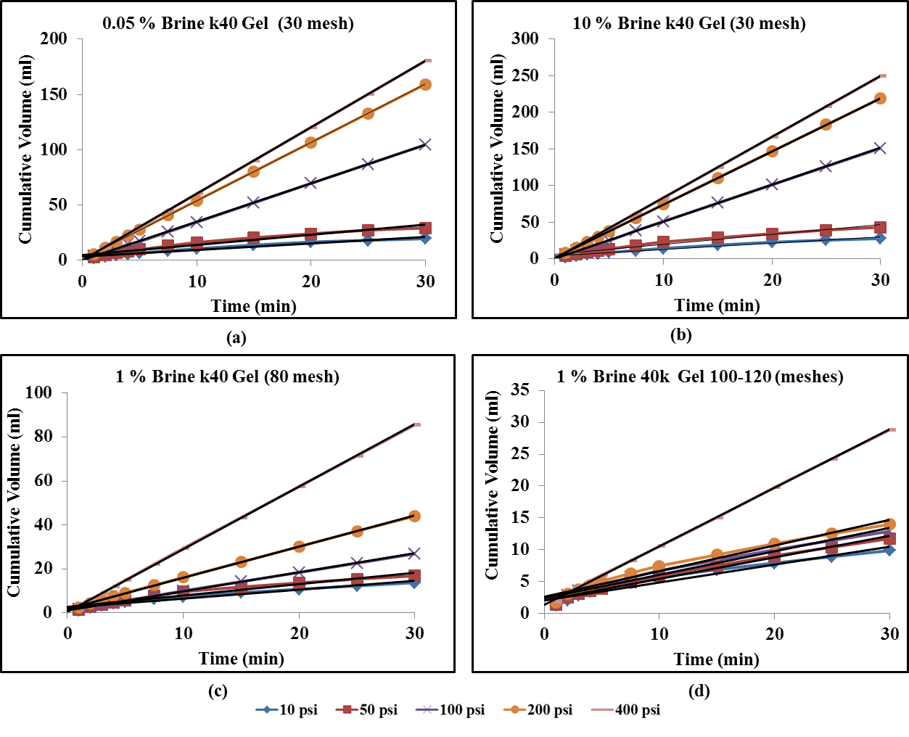
Quantitative Analytical Model
Table 1. Shows the Quantitative Analytical Model Equations for Liquiblock TM 40K Gel with Core Permeability of 5-25 mD for Various Particle Sizes and Brine Concentrations
Particle Size (mesh) | NaCl % | Pressure (psi) | Fitting Equation | R²
30 | 0.05 | 10 | V = 0.6053t + 3.3299 | 0.9638
 |  | 50 | V = 0.9129t + 4.672 | 0.9627
 |  | 100 | V= 3.4697t + 0.2552 | 0.9999
 |  | 200 | V = 5.2797t + 1.062 | 1
 |  | 400 | V = 6t + 0.25 | 1
30 | 10 | 10 | V = 0.8675t + 4.2124 | 0.9741
 |  | 50 | V = 1.3495t + 6.2147 | 0.9709
 |  | 100 | V = 5.0218t + 0.7348 | 0.9999
 |  | 200 | V = 7.2757t + 1.2437 | 1
 |  | 400 | V = 8.302t + 0.3097 | 1
80 | 1 | 10 | V = 0.4054t + 2.4853 | 0.9615
 |  | 50 | V = 0.5212t + 2.7319 | 0.9559
 |  | 100 | V = 0.8689t + 1.037 | 0.9996
 |  | 200 | V = 1.4184t + 1.7904 | 0.9994
 |  | 400 | V = 2.8396t + 0.6267 | 0.9999
100-120 | 1 | 10 | V = 0.2804t + 2.1115 | 0.9552
 |  | 50 | V = 0.3396t + 2.0403 | 0.9842
 |  | 100 | V = 0.369t + 2.3905 | 0.9804
 |  | 200 | V = 0.401t + 2.6657 | 0.9752
 |  | 400 | V = 0.9184t + 1.341 | 0.9997
Figure 1.Typical Filtration Curves for LiquiblockTM40K Gel with 5-25mD: a)1% Brine with 30 mesh b) 10% Brine with 30 mesh c) 1% Brine with 80 mesh d) 1% Brine with 100-120 meshes

Slide 27
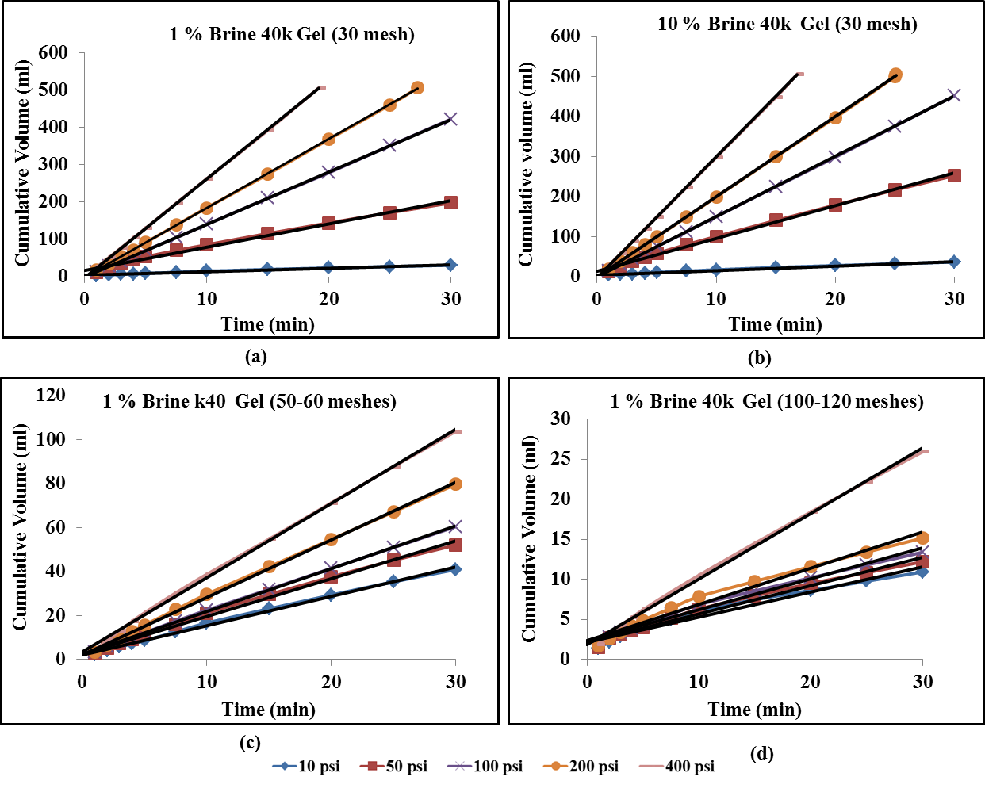
Quantitative Analytical Model
Table 2. Shows the Quantitative Analytical Model Results Liner Equations Liquiblock TM 40K gel with Core Permeability of 100-120 mD for Various Particle Sizes and Brine Concentrations
Particle Size (mesh) | Brine Concentration (%) | Pressure (psi) | Fitting Equation | R²
30 | 1 | 10 | V = 0.9518t + 3.9823 | 0.9849
 |  | 50 | V = 6.2262t + 17.708 | 0.9914
 |  | 100 | V = 14.039t + 0.1579 | 1
 |  | 200 | V = 18.552t - 1.8127 | 1
 |  | 400 | V = 26.379t - 1.1825 | 1
30 | 10 | 10 | V = 1.1206t + 4.8726 | 0.9884
 |  | 50 | V = 8.1346t + 14.637 | 0.9967
 |  | 100 | V = 15.039t + 0.1579 | 1
 |  | 200 | V = 20.082t - 0.8346 | 0.9999
 |  | 400 | V = 30.138t - 1.703 | 1
50-60 | 1 | 10 | V = 1.3416t + 2.0352 | 0.9963
 |  | 50 | V = 1.7164t + 2.4766 | 0.9957
 |  | 100 | V = 1.9533t + 2.3838 | 0.9995
 |  | 200 | V = 2.6199t + 2.1604 | 0.9988
 |  | 400 | V = 3.3885t + 3.4377 | 0.9986
100-120 | 1 | 10 | V = 0.3139t + 2.1768 | 0.9656
 |  | 50 | V = 0.3546t + 2.1567 | 0.9826
 |  | 100 | V = 0.3842t + 2.3801 | 0.9877
 |  | 200 | V = 0.4529t + 2.3416 | 0.9791
 |  | 400 | V = 0.8185t + 1.8896 | 0.9975
Figure 2. Typical Liner Curves Analytical Model for Liquiblock TM 40K Cel with 100-120 mD: (a) 1% Brine with 30 mesh (b) 10 % Brine with 30 mesh (c) 1% Brine with 50-60 meshes (d) 1% Brine with 100-120 meshes

Slide 28
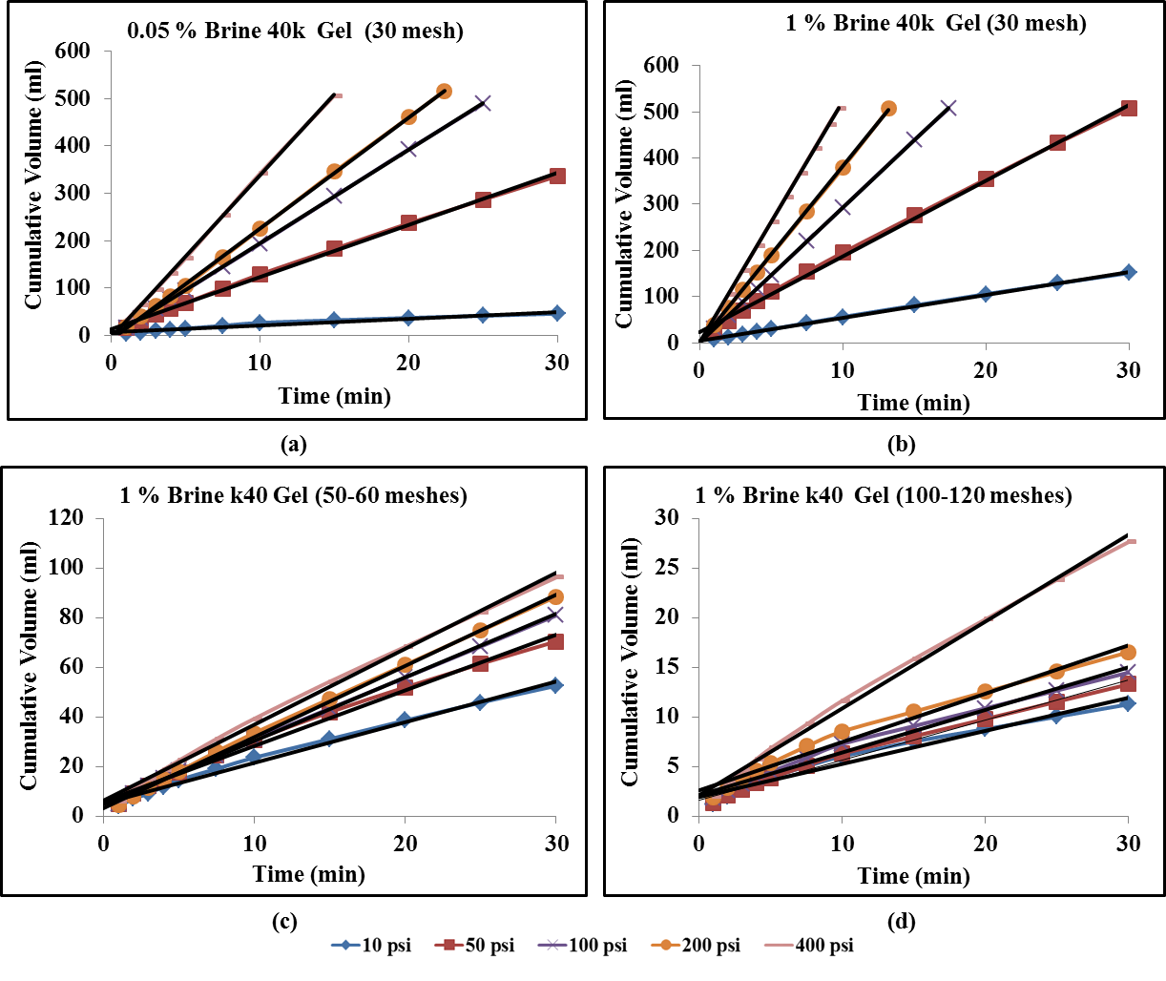
Quantitative Analytical Model
Table 3. Shows the Quantitative Analytical Model Results Liner Equations Liquiblock TM 40K Gel with Core Permeability of 290-320 mD for Various Particle Sizes and Brine Concentrations
Particle Size (mesh) | Brine Concentration | Pressure (psi) | Fitting Equation | R²
30 | 0.05 | 10 | V = 1.4523t + 5.9433 | 0.9506
 |  | 50 | V = 11.049t + 11.578 | 0.9982
 |  | 100 | V = 19.745t - 3.5441 | 1
 |  | 200 | V = 23.503t - 9.8703 | 0.9999
 |  | 400 | V = 34.267t - 5.3881 | 0.9998
30 | 1 | 10 | V = 4.9922t + 4.2492 | 0.9988
 |  | 50 | V = 16.435t + 22.47 | 0.9979
 |  | 100 | V = 29.139t + 1.1352 | 1
 |  | 200 | V = 38.187t - 0.4057 | 0.9999
 |  | 400 | V = 52.417t + 0.1568 | 1
50-60 | 1 | 10 | V = 1.6433t + 5.0904 | 0.9911
 |  | 50 | V = 2.2391t + 5.935 | 0.9928
 |  | 100 | V = 2.5645t + 4.5541 | 0.9988
 |  | 200 | V = 2.877t + 3.211 | 0.9988
 |  | 400 | V = 3.0678t + 6.2657 | 0.9966
100-120 | 1 | 10 | V = 0.3337t + 1.9061 | 0.9701
 |  | 50 | V = 0.4034t + 1.6256 | 0.9895
 |  | 100 | V = 0.4288t + 2.1567 | 0.9869
 |  | 200 | V = 0.4896t + 2.5707 | 0.9805
 |  | 400 | V = 0.8746t + 2.1282 | 0.9956
Figure 3.Typical Liner Curves Analytical Model for Liquiblock TM 40K Gel with 290-320 mD: (a) 0.05% Brine with 30 mesh (b) 1 % Brine with 30 mesh (c) 1% Brine with 50-60 meshes (d) 1% Brine with 100-120 meshes

Slide 29
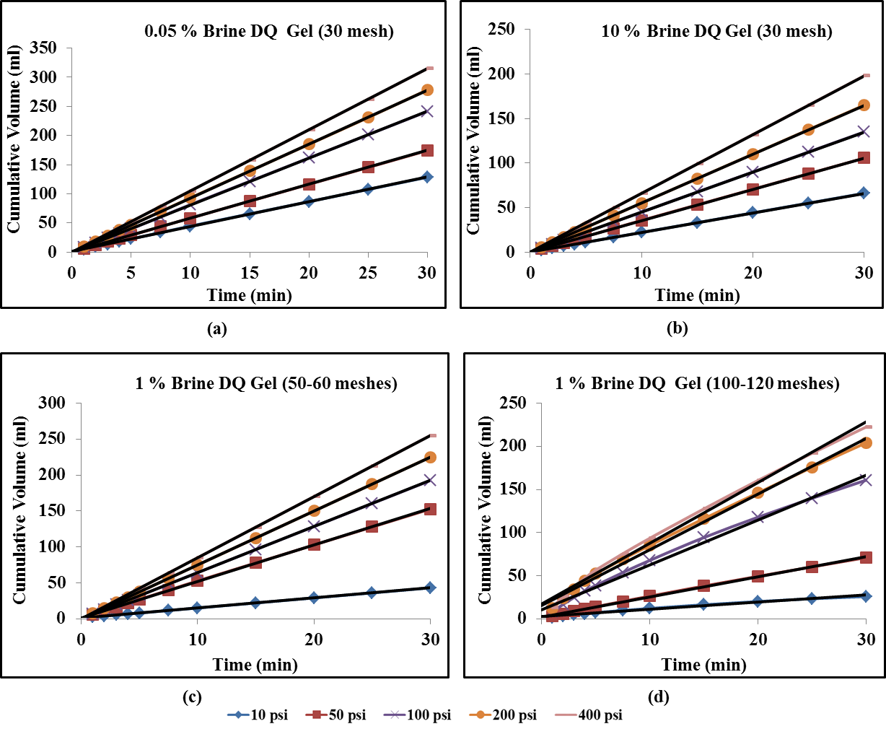
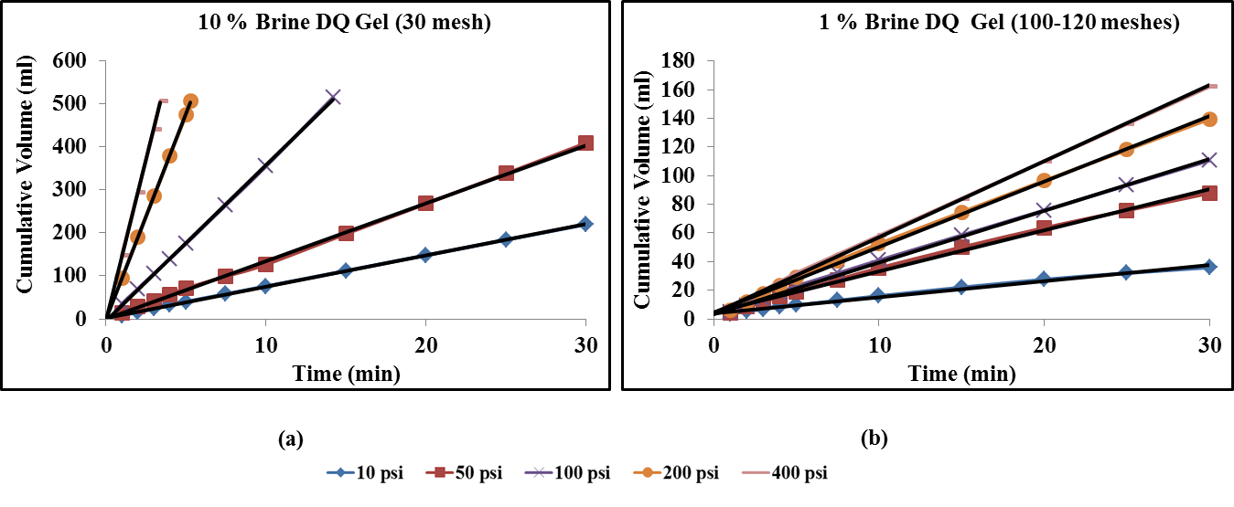
Quantitative Analytical Model
Figure 5. Typical Liner Curves Analytical Model for DQ Gel with 100-120 mD: (a) 10% Brine with 30 mesh (b) 1 % Brine with 100-120 meshes
Figure 4. Typical Liner Curves Analytical Model for DQ Gel with 5-25 mD: (a) 0.05% Brine with 30 mesh (b) 10 % Brine with 30 mesh (c) 1% Brine with 50-60 meshes (d) 1% Brine with 100-120 meshes

Slide 30
Quantitative Analytical Model
Table 4. Shows the Quantitative Analytical Model Results Liner Equations DQ Gel with Core Permeability of 5-25 mD for Various Particle Sizes and Brine Concentrations
Particle Size (mesh) | Brine Concentration | Pressure (psi) | Fitting Equation | R²
30 | 0.05 | 10 | V = 4.2701t + 0.9464 | 0.9999
 |  | 50 | V = 5.8084t + 0.0429 | 1
 |  | 100 | V = 8.0679t - 0.1105 | 1
 |  | 200 | V = 9.2589t + 0.14 | 1
 |  | 400 | V = 10.5t | 1
30 | 1 | 10 | V= 3.1817t - 0.6141 | 1
 |  | 50 | V = 4.6267t + 0.557 | 1
 |  | 100 | V = 5.8436t + 0.4783 | 1
 |  | 200 | V = 6.9t | 1
 |  | 400 | V = 7.8t | 1
30 | 10 | 10 | V = 2.2t | 1
 |  | 50 | V = 3.5213t + 0.0127 | 1
 |  | 100 | V = 4.5t - 0.1 | 1
 |  | 200 | V = 5.5t | 1
 |  | 400 | V = 6.6t | 1
50-60 | 1 | 10 | V = 1.4043t + 1.2609 | 1
 |  | 50 | V = 5.0672t + 1.5313 | 0.9999
 |  | 100 | V = 6.4105t + 0.4281 | 1
 |  | 200 | V = 7.501t + 0.1796 | 1
 |  | 400 | V = 8.501t + 0.2796 | 1
80 | 1 | 10 | V = 1.222t + 1.473 | 0.9997
 |  | 50 | V = 4.0672t + 1.7313 | 0.9998
 |  | 100 | V = 5.1324t + 1.7069 | 0.9997
 |  | 200 | V = 6.501t + 0.1796 | 1
 |  | 400 | V = 7.5t | 1
100-120 | 1 | 10 | V = 0.8293t + 2.8354 | 0.9842
 |  | 50 | V = 2.3431t + 2.0654 | 0.9987
 |  | 100 | V = 5.2105t + 10.772 | 0.9928
 |  | 200 | V = 6.4458t + 15.864 | 0.9944
 |  | 400 | V = 7.0541t + 17.127 | 0.9941
Table 5. Shows the Quantitative Analytical Model Results Liner Equations DQ Gel with Core Permeability of 100-120 mD for Various Particle Sizes and Brine Concentrations
Particle Size (mesh) | Brine Concentration | Pressure (psi) | Fitting Equation | R²
30 | 10 | 10 | V = 7.2733t + 2.4563 | 0.9998
 |  | 50 | V = 13.502t - 0.3676 | 0.9993
 |  | 100 | V = 36.251t - 4.1154 | 0.9997
 |  | 200 | V = 95.353t - 0.7789 | 0.9999
 |  | 400 | V = 148.88t - 1.8588 | 0.9998
100-120 | 1 | 10 | V = 1.1287t + 3.7965 | 0.9929
 |  | 50 | V = 2.8852t + 4.165 | 0.9955
 |  | 100 | V= 3.6056t + 3.4918 | 0.9988
 |  | 200 | V= 4.5652t + 4.5052 | 0.9984
 |  | 400 | V= 5.2969t + 4.0754 | 0.9994

Slide 31
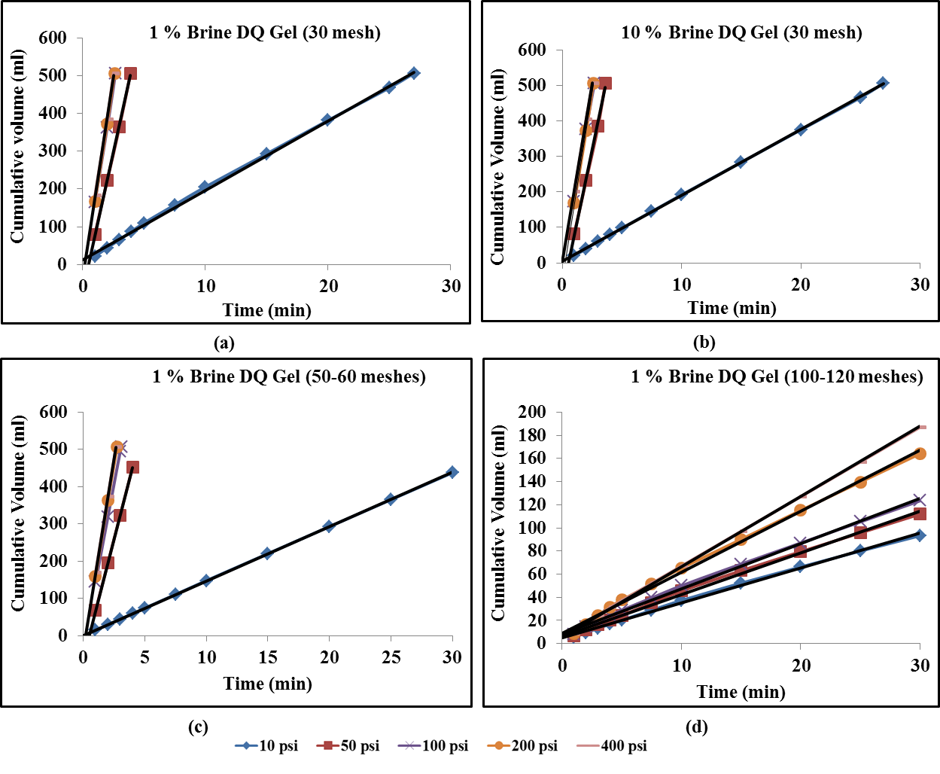
Quantitative Analytical Model
Table 6. Shows the Quantitative Analytical Model Results Liner Equations DQ Gel with Core Permeability 290-320 mD for Various Particle Sizes and Brine Concentrations
Particle Size (mesh) | Brine Concentration | Pressure (psi) | Fitting Equation | R²
30 | 0.05 | 10 | V = 20.155t + 8.5524 | 0.9993
 |  | 50 | V = 161.62t - 20.959 | 0.9999
 |  | 100 | V = 199.78t - 20.591 | 0.9997
 |  | 200 | V = 204.43t - 16.544 | 1
 |  | 400 | V = 202.29t + 2.1429 | 0.9999
30 | 1 | 10 | V = 18.403t + 13.165 | 0.9989
 |  | 50 | V = 146.3t - 69.089 | 0.9994
 |  | 100 | V= 203.08t - 39.833 | 0.9995
 |  | 200 | V= 211.84t - 46.429 | 0.9995
 |  | 400 | V= 213.18t - 33.382 | 0.9982
30 | 10 | 10 | V = 18.641t + 3.8415 | 0.9990
 |  | 50 | V = 161.17t - 85.316 | 0.9962
 |  | 100 | V = 196.44t - 20.233 | 0.9992
 |  | 200 | V = 211.07t - 45 | 0.9993
 |  | 400 | V = 199.37t + 1.8362 | 0.9996
50-60 | 1 | 10 | V = 14.567t + 1.4621 | 1
 |  | 50 | V = 128t - 60 | 1
 |  | 100 | V = 173.44t - 27.825 | 0.9998
 |  | 200 | V = 198.59t - 36.973 | 0.9996
 |  | 400 | V = 203.67t - 33.073 | 1
100-120 | 1 | 10 | V = 3.0261t + 4.7957 | 0.9972
 |  | 50 | V = 3.6166t + 6.1198 | 0.9968
 |  | 100 | V = 3.9188t + 8.0818 | 0.9972
 |  | 200 | V = 5.2669t + 9.0281 | 0.9969
 |  | 400 | V = 6.0806t + 5.439 | 0.9995
Figure 6. Typical Liner Curves Analytical Model for DQ Gel with 290-320 mD: (a) 1% Brine with 30 mesh (b) 10 % Brine with 30 mesh (c) 1% Brine with 50-60 meshes (d) 1% Brine with 290-320 meshes

Slide 32
Conclusions
It is the first time to use quantitative analytical model to analysis the formation damage by the PPGs.
The relationship curves between the cumulative volume versus filtration time show that if the value of the curve intercept b > 2 the gel will damage the formation.
Water loss value from the particle gel can give an indication about the formation damage. Weak gels loss more water than strong gel. Therefor the particle sizes will be smaller and penetrate further through the reservoir rocks.
Preformed particle gels loss water at first injection pressures. The shift of the volume vertically in the y-intercept because the Preformed particle gels lose some water.
PPG damage on rocks was affected by particle sizes and brine concentrations; more damage occurred with a small particle size (100-120 meshes) and a low brine concentration (0.05 wt% NaCl).
PPG damage on rocks was affected by core permeability; more damage occurred when a high-permeability rock of (290-320 mD) was used.
The damage caused by PPGs on unswept, low-permeability, oil-rich zones could be effectively controlled by controlling particle gel strength, gel type, particle size, and brine concentration.
This research results can be used to properly select the gel particles that will not damage the formation for the best a particle gel treatment.

Slide 33
Acknowledgments
The authors gratefully acknowledge the financial support given for this work by Research Partnership to Secure Energy for America (RPSEA).
Also the authors would like to thank McCoy School of Engineering, Midwestern State University, Wichita Falls, Texas, USA.
Petroleum Engineering Department at Missouri University of Science and Technology, Rolla, Missouri, USA.

Slide 34
Any Questions ?
THANK YOU !

