Slide 1


Role of Nigella sativa oil and antidiabetic drugs in modifying the brain insulin signaling in streptozotocin-induced diabetic rats
Mahmoud Balbaa
Department of Biochemistry
Faculty of Science
Alexandria University
Egypt
Notes:
1

Slide 2

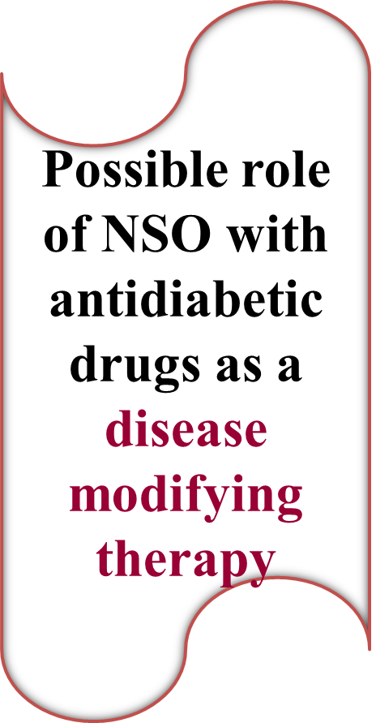
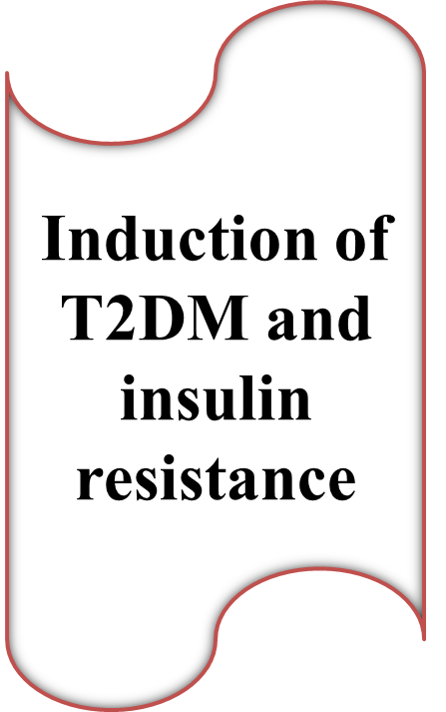
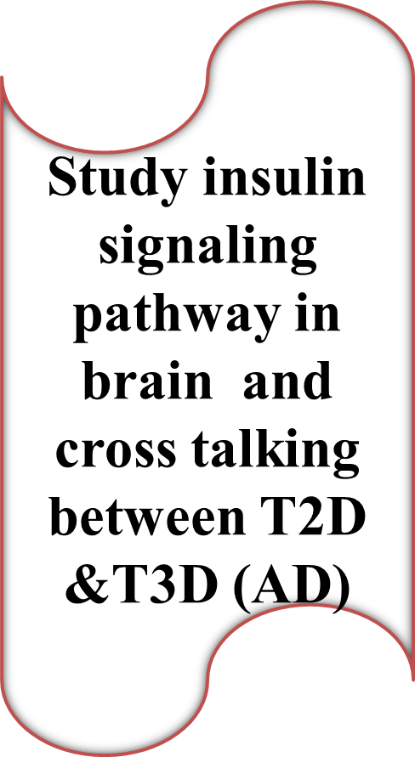



Slide 3
Type 2 Diabetes Mellitus
Disease that generally develops over a period of years.
Accounts for about 90-95% of all diagnosed
cases of diabetes.
It usually begins as insulin resistance and cells do not use insulin properly.
The pancreas gradually loses its ability to produce insulin.

Slide 4
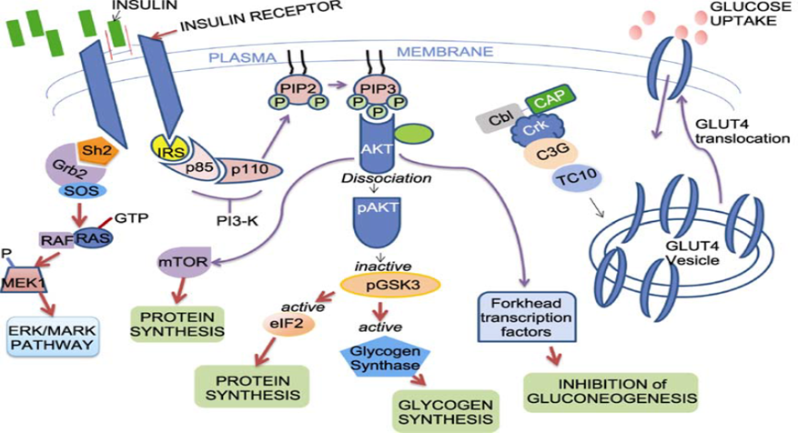
Insulin signaling pathway
(Kumar et al., Protein & Cell, 2012, 3: 726)

Slide 5
Risk Factors from T2DM
T2DM (Strong) 45-90%, has 4-fold higher risk for AD
Depression& Oxidative Stress
Obesity, High Cholesterol &Blood Pressure
Inflammation
Chronic neuro-inflammation, microglia activation & cytokines production

Slide 6
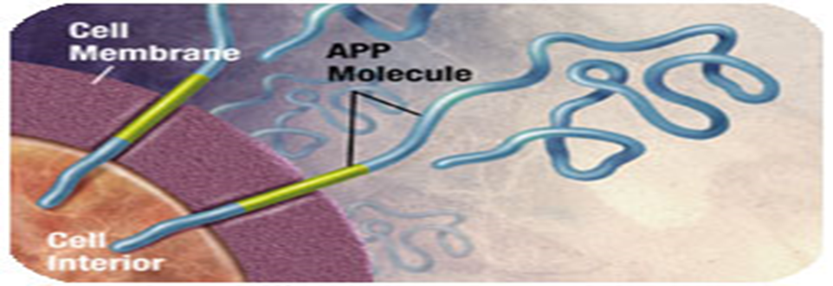
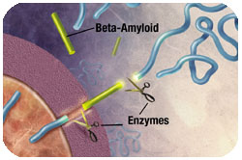
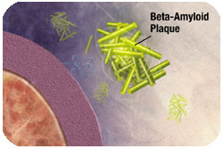
AD Biomarkers (Aβ plaques formation)
Beta-amyloid Plaques
Amyloid precursor protein (APP) is the precursor to amyloid plaque.
APP sticks through the neuron membrane.
Enzymes cut the APP into fragments including beta-amyloid.
Beta-amyloid fragments come together to form plaques.

Slide 7
AD Biomarkers
p-tau-formation
The change of tau causes microtubules to collapse and tau proteins clump together to form neurofibrillary tangles.

Slide 8
The Therapeutic approach
Recently, several types of research have studied the efficacy of medicinal plants/herbs in the modulation of inflammation, oxidative markers and alteration of lipid profile in T2DM.

Slide 9

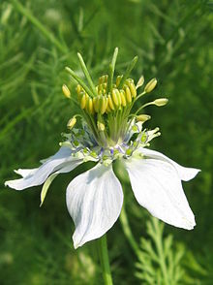
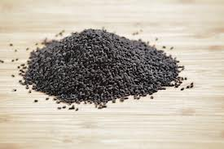

Slide 10
Biological Effect of NS
Extensive studies on NS have been carried out by various researchers and a wide spectrum of its pharmacological actions have been explored which may include:
- anti-diabetic.
-anticancer.
- anti-inflammatory.
- antioxidant properties.

Slide 11
Experimental Design
180 male albino rats aging 8 to 10 weeks, weighing 110 to 150 gm
(8 rats/group) were divided into 17 groups

Slide 12
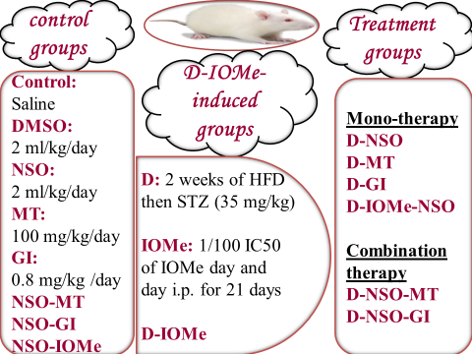
Experimental Groups

Slide 13
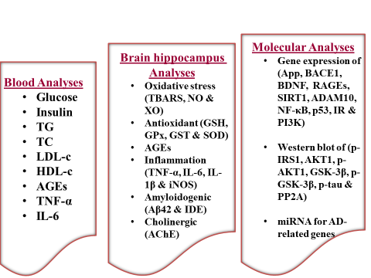
In Vivo Study

Slide 14
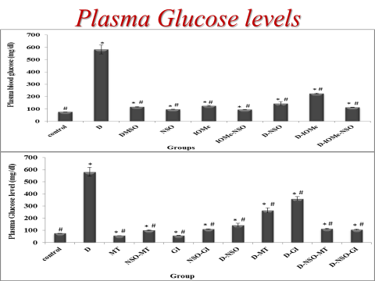
Routine Biochemical Analyses

Slide 15
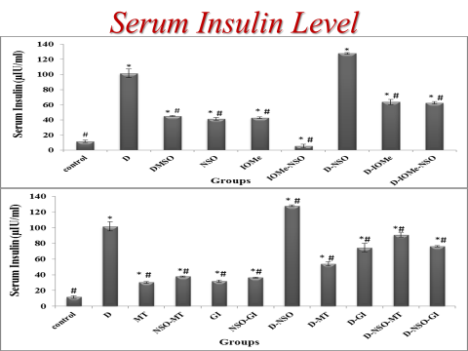

Slide 16
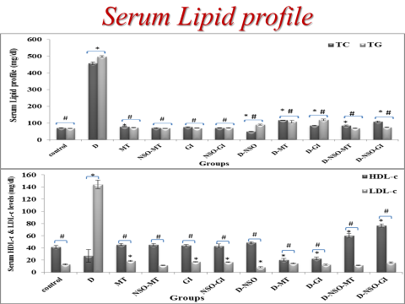

Slide 17
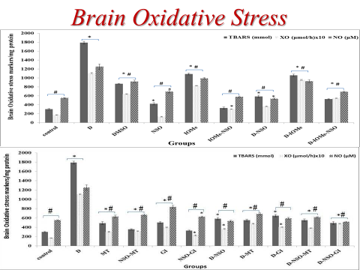
Oxidant & Antioxidant parameters

Slide 18
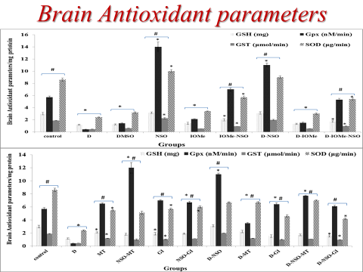

Slide 19
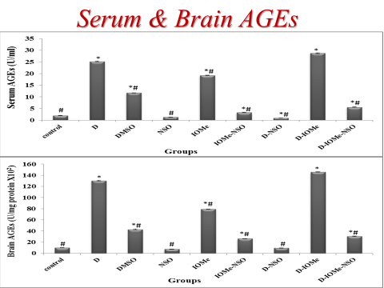
AGEs and brain insulin resistance

Slide 20
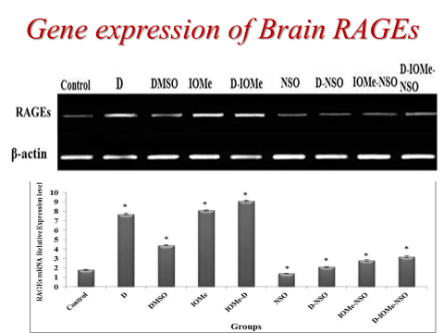

Slide 21
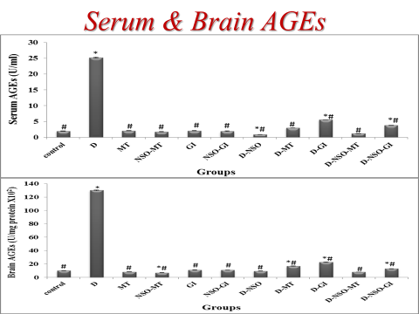

Slide 22
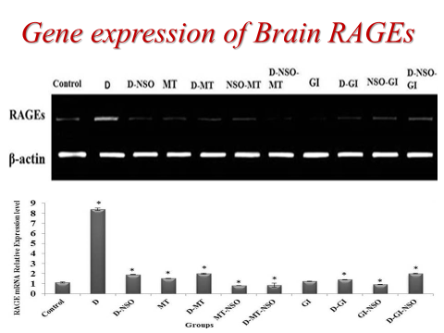

Slide 23
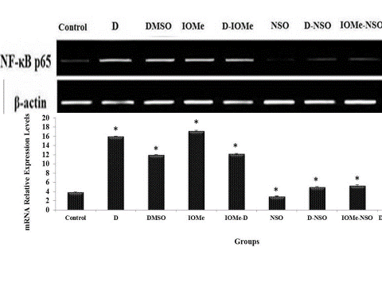
Peripheral & Central Inflammation
Effect of D-IOMe-injection and NSO treatment on gene expression profile of brain inflammatory markers

Slide 24
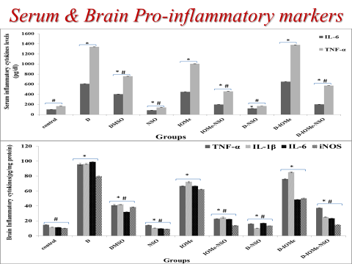

Slide 25
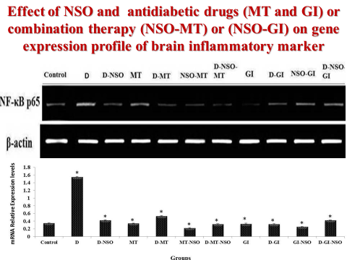

Slide 26
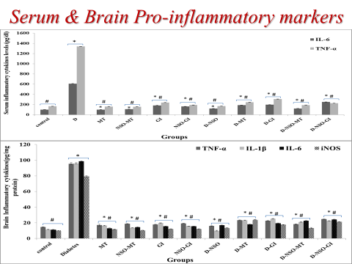

Slide 27
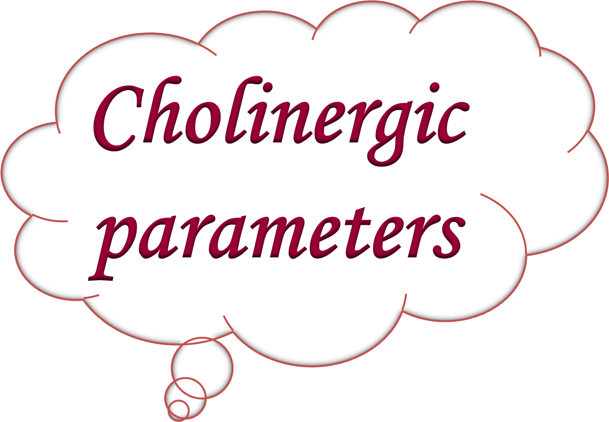

Slide 28
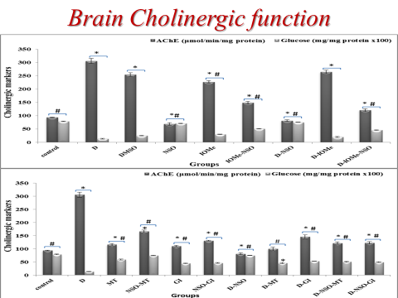

Slide 29
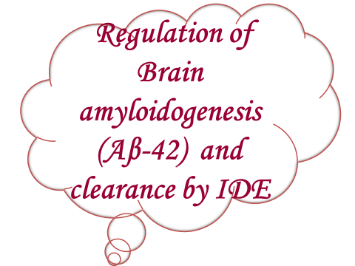

Slide 30
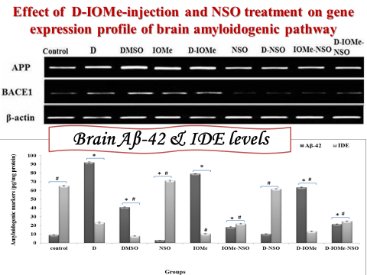

Slide 31
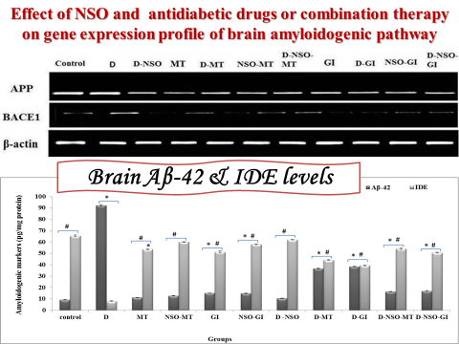

Slide 32
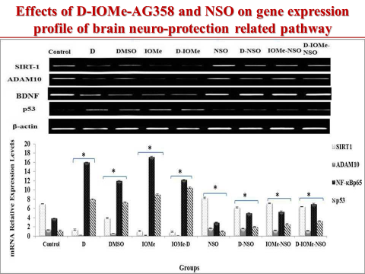

Slide 33
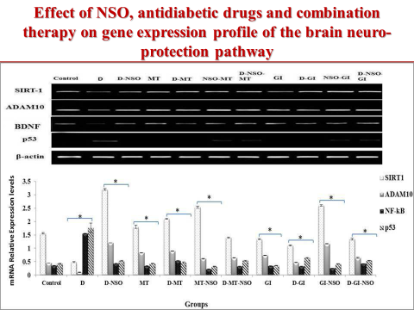

Slide 34
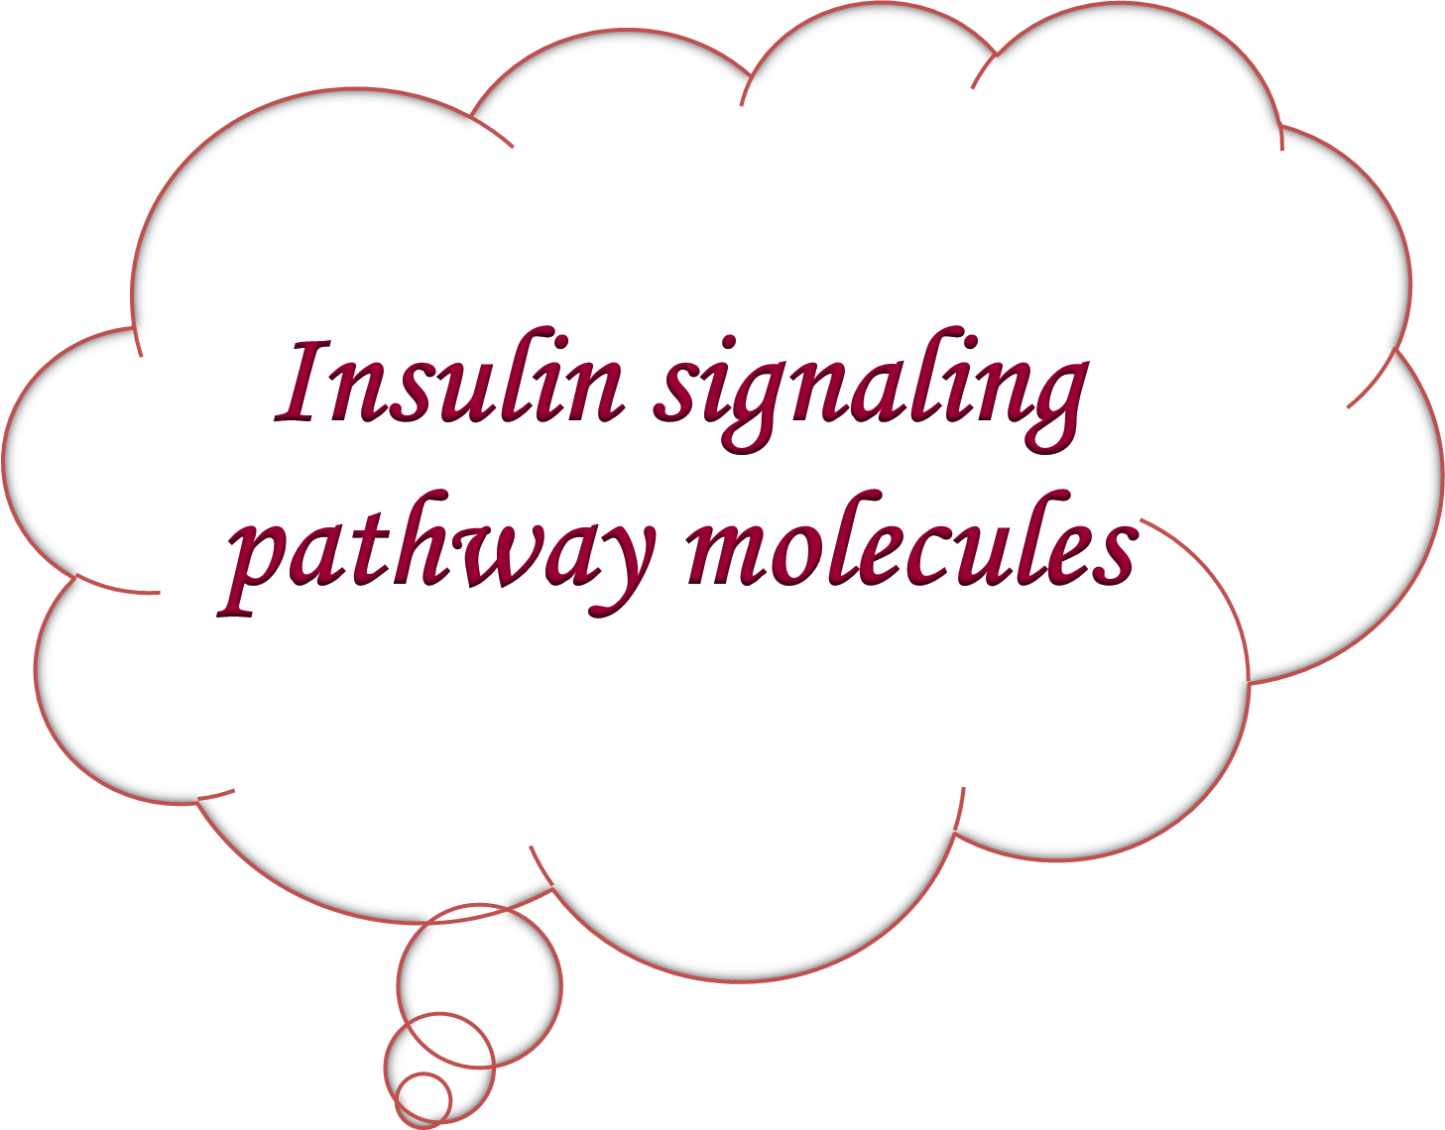

Slide 35
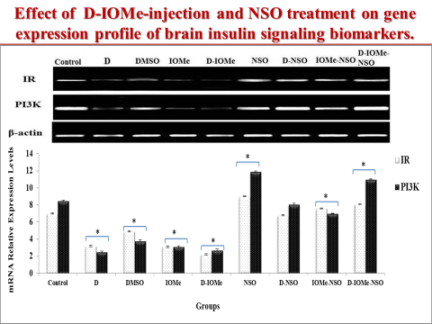

Slide 36
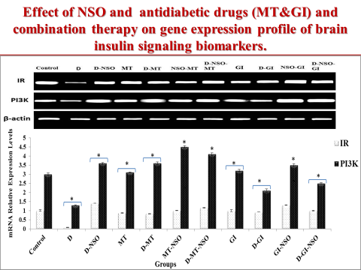

Slide 37
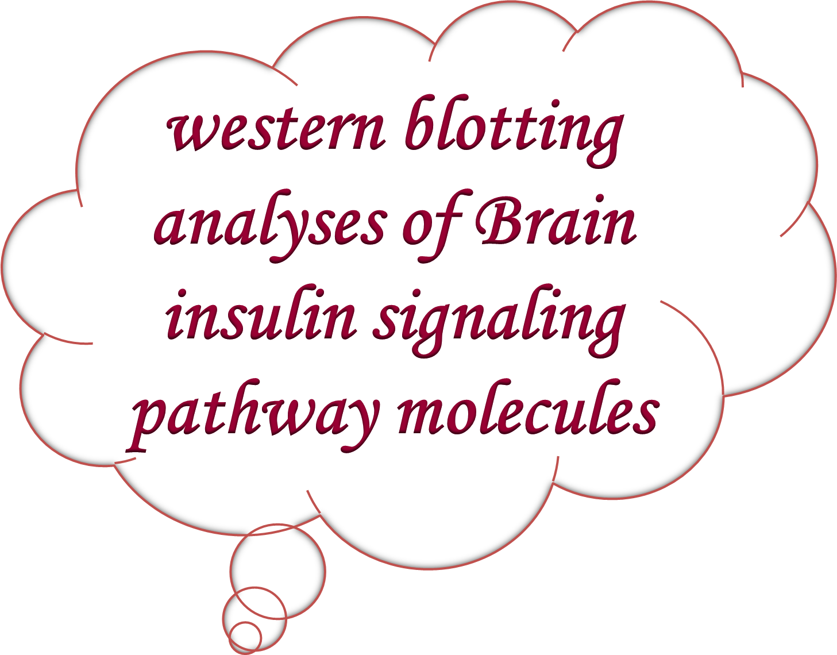

Slide 38
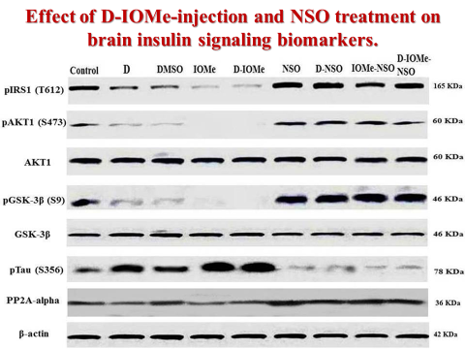

Slide 39
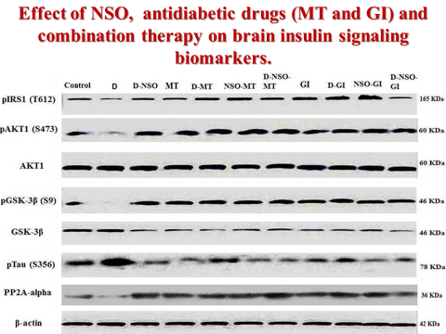

Slide 40


Slide 41
The anti-inflammatory and antioxidant effects of NSO are more than that anti-diabetic drugs in the improvement of all markers.
NSO alone ameliorate the neuro-inflammation, brain insulin resistance and amyloidogenic pathways.
MT & GI improve brain insulin signaling, exhibited antioxidant and anti-inflammatory effects, besides its glycemic control, also they displayed an anti-amyloidogenic and neuro-protection effect.
MT&NSO considered a promising target as disease modifying therapy for the insulin resistance brain state in T2D.

Slide 42
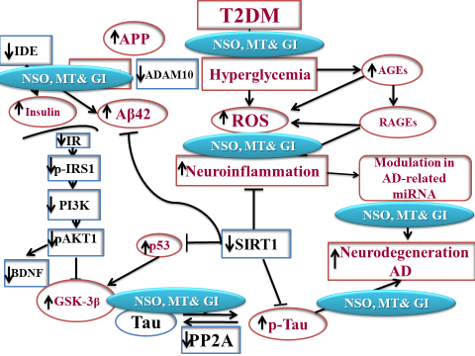

Slide 43



