Slide 1
About OMICS Group
OMICS Group is an amalgamation of Open Access Publications and worldwide international science conferences and events. Established in the year 2007 with the sole aim of making the information on Sciences and technology ‘Open Access’, OMICS Group publishes 500 online open access scholarly journals in all aspects of Science, Engineering, Management and Technology journals. OMICS Group has been instrumental in taking the knowledge on Science & technology to the doorsteps of ordinary men and women. Research Scholars, Students, Libraries, Educational Institutions, Research centers and the industry are main stakeholders that benefitted greatly from this knowledge dissemination. OMICS Group also organizes 500 International conferences annually across the globe, where knowledge transfer takes place through debates, round table discussions, poster presentations, workshops, symposia and exhibitions.

Slide 2
OMICS International Conferences
OMICS International is a pioneer and leading science event organizer, which publishes around 500 open access journals and conducts over 500 Medical, Clinical, Engineering, Life Sciences, Pharma scientific conferences all over the globe annually with the support of more than 1000 scientific associations and 30,000 editorial board members and 3.5 million followers to its credit.
OMICS Group has organized 500 conferences, workshops and national symposiums across the major cities including San Francisco, Las Vegas, San Antonio, Omaha, Orlando, Raleigh, Santa Clara, Chicago, Philadelphia, Baltimore, United Kingdom, Valencia, Dubai, Beijing, Hyderabad, Bengaluru and Mumbai.

Slide 3
CELLULAR AND MOLECULAR ACTIONS OF GROWTH FACTORS
^{Mahmoud Balbaa}
Department of Biochemistry, Faculty of Science, Alexandria University, Alexandria, Egypt

Slide 4
Growth Factors & Cell Cycle
Gene Transcription
Growth Factors
Receptors
+
S
Priming
G₀
G₁
Cell Cycle
G₂
M

Slide 5
Growth factors and their receptors are important signaling molecules, which are involved in the regulation of cell growth.
Epidermal growth factor (EGF) pathway plays an important role in tumorigenesis, including Hepatocellular Carcinoma. EGF polymorphisms are associated with susceptibility to several types of cancers.
Epidermal growth factor receptor (EGFR) is considered as an important signaling hub where different proliferative and survival signals converge.

Slide 6
Overexpression/activation of EGFR is associated with metastasis, poor prognosis and resistance to chemotherapy.
EGFR is overexpressed or activated by autocrine or paracrine growth factor loops in at least 50% of epithelial malignancies.

Slide 7
Human Epidermal Growth Factor Receptor Family
No specific
ligands -
often acts as
dimer partner
NRG2
NRG3
Heregulins
β-cellulin
EGF, TGFα , β Cellulin
Amphiregulin, HB-EGF
Heregulins
TK
TK
TK
erbB1
HER1
EGFR
erbB2
HER2
neu
erbB3
HER3
erbB4
HER4

Slide 8
EGFR Structure
Extracellular Domain
Transmembrane Domain
TK
Intracellular Domain

Slide 9
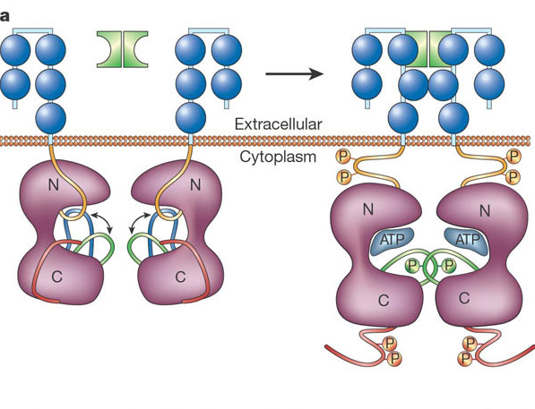
Receptor Dimerization and Kinase Activation
From Hunter (2001) Nature 411,355.

Slide 10
EGFR Stimulation & dimerisation
TK
TK
TK
TK
EGFR Homo Dimerisation
erbB1
HER1
EGFR
erbB2
HER2
neu
erbB3
HER3
erbB4
HER4

Slide 11
EGFR Function in Normal Cell
ATP
TK
TK
ATP
+
Gene Transcription
Cell Cycle Progression
Cell Proliferation
Antiapoptosis
Angiogenesis

Slide 12
EGFR signal transduction in tumour cells
TK
TK
PI3-K
pY
pY
GRB2
pY
SOS
STAT3
RAS
RAF
PTEN
AKT
MEK
Gene transcription
G₁
MAPK
M
S
Proliferation/
maturation
Survival
(anti-apoptosis)
G₂
Chemotherapy /
radiotherapy
resistance
Metastasis
Angiogenesis

Slide 13


Strategies to inhibit EGFR signaling
Anti-ligand
mAbs
EGFR tyrosine
kinase inhibitors
Bispecific
Abs
Immune effector cell
Anti-EGFR mAbs
ATP
TK
TK
TK
TK
-
-
-
-

Slide 14
Transforming Growth Factor β (TGFβ) Signals
A large class of molecular signals involved in regulating development (bone growth, mesoderm formation, formation of cell-adhesion molecules and anti-proliferation effects).
The activated TGFβ receptor directly phosphorylates a transcription factor.

Slide 15
Human TGFβ Signal Molecules
Three tissue-specific isoforms:
TGFβ – 1
TGFβ – 2
TGFβ - 3
Dimeric homo- or hetero- forms.

Slide 16
TGFβ-1 is a multifunctional cytokine involved in the regulation of growth and differentiation of both normal and transformed cells. It has been reported that TGFβ-1 mRNA and its protein were overexpressed in hepatocellular carcinoma tissues.

Slide 17
There is an evidence that TGFβ modulates the high-affinity receptors for EGF and TGFα. EGFR and TGFα are targets for TGFβ in some cells.

Slide 18
Protein Tyrosine Kinases (TKs)
Receptor tyrosine kinases (RTK)
  insulin receptor
  EGF receptor
  PDGF receptor
  TrkA
  Non-receptor tyrosine kinases (NRTK)
  c-Src
  Janus kinases (Jak)
  Csk (C-terminal src kinase)
  Focal adhesion kinase (FAK)

Slide 19
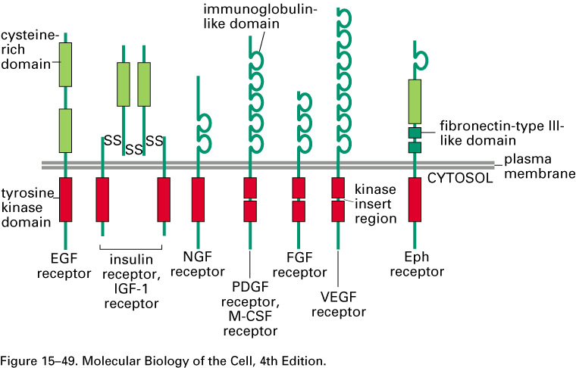
Subfamilies of Receptor Tyrosine Kinases

Slide 20
Evaluation of EGF, p-EGFR and TGFβ-1
Levels of EGF, p-EGFR and TGFβ-1 in chronic hepatitis C (CHC) and hepatocellular carcinoma (HCC) patients in early and late stage of histopathological stages of HCC patients.
EGF was determined by quantitative sandwich enzyme immunoassay technique. p-EGFR was determined by using PTK kit assay system (ELISA technique). TGF-β1 was estimated using DRG TGF-β1 ELISA technique.

Slide 21
There are significant higher serum levels of EGF and TGFβ-1 in patients with HCC compared to their level in patients with CHC infection and control subjects. The levels of p-EGFR in HCC and CHC patients show a highly significant difference between patients.

Slide 22
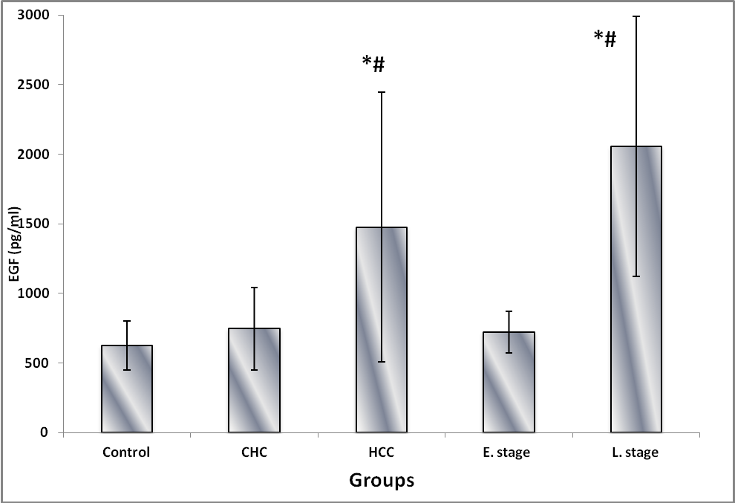
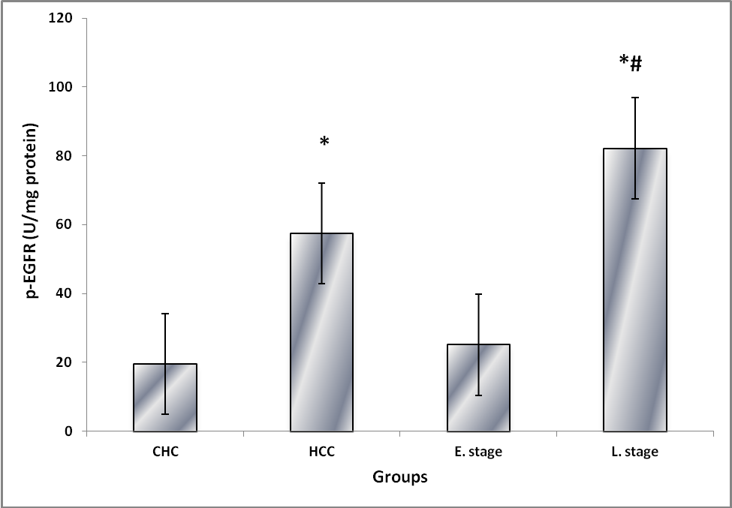
EGF and p-EGFR
EGF
p-EGFR
Notes:
Levels of EGF and p-EGFR in control subjects, CHC and HCC patients in histopathological stages (early and late stage) of HCC patients. Significant difference is compared to the control or CHC. * P<0.01: compared to control; #P<0.01: compared to CHC or E. stage. E stands for early and L stands for late

Slide 23
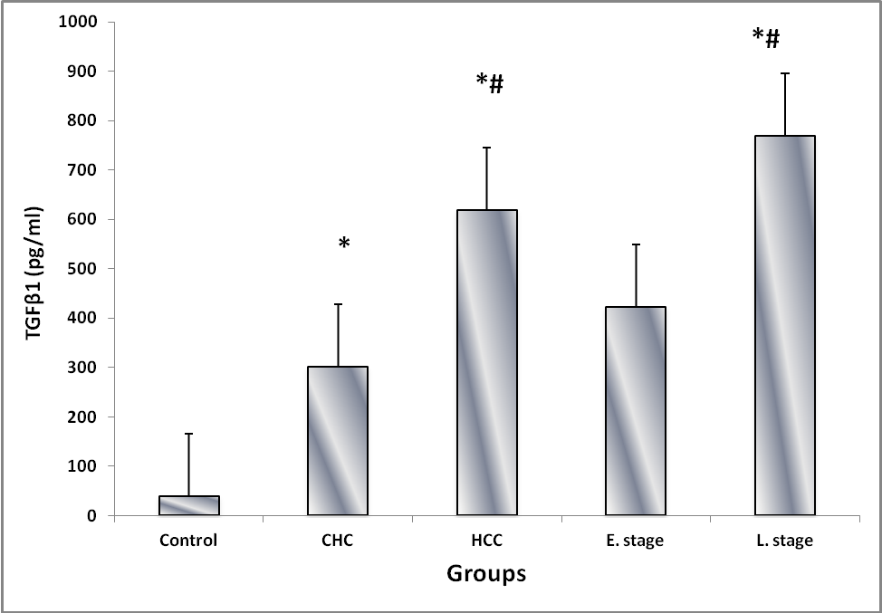
Levels of TGFβ-1
TGFβ-1
Notes:
Levels of TGFβ1 in control, CHC and HCC patients in histopathological stages (early and late stage) of HCC patients. Significant difference is compared to the control or CHC. *P<0.01: compared to control; #P<0.01: compared to CHC or E. stage. E stands for early and L stands for late.

Slide 24
Level of serum alfa-fetoprotein (AFP), aspartate aminotransferase (AST), alanine aminotransferase (ALT) and albumin of patients having HCC and CHC compared to control subjects.
Variable | Control (n = 20) | CHC (n = 20) | HCC (n = 30)
AFP (ng/ ml) | 1.6 ± 0.26 | 23.5 ± 2.3* | 445 ± 50.8*
ALB (g/dl) | 4.6 ± 0.07 | 3.3 ± 0.06* | 2.6 ± 0.05*
AST (U/L) | 19.4 ± 0.4 | 76.4 ± 3.4* | 58.5 ± 1.3*
ALT (U/L) | 15.6 ± 0.59 | 62.2 ± 4.97* | 38.1± 1.65*

Slide 25
Conclusion
EGF and its recptor phosphorylated form could be used as sensitive biomarkers for the diagnosis and prognosis of HCV-induced HCC. In conclusion, various growth factors are involved in different biological processes, some of which have a clinical importance in disease.
.

Slide 26
References
Balbaa, M., Bassiouny, K. and El-Ashry, E. S. (2008). Current Trends in Medicinal Chemistry, 5: 33-44.
Shehata, F., Abdel Monem, N., Sakr, M., Kasem, S. and Balbaa, M. (2013). Medical Oncology. DOI: 10.1007/s12032-013-0673-x.
Balbaa, M. (2013). Biochemistry & Physiology: Open Access, 2: 4, http://dx.doi.org/10.4172/2168 -9652.1000e118.

Slide 27
THANK YOU

Slide 28
Let us meet again..
We welcome you all to our future conferences of OMICS International
4th Annual Conference on European Pharma Congress
June 18-20,2016, Berlin, Germany.
http://europe.pharmaceuticalconferences.com/

