Slide 1
The effect of early exposure to haptic feedback during preclinical dental education on the development of psychomotor skills in Restorative Dentistry?
  Mahmoud M Bakr, Ward L Massey, Heather Alexander
  Presenter:
  Dr. Mahmoud Bakr
  Lecturer in General Dental Practice
  B.D.S, M.D.S (Cairo University), Grad Cert High ED (Griffith university), ADC
  Member of the Australian Dental Association (ADA), the Australian Biology Institute Inc. (ABI) the International Association of Dental Research (IADR) and the Egyptian Dental Union (EDU)

Slide 2
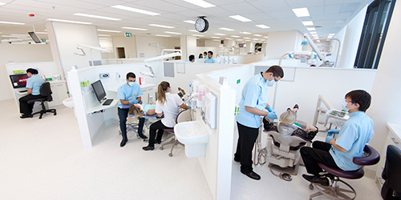
Introduction and background
In dentistry, the early development of clinical skills is a very important factor in professional training. The most important skill is the development of a fine sense of touch and pressure.
Visual skills are easily taught as they can be described. However, the tactile sense is not easily described and needs to be experienced together with feedback from a supervisor.

Slide 3
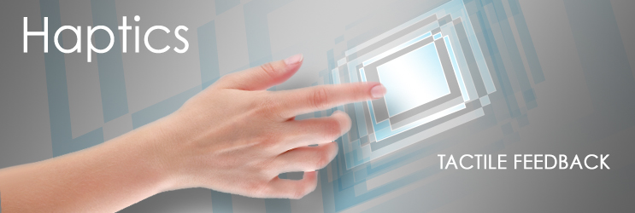
Haptic technology:
Haptic technology is a tactile feedback technology that takes advantage of a user's sense of touch by applying realistic force feedback to the user.
Haptic technology has been used with great success in the fields of medicine and surgery.

Slide 4
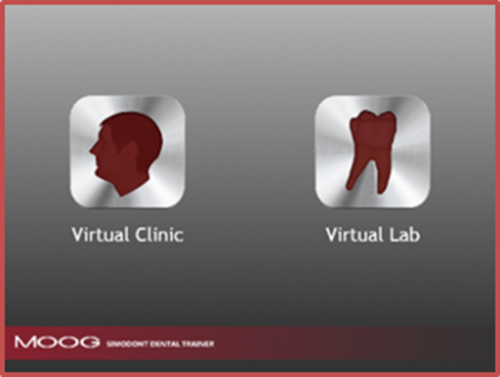
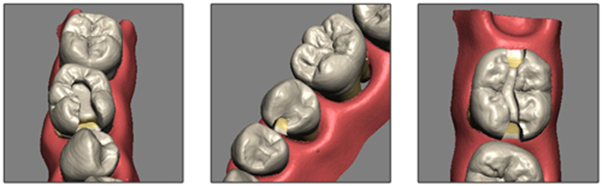
Virtual dental simulation:
Trials to develop a haptic-based Virtual Reality Dental Simulator started in 2006 by developing PerioSim™ which allows trainee to practice diagnosing periodontal diseases.
In Dentistry, early studies investigated the use of virtual reality technology in different fields such as Orthodontics, Restorative Dentistry, Orthognathic Surgery, Implantology and Endodontics.

Slide 5
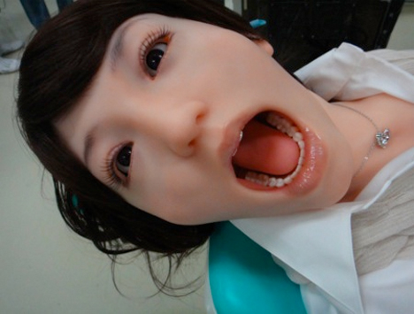
Virtual dental simulation:
Recently in Japan, a robot patient capable of performing unexpected real life situation reactions such coughing, shaking neck, tongue thrusting and salivary secretion was introduced to be used in dental education as well as medical emergency education in a dental setting, and showed effectiveness in those fields.
This is a robot not a real patient!

Slide 6
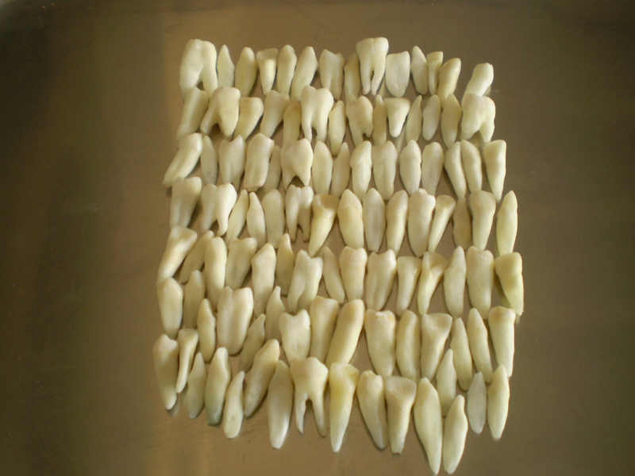
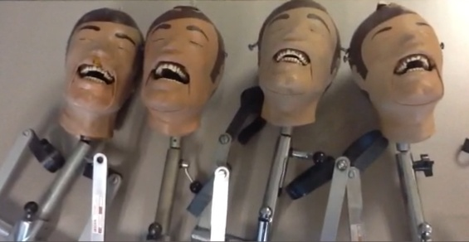
Why Virtual dental simulation?
Current traditional pre-clinical simulation methods require the use of human extracted or plastic teeth on a manikin. The limitations of these methods include:
Shortage of suitable human extracted teeth for training.
Plastic teeth do not simulate the pathologies in real teeth.
Lack of flexibility in simulating real clinical cases.
Subjective feedback in some cases from instructors.

Slide 7
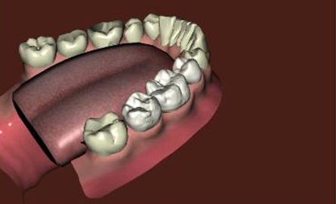
Advantages and disadvantages of virtual dental simulation
Advantages include:
Ability to perform complex procedures in a safe environment.
A well calibrated non-subjective feedback mechanism.
Less number of instructors required per session.
Ease of accessibility for students at any time for extra practice.
Disadvantages include:
High cost and a long process of assimilation.
Lack of acceptance by some staff.
Lack of long term data validating the current technologies.
Decreases the element of human interaction between students and instructors which builds up their communication skills and clinical judgement.

Slide 8
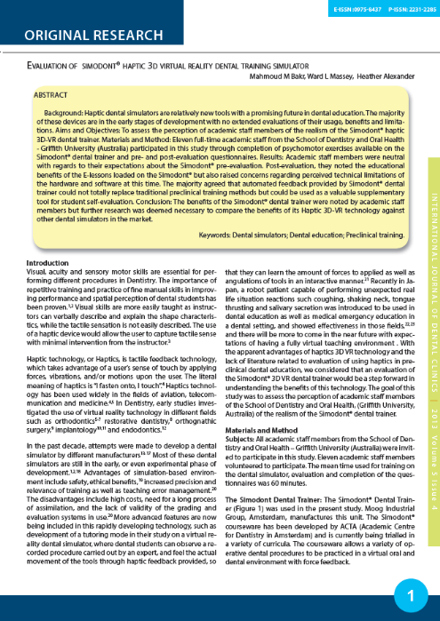
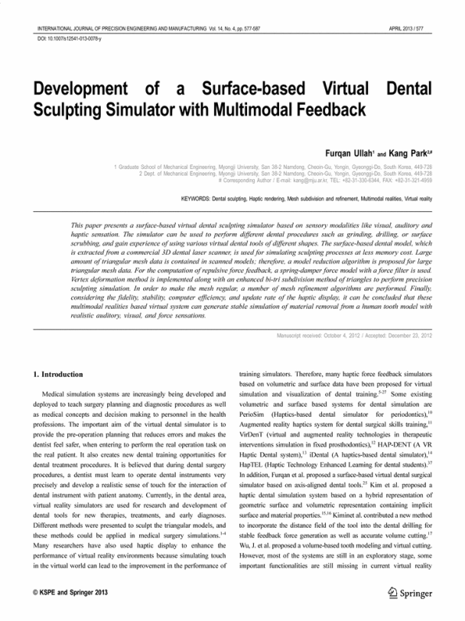
Aim of the study
Most of the virtual simulators are still new and well controlled studies of their effectiveness are lacking.
The aim of this study was to investigate the students’ perception of the MOOG Simodont® Virtual Dental Trainer, and evaluate the effect of early exposure to haptic feedback via this simulator on the development of psychomotor skills and on the subsequent performance of a previously unseen manual task.

Slide 9
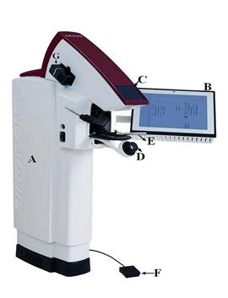
Simodont dental trainer®
The Simodont® Dental Trainer was used in the present study (manufactured by Moog Industrial Group, Amsterdam). The Simodont® courseware has been developed by ACTA (Academic Centre for Dentistry in Amsterdam) and is currently being trialled in a variety of curricula.
Simodont® dental trainer. A= The simulator unit, B= Panel PC, C= Stereo projection, D= Spacemouse, E= Handpiece, F= Foot pedal, G= Projector.

Slide 10
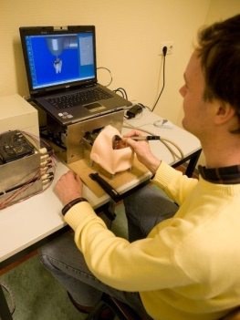
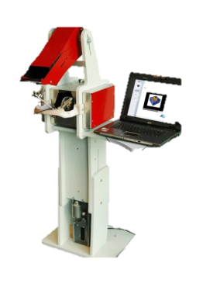
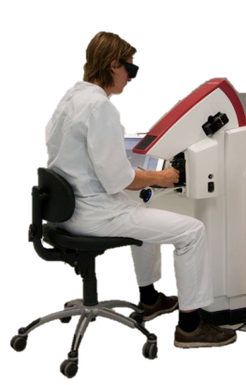
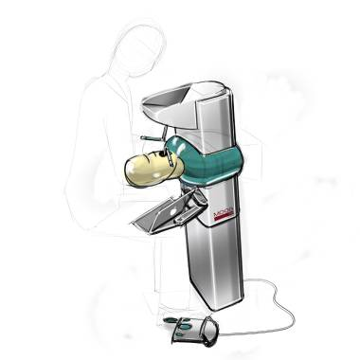
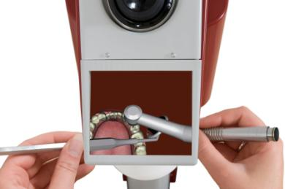
Development of the Simodont Dental Trainer
2006
2007
2010
2005

Slide 11
Subjects:
Forty (40) second year dentistry student volunteers, who at the time of participation had received only eight weeks of preclinical training on a manikin-based (ADEC) dental simulator, participated in the study and were randomly divided into two groups:
Group (A) (Early haptic group): twenty students who received their initial training on the haptic trainer, followed by a second session where they were asked to perform a similar task in a non-haptic environment.
Group (B) (Late haptic group): twenty students who commenced training in a non-haptic environment, followed by a second session where they were asked to perform a similar task in a haptic environment.
Students were asked to complete a pre-experimental and post-experimental questionnaire before after using the Simodont®. All students were then asked to perform to perform an additional unseen and previously un-attempted task (a Class II Disto-occlusal Amalgam preparation on a Permanent Mandibular First Molar represented on a Learn-A-Prep II block) to assess any changes in their psychomotor skills.

Slide 12
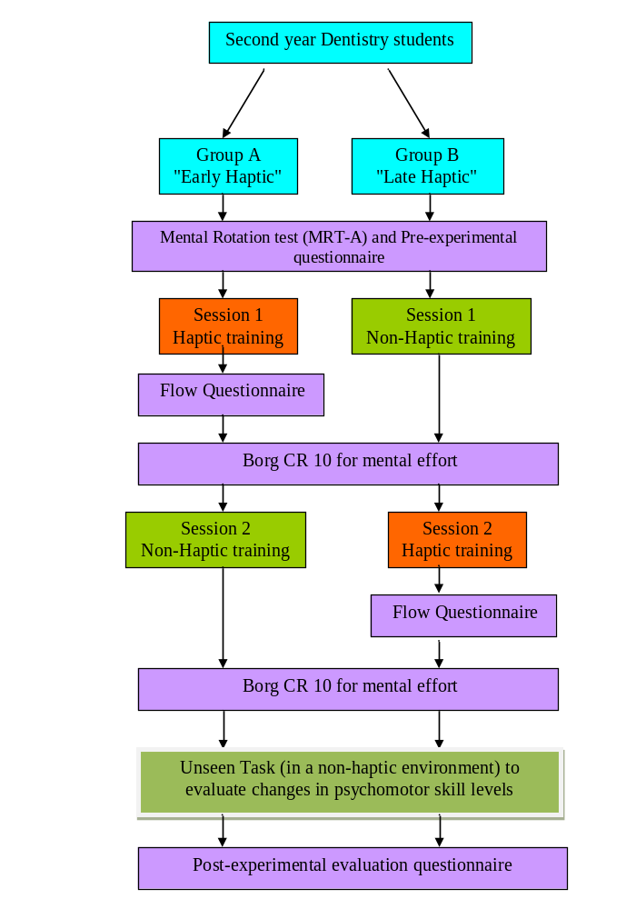
Study design:

Slide 13
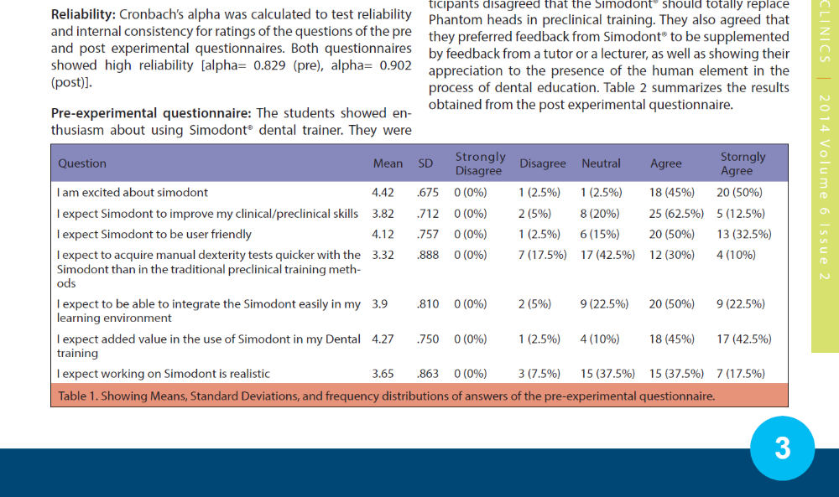
Results:
Pre-experimental questionnaire:
The students showed enthusiasm about using Simodont® dental trainer. They were less positive about the expected realism of working on the Simodont. They were almost neutral in their expectations to acquire manual dexterity skills quicker with the Simodont® than in the traditional preclinical training methods. Overall, the students’ attitude towards using Simodont® in education was positive. They expected added value in the use of Simodont® in their dental training, and also expected to be able to integrate the dental simulator easily in their learning environment.

Slide 14
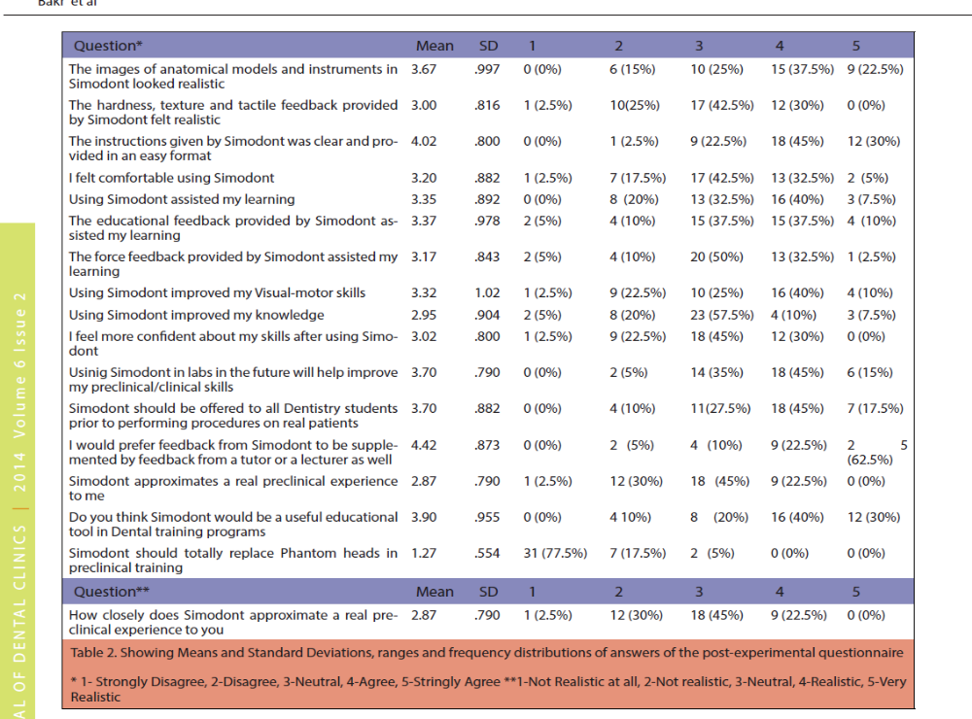
Post-experimental questionnaire:
There was a degree of satisfaction with some features of Simodont® dental trainer, while the feedback about other features was less positive. Students rated the realism of the images of anatomical models and instruments in Simodont higher than the fidelity of the hardness, texture and tactile feedback provided by Simodont®. Overall, only 22.5% of participants agreed that Simodont® approximates of a real preclinical experience.

Slide 15
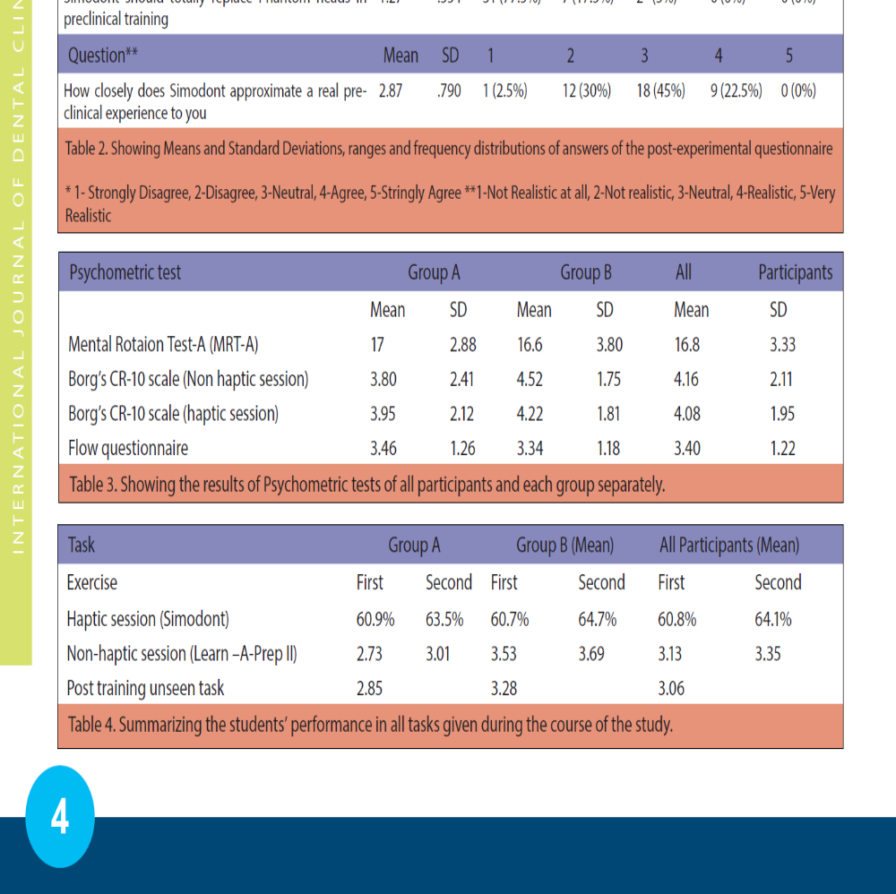
Psychmetric tests:
Statistical analysis showed the absence of significant differences between participants of both groups in terms of visual-spatial abilities, mental effort and responses to the flow questionnaire.

Slide 16
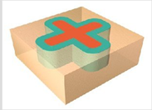
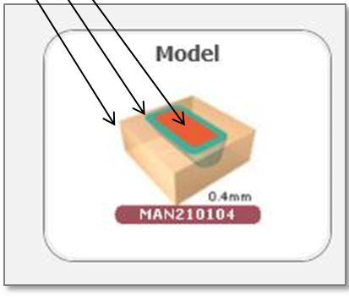
Manual training tasks:
There were no significant differences between students of group A and group B in terms of their performance in the haptic session (Paired t-test; P= 0.549 for the first exercise and P= 0.942 for the second exercise). There was a clear trend of obtaining higher scores in the second exercise in both haptic and non-haptic sessions. Statistical analysis of the students’ marks in the final unseen task showed a non- significant difference between the average scores of both groups in this task (Paired t-test; P= 0.066) which indicates that (B) students (late haptics) performed slightly better than group (A) students (early haptics) in the final unseen exercise.

Slide 17
Discussion:
The results obtained from this study confirmed the results from a previous study by the same research, which aimed at evaluation of the Simodont® dental trainer by a group of academics.
Our results suggest that longer exposure to haptic feedback might affect the performance curve positively and improve skills, speed and accuracy, which is a point for studies in the future.
Including two additional groups (One group using haptic feedback in both sessions and one group performing without haptic feedback in both sessions) and investigating the effect of long term exposure to haptics on performance in Restorative Dentistry tasks would have aided in developing a better understanding of the value of haptic feedback.

Slide 18

Discussion:
The question of whether students with lower levels of visual-spatial ability would perform well on the Simodont® or not? still requires further investigations.

Slide 19
Conclusions and recommendations:
The Simodont® dental trainer was well accepted by students in our study and they felt it could be easily integrated in their learning environment.
Students perceived many educational advantages to the Simodont® dental trainer and noted some technical limitations.
Students’ responses indicated they felt that the Simodont® cannot solely replace neither traditional educational methods nor a human lecturer or tutor.
There is no clear evidence in this study that short-term and early exposure to haptic 3D VR feedback helps in development of psychomotor skills in Restorative Dentistry ahead of existing manikin based methods.
More studies are required to investigate the value of long-term use of the Simodont® dental trainer for novice and expert users.

Slide 20
Acknowledgements:
Simodont® dental trainers were leased from the manufacturers for evaluation and assessment. No Simodont company representative was involved in designing the study or analyzing the results. This study was not financially supported by any commercial sources.
The images used in this study remain the proprietary property of MOOG Inc. and can only be used and reproduced with the explicit approval of MOOG Inc.

Slide 21
References:
Arnold DS, Philip GB, James D, Seema A, Milos Z. Assessment of Faculty Perception of Content Validity of PerioSim©, a Haptic-3D Virtual Reality Dental Training Simulator. J. Dent.Edu 2007; 71(12): 1574-1582.
Bakr M, Massey W, Alexander H. Academic evaluation of Simodont® haptic 3D virtual reality dental training simulator. Int J Dent Clin. 5(4): 1-6.
Carriere J, Carriere L. Softlanding treatment through inverse anchorage and virtual reality.J Clin Orthod 1995;29:479–86.
Harris W. How Haptic Technology Works. [Accessed September 26, 2013]. Available from:http://electronics.howstuffworks.com/gadgets/other-gadgets/haptic-technology.html
Herder J, Myszkowski K, Kunii TL, Ibusuki M. A virtual reality interface to an intelligent dental care system. Stud Health Technol Inform 1996;29:400–10.
Kim L, Hwang Y, Park SH, and Ha S. Dental training system using multi-modal interface. Computer-Aided Design & Applications. 2005; 2(5) :591–598.
Luciano CJ. “Haptics-based virtual reality periodontal training simulator,” Master's thesis, Graduate College of the University of Illinois, 2006.
Lyroudia K, Mikrogeorgis G, Bakaloudi P, Kechagia E, Nikolaidis N, Pitas I. Virtual endodontics: three dimensional tooth volume representations and their pulp cavity access. J Endod 2002;28:599-602.
Seipel S, Wagner IV, Koch S, Schneide W. Oral implant treatment planning in a virtual reality environment. Comput Methods Programs Biomed 1998;57:95–103.
Snow MD, Graham JA, Yates WJ. Interactive computer technologies in dentistry: virtual reality in orthodontics. Stud Health Technol Inform 1996;29:411–22.
Verstreken K, Van Cleynenbreugel J, Marchal G , Van Steenberghe D, Suetens P. Computer assisted planning of oral implant surgery: an approach using virtual reality. Stud Health Technol Inform 1996;29:423–34.
Wagner A, Rasse M, Millesi W, Ewers R. Virtual reality for orthognathic surgery: the augmented reality environment concept. J Oral Maxillofac Surg 1997;55:456–63.

