Slide 1

Nutrition Education for Adolescent Athlete: Nutrition Curriculum
Mahmoud Alkhateib,PhD
Sports Dietitian - Orthopedic and Sports Medicine Hospital (Aspetar), Qatar
Notes:
Aspetar is the world’s leading specialised orthopedic and spors medicine hospital staffed by some of the world’s leading sports medicine practioners and researchers
Aspetar accerdited by FIFA medical cenetr of excellence

Slide 2

Aspire Academy
Notes:
Aspire academy is mandated to provide sports training and education to students with sporting potential, in an exceptional learning sporting environment

Slide 3
Background
Nutrition education is an evidence-based way to improve health outcomes and foster healthy eating habits for a lifetime in school children (CNR, 2015).
Research validates that behavioral change correlates positively with the amount of nutrition instruction received (CDC, 1996).
School athletes lack the knowledge to make good nutritional decisions to improve health, performance and growth (Douglas,1984; Cotugna,2005; Shifflett,2002)

Slide 4
Why Teach Nutrition
Promote optimal childhood health
Rise nutrition awareness among students
Improve dietary intake and perceived sport performance among athletes.
Achieve full educational potential by providing them with the skills and support they need to adopt long-term healthy eating behaviors.

Slide 5
Nutrition Curriculum
Develop and implement nutrition education curricula at Aspire academy school for grades 7 & 8.
Conceptual Framework
Who: learners, teachers.
What: purpose, educational experiences, contents.
How: organized, evaluate
Notes:
Who are learner target group
Who will teach this curriculum
What are the purposes that an educational program should seek to attain
What educational experiences can be provided
How can these educational experiences ot activities be organized
How we can evaluate whether these purposes are being attained

Slide 6
Curriculum Development Process
Select Frame Work
March 2015
Select Content & Objectives
April 2015
Design & Learning Experiences
May – June 2015
Start & Evaluate
Sep.2015
Assess Needs
Feb. 2015
Tyler’s Model
Notes:
Assess needs and interests \: learners themselves what are their nutritional needs and interests, nutritional problems they have , nutritional knowledge, their food attitudes, educational needs,.
Society: what does the nation need in terms of the nutritional health of its citizens what are the nutrition goals of the country.
Nutritionist: what do they think people should know
Teachers: the experience and knowledge they have , the time and recourses their own nutritional knowledge
After that how we can select the framework articulate with our educational philosophy and psychology
Design the learning experiences to reach objectives – activities , to bring about the desired changes in students
Evaluate if objectives have been met – if not, analyze and redirect by going back to step one.
Scenario: a nutrition eductaor asked to design a five session program on nutrition for parents of adolscents in a small village. She choose her first lecture on carbs, protein and fat. She is in the middle of it when a member of the audience mother ask loudly do you have recipes for making good healthy snacks for my child to eat after school. Followed by fall of questions from others on how to select and prepare foods and non on the topic of the lecture

Slide 7
Food Habits Among Qatari School Children
 | Boys |  | Girls |  | Total
Skipping Meals | No | % | No | % | No |  | %
Breakfast | 150 | 30.5 | 324 | 32.2 | 474 | 31.6
Lunch | 35 | 7.1 | 53 | 5.3 | 88 | 5.9
Dinner | 30 | 6.1 | 48 | 4.8 | 78 | 5.2
Total | 215 | 45.9 | 425 | 44.3 | 640 | 44.8
Eating Fast Food
1-2 time / week | 358 | 72.8 | 790 | 78.7 | 1148 | 76.6
3-4 time / week | 77 | 15.7 | 98 | 9.8 | 175 | 11.7
> 4 time / week | 16 | 3.3 | 28 | 2.8 | 44 | 2.9
Eat meals at regular times | 337 | 68.5 | 691 | 69.1 | 1028 | 68.8
Watching TV during eating | 360 | 73.3 | 705 | 70.6 | 1065 | 71.0
Eating between meals | 463 | 93.9 | 937 | 93.2 | 1400 | 93.4
Sweets | 249 | 50.5 | 510 | 50.7 | 759 | 50.6
Carbonated beverages | 147 | 29.8 | 201 | 20.0 | 348 | 23.2
Chips | 292 | 59.2 | 574 | 57.1 | 866 | 57.8
Chocolate | 215 | 43.6 | 441 | 43.8 | 656 | 43.8
Sandwich | 149 | 30.2 | 282 | 28.0 | 431 | 28.8
Fruit | 200 | 40.6 | 464 | 46.1 | 664 | 44.3
Alkhateib M. et al (2013): Influence of dietary habits on body weight in Qatari school children. Obesity Facts, 6(suppl. 1):164

Slide 8
Obesity Among Qatari School Children
Alkhateib M. etal (2013): Influence of dietary habits on body weight in Qatari school children. Obese. Facts, 6(suppl. 1):164

Slide 9
Assessment needs
Health Center | Learners | Nutritionist | Teachers | Coaches
Vitamin D & Iron deficiency | Poor nutrition Knowledge | Basic Nutrition knowledge | Objectives, expectations, activities | Meals Frequency & Consistency
Healthy eating | Missing Meals | Healthy eating & behavior | Lesson plan | Hydration
Food related disease | Junk foods | Macro & Micro Nutrients | Teacher supplements | Food wastage
Assessment of Needs, Aspire Academy, 2015

Slide 10
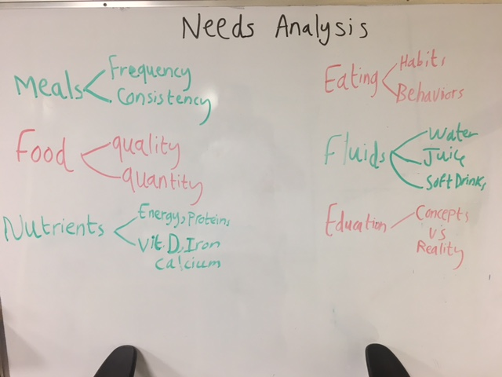

Slide 11
Nutrition Curriculum – Syllabus (Grade 7)
  Aspire Cafeteria Rules & Behavior.
  Aspire Food System
  Serving Size
  Nutrition & Energy
  Growth
  Identify Body’s Nutritional Needs
  Nutrition in Health & Disease
  Qatar Dietary Guidelines
  Food Label
  Fluids

Slide 12
Nutrition Curriculum – Syllabus (Grade 8)
  Nutrients
  Carbohydrate
  Dietary Fiber
  Protein
  Fat
  Vitamins
  Vitamin D
  Minerals
  Iron
  Calcium
  Water

Slide 13
Curriculum Implementation
Nutrition Curriculum should:
Address the needs and interests of students, the teachers and the school
Relevant to program goals
Take into account what children already know and can do
Culturally appropriate
Delivered in a way children can understand and teach the skills and knowledge required to improve or strengthen healthy eating habits

Slide 14
Curriculum Implementation
Cross Curricula – Science.
One nutrition class / week.
Deliver the facts in a different ways.
Daily monitoring during meals intake.

Slide 15
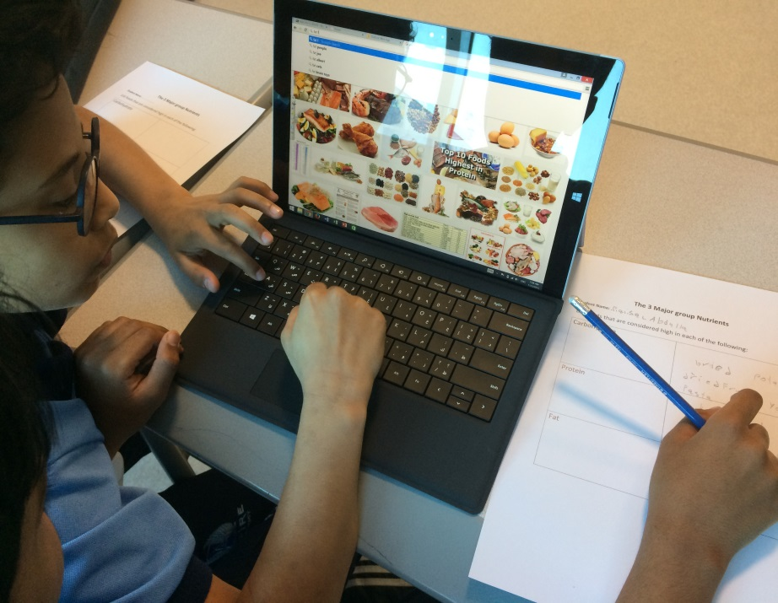
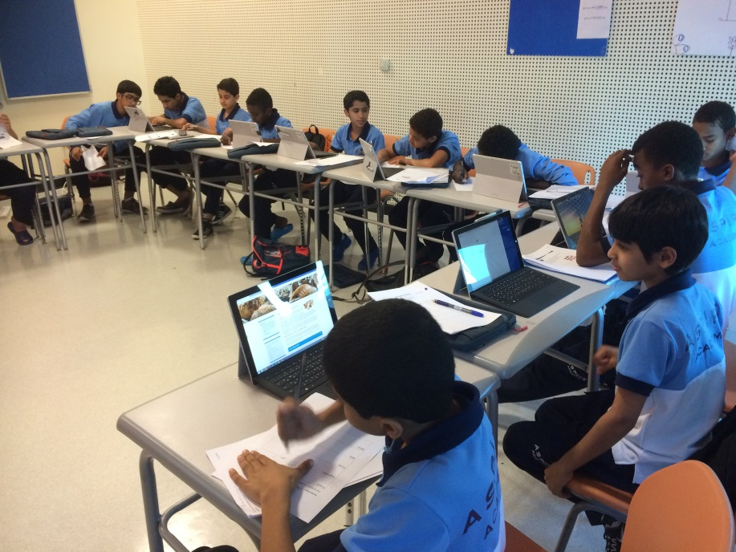
Using Technology

Slide 16
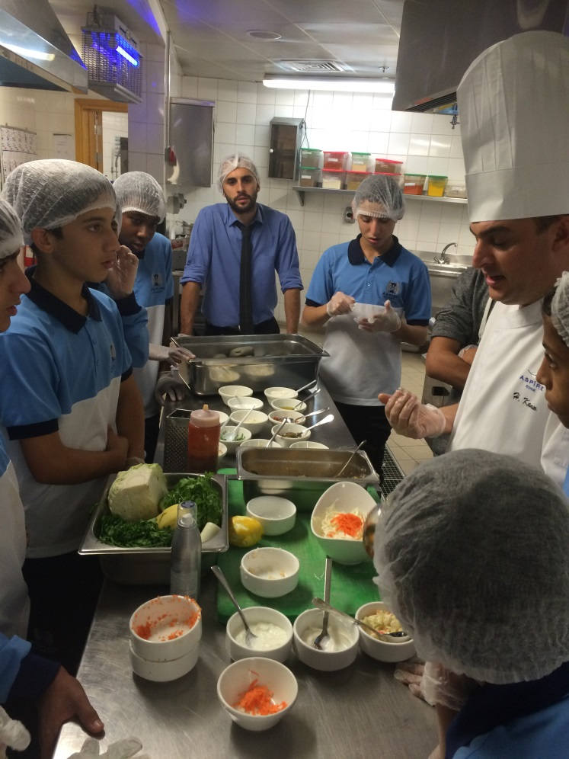
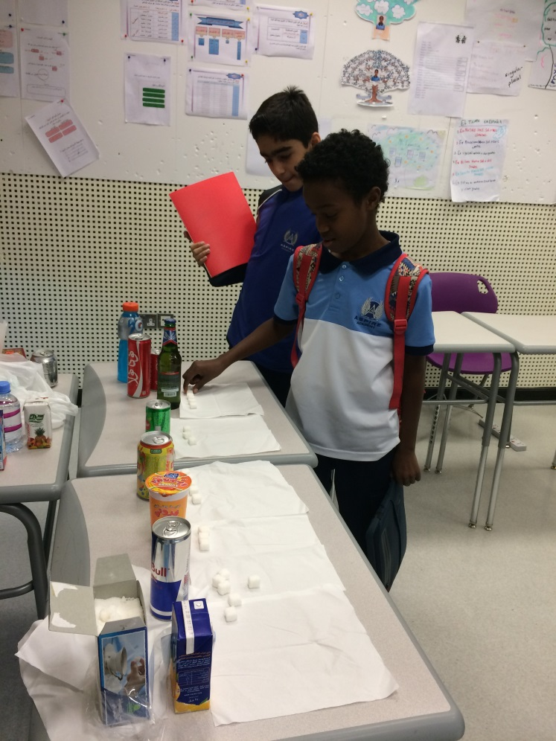
Live Cooking Lessons

Slide 17

Aspire Food System
ENERGISE FOODS
PROTECT FOODS
(Carbs)
(Vitamins and Minerals)
Pasta, Rice, Bread, Potato,
Cereals
Fruits
Vegetables
REPAIR FOODS
(Proteins)
Meat, chicken, fish, dairy, eggs, legumes, nut

Slide 18
How to improve nutrition education in schools?
Schools should provide nutrition education that:
Target specific behaviors or practices.
Focus on the interests and motivations of targeted population.
Provide sufficient time and intensity
Using multiple components – like classroom-based strategies, cafeteria interventions, and home and community components to focus on specific positive behaviors
Includes training for teachers and other staff

Slide 19
Effect of nutrition education – Case Study
A study objected to determine the effect of nutrition curriculum on selected food/nutrition attitudes, and food behaviors of high school students.
Methodology:
Experimental group was pretested, taught nutrition via the curriculum, and post-tested. Control group was pretested and post-tested. Three instruments used to collect data: a nutrition knowledge test, a food/ nutrition attitude instrument containing four scales, and a two part food behavior assessment form.

Slide 20
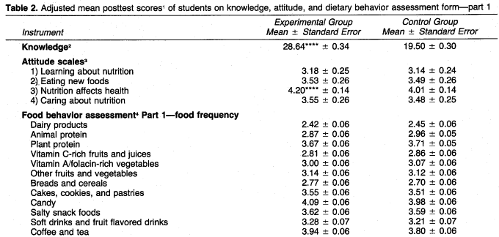
Parks,R.B .Helwig and others .2016
Developing a Performance Nutrition Curriculum for Collegiate Athletics.
Journal of Nutrition Education and Behavior, 48(6). doi:10.1016/j.jneb.03.002
Notes:
The results indicate that the experimental group had significantly improved knowledge scores and improved attitude scores on the scale entitled nutrition affects health.
No significant changes were observed in post-test scores on the food behavoir assessment form.

Slide 21
References
Alkhateib M. et al (2013): Influence of dietary habits on body weight in Qatari school children. Obesity Facts, 6(suppl. 1):164
Contento, I. R. (2008). Nutrition education: linking research, theory, and practice. Asia Pacific Journal of Clinical Nutrition, 17(S1), 176-179.
Parks, R. B., Helwig, D., Dettmann, J., Taggart, T., Woodruff, B., Horsfall, K., & Brooks, M. A. (2016). Developing a Performance Nutrition Curriculum for Collegiate Athletics. Journal of Nutrition Education and Behavior, 48(6). doi:10.1016/j.jneb.2016.03.002
Perez-Rodrigo, C., & Aranceta, J. (2003). Nutrition education in schools: experiences and challenges. European Journal of Clinical Nutrition, 57, S82-S85.
USDA Food and Nutrition Service. (2010). Nutrition Education and Promotion: The Role of FNS in Helping Low-Income Families Make Healthier Eating and Lifestyle Choices
Wang, D., Stewart, D., Chang, C., & Shi, Y. (2015). Effect of a school-based nutrition education program on adolescents’ nutrition-related knowledge, attitudes and behavior in rural areas of China. Environmental Health and Preventive Medicine, 20(4), 271–278.

