Slide 1
About Omics Group
OMICS Group International through its Open Access Initiative is committed to make genuine and reliable contributions to the scientific community. OMICS Group hosts over 400 leading-edge peer reviewed Open Access Journals and organize over 300 International Conferences annually all over the world. OMICS Publishing Group journals have over 3 million readers and the fame and success of the same can be attributed to the strong editorial board which contains over 30000 eminent personalities that ensure a rapid, quality and quick review process.

Slide 2
About Omics Group conferences
OMICS Group signed an agreement with more than 1000 International Societies to make healthcare information Open Access. OMICS Group Conferences make the perfect platform for global networking as it brings together renowned speakers and scientists across the globe to a most exciting and memorable scientific event filled with much enlightening interactive sessions, world class exhibitions and poster presentations
Omics group has organised 500 conferences, workshops and national symposium across the major cities including SanFrancisco,Omaha,Orlado,Rayleigh,SantaClara,Chicago,Philadelphia,Unitedkingdom,Baltimore,SanAntanio,Dubai,Hyderabad,Bangaluru and Mumbai.

Slide 3


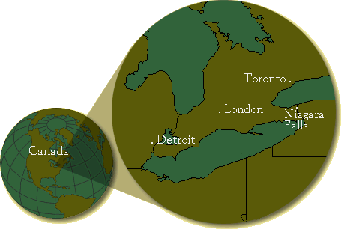
Optoelectronics of
Nanocomposites
Mahi R. Singh
msingh@uwo.ca
Department of Physics and Astronomy
Western University
(The University of Western Ontario)
London, Canada
optics2014

Slide 4


Niagara Falls

Slide 5
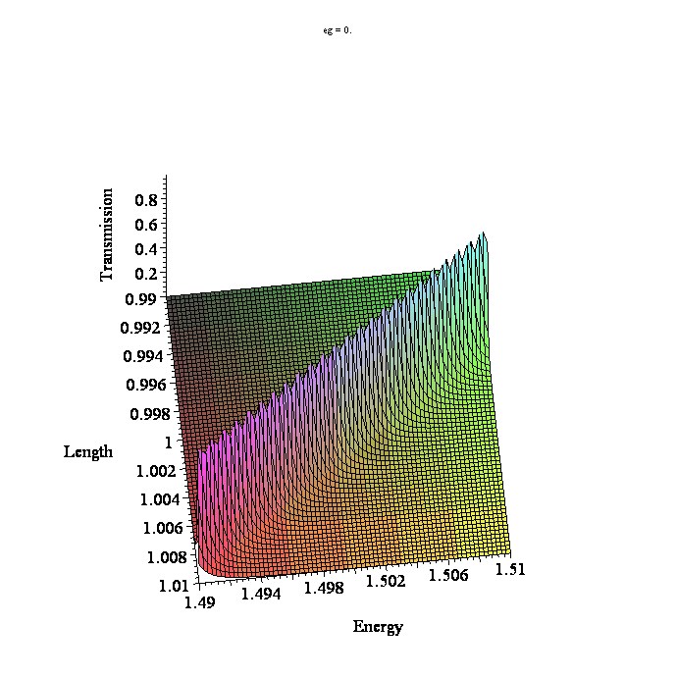
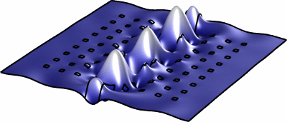
Outline
Hybrid Metallic Nanomaterials
Metallic nanomaterials: plasmonics
    Nobel metals : Gold, Silver
    Graphene
    Metamaterials
Photonic materials: Photonics
    Metamaterials
    Photonic crystals
One- and two-photon switching
sensors
Photoluminescence enhancement
Conclusion

Slide 6
Collaborators
  Graduate Students
  J. Cox
  D. Schindel
  C. Racknor
  Ifte Haque
  M. Brzozowski
  S. Balakrishan
  Undergraduate Students
  J. Richmond
  J. Flannery
  J. McKechnie
  Scientists
  Scott Barrie
  Chandra Shekhar
  S.P. Singh
  International Collaborations
  UK
  Y. Zhang
  D. Birch
  Y. Chen
  Spain
  M. Antón,
  F. Carreño,
  S. Melle,
  O. Calderón,
  E. Cabrera-Granado,
  USA
  S. Sadeghi
  S. Pinnepalli
  R. Agarwal
  G. Gumbs
  Argentina
  C. Bildering
  A. Bragas
  Israel
  Boris Fainberg HIT
  Eugene Kogan- Bar Ilan
  M. Auslender: Ben Guiran
  Egypt
  Aarafa H. Aly
  Canadian Collaborations
  M. Zinke-Allmang
  S. Mittler
  Jai Sabrinathan
  R. Lipson

Slide 7
Hybrid Nanomaterials
Nanomaterials:
Metamaterials
Graphene
Semiconductor nanoparticles (quantum dots, nanocrystals, nanowires, etc.)
Metallic nanoparticles (spheres, nanorods, nanodisks, etc.)
Substrate examples:
  Metamaterials
  Dielectric material
  Excitonic material
  Polaritonic material
  Polar materials
  Photonic crystal
Semiconductor Quantum Dot
Graphene

Slide 8
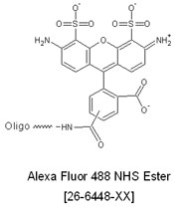
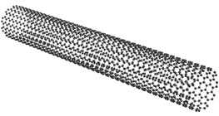
Hybrid Nanomaterials
By using various combinations of nanostructures
one can create enormous numbers of nanocomposite (hybrid) materials.
Substrates: dielectrics, photonic crystals, metamaterials
Metal
Nanoparticle
Semiconductor Quantum Dot
Semiconductor Quantum Dot
Metal
Nanorod
Semiconductor Quantum Dot
Semiconductor Quantum Dots
Graphene
Molecular Dye, Biomaterials
Semiconductor Quantum Dot
Quantum Dot
(PbSe)
Metamaterial
Carbon Nanotube
Semiconductor Quantum Dot

Slide 9
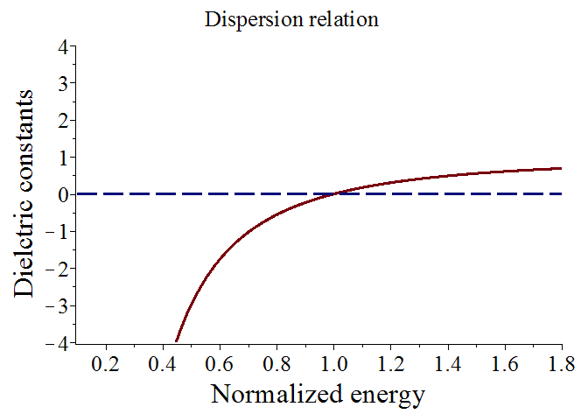
Metallic Nanomaterials: Plasmonics
J. Cox and Mahi Singh, Nanotechnology (2013)
Metallic nanostructures: Gold, silver, copper
Metals have free electrons which oscillate collectively to produce plasmons
Dielectric constant
Dielectric constant is negative

Slide 10

Metallic Nanomaterial: Graphene
Graphene was invented by a Canadian physicist
P.R. Wallace (1915-2006)
McGill University, Montreal
Worked with Leopold Infeld, (Albert Einstein), NF Mott
1947: P.R. Wallace : Phys. Rev. 71, 622-634 (1947)
Graphite-moderated nuclear reactor project
(this project was part of a plan to develop
nuclear weapons during the II world war)
Graphene is a gapless semiconductor
2010 Nobel Prize in Physics:
Andre Geim, Konstantin Novoselov

Slide 11
Mahi Singh and PR Wallace
Gapless Semiconductors
M. SINGH and P.R. WALLACE , J. PHYSICS C 20, 2169, (1987).
GUPTA, WALLACE and SINGH , J .PHYSICS C19, 6373 (1986).
M. SINGH and P.R. WALLACE, SOLID STATE COMMUN. 53, 165 (1985).
M. SINGH and P.R. WALLACE, J. PHYSICS C17, 5303 (1984).
M. SINGH amd PR Wallace, J. PHYS. CHEM. SOLIDS 45,409 (1984).
M. SINGH, P.R. Wallace and J. Leotin, J. PHYS. C17, 1385 (1983).
M. SINGH and P.R. WALLACE , J. PHYS. C16, 3877 (1983).
SINGH, LEOTIN and WALLACE, PHYS. STAT. SOLIDI B115, 105 (1983).
M. SINGH and P.R. WALLACE , SOLID STATE COMM. 45, 9 (1983).
M. SINGH, J. and P.R. WALLACE , PHYSICA B117, 441 (1983).
SINGH, P.R. WALLACE, ASKENAZY, J. PHYSICS C15, 6731 (1982).
SINGH, CISOWSKI, WALLACE, PORTAL, BROTO,
Phys. Stat SOLIDI B114, 481 (1982).
(1915-2006)
P.R. Wallace
McGill University, Montreal
I called him “SIR” and he did not like it.
I have a graduate student who always calls me “SIR” and I like it and he is my favorite student.

Slide 12
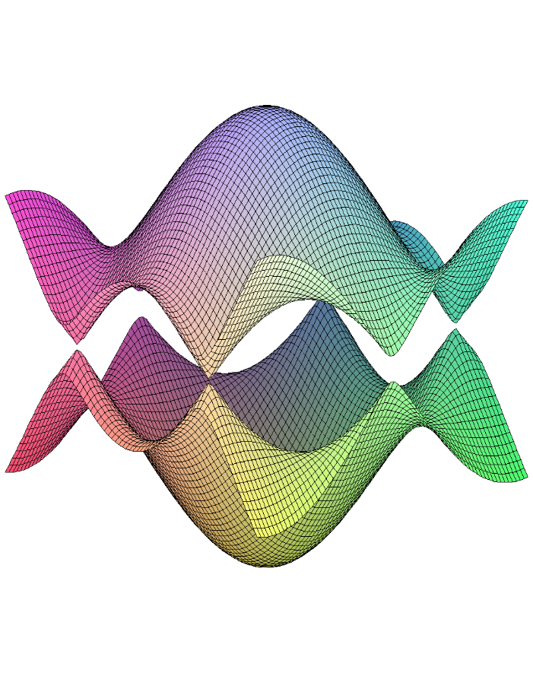
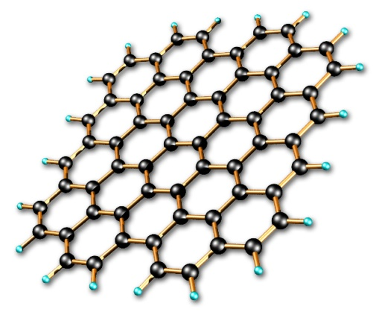

Graphene : Plasmonics
P.R. Wallace, Phys. Rev. 71, 622-634 (1947)
Graphene is a two dimensional sheet of carbon atoms which are arranged in the honey comb structure.
Carbon atoms (Honey comb structure)
E
Band structure:
Gapless semiconductor and acts as a metal.
k.p method
Tight binding method
k
Mahi R. Singh, Electronic, Photonic, Polaritonic and Plasmonic Properties of aterials
(Wiley Custom, Toronto, 2014)
Dielectric constant
E
k
Dielectric constant is negative
A.N. Grigorenko et al, Nature Photonics 6, 749 (2012)

Slide 13
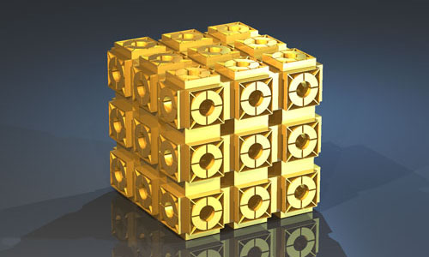
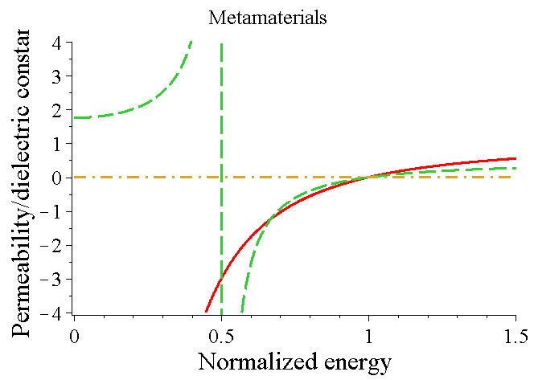
Metamaterials: Plasmonics
Mahi Singh. J. Cox, M. Brzozowski : J. Physics D: Applied Physics (2014)
Mahi Singh. C. Rackner, M. Brzozowski: Physical Review A (2014)
J.C. Bose, Proc. Royal Soc. 63, 146 (1988)
J.B. Pendry, Phys. Rev. Lett. 85, 3966 (2000)
Artificial materials made from negative dielectric constant an negative magnetic permeability
Unit cell =20-500nm, energy range= GHz-THz
Unit cell
Split ring
resonators
(SRR)
Metallic
rod
2-D-Metamaterial
3-D metamaterials
a
Dielectric constant negative magnetic permeability
A
B
Note: ϵ and µ are negative between A and B
Dielectric constant is negative

Slide 14
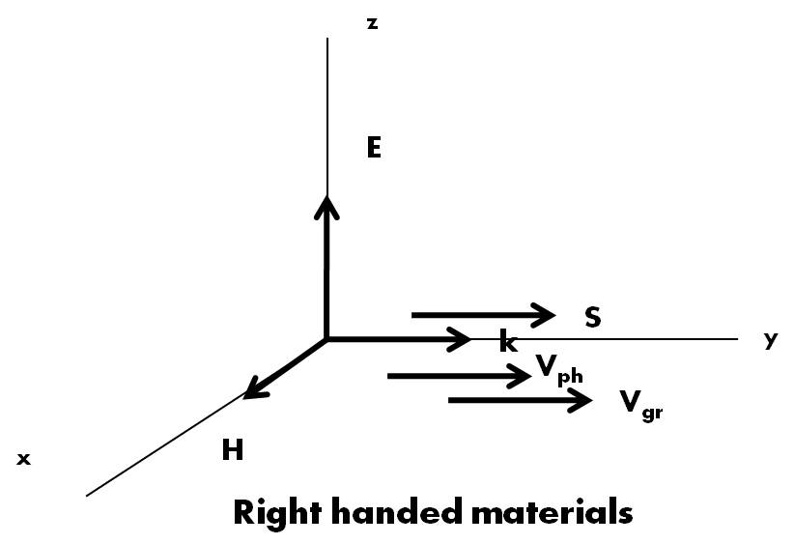
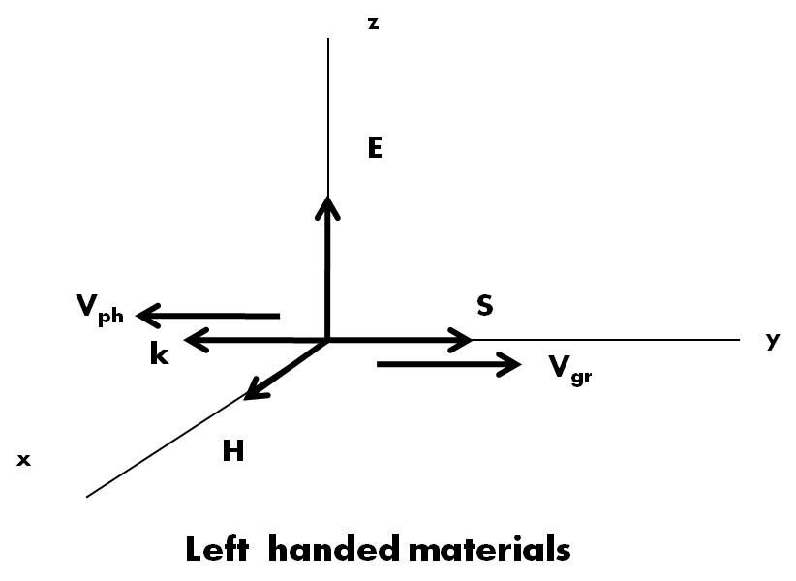
Metamaterials: plasmonics
Mahi Singh. J. Cox, M. Brzozowski : J. Physics D: Applied Physics (2014)
Mahi Singh. C. Rackner, M. Brzozowski: Physical Review A (2014)
Natural Materials
Maxwell equations:
Poynting Vector (direction of the energy flow)
Natural materials follow the Right Hand Rule (Right handed materials)
Metamaterials
Maxwell equations:
Poynting Vector (direction of the energy flow)
Metamaterials follow the Left Hand Rule (Left handed handed materials)

Slide 15
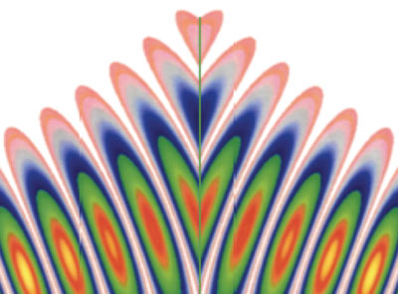
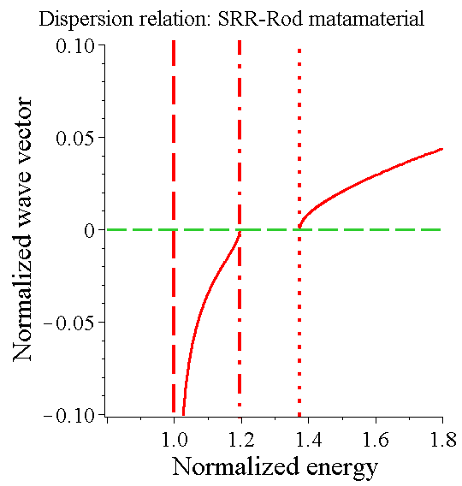
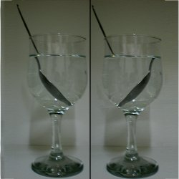
Metamaterials: plasmonics
Mahi Singh. J. Cox, M. Brzozowski : J. Physics D: Applied Physics (2014)
Mahi Singh. C. Rackner, M. Brzozowski: Physical Review A (2014)
Snell’s law
Natural
material
Metamaterial
Incident light
Refracted light
Band structure
Incident light
Refracted light
3-D metamaterials
Band gap
Cloaking: spaceships and individuals entirely invisible in light.

Slide 16
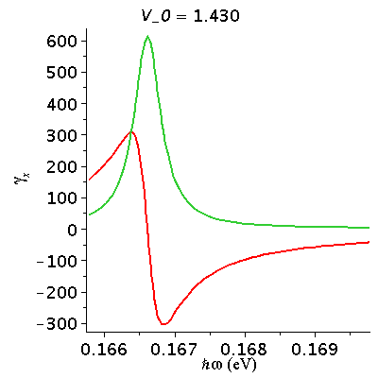
Electric Field: Metallic Nanomaterials
J. Cox and Mahi Singh, Nanotechnology (2013)
SPP Electric Field
Graphene: Gate voltage
Plasmon frequency can be changed by applying the gate voltage.
Gate voltage changes the Fermi energy.
Parameters: Radius= 8 nm; v_{F} = c/300; µ = 10000 cm²V⁻¹s^{-1;} ε_{b} = 10.89 (GaAs)

Slide 17
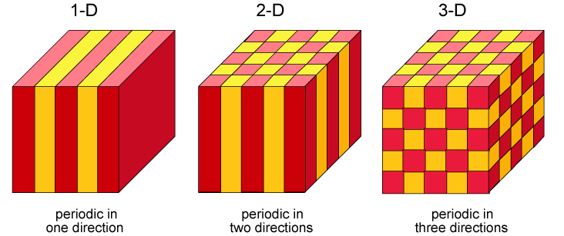

Photonic Crystals: Photonics
Photonic Insulators
E. Yablonovitch, PRL 58, 2059 1987
Semiconductors of Light
S. John, PRL 58, 2486 1987
Periodic dielectric
lattice
Periodic dielectric
constant function
Revenge of
Electromagnetism
Stop Bands: control
of light propagation
Complete and Partial
gaps
Source: math.utwente.nl/~hammer/Metric/Illust/
Source: “Photonic
Crystals”,
Joannopoulos,
Meade and
Winn.
n₁
n₂

Slide 18
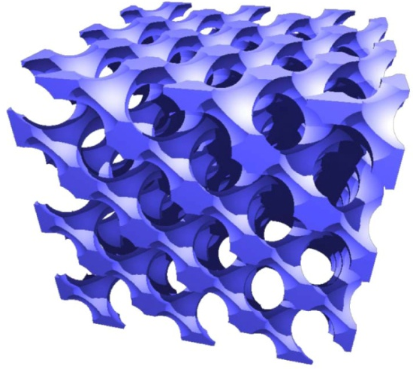
Photonic Materials: Photonics
I. Haque and Mahi Singh. J. Phys. Condens. Matter 19, 156229 (2007)
Air
Dielectric spheres (Si) in air
Lattice constant a=300nm; Radius r/a=0.3;
Spheres= Si (n=3.4); Background air (n=1)
a=300nm
Radius= r
Photonic
crystal
Conduction band (CB)
Energy gap
Valence band (VB)
Note: The location and value of the gap
depend on the refractive index.
Source: S. John, O. Toader and K. Busch, PBG Materials: A Semiconductor for Light, 2002.

Slide 19
Metamaterials: Photonics
Mahi Singh. J. Cox, M. Brzozowski : J. Physics D: Applied Physics (2014)
Mahi Singh. C. Rackner, M. Brzozowski: Physical Review A (2014)
Band structure:
Metamaterials have Periodic structure
Solving Maxwell equations in
periodic refractive index
2-D-Metamaterial
3-D metamaterials
Band gap

Slide 20
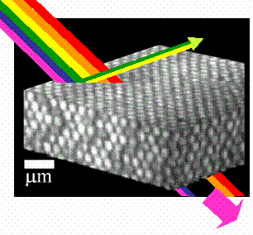
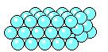

Metamaterials/photonic crystal
Reflected Colours
-Yellow
-Green
Transmitted Colours
-Purple
-Orange
-Red
-Blue
http://people.umass.edu/dinsmore/gif_images/photonics3.gif

Slide 21
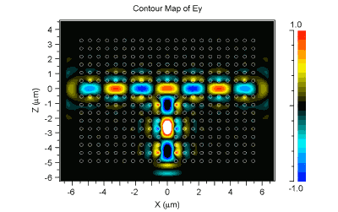
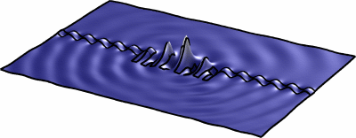
Photonic Crystals: Applications
Photons are confined in a nano-size material
Photons are confined in 2-d
nanometer
Source: math.utwente.nl/~hammer/Metric/Illust/
90º Light Splitter
http://www.photeon.com/images/pc/animation.gif

Slide 22
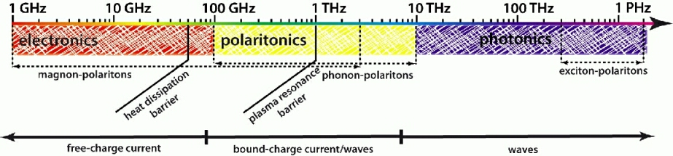
Applications: Polaritonic Materials
C. Racknor, Mahi Singh. Phys. Rev. B 82, 155130 (2010)
Cox, Singh and Racknor, Nano Lett. 11, 5284 (2011)
Polaritonic materials have a band gap that lies in the terahertz frequency range.
This opens a new realm of possibilities for opto-electronic devices because this range of frequencies is intermediate between the operational frequency ranges of photonics and electronics.

Slide 23
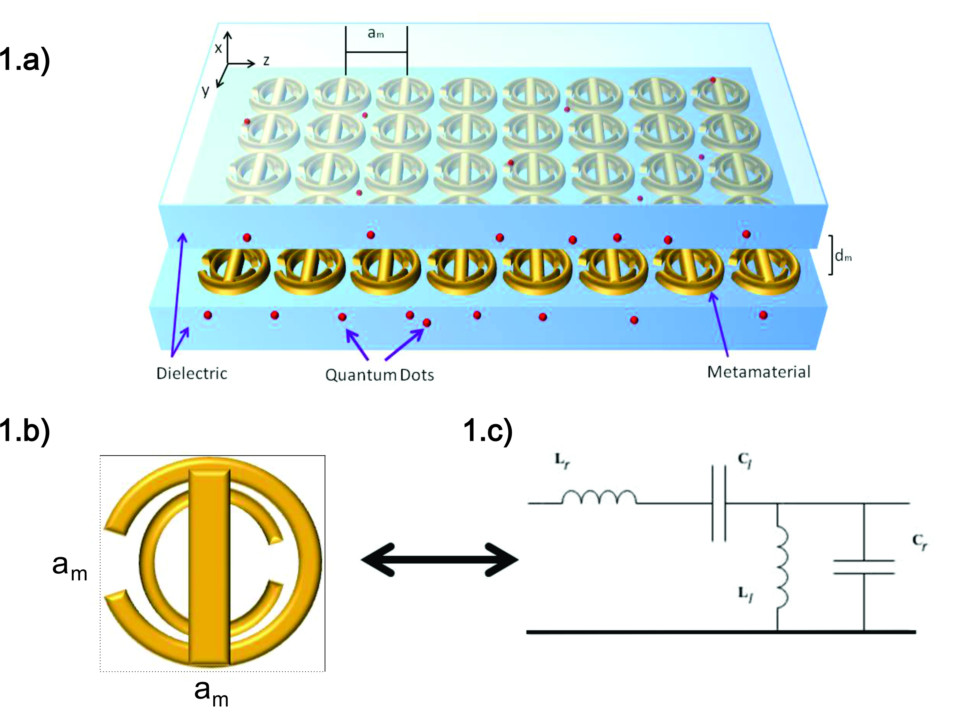
Graphene/Quantum Dot Hybrid
deposited on a Photonic Crystal /Metamaterials
We consider a nanocomposite consisting of a graphene nanoflake and a QD
The graphene-QD nanocomposite is embedded in a photonic crystal
When external laser fields are applied, plasmons in graphene interact with excitons in the QD
Photonic crystal serves as an electromagnetic reservoir for the QD
Quantum Dot
Graphene Nanoflake
Photonic Crystal
Cox , Singh et al, Physical Review B 86, 125452 (2112)
Singh ,Cox et al , Advance Materials (2013)

Slide 24
Dipole-Dipole Interaction
In QD-MNP hybrids, excitons in the QD and localized surface plasmons in the MNP interact via the dipole-dipole interaction (DDI)
This interaction is strong when the QD and MNP are in close proximity and their optical excitation frequencies are resonant
Cox and Singh, Physical B 86, 125452 (2012)
Hatef and Singh, Nanotechnology 23, 205203 (2012)
Quantum Dot
Dipole-Dipole Interaction
Semiconductor Quantum Dot
External Field E₀ cos(ωt)
R
Metal
Nanoparticle
Graphene Nanodisk

Slide 25
Excitons-SPPs Interaction
Mahi Singh. J. Cox, M. Brzozowski : J. Physics D: Applied Physics (2014)
In QD-MNP hybrids, excitons in the QD and localized surface plasmons in the MNP interact via the excitons-SPPs (dipole-dipole interaction (DDI)).
This interaction is strong when the QD and MNP are in close proximity and their optical excitation frequencies are resonant
Quantum Dot
Dipole-Dipole Interaction
External Field E₀ cos(ωt)
R
QD-metamaterial nanocomposites

Slide 26
Graphene/Quantum Dot Hybrid
Cox, Singh et al., Physical Review B 86, 125452 (2012)
It is considered that the resonance frequencies of the QD lie near ω_{sp} = 0.803 eV
Initially we consider the case where the transition dipole moments (fields) µ₁₂ (E₂) and µ₁₃ (E₃) are aligned along the z- and x-directions, respectively
Therefore only µ₁₃ and E₃ couple to graphene
z
E₂
E₃
x
R
δ₂
δ₃
Γ₃₁
ω_{sp}
E₂⁰
Γ₂₁
E₃⁰
Photonic Crystal
Graphene Nanoflake
Quantum Dot

Slide 27
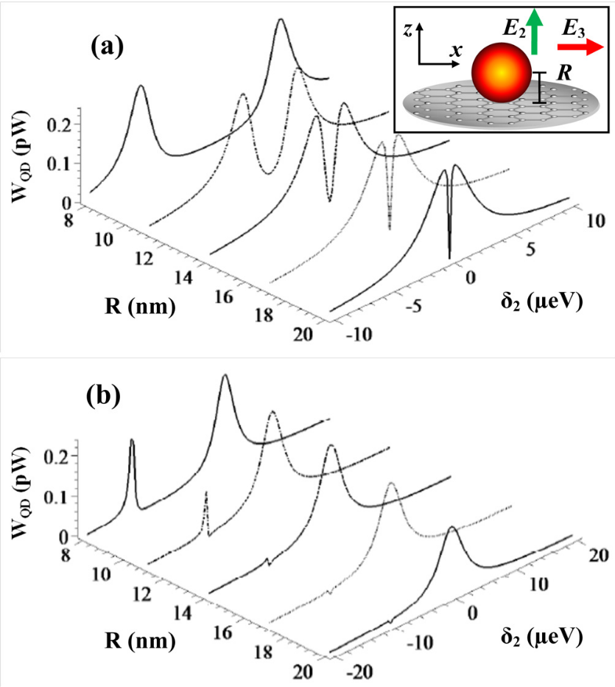
Power Absorption in QD
Here the power absorbed by the QD is calculated while varying the graphene-QD separation R
Narrow minima for larger values of R is due to electromagnetically induced transparency
For small values of R, the spectrum splits into two peaks due to the DDI
Power is absorbed by the QD at two frequencies
(a) δ₃ = 0; (b) δ₃ = 10 μeV
Cox , Singh et al, Physical Review B 86, 125452 (2112)

Slide 28
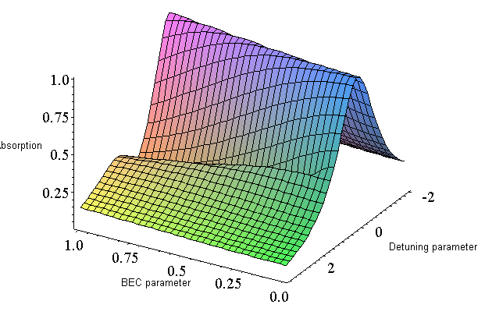
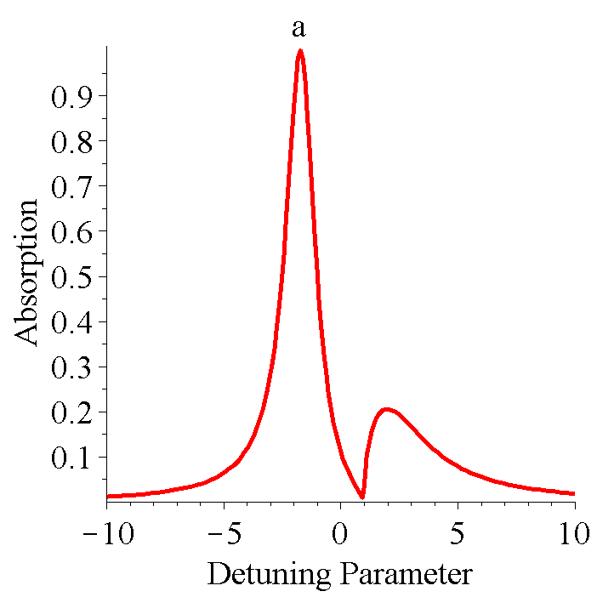
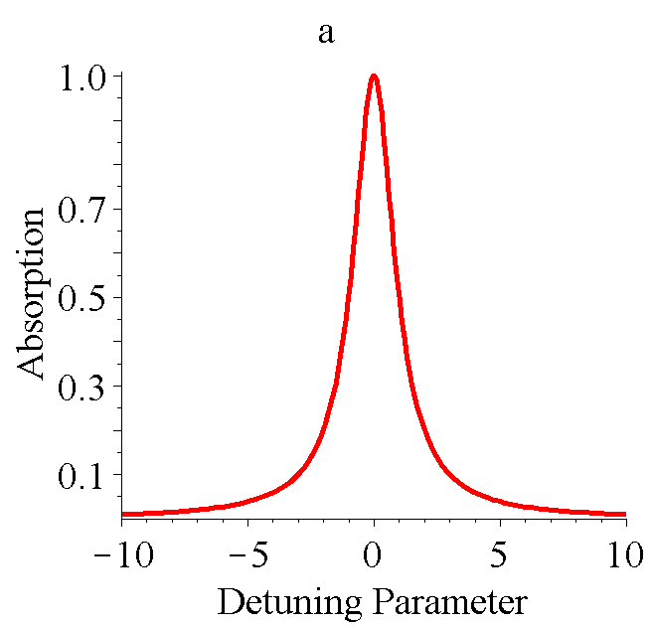
Switching Mechanism: One-photon spectroscopy
Cox, Singh et al., Physical Review B 86, 125452 (2012)
ABSORPTION:
transition from state from 2 to 1
DDI: changes with R
DDI: Gate voltage
ω_{sp}
ω_{sp}
Strong DDI coupling
Weak DDI coupling
coupling
Photon-atom coupling
TWO PEAKS.
Photon-atom coupling = 0
ONE PEAK.

Slide 29
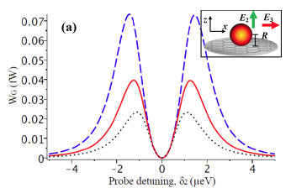
Sensing Mechanism: Substrate effect
When a QD is in contact with biomolecules, molecular beacons, DNA or aptamers, its dielectric constant can be modified.
This effect has also been verified experimentally by Dong et al., where upon integrating a molecular beacon to a CdTe-QD it was found that the fluorescence quenching due to graphene is modified.
H. Dong et al., Anal. Chem 82, 5511 (2010).
ε_{d} = 10 (dotted curve)
ε_{d} = 12 (solid curve)
ε_{d} = 14 (dashed curve)
Energy transfer to graphene when the QD dielectric constant is changed
  Detection of biological molecules
Cox and Singh, Physical Review B 86, 125452 (2012);
Singh, Racknor and Schindel App. Phys. Lett. 101, 051115 (2012)

Slide 30
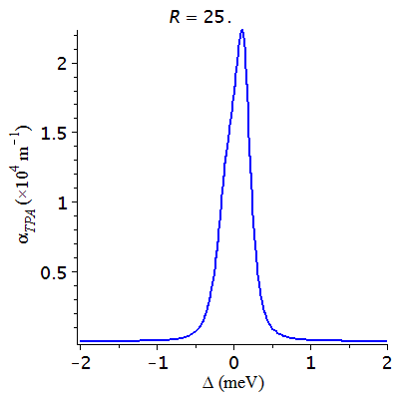
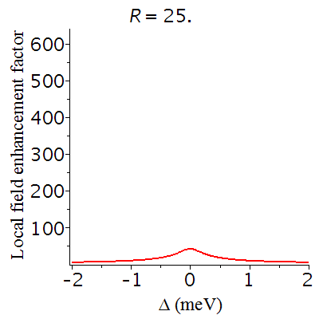
Two-Photon Process: QD-Graphene
DDI splitting
Here the two-photon absorption coefficient is calculated as a function of the two-photon detuning parameter.
The center-to-center distance between the quantum dot and graphene nanodisk, R, is varied
Quantum Dot
External Field
R
Graphene Nanodisk
DDI increases
ω
ω₀
ω
ω
ω_{sp}
Quantum Dot
Graphene Nanodisk
Singh, Cox et al., J. Phys.: Condens. Matter 25 (2013) 385302

Slide 31
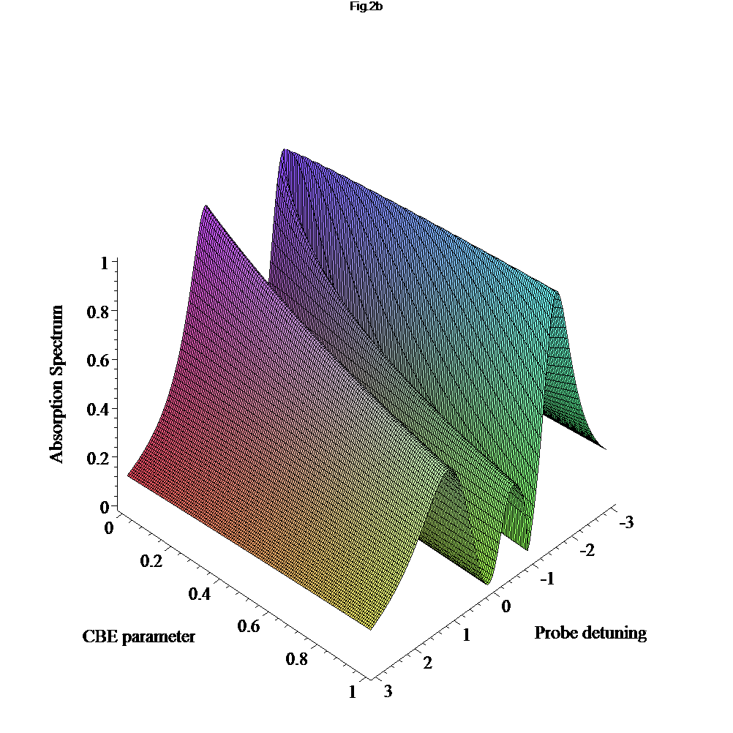
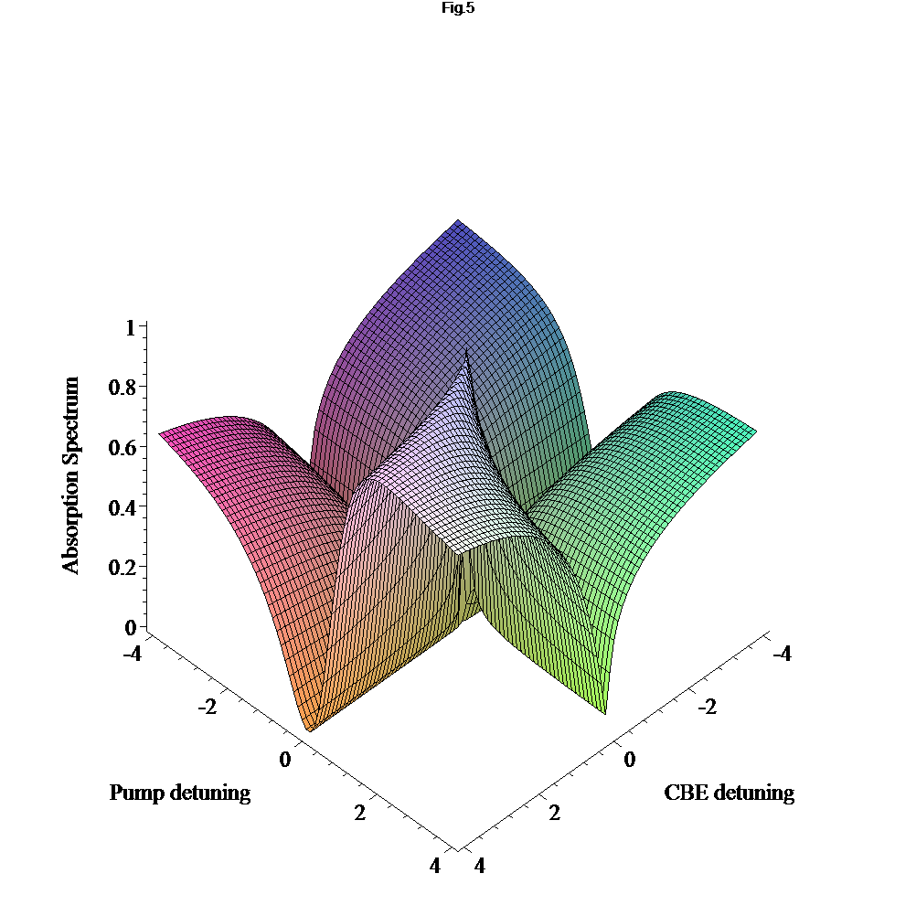
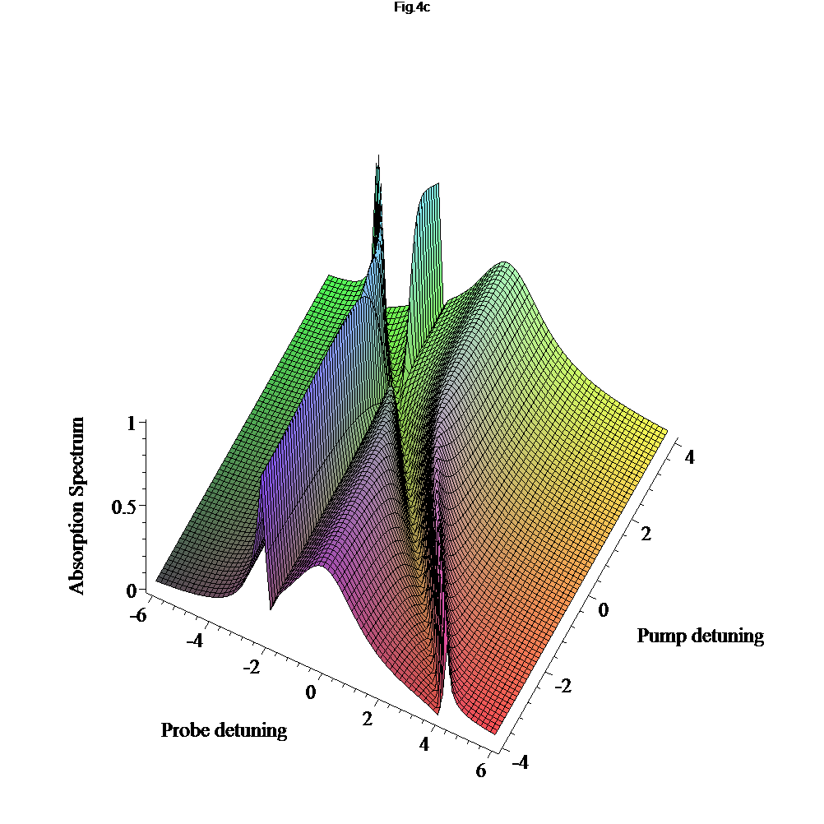
One-Photon Process
DDI + Pump Field Effects
Singh: Optics Letters 34, 22 (2009)
Singh: Journal of Applied Physics 106, 063106 (2009.
Singh: Phys. Rev. B80 195303 (2009)
Singh: Phys. Rev. A 79, 013826 (2009).
Pump
Probe
ω_{sp}
Quantum dot
Metallic nanoparticle
Sydney opera house ?
PHYSICAL REVIEW WEBSITE
Main Results: The system switches from one transparent state
to two transparent states

Slide 32
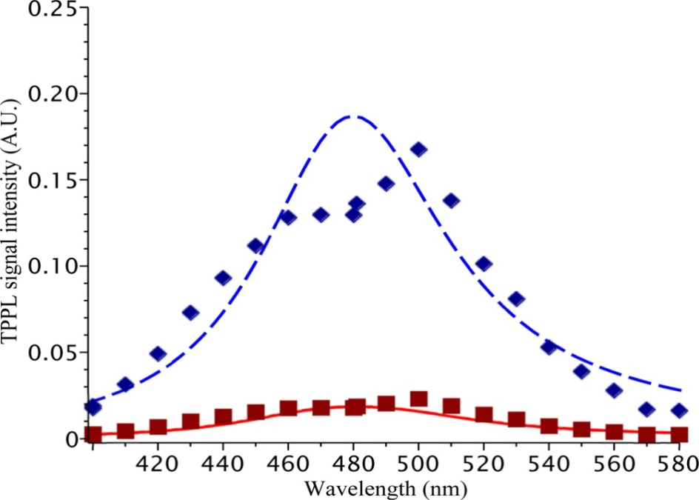
Two-photon photoluminescence Quenching
Cox, Singh, Bildering, Bragas, Advanced Materials 1, 460 (2013)
Two-photon photoluminescence (TPPL) from CdS QDs alone (dashed curve) and from QD-Au MNP hybrid system (solid curve)
TPPL from the QDs is quenched in the presence of the MNPs since the energy is transported from QD to MNP.
Metal
Nanoparticle
Semiconductor Quantum Dot
CdS-QD
ω
< 2ω
CdS-QD+ Au-MNP
Probe laser
ω
DDI
Control laser
MNP
PL in QD

Slide 33
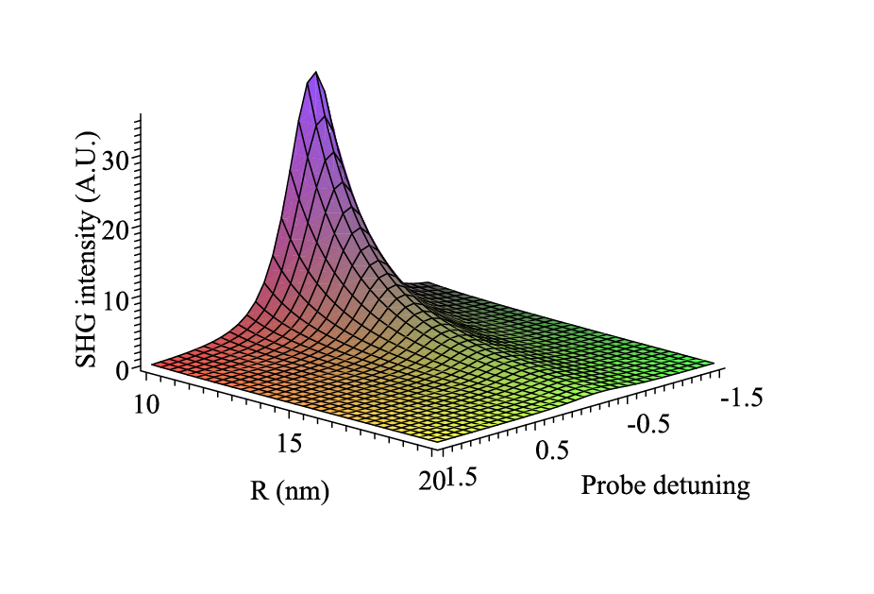
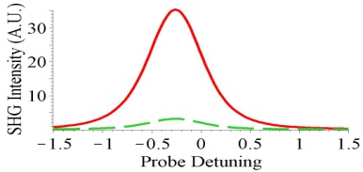
Second Harmonic Generation
Singh., Nanotechnology 24 (2013) 125701
Enhancement effect:
We consider a QD-metallic nanorod hybrid deposited on s substrate
Metal Nanorod
Quantum Dot
E₃
γ₃
DDI
I₂
R
DDI
E₂
R
E₂
γ ₂
E₂
QD
E₂
Quantum Dot
Metallic nanoparticle
MNP
Enhancement of SHG is predicted due DDI
Switching on and off of the SHG is found

Slide 34
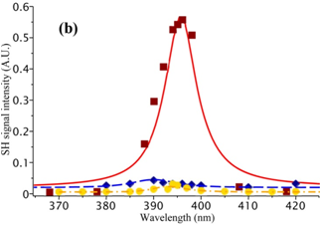
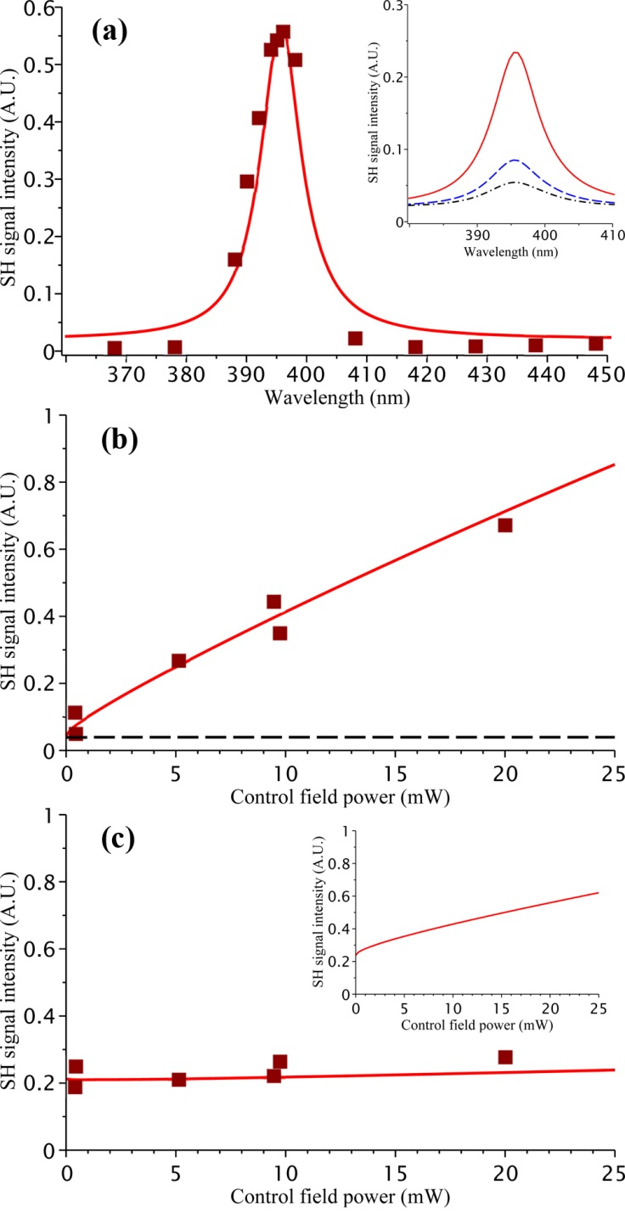
Second Harmonic Generation
Enhancement and switching
Cox, Singh, Bildering, Bragas, Advanced Materials 1, 460 (2013)
QD/Au-MNP
Enhancement of SHG :
observed in 40 nm Au MNP-CdS-QD hybrid system . R = 41.5 nm.
QD
Switching: Due to control field intensity and frequency
Switching DDI;: Dotted curve to solid curve
Dotted curve: The control field frequency is not resonance with the SPP of MNP: No DDI
Solid curve: With control field : DDI
QD/Au-MNP
ω
DDI
Control laser
ω
QD/Ag-MNP
NO SHG in Ag-MNP- QD
Control field frequency is not resonance with AU surface plasmon frequency.
MNP

Slide 35
Three level Quantum Dot
Mahi Singh. J. Cox, M. Brzozowski : J. Physics D: Applied Physics (2014)
)
It is considered that the resonance frequencies of the QD lie near ω_{sp}
Initially we consider the case where the transition dipole moments (fields) µ₁₂ (E₂) and µ₁₃ (E₃) are aligned along the z- and x-directions, respectively
Therefore only µ₁₃ and E₃ couple to SSP of metamterials
z
E₂
E₃
x
R
δ₂
δ₃
Γ₃₁
ω_{sp}
E₂⁰
Γ₂₁
E₃⁰
Nanocomposite
Quantum Dot

Slide 36
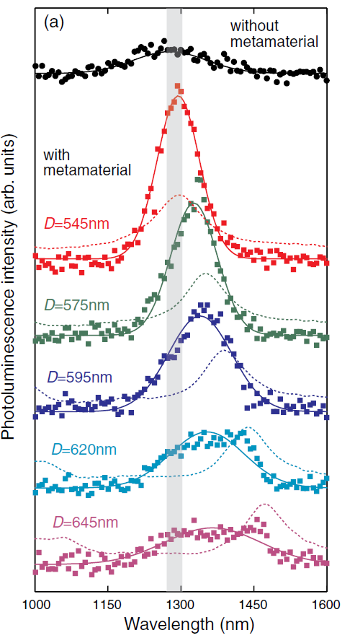
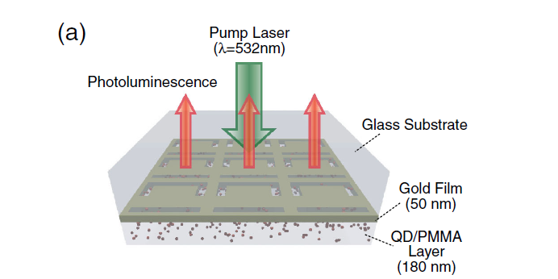
Enhancement of photoluminescence
in metamaterials hybrid
Mahi Singh. J. Cox, M. Brzozowski : J. Physics D: Applied Physics (2014)
Mahi Singh. C. Rackner, M. Brzozowski: Physical Review A (2014)
Peak height is enhanced in the presence of the metamaterial (DDI)
Peak position changes with the unit cell size (shift in the SPP energy)
Metamaterial
Quantum Dot
(PbSe)
Tanaka et al. , PRL 105, 227403 (2010)
Q= quantum yield
W_abs = energy absorption rate
= Probe field
= SPP field
= QD induced SPP
QD
cc
SPP Field
Probe field
ω_{sp}
QD induced SPP

Slide 37
Conclusions
  Hybrid Nanomaterials
  Switching mechanism
  Sensing mechanism
  PL enahncement
  Ane ke liye DHANYABAD
  (Thanks for coming)

Slide 38
Let Us Meet Again
We welcome all to our future group conferences of Omics group international
Please visit:
www.omicsgroup.com
www.Conferenceseries.com
http://optics.conferenceseries.com/

