Slide 1


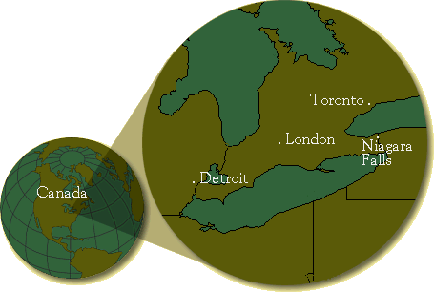
Study of quantum optics
(light-matter interaction)
in metamaterial nanostructures
Mahi R. Singh
msingh@uwo.ca
Department of Physics and Astronomy
Western University
(The University of Western Ontario)
London, Canada
Frankfurt (11 August, 2015

Slide 2


Niagara Falls

Slide 3
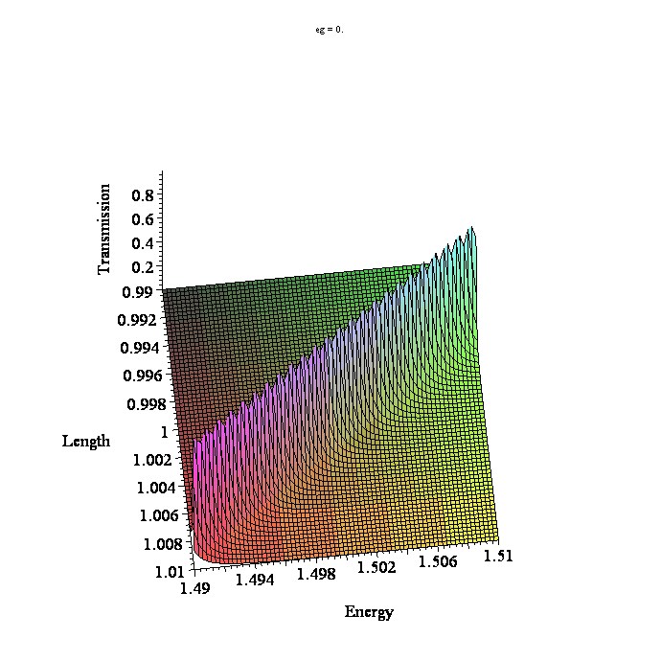
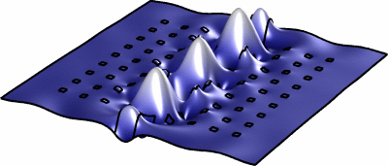
Outline
Introduction
Metamaterials , metals, graphene
Metamaterial Hybrids
Surface plasmon polaritons
Controlling light-matter interaction
(Photoluminescence)
Conclusion

Slide 4
Collaborators
  International Collaborations
  UK
  Y. Zhang
  D. Birch
  Y. Chen
  Spain
  M. Antón,
  F. Carreño,
  S. Melle,
  O. Calderón,
  E. Cabrera-Granado,
  USA
  S. Sadeghi
  S. Pinnepalli
  R. Agarwal
  G. Gumbs
  Argentina
  C. Bildering
  A. Bragas
  Israel
  Boris Fainberg HIT
  B. Apter, HIT
  Eugene Kogan- Bar Ilan
  M. Auslender: Ben Guiran
  Graduate Students
  C. Racknor
  Ifte Haque
  M. Brzozowski
  S. Balakrishan
  Kieffer Davieu
  Undergraduate Students
  J. Richmond
  J. Flannery
  J. McKechnie
  Scientists
  Scott Barrie
  Chandra Shekhar
  S.P. Singh
  Egypt
  Aarafa H. Aly
  Canadian Collaborations
  F. Lagugne-Labarthet
  M. Zinke-Allmang
  S. Mittler
  Jai Sabrinathan
  Jeff Carson

Slide 5
Metamaterials
Metamaterials:
They are artificial materials which are not found in nature.
Dielectric materials are arranged in a periodic structure.
J.C. Bose, Proc. Royal Soc. 63, 146 (1888) (Bosons and Fermions)
Negative refractive index materials or Left handed materials (metamaterials)
Size of the unit cell < wave length of light
V. Vaselago, Sov. Phys.-Ups (1968);
J.B. Pendry, Phys. Rev. Lett. 85, 3966 (2000)
Photonic Crystals: size of the unit cell ~ wave length of light
E. Yablonovitch, PRL 58, 2059 (1987) ;
S. John, PRL 58, 2486 (1987)
Nobel Prize in (20??)
John, Yablovitch, Pendry

Slide 6
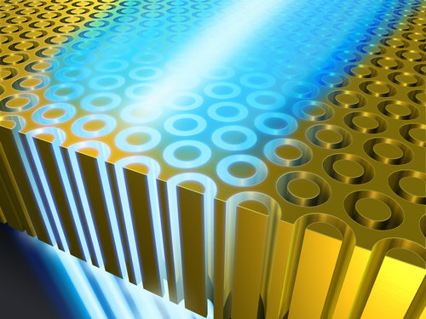
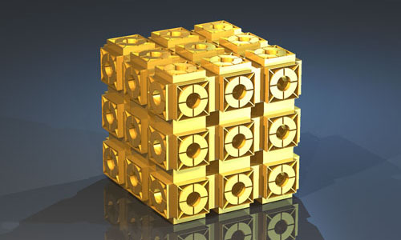
Metamaterials
Nano-holes are arranged in a periodic structure
SRR-MR are arranged in a periodic structure
Unit cell
Split ring
resonators
(SRR)
Metallic
rod
a
Unit cell =20-500nm, energy range= GHz-THz

Slide 7
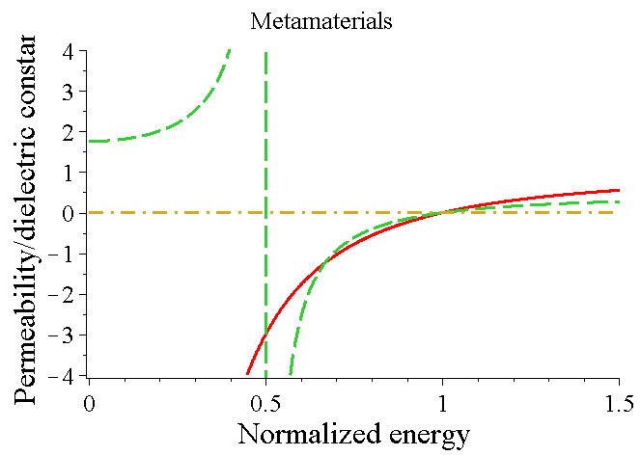
Metamaterials
(Negative refractive index materials)
Natural Materials:
They have positive dielectric constant (ԑ) and a negative magnetic permeability (μ)
Metamaterials:
They have positive dielectric constant (ԑ) and a negative magnetic permeability (μ)
Unit cell
A
B
a
S=1 : Natural Materials
S=-1: Negative refractive index materials
Note: ϵ and µ are negative between A and B

Slide 8
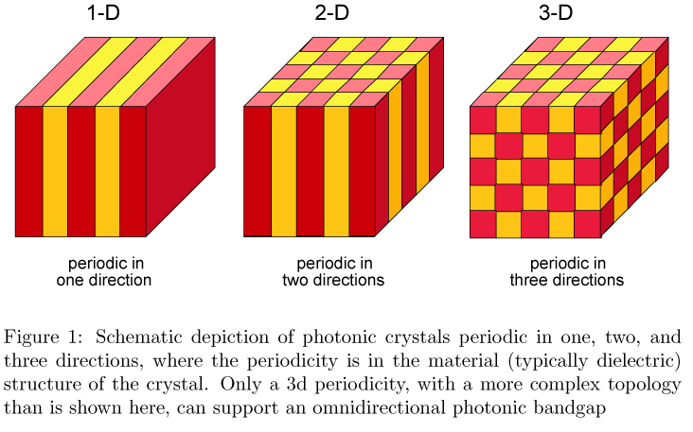
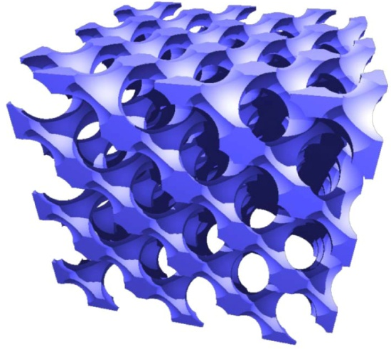
Metamaterials: Photonic Crystals
Dielectric spheres (Si) are arranged
periodically in air
I. Haque and Singh. J. Phys. Condens. Matter 19, 156229 (2007)
Air spheres (Si) are arranged periodically in Si
S. John et. al, PBG Materials: A Semiconductor for Light, 2002.

Slide 9
Photonic Materials: Dielectrics
I. Haque and Mahi Singh. J. Phys. Condens. Matter 19, 156229 (2007)
Air
Dielectric spheres (Si) in air
Lattice constant a=300nm; Radius r/a=0.3;
Spheres= Si (n=3.4); Background air (n=1)
a=300nm
Radius= r
Photonic
crystal
Conduction band (CB)
Energy gap
Valence band (VB)
Note: The location and value of the gap
depend on the refractive index.
Source: S. John, O. Toader and K. Busch, PBG Materials: A Semiconductor for Light, 2002.

Slide 10
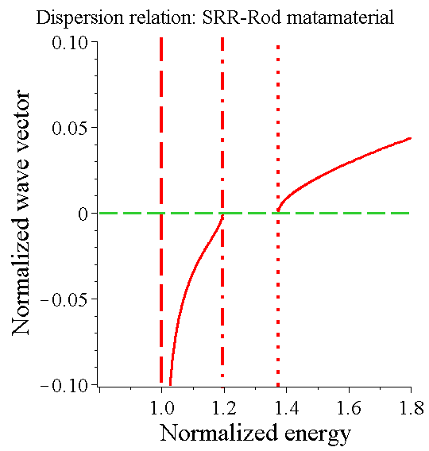
Metamaterials: Band structure
Mahi Singh. J. Cox, M. Brzozowski : J. Physics D: Applied Physics (2014)
Mahi Singh. C. Rackner, M. Brzozowski: Physical Review A (2014)
SRR-MR Lattice
Unit cell
Split ring
resonators
(SRR)
Metallic
rod
a
Band gap

Slide 11
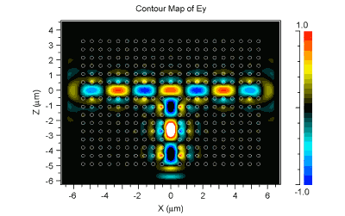
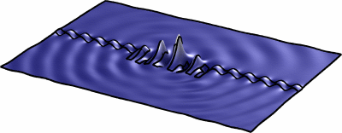
Metamaterials:
Applications
Photons are confined in a nanosize material
Photons are confined in 2-d
nanometer
Source: math.utwente.nl/~hammer/Metric/Illust/
90º Light Splitter
http://www.photeon.com/images/pc/animation.gif

Slide 12
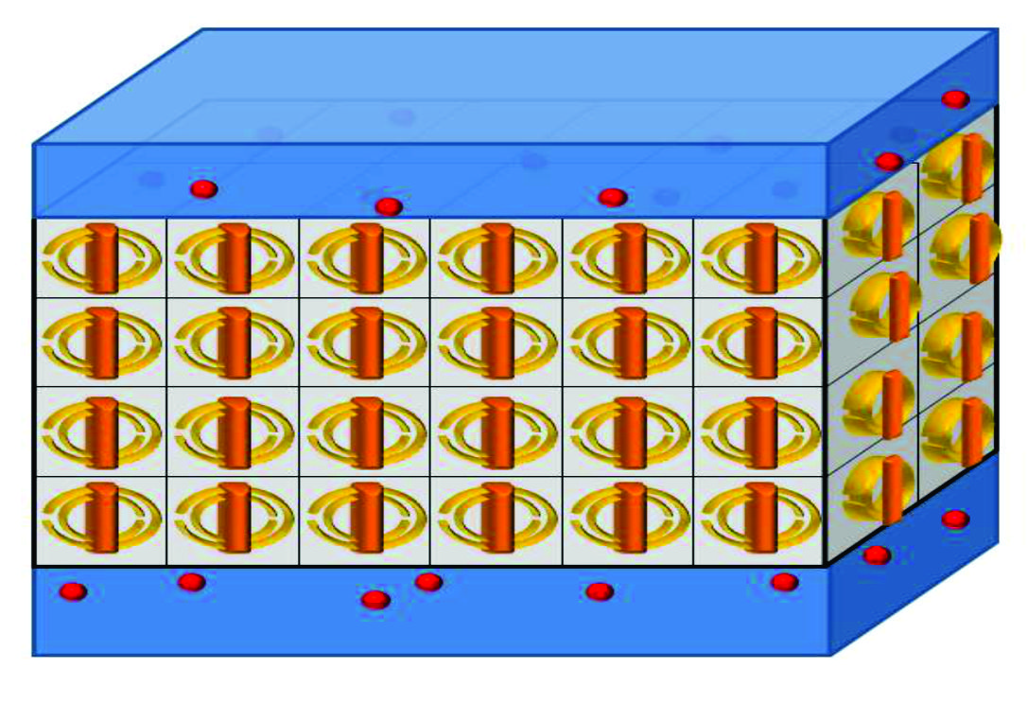
Metamaterial Hybrids
Quantum dot-metamaterial
Quantum dot-Photonic crystals
Cox , Singh et al, J. Phys. D B 86, 125452 (2015)
Quantum Dot (PbSe)
Metamaterial
Quantum dot-metamaterial waveguide
Quantum Dots
Metamaterial
Quantum
dots
Photonic Crystal
Schematic Diagram of Metamaterial Waveguide
Cox , Singh et al, Physical Review B 86, 125452 (2112)

Slide 13
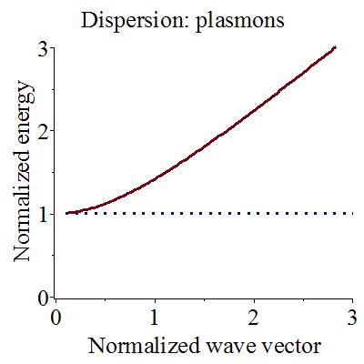
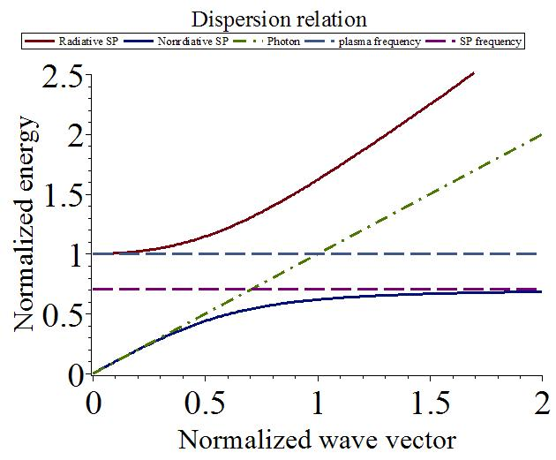
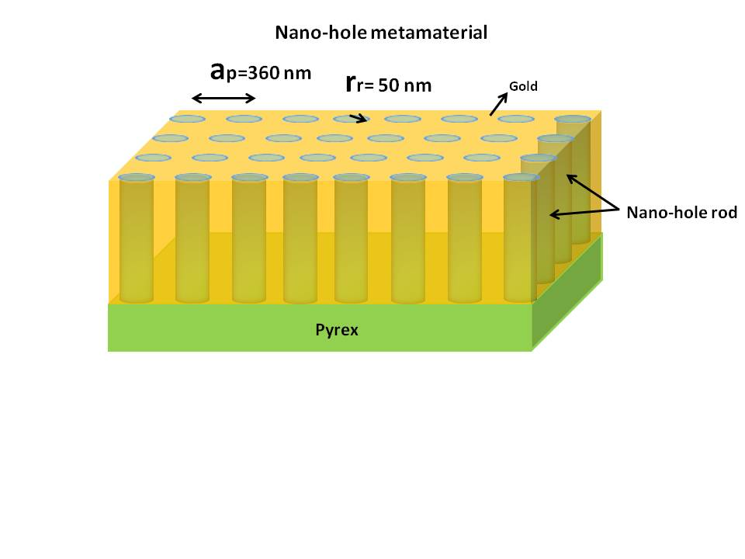
Surface plasmon polaritons (SPPs)
Mahi Singh. J. Cox, M. Brzozowski : J. Physics D: Applied Physics (2014)
Light propagation in metamaterial
Plasmon polaritons
Metamaterial heterostructure
Using boundary conditions at the interface
Plasmon polaritons
metamaterial
SPP
Dielectrics
Dipole field produced at distance R

Slide 14
Plasmonics and Nanophotonics
Surface plasmon polaritons (SPPs)
Mahi Singh. J. Cox, M. Brzozowski : J. Physics D: Applied Physics (2014)
Metals: Light propagation
Plasmon polaritons
Transmission
Metallic heterostructures/spheres
Using boundary conditions at the interface
Reflection
Dielectrics
Espp
Dielectrics
SPP
metal
metal
Espp
Espp
D=50nm
Plasmon polaritons
Nanophotonics:
Dipole field produced by SPPs at distance R
SPP

Slide 15
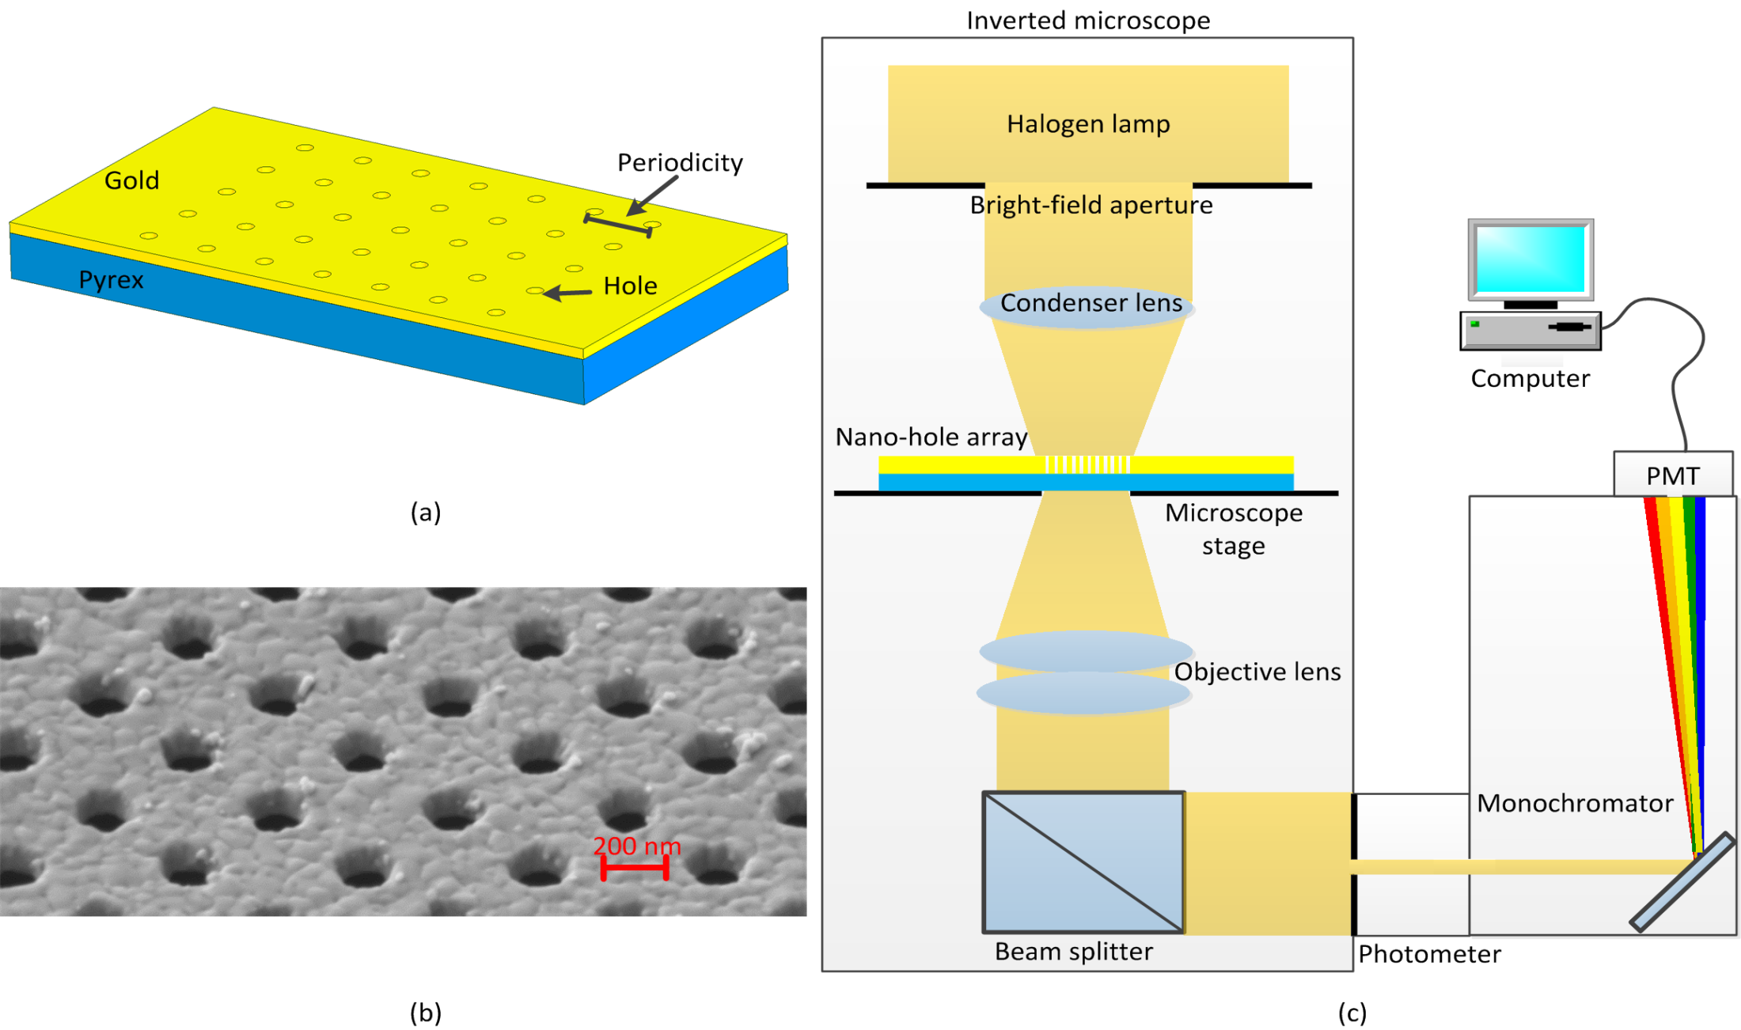
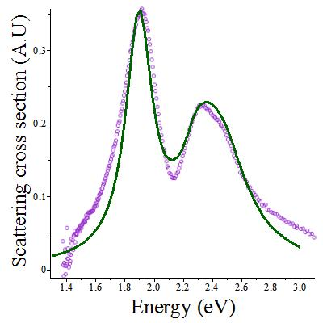
SPP in Nano-hole metamaterials
Fabricate at Western by Jeff Carson group (Medical College)
Measured scattering cross section
Singh, Carson, Reza, Balakrishan, J. Appl. Phys. (accepted 2015)
Carson, Singh etal. ACS Nano (communicated)
SPP mode n = 1
Exp
SPP mode
n =2
theory
SPP modes are quantized: n = 1, 2

Slide 16
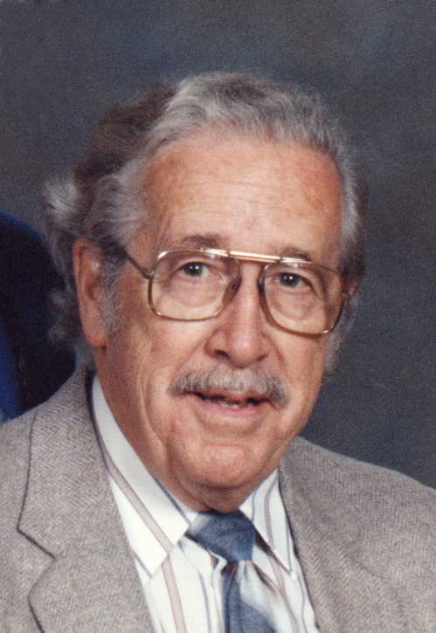
Graphene
(Plasmonics and Nanophotonics)
Graphene was invented by a Canadian physicist
P.R. Wallace (1915-2006)
McGill University, Montreal
Worked with Leopold Infeld, (Albert Einstein), NF Mott
1947: P.R. Wallace : Phys. Rev. 71, 622-634 (1947)
Graphite-moderated nuclear reactor project
(this project was part of a plan to develop
nuclear weapons during the II world war)
Graphene is a gapless semiconductor
2010 Nobel Prize in Physics:
Andre Geim, Konstantin Novoselov

Slide 17
Mahi Singh and PR Wallace
Gapless Semiconductors
M. SINGH and P.R. WALLACE , J. PHYSICS C 20, 2169, (1987).
GUPTA, WALLACE and SINGH , J .PHYSICS C19, 6373 (1986).
M. SINGH and P.R. WALLACE, SOLID STATE COMMUN. 53, 165 (1985).
M. SINGH and P.R. WALLACE, J. PHYSICS C17, 5303 (1984).
M. SINGH amd PR Wallace, J. PHYS. CHEM. SOLIDS 45,409 (1984).
M. SINGH, P.R. Wallace and J. Leotin, J. PHYS. C17, 1385 (1983).
M. SINGH and P.R. WALLACE , J. PHYS. C16, 3877 (1983).
SINGH, LEOTIN and WALLACE, PHYS. STAT. SOLIDI B115, 105 (1983).
M. SINGH and P.R. WALLACE , SOLID STATE COMM. 45, 9 (1983).
M. SINGH, J. and P.R. WALLACE , PHYSICA B117, 441 (1983).
SINGH, P.R. WALLACE, ASKENAZY, J. PHYSICS C15, 6731 (1982).
SINGH, CISOWSKI, WALLACE, PORTAL, BROTO,
Phys. Stat SOLIDI B114, 481 (1982).
(1915-2006)
P.R. Wallace
McGill University, Montreal
I called him “SIR” and he did not like it.
I have a graduate student who always calls me “SIR” and I like it and he is my favorite student.

Slide 18
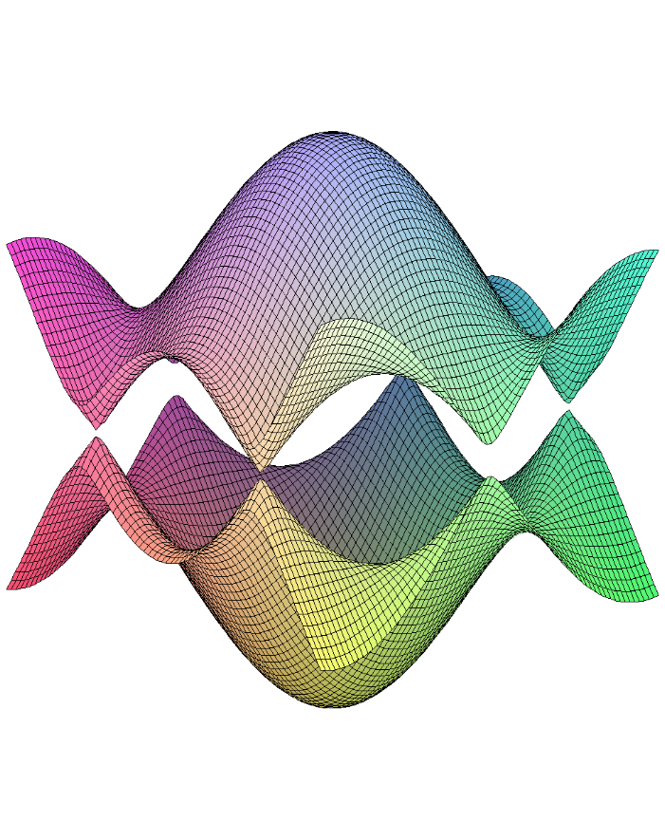
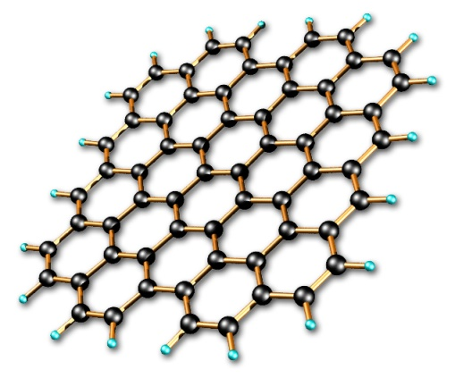

Graphene Band Structure
P.R. Wallace, Phys. Rev. 71, 622-634 (1947)
Graphene is a two dimensional sheet of carbon atoms which are arranged in the honey comb structure.
Carbon atoms (Honey comb structure)
E
k
Band structure:
Gapless semiconductor and acts as a metal.
k.p method
Tight binding method
Mahi R. Singh, Electronic, Photonic, Polaritonic and Plasmonic Properties of materials
(Wiley Custom, Toronto, 2014)
Summary
Graphene acts like a metal.
E
k
A.N. Grigorenko et al, Nature Photonics 6, 749 (2012)

Slide 19
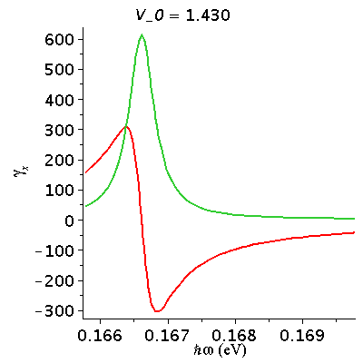
Graphene: Bound Surface Plasmons
J. Cox and Mahi Singh, Nanotechnology (2013)
Plasmon frequency can be changed by applying the gate voltage.
Gate voltage changes the Fermi energy.
Gate voltage
Intensity of light emitted by SPPs
Graphene
Nanodisk
V_{G}
Substrate
Parameters: Radius= 8 nm; v_{F} = c/300; µ = 10000 cm²V⁻¹s^{-1;} ε_{b} = 10.89 (GaAs)

Slide 20
QD-metamaterial hybrid
Excitons-SPPs Interaction
In QD-MNP hybrids, excitons in the QD and localized surface plasmons in the metamaterials interact via the excitons-SPPs (dipole-dipole interaction (DDI)).
This interaction is strong when the QD and metamaterial are in close proximity and their optical excitation frequencies are resonant
Quantum Dot
Dipole-Dipole Interaction
External Field E₀ cos(ωt)
R
QD-metamaterial nanocomposites
Singh. Et sl. : J. Physics D: Applied Physics (2014)

Slide 21
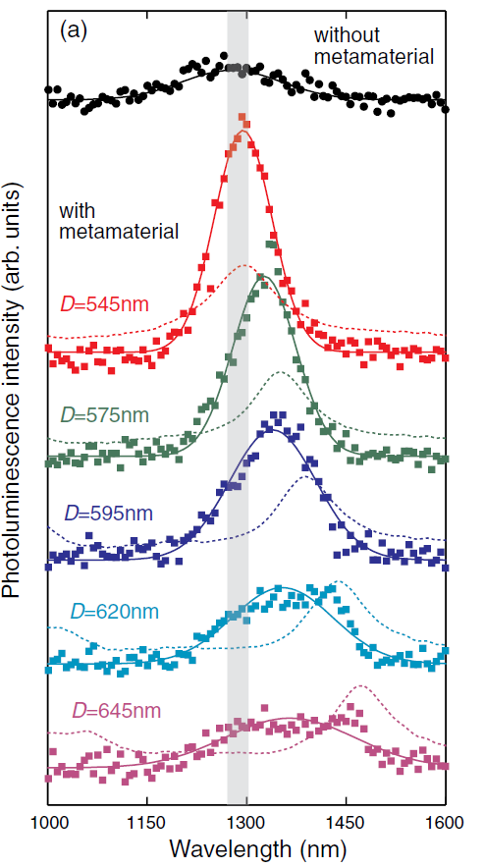
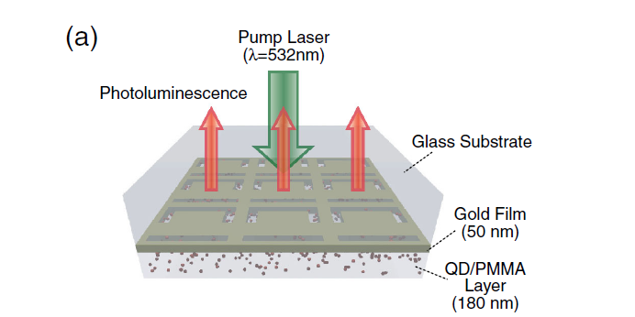
Enhancement of photoluminescence
in metamaterials hybrid
Singh. Cox, Brzozowski : J. Phys. D: Appl. Phys. 47, 085101 (2014)
Peak height is enhanced in the presence of the metamaterial (DDI)
Peak position changes with the unit cell size (shift in the SPP energy)
Metamaterial
Quantum Dot
(PbSe)
Tanaka et al. , PRL 105, 227403 (2010)
Q= quantum yield
W_abs = energy absorption rate
= Probe field
= SPP field
= QD induced SPP
QD
cc
SPP Field
Probe field
ω_{sp}
QD induced SPP

Slide 22
Metamaterial wave guide
Singh. Rackner, Brzozowski: J. Phys. D: Appl. Phys. 48, 145301 (2015)
We consider a nanocomposite consisting of a metamaterial and a QD
The nanocomposite is embedded in a polar material
When external laser fields are applied, plasmons in metamaterial interact with excitons in the QD
Polar crystal serves as an electromagnetic reservoir for the QD
Quantum
dots
Schematic Diagram of Metamaterial Waveguide

Slide 23
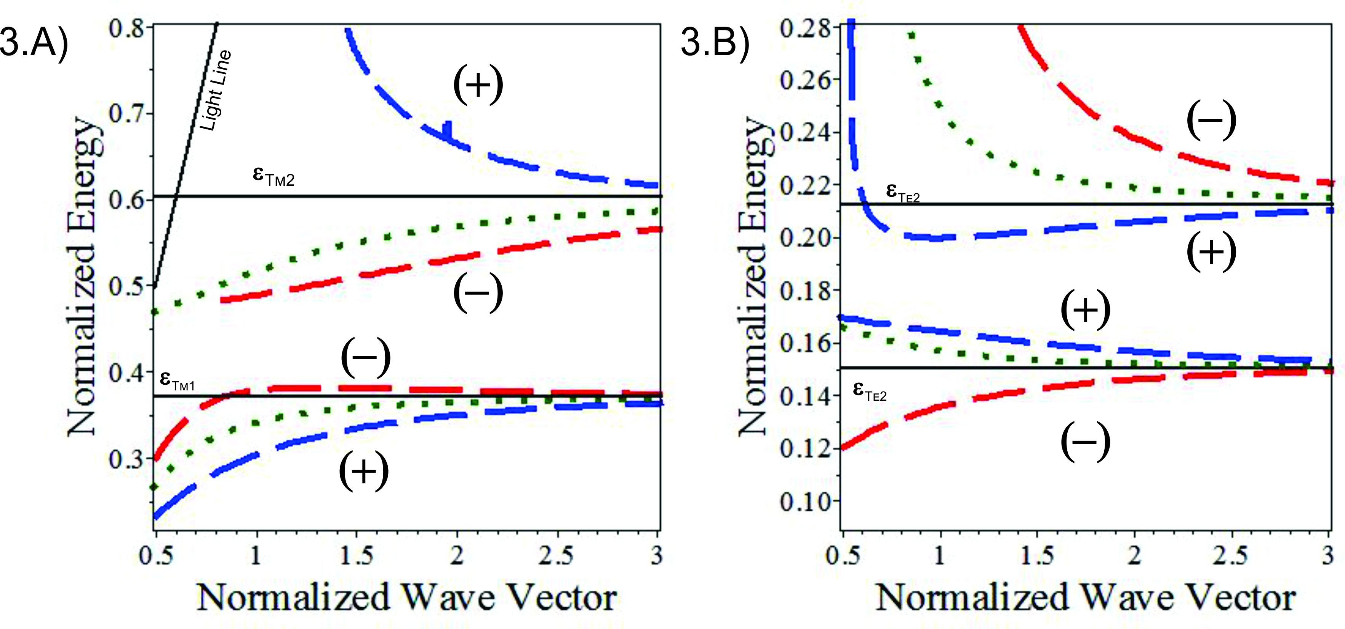
Splitting of SPP branch in to two branches in waveguide
Singh. Rackner, Brzozowski: J. Phys. D: Appl. Phys. 48, 145301 (2015)
Mahi Singh. C. Rackner, M. Brzozowski: Physical Review A (2014
SSP are produced at interface 1 and interface 2
SPPs- interface 1 interacts with SPPs -interface 2 via DDI
when d< spp wavelength
SPP branch splits into two branches (two types of SPPs)
Schematic Diagram of Metamaterial Waveguide
DDI splitting
Dotted line : single SPP branch

Slide 24
Three level Quantum Dot
Singh. Rackner, Brzozowski: J. Phys. D: Appl. Phys. 48, 145301 (2015)
It is considered that the resonance frequencies of the QD lie near ω_{sp}
Quantum
dots
Schematic Diagram of Metamaterial Waveguide
δ₂
δ₃
Γ₃₁
ω_{sp}
E₂⁰
Γ₂₁
E₃⁰
Quantum Dot

Slide 25
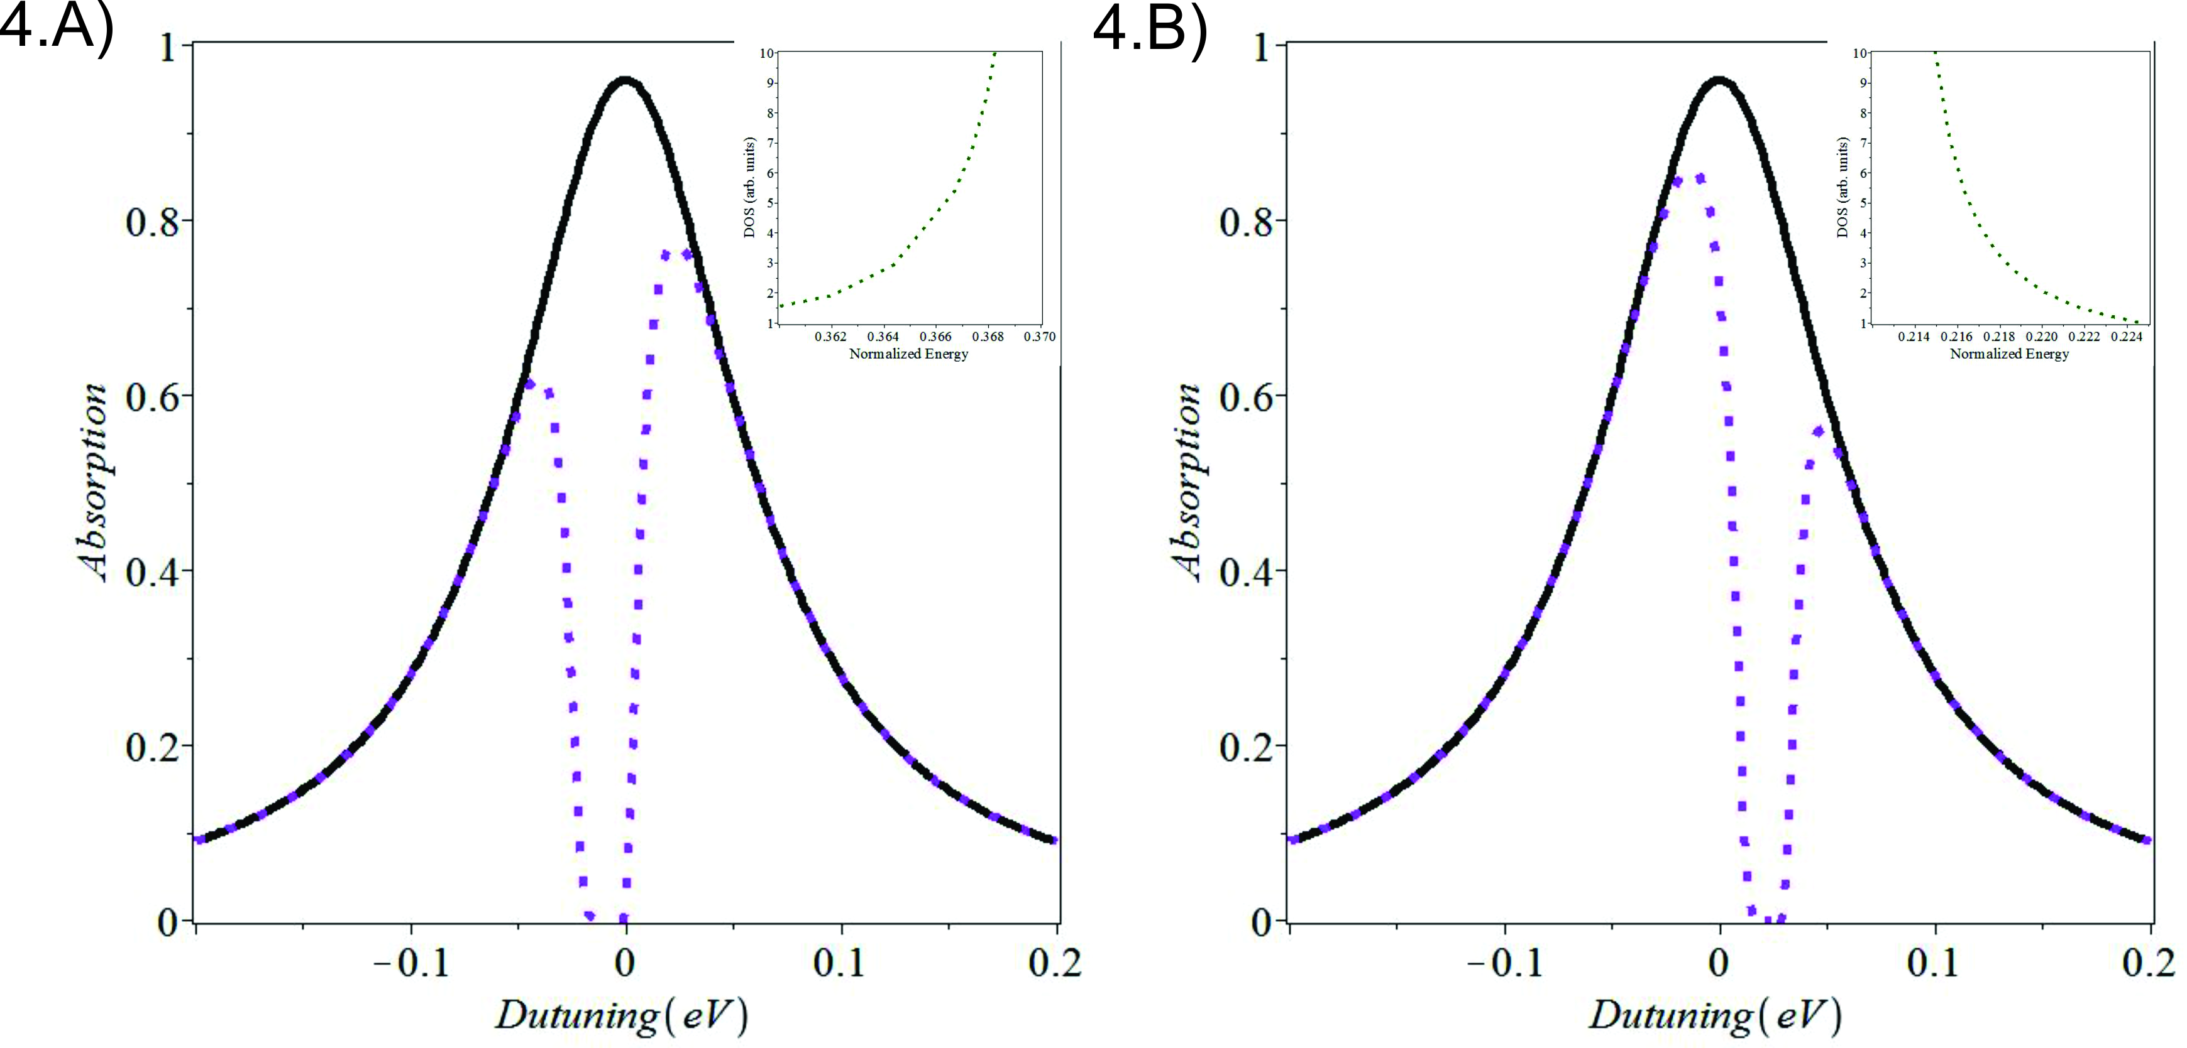
SPP induced transparency
Strong DDI coupling
One peak to two peak splitting:
transition from state from 2 to 1
DDI: changes with R
ω_{sp}
QD
Metamaterial
TE Mode
TM-Mode
Solid line: one peak: No DDI
Dotted line two peaks: with DDI
MINIMUM is the TRANSPARENT state

Slide 26
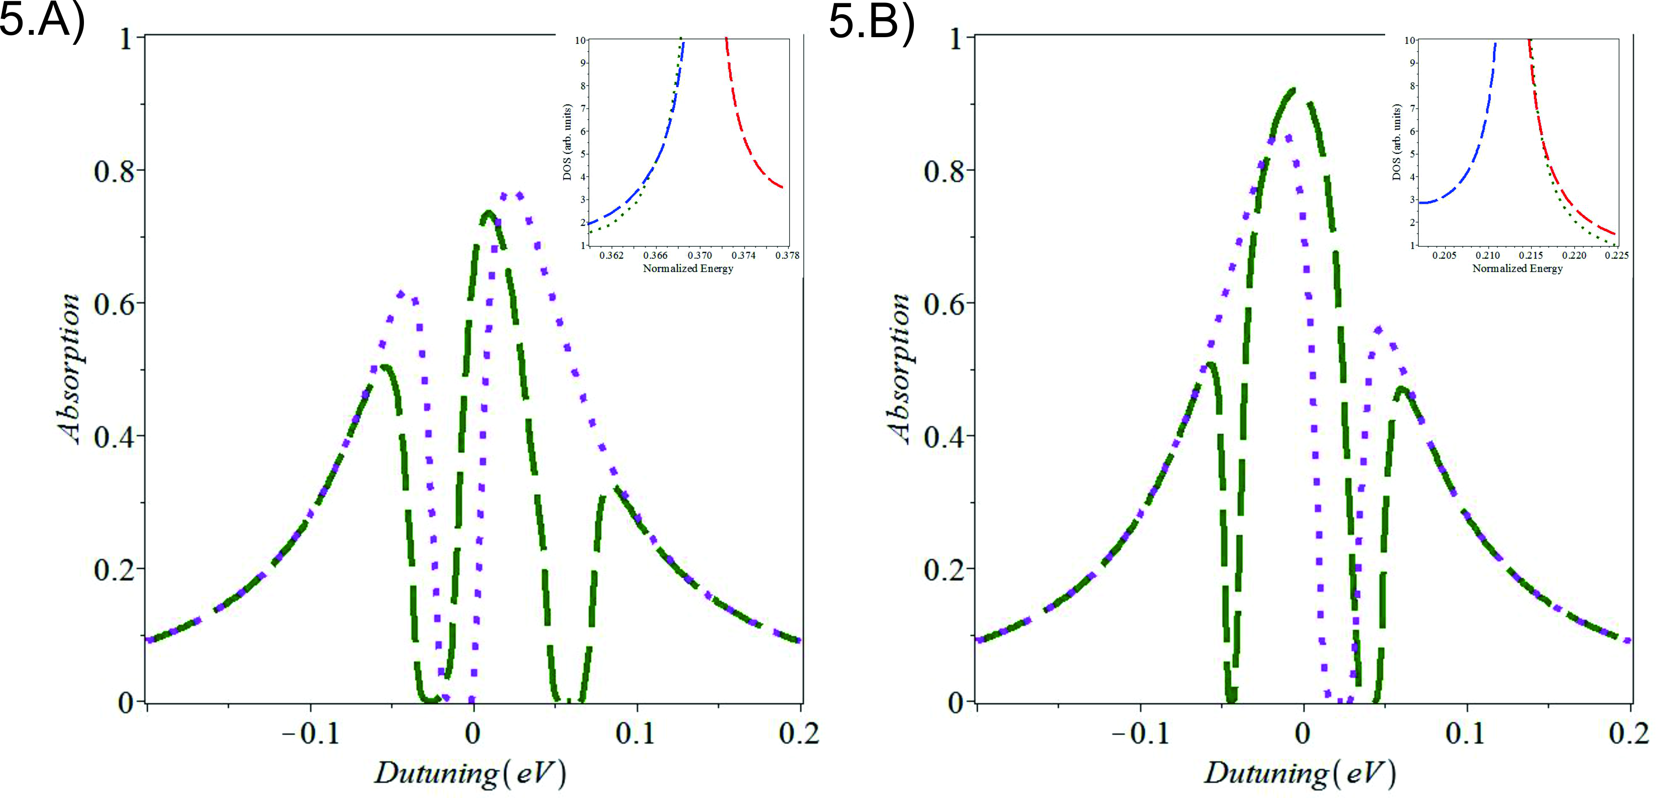
DDI induced transparency
Singh. Rackner, Brzozowski: J. Phys. D: Appl. Phys. 48, 145301 (2015)
interface 1
Two minima
Solid line
Single minimum
Dotted line
Due to DDI coupling a single transparent state splits into two transparent state.

Slide 27
Graphene
(Plasmonics and Nanophotonics)
Graphene was invented by a Canadian physicist
P.R. Wallace (1915-2006)
McGill University, Montreal
Worked with Leopold Infeld, (Albert Einstein), NF Mott
1947: P.R. Wallace : Phys. Rev. 71, 622-634 (1947)
Graphite-moderated nuclear reactor project
(this project was part of a plan to develop
nuclear weapons during the II world war)
Graphene is a gapless semiconductor
2010 Nobel Prize in Physics:
Andre Geim, Konstantin Novoselov

Slide 28
Mahi Singh and PR Wallace
Gapless Semiconductors
M. SINGH and P.R. WALLACE , J. PHYSICS C 20, 2169, (1987).
GUPTA, WALLACE and SINGH , J .PHYSICS C19, 6373 (1986).
M. SINGH and P.R. WALLACE, SOLID STATE COMMUN. 53, 165 (1985).
M. SINGH and P.R. WALLACE, J. PHYSICS C17, 5303 (1984).
M. SINGH amd PR Wallace, J. PHYS. CHEM. SOLIDS 45,409 (1984).
M. SINGH, P.R. Wallace and J. Leotin, J. PHYS. C17, 1385 (1983).
M. SINGH and P.R. WALLACE , J. PHYS. C16, 3877 (1983).
SINGH, LEOTIN and WALLACE, PHYS. STAT. SOLIDI B115, 105 (1983).
M. SINGH and P.R. WALLACE , SOLID STATE COMM. 45, 9 (1983).
M. SINGH, J. and P.R. WALLACE , PHYSICA B117, 441 (1983).
SINGH, P.R. WALLACE, ASKENAZY, J. PHYSICS C15, 6731 (1982).
SINGH, CISOWSKI, WALLACE, PORTAL, BROTO,
Phys. Stat SOLIDI B114, 481 (1982).
(1915-2006)
P.R. Wallace
McGill University, Montreal
I called him “SIR” and he did not like it.
I have a graduate student who always calls me “SIR” and I like it and he is my favorite student.

Slide 29
Graphene Band Structure
P.R. Wallace, Phys. Rev. 71, 622-634 (1947)
Graphene is a two dimensional sheet of carbon atoms which are arranged in the honey comb structure.
Carbon atoms (Honey comb structure)
E
k
Band structure:
Gapless semiconductor and acts as a metal.
k.p method
Tight binding method
Mahi R. Singh, Electronic, Photonic, Polaritonic and Plasmonic Properties of materials
(Wiley Custom, Toronto, 2014)
Summary
Graphene acts like a metal.
E
k
A.N. Grigorenko et al, Nature Photonics 6, 749 (2012)

Slide 30
Conclusions
  Metamaterials
  Controlling light-matter interaction (Photoluminescence)
  Ane ke liye DHANYABAD
  (Thanks for coming)

