Slide 1

Regulatory requirements and benefits converting to Continued Process Verification

Slide 2

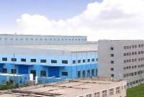

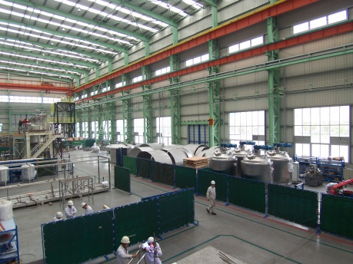
Magnus and Pharmadule at a glance
Director Regulatory Affairs, formerly scientific coordinator in the Inspections Sector , EMA
Responsible for Registration and Quality Management for both manufacturing and R&D-projects
Stockholm
Shanghai
  Pharmadule
    Established in 1986
    Acquired by Morimatsu Group in 2011
    Has built >60 Pharmaceutical facilities
    Big Pharma – Worldwide
    5 facilities in China
    Full scope
      Facilities
      Regulatory Compliance

Slide 3
Agenda
  What is Process Validation
  Continued Process Verification
  Conclusions
Stockholm
Shanghai

Slide 4
Definition
Process Validation EU:
The documented evidence that the process, operated within established parameters, can perform effectively and reproducibly to produce a medicinal product meeting its predetermined specifications and quality attributes.
Process Validation FDA
The collection and evaluation of data, from the process design stage through commercial production, which establishes scientific evidence that a process is capable of consistently delivering quality product.

Slide 5
New approach to PV – Continuous/continual …
Continuous Process Verification:
An alternative approach to process validation in which manufacturing process performance is continuously monitored and evaluated. (ICH Q8)
Continued Process Verification:
Documented evidence that the process remains in a state of control during commercial manufacture (FDA PV guide).
In the draft EU Annex 15 the word ”on-going” has replaced ”continued”

Slide 6
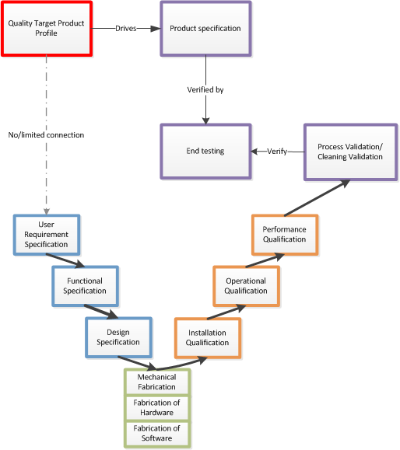
Traditional Process Verification via V-model
Three Batches
Extended tests
Gap to be bridged by QbD

Slide 7
A new approach to Process Validation & compliance
    FDA PV - From Process Design throughout Continued Process Verification
Stage 1 –
Process Design
Stage 2 –
Process Qualification
Verification
Facility Design
Facility and Equipment Qualification
Process Performance Qualification (PV)
Change Control
Change Control
In control
Stage 3 –
Continued Process Verification
To market
    References: FDA Process Validation: General Principles and Practices
    EMA Guidelines for GMP Annex 15 (draft issued February 2014)
Notes:
How do we translate this into a workable model?

Slide 8
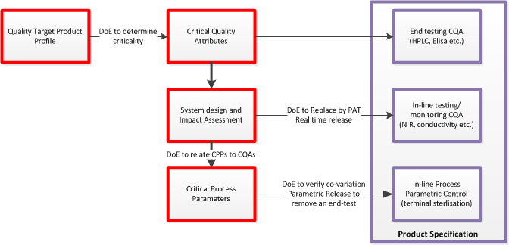
QbD and Continous Process Verification

Slide 9
QbD and Continous Process Verification
QbDd
CPV
Hybrid Specifications
may be the future

Slide 10
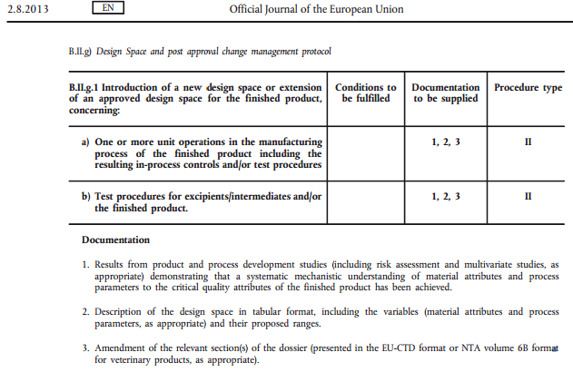
New EU variations regulation

Slide 11
In the future: Continued Process Verification
May be an option
  Under which conditions?
  How can it be achieved?

Slide 12

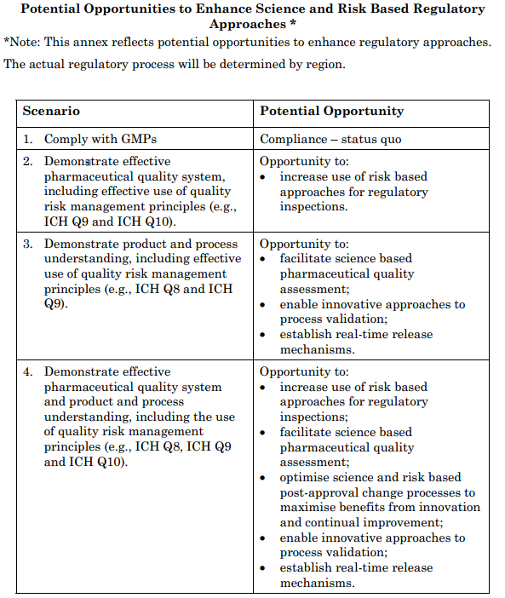
ICH Q10 – Pharmaceutical Quality System 2008

Slide 13
Pharmaceutical Quality System (EU GMP)
Product Quality Review
§1.10
Regular periodic or rolling quality reviews of all authorised medicinal products should be conducted with the objective of verifying the consistency of the existing process, the appropriateness of current specifications for both starting materials and finished product, to highlight any trends and to identify product and process improvements.

Slide 14
Pharmaceutical Quality System (EU GMP)
§1.11
The manufacturer should evaluate the results of the review and an assessment made as to whether corrective and preventive action or any revalidation should be undertaken, under the Pharmaceutical Quality System

Slide 15
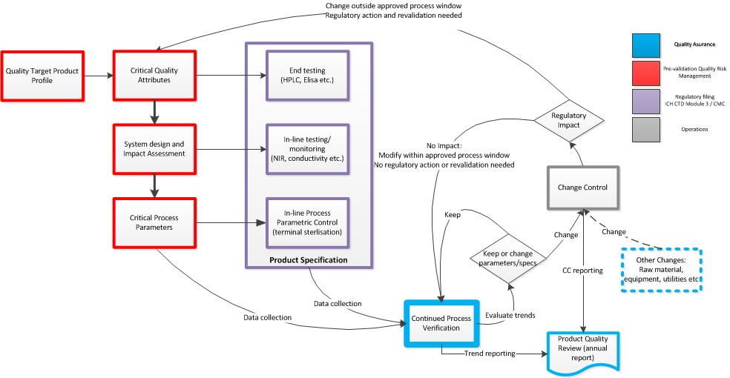
Continued Process Verification – During Life Cycle

Slide 16
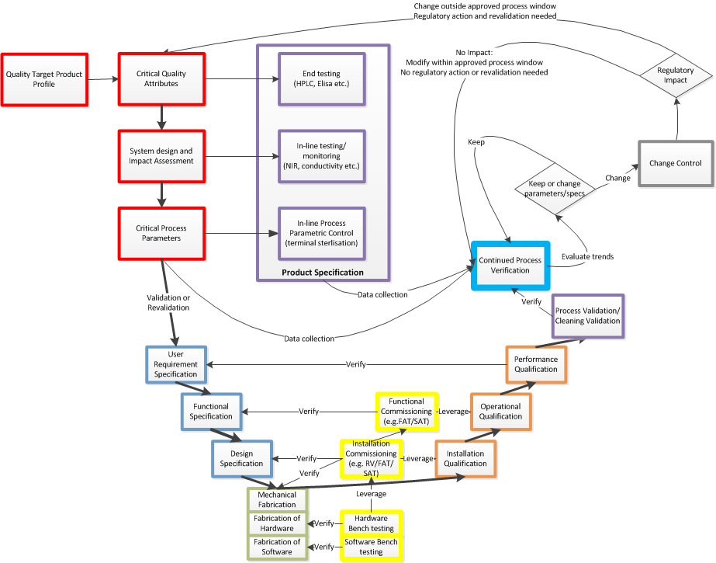
Total PV and CPV life-cycle model

Slide 17
How to record Continued Compliance
Quality System
Change control (as mentioned before)
Annual Product Quality Reviews
Risk and science-based PV (but not necessarily QbD/Continuous Process Verification)

Slide 18
Conclusions
Continued Process Verification
  Can be done without variation registration
  Requires Quality management system
    Change control
    Product quality reviews
    Science and risk based process control
  Implementing Continued probably makes more business sense than registering Continous …

Slide 19
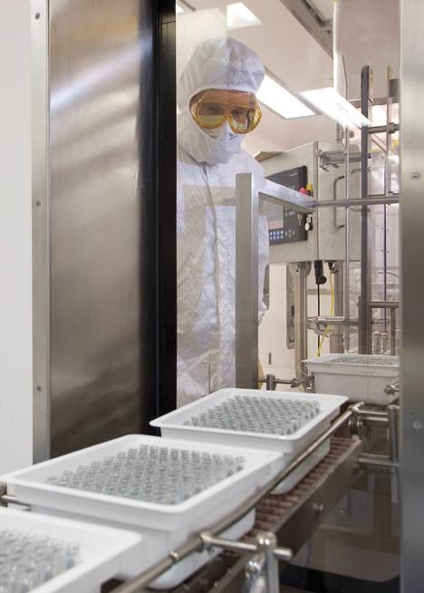


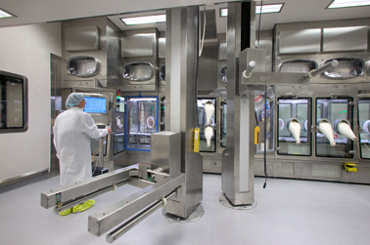
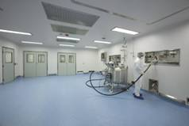

Thanks for your attention
Questions?
magnus.jahnsson@pharmadule.com
www.pharmadule.com

