Slide 1


Slide 2



IMMEDIATE UNRESTRICTED VERSUS GRADUATED
WEIGHT BEARING AFTER PRIMARY
CEMENTLESS TOTAL HIP
ARTHROPLASTY
BY
MAGDY M. A. SHABANA , PH. D. in PT
ASSISTANT PROFESSOR AT FACULTY OF APPLIED SCEIENCES
Buraydah colleges
PHYSICAL THERAPY FELLOW AT CAIRO UNIVERSITY HOSPITALS
CAIRO UNIVERSITY
2016

Slide 3
Introduction
The THA defined as surgical reconstruction of newly artificial, painless, movable, and stable artificial hip joint. It was John Charnley 1960 who led the way in establishing total hip replacement as a useful procedure. ( Siopack and Jergesen 1995)
Hip replacement has become one of the major surgical advances of this century, at an estimated occurrence between 500.000 and 1 million per year. (Stanfield and Nicol, 2002).
From the Swedish National Hip Arthroplasty Registry we learn that osteoarthritis is the primary reason for THA in 75% of patients . (Soderman., 2000).

Slide 4
The overall goals of joint replacement are pain relief, increased function, and return to normal and to provide long-term restoration of all functional mobilities (Harkess, 1998).

Slide 5
Over the past years, we have seen a worldwide increase in the use of uncemented THAs as compared to the cemented options, and increased further in the past 10 years from 53 to 62%.
( Canadian institute for health information 2006).

Slide 6
Mechanical loading can have potent effects on skeletal form and health. Both intrinsic and extrinsic factors contribute to bone structure and function.
The definitive explanation of mechanical-loading and (or) bone-cell mechanotransductive phenomena, however, remains elusive ( Zernike et al., 2010).

Slide 7
Immediate weight bearing no doubt would facilitate rehabilitation for many patients. (Lena RPT and Nils , 2001).

Slide 8
According to the Cochrane methodology, It Was found moderate to strong evidence that no adverse effects on subsidence and osseous integration of the femoral stem after cementless THA occur after immediate UWB. (Holam, et al 2007).

Slide 9
Statement of the problem
Does the immediate unrestricted weight bearing on the operated leg after cementless THA , slow down the rehabilitation progress ……..?

Slide 10
Statement of the problem
In many protocols for rehabilitation following cementless THA, protected weight-bearing for 6 weeks after surgery is generally recommened (Eng.,1986).

Slide 11
Early discharge, relatively accelerated functional recovery and independency in activities of daily living (ADL’S) are important goals of these joint recovery projects. These goals could be reached earlier and maximized if immediate postoperative unrestricted weight bearing (UWB) can be allowed on the THA (Roos EM 2003).

Slide 12
Aim of the study:
To examine the effect of immediate UWB on minimizing the hospital stay time and shortened the rehabilitation process after primary cementless THA.
To examine the effect of immediate UWB on accelerating gait parameters improvement and independency after primary cementless.
To examine the effect of immediate UWB on helping avoid assisted device dependency after primary cementless THA.

Slide 13
Significance of the study:
It is hoped from the study to help patients of primary cementless THA to restore independency in gait and all other function mobilities and to shorten the hospital stay time and shortened the rehabilitation process without use of assistive device or even with the least assistive device.
Accelerated rehabilitation programs for THA are becoming increasingly popular to shorten hospital stay and to facilitate rapid restoration of function. The goals of these rehabilitation programs mainly based on progressive gait training could be more easily achieved if immediate UWB could be allowed after a THA. (Holam, 2007).

Slide 14
Hypotheses of the study:
There is no significant difference of immediate unrestricted versus graduated weight bearing within the first 6 and 12 weeks after primary cementless THA on :
clinical outcome of the rehabilitation process by using Harris hip score(HHS).
vertical micromigration of femoral stem ( radiological assessment).
lower extremity performance determined by using short physical performance battery (SPPB).

Slide 15
Total Hip Arthroplasty:
THA is an orthopedic procedure that involves the surgical excision of the head and part of the neck of the femur and removal of the acetabular cartilage down to subchondral bone. a metal femoral prosthesis, composed of a stem and head, is inserted into the femoral medullary canal. (Siopack and Jergesen 1995).
The aim of cementless joint replacement is to achieve better results than with cemented replacement. First-generation cementless implants were associated with a high incidence of thigh pain, aseptic loosening, stress shielding and osteolysis, (Callaghan et al., 1988) but the longevity of some of the components was impressive (Teloken et al., 2002).

Slide 16
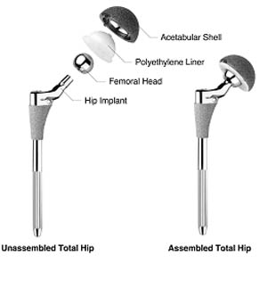
Total Hip Arthroplasty:

Slide 17
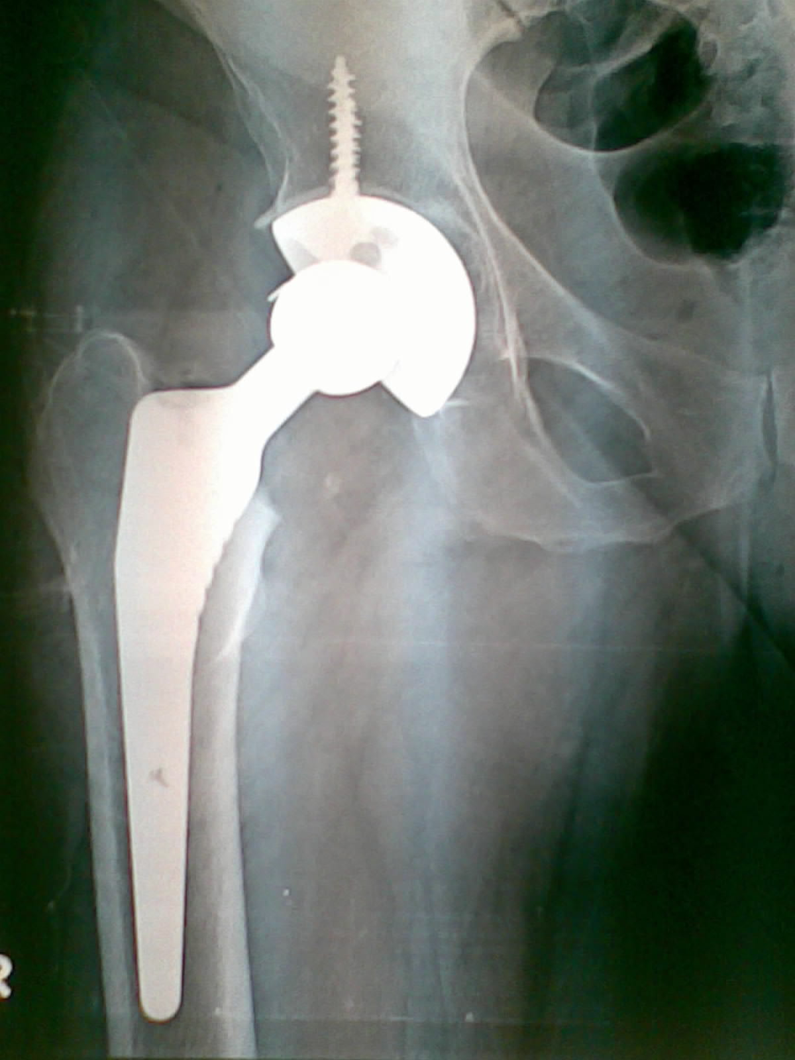
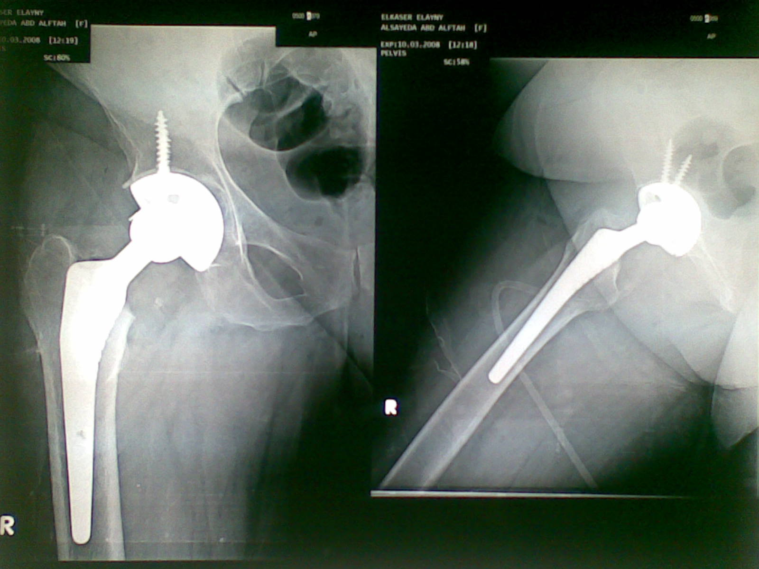
Total Hip Arthroplasty:

Slide 18
Gait training
Rehabilitation program was effective in improving hip muscle strength, walking speed, and function in patients after THA, who participated in the program at least 3 times a week for 6 weeks (Jan et al., 2004).
The patient is encouraged to participate in Gait training or ambulation within the rehabilitation program as an activity of a basic need to move from one place to another. As such, it is one of the most common activities that people do on their daily living.( Wessels et al., 2010).

Slide 19
patients and Methods
patients :
Twenty patients with primary cementless THA .
randomly assigned into two groups ( group A and group B ).
age range 50-65 years.
group A started immediate unrestricted weight bearing (UWB) gait training within physical therapy program and group B started with limited weight bearing (LWB) gait training.
Both groups were tested within the first week postoperative and at 6th & 12th week postoperative respectively.

Slide 20
Inclusion criteria
All patients selected for this study have had the following criteria:
It was the first time and cementless THA.
All patients have followed their entitled physical therapy program and precautions.
patients of group A under UWB was allowed to use a cane or one crutch in the first week or within the hospital stay and not to relief weight from the operated leg but only for safety or balancing.

Slide 21
Exclusion criteria:
All patients selected for this study have been justified as follow.
Persons with a hip implant due to rheumatoid disease, tumors or developmental dysplasia of hip have been excluded and also morbid obese subjects with body mass index (BMI) of 30 or greater have been excluded.
patients selected did not require any special footwear or foot orthotics for walking.

Slide 22
Instrumentations and measurments
Harris Hip Score.
Short physical performance battery.
AXIOM Luminos dRF .
The Biodex Unweighing System .
Weight Scale.

Slide 23
Harris Hip Score:
Harris hip score (HHS) was used to assess the outcome of total hip arthroplasty.
Harris hip score can be used by a physician or a physiotherapist to study the clinical outcome of hip arthroplasty (Söderman et al 2001).

Slide 24
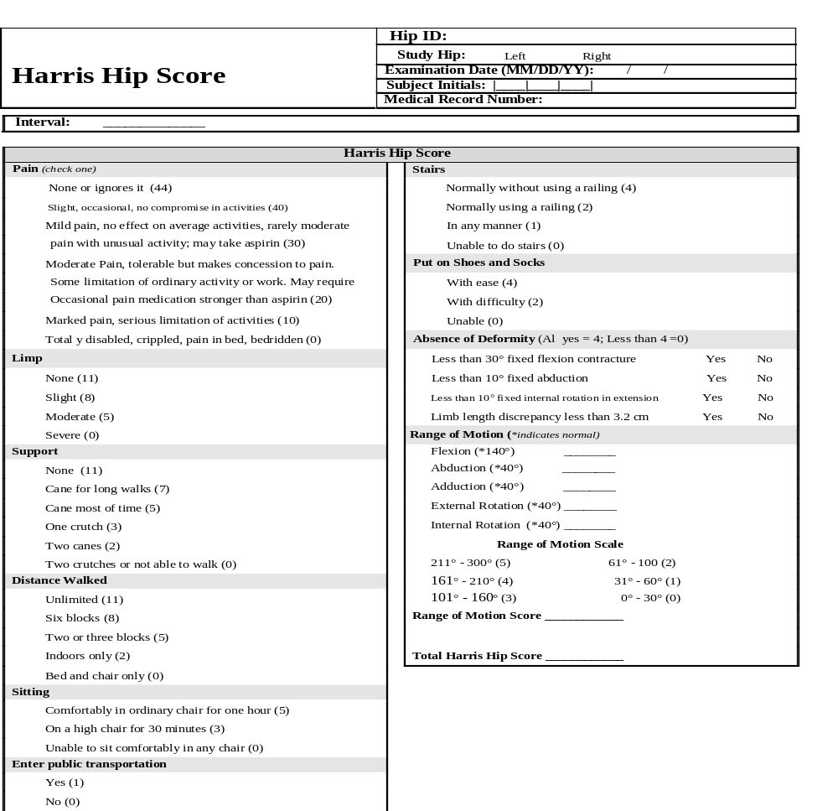

Slide 25
Grading for the Harris Hip Score
The domains of HHA covered are pain, function, absence of deformity, and range of motion. There are 10 items. Response options/scale. The score has a maximum of 100 points (best possible outcome) covering pain (1 item, 0–44 points), function (7 items, 0–47 points), absence of deformity (1 item, 4 points), and range of motion (2 items, 5 points).
Successful result = post operative increase in Harris Hip Score of > 20 points + radiographically stable implant + no additional femoral reconstruction.
Or <70 means Poor
70 - 79 means Fair
80-89 means Good
90 -100 means Excellent

Slide 26
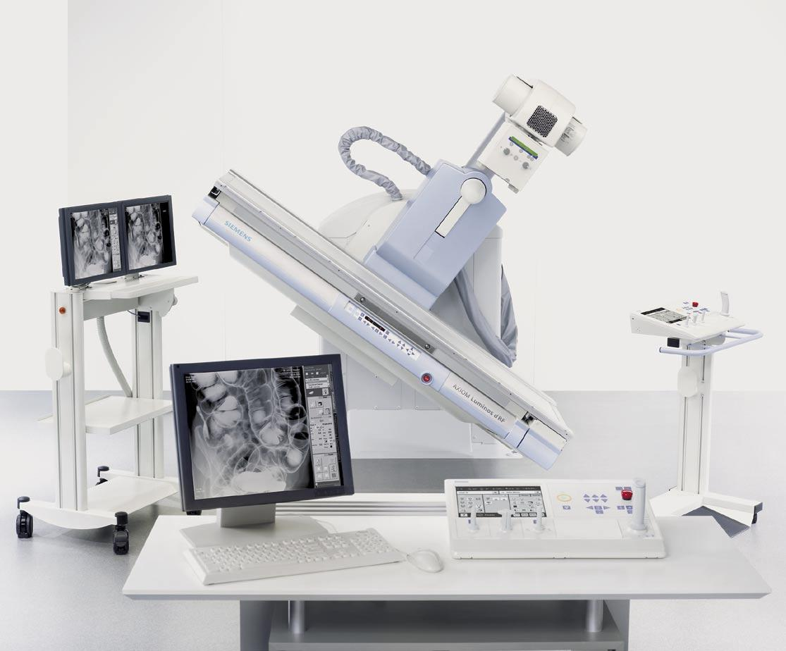
AXIOM Luminos dRF :
The 2-in-1 Solution – Remote-Controlled Fluoroscopy and Radiography System with Flat Detector (FD)

Slide 27
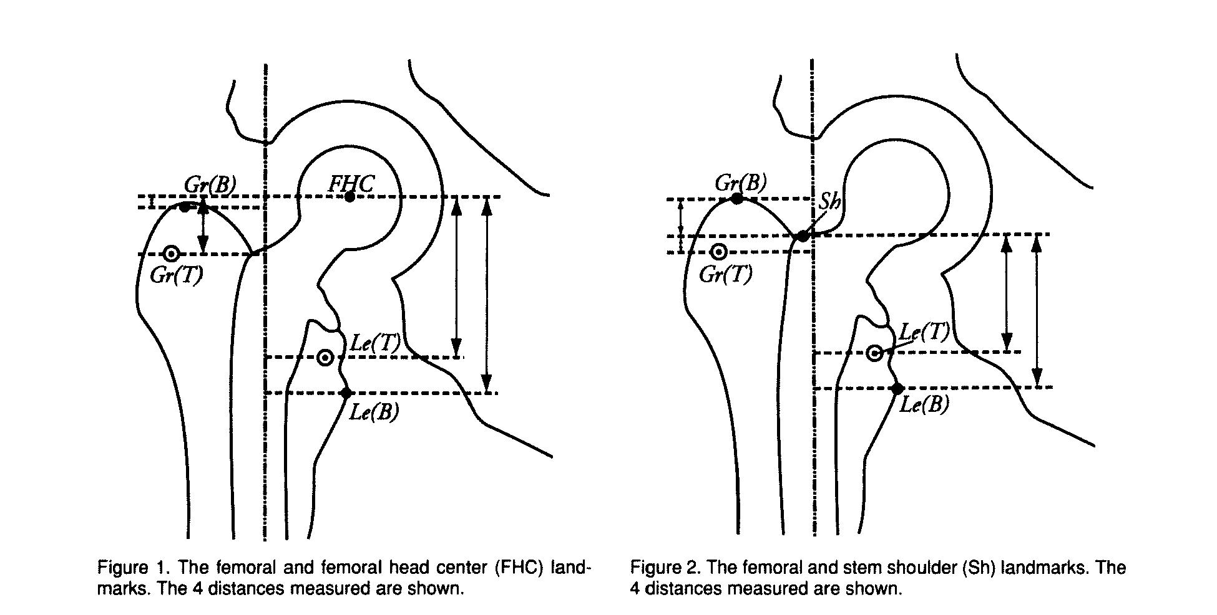
Accuracy of migration analysis of hip arthroplasty
Digitized photography versus radiostereometric analysis.

Slide 28
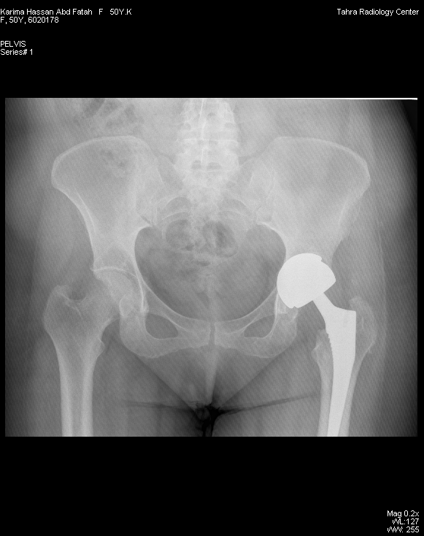
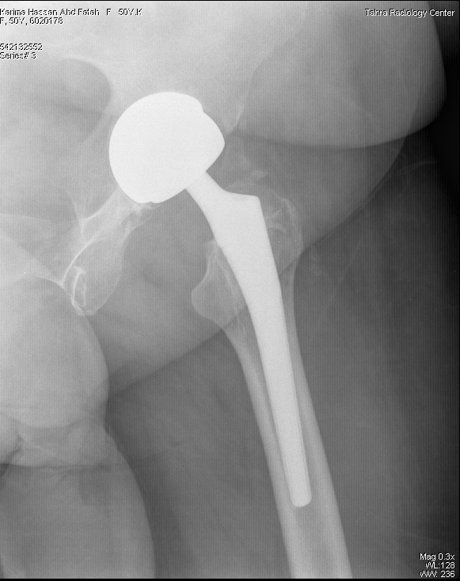

Digitized photography of migration analysis of hip arthroplasty

Slide 29
Short physical performance battery:
Short physical performance battery (SPPB) is an increasingly common test used to measure lower extremity performance in older adults. It includes a strength, balance, gait and endurance. The SPPB involves timing performance on the following items :
five chair stands (no arms).
8-ft walk test .
three hierarchical balance tests (side by side stance, modified tandem stance ,or tandem stance)
(Ostir et al., 2002).

Slide 30
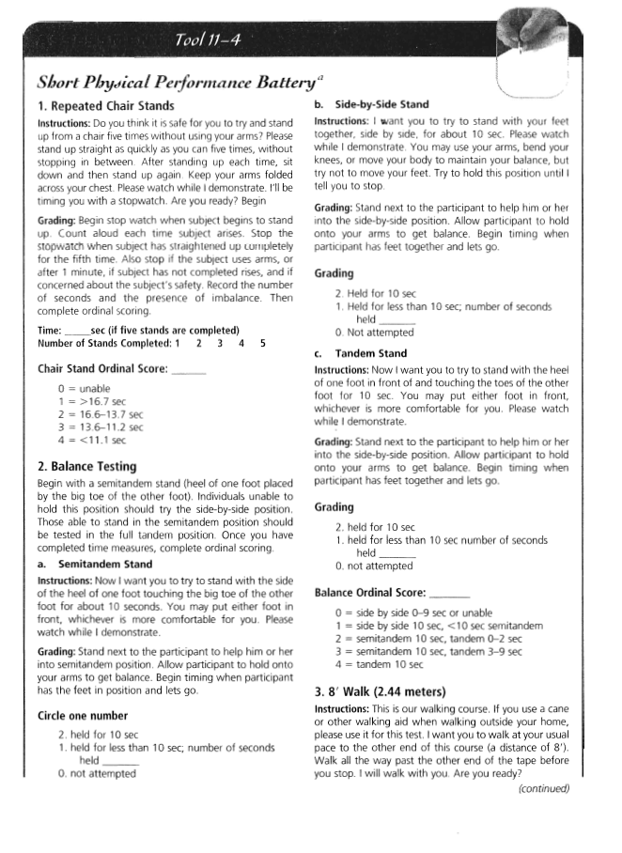
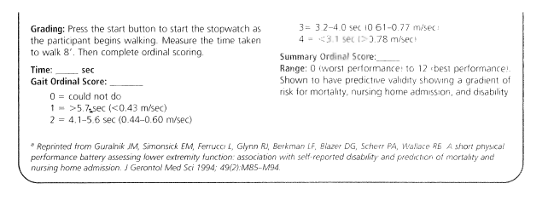
Short Physical Performance Battery

Slide 31
Gait Ordinal Score: _____
0 = could not do
1 = >5.7 sec (<0.43 m/sec)
2 = 4.1-6.5 sec (0.44-0.60 m/sec)
3 = 3.2-4.0 (0.61-0.77 m/sec)
4 = <3.1 sec (>0.78 m/sec)
Chair Stand Ordinal Score: _____
0 = unable
1 = > 16.7 sec
2 = 16.6-13.7 sec
3 = 13.6-11.2 sec
4 = < 11.1 sec
Balance Ordinal Score: _____
0 = side by side 0-9 sec or unable
1 = side by side 10, <10 sec semitandem
2 = semitandem 10 sec, tandem 0-2 sec
3 = semitandem 10 sec, tandem 3-9 sec
4 = tandem 10 sec

Slide 32
Grading SPPB
Ranged from 0 ( worst performance ) to 12 ( the best performance ).
shown to have predictive validity showing a gradient of risk for mortality.

Slide 33
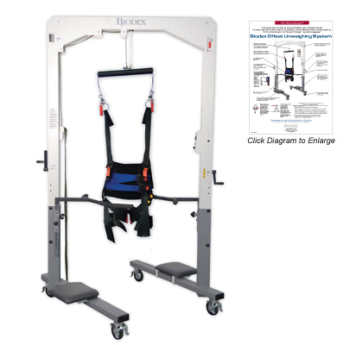
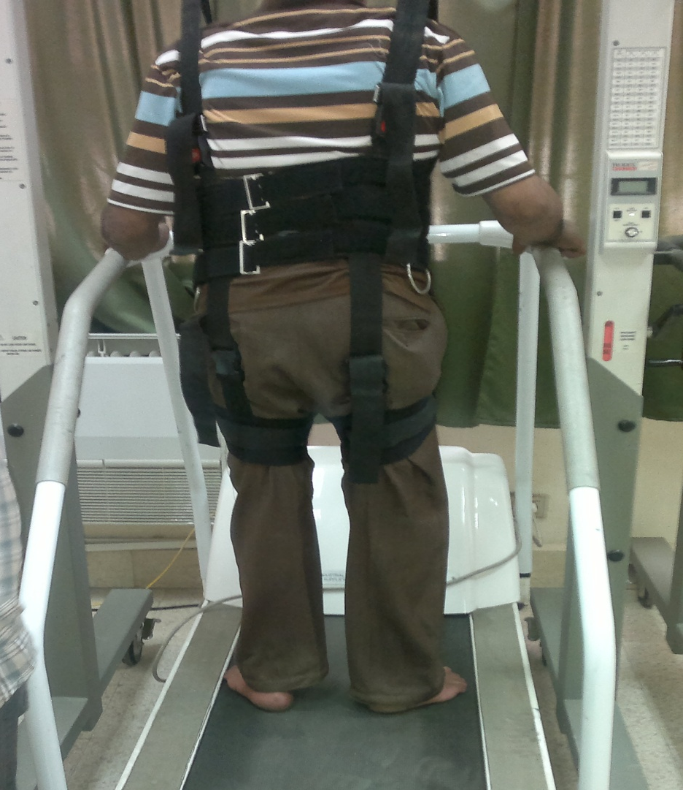
The Biodex Unweighing System:

Slide 34

Weight Scale
floor Weight scale RTZ-125 model

Slide 35
Preparatory procedures
patients were given a full explanation about the program, allowed to ask any question about it. they agreed to share in the study, each of them has been examined and asked about his/her dominant hand, medical history, sign the consent.

Slide 36
Methodology
patientts was oriented to the procedures of training and assessment tools, informed for the requirements and assuring their understanding.
Every patient was assessed for weight and height to determine BMI.
BMI Categories:
Underweight = <18.5
Normal weight = 18.5–24.9
Overweight = 25–29.9
Obesity = BMI of 30 or greater

Slide 37
Assessment procedure
Clinical evaluations:
Clinical evaluations have been performed immediate ( within the first week) post operative, then six weeks and finally 12 weeks after the surgery. The Harris hip score (HHS) and SPPB has been used to evaluate the outcome of the operations., Changes in harris hip score, SPPB and verical micromotion of the femoral stem has been measured and the statistcally analyzed with ANOVA test.

Slide 38
Radiographic evaluation:
Radiographic evaluations initiated at the discharge day postoperatively, then followed at 6 weeks and 12 weeks after the operation. The axial migration of the stem has been measured digitaly ( as shown before).
The vertical distance between the two points has been measured on each film and the difference considered as a measure of the subsidence of the prosthesis. Three different sets of readings were made on each digitized film by a single observer.

Slide 39
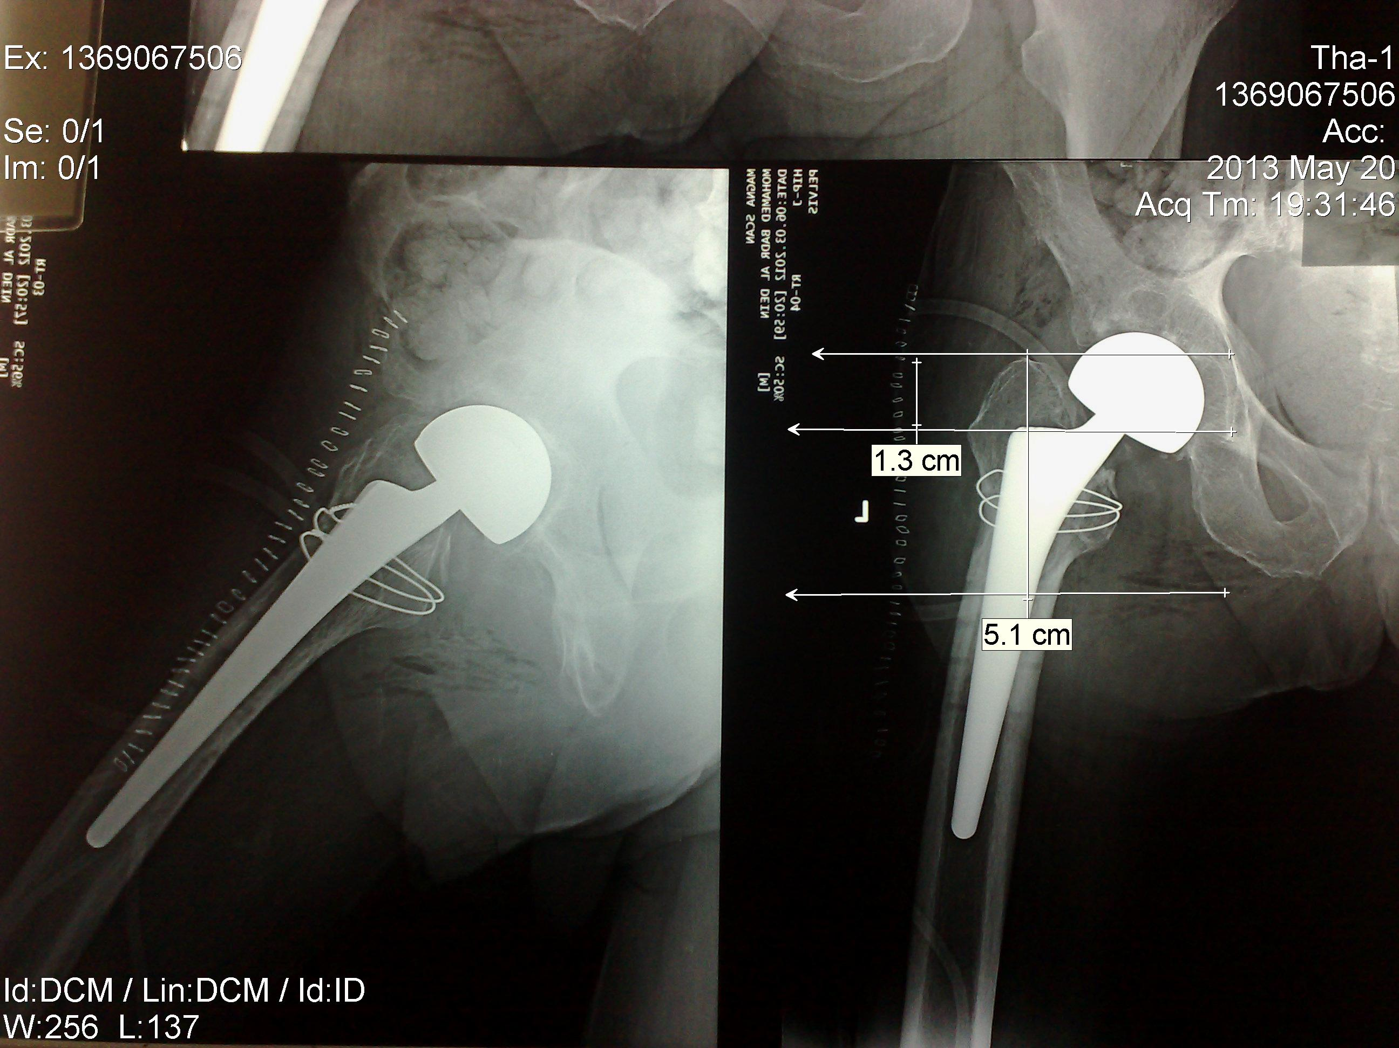
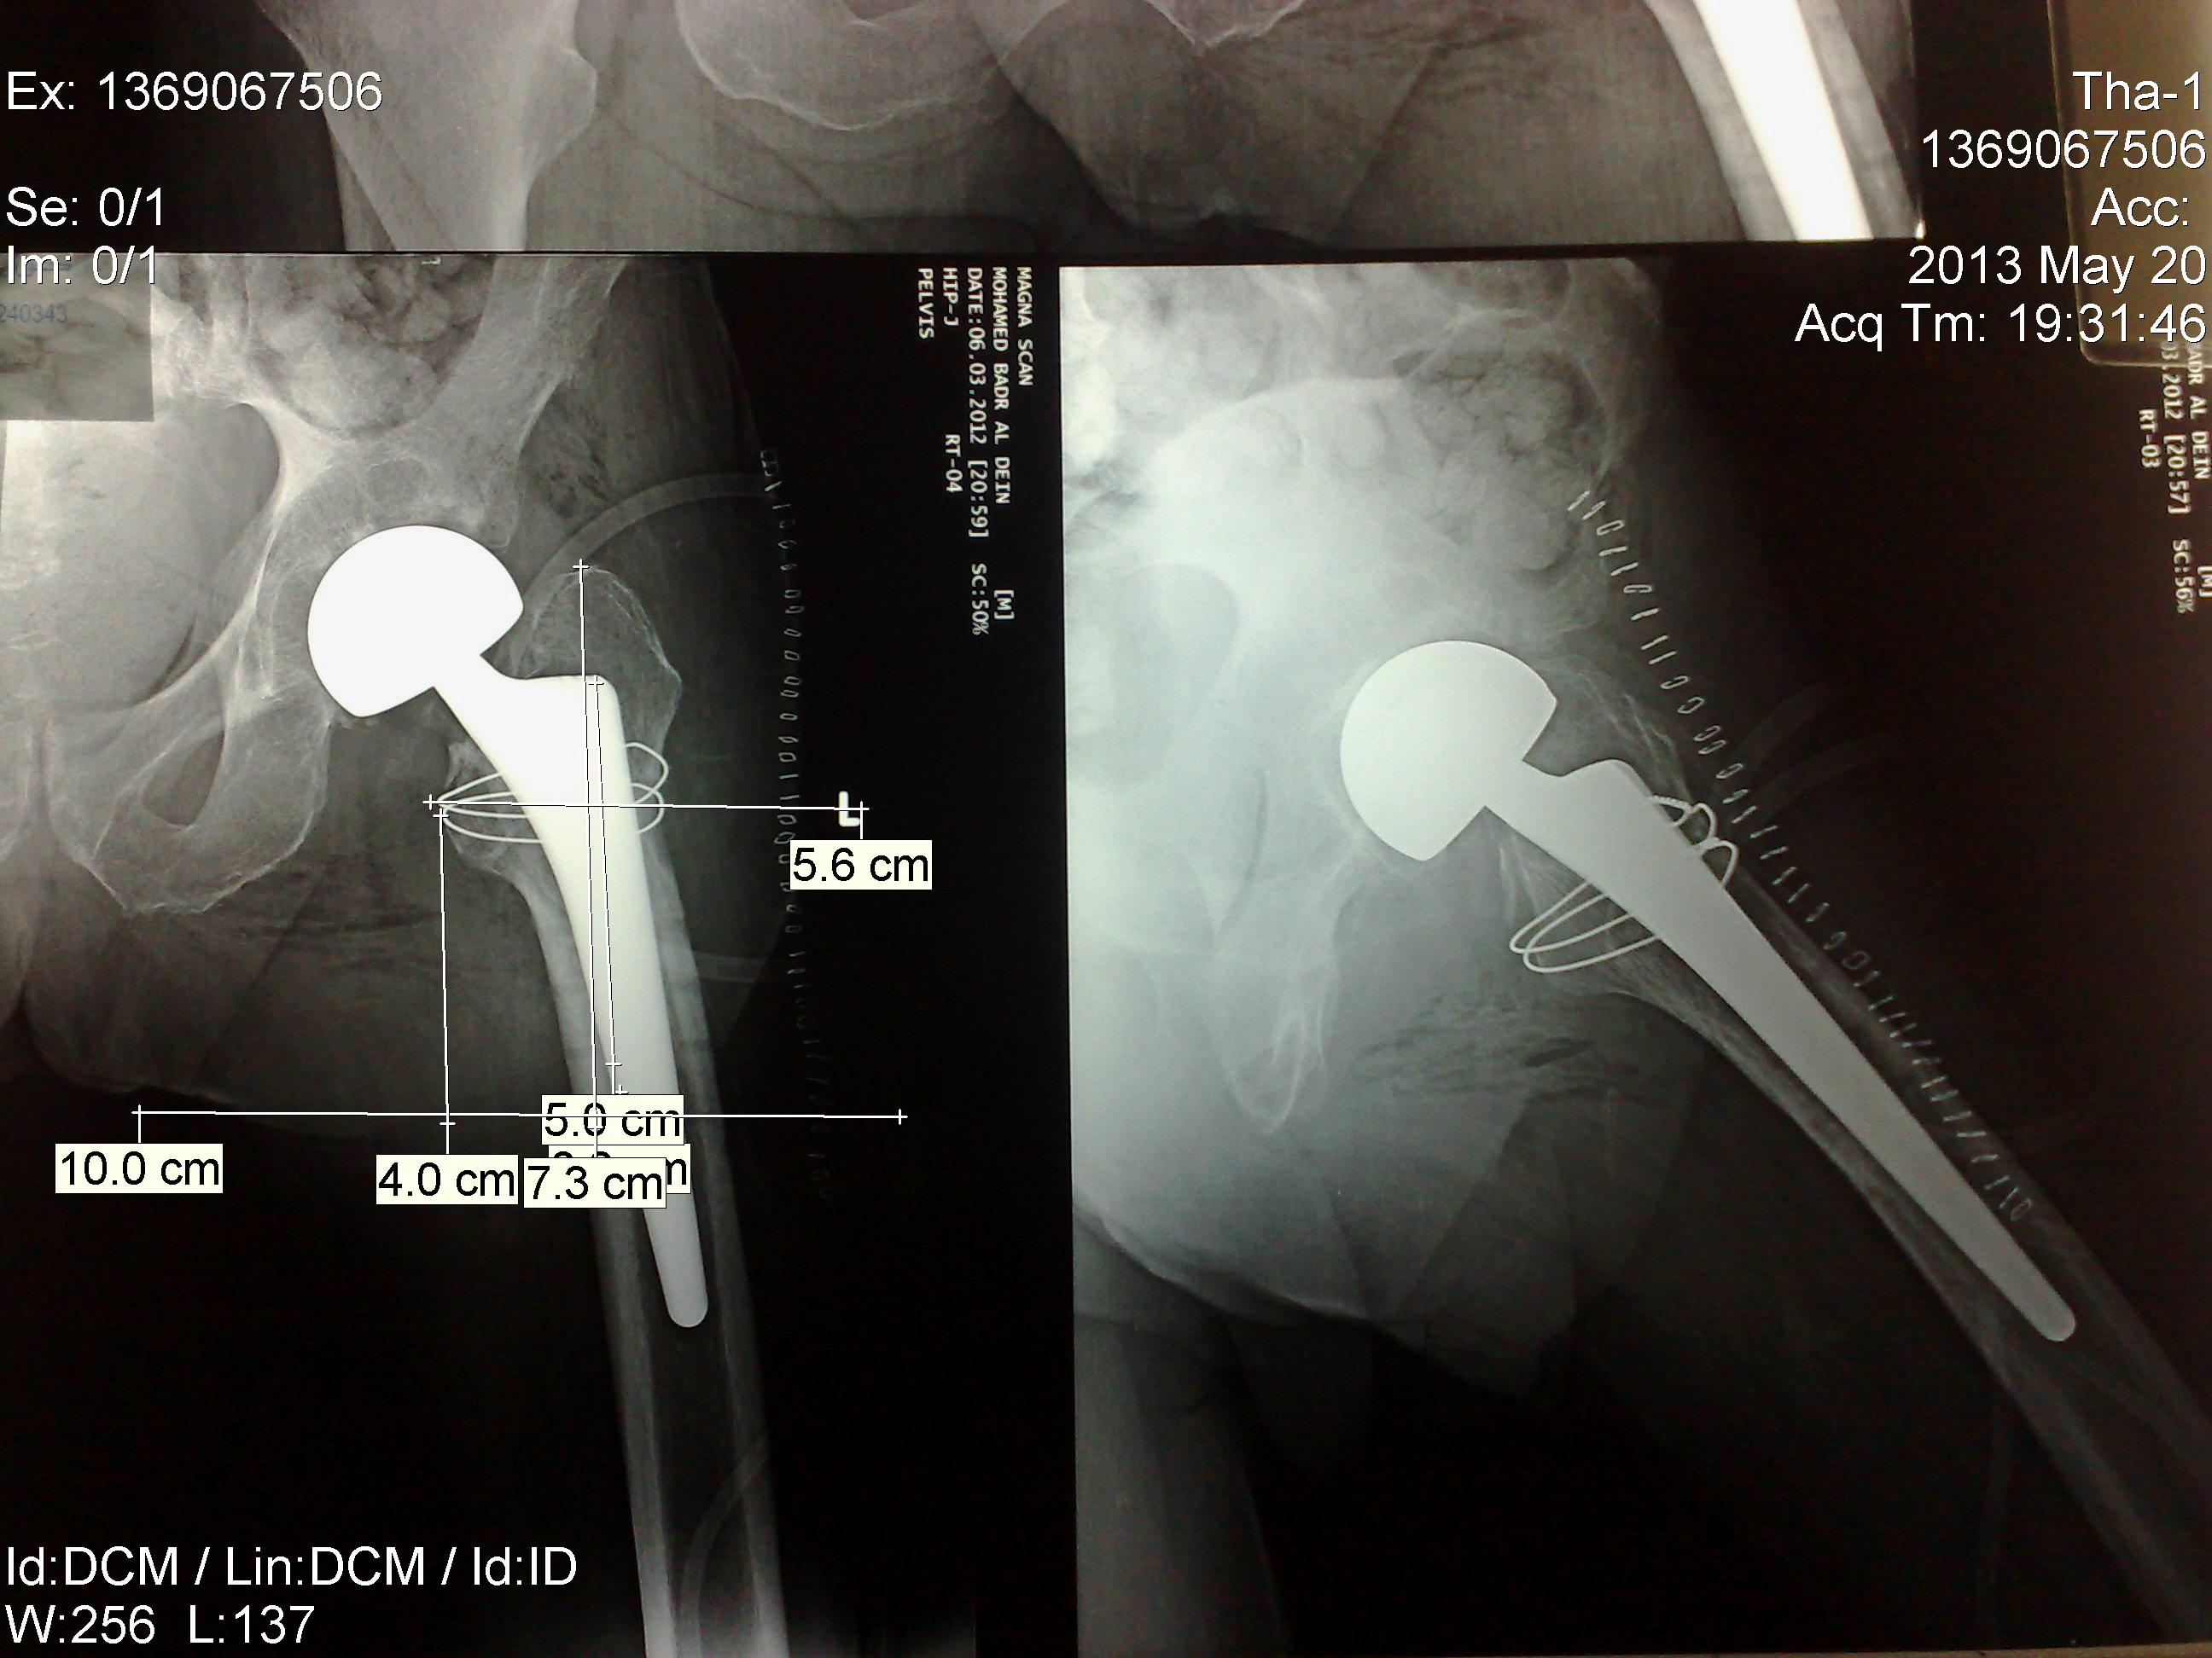
Digitized photography analysis
(a)tip of the greater trochanter
(a)tip of the greater trochanter
(a)tip of the greater trochanter
(b) outermost tip of the lateral flare
(b) outermost tip of the lateral flare
reference point on the stem

Slide 40
Physical therapy program (both groups):
Postoperative day 1
  Bedside exercises are initiated (eg, ankle pumps, quadriceps sets, gluteal sets)
  Review of hip precautions and weight-bearing status( as indicated for each group).
  Bed mobility and transfer training (ie, bed to/from chair)
Postoperative day 2
  Gait training was initiated with use of assistive devices for group B (eg, crutches, walker) while group A started UWB unless pain intolerable so allowed to use a cane as needed.
  Continue functional transfer training
Postoperative day 3-5
  Progression of ROM and strengthening exercises to the patient's tolerance (reaching 90° of flexion of hip & abduction 45° and progressive resistive exercises)
  Progression of ambulation on level surfaces (ambulation from few steps to at least 20 feet)
  Progression of ADL training .

Slide 41
Postoperative from discharge day to 12 weeks
  Therapeutic ex’s : Stretching exercises to reach 90 degrees and abduction to 45 degrees , then Strengthening exercises, active assisted to active resistive e.g., seated leg extension, sidelying/ standing hip abduction, standing hip extension and hip abduction, knee bends, bridging for 10 repetition time 3 each.
  Gait training: Progression of ambulation has been continued using unweighing treadmill or appropriate assistive device for weight bearing precaution with group B.
  ADL training: Progression of independence with all ADL"S.

Slide 42
Gait training
Group B (GWB) used unloading treadmill initially and then appropriate assistive device for gait training while adjusting the weight bearing as permited to start with 20% to 30% of body weight (BW) in the first three weeks to reach 60% of BW by the end of six weeks or otherwise orthopdic surgeon recommendation report., while patients continued using assistive device (AD) in the form of walker or bilateral crutches till end of the six week and then reduced the AD after the six weeks to a cane or one crutch to get rid of by the end of the twelve weeks.

Slide 43
Statistical analysis:
By using ANOVA to analyze data collected of the both groups and each for three specific intervals ( Both groups will be tested at discharge from hospital and at 6th & 12th week postoperative respectively ) .
Mann Whitney test.
Friedman ANOVA .
Wilcoxon sign rank test for pair wise comparison.
Chi square test.
The data were considered significant if p value was ≤ 0.05 and highly significant if p value < 0.01. Statistical analysis was performed with the aid of the SPSS computer program (version 16 windows).

Slide 44
Results
HHS and so SPPB showed no group difference.
There was no statistical significant difference between the HHS and SPPB measured at different times of assessment in the two studied groups.
there was statistical significant increase in the HHS and SPPB in 6 weeks and 12 weeks when compared to initial assessment in each group.
HHS and SPPB were significantly increased in 12 week assessment when compared to 6 week assessment.
Radiological vertical micromigration of femoral stem assessments have revealed no statistical significant difference between group A and group B.

Slide 45
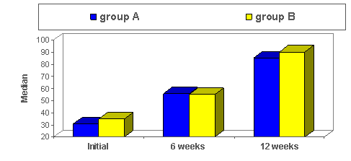
Comparison between the median values of the Harris hip score measured at different times of treatment in the two studied groups.

Slide 46
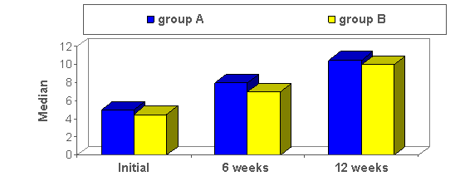
Comparison between the median values of the short physical performance battery in the two studied groups measured at different times of assessment.

Slide 47
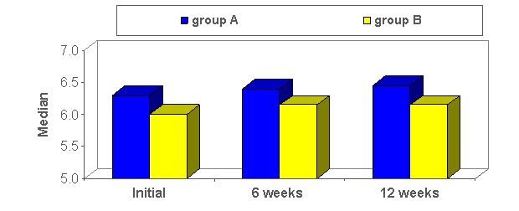
Comparison between the median values of the radiological vertical micromigration of femoral stem in the two studied groups measured at different times of assessment.

Slide 48
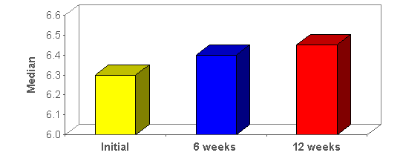
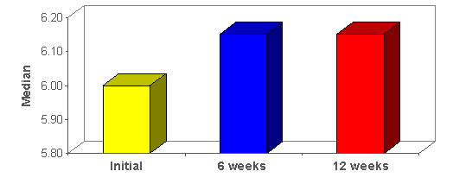
Comparison between the median values of the radiological vertical micromigration of femoral stem measured at different times of assessment in the group A.
Comparison between the median values of the radiological vertical micromigration of femoral stem measured at different times of assessment in group B.

Slide 49
Discussion
The clinical results of the study comply with most of the previous researches conclusions regarding the changes of the functional improvements assessed by HHS and SPPB and also regarding the vertical micromotion of the femoral stem. , the results have revealed no significant different between both research groups ( A and B ).

Slide 50
SUMMARY
This study was conducted to assess the efficacy of immediate unrestricted weight bearing gait training program in the treatment of primary cementless total hip arthroplasty patients.
Twenty patients with primary cementless THA have participated in this study, with age range 50-65 years.
Assigned into two groups (group A and group B), group A started immediate unrestricted weight bearing (UWB) gait training within rehabilitation program and group B started with graduated weight bearing (GWB) gait training.
the collected data has been analyzed using unpaired t-test, and ANOVA.
comparison between the data collected from both groups regarding vertical migration of the prosthetatic stem revealed nonsignificant subsidence (Femoral component subsidence was defined as a change of more than 4 mm) .

Slide 51
CONCLUSION
Bending on the presented data, it is possible to conclude that immediate unrestricted weight bearing gait training program has no adverse effect in the treatment of primary cementless total hip arthroplasty.

Slide 52
RECOMMENDATIONS
The results of the present study have stimulated concerns regarding the following:
  Further research needs to be conducted to assess life time expectations for cementless THA using different types of weight bearing precaution .
  Research regarding the immediate unrestricted weight bearing gait training with using bigger sample would be encouraged.
  Research the effect of balance training program accompanied with UWB on gait parameter deviations after cementless total hip arthroplasty.

Slide 53
بسم الله الرحمن الرحيم
يرفع الله الَذين آمنوا منكم و الذين أوتوا العلم درجات و الله بما تعملون خبير.
المجادلة١١

Slide 54




Slide 55

Thank You

