Slide 1
Conference Series LLC Conferences
Conference Series LLC is a pioneer and leading science event organizer, which publishes around 500 open access journals and conducts over 500 Medical, Clinical, Engineering, Life Sciences, Pharma scientific conferences all over the globe annually with the support of more than 1000 scientific associations and 30,000 editorial board members and 3.5 million followers to its credit.
Conference Series LLC has organized 500 conferences, workshops and national symposiums across the major cities including San Francisco, Las Vegas, San Antonio, Omaha, Orlando, Raleigh, Santa Clara, Chicago, Philadelphia, Baltimore, United Kingdom, Valencia, Dubai, Beijing, Hyderabad, Bengaluru and Mumbai.

Slide 2
Smoke and Mirrors: Limited value of Relative Risk Reductions for assessing the benefits of disease-modifying therapies for Multiple Sclerosis
Magd Zakaria
Prof. of Neurology,
Head of the Neuropsychiatry department , Ain Shams University, Cairo, Egypt

Slide 3

Evidence Based Medicine
(EBM)
The proper interpretation of the medical literature
Correction of medical misconceptions

Slide 4
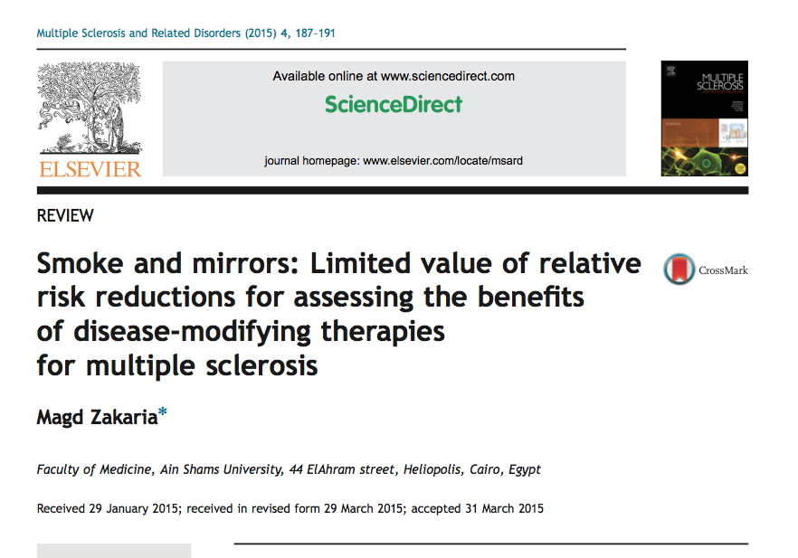
Smoke and Mirrors: Limited value of Relative Risk Reductions for assessing the benefits of disease-modifying therapies for Multiple Sclerosis
Magd Zakaria
Prof. of Neurology Ain Shams University, Cairo, Egypt

Slide 5
AIM
To show that there is a worldwide
misconception among MS specialists
concerning the main statistical parameter
used to express the different outcome
measures in the MS clinical trials, namely,
the Relative Risk Reduction

Slide 6
This misconception is critical
It is worldwide

Slide 7
All our knowledge about the efficacy of DMD’s is from the results of the RCT’s which represents the highest level of EBM

Slide 8
Relapse Rate Reduction as a Clinical Outcome Expressed as Relative Risk Reduction (RRR)
MS
Drug | Trial | RRR (%)
Natalizumab | AFFIRM | 68
Cladribine | CLARITY | 58
Fingolimod | FREEDOMS 1 | 54
BG – 12 | DEFINE | 53
Teriflunamide | TEMSO - TOWER | 31.5 36.3
IFN – β1b Sc | Pivotal | 34
IFN – β1a Sc | PRISMS | 33
IFN – β1a IM | MSCRG | 32
GA | Pivotal | 29

Slide 9
Is This Parameter (RRR) a True Marker of Clinical Efficacy??
What Does It Actually Reflect??
What Do Statisticians Say About The Value Of The RRR??

Slide 10
Basic Statistics

Slide 11
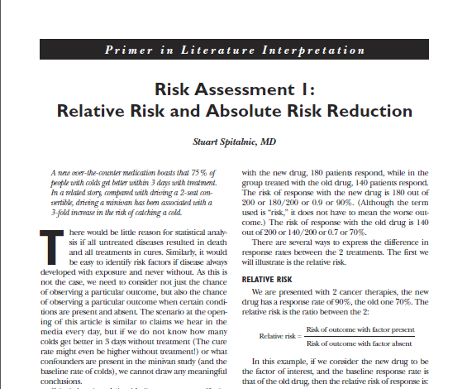

Slide 12
Event Rate (Relapse) =
No. of patients with a relapse Total No. of the group
Ratio or percentage

Slide 13
Absolute Risk Reduction
( ARR )
How many events did this drug prevent ?
Placebo event rate – drug event rate

Slide 14
Number Needed To Treat
(NNT)
To Prevent One Outcome (Relapse), How Many Patients Do I Need To Give The Drug?
NNT = 100 OR 1
ARR ARR
Percentage
Ratio

Slide 15
Relative Risk Reduction =
Number of events prevented by the drug IN RELATION or RELATIVE to the events in the placebo
Absolute Risk Reduction
Placebo Event (Relapse) Rate
X 100

Slide 16
Trial (1)
A double blind Placebo controlled study with a new M.S. drug (A) included 100 Placebo cases and 100 (A) cases and the primary end point was the occurrence of a relapse. 40 cases in the Placebo group versus 20 cases in the (A) group had a relapse at the end of the trial.
Event Rate (Relapse)
Placebo | Drug | ARR | RRR | NNT
40 = 40% 100 | 20 = 20% 100 | 40% – 20% = 20 % = 20 | 20 = 50% 40 | 100 = 5 20

Slide 17
Trial (2)
A double blind Placebo controlled study with a new M.S. drug (B) included 100 Placebo cases and 100 (B) cases and the primary end point was the occurrence of a relapse. 4 cases in the Placebo group versus 2 cases in the (B) group had a relapse at the end of the trial.
Event Rate (Relapse)
Placebo | Drug | ARR | RRR | NNT
4 = 4% 100 | 2 = 2% 100 | 4% – 2% =2% =2 | 2 = 50% 4 | 100 = 50 2

Slide 18
Trial (3)
A double blind Placebo controlled study with a new M.S. drug (C) included 100 Placebo cases and 100 (C) cases and the primary end point was the occurrence of a relapse. 90 cases in the Placebo group versus 60 cases in the (C) group had a relapse at the end of the trial.
Event Rate (Relapse)
Placebo | Drug | ARR | RRR | NNT
90 = 90% 100 | 60 = 60% 100 | 90 – 60 = 30% = 30 | 30 = 33.3% 90 | 100 = 3.3 30

Slide 19
Comparison
 | Trial (1) | Trial (2) | Trial (3)
Relapse Rate in the placebo | 40% | 4% | 90%
Relative Risk Reduction (RRR) | 50% | 50% | 33.3%
NNT | 5 | 50 | 3.3
Absolute Risk Reduction(ARR) | 20 | 2 | 30
The value of the RRR depends on the RISK. Without knowing the level of Risk in the control group, one cannot assess the effect size in the treatment group. Treatments with very large RRR may have a small clinical effect in conditions where the control group has a very low Event Rate. On the other hand, modest RRR can assume major clinical importance if the control Event Rate is large.
(Sacket et al, How to Practice And Teach EBM, Churchil Livingston 1997)

Slide 20
The RRR does not take into account the initial baseline risk of the outcome event making an insignificant finding appear significant.
Data expressed as the RRR is popular with sales representatives and journal articles.
“Beware and don’t be fooled! Always check the ARR too”
- Rob Cutforth, University of Nottingham, 2006.
www. Nottingham.ac.uk

Slide 21
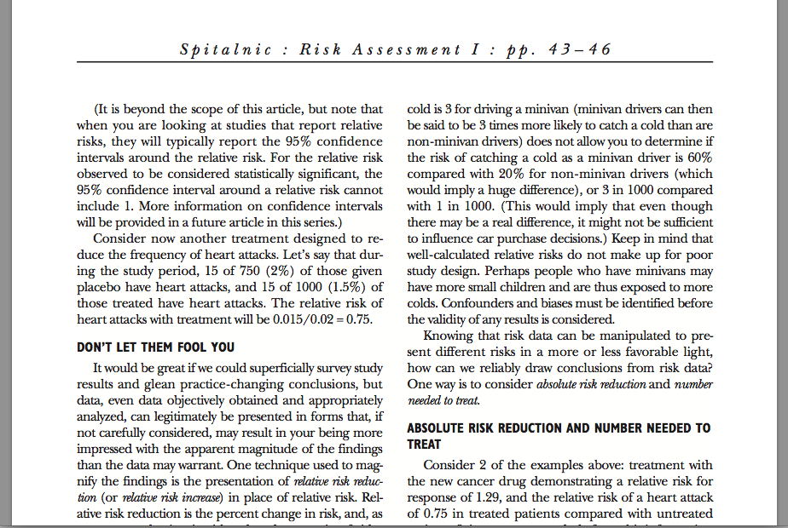

Slide 22
The Three Basic Statistical Rules For Evaluating The Significance Of The Relative Risk Reduction

Slide 23
The RRR tells us little about the ABSOLUTE clinical benefit of any new drug

Slide 24
A high RRR may result from a clinically insignificant change in the event rate if the event rate of the placebo is very low ( trial 2 )
 | Trial (1) | Trial (2) | Trial (3)
Risk (Relapse) in Placebo Group | 40% | 4% | 90%
Relative Risk Reduction (RRR) | 50% | 50% | 33.3%
NNT | 5 | 50 | 3.3
Absolute Risk Reduction(ARR) | 20 | 2 | 30

Slide 25
The RRR may be low even when a larger number of patients are protected from relapsing (trial 3 )
 | Trial (1) | Trial (2) | Trial (3)
Risk (Relapse) in Placebo Group | 40% | 4% | 90%
Relative Risk Reduction (RRR) | 50% | 50% | 33.3%
NNT | 5 | 50 | 3.3
Absolute Risk Reduction(ARR) | 20 | 2 | 30

Slide 26
THE KEY TO UNDERSTAND THE
VALUE OF THE RRR IS TO LOOK AT THE EVENT RATE IN THE PLACEBO GROUP

Slide 27
Accordingly, it is meaningless to compare RRR values between different trials where the placebo groups may have different background risks of events

Slide 28
Special Relevance To Multiple Sclerosis

Slide 29
Two-year Relapse Reduction: Relative Risk Reduction Vs. Absolute Risk Reduction
 | Relative Risk Reduction (%) | Annualized Relapse Rate for Placebo | Absolute Risk Reduction | No. needed to treat
IFN – β1b Sc Pivotal Trial | 34 | 1.27 | 0.43 | 2.3
IFN – β1a Sc PRISMS Trial | 33 | 1.28 | 0.42 | 2.4
IFN – β1a IM MSCRG | 32 | 0.90 | 0.29 | 3.4
GA Pivotal Trial | 29 | 0.84 | 0.24 | 4.2
Natalizumab AFFIRM Trial | 68 | 0.78 | 0.50 | 2.0
Fingolimod FREEDOMS | 54 | 0.40 | 0.22 | 4.5
Cladribine CLARITY | 58 | 0.33 | 0.19 | 5.3
BG – 12 DEFINE | 53 | 0.36 | 0.19 | 5.3
TEMSO Teriflunamide | 31.5 | 0.54 | 0.17 | 5.9
TOWER Teriflunamide | 36 | 0.5 | 0.18 | 5.6

Slide 30
Direct Head To Head Comparative Trials

Slide 31
GA Pivotal
29%
DEFINE
(BG12)
53%
CONFIRM
Post Hoc Analysis : No statistical Difference

Slide 32
Result | Trial | Comparison
IFN beta 1a SC | EVIDENCE | Interferon beta 1a SC Interferon beta 1a IM
IFN beta 1b sc | INCOMIN | Interferon beta 1b SC Interferon beta 1a IM
Equal Equal | BEYOND REGARD | Interferon beta 1b vs GA Interferon beta 1a sc vs GA
Fingolimod | TRANSFORMS | Fingolimod Interferon beta 1a IM
IFN beta 1a equal 14mg teriflunamide | TENERE | Teriflunamide Interferon beta 1a SC
Alemtuzumab | CARE MS | Alemtuzumab Interferon beta 1a SC

Slide 33
Take Home Messages

Slide 34
The value of the RRR as a clinical outcome, depends on the Risk ( the event rate in the placebo )

Slide 35
Low Event Rates in the placebo group may yield high RRR yet they are clinically non significant, as reflected by a low Absolute Risk Reduction and a high NNT.

Slide 36
While modest RRR may be clinically more significant if the Event Rate of the placebo group is high.

Slide 37
RRR + Event Rate in The Placebo +ARR +NNT

Slide 38
But If You Look At The RRR Alone
SMOKE AND MIRRORS

Slide 39
Each trial has its own specific characteristics and cross comparison between different trials for RRR or even for NNT is wrong.

Slide 40
These numbers may change for the SAME DRUG in different trial conditions and the most dangerous approach for EBM is to GENERALIZE the results

Slide 41
Direct Head To Head Comparative Trials is the Best Way to Assess the Relative Efficacy of Different Drugs

Slide 42

A very high RRR in a very low Placebo Event Rate is clinically Meaningless.
Spitalnic, 2005

Slide 43

THANK YOU

Slide 44
Let us meet again..
We welcome you to our future conferences of Conference Series LLC
through
9th International Conference and Exhibition on Pharmacovigilance
July 17-19, 2017 Munich, Germany
http://pharmacovigilance.pharmaceuticalconferences.com/

