Slide 1
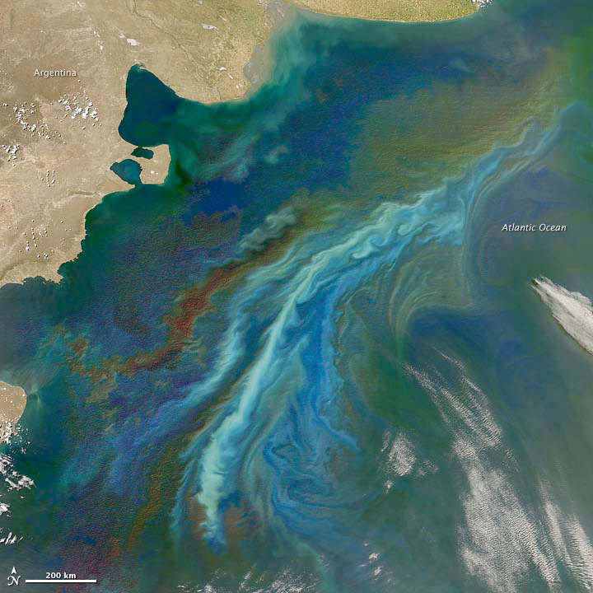

A Study of Phytoplankton Communities and Related Environmental Factors of Ratnagiri sea coast
Madhura Mukadam and Arvind Kulkarni
Department of Zoology,
Gogate Jogalekar College, Ratnagiri, (MS), India.

Slide 2

INTRODUCTION
Phytoplankton is a vital and important organism as a producer of the primary food supply of the sea.
Its study includes a variety of taxonomic groups (cyanobacteria, diatoms, dinoflagellates, silicoflagelates, coccolithophorids, and many other flagellates) that inhabit the water column.
Marine phytoplankton of the world may include as many as 17 classes and an estimated number of 498 ± 15 genera and 3,910 ± 465 species (Sournia et al. 1991).
Through the process of photosynthesis, also extract carbon dioxide from the atmosphere, and play an important role in the balance of greenhouse gases that control global climate(Alles, 2011).

Slide 3

These are the skeletons of food web dynamics, which control many ecological processes such as carbon budget, modulation of sea surface temperature(SST) affecting global climate.
They are very efficient and easily detectable indicators of ecological alteration.
Presence of certain species of phytoplankton can trigger the fishery or deplete it also resulting in toxicity.
The most important factors determining the values of the photosynthetic parameters in natural phytoplankton populations are - light, temperature, nutrient concentration, and pigment content in algae.

Slide 4
Importance of Phytoplankton in Food Chain :
Predominantly autotrophic or holophytic organisms (they build organic matter from inorganic materials present in their environment).
Marine phytoplankton is the most important producer of organic substances and determine the basic primary productivity of the ecosystem.
Under favourable conditions, phytoplankton is capable of remarkably rapid growth, sometimes producing new organic materials equalling its own weight within 24 hours, a rate greater than that achievable by terrestrial plants.
All other living forms of higher trophic levels are directly or indirectly dependant on phytoplankton for energy supply and hence perform vital functions (Chandy et al.1991).

Slide 5
Factors Affecting Primary Production
Physico-chemical factors like Light, temperature and availability of nutrients.
Biomass of phytoplankton and consequently primary production, display strong seasonal variation in accordance with climatic conditions and other oceanic phenomena such as upwelling and turbulence (Eddy diffusion) in addition to the grazing rate of herbivorous zooplankton of the local habitat.
Since primary production depends on the ability of plants to absorb and utilize light in photochemical reactions, it is confined to the illuminated surface zone of the sea (euphotic zone).
Seasonal variations in light intensity and other factors that affect light penetration influence photosynthesis to a great extent.

Slide 6

Rate of photosynthesis increases with rising temperature up to a maximum, but then diminishes sharply with further rise in temperature.
Ability of organisms to perform photosynthesis depends on their adaptability to ambient conditions and different species are suited to different range of temperature.
In addition to its direct effect on rate of photosynthesis, temperature also influences production through its effects on movement and mixing of the water, and hence on the supply of nutrients to the euphotic levels.
Availability of biolimiting elements such as nitrogen, phosphorous and silica is an important factor affecting primary production.

Slide 7
Significance of Phytoplankton
Diatoms are the important group of phytoplankton engaged in primary production.
Distribution and abundance of diatoms indicate a conducive environment for active growth and survival of other forms of life.
Population density of marine animals and their reproductive cycle are related to the abundance of phytoplankton.
This is because those animals themselves and/or their metamorphosing young ones (larvae) are dependent on diatoms, dinoflagellates etc. for nutrition.
High plankton density is associated with similar increase in bacterial population mainly involved in decomposition of particulate organic matter from fecal pallets and the bodies of dead organisms.

Slide 8
MATERIALS AND METHODS
Samples are being collected from one location (Mirkarwada) on fortnightly basis (30m/50m) and from two other locations (Dabhol and Burondi) samples are being collected quarterly.
Phytoplankton collection was done using conical nylon bags (30cm diameter) made up of 30 no. bolting silk cloth is used for filtering 100 L of surface water with a bucket of 25 liters volume and the plankton was thus concentrated.
The net was washed again with sea water and concentrated plankton was collected in 100 ml volume screw capped airtight plastic bottles.
The samples were preserved on site by adding 1 ml of Lugol’s iodine. The sample was allowed to settle prior to analysis.

Slide 9

The enumeration of phytoplankton was carried out by obtaining 1 ml of plankton sample from the stock through the Stampel pipette. This volume was transferred to a Sedgwick Rafter counting cell.
Counting of the individual plankton was done by using the formula.
Plankton units/Liter = N x C x 10
Y
The species-wise phytoplankton were counted. This was repeated by taking one ml of sample twice and from average of the three samples data was calculated.
Thus, average number of phytoplankton present in a liter of water sample was then calculated and final results are expressed as no. of cells.
For chlorophyll analysis samples are filtered on board and other samples for nutrient analysis are analyzed in the laboratory on the next day.

Slide 10
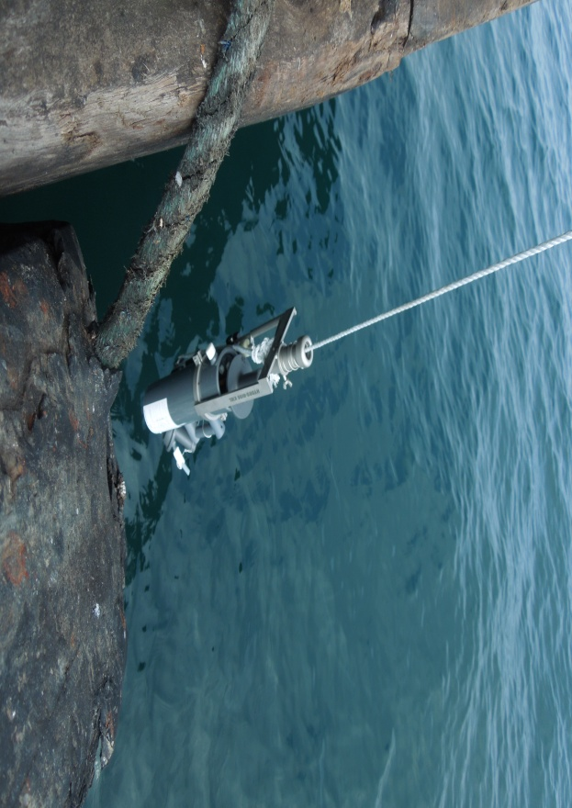

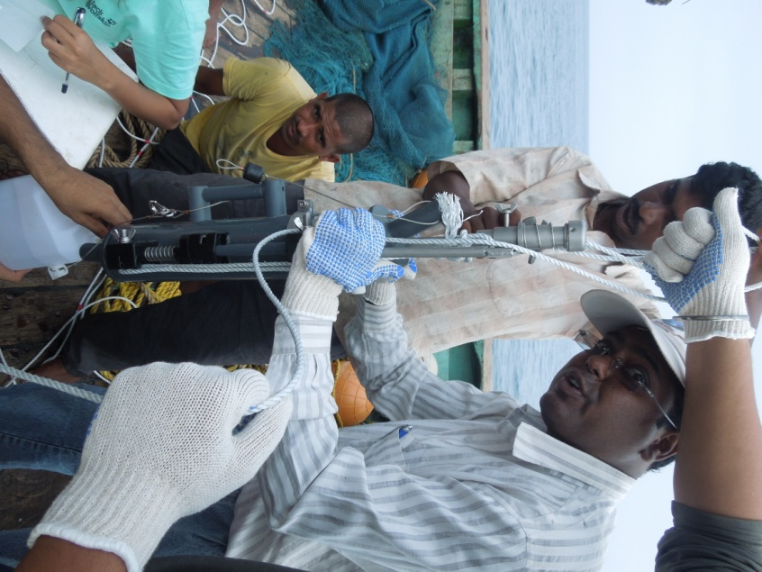
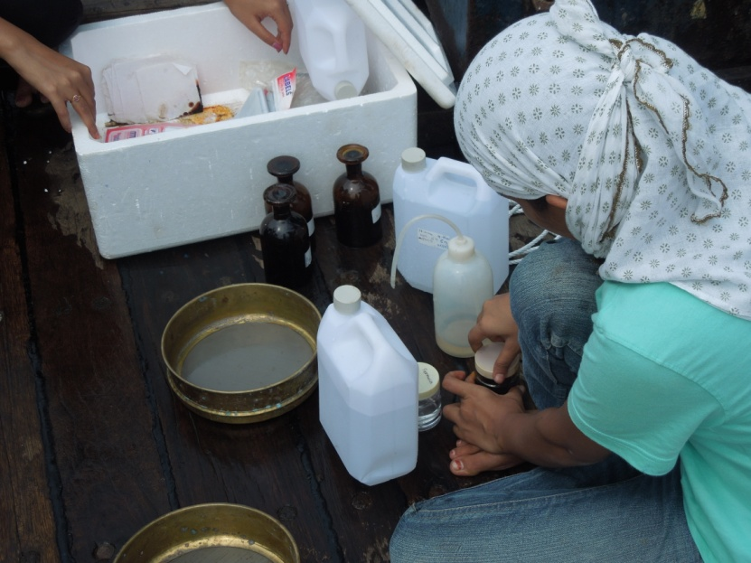

SAMPLING

Slide 11
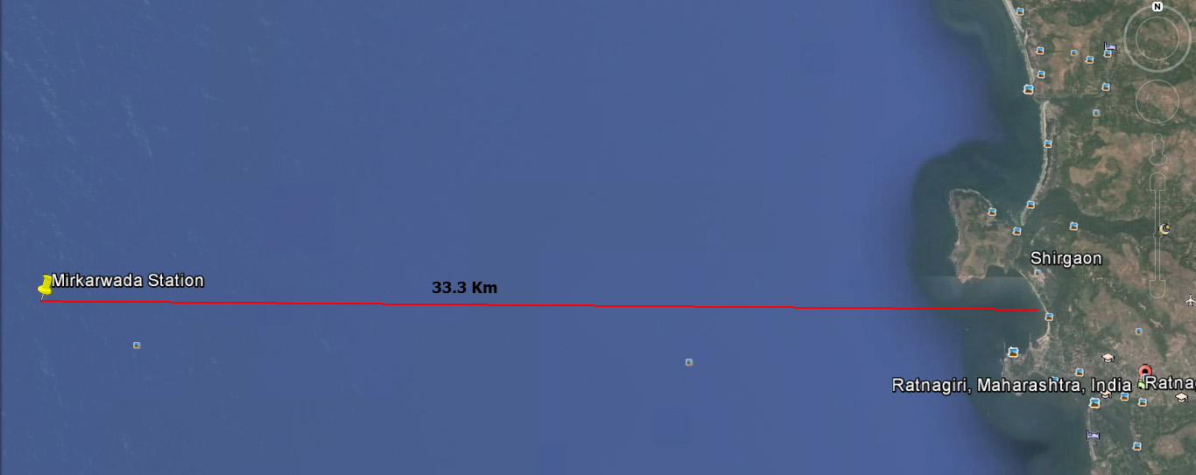
STUDY AREA
MIRKARWADA SAMPLING STATION
MIRKARWADA SAMPLING STATION
Mirkarwada Station GPS position
17°.00.210N
72°.58.920E

Slide 12
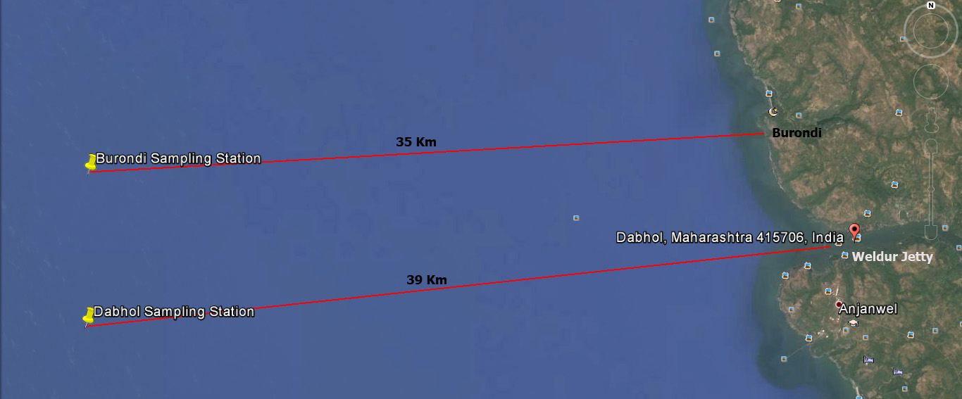
DABHOL AND BURONDI SAMPLING STATION
Burondi Station GPS Position
17⁰.36’10.99N
72⁰.48‘29.72E
Dabhol Station GPS Position
17⁰.32'32.11"N
72⁰.48'0.80"E

Slide 13
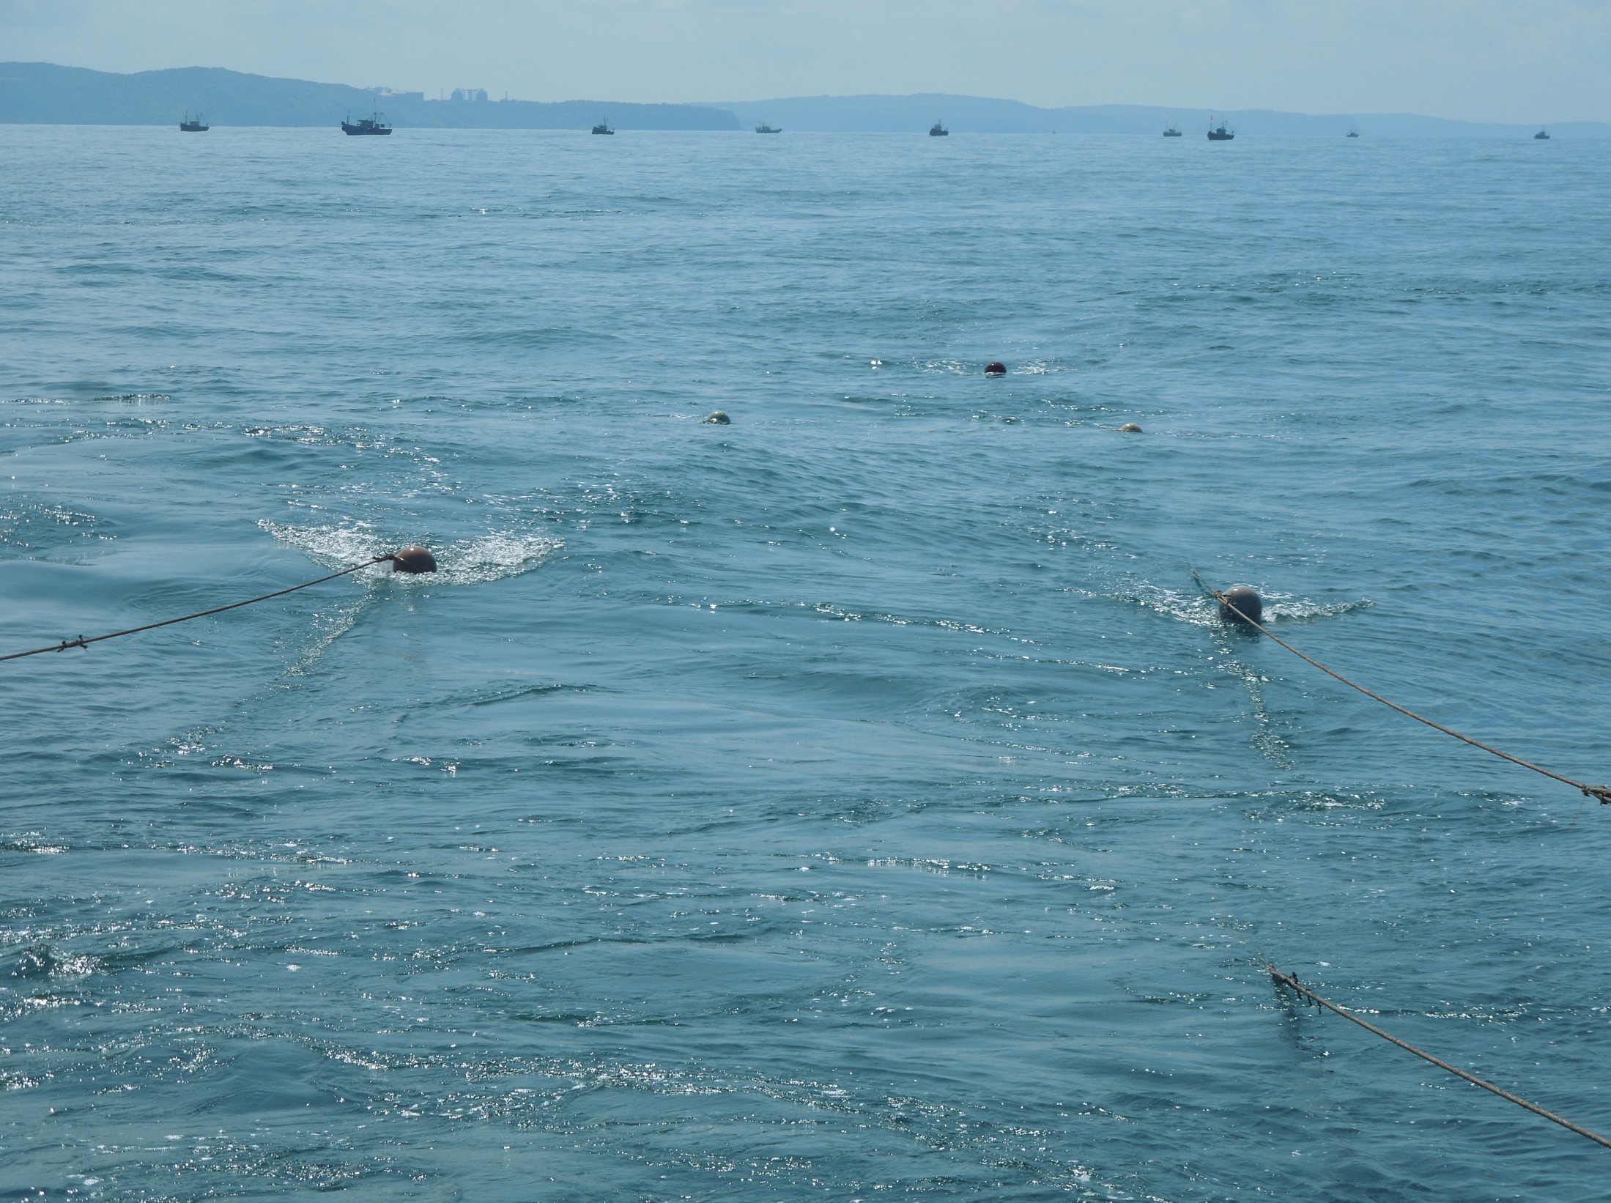
RESULTS AND DISCUSSION

Slide 14
Min 27 Max 29.5
Min 5.4 Max 8.7
Min 33 Max 40
Min 0.58 Max 4.32
Temperature showed decreasing trend while pH, Salinity and DO Showed increasing trend from October to March,2014

Slide 15
Min 0.5 Max 5.53
Chlorophyll a was found to be higher at 1:00 PM than 11:00 AM and 3:00 PM
Secchi Depth showed decreasing trend, and low values of Secchi depth correlates with low concentration of chlorophyll from 27 Dec 13 till 3 March,14 at Mirkarwada station

Slide 16
Ranked graphs shows phytoplankton variations which have been
plotted showing species present at all 6/5 or 4 depths with time series

Slide 17
As a general feature, Phytoplankton density was higher at 1:00 PM than at 3:00 PM
Coscinodiscus was most prominent genus followed by Fragillaryopsis, Nitzschia, Pleurosigma, Chaetoceros and Thallasionema

Slide 18
Genus | No of Species
Asterionella | 2
Ceratium | 18
Dictiocha | 2
Dinophysis | 2
Ditylum | 2
Gonyaulux | 2
Gunardia | 2
Miniduscus | 2
Nitzschia | 5
Ornithoceros | 3
Peridinium | 5
Pleurosigma | 5
Prorocentrum | 5
Rhizosolenia | 6
Thallasionema | 2
Thallasiothrix | 3
The Identified Genera are 60
16 genera comprised of 66 species

