Slide 1
Lignocellulolytic Activity of Soil Fungi Isolated from Different Scenarios of Conservation Agriculture
Madhu Choudhary^{*1}, Neelam Garg¹ and PC Sharma²
¹Deparment of Microbiology, Kurukshetra University, Kurukshetra-136 119, Haryana
²Division of Crop Improvement, CSSRI, Karnal -132 001, Haryana

Slide 2
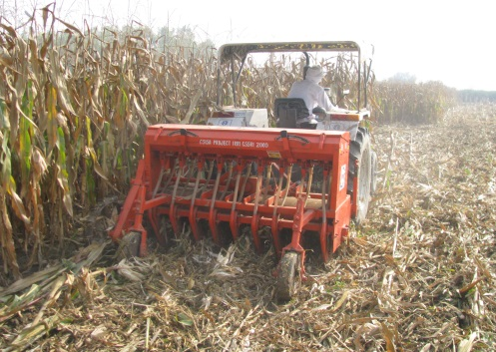
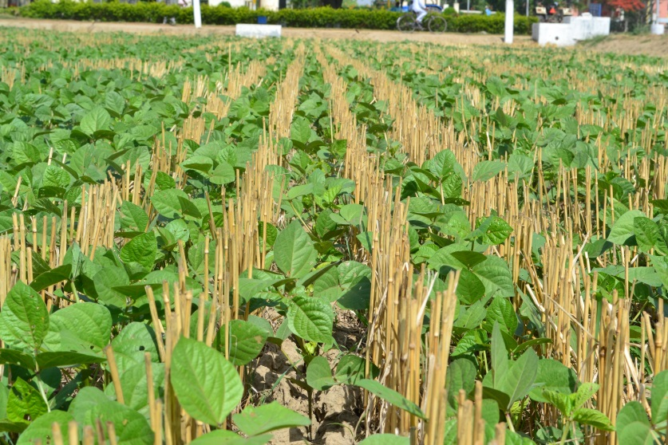
on
“Conservation agriculture (CA) aims to conserve, improve and make more efficient use of natural resources through integrated management of available soil, water and biological resources combined with external inputs. It contributes to environmental conservation as well as to enhanced and sustained agricultural production. It can also be referred to as resource efficient or resource effective agriculture.” (FAO http://www.fao.org/ag/ca/11.html)

Slide 3
Why Conservation Agriculture is needed?
(i) Overexploitation of groundwater resources:
leading to a decline in the groundwater table
increased energy cost of pumping water,
Detrioration of groundwater quality
(ii) declining soil organic matter and increasing multiple deficiencies of major nutrients (N, P, K, and S) and micronutrients (Zn, Fe, and Mn) due to their over mining from soils
(iii) excessive withdrawal of water for irrigation also led to impurities (heavy metal contamination etc.) and increasing salinity
(iv) the development of herbicide resistance and a shift in weed flora and pest populations
(v) poor management of crop residues, leading to their burning.
(vi) food and nutritional insecurity

Slide 4
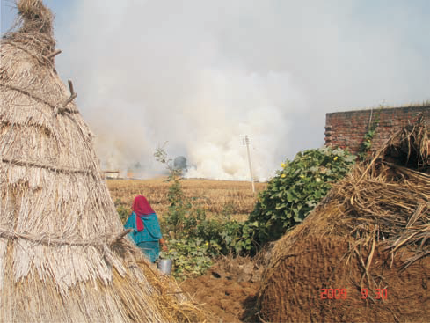
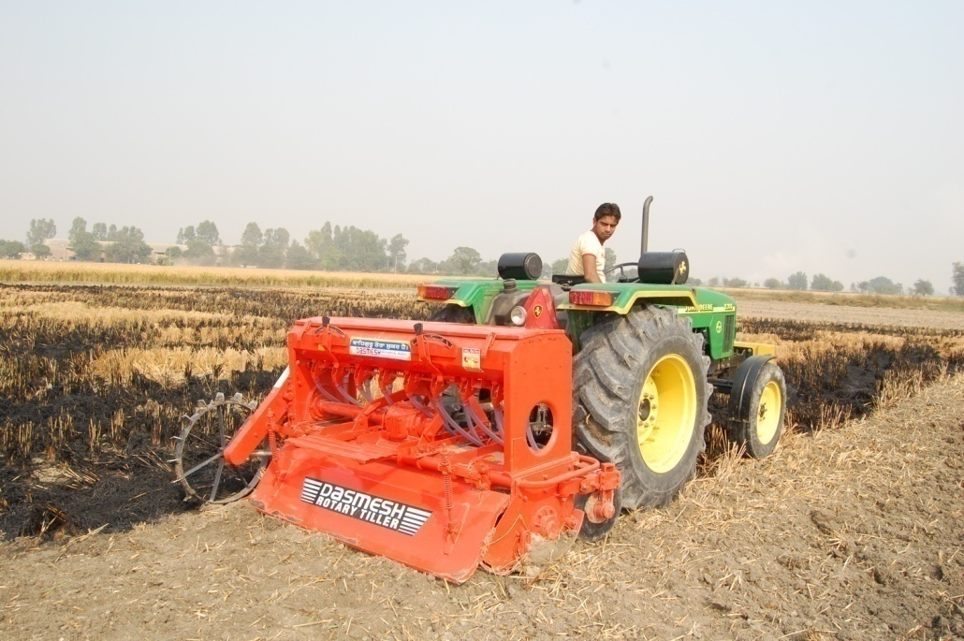
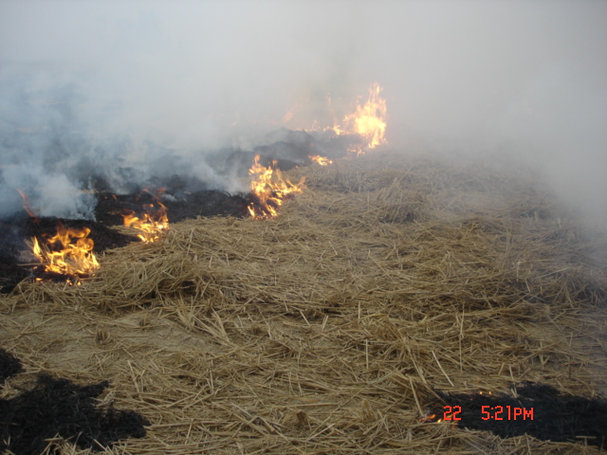
Unsustainability mainly caused by:
Tillage
Soil Organic matter decline
Soil structural degradation
  Water and wind erosion
  Reduced water infiltration rates
  Surface sealing and crusting
  Soil compaction
Insufficient return of organic material
Mono cropping

Slide 5

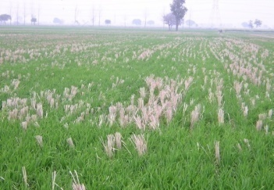
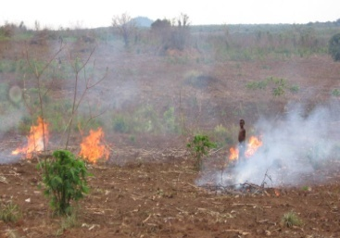
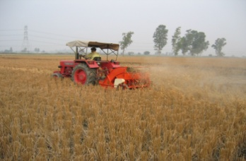
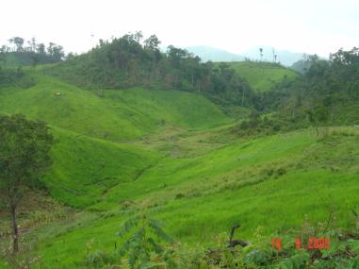
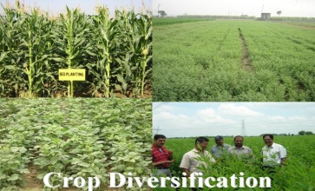
Unsustainable to Sustainable Agriculture
What components needs shift?
Unsustainable Agriculture |  | Sustainable Agriculture
Ploughing/tilling the soil |  | Minimum soil disturbance- No-till/minimum till
Removing all organic material |  | Rational soil cover- Residue management
Monoculture |  | Efficient crop rotations- Crop diversification
CA includes all of the other principles of sound crop management – we just need to remove the ills of the past
Notes:
Reduced tillage and crop residue retention have been proposed, as they facilitate water infiltration, reduce erosion, improve soil structure, increase soil organic matter and carbon content, and moderate soil temperatures.
Compared with conventional tillage and crop residue removal, these practices can also decrease production costs by reducing the use of heavy machinery, fuels, water, and fertilizers.

Slide 6
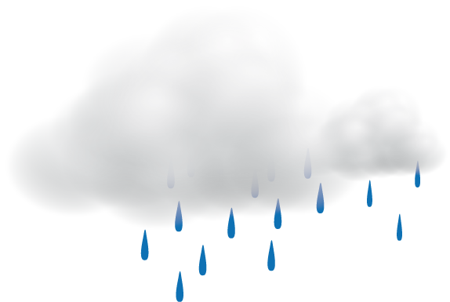


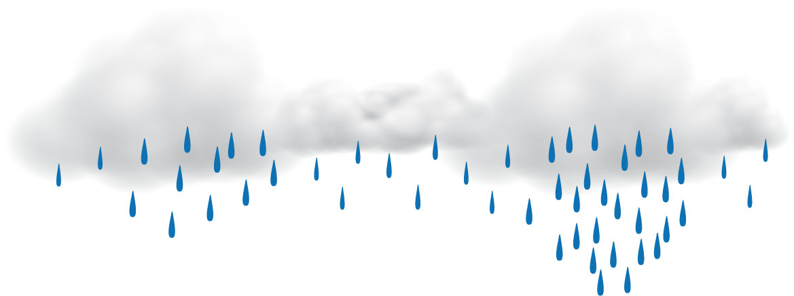



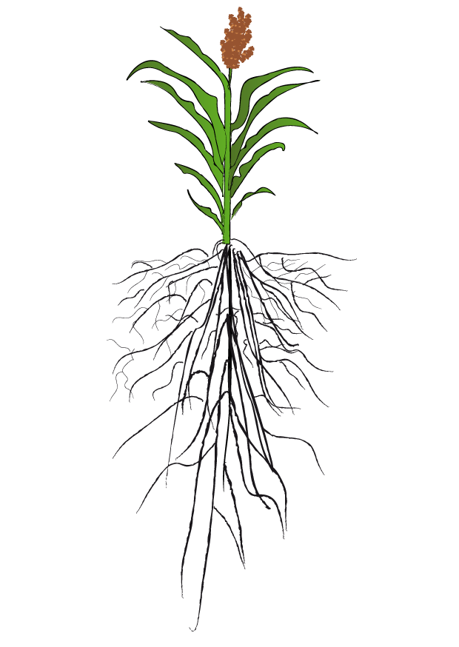
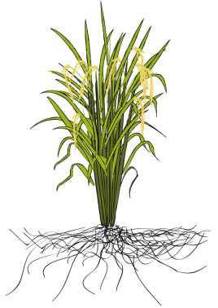
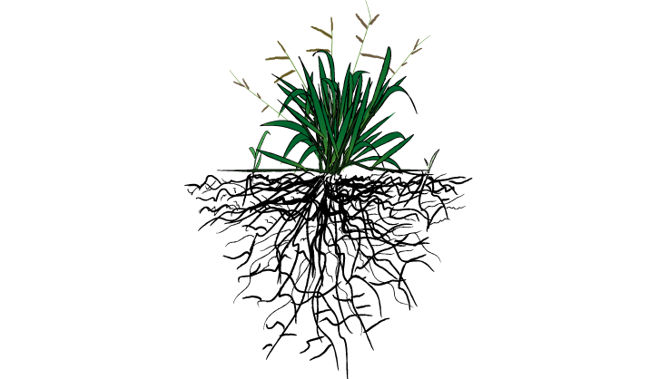
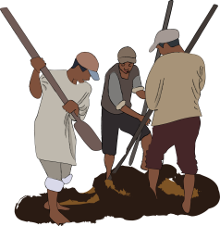

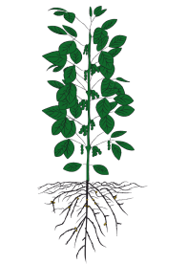
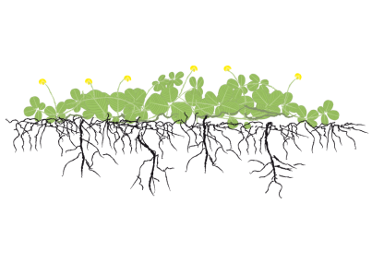
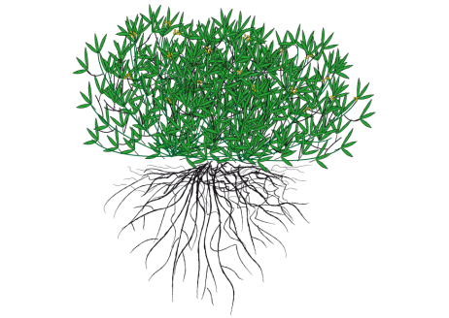
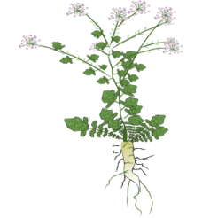
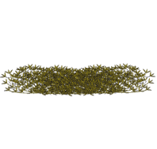
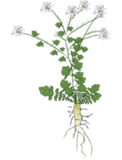
Conservation agriculture systems
CA is based on three principles applied simultaneously (FAO, 2009)
1
2
3
Minimum mechanical
soil disturbance
(the minimum soil disturbance necessary to sow the seed)
Permanent organic
soil cover
(retention of adequate levels of crop residues on the soil surface)
Diversified crop rotations including cover crops
(to help moderate possible weed, disease and pest problems)
Notes:
CA is a broader concept than No-till.
CA: a resource-saving agricultural production system that aims to achieve production intensification and high yields while enhancing the natural resource base through compliance with three interrelated principles, along with other good production practices of plant nutrition and pest management:
Minimum mechanical soil disturbance with direct seeding: planting crops into untilled soil by opening a narrow slot, trench or band only of sufficient width and depth to obtain proper seed coverage. No other soil tillage is done.
Permanent or continuous no-till is meant, rather than not tilling in one season and tilling in the other, or occasionally not tilling the soil.
Permanent soil organic cover with crop residues and/or cover crops to the extent allowed by water availability;
Species diversification through varied crop associations and/or rotations (involving annual and/or perennial crops including trees).

Slide 7
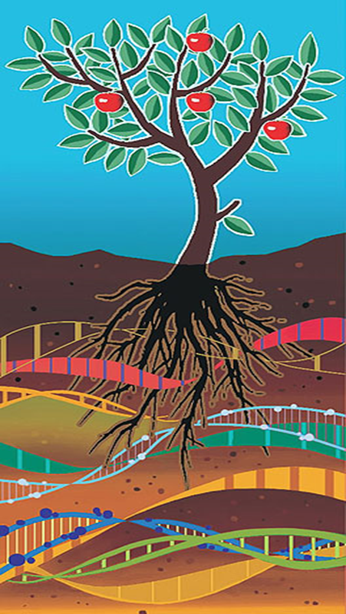
The positive effect of these practices seems to be correlated with the improvement of soil structure
higher availability of organic substrates for microorganisms.
Improved soil structure allows
better soil aeration
diffusion of water and nutrients through the soil profile,
while the retention of crop residues
enhances microbial activity and
the soil microbial biomass content.
These improvements in soil quality can also increase soil microbial diversity, thus protecting crops against pests and diseases through competition for soil nutrients.

Slide 8
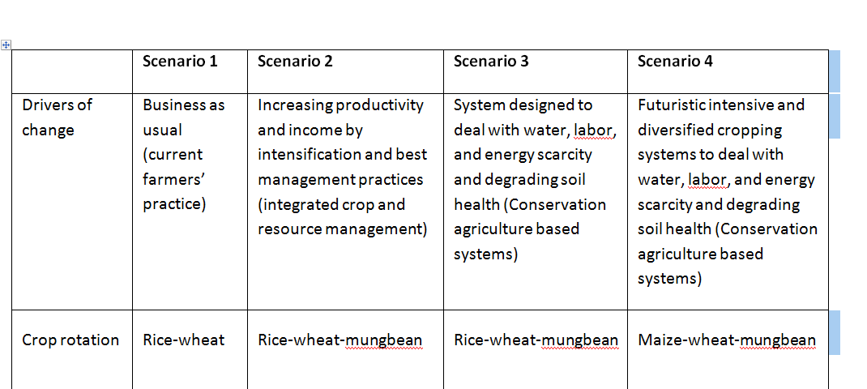
Drivers of agricultural change, crop rotation, tillage, crop establishment method, and residue management of different scenario :

Slide 9
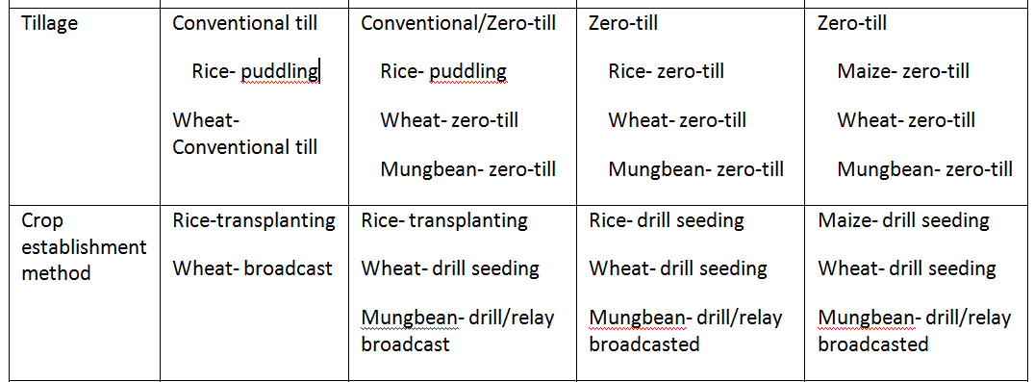
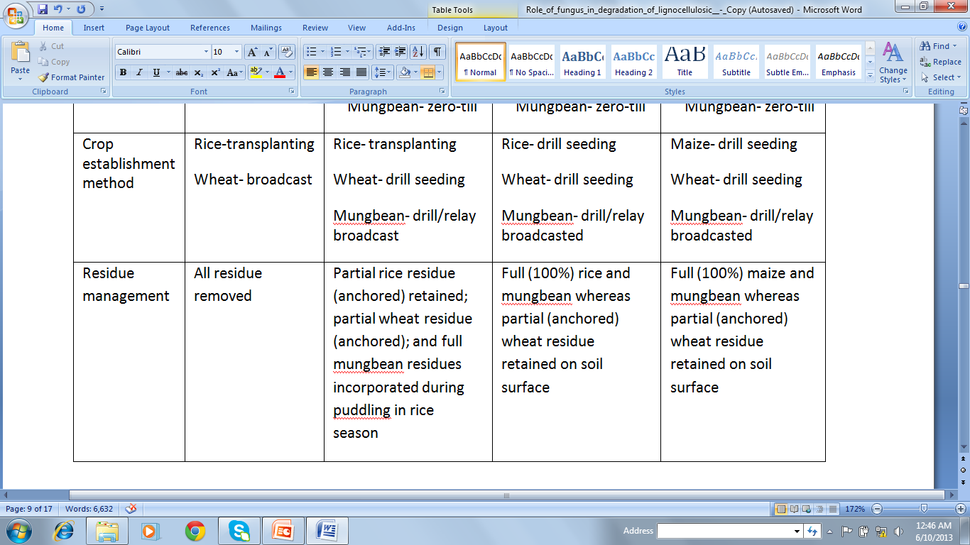

Slide 10
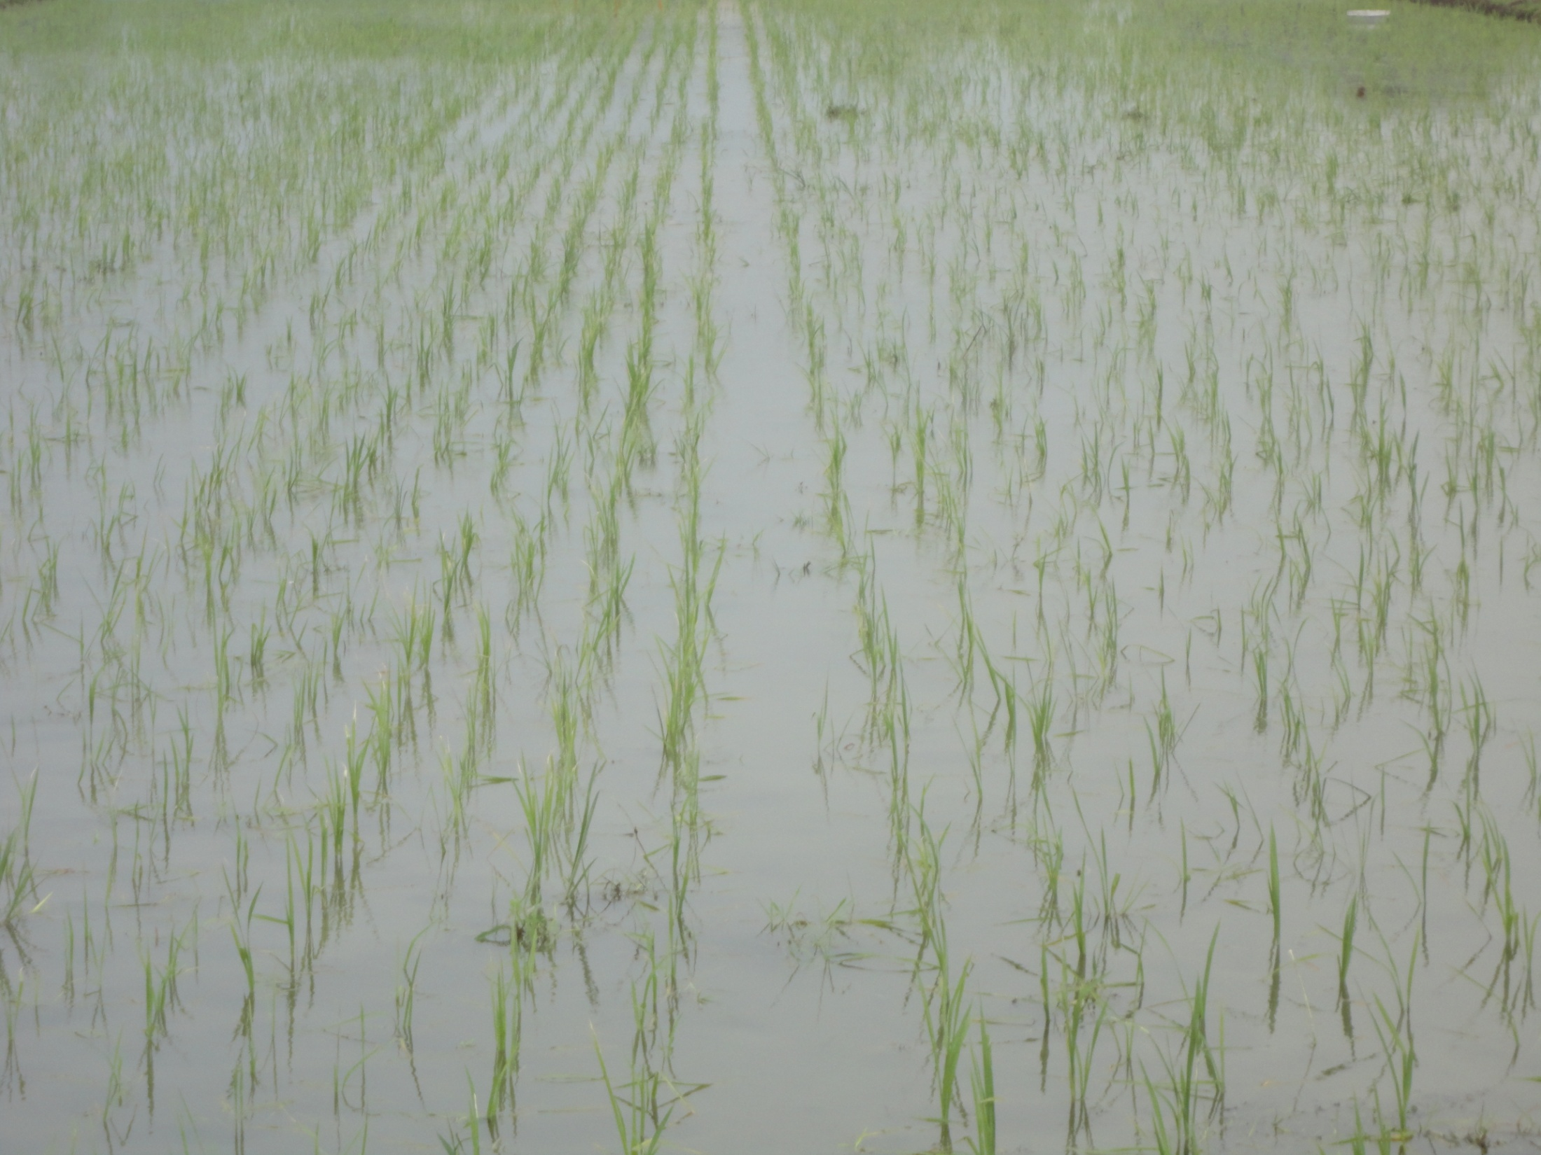
Scenario 1 Farmer’s practice

Slide 11
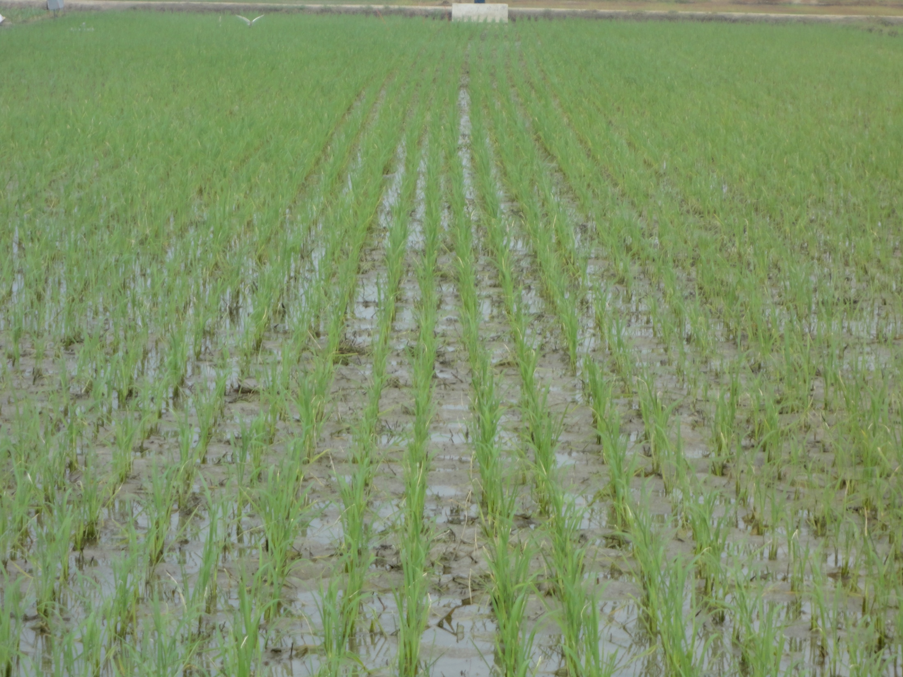
Scenario 2 R-W-M CT/ZT

Slide 12
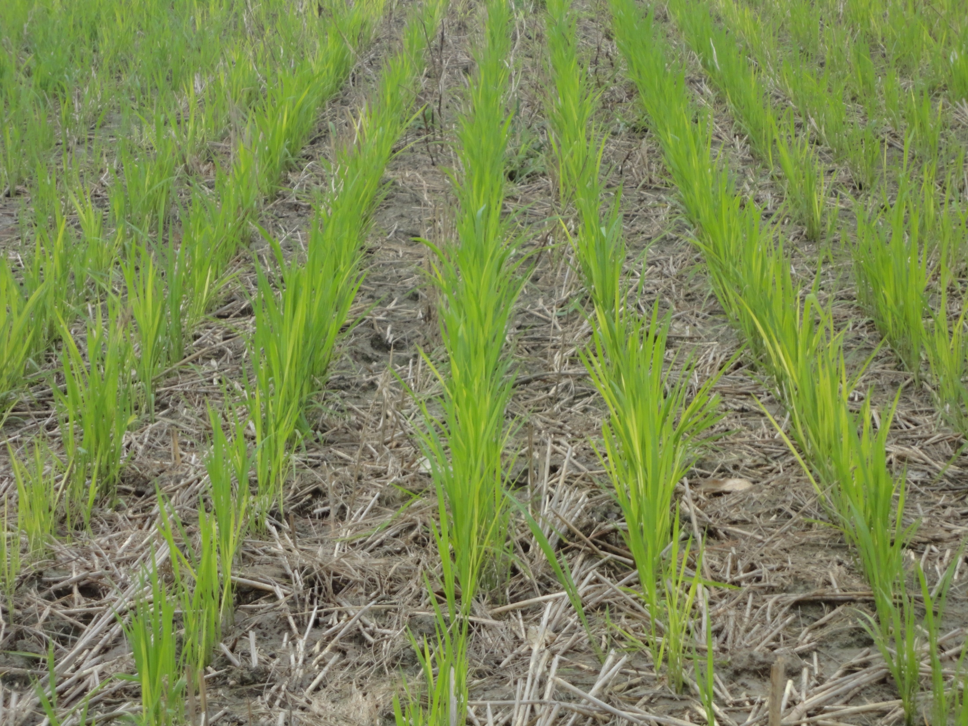
Scenario 3 R-W-M ZT/ZT

Slide 13
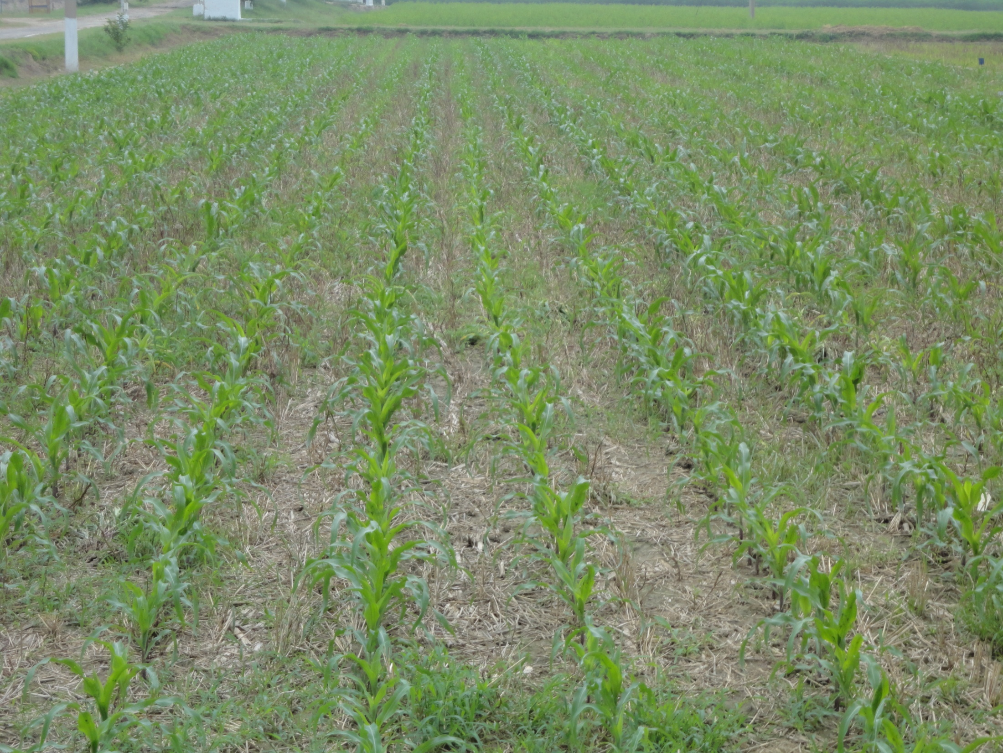
Scenario 4 M-W-M ZT

Slide 14
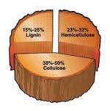
Lignocellulose is the major structural component of plants and represents a major source of renewable organic matter. Lignocellulose consists of lignin, hemicellulose and cellulose.
In systems where crop residue is left on the surface, saprophytic fungi dominate, slowly breaking down more resistant substrates (Moore et al., 2003).

Slide 15
Isolation of fungus and their screening for cellulolytic activity
Quantitative assay of lignocellulolytic activity of screened isolates.
Study of selected fungus for decomposition of lignocellulosic residues in laboratory

Slide 16
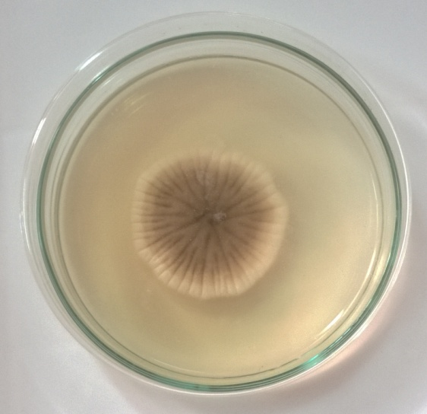
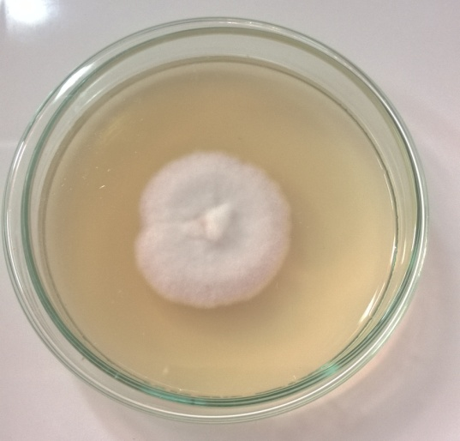
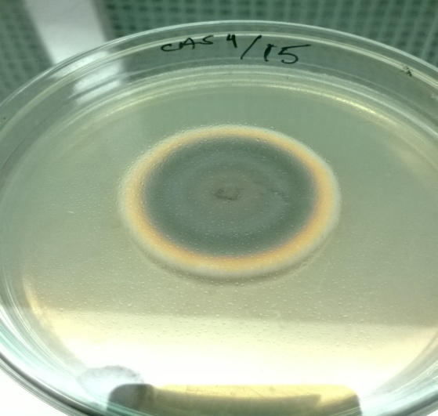
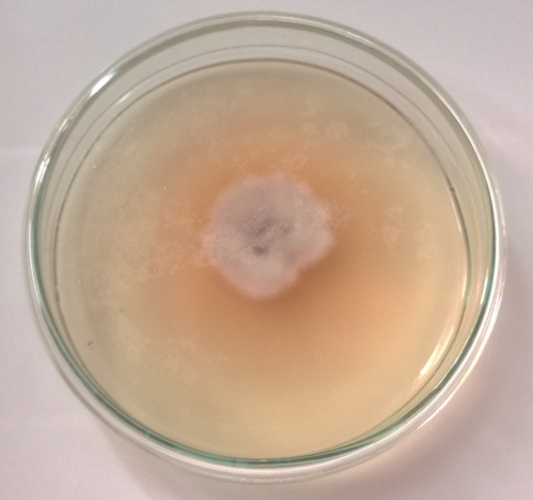
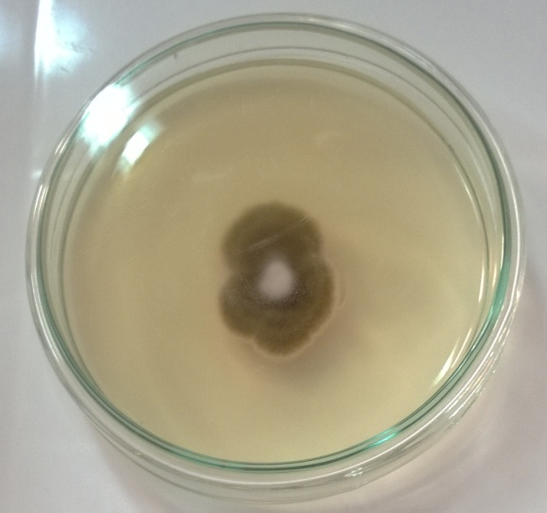
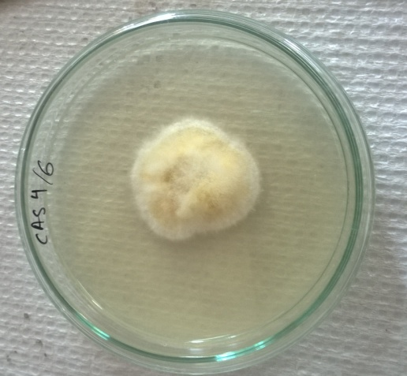
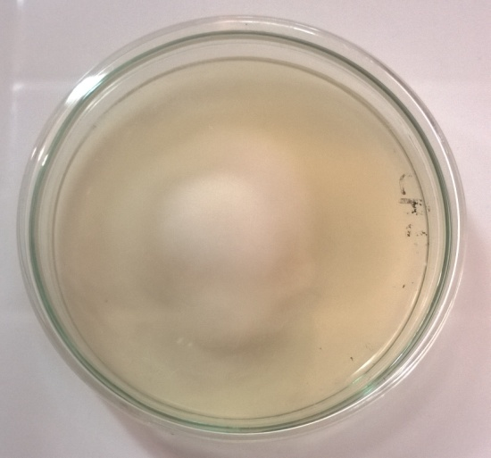
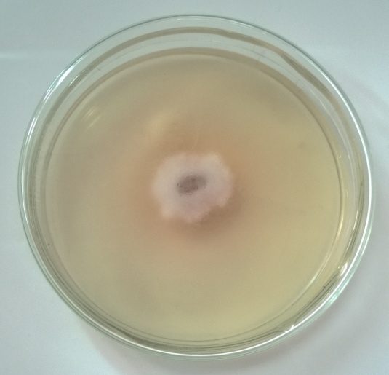
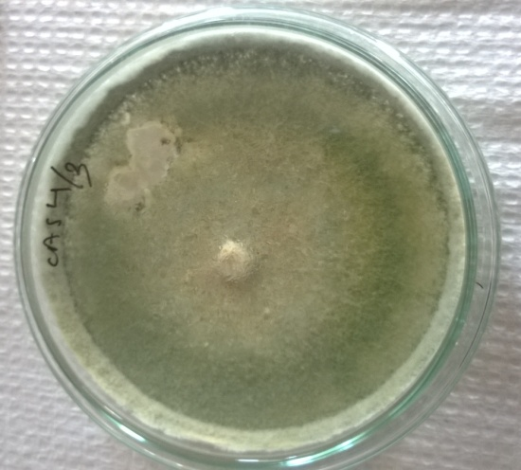
72 fungus isolated from soil on three types of media- PDA,RBA and CDA
Notes:
These could be used to finally enhance degradation of huge amount of cellulosic biomass deposited during every season, leading to improvement of soil health and reduction in environmental problems.

Slide 17
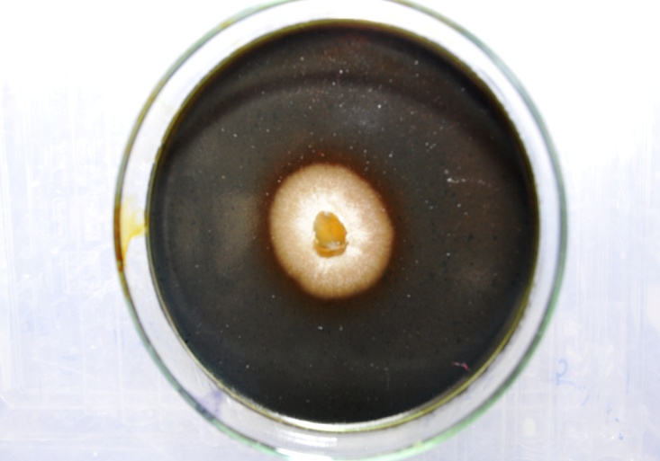
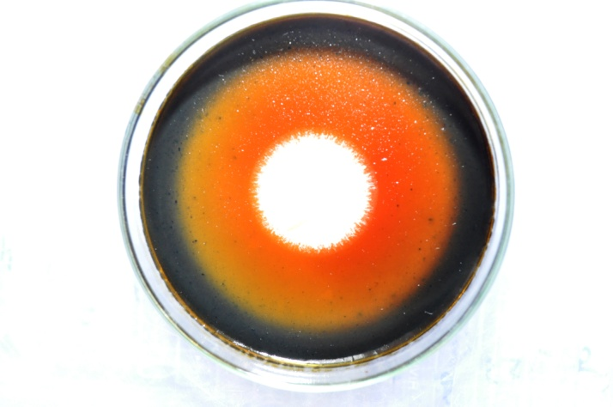
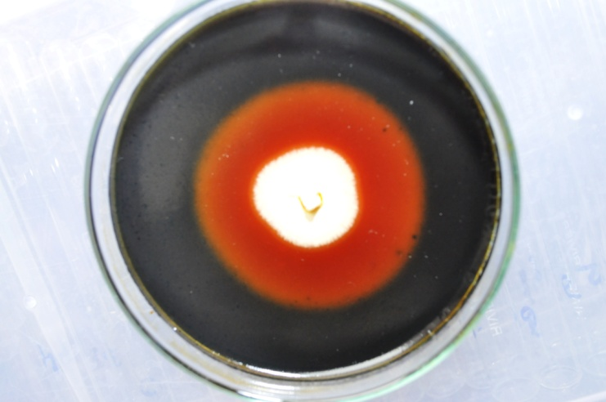
Primary screening of isolates for cellulolytic activity
No zone
Clearing zone around growth
Growth of fungus on Carboxy Methyl Cellulose agar plates showing cellulolytic activity

Slide 18
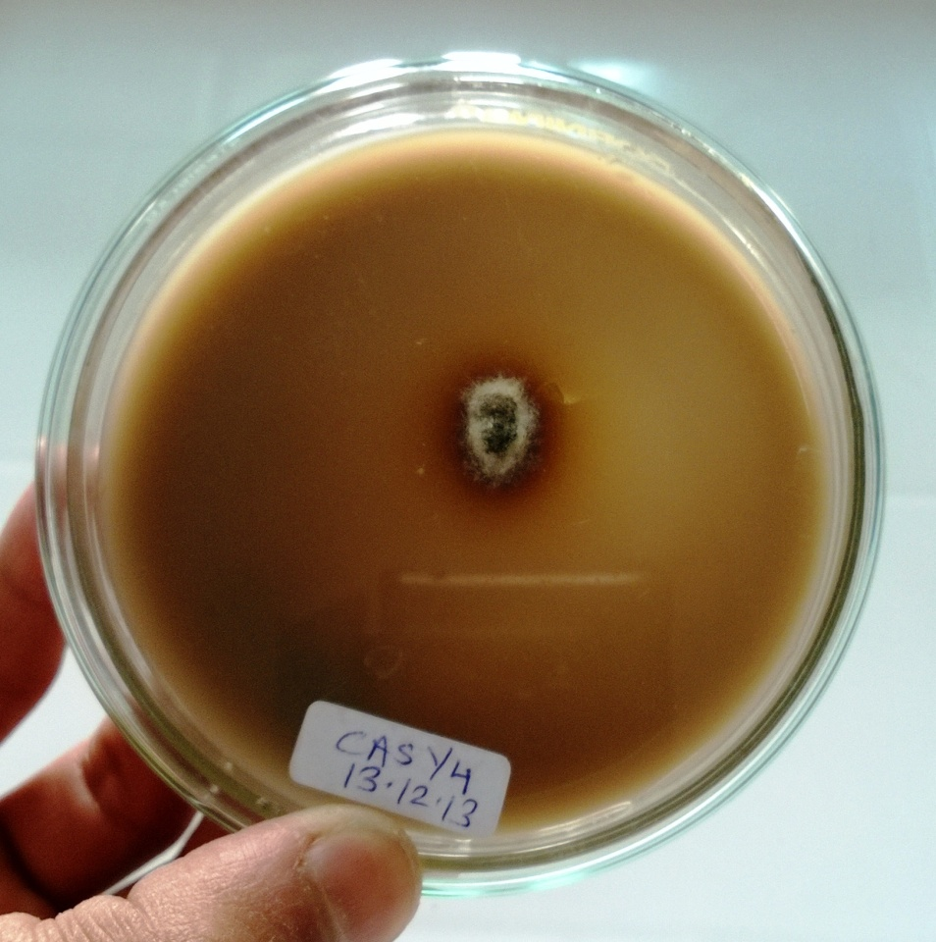
Dark zone
Growth of fungus on Tannic acid agar plates showing lignolytic activity

Slide 19
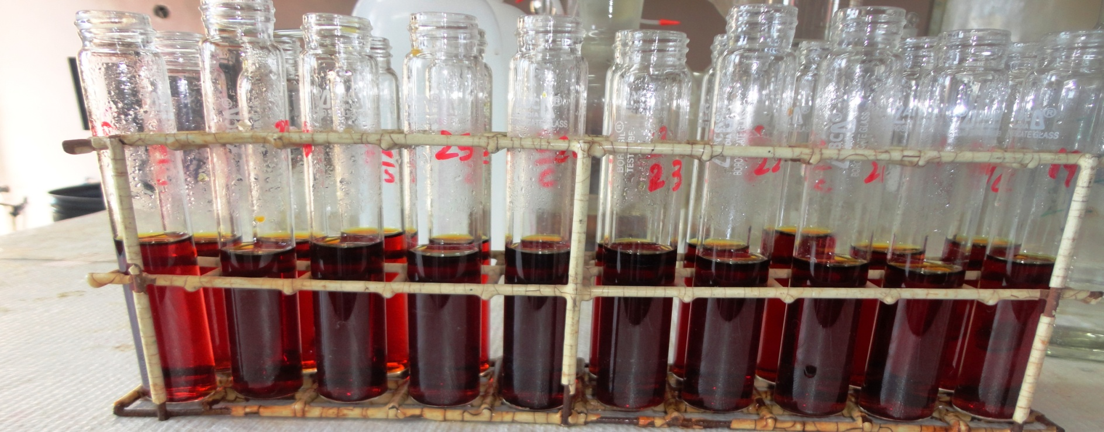
After primary screening Isolates having I_{CMC} > 0.5 were selected. These 19 cultures were grown in broth containing powdered straw as a sole source of carbon. Culture filtrate was used for estimation of different enzyme activity. Activity of CMCase is recorded upto 0.479 IU/ml, Cellobiase activity upto 0.379 IU/ml, Fpase activity upto 0.207 IU/ml and Xylanase activity is upto 1.6849 IU/ml.

Slide 20
MWM – Maize- Wheat- Mungbean
RZWM- Rice Zerotill- Wheat- Mungbean
RPWM- Rice Puddled- Wheat- Mungbean
RPW- Rice Puddled- Wheat

Slide 21
MWM – Maize- Wheat- Mungbean
RZWM- Rice Zerotill- Wheat- Mungbean
RPWM- Rice Puddled- Wheat- Mungbean
RPW- Rice Puddled- Wheat

Slide 22
MWM – Maize- Wheat- Mungbean
RZWM- Rice Zerotill- Wheat- Mungbean
RPWM- Rice Puddled- Wheat- Mungbean
RPW- Rice Puddled- Wheat

Slide 23
MWM – Maize- Wheat- Mungbean
RZWM- Rice Zerotill- Wheat- Mungbean
RPWM- Rice Puddled- Wheat- Mungbean
RPW- Rice Puddled- Wheat

Slide 25
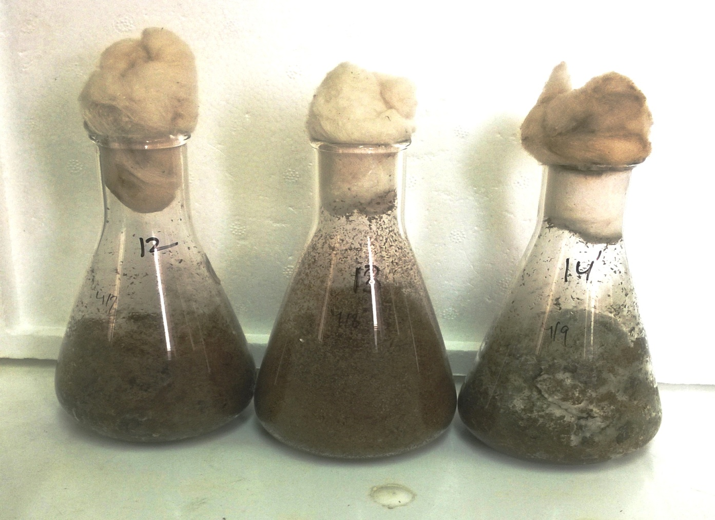
On the basis of comparative study of enzyme activities 11 isolates are selected for further research. Selected fungus were inoculated on solid media composed of chopped straw and having 70 % moisture.

Slide 26
Enzyme activities in Solid State
Isolate | Cellobiase | CMCase | FPase | Xylanase
MWM 1/3 | 1.338 | 4.617 | 1.051 | 21.938
MWM 1/6 | 0.325 | 4.326 | 0.745 | 18.244
MWM 1/9 | 4.840 | 4.410 | 0.709 | 18.866
MWM 1/10 | 1.275 | 3.528 | 0.656 | 22.060
RZWM 2/2 | 1.533 | 4.960 | 1.413 | 22.400
RPWM 3/1 | 2.007 | 4.430 | 0.678 | 17.871
RPWM 3/2 | 2.685 | 2.455 | 1.093 | 19.924
RPW 4/7 | 0.403 | 2.270 | 0.320 | 18.173
RPW 4/9 | 1.635 | 1.938 | 0.407 | 10.683
RPW 4/13 | 1.733 | 2.133 | 0.220 | 12.701
RPW 4/14 | 0.047 | .807 | 0.138 | 2.359
Activities are in IU/gm
MWM – Maize- Wheat- Mungbean
RZWM- Rice Zerotill- Wheat- Mungbean
RPWM- Rice Puddled- Wheat- Mungbean
RPW- Rice Puddled- Wheat

Slide 27
Morphological identification of Isolates
Isolate number | Isolate name
MWM 1/3 | Aspergillus flavus
MWM 1/6 | Aspergillus terreus
MWM 1/9 | Aspergillus terreus
MWM 1/10 | Aspergillus flavus
RZWM 2/2 | Penicillium janthinellum
RPWM 3/1 | Aspergillus niger
RPWM 3/2 | Alternaria alternata
RPW 4/7 | Aspergillus terreus
RPW 4/9 | Penicillium oxalicum
RPW 4/13 | Penicillium oxalicum
RPW 4/14 | Cladosporium cladosporoides

Slide 28
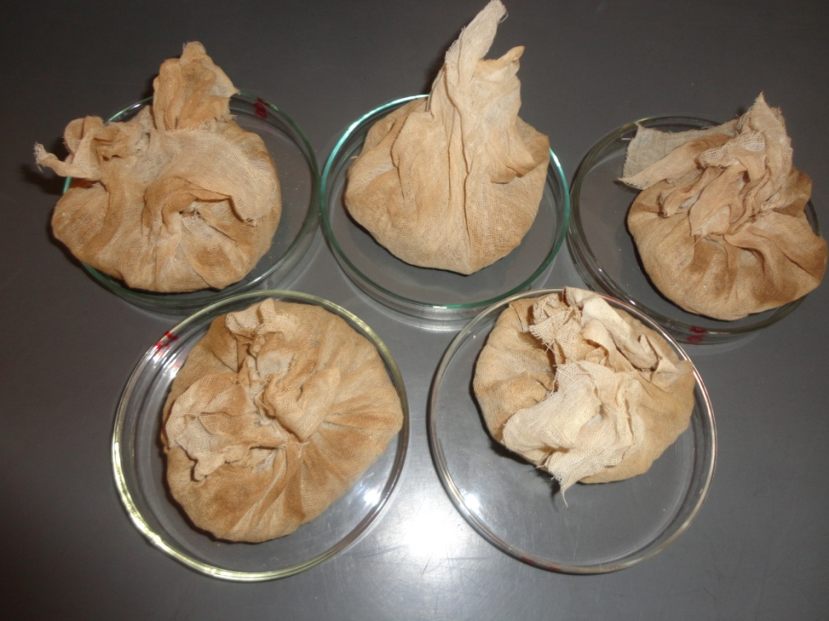
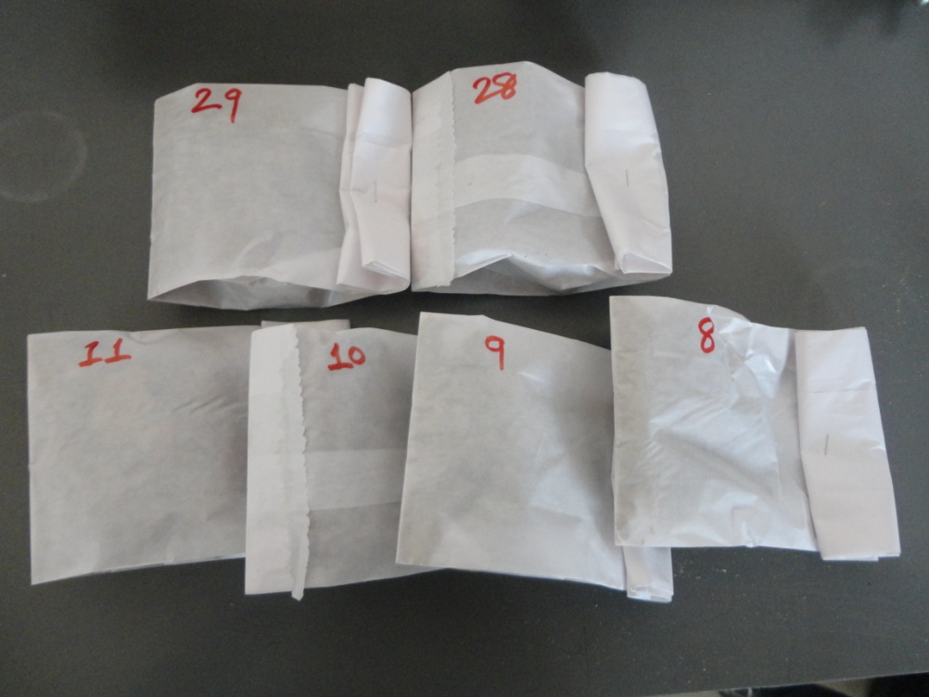
Solid media was filtered by muslin cloth and residual straw was collected. Residual straw was dried and further analysis for ADF, NDF, cellulose and lignin is going on.

Slide 29
THANK YOU

