Slide 1

Maclin Dayod
Bio-fortification of rice grain:
A case study in Sarawak using calcium silicate and organic fertiliser
Agri2015
13-15 July 2015
Doubletree by Hilton, Beijing, China
Notes:
Have you eaten your rice today?

Slide 2
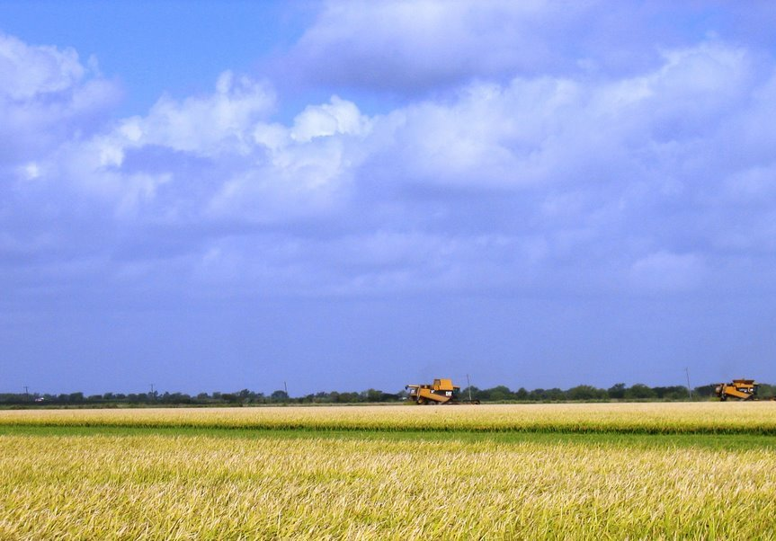
Interesting and Fun Facts on Rice
A typical greeting in Bangladesh, China & Thailand – “Have you eaten your rice today?”
Honda means “main rice field”
Toyota means “bountiful rice field”
Japanese word for cooked rice = meal
In Japanese - Breakfast, lunch & dinner = asa gohan (morning rice), hiru gohan (afternoon rice) & ban gohan (evening rice)
In Lao PDR & Thailand, eating rice = eating food
Notes:
Well, I believe many of your are not aware of these interesting and fun facts on rice. For example …

Slide 3
Is there a short-cut to increase yield and nutritional quality in rice?
Breeding IS the way forward – but it is time consuming
Many studies have reported the beneficial effects of CaSi on yield in rice – but nutritional quality always overlooked
No comprehensive study in Sarawak yet.
Notes:
Rice is a staple for more than half of the world population. But, is there really a need to increase SSL in Sarawak to 70%? Do we really need to eat that much rice? Most important, is there a short-cut to increase yield and nutritional quality in rice? I believe breeding is the way forward but is time consuming. You cannot just pick two varieties, cross them and pray for miracle to happen.

Slide 4
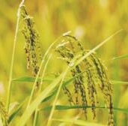
Beneficial effects of silicon on plant growth in relation to biotic and abiotic stresses. TRENDS in Plant Science. 11(8)
Increase canopy photosynthesis
Increase stress resistance
Enhance resistance to biotic stress
Disease
e.g. blast, powdery mildew
Pest
e.g. stem borer, planthopper
Alleviate abiotic stress
Chemical stress
Alleviate metal toxicity
Si
e.g. Al, Cd, As, Mn, Fe
Improve nutrient imbalance
e.g. N excess, P deficiency
Alleviate salt stress
Higher Yield
Physical stress
Prevent lodging
Increase resistance to low/high temperature
Increase resistance to drought stress
Increase resistance to radiation stress
Notes:
Silicon has been reported to have many beneficial effects on plant growth and yield. This figure shows some of the effect of silicon. For example ….

Slide 5
Calcium :
both versatile nutrient and specific signal
participates in metabolic processes of other nutrients uptake
promotes proper plant cell elongation
strengthen cell wall structure
participates in enzymatic and hormonal processes
helps in protecting the plant against heat stress
helps in protecting the plant against diseases
affects fruit quality
has a role in the regulation of stomata
has a direct role in photosynthesis

Slide 6
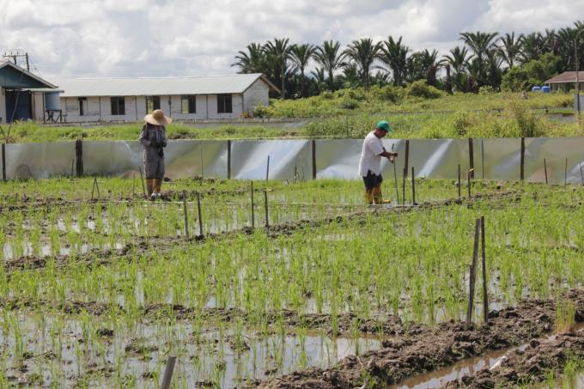
Objective
To compare impact of GML, CaSi and OF on grain yield and nutritional quality in rice.

Slide 7
Materials and Methods
Variety Ukong was used a test plant
Trial was laid down at Paya Paloh, Samarahan
4 treatments (1 t/ha GML, 1.36 t/ha CaSi, 1.76 t/ha CaSi and 2.16 t/ha organic fertiliser)
4 replicates arranged in RCBD
Prices of the fertilisers :
      GML = RM 0.36/kg
      CaSi = RM 8.28/kg
      Organic fertiliser = RM 2.64/kg

Slide 8
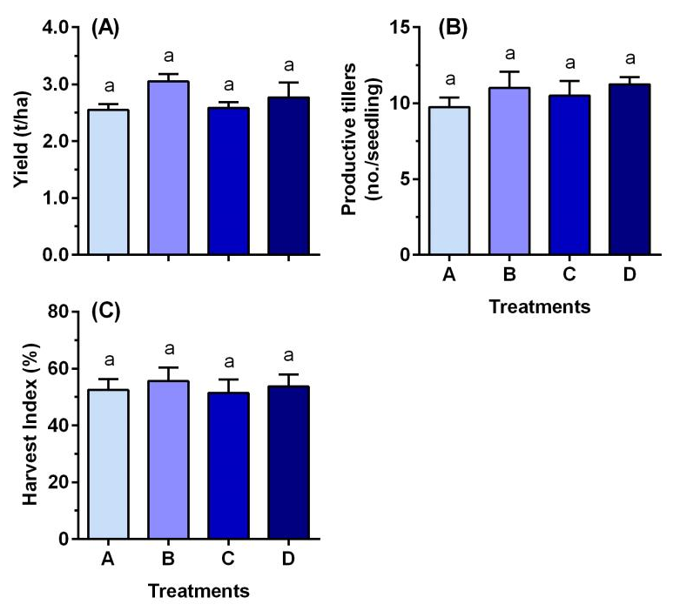
RESULTS
No difference in yield, no. of productive tillers & harvest index
BUT based on production cost, GML is superior

Slide 9
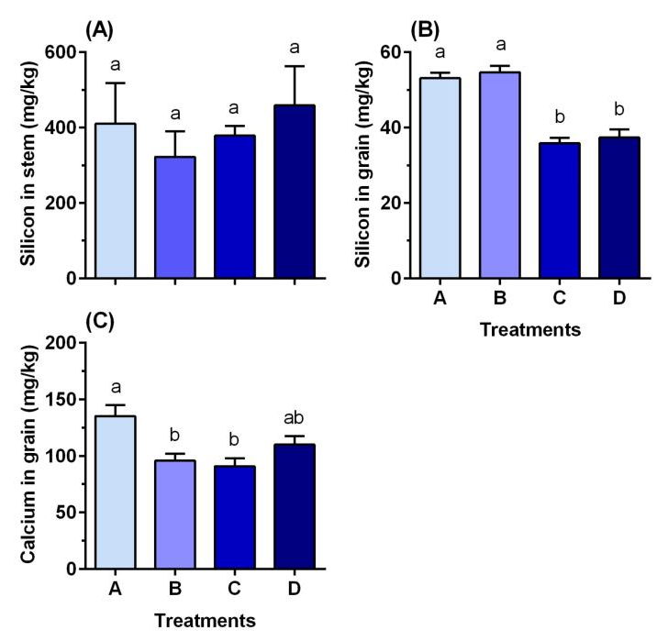
RESULTS
Too much CaSi can reduce Si and Ca accumulation in the grain
Si values in straw and grain, and Ca value in grain are consider low.

Slide 10
Implications of this work
There is no such thing as “one size fits all”
    Some varieties may not be responsive to certain fertilisers
“Grain nutritional quality = yield” : do you prefer a plate-full of low quality rice or a quarter-full plate with rice pack with nutrition.
Many factors affect grain yield and nutritional quality – soil, fertilisers, management practices
Some rice varieties may be intrinsically have low ability to accumulate certain nutrients
Screening for Si transporter in rice – future work

Slide 11
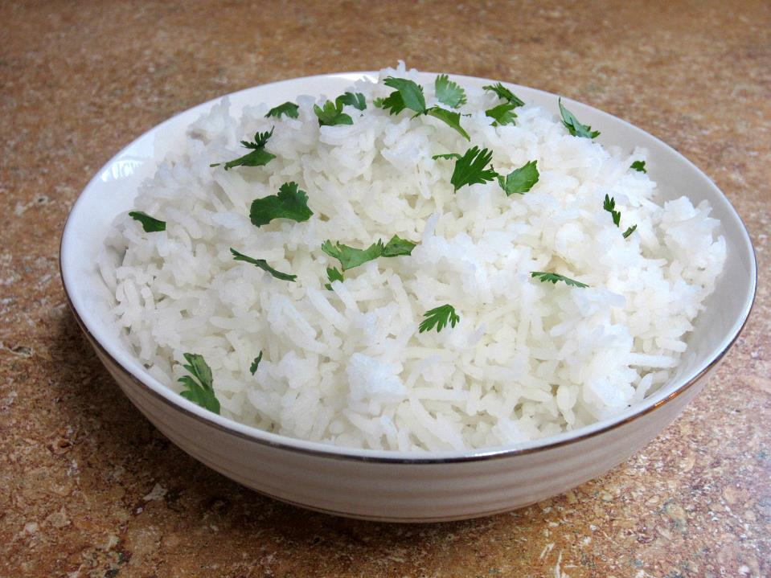
Thank you for your attention
“Have you eaten your rice today?”

