Slide 1
Rooftop Rainwater Harvesting for Recharging Shallow Groundwater
By
Prof. Rameshwar Rao,
Vice-Chancellor, JNTUH, Telangana State, India.
Dr.M.V.S.S.Giridhar,
Assistant Professor, CWR, JNTUH, Telangana State, India

Slide 2
Outline of the presentation
Basics of water resources
Need of Rainwater harvesting
Components of rainwater harvesting
Types of rainwater harvesting
Case study
Objectives of the project

Slide 3
Outline of the presentation cont…
Scope of artificial recharge
Baseline details
Existing Built-up area
Proposed Structures
Maps developed in GIS environment
Impact of artificial recharge of rainwater

Slide 4
WATER!!!!!!!
THE PRECIOUS GIFT OF NATURE
CONSERVE IT!!
DO NOT WASTE IT!!

Slide 5
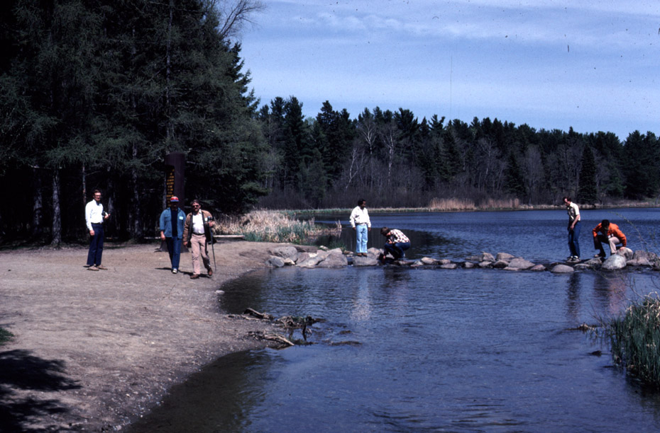
Water is the driver of life
-Leonardo da Vinci

Slide 6
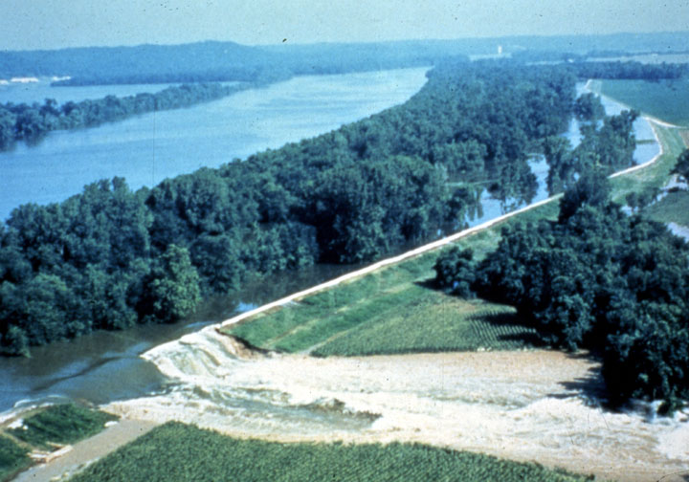
Water is indispensable for life and more so for man.
The need for water is felt more and more for better living in modern times.

Slide 7

GLOBAL WATER INVENTORY
World’s water is 1357.5m.cu.Km
97% is in oceans as saline water

Slide 8
Cont…
Only 3% i.e. 37.5 m.cu.km. is fresh water
Out of this, about 8.5 m.cu.km is available for use
The remaining is in the form of ice

Slide 9
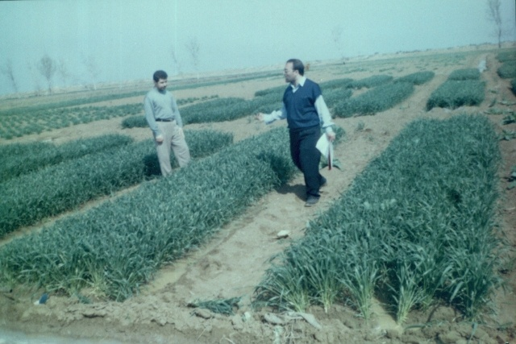
Cont…
The per capita consumption has increased from few litres in the stone age to as much as 600litres in developing countries today

Slide 10
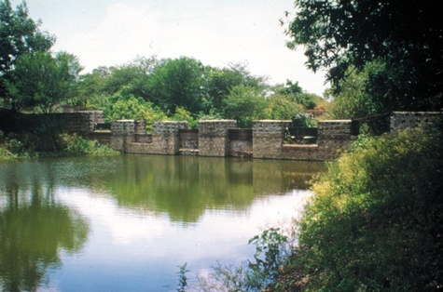
Water Availability
Year Per Capita Availability
2000 --- 2100 m³ (comfortable)
2025 --- 1700 m³ (stress level)
2050 ----1236 m³ (scarcity level)
Agriculture sector is largest user (80%) of water resources
“More usage Per Drop”

Slide 11
Only 12% of rainwater is being used in country
The rest flows into sea
Only 10% of surface water and 90% of groundwater are being used for drinking purposes

Slide 12
The World Bank estimates that by the year 2025 3.25 billion people in 52 countries will live in conditions of water shortage

Slide 13
?
What is the solution

Slide 14
RAINWATER HARVESTING

Slide 15
Harvest it
Filter it
Store it
Use it (if excess)
Recharge it

Slide 16
RAINWATER HARVESTING cont…
RWH is the best option.
RWH system is practically used from prehistoric period.
This is a simple and economically viable technology.
The Indian climatic conditions
Rainfall days less than 50 only
Rainwater falling over terrace or roof can be collected and stored otherwise goes to the sea through rivers

Slide 17
Cont…
RAINWATER HARVESTING cont…
Rainwater is the purest form of water.
It is the primary source of water and other sources are dependant on rainfall.
RWH should be viewed with a positive attitude

Slide 18
Benefits
To harness good quality water resource now being wasted
To augment the expensive piped water supply
To save expenditure on water
To prevent soil erosion and urban flooding
Inexpensive and simple technology
Aids ecological conservation
To prevent groundwater depletion

Slide 19
Classification of RWH
land-based RWH
Land-based rainwater harvesting occurs when rainwater runoff from the land is collected in ponds before it has a chance to reach a river or stream.

Slide 20
Roof-based harvesting
Roof-based harvesting, on the other hand, involves collecting the rainwater that falls on a roof before the water even reaches the ground.

Slide 21
Methods of Rain Water Harvesting
a collection area
a conveyance system
filtration system
storage facility
Storage of rain water and its use
Recharging the underground aquifer

Slide 22
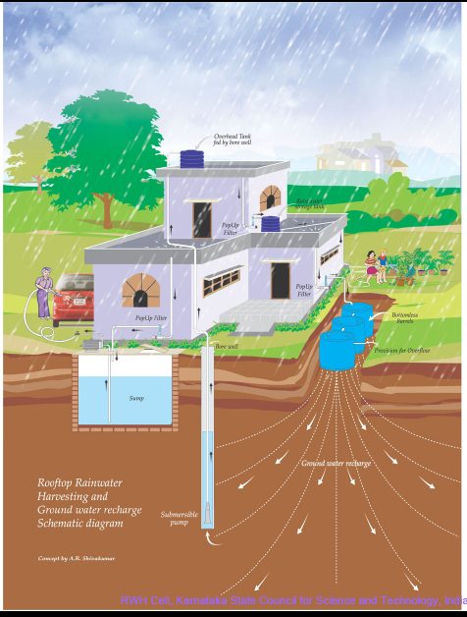
Components of Rainwater Harvesting System
Catchment area
Conveyance system
First rain separator
Filter unit
Storage
Delivery system
Usage
Recharge

Slide 23

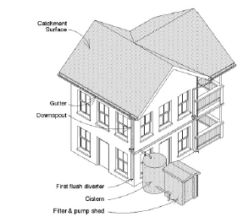
Rainwater Harvesting
System Components
Catchment surface: the collection surface from which rainfall runs off
Gutters and downspouts: channel water from the roof to the tank
Leaf screens, first-flush diverters, and roof washers: components which remove debris and dust from the captured rainwater before it goes to the tank

Slide 24
Rainwater Harvesting System Components cont…
Cisterns: One or more storage tanks, also called cisterns
Delivery system: gravity-fed or pumped to the end use
Treatment/purification: for potable systems, filters and other methods to make the water safe to drink

Slide 25
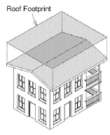
Collection area
The collection area in most cases is the roof or terrace of the building

Slide 26
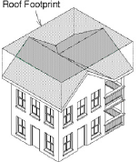
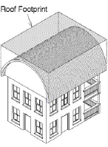
Different roofs

Slide 27
Rainwater harvesting, use and recharge in JNTUH – a Case study

Slide 28
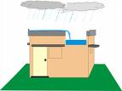
OBJECTIVES OF THE PROJECT
Large roof area is available in the campus to tap the rain water for augmenting ground water resources.
The campus is located in the capital of Hyderabad and it is more suitable for demonstrative purpose.

Slide 29
Objectives of the Project cont…
As JNTU Hyderabad is having Centre for Water Resources Department and running M.Tech and M.Sc courses on Water resources, these structures will be useful for permanent field demonstration and experimental research activity for students.

Slide 30
Objectives of the Project cont…
To conduct regular training programmes to public and disseminate the information about the significance of the artificial recharge activities

Slide 31

Objectives of the Project cont…
To harvest, store and reuse for drinking, domestic purposes, gardening etc., in the campus.
To recharge excess water from storage sumps into the ground through recharge pits and shafts.

Slide 32
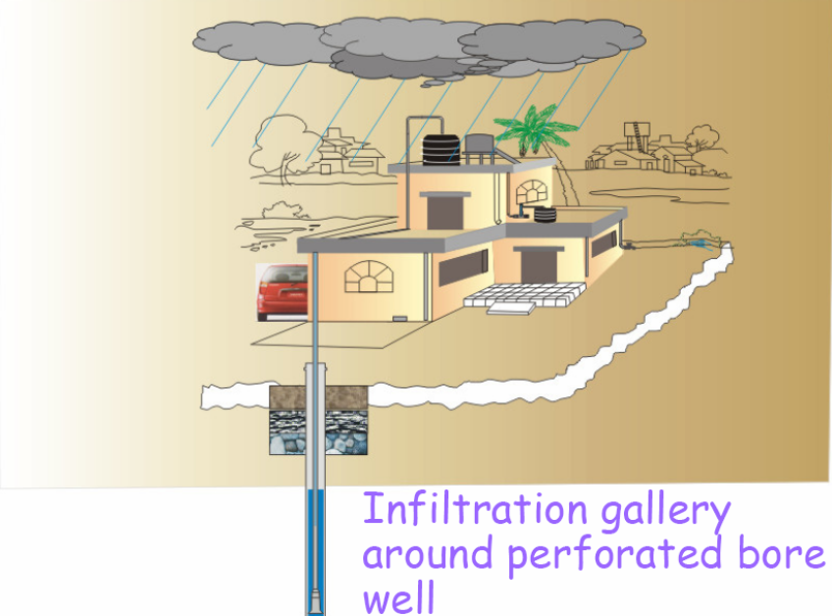
Objectives of the Project cont…
To encourage farm rain water harvesting so as to harvest the rainfall falling other than roof-top area within the campus.
To prepare the reports and disseminate to the public and to various government agencies

Slide 33
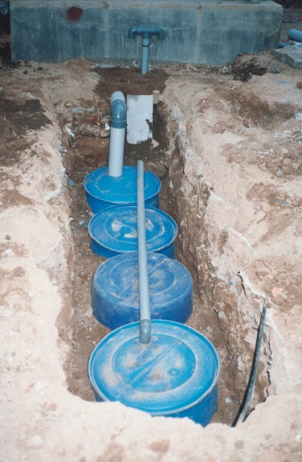
Objectives of the Project cont…
To monitor and record ground water level fluctuations in the observation wells on daily basis using automatic water level recorders.
To recharge ground water through recharge pits along with recharge shafts, there by increasing the ground water levels

Slide 34
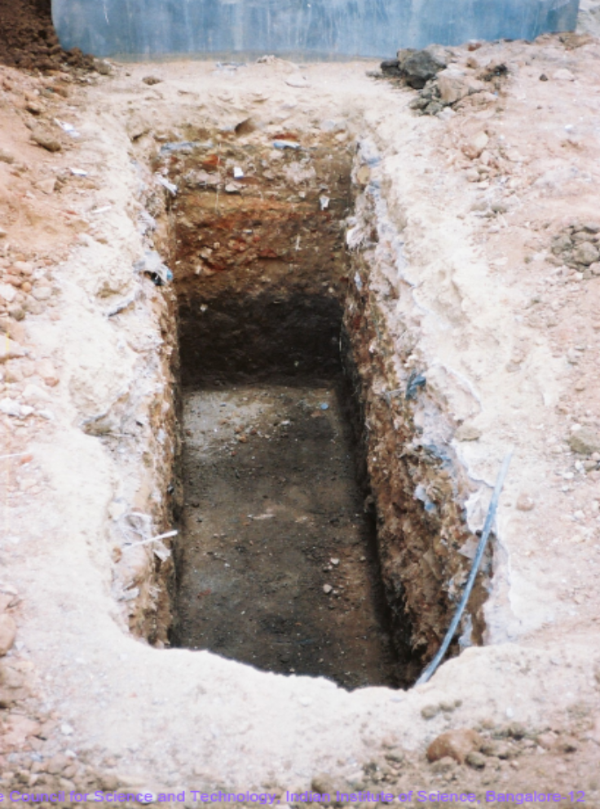
Scope of artificial recharge
There are several buildings in the campus with large roof area and there is a lot of scope for roof-top rain water harvesting in the campus.
Also, there is adequate open area (either paved or covered with grass/vegetation) from which runoff could be harvested and used for recharging the aquifers below the ground

Slide 35

Available built-up area and other particulars related to artificial recharge
Sl. No | Description of Item | Quantity
1 | Total existing built-up area within the campus | 53,822m²
2 | Normal yearly rainfall | 810 mm
3 | Maximum water can be harvested in a normal year @80% of the rainfall as runoff | 34,877 m³
4 | Max rainfall in a day | 70 mm
5 | Maximum water can be harvested on a maximum rainfall day | 3014 m³

Slide 36
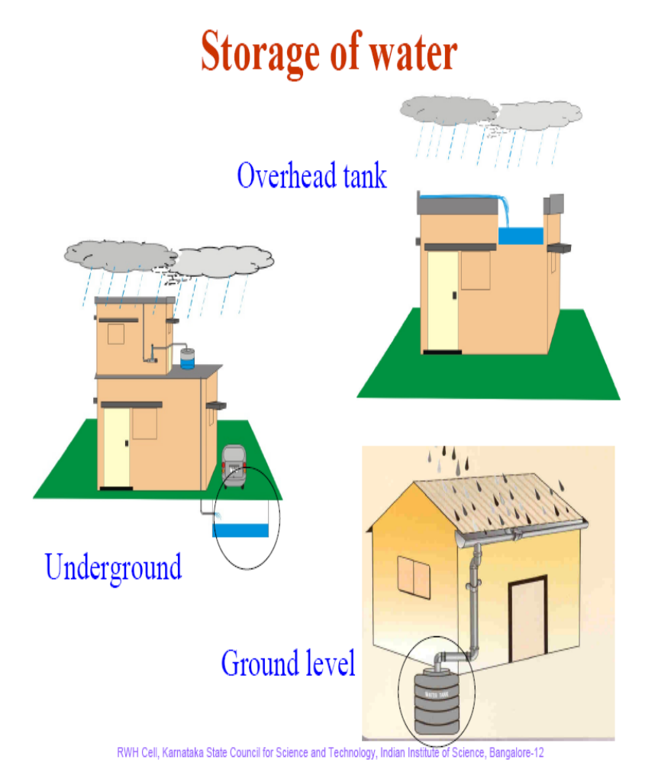
Built-up area and other particulars related to artificial recharge under consideration
Sl. No | Description of Item | Quantity
1 | Built-up area | 11,339 m²
2 | Normal yearly rainfall | 810 mm
3 | Maximum water can be harvested in a normal year | 7347.67 m³
4 | Max rainfall in a day | 70 mm
5 | Maximum water can be harvested on a maximum rainfall day | 635.0m³

Slide 37
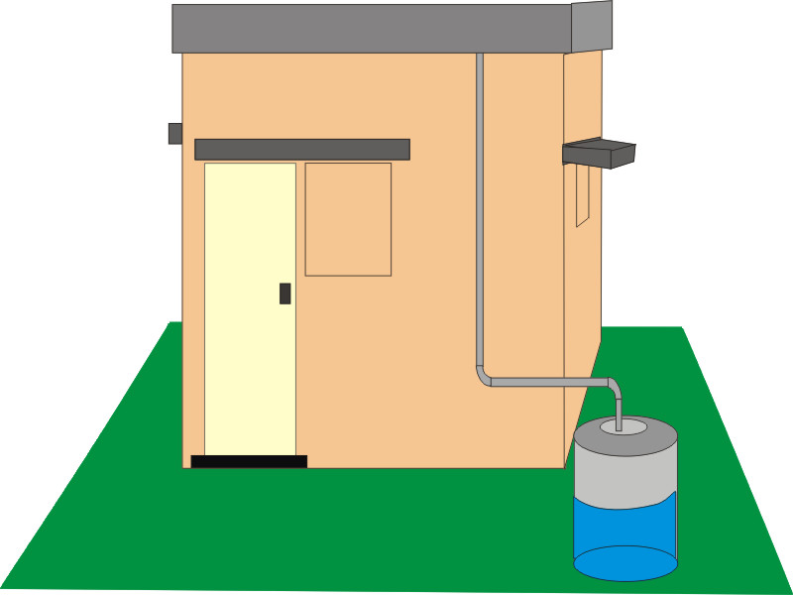
Land use land cover details in the study area
Sl.No | Description of the item | Area in m²
1 | Total built-up area | 53822.33
2 | Vegetation and parking | 30182.92
3 | Shed area | 8540.22
4 | Open area | 150604.29
5 | Other area | 117733.54
6 | Total area | 89.19acres

Slide 38
Normal monthly annual rainfall in mm
Months | Jan | Feb | Mar | Apr | May | Jun | Jul | Aug | Sep | Oct | Nov | Dec
Normal Monthly Rainfall (mm) | 10.9 | 8.2 | 18.9 | 20.9 | 31.6 | 116.3 | 170.6 | 190.4 | 114.1 | 108.5 | 26.1 | 5.3
Rainy Days | 0.7 | 0.4 | 1 | 1.7 | 2.4 | 7 | 9.9 | 11.4 | 6.8 | 5.5 | 1.3 | 0.3

Slide 39
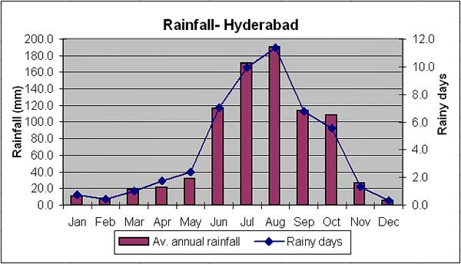
Normal rainfall over the study area

Slide 40
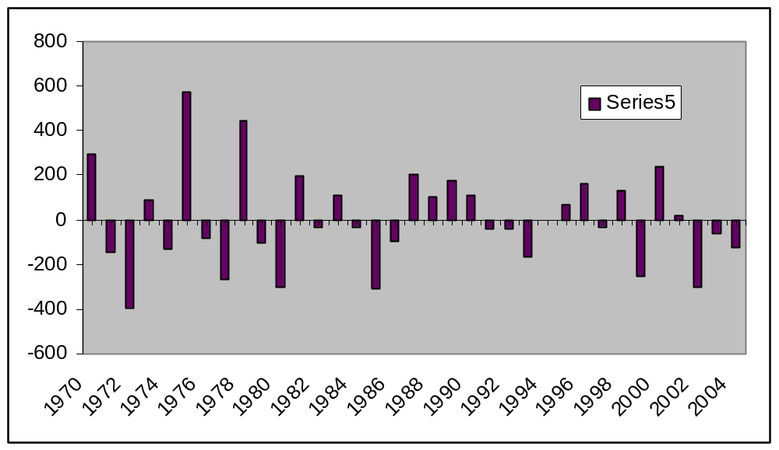
Percentage of deviation over normal rainfall

Slide 41
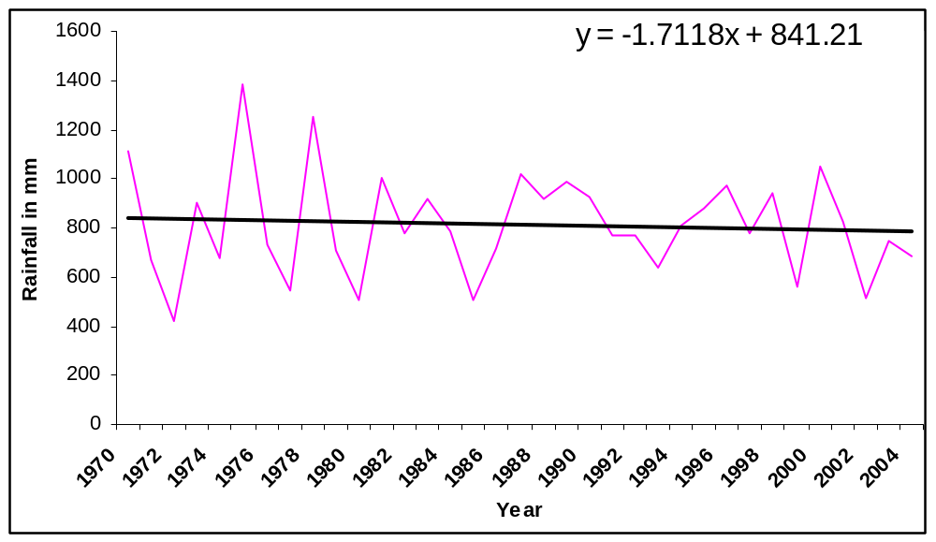
Trend line of rainfall over Hyderabad

Slide 42
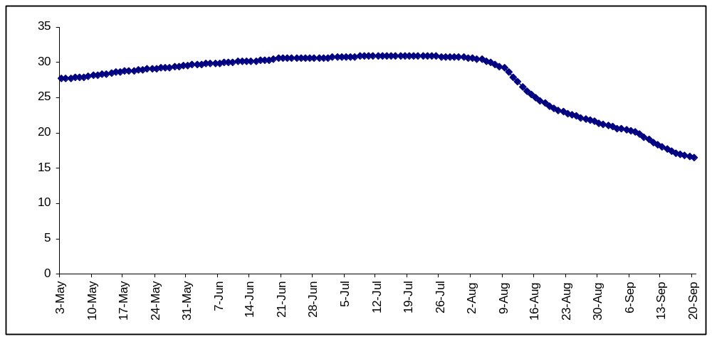
Water level fluctuations for a period of May to September at 30 min interval

Slide 43
Details about the name of the building, existing built-up area, maximum amount of water can be harvested on a normal year and on a maximum rain day
S. NO | NAME OF THE BUILDING | AREA in m² | Max. water can be harvested in a normal year in m³ | Max. Water can be harvested on a max rainy day in m³
1 | CSE Building (Old) | 584.25 | 378.594 | 32.718
2 | ANDHRA BANK(G.F) | 312.8 | 202.6944 | 17.5168
3 | RECTOR/REGISTRAR QAR | 315.84 | 204.6643 | 17.68704
4 | VC'S LODGE | 280.01 | 181.4465 | 15.68056
5 | C DAC BUILDING | 494.44 | 320.3971 | 27.68864
6 | GUEST HOUSE * | 900.87* | 583.7638 | 50.44872
7 | MECHANICAL BUILDING * | 890* | 576.72 | 49.84
8 | METALLURGICAL BUILDING | 1352 | 876.096 | 75.712
9 | ESTATE OFFICE | 202.46 | 131.1941 | 11.33776
10 | CANTEEN | 382.69 | 247.9831 | 21.43064
11 | PRINCIPAL'S OFFICE | 2179.57 | 1412.361 | 122.0559
12 | EEE BUILDING | 2921.31 | 1893.009 | 163.5934
13 | UGC-ASC BUILDING * | 1760.47* | 1140.785 | 98.58632
14 | A2 TYPE QUARTERS | 732.55 | 474.6924 | 41.0228
15 | B2,B3&B4 TYPE QUARTERS | 2047.89 | 1327.033 | 114.6818
16 | ECE Builiding | 1144.02 | 741.325 | 64.06512
17 | ADMINISTRATIVE BUILDING(G.F,F.F,&S.F) | 1394.34 | 903.5323 | 78.08304
18 | CIVIL ENGG. BUILDING * | 1774.4* | 1149.811 | 99.3664
19 | SIT Builiding | 2225.58 | 1442.176 | 124.6325
20 | UNIVERSITY HEALTH CENTRE(G.F.) | 502.32 | 325.5034 | 28.12992

Slide 44
Details about the name of the building, existing built-up area, maximum amount of water can be harvested on a normal year and on a maximum rain day
21 | LIBRARY BUILDING | 1677 | 1086.696 | 93.912
22 | DIRECTOR'S QUARTERS(G.F&F.F) | 207.6 | 134.5248 | 11.6256
23 | A-TYPE QUARTERS(OLD) | 534.38 | 346.2782 | 29.92528
24 | B-TYPE QUARTERS(OLD) | 441.44 | 286.0531 | 24.72064
25 | C-TYPE QUARTERS(OLD) | 313.66 | 203.2517 | 17.56496
26 | BOYS HOSTEL(OLD) | 1518.76 | 984.1565 | 85.05056
27 | GIRLS HOSTEL(OLD) | 1328.17 | 860.6542 | 74.37752
28 | SPORTS COMPLEX(G.F) | 437.12 | 283.2538 | 24.47872
29 | KRISHNA HOSTEL SHED | 3743.75 | 2425.95 | 209.65
30 | MECHANICAL SHEDS | 4198.17 | 2720.414 | 235.0975
31 | GENERATOR | 82.07 | 53.18136 | 4.59592
32 | GEO TECH | 252.28 | 163.4774 | 14.12768
33 | SHEDS NEAR REG/REC.QTRS | 263.95 | 171.0396 | 14.7812
34 | PG BOYS HOSTEL * | 3596.21* | 2330.344 | 201.3878
35 | A3TYPE QUARTERS | 801.5 | 519.372 | 44.884

Slide 45
Details about the name of the building, existing built-up area, maximum amount of water can be harvested on a normal year and on a maximum rain day
36 | B5 TYPE QUARTERS | 615.98 | 399.155 | 34.49488
37 | GIRLS HOSTEL(OLD) * | 1802.26* | 1167.864 | 100.9266
38 | IIC BUILDING | 950 | 615.6 | 53.2
39 | TBI BUILDING | 765.6 | 496.1088 | 42.8736
40 | ADMINISTRATIVE BUILDING(T.F) | 1394.34 | 903.5323 | 78.08304
41 | IST BUILDING | 1354 | 877.392 | 75.824
42 | CENTRALIZED | 1446.38 | 937.2542 | 80.99728
43 | EXAMINATION BUILDING | 1453.74 | 942.0235 | 81.40944
44 | ANDHRA BANK(F.F) | 331.91 | 215.0777 | 18.58696
45 | GUEST HOUSE (DINING -F.F&S.F) | 330 | 213.84 | 18.48
46 | UNIVERSITY HEALTH CENTRE(F.F.) | 502.32 | 325.5034 | 28.12992
47 | SPORTS COMPLEX(F.F,S.F) | 874.24 | 566.5075 | 48.95744
48 | DIRECTOR'S QUARTERS(S.F) | 207.6 | 134.5248 | 11.6256
 | TOTAL Plinth area | 53822.24 | 34876.81 | 3014.045
* Structure considered for rainwater harvesting

Slide 46
PROPOSED STRUCTURES
Farm rainwater harvesting structures
Three Observation wells in the campus
Roof-top rainwater harvesting with a capacity of 50,000 litres and re-use (at two places)
Roof top rainwater harvesting with a capacity of two lakh liters and re-use
Roof top rainwater collection with a capacity of 1,00,000 liters along with recharge shafts and supported with side brick walls (three places)

Slide 47
Farm rainwater harvesting structures
There are three distinct watersheds covering JNTUH campus from which surface runoff could be harvested for recharging the ground water aquifers.
Recharge pond with suitable silt trap, inlet and outlet are proposed to be constructed.
The detailed estimate has been prepared for this proposal with SSR rates approved by the Andhra Pradesh state government for the year 2008-09.
Two recharge shafts are also planned with in the recharge pit with coir.
The diameter of well is proposed to be 6”.

Slide 48
Farm rainwater harvesting structures cont…
These wells would be helpful in recharging aquifers at various depths below the ground surface.
It is also planned to irrigate near by avenue plants with the water stored in the sump.
The rates include transportation and installation charges for irrigating the avenue plants in the surrounding of the proposed rain water harvesting sump for reuse purpose.

Slide 49
Three Observation wells in the campus
Presently, one observation well is located near the hydro-meteorological station near the field farm to monitor fluctuations in the ground water levels for every 30 minutes using automatic water level recorder.
These water levels are monitored since 2008 and found to be 25m to 30 m deep in pre-monsoon period and 16m to 19 m in post-monsoon.
It is proposed to dig and install Three more observation wells with proper protection work.

Slide 50
Three Observation wells in the campus cont….
It is proposed to monitor daily water level fluctuations throughout the year, and to notify the fluctuations for pre and post monsoon.
It is also proposed to compare and identify the impact of rain water harvesting structures before and after execution.

Slide 51
Roof-top rainwater harvesting with a capacity of 50,000 litres and re-use
Keeping in view the availability of roof area of various buildings in JNTU campus, roof top rain water harvesting for collecting and storing rain water from roof tops of buildings and its re-use is proposed.
From the roof top, the water is diverted to disc filter unit of higher capacity.
From the filter unit, the pure water is led to leak proof storage tank.

Slide 52
Roof-top rainwater harvesting with a capacity of 50,000 litres and re-use cont…
Provision for pumping and pipe line system for taking the water from the storage tank to overhead tank is also proposed.
The budget requirement is for installing the pipe line for collecting the roof top rain water, installation of filter unit, construction of 50,000 litres leak proof storage tank and pumping system

Slide 53
Roof-top rainwater harvesting with a capacity of 50,000 litres and re-use cont…
Initially, this water will be reused for gardening, flushing and other regular uses.
However, this water will be tested as for BIS norms and it may also be used for drinking purpose if it matches standard norms as per water quality.
This water will be assessed for quality for complying with BIS norms and its safe for re-use.
This will be useful at the level of individual buildings.
These structures shall be useful to demonstrate to public as well as students in the campus.

Slide 54
Roof top rainwater harvesting with a capacity of two lakh liters and re-use
Keeping the large roof area of different buildings in the JNTU campus, roof top rain water harvesting for collecting and storing rain water from roof tops of buildings is proposed.
From the roof top the water is diverted to filter unit (perforated lid on top, layers of pebbles, coarse sand and gravel).
From the filter unit the pure water is led to leak proof (water and air) storage tank.
Provision for pumping and pipe line system for taking the water from the storage tank to overhead tank is also proposed.

Slide 55
Roof top rainwater harvesting with a capacity of two lakh liters and re-use cont…
Thus the total budget is required for installing the pipe line for collecting the roof top rain water, installation of filter unit, construction of 2.0 lakh liters leak proof storage tank and pumping system etc.
Initially, this water will be reused for gardening, flushing and other regular uses.
However, this water will be tested as for BIS norms and it may also be used for drinking purpose if it matches standard norms as per water quality.

Slide 56
Roof top rainwater harvesting with a capacity of two lakh liters and re-use cont…
This water will be assessed for quality for complying to BIS norms and its safe use.
This will be useful at the level of colonies, colleges, group of houses, gated communities etc.,.
These structures shall be useful to demonstrate to public under this category.

Slide 57
Roof top rainwater collection with a capacity of 1,00,000 liters along with recharge shafts and supported with side brick walls
Two bore holes with accessories and water collection system at three different places for injection of rain water from surface to underground formation are proposed.
The diameter of recharge shaft is proposed to be 200 mm.

Slide 58
Roof top rainwater collection with a capacity of 1,00,000 liters along with recharge shafts and supported with side brick walls cont…
These wells would be helpful in recharging both confined and unconfined aquifers situated at various depths below the ground surface.
These recharge shafts are more beneficial where deep aquifers which are depleted are to be recharged and also where economy of space is important criterion.

Slide 59
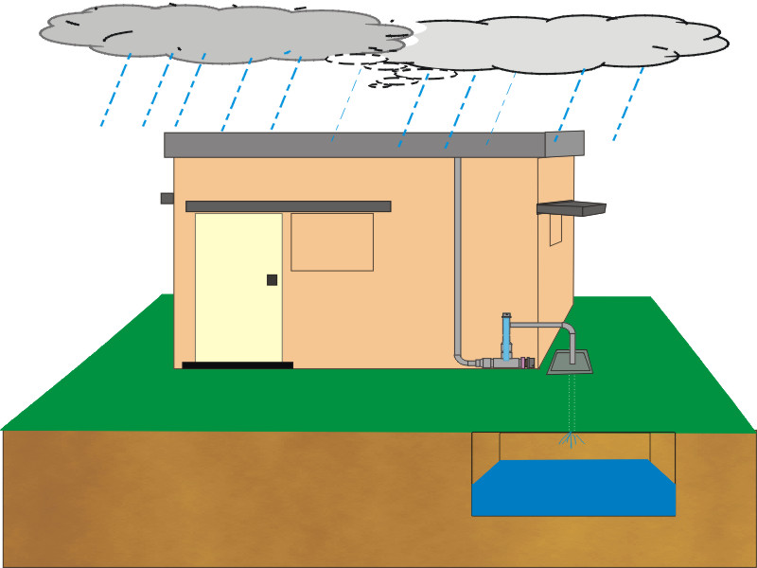
Undertaking from the Agency for O & M of Recharge Facility, cont…
Bore wells, if abandoned shall be used as recharge wells by constructing rain water harvesting pits, by making slots to the casing pipe. These will recharge the deeper aquifers directly.

Slide 60
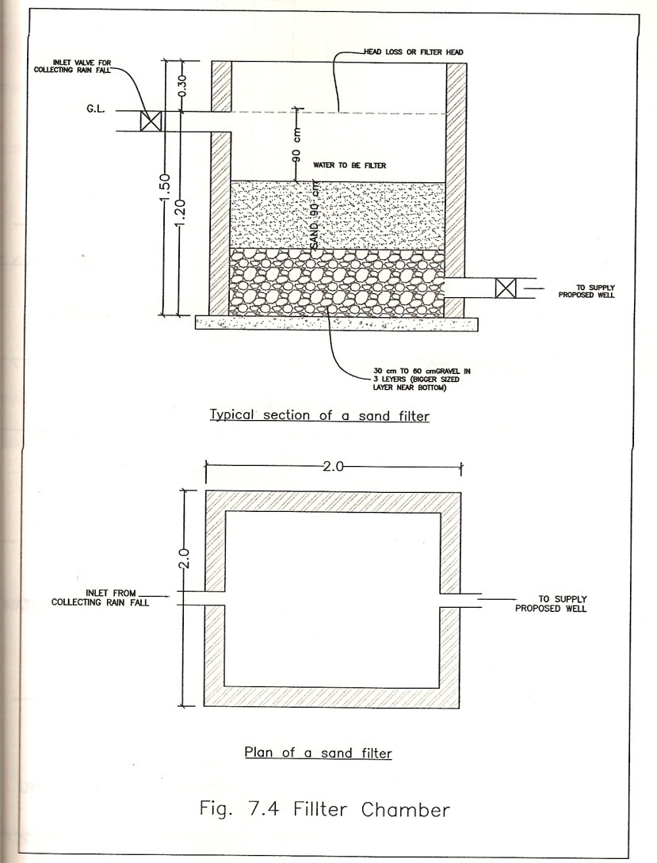
Undertaking from the Agency for O & M of Recharge Facility, cont…
Occasionally, filter beds shall be cleaned by removing the sand and gravel, and fresh sand and gravel may be replaced once in two years or when ever the situation demands.

Slide 61
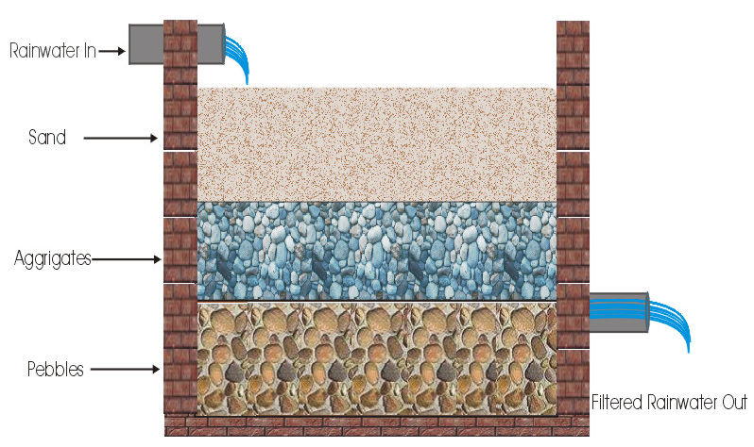
Undertaking from the Agency for O & M of Recharge Facility, cont…
Removal of silt in the silt chambers, storage tanks, recharge pits shall be taken up at regular intervals for proper maintenance of the recharge structures.

Slide 62
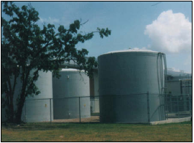
Undertaking from the Agency for O & M of Recharge Facility, cont…
During the rainy season, after every rain spell in each month the mud cake and waste material on top of the sand layer shall be removed and cleaned properly for the effective filtration of rain water.

Slide 63
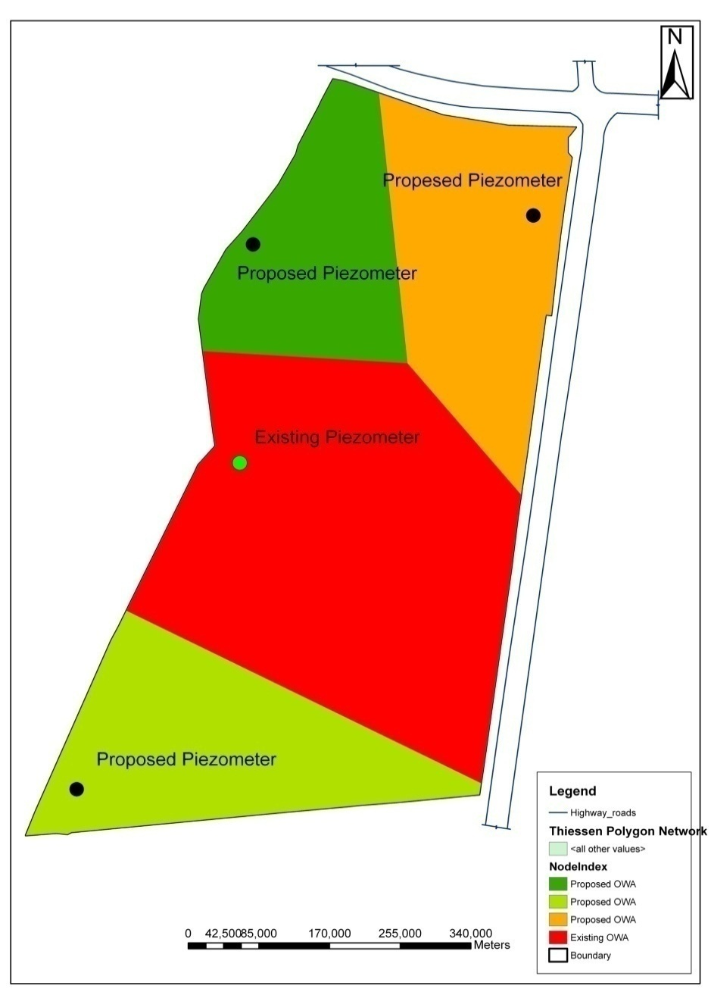
Proposed piezometer locations along with its influence as calculated using Thiessen polygon network method in GIS environment

Slide 64
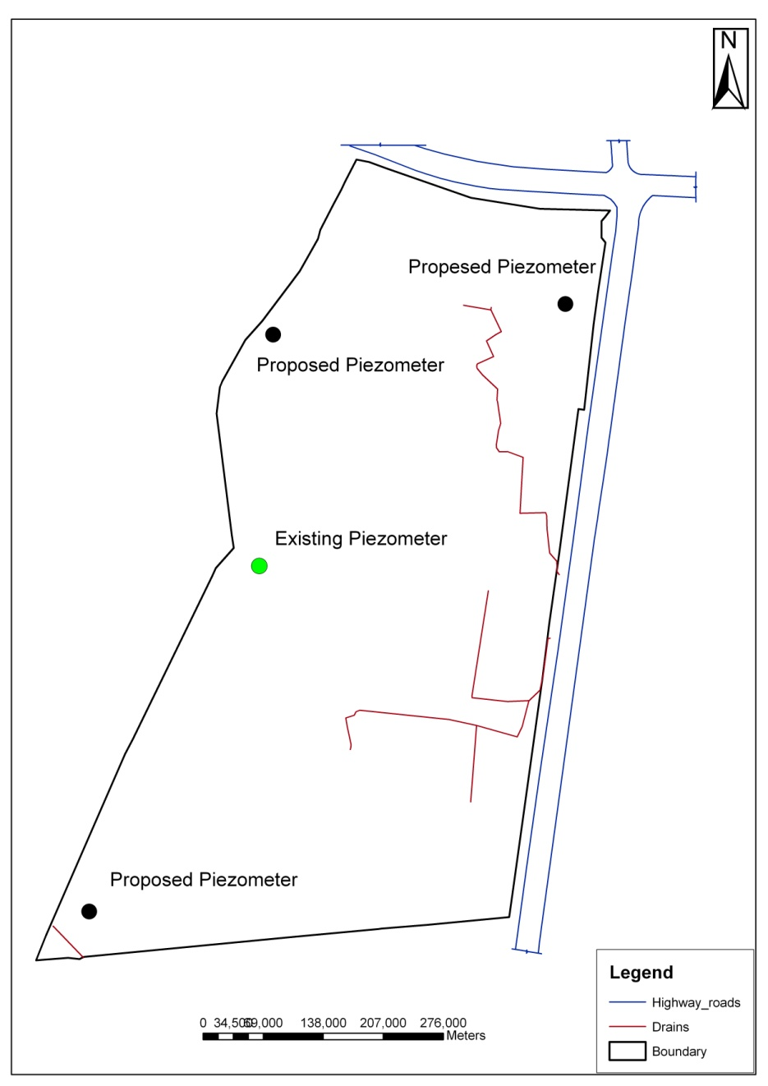
Drainage area

Slide 65
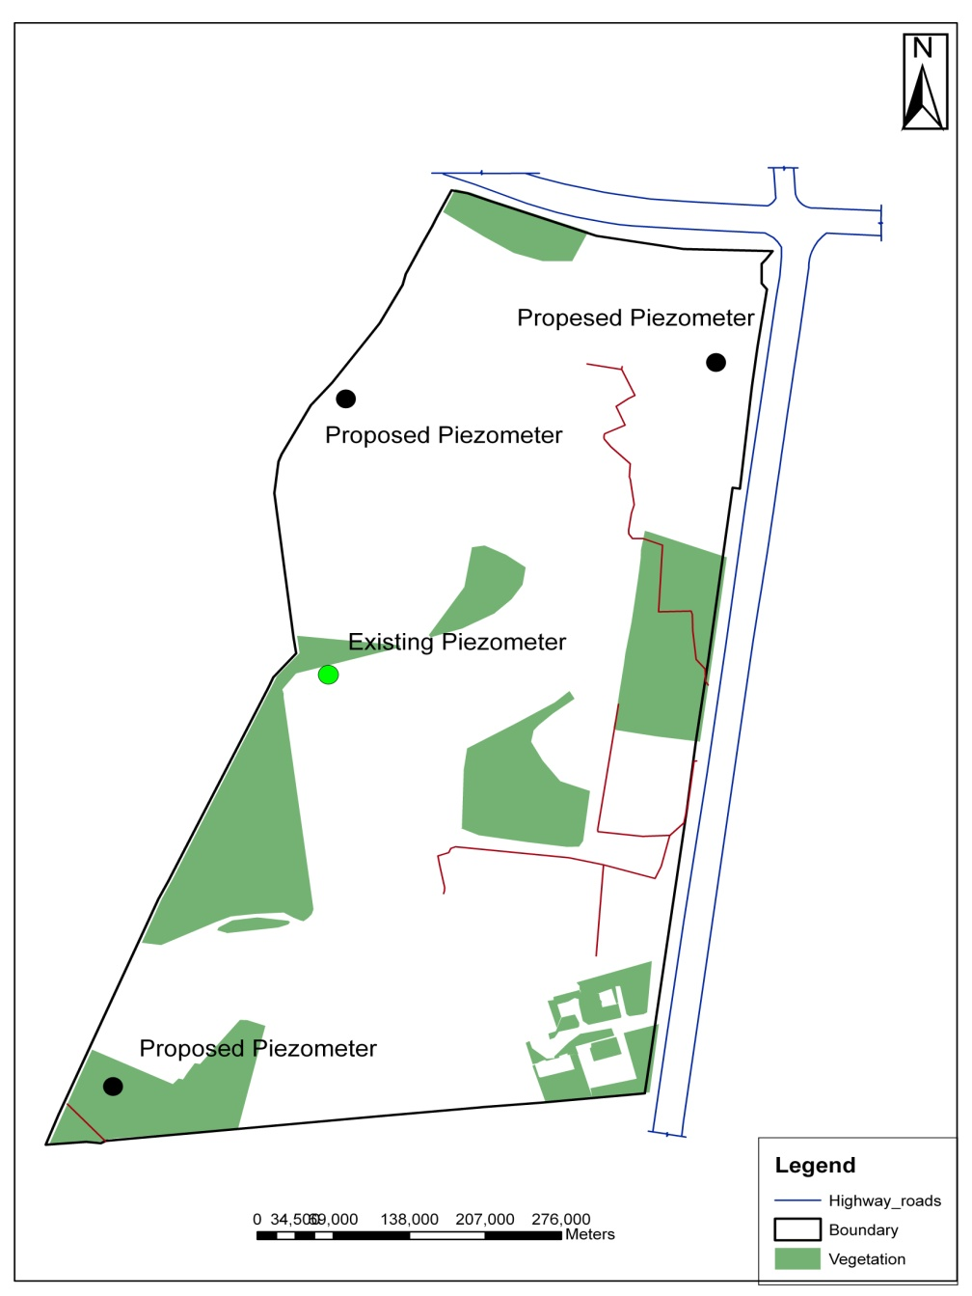
Vegetation area

Slide 66
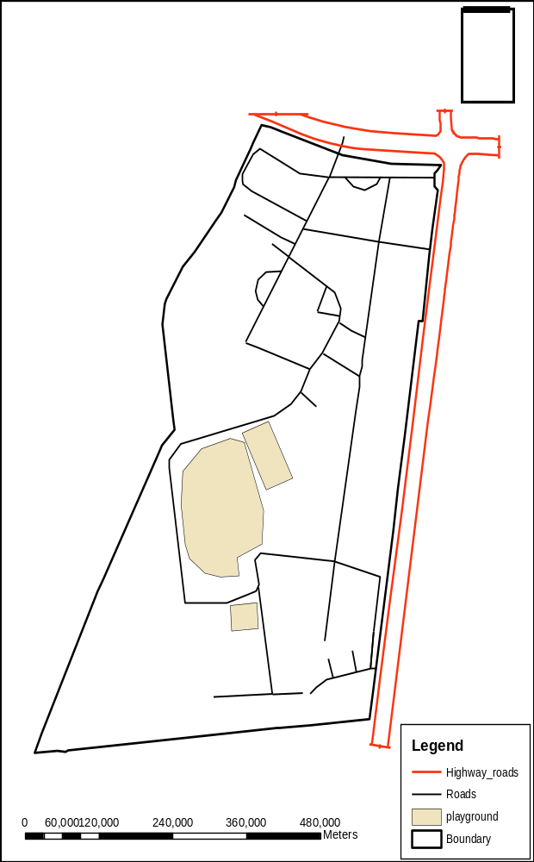
Roads along with Playground

Slide 67
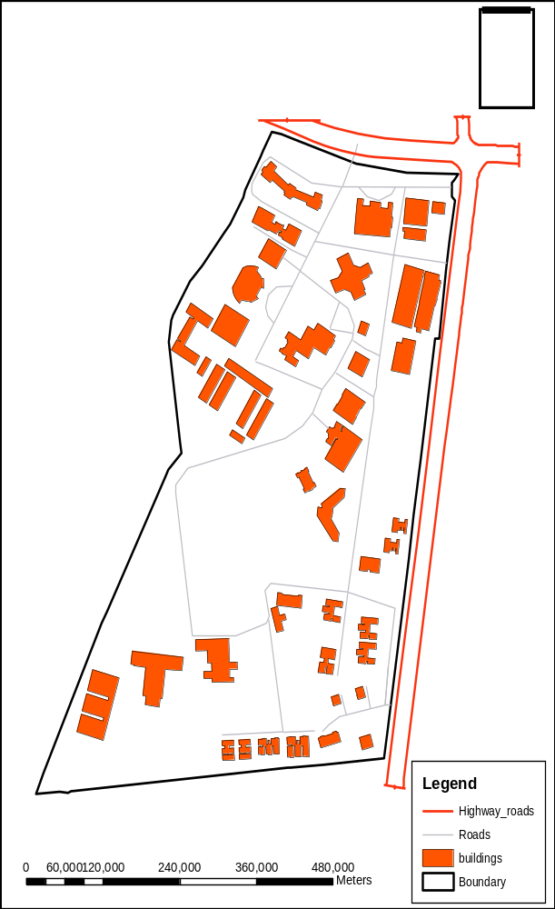
Buildings along with Roads

Slide 68

Piezometer well locations

Slide 69
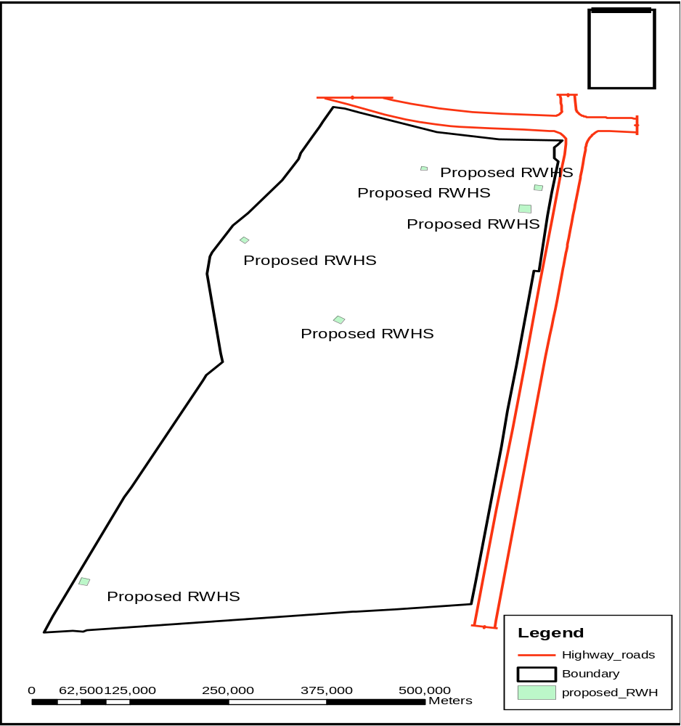
Locations of proposed Rainwater Harvesting Structures

Slide 70
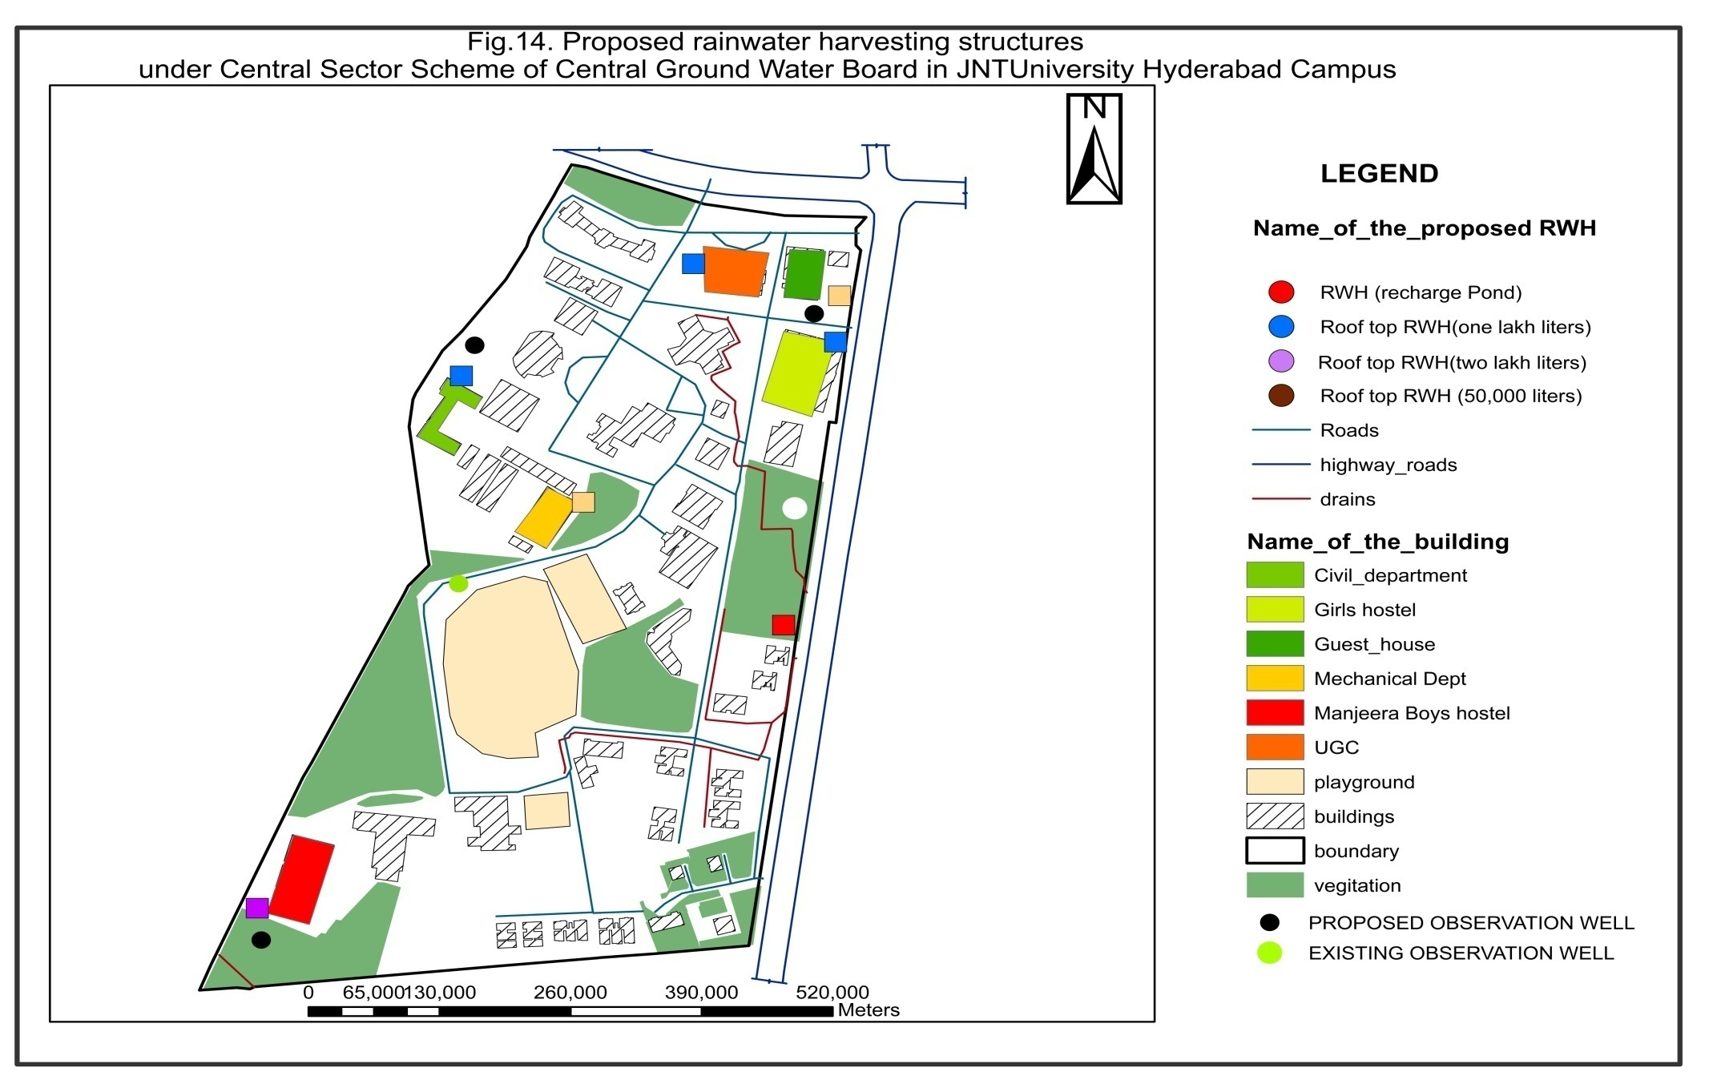
Locations of Existing buildings and proposed Rainwater Harvesting
Structures along with layout of the Campus

Slide 71
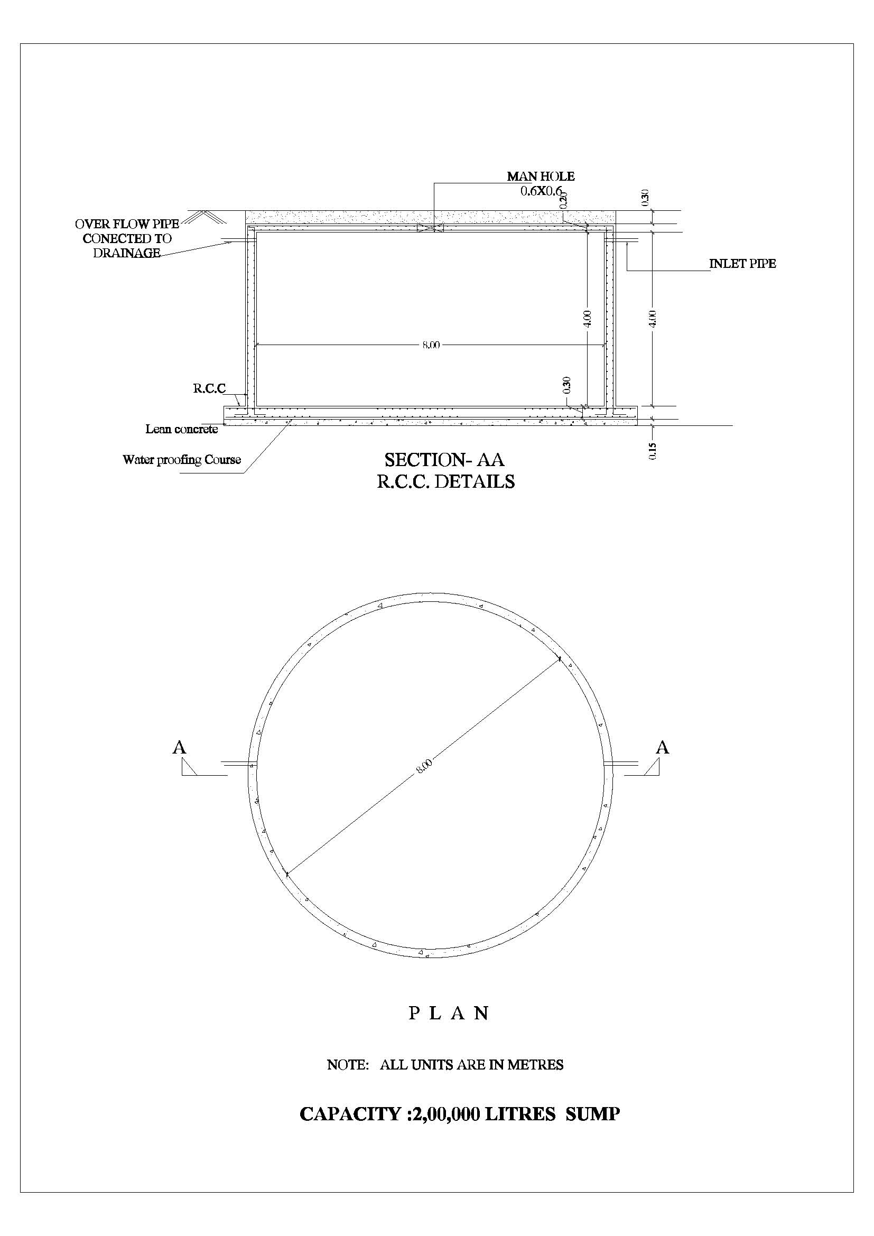
Roof top rainwater harvesting with a capacity of two lakh liters and re-use

Slide 72
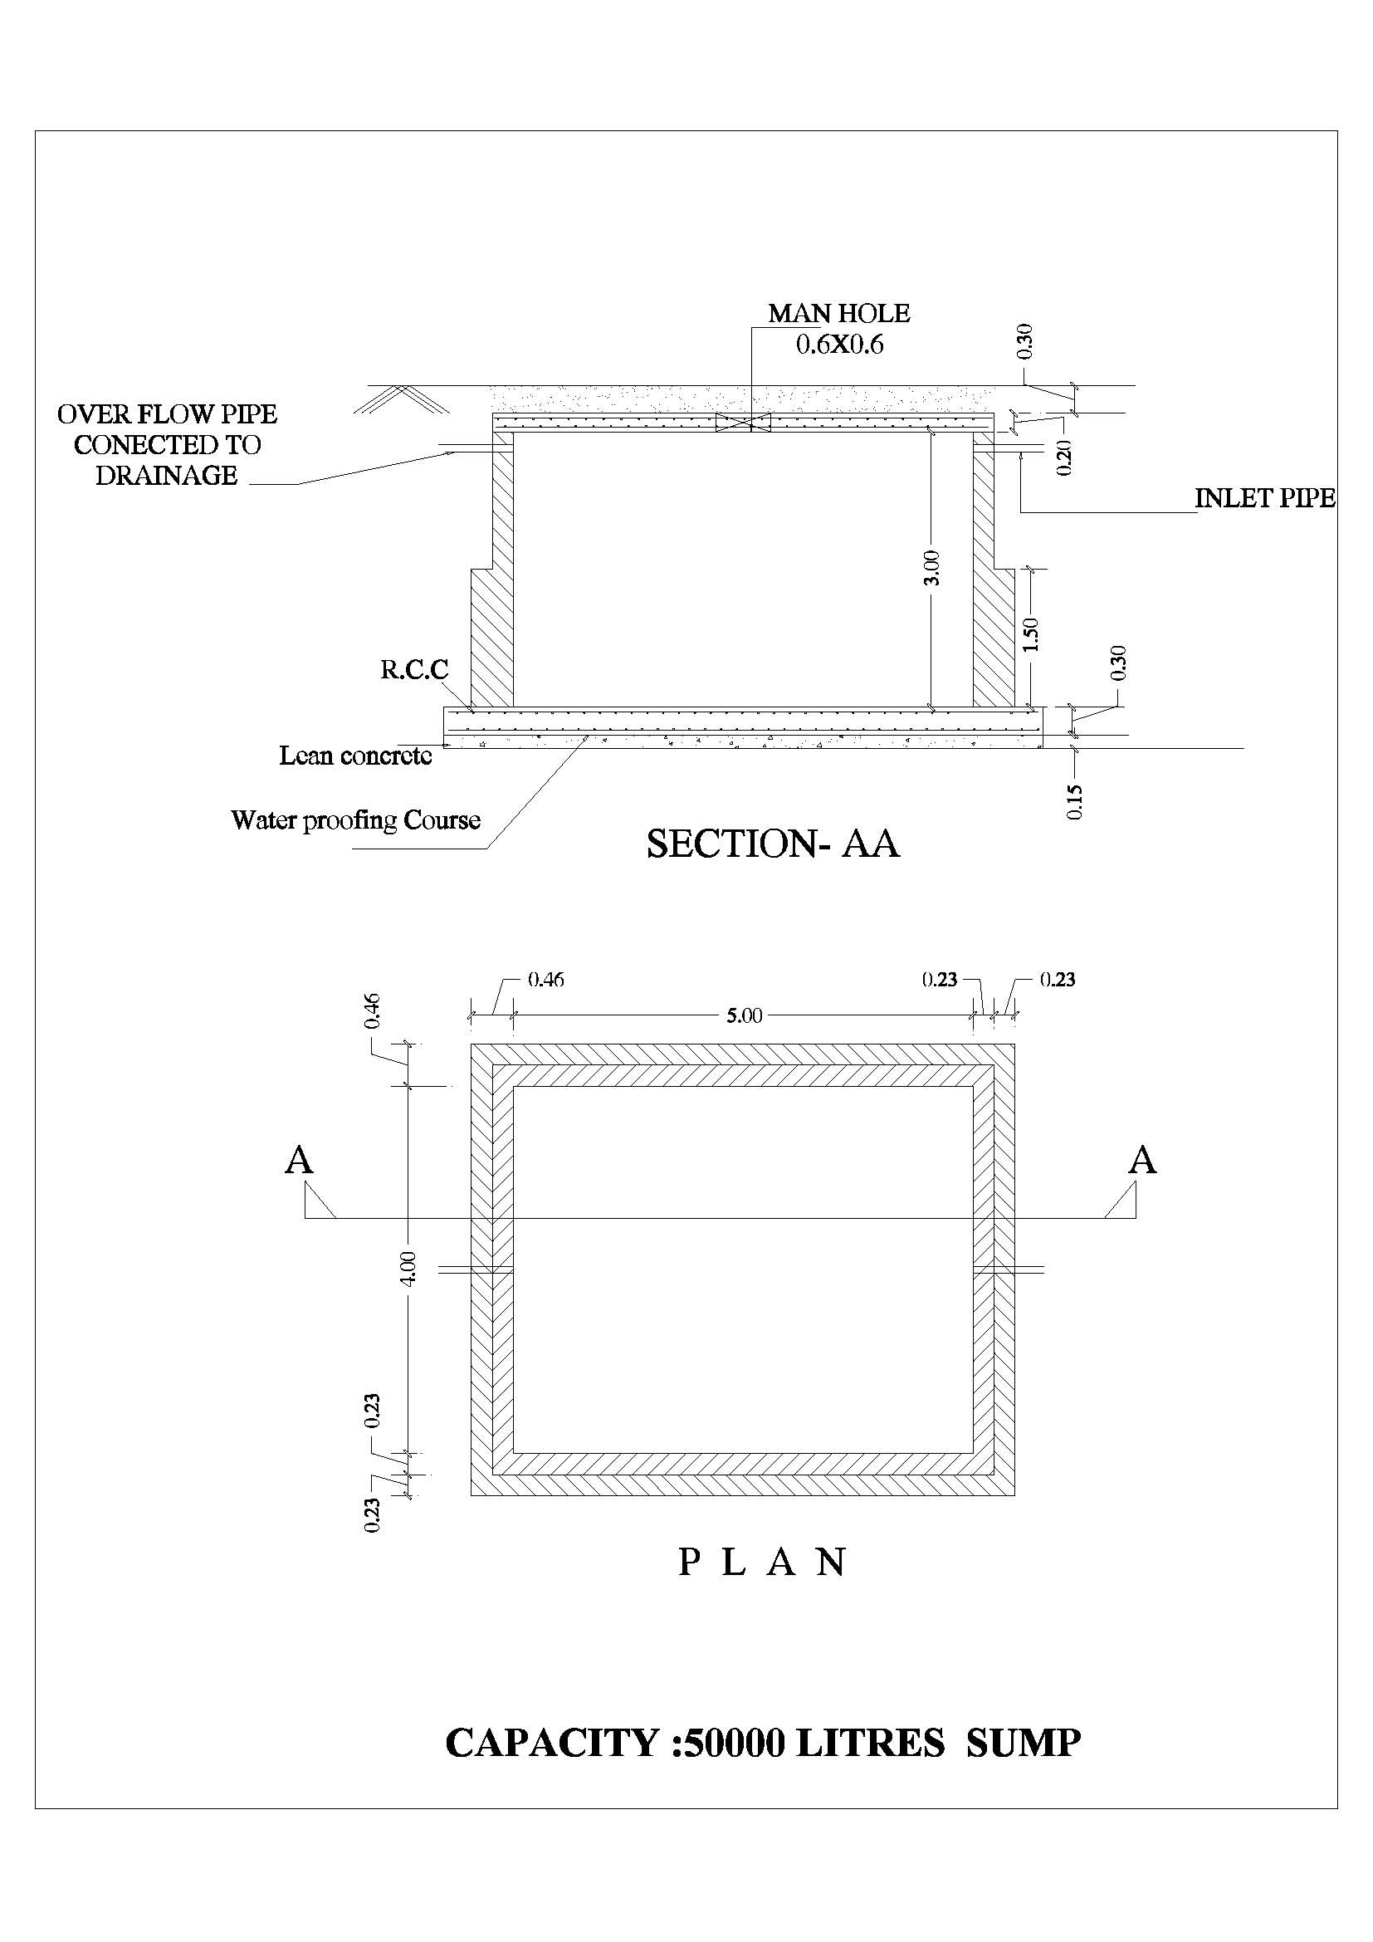
Roof top rainwater harvesting with a capacity of 50,000 liters with brick walls

Slide 73
Impact of
Artificial Recharge of Rainwater in
JNTU Hyderabad campus

Slide 74
Structures Constructed
Sl. No |  | Title of the structure | Location
1 |  | Main structure: Recharge pond with two recharge shafts | Besides Mechanical Engineering building, JNTUH Campus
ASSOCIATE STRUCTURES
Piezometers – 03 Nos
2 | Piezometer -1 with a depth of 30mts |  | Between Girls hostel compound wall and new incubator building, JNTUH Campus
3 | Piezometer – 2 with a depth of 30mts |  | Behind EEE Department, College of Engineering, JNTUH Campus
4 | Piezometer -3 with a depth of 30mts |  | Behind new JNTUHIST Building, JNTUH Campus
Sump (50,000lit capacity) - 02 Nos
5 | Roof top rainwater harvesting structure with a capacity of 50,000 liters for reuse. |  | Behind old quarters, JNTUH Campus
6 | Roof top rainwater harvesting structure with a capacity of 50,000 liters for reuse. |  | Behind New quarters, JNTUH Campus

Slide 75
Structures Constructed
Sump (2,00,000 lit capacity) – 01 Nos.
7 | Roof top rainwater harvesting sump with a capacity of 2,00,000 liters for reuse. | In front of Manjeera Hostel, JNTUH Campus
Sump (1,00,000 lit capacity) – 03 Nos.
8 | Roof top rainwater harvesting structure with a capacity of 1,00,000 liters along with two bore well for recharge. | Behind EEE Department, College of Engineering, JNTUH
9 | Roof top rainwater harvesting structure with a capacity of 1,00,000 liters along with two bore well for recharge. | Between Girls hostel compound wall and new incubator building
10 | Roof top rainwater harvesting structure with a capacity of 1,00,000 liters along with two bore well for recharge. | Behind new JNTUHIST Building, JNTUH

Slide 76
Recharge of rainwater through injection wells in the JNTUH campus:
Location of the structure: NEAR LIBRARY
Estimated Cost: 5, 50,000 Rupees
Quantity of rainwater harvested and recharged during the year 2012 and 2013
Sl. No | Month | Rainfall (mm) |  | Quantity of rainwater recharged (lts)
 |  | 2012 | 2013 (25-11-2013) | 2012 | 2013 (25-11-13)
1 | April | --- | 72 | --- | 66096
2 | May | --- | 14 | --- | 12852
3 | June | 200.1 | 120.4 | 183691.8 | 110527.2
4 | July | 193.2 | 380.1 | 177357.6 | 348931.8
5 | August | 170 | 160.6 | 156060 | 147430.8
6 | September | 94.8 | 170.2 | 87026.4 | 156243.6
7 | October | 61.6 | 168.8 | 56548.8 | 154958.4
8 | November | 55 | 13.8 | 50490 | 12668.4
9 | December | --- | --- | --- | --
 | Total | 774.7 | 1099.9 | 7,11,174.6 | 10,09,708.2

Slide 77
Location of the structure: Near Girls Hostel
Estimated Cost: 5, 50,000 Rupees
Quantity of rainwater harvested and recharged during the year 2012 and 2013
Sl. No | Month | Rainfall (mm) |  | Quantity of rainwater recharged (lts)
 |  | 2012 | 2013 (25-11-2013) | 2012 | 2013 (25-11-13)
1 | April | --- | 72 | --- | 83073.6
2 | May | --- | 14 | --- | 16153.2
3 | June | 200.1 | 120.4 | 230875.38 | 138917.52
4 | July | 193.2 | 380.1 | 222914.16 | 438559.4
5 | August | 170.0 | 160.6 | 196146 | 185300.28
6 | September | 94.8 | 170.2 | 109380.24 | 196376.8
7 | October | 61.6 | 108.8 | 71074.08 | 194761.4
8 | November | 55.0 | 13.8 | 63459
9 | December | --- | ----- | ---
 | Total | 774.7 | 1099.9 | 8,93,848.86 | 1269064.62
Total quantity of rainwater recharged through this structure: 21,62,913.48
(Twenty one Lakhs sixty two thousand nine hundred and thirteen liters)

Slide 78
Location of the structure: Near New IST
Estimated Cost: 5, 50,000 Rupees
Quantity of rainwater harvested and recharged during the year 2012 and 2013
Total quantity of rainwater recharged through this structure: 11, 48,942.34
(Eleven Lakhs forty eight thousand nine hundred and forty three liters)
Sl. No | Month | Rainfall (mm) |  | Quantity of rainwater recharged (lts)
 |  | 2012 | 2013 (25-11-13) | 2012 | 2013 (25-11-13)
1 | April | --- | 72 | --- | 44128.8
2 | May | --- | 14 | --- | 8580.6
3 | June | 200.1 | 120.4 | 122641.29 | 73793.16
4 | July | 193.2 | 380.1 | 118412.28 | 232963.3
5 | August | 170.0 | 160.6 | 104193 | 98431.74
6 | September | 94.8 | 170.2 | 58102.92 | 104315.6
7 | October | 61.6 | 108.8 | 37754.64 | 103457.5
8 | November | 55.0 | 13.8 | 33709.5 | 8458.02
9 | December | --- | --- | --- | ---
Total |  | 774.7 | 1099.9 | 4,74,813.63 | 6,74,128.71

Slide 79
Location of the structure: new quarters
Estimated cost: 5, 00,000 rupees
Quantity of rainwater harvested and recharged during the year 2012 and 2013
Total quantity of rainwater recharged through this structure: 37, 38,702.24
(Thirty Seven Lakhs thirty eight thousand seven hundred and two liters)
Sl. No | Month | Rainfall (mm) |  | Quantity of rainwater recharged (lts)
 |  | 2012 | 2013 (25-11-13) | 2012 | 2013 (25-11-13)
1 | April | --- | 72 | --- | 143596.8
2 | May | --- | 14 | --- | 27921.6
3 | June | 200.1 | 120.4 | 399079.44 | 240125.76
4 | July | 193.2 | 380.1 | 385378.08 | 758071.44
5 | August | 170.0 | 160.6 | 339048 | 320300.64
6 | September | 94.8 | 170.2 | 189069.12 | 339446.9
7 | October | 61.6 | 108.8 | 122855.04 | 336654.7
8 | November | 55.0 | 13.8 | 109692 | 27522.72
9 | December | --- | --- | --- | ----
Total |  | 774.7 | 1099.9 | 15,45,121.68 | 21,93,640.56

Slide 80
Location of the structure :Old Quarters
Estimated Cost: 5, 00,000 rupees
Quantity of rainwater harvested and recharged during the year 2012 and 2013
Sl. No | Month | Rainfall (mm) |  | Quantity of rainwater recharged (lts)
 |  | 2012 | 2013 (25-11-2013) | 2012 | 2013 (25-11-2013)
1 | April | --- | 72 | --- | 63180
2 | May | --- | 14 | --- | 12285
3 | June | 200.1 | 120.4 | 175587.75 | 105651
4 | July | 193.2 | 380.1 | 169533 | 333537.75
5 | August | 170.0 | 160.6 | 149175 | 140926.5
6 | September | 94.8 | 170.2 | 83187 | 149350.5
7 | October | 61.6 | 108.8 | 54054 | 148122
8 | November | 55.0 | 13.8 | 48262.5 | 12109.5
9 | December | --- | --- | --- | ----
Total |  | 774.7 | 1099.9 | 6,79,799.25 | 9,65,162.25
Total quantity of rainwater recharged through this structure: 16,44,961.5
(Sixteen Lakhs forty four thousand nine hundred and sixty one liters)

Slide 81
Recharge through open pond with two recharge wells:
IN 2012
    Amount of rainfall received during the year 2012: 774.7
    Catchment area : 05 acres: 20235 m²
    Runoff =7,830.945 m³
    Total quantity of rainfall received and harvested : 7830 m³ or 78,30,000 liter
IN 2013 (Till 25- 11-2013
    Amount of rainfall received during the year 2013 upto 25-11-2013: 1099.9mm
    Catchment area : 05 acres: 20235 m²
    Runoff = 11119 m³
    Total quantity of rainfall received and harvested : 11,119 m³ or 1,11,19,000 liters

Slide 82
Total quantity of rainwater recharged during the year
2012 and 2013
Sl. No | Location of the structure | Quantity of rainwater recharged during the year 2012 | Quantity of rainwater recharged during the year 2013 | Total till 25-11-2013
1 | Near library | 7,11,174.6 | 5,38,407 | 12,49,582
2 | Near Girls Hostel | 8,93,848.86 | 6,76,703.7 | 15,70,553
3 | Near New IST | 4,74,813.63 | 35,9,465.9 | 8,34,280
4 | New Quarters | 15,45,121.7 | 11,69,716 | 27,14,837
5 | old Quarters | 6,79,799.25 | 9,65,162.3 | 16,44,962
6 | Open pond | 1,56,76,054 | 2,22,57,000 | 3,79,33,054
Total |  |  |  | 4,59,47,268
Total quantity of rainwater recharged through this structure: 4,59,47,268
(Four crores fifty nine Lakhs forty seven thousand two hundred and sixty eight liters)

Slide 83
Reuse of rainwater in the JNTUH campus:.
Location of the tank: Manjeera hostel
Estimated Cost: 9, 50,000 Rupees
Quantity of rainwater harvested and reused during the year 2012 and 2013
Sl. No | Month | Rainfall (mm) |  | Quantity of rainwater reused (lts)
 |  | 2012 | 2013 (25-11-2013) | 2012 | 2013 (25-11-2013)
1 | April | --- | 72 | --- | 40176
2 | May | --- | 14 | --- | 7812
3 | June | 200.1 | 120.4 | 111655.8 | 67183.2
4 | July | 193.2 | 380.1 | 107805.6 | 212095.8
5 | August | 170.0 | 160.6 | 94860 | 89614.8
6 | September | 94.8 | 170.2 | 52898.4 | 94971.6
7 | October | 61.6 | 108.8 | 34372.8 | 94190.4
8 | November | 55.0 | 13.8 | 30690 | 7700.4
9 | December | --- | --- | --- | ---
Total |  | 774.7 | 1099.9 | 4,32,282.6 | 2,86,477.2
Total quantity of rainwater recharged through this structure: 10, 46,026.8 liters
(Ten Lakhs forty Six thousand twenty six liters)

Slide 84
Total quantity of rainwater recharged during the year 2012 and 2013
Sl. No | Location of the structure | Quantity of rainwater recharged during the year 2012 | Quantity of rainwater recharged during the year 2013 | Total till 31-07-2013
1 | Near library | 711174.6 | 538407 | 1249582
2 | Near Girls Hostel | 893848.86 | 676703.7 | 1570553
3 | Near New IST | 474813.63 | 359465.9 | 8,34,280
4 | New Quarters | 1545121.7 | 1169716 | 2714837
5 | old Quarters | 679799.25 | 965162.3 | 1644962
6 | Open pond | 15676054 | 22257000 | 37933054
Total | Total |  |  | 4,59,47,268
Total quantity of rainwater recharged through this structure: 4,59,47,268
(Four crores fifty nine lakhs forty seven thousand two hundred and sixty eight liters)

Slide 85
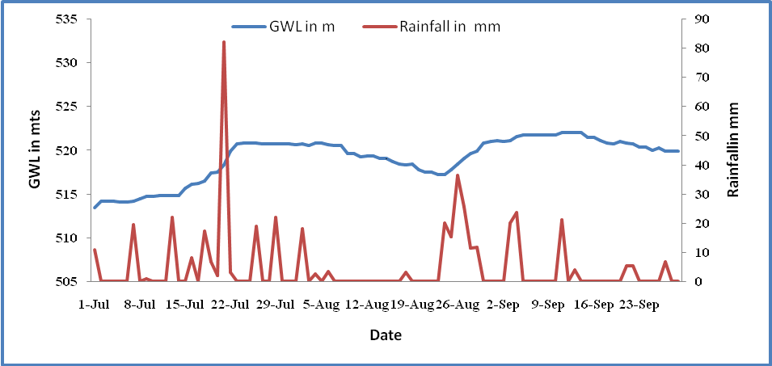
VARIATION OF DAILY GROUNDWATER LEVEL AND RAINFALL FOR THE MONTHS OF JULY TO SEPTEMBER 2012 FOR THE PIEZOMETER LOCATED BEHIND LIBRARY BUILDING IN THE CAMPUS.
Lowest ground water level 513.4 msl observed on 01-07-2013
Maximum ground water level 522.0 msl observed 14-09-2013
Static water level rise is around 8.6 m due to recharge of rainwater in this watershed.

Slide 86
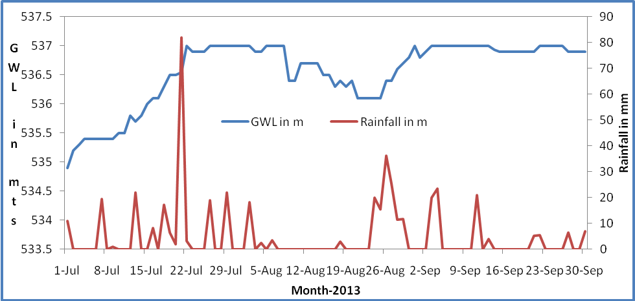
VARIATION OF DAILY GROUNDWATER LEVEL AND RAINFALL FOR THE MONTHS OF JULY TO SEPTEMBER 2012 FOR THE PIEZOMETER LOCATED NEAR GIRLS HOSTEL IN THE CAMPUS
Lowest ground water level 537.0 msl observed on 22-07-2012
Maximum ground water level 534.9 msl observed 01-07-2012
Static water level rise is around 2.1 m due to recharge of rainwater in this watershed

Slide 87
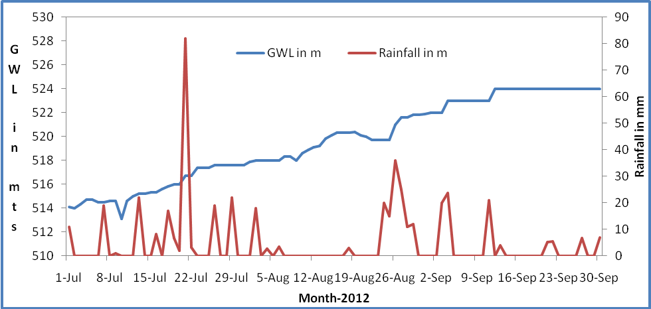
Variation Of Daily Groundwater Level And Rainfall For The Months Of July To September 2012 For The Piezometer Located Near New IST Building In The Campus.
Lowest ground water level 524.0 msl observed on 09-12-2012
Maximum ground water level 513.1 msl observed 07-10-2012
Static water level rise is around 10.9 m due to recharge of rainwater in this watershed

Slide 88
Variation of daily groundwater level and rainfall for the months of April to November (25.11.2013) 2013 for the piezometer located behind library building in the campus.

Slide 89
Variation of daily groundwater level and rainfall for the months of April to November (25.11.2013) 2013 for the piezometer located near girls hostel in the campus

Slide 90
Variation of daily groundwater level and rainfall for the months of April to November (25.11.2013) 2013 for the piezometer located near new IST building in the campus.

Slide 91
Electronic Video Coverage by Media
Sl. No | Name of the channel | Name of the programme | Date and time | Duration | Youtube link
1 | ETV | Inkudu Guntalu | 10-03-2013, 11.00 am | 2min 30sec | http://youtu.be/SSs4OC28Trk
2 | ETV2 | Inkudu Guntalu | 11-03-2013, 8.30 am | 2min 30sec | http://youtu.be/0q9BJoNDxf4
3 | ETV2 | Jala Samrakshanalo JNTU | 14-07-2013, 9:30 pm | 2min 30sec | http://youtu.be/scAvr_BBTkc
4 | ETV2 | Jala Samrakshanalo JNTU | 15-07-2013, 12:30 pm | 2min 30sec | http://youtu.be/scAvr_BBTkc
5 | Zee 24 hours (Telugu) | Inkudu Guntalu | 25-07-2013, 8:30 pm | 45 sec | http://youtu.be/N6ljvYkgw7E

Slide 92
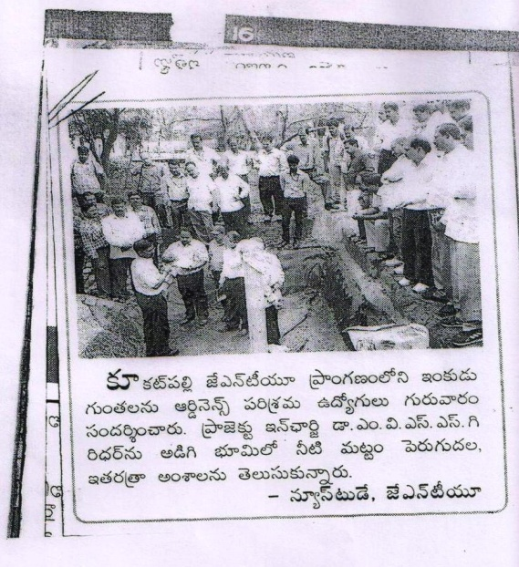
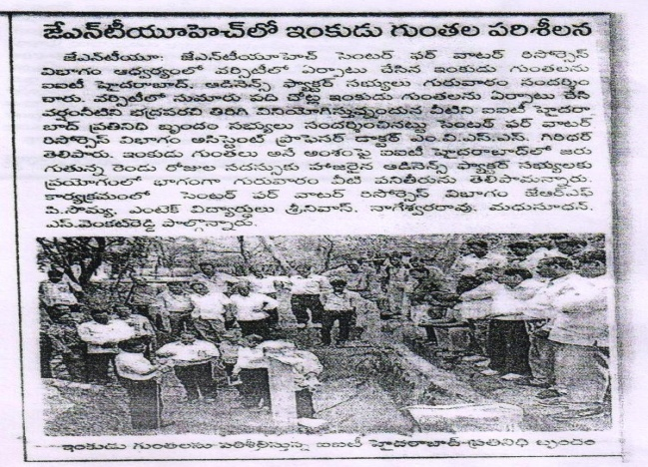
Name of the Organization visited: Employees of Ordinance Factory, Hyderabad Title of the training programme: 2 Day training on Rainwater Harvesting Training by: IIT Hyderabad Date of visit: 25.07.1013 No. of Participants: 40 Published in: Eenadu News paper on 26th July in Kukatpally edition
 | Visit by: Ordinance Factory Employees Title: 2 Day training on Rainwater Harvesting Training by: IIT Hyderabad Date of visit: 25.07.1013 No. of Participants: 40 Published in: Andhra Jyothi News paper on 26th July in Kukatpally edition

Slide 93
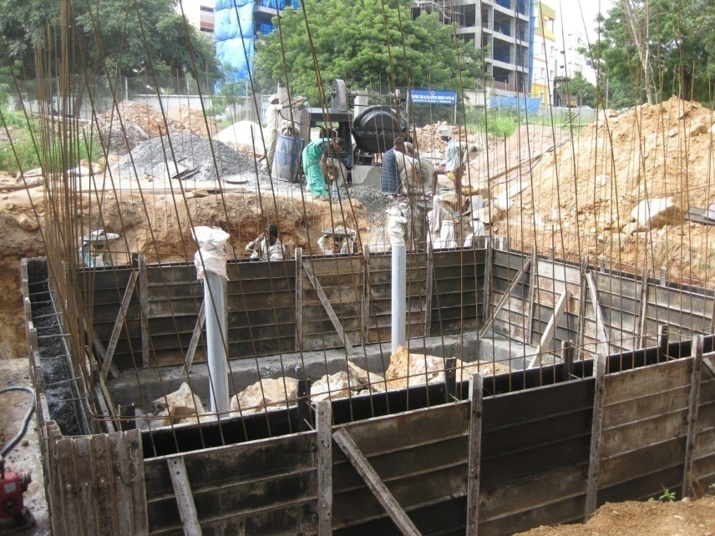
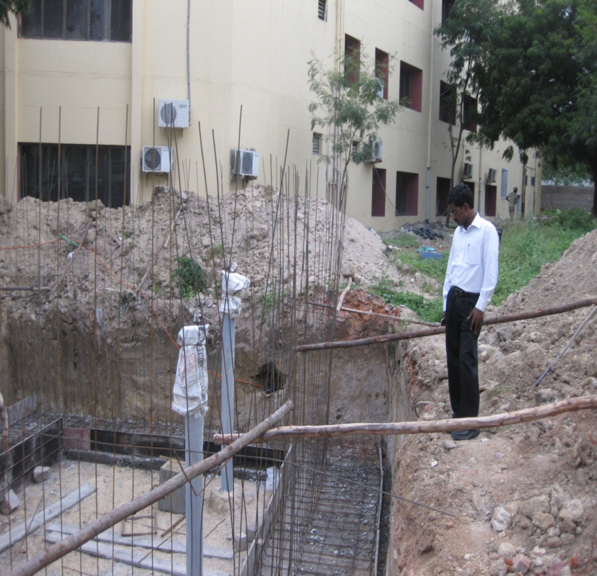
Photos During Construction of the Structures

Slide 94
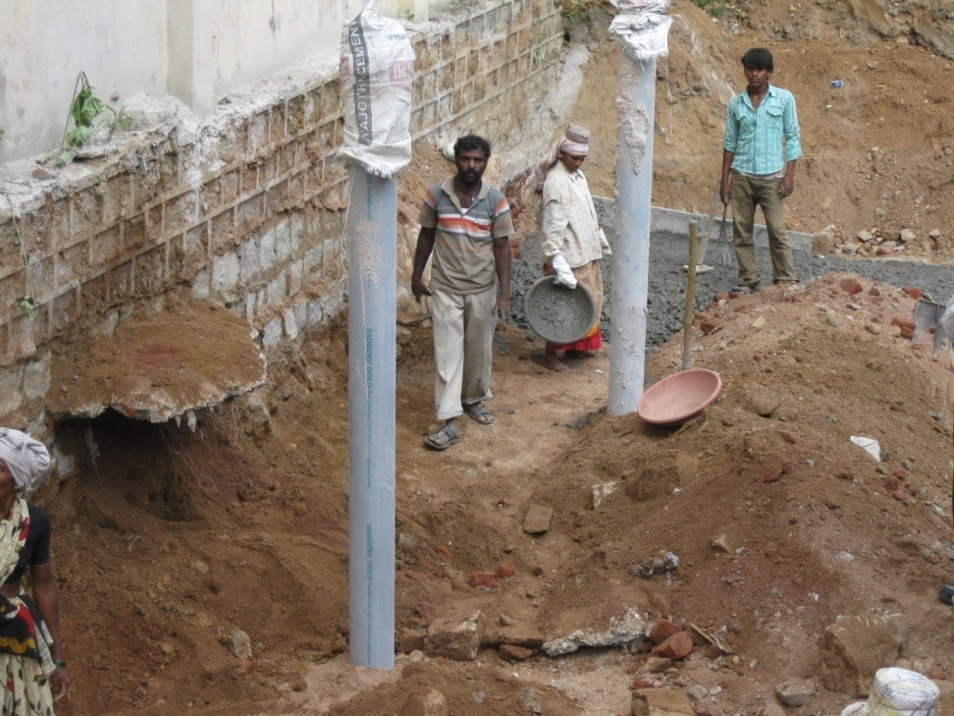
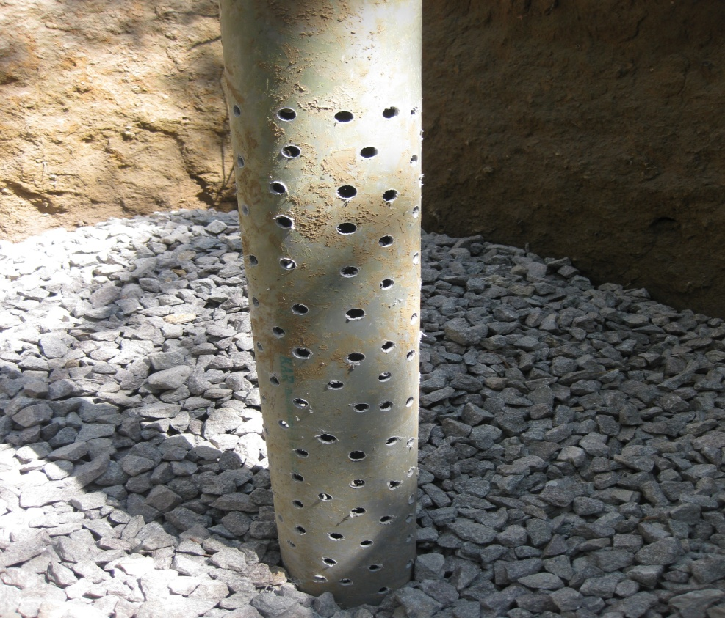

Slide 95
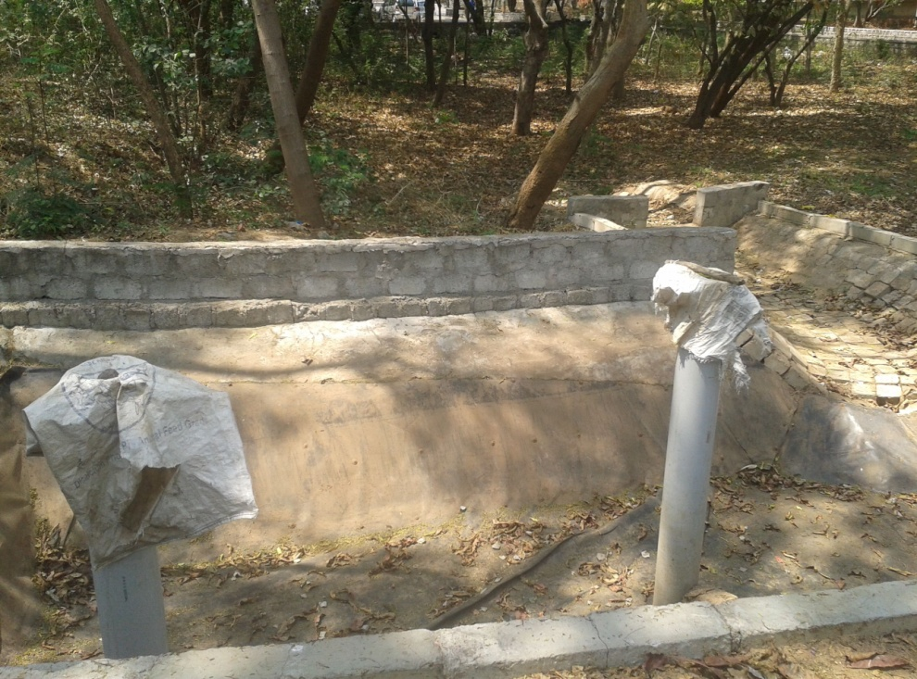
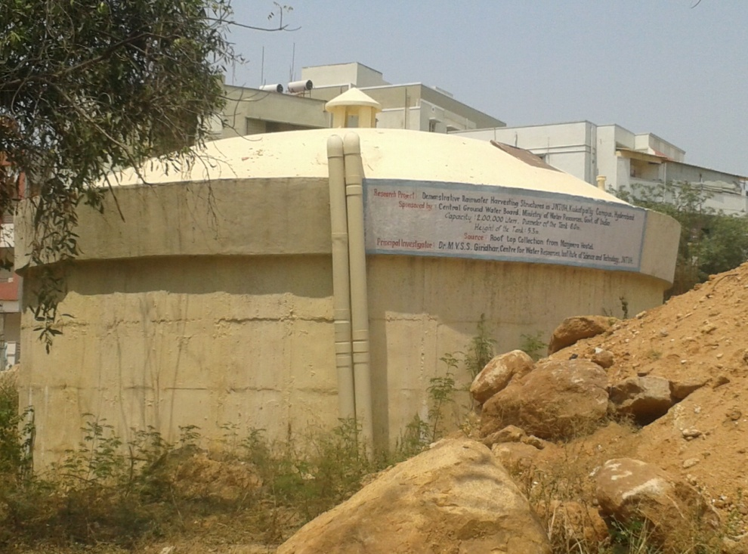
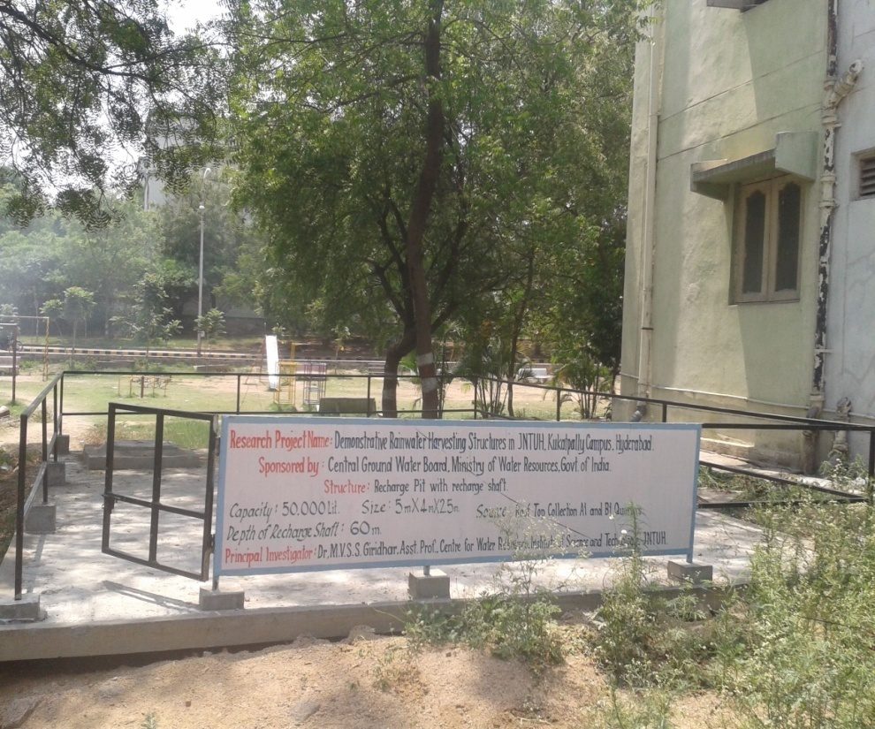
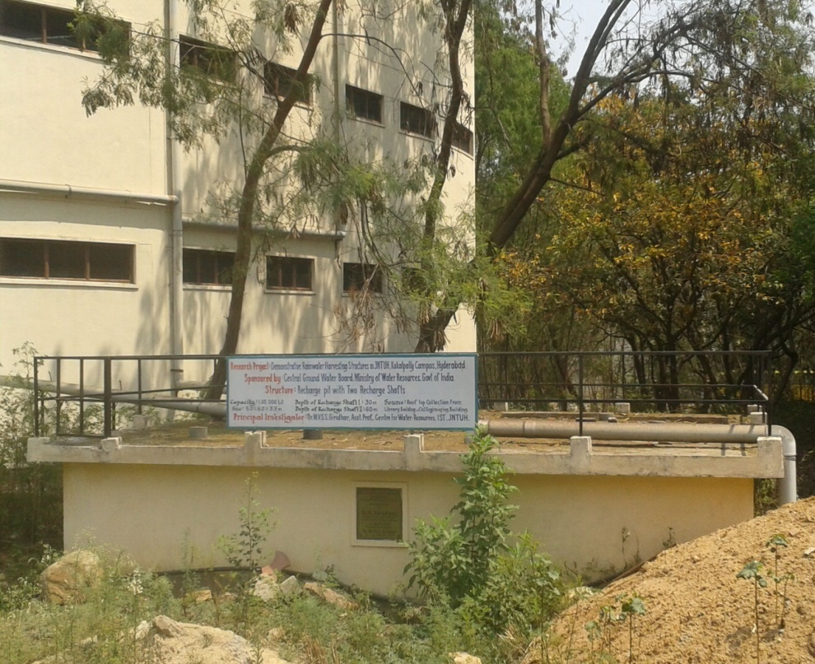


Slide 96

Thank You
. .

