Slide 1
Studies on Solution behavior of Xanthan gum in Presence of Anionic/Cationic Surfactants
MOHAMMAD KAMIL
Professor & Chair
Department of Petroleum Studies
Z. H. College of Engineering & Technology
AMU Aligarh-202002, INDIA
&
Chairman, FIE, IEI, Aligarh Local Centre, India
mkamilamu@gmail.com
5th World Congress on Petrochemistry and Chemical Engg.
Dec. 5-7, 2016, Phoenix, USA

Slide 2
OUTLINE
INTRODUCTION
POLYMER –SURFACTANT INTERACTIONs
BACK GROUND INFORMATION
OBJECTIVES OF RESEARCH
EXPERIMENTAL METHODS AND PROCEDURE
RESULTS AND DISCUSSION
CONCLUSIONS
FUTURE RECOMMENDATIONS

Slide 3
Introduction
Systems containing water, ionic or non-ionic surfactants and water-soluble polymers are vitally important to the success of product formulations and aimed at a fundamental understanding of their properties for their use in various industrial applications such aspharmaceuticals and biomedical, personal care product, detergency, paints and coating, oil drilling and enhanced oil recovery fluid, food and mineral processing etc.
.In the past, surfactants and polymers were used separately in many applications mainly for their individual function rather than for those arising out of their mutual interactions.
When these two entities are present in systems, they generally provide better properties as compared to single entity.
When present together, they can interact to provide beneficial properties or unusual and unwanted properties, such as hydrophobic aggregation, viscosity enhancement, gel formation, solubilisation and phase separation.
These Phenomena can be controlled, influenced and employed in specific applications.

Slide 4

Cont.
To recover the petroleum from depleted oil wells by enhanced oil recovery processes as surfactant-polymer flooding, foaming and acid fracturing, gel formation are commonly employed.
The purpose of surfactant–polymer flooding is to produce oil from reservoir which held back by capillary forces after water flooding. Injection of surfactant-polymer solution leads to reduction in interfacial tension between oil and water thereby leading to mobilization of the residual oil.
Synergism interaction of surfactant and polymer are used in many formulation and industrial process to boost the properties of surfactant and lead to unwanted and undesirable property changes.

Slide 5

Surfactants
SURFace ACTive AgeNTS (referred to as SURFACTANTS) are amphipathic molecules that, when present at low concentration in a system, have the property of adsorbing onto surfaces or interfaces of the system and of altering to a marked degree the surface or interfacial free energies of those surfaces or interfaces.)
The molecule is composed of non-polar hydrophobic portion and a polar hydrophilic portion. The polar or ionic portion of the molecule interacts strongly with water via dipole or ion-dipole interactions.
The non-polar part is hydrocarbon chain that has least affinity for water molecules. It is well known that surface-active molecules undergo self-organized aggregates known as micelles above a certain concentration, which is known as the critical micelle concentration, cmc. Mcbain and Hartley from their preliminary research work had concluded that the micelles are spherical or roughly spherical in their shape.

Slide 6
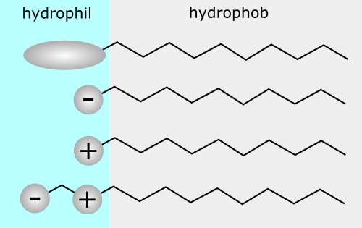
Types of Surfactants
Nonionic
Anionic
Cationic
Zwitterionic

Slide 7

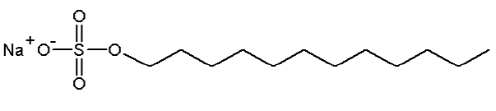
Ionic surfactant
Anionic surfactants
A surfactant with negatively charge head group such as Sodium dodecyl sulfonate (SDS)
Notes:
Anionic – The surface-active portion bears a negative charge alkane carboxylic salts (soap) Alkane sulfonic salts (detergents)
Alkyl-aromatic sulfonic salts Others: Phosphates, phosphoric salt

Slide 8


Cont..
Cationic Surfactant
Surface-active portion bears a positive charge for example Cetyltrimethylammonium Bromide( CTAB)
Br¯
Notes:
Cationic – The surface-active portion bears a positive charge Amine salts , Quaternary ammonium salts

Slide 9
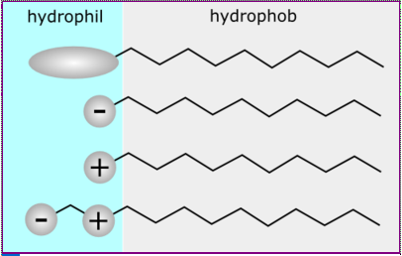
Non ionic surfactant
A surfactant with no charge group or in otherwords surface-active portion bears no apparent ionic charge.
For example:
polyoxyethylene 20 cetyl ether (Brij58)
C₁₆H₃₃(O CH₂CH₂)₂₀­­­ –OH
Notes:
Nonionic – The surface-active portion contains no charge Long chain ethers,Fatty acid esters, Amides

Slide 10
Cont..
Zwitterionic:
Both positive and negative charges may be present in the surface-active portion. Exhibit anionic behavior at higher pH values and cationic behavior near or below their iso – electric points. These may contain two charged groups with different sign, for example, N-dodecyl-N,N-dimethylbetaine (C₁₂H₂₅N⁺(CH₃)₂CH₂COO– ).
Notes:
Zwitterionic – The surface-active portion bears both charges , Long-chain amino acid salts, Betaines

Slide 11


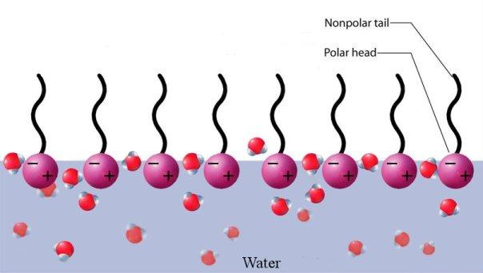


Surfactants
Surface Activity
Associative Colloids
Concentration
Experimental
conditions

Slide 12
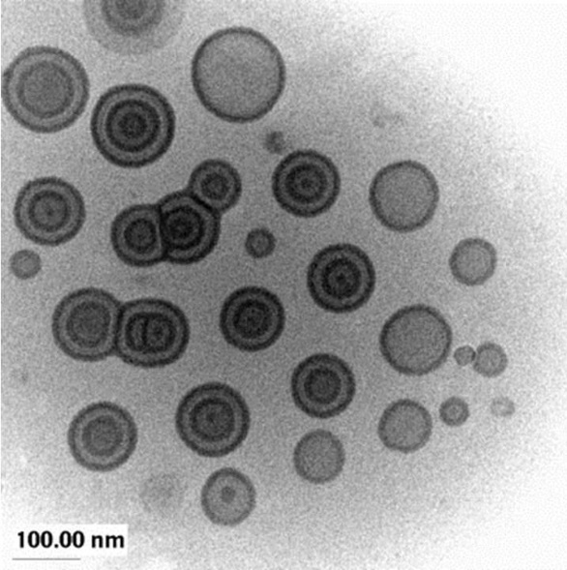
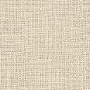
Micelles and Types of Micelles
Micelles have highly dynamic structures because they are only held together by physical interactions that are relatively weak, compared to the thermal energy of the system.
Two relaxation processes are involved in micellar solutions. The first one is the fast relaxation process with relaxation time τ₁ (generally in the order of microseconds), which is associated with the fast exchange of monomers between micelles and the surrounding bulk phase. The second relaxation time τ₂ (usually in the order of milliseconds) is attributed to the micelle formation and dissociation process.
Irregular surface of micelle compared to smooth uniform surface.
Cryo-Tem picture of micelles

Slide 13
Micelle formation
Micelle is pool of surfactant unimers.
At higher surfactant concentration, when all interfaces get saturated, the overall energy reduction may continue through some other mechanisms.
These mechanisms may include crystallization or precipitation of the surfactant from solution, or aggregate formation.
Shape and size of micelle can be controlled by changing the surfactant structure as well as by varying solution conditions like temperature, overall surfactant concentration, surfactant composition (in the case of mixed surfactant systems).

Slide 14
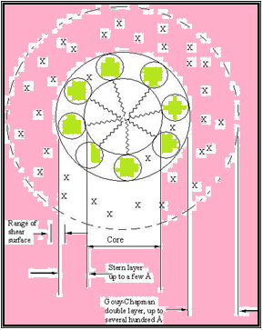
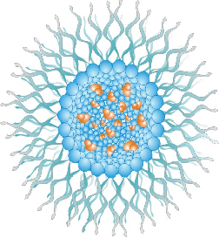
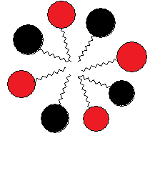
Types of Micelles
Normal Micelles
Reverse Micelles
Mixed Micelles

Slide 15
Surfactant existence in different phases dependent on surfactant concentration

Slide 16
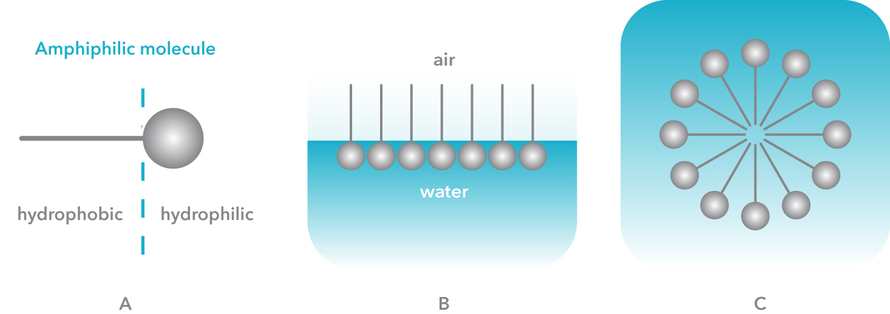
Micelle, a Latin term, means “small bit” and was coined by J. W. McBain in 1920 to describe colloidal sized particles of detergents and soaps, and the phenomenon of self-association of amphiphilic monomers into the micelle was called micellization. The driving force behind micellization is the hydrophobic effect which was proposed by G. S. Hartley in 1936.

Slide 17
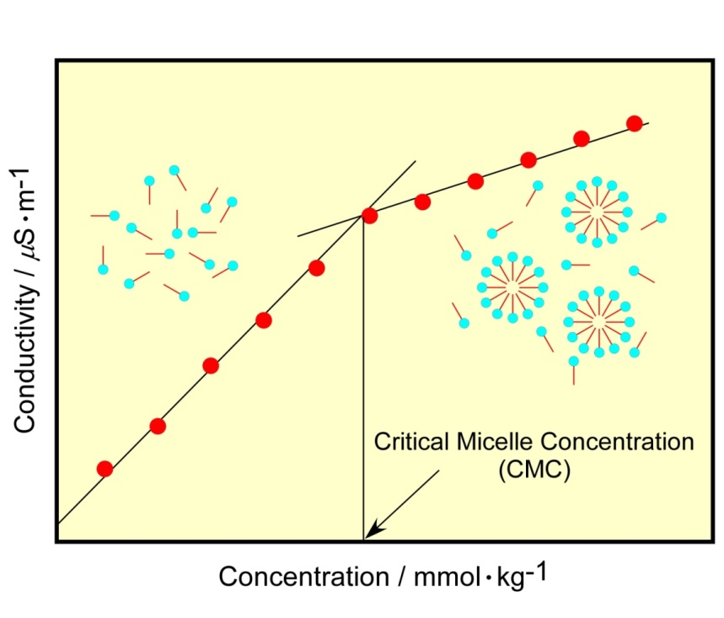
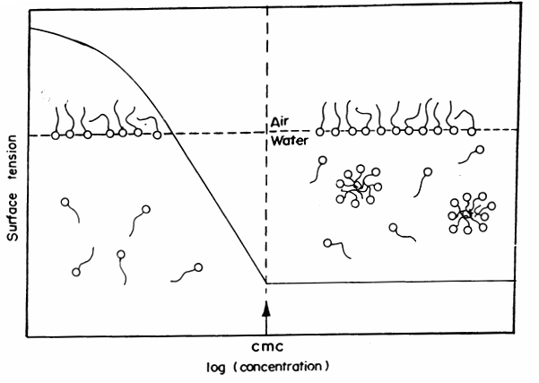
The threshold concentration at and above which micelles first appear in solution is termed as the critical micelle concentration (CMC), a term proposed by Bury and Davies in 1930. The physico-chemical properties of surfactants vary above and below the CMC value. Below the CMC value, the physico-chemical properties of ionic surfactants resemble those of strong electrolytes. Above the CMC value, these properties change drastically, indicating a highly cooperative association process is taking place.

Slide 18
Gemini Surfactants
A new class of surfactants, known as the ‘gemini’ surfactants, has been introduced to the scientific world in the recent past. Gemini or dimeric surfactants are defined as surfactants made up of two identical amphiphilic moieties connected at the level of head groups, or of the two alkyl chains but still very close to the head groups, by a spacer group . The head group, like the conventional surfactant, can be anionic, cationic, nonionic, or zwitterionic whereas the spacer group is hydrophilic or hydrophobic, rigid (stilbene) or flexible.

Slide 19
Gemini vs. Conventional
They are 10–100 times more efficient at reducing the surface tension of water and the interfacial tension at an oil/water interface than conventional surfactants.
They appear to have better solubilizing, wetting, and foaming ability than the conventional surfactants. Some anionic gemini surfactants have low Krafft temperatures, which make them applicable in cold water. Also, cationic gemini surfactants possess interesting biological properties.
The aqueous solutions of some gemini surfactants with a short spacer can have special rheological properties at relatively low concentration.
The micelles present in solutions of some gemini surfactants can have unusual shapes as, for instance, ring-like or elongated with numerous branches.

Slide 20
continued
Biosurfactant
Biosurfactant are the biological surface active agents, produced by microorganisms, plants and animals including humans.
Speciality Surfactants – Fluorocarbon and Silicone Surfactants
These surfactants may lower the surface tension of the water below
20 mN.m-1.
These surfactants have good thermal and chemical stability and they are excellent wetting agents for low energy surfaces and they are costly than conventional surfactants.
Polymeric Surfactants
These surfactants are the modified in several ways to produce molecules that are suitable as emulsifiers, dispersants in extreme conditions such as high or low pH.

Slide 21
Classification of Polymers
Thermoplastics and
Thermosets.
A more important classification of polymers is based on the molecular structure.
Linear-chain polymer
Branched-chain polymer
Network or gel polymer
Polymers are also classified according to method of preparation:
Addition polymers, usually the monomers are unsaturated (Alkenes) ex. Polyethylene
Condensation polymers, usually the monomers have functional groups like acids and hydroxyl ex. Polyamides (Nylon)

Slide 22
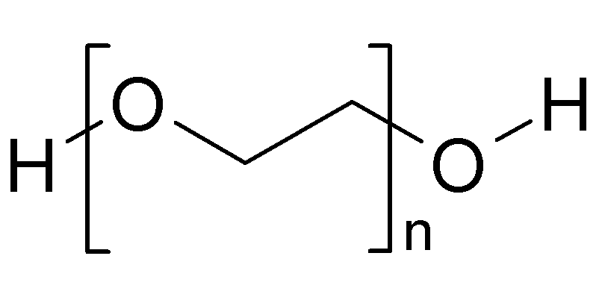
Polymers
Synthetic
Natural
Plolyethyleneglycol (PEG) (nonionic)
Proteins, DNA, RNA,
Polysaccharides, Lipids

Slide 23
continued
Commercial polymers
widely used commercial polymers styrene-butadiene rubber, nylon, PE, PP, PVC, ABS, SAN, PMMA and Xanthan gum etc.
Xanthan gum is a polysaccharide. It is also known as the anionic polyelectrolyte.
The commercial polymers are the highly branched, and dimers and trimers are truly linear. The molecular weight distribution ranges from the 2*10⁶ to 20*10⁶ Da.
The variations of fermentation conditions used in production are factors that can influence the molecular weight of Xanthan gum [10].

Slide 24
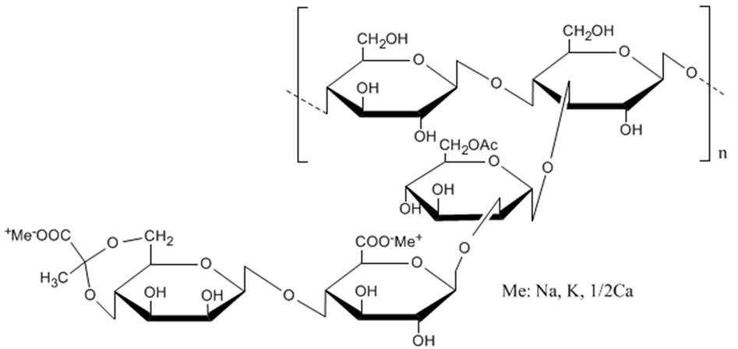
continued
Xanthan gum is a microbial polysaccharide of the great commercial significance.
Chemical structure of the Xanthan gum :

Slide 25
continued
It is a heteropolysaccharide with a primary structure consisting of repeated pentasaccharide units formed by two glucose units, two mannose units, and one glucuronic acid unit.
Xanthan gum used in a wide variety of foods for a number of important reasons, including emulsion stabilization, temperature stability, and as thickening agents

Slide 26
Factors Influencing the Polymer Surfactant interaction
Temperature
Addition of electrolyte
Surfactant chain length
Surfactant structure
Surfactant Classes
Polymer molecular weight
Amount of polymer
Polymer structure and hydrophobicity

Slide 27
Techniques used to study Polymer surfactant interaction
Surface Tension Measurement
Conductivity
Fluorescence
Nuclear Magnetic Resonance
Viscosity
Light scattering techniques
Calorimetric Measurements
Electromotive Force
Gel Permeation Chromatography (GPC) etc.

Slide 28
Surfactant Aggregates
Unimers
Normal micelles
cylindrical
spherical
Inverted hexagonal phase
Reverse micelles
Bilayer lamella
4 nm
Notes:
Molecules of amphiphilic surfactants in solution self-assemble into various supramolecular aggregates. This slide shows typical changes in surfactant self-assembly and morphologies formed with decreasing water content in the system (water content decrease is shown by arrows)
These can attain spherical, cylindrical, or planar (discs or bilayers) shapes.

Slide 29
Polymer Surfactant Interactions
Interaction occurs in two ways:
First, the interaction is possible for polymers with negative or positive charge with oppositely charged ionic surfactant; here the electrostatic interactions play a profound role.
The second type is the interaction between nonionic polymer and ionic surfactant, a hydrophobic interaction between the hydrophobic parts of both polymer and surfactant is the driving force for the interaction in this category. Generally the addition of the polymer to a surfactant solution results in a modification of the aggregation process and therefore association describes the interaction in a better way.

Slide 30
Free micelle formation starts when the chemical potential of the surfactant becomes equal to that for the case of micelle formation in aqueous solution, i.e., CMC which is dependent on polymer concentration.
An addition of polymer to a surfactant solution induces aggregation of the surfactants
Two critical concentrations, CAC (critical aggregate concentration), and the other CMC (critical micelle concentration), characterize this interaction as depicted in Figure

Slide 31
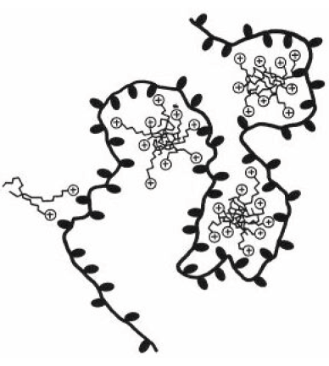
Types of interactions :
Electrostatic interaction (if the polymer in solution and the surfactant are oppositely charged)
Hydrophobic interaction ( between the hydrophobic part of both the polymer and surfactant)
The presence of similarities between the surfactant and polymer attract the surfactant molecules to certain position in polymer.
Notes:
The presence of polymeric chains induces the formation of micelles

Slide 32
The CAC corresponds to the onset of the interaction between the surfactant and the polymer, as the concentration of surfactant is increased, ‘binding” of surfactant molecules to the polymer continues until the activity of the surfactant reaches a point where any further increase in surfactant concentration results in the formation of regular surfactant micelles. This point, known as CMC, is often referred to as the saturation concentration for the polymer means the point at which any additional surfactant goes into the formation of regular micelles.

Slide 33
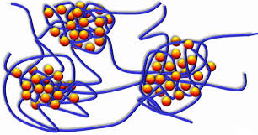
It is generally accepted that the addition of the polymer to a surfactant solution results in a modification of the aggregation process and therefore association or aggregation better describes the interaction. The model presented by Jones and further modified by Cabane , proposed a structure in which the aggregated surfactant is surrounded by macromolecules in a loopy configuration. A schematic picture of this structure, sometimes referred to as ‘‘pearl-necklace model’’.
Schematic representation of a surfactant-polymer complex in aqueous solution.

Slide 34
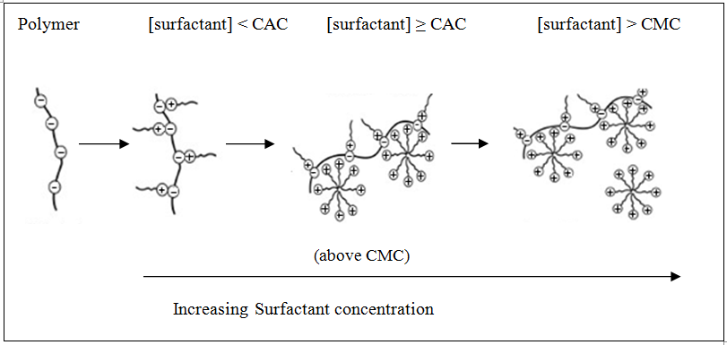
Figure : Schematic representation of Polymer -Surfactant interaction

Slide 35
General Applications of Polymer-Surfactant Mixtures
Polymers are added to surfactants to:
control the phase behavior (e.g., to solubilize water insoluble polymers),
control the interfacial properties (e.g., to stabilize suspensions which depend on a complex interplay
between different pair interactions. Addition of a polymer
can either remove a surfactant from a surface or enhance
its adsorption to a surface).
achieve a suitable rheology
The polymer induced micellization lead to a lower surfactant free molecules concentration and activity (e.g., in skin formulations, free surfactant molecules cause skin irritation)

Slide 36
Chemical EOR systems include surfactants, polymers, alkali agents, or combinations there of. Addition of polymer to small slugs of surfactant solutions has been observed to give large effects on oil recovery in core floods. Surfactants and alkali agents can lower interfacial tension between oil and water, thereby mobilizing the immobile oil
Polymers are used to viscosify aqueous solutions and maintain mobility control, because if mobility control is lost, then oil recovery is reduced.

Slide 37
OBJECTIVEs OF RESEARCH
Interaction between xantan gum and SDS, and cationic surfactants (CTAB and G5) at various concentrations by measuring the conductivity and surface tension of the solution. The effect of salts (Na2CO3 and NaCl) and alkali (NaOH) on the interaction between the polymer and surfactant system has also been discussed.
to gain a better understanding of how the Anionic/cationic surfactant interacts with water soluble polymer. We have attempted to develop an empirical expression for the dependence of
CMC on polymer concentration, C_{P}, and temperature, T, and

Slide 38
EXPERIMENTAL METHODS AND PROCEDURE
In the present research , interaction of Xanthan gum with surfactants (SDS, CTAB and 16-5-16) was carried out by conductivity and Surface Tension measurements.
different concentrations of Xanthan gum
20 ppm, 50, ppm, 100 ppm, 700 ppm, 1200 ppm were used.

Slide 39
Conductivity Measurements
The conductivity measurements were performed on the digital conductivity meter (Systronics Conductivity-TDS Meter 308, range 0.1 μS to 100 mS, accuracy ±1% of F.S. ± 1 digit, India).
The temperature within uncertainties of ± 0.1 K was maintained in a bath, 25 ml of the polymer solution consisting of an appropriate amount of polymer in water was taken in the conductivity cell at the desired temperature. Then a known amount of stock solution of surfactants made with the same polymer solution was added. In this way, the precise conductance of xanthan gum + surfactant mixture over the complete mole fraction range in aqueous xanthan gum was measured.

Slide 40
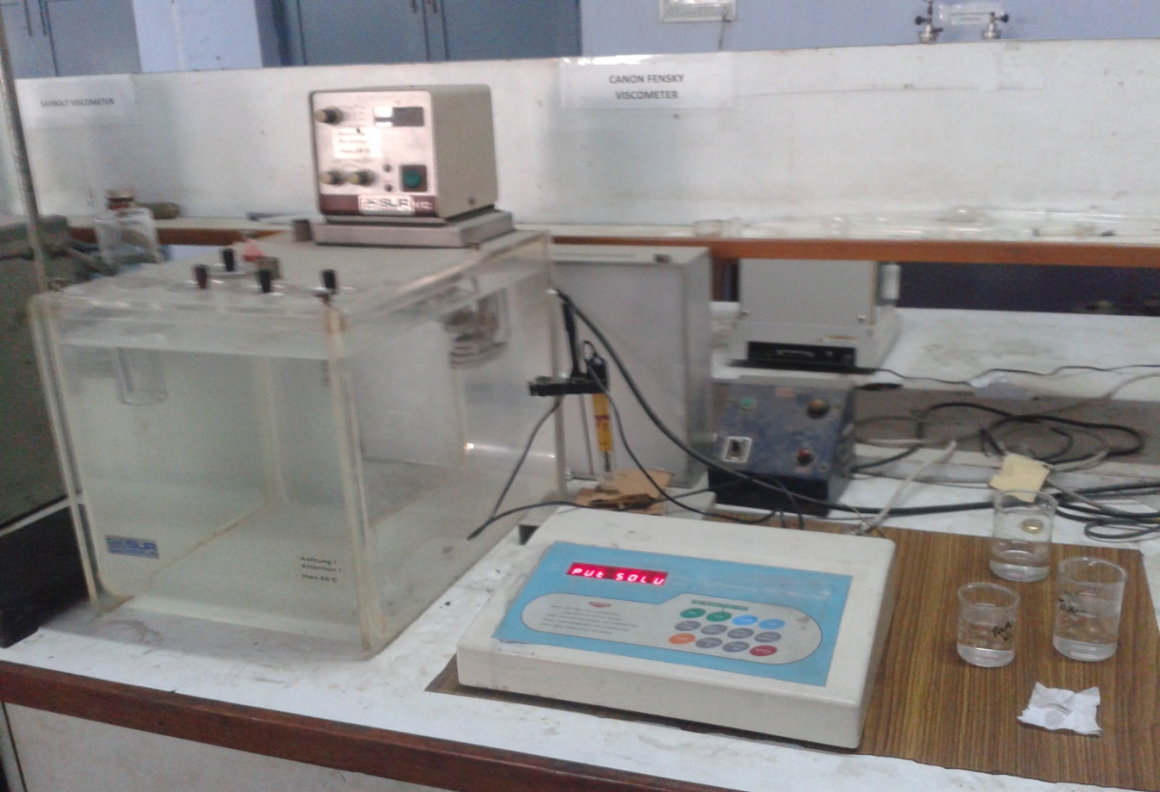
Continued
Conductivity meter

Slide 41
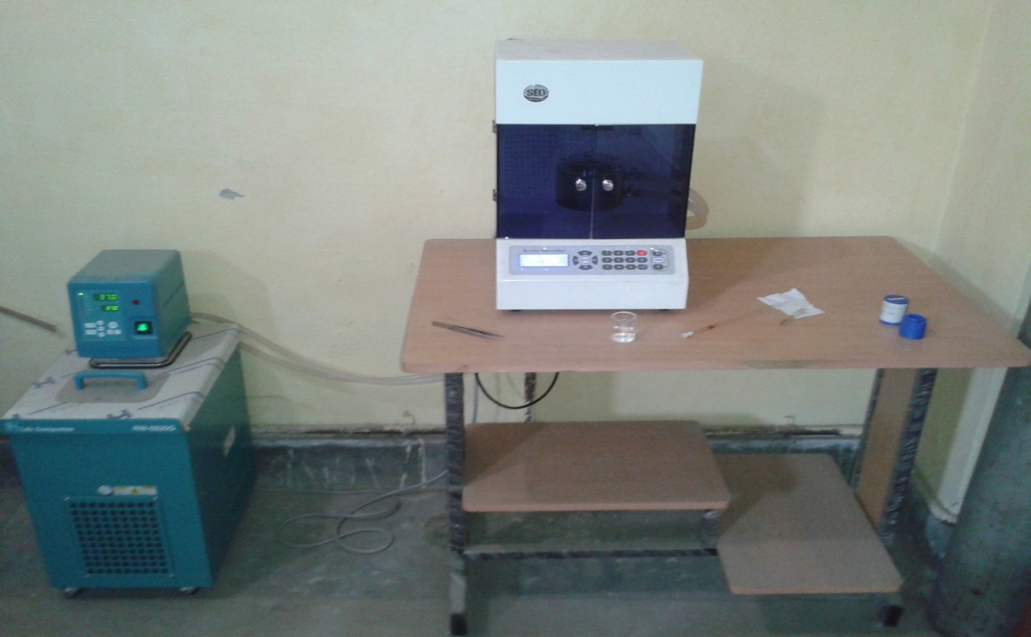
Surface Tension Analyser

Slide 42
RESULTS AND DISCUSSION
Interaction between water soluble polymer and anionic, cationic and gemini surfactant has been studied by surface tension and conductivity measurements at two different temperatures 310.15 K and 318.15 K .
SDS, CTAB and 16-5-16 were used as surfactant while Xanthan gum was used as water soluble polymer for the present study.
Conductivity results
Conductivity of the aqueous solutions with and without polymer is nothing but the dissociated cations and anions of the polymer and surfactant.

Slide 43
Fig. 1 represents specific conductivity as a function of SDS concentrations, in the absence of the polymer at 310.15 K and 318.15 K.
One break point is observed The intersection point of the two straight lines represents the usual CMC of surfactants

Slide 44
Further the interaction of polymer with cationic surfactant (CTAB) is observed from the conductivity measurements.
Fig. 2

Slide 45
Conductivity Results
The two breaks in the presence of polymer are ascribed to the occurrence of two kinds of aggregation phenomena. The first break is called CAC where the interaction of polymer chain with surfactant starts. The second break point is called as CMC, where the polymer chain with surfactant and/or micelle‐like aggregates gets saturated, followed by formation of normal micelles on adding a greater amount of surfactant.

Slide 46
The cmc values in the presence of polymer molecule are higher than the values in the absence of the polymer molecule, cac and cmc increases as the concentration of polymer and temperature increase.
Fig. 3 Effect of Xanthan gum on conductivity of SDS at 310.15 K.
Plots show two breaks in the presence of polymer in comparison to a single break observed in the absence of polymer

Slide 47
Fig. 4 shows the variation of the cac and cmc at 318.15 K. the trend of the curve is almost similar as earlier in Fig. 2. However the cac and cmc values are higher at 318.15 K.

Slide 48
Similar trend is observed at 318.15 K as shown below. Both cac and cmc are slighter higher than at 310.15 K.
Fig. 5

Slide 49
Table 1. Values of cac, cmc for CTAB and SDS in solutions containing different weight percentages of xanthan gum (determined from conductivity measurements).
ª Literature value (Kabir-ud-Din,* M. A. Rub, A. Z. Naqvi, J. Phys. Chem. B 114 (2010) 6354).
Xanthan gum (ppm) | Temperature (K) | CTAB |  | SDS
 |  | cac (mmol/dm³) | cmc (mmol/dm³) | cac (mmol/dm³) | cmc (mmol/dm³)
0.00 | 310.15 | - | 0.950 (0.990)ª | - | 8.80 (10.0)ª
 | 318.15 | - | 1.05 | - | 9.60
100 | 310.15 | 0.2 | 0.75 | 2.0 | 10.0
 | 318.15 | 0.4 | 1.15 | 2.2 | 11.0
700 | 310.15 | precipitation | Precipitation | 2.6 | 11.6
 | 318.15 | precipitation | precipitation | 3.2 | 11.6
1200 | 310.15 | precipitation | precipitation | 4 | 10.2
 | 318.15 | precipitation | precipitation | 3.5 | 10.5

Slide 50
The two breaks in the presence of polymer
Occurrence of two kinds of aggregation phenomena
The first break is called CAC
where the interaction of polymer chain with surfactant starts
The second break point is called as CMC
where the polymer chain with surfactant and/or micelle-like aggregates gets saturated, followed by formation of normal micelles on adding a greater amount of surfactant

Slide 51
Both CAC and CMC values increase with temperature for all concentrations of polymers as per details given in Tables 1 and 2 respectively. Obviously, the processes of aggregation/ micellization are less favored at higher temperatures.
For the xanthan gum the dependency of CMC on polymer concentration, C_{P}, and on temperature, T, was obtained by regression using a power law model
CMC = k [C_{P}]^{n1} [T]^{n2}
The values of constant k and indices n₁ and n₂ are calculated . For all the systems the maximum value for the mean absolute deviation (MAD) was found to be less than 8.2 % .

Slide 52
The free energy of aggregation, ∆G_{agg}, and the free energy of micellization, ∆G_{mic}, can be calculated using the following Equations.:
∆G_{agg} = RT (2–g₁) lnX_{CAC}
∆G_{mic} = RT (2 –g₂) lnX_{CMC}
In case of gemini surfactants, the above two equations become:
∆G_{agg} = 2RT (1.5–g₁) lnX_{CAC}
∆G_{mic} = 2RT (1.5–g₂) lnX_{CMC}
The free energy of transfer, ∆G_{t}, associated with the binding interaction between surfactant and polymer, is given by
∆G_{t} = ∆G_{agg} – ∆G_{mic}

Slide 53
Surface tension
Surface tension (γ) of the aqueous surfactant solution was measured by tensiometer (Hardson & Co., Kolkata) at room temperature using a platinum ring. The tensiometer was calibrated against water. In an experimental run, the γ at each mole fraction was measured by successive addition of concentrated solution of the mixture in pure water at room temperature and the surface tension was measured after proper and thorough mixing and equilibration. In order to determine the values of critical micelle concentration (cmc), two γ concentration characterized by linear decrease of the surface tension and the second one to the region of concentration with nearly constant surface tension. The cmc values were obtained from the break point of the surface tension vs. concentration curves. The accuracy on the individual surface tension reading is approximately 0.5mNm⁻¹ [4,7]

Slide 54
Surface Tension Method
The surface tension was measured for SDS,CTAB, and gemini surfactants (16-5-16) solutions in presence and absence of different weight percentages of Polymer. The surface tension profiles as a function of concentration of SDS, CTAB, 16-5-16 at 298.15 K in pure water is shown in Figs. 6-13. The cmc has been obtained from a sharp break in surface tension versus log [surfactant] plot and these values agree well with those reported in literature [5, 7].
Surface tension versus surfactant concentration plots in the presence of polymer shows two distinct zones as shown in various Figures.

Slide 55
The slope of tensiometric profile near the cmc is the measure of interfacial adsorption efficiency of the surfactant and is quantified as Gibbs surface excess. The Gibbs surface excess indicating the effectiveness of surfactants to be adsorbed at interface as compared to the bulk phase has been calculated from the slope of tensiometric isotherm using the following equation:
Γ_{max} = - 1/2.303 nRT lim (dγ/d log[surfactant]) (1)
_{c →cmc}
where Γ_{max} is in mol.m^{-2,} and n is the number of species per surfactant molecule at the air/ solution interface and R is the gas constant.
Γ_{max} values decreases with the increase in Polymer concentration as addition of Polymer to water leads to decrease the dielectric constant of the medium . Surfactant molecule becomes less active and capability of surfactant inactivation increases with increase in Polymer concentration.

Slide 56
Assuming complete monolayer formation at cmc, the area of exclusion per surfactant monomer (A_{min}) at air-water interface can be calculated from the following relation:
(A_{min}) = 10²⁰ /(N_{A} Γ_{max} ) (A² molecule⁻¹)
where A_{min} is in A².molecule⁻¹ and N_{A} is the Avogadro’s number. The A_{min} values increase with Polymer concentration, which is probably due to the strong electrostatic repulsions and more steric factor between surfactants and polymer i.e with the addition of Polymer, lesser number of surfactant molecules are adsorbed at the air/water interface, leading to the availability of larger space per molecule at the interfacial region [2,4,7].
The A_{min} values for CTAB are found to be lower than that of gemini surfactants. Thus it can be seen that the A_{min} values follow the sequence G5 > CTAB and SDS among the studied surfactants. The values of surface parameters at different temperatures are given in Tables. The highest value of A_{min} shows the close fitting of surfactants head on micelle. The closest fitting of surfactant heads increases with the concentration of polymer as observed earlier [ 4,7].
Notes:
The shapes of micelles can be estimated from the packing parameter (p) which was calculated using the equation from the literature.

Slide 57
Surface tension of surfactants
It is well known that surfactants reduce the surface tension of water by getting adsorbed on the liquid–gas interface. The CMC, one of the main parameters for surfactants, is the concentration at which surfactant solutions begin to form micelles in large amounts. Surface tensions of the surfactant (SDS , CTAB and G5) solutions at different concentrations were measured and plotted as a function of concentration .

Slide 58
The concentration at the turning point of the curve is cmc.
Fig. 6 variation of surface tension with[SDS] at different temperatures

Slide 59
Surface tension of Surfactant- polymer mixtures
Different techniques are used to examine the water soluble polymer–surfactant aggregates formed in solution. The interaction of water-soluble polymers with anionic surfactants has been studied by surface tension and conductivity measurements. The main characteristic of surfactants is to lower the interfacial tension between an aqueous solution and some other phases. But for ionic surfactant, these properties are modified by the presence of polymer in aqueous solution.

Slide 60
Fig. 7(a) Effect of (xanthan gum) on surface tension of SDS at 310.15 K
Surface tension of surfactant solution increases in the presence of polymer.

Slide 61
Now similar trends is observed at 318.15 K.
Both cac and cmc values at 318.15 K are slighter higher than cac and cmc values at 310.15 K.
Fig. 7(b) at 318.15 K.

Slide 62
The surface tension measurements were also made to determine the cac, cmc with and without polymer for the CTAB at 310.15 K 318.15 K.
Polymer concentration was fixed at 100 ppm. Beyond this concentration limit, precipitation appeared. The experiments were carried out at 310.15 K and 318.15 K.
Fig. 8 shows the effect of xanthan gum on surface tension of the aqueous solution of CTAB.

Slide 63
Figure 8 Variations of interfacial tension with surfactant concentration at 310.15 K and 318.15 K
Surface tension of the aqueous solution of the surfactant decreases with increasing concentration of the CTAB.

Slide 64
Figure 9 Effect of Xanthan gum on surface tension of CTAB at 310.15 K.

Slide 65
It is clear that the surface tension decrease with the addition of a small amount of CTAB.
Figure 10 Effect of Xanthan gum on surface tension of CTAB at 318.15 K.

Slide 66
Surface tension of the gemini surfactant (16-5-16) in the absence of the polymer at 310.15 K and 318.15 K is given in Fig. 11.
Fig. 11 Variations of interfacial tension with surfactant concentration at 310.15 K and 318.15 K.

Slide 67
continued
The cac and cmc values for 16-5-16 are very small in comparison to convention surfactants (SDS and CTAB).
When no polymer is present the surface tension is seen to decrease with increase in surfactant concentration of 16-5-16.
In gemini surfactant, two hydrophobic groups in a single molecule are more disruptive to the water than the individual chains in conventional surfactants.

Slide 68
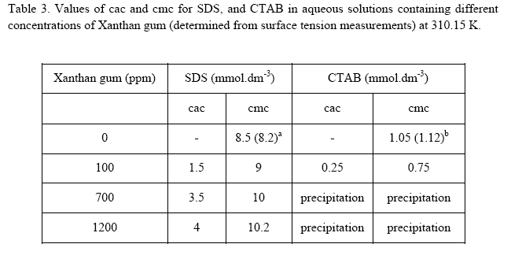
Notes:
Therefore all the resulted values by the Surface tension measurements from above figures are shown below in Table 3 and 4 respectively.

Slide 69
Moreover, aqueous solutions of some cationic gemini surfactant (16-5-16) with Xanthan gum exhibit strong viscosifying capability.
gemini surfactant with low concentration 20 ppm and 50 ppm of the polymer Xanthan gum at 310.15 K and 318.15K , shown in Figs. 12 and 13.
Beyond the concentration of 50 ppm of Xanthan gum solutions, precipitation formed with the gemini surfactant 16-5-16.

Slide 70
continued
Figure 12 Effect of Xanthan gum on surface tension of 16-5-16 .

Slide 71
continued
Figure 13 Effect of Xanthan gum on surface tension of 16-5-16 at 318.15 K.

Slide 72
continued
A comparison of the cac values for surfactants (CTAB, SDS and 16-5-16) suggests that these are not close to each other for CTAB, SDS and 16-5-16.
The higher value of the cac of SDS is related to the weaker association of the SDS with Xanthan gum in comparison to the CTAB and 16-5-16.
Strength of the interaction for the above anionic surfactant (SDS), cationic surfactant CTAB and cationic 16-5-16 with Xanthan gum is
SDS<CTAB<16-5-16
The cmc values obtained from surface tension data agrees well with the ones obtained from conductivity measurements. The small differences may be related with a specific techniques used.

Slide 73
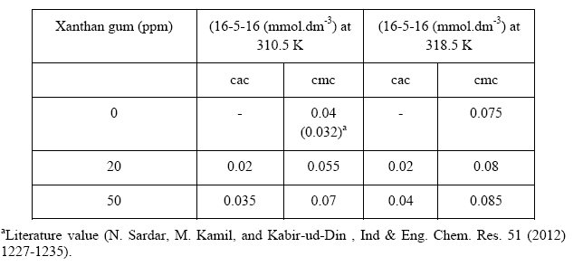
Table 5 Values of cac and cmc for 16-5-16 in aqueous solutions containing different concentrations of Xanthan gum (determined from surfactant tension measurements) at 310.15 K and 318.15 K.

Slide 74
Therefore, as the temperature increased both cac and cmc values increased for all concentrations of the polymer. Generally, the effect of the temperature on the cmc of surfactants in aqueous system is complex. On the one side, temperature increase causes decrease hydration of the hydrophilic group, which is in the favor of the micellization. But on another side, temperature increase also cause disruption of the structure water surrounding the hydrophobic group, which disfavors micellization. The relative magnitude of two opposite effects, so, determines whether the cmc increased or decreased over the particular temperature range [45]. In the present study the cmc values increased with the increase in temperature indicating that the micellization is less favored in these three systems, Xanthan gum/SDS, Xanthan gum/CTAB, and Xanthan gum/16-5-16.

Slide 75
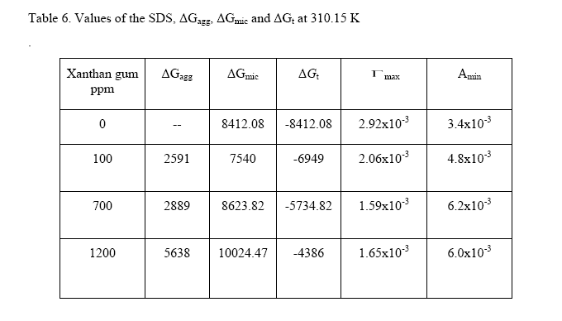
ΔG_{agg}, ΔG_{mic}, and ΔG_{t}, associated with the binding interaction between surfactant and polymer are calculated from the conductivity graphs. And also calculated the Gibbs surface excess and (A_{min}).

Slide 76
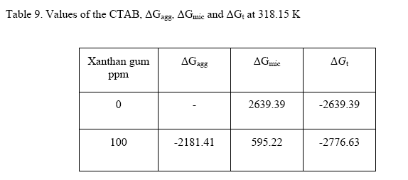
The negative values of ΔG_{t} confirm the feasibility of interaction between the surfactants and polymer

Slide 77
Effect of salt on surfactant–polymer interaction
Addition of salt significantly reduces the CMC of ionic surfactants. For surfactant–polymer system, CAC also decreases drastically in the presence of salt, indicating that association starts at a much lower concentration of the surfactant. The effects of 1% Na2CO3 and 1% NaCl on polymer– surfactant interaction has been reported [4]. It may be seen that in the presence of salt, the surface tension of the solution significantly decreases. This reduction in surface tension is probably due to the increasing binding ability between surfactant and polymer in the presence of salt. Also reported that in salt solution with higher ionic strength, the formation of micelles and surfactant–polymer complexes is promoted due to reduction in electrostatic repulsion between the ionic surfactant head groups, which stabilizes the surfactant micelle structure.

Slide 78
CONCLUSIONS following conclusions can be drawn from experimental studies:
The lowering of surface tension with increase in concentration of surfactants is higher in the case of 16-5-16, and also the cmc value of 16-5-16 is lower than that of SDS and CATB due to the difference in their head groups.
Surface tension of the surfactant solutions decreases in the presence of polymer.
Surface tension of Xanthan gum and SDS system taken together was found to more decrease than 16-5-16 and CTAB with increasing concentration of the polymer for the same concentration of surfactant, as Xanthan gum itself shows lower surface tension in aqueous solution.

Slide 79
continued
The surface tension vs. surfactant concentration plots in the presence of polymer shows two distinct zones and the interaction between surfactant and polymer is strongly dependent on the surface tension concentration. The maximum interaction occurs between cac and cmc of the surfactant.
The interaction between polymer and surfactant observed by surface tension measurements was found to be supported by the conductivity measurements also.

Slide 80
FUTURE WORK
In future investigation:
other conventional surfactants, gemini surfactants, and mixed surfactants may be used.
Further other techniques ( Calorimetry, NMR, Light- scattering etc.) may be used to understand the interaction of Xanthan gum with surfactants.

Slide 81
REFERENCES
K. Holmberg, B. Jonsson, B. Kronberg and B. Lindman, “Surfactants and polymers in aqueous solution”, 2nd ed. John Wiley & Sons, Ltd. England, 2002.
T. F. Tadros, “Applied surfactants, principals and applications”, Wiley-VCH Verlag GmbH & Co. KGA, Weinheim, 2005.
A. Kumar, R. K. Gupta, “Fundamentals of polymer engineering”, 2nd ed. revised and expanded, Marcel Dekkerr, inc., Newyork, 2003.
A. Mevawalla, “Achieving Drag Reduction through Polymer-Surfactant Interaction”, Waterloo, Ontario, Canada , 2013.
A. Capalbi and C. L. Mesa, “polymer-surfactant interactions”, J. of Thermal Analysis and Calorimetry, Vol. 66 (2001) 233-241.
M. J. Rosen, “surfactants and interfacial phenomena”, 3rd Edi. A John Wiley & Sons, Inc., New Jersey, 2004.
T. Austad, K. Taugbol, “Chemical flooding of oil reservoirs Dissociative surfactant-polymer interaction with a negative effect on oil recovery”, Colloid Surf. A 103 (1995) 73-81.
P. Hansson and B. Lindman, “Surfactant-polymer interactions”, Curr. Opin. Colloid & Interface Sci. (1996) 604-613.
J. A. Casas, V. E. Santos, F. G. Ochoa, “Xanthan Gum production under several operational conditions: molecular structure and rheological properties”, Enzyme and Microbial Technology 26 (2000) 282–291.
F. G. Ochoa, V. E. Santos, J. A. Casas, E. Goamez, “Xanthan gum: production, recovery, and properties”, Biotechnology Adv. 18 (2000) 549-579

Slide 82
continued
F. G. Ochoa, V. E. Santos, J. A. Casas, E. Goamez, “Xanthan gum: production, recovery, and properties”, Biotechnology Adv. 18 (2000) 549-579
S. K. Hait and S. P. Moulik, “Gemini surfactants: A distinct class of self-assembling molecules”, Curr. Sci., Vol. 82, No. 9, May 16th, 2002.
H. Diamant and D. Andelman, “Models of Gemini Surfactants”, Gemini Surfactants: Interfacial & Solution Phase Behavior, R. Zana and J. Xia (eds.), Marcel Dekker, New York, 2003.
A. J. Kirby, P. Camilleri, J. B. F. N. Engberts, Martin . Feiters, R. J. M. Nolte, O. Soderman, M. Bergsma, P. C. Bell, M. L. Fielden, C. L. G. Rodriguez, P. Gudat, A. Kremer, C. M. Gregor, C. Perrin, G. Ronsin, and M. C. P. Eijk, “Gemini Surfactants: New Synthetic Vectors for Gene Transfection”, Angew. Chem. Int. Ed. 42 (2003) 1448– 1457.
B. S. Sekhon, “Gemini (dimeric) surfactants the two-faced molecules”, Resonance /2004.
E. I. Yaseen, T. J. Herald, F. M. Aramouni, S. Alavi, “Rheological properties of selected gum solutions”, Food Research International 38 (2005) 111–119.
A. A. Dementiev, A. A. Baikov, V. V. Ptushenko, G. B. Khomutov, A. N. Tikhonov, “Biological and polymeric self-assembled hybrid systems: Structure and properties of thylakoid/polyelectrolyte complexes”, Biochimica et Biophysica Acta 1712 (2005) 9 – 16.
M. A. Bahria, M. Hoebeke, A. Grammenos, L. Delanaye , N. Vandewalle, and A. Seret, “Investigation of SDS, DTAB and CTAB micelle micro viscosities by Electron Spin Resonance”, Colloids Surf. A 290 (2006) 206-212.
D. J. F. Taylor, R. K. Thomas, J Penfold, “Polymer/surfactant interactions at the air /water interface”, Adv. Colloid Interface Sci. 132 (2007) 69-110.
M. F. Torres, A. J. Muller, M. A. Szidarovszky, A. E. Saez , “Shear and extensional rheology of solutions of mixtures of poly (ethylene oxide) and anionic surfactants in ionic environments”, J. Colloid and Interface Sci. 326 (2008) 254–260.
A. J. M. Valente, H. D. Burrows, S. M. A. Cruz, R. F. P. Pereira, A. C. F. Ribeiro, V. M. M. Lobo, “Aggregation and micellization of sodium dodecyl sulfate in the presence of Ce(III) at different temperatures: A Conductometric study”, J. Colloid and Interface Sci. 323 (2008) 141–145

Slide 83
continued
N. Dubey, “A Conductometry study of ienteraction between sodium dodecyl sulfate and 1- propanol, 1-butanol, and 1-hexanol at different temperatures”, J. Surface Sci. Vol 24, No. 3-4, (2008) 139-148.
M. Y. Khan, A. Samanta, K. Ojha, and A. Mandal , “Interaction between aqueous solutions of polymer and surfactant and its effect on physiochemical properties’, Asia- Pac. J. Chem. Eng. (2008) 579-589.
T. Patel, P. Bahadur, J. Mata, “The clouding behaviour of PEO–PPO based triblock copolymers in aqueous ionic surfactant solutions: A new approach for cloud point measurements”, J. Colloid and Interface Sci. 345 (2010) 346–350.
D. A. Z. Wevera, F. Picchionia, A. A. Broekhuisa, “Polymers for enhanced oil recovery: A paradigm for structure–property relationship in aqueous solution”, Progress in Polymer Sci. 36 (2011) 1558– 1628.
N. Sardar, M. Kamil, and Kabir-ud-Din, “Interaction between Nonionic Polymer Hydroxypropyl Methyl Cellulose (HPMC) and Cationic Gemini/Conventional Surfactants”, Ind. Eng. Chem. Res., 51 (2012) 1227−1235.
N. Azum , A. M. Asiri, M. A. Rub, A. O. Al-Youbi, A. Khan , “Thermodynamic aspects of polymer–surfactant interactions: Gemini (16-5-16)-PVP-water system”, Arabian j. of chem. 2012.
B. Kumar, D. Tikariha, K. K. Ghosh, P. Quagliotto, “Effect of short chain length alcohols on micellization behavior of cationic gemini and monomeric surfactants”, J. of Molecular Liquids 172 (2012) 81–87.
S. I. Karakashev, M. V. Grozdanova, “Foams and antifoams”, Adv. Colloid and Interface Sci. 176 –177 (2012) 1–17.
N. Sardar, M. Kamil, Kabir-ud-Din, “Solution behavior of anionic polymer sodium carboxymethylcellulose (NaCMC) in presence of cationic gemini/conventional surfactants”, Colloids and Surf. A: Phys. Eng. Aspects 415 (2012) 413– 420.
S. I. Chenga, D. C. Stuckeya, “Protein precipitation using an anionic surfactant”, Process Biochemistry 47 (2012) 712–719.
B. Kumar, D. Tikariha, K. K. Ghosh, N. Barbero, P. Quagliotto, “ Effect of polymers and temperature oncritical micelle concentration of some gemini and monomeric surfactants”, J. Chem. Thermodynamics 62 (2013) 178-185.

Slide 84
continued
A. Bera, T. Kumar, K. Ojha, A. Mandal, “Adsorption of surfactants on sand surface in enhanced oil recovery: Isotherms, kinetics and thermodynamic studies”, Applied Sur. Sci. 284 (2013) 87– 99.
R. Yuana, Y. Li, Chunxiu Li, H. Fangb, W. Wangb, “Study about how the metal cationic ions affect the properties of partially hydrolyzed hydrophobically modified polyacrylamide (HMHPAM) in aqueous solution”, Colloids and Sur. A: Physicochem. Eng. Aspects 434 (2013) 16– 24.
C. Wang, X. Li, P. Li, Y. NiuKey, “ Interactions between fluorinated cationic guar gum and surfactants in the dilute and semi-dilute solutions”, Carbohydrate Polymers 99 (2014) 638– 645.
U. S. Siddiqui, J. Aslam, W. Husain Ansari, Kabir-ud-Din, “Micellization and aggregation behavior of a series of cationic Gemini surfactants (m-s-m type) on their interaction with a biodegradable sugar-based surfactant (octyl-_-D-glucopyranoside)”, Colloids and Surfaces A: Physicochem. Eng. Aspects 421 (2013) 164– 172.
D. Kumar, M. A. Rub, M. Akram, Kabir-ud-Din, “Interaction between dipeptide (glycyl-phenylalanine) and ninhydrin: Role of CTAB and Gemini (16-s-16, s = 4, 5, 6) surfactant micelles”, J. Colloid and Interface Sci. 418 (2014) 324–329.
A. K. Tiwari, Sonu, S. K. Saha, “Aggregation properties and thermodynamics of micellization of Gemini surfactants with diethyl ether spacer in water and water–organic solvent mixed media”, J. Chem. Thermodynamics 70 (2014) 24–32.
B. Gao, M. M. Sharma, “A family of alkyl sulfate gemini surfactants. Characterization of surface properties”, J. Colloid and Interface Sci. 404 (2013) 80–84.
S. Aidarova, A. Sharipova, J. Krägel, R. Miller, “Polyelectrolyte/surfactant mixtures in the bulk and at water/oil interfaces”, Adv. in Colloid and Interface Sci. 205 (2014) 87–93.
H. Peia, G. Zhanga, Jijiang Gea, L. Zhanga, H. Wangaa, “Effect of polymer on the interaction of alkali with heavy oil and its usein improving oil recovery”, Colloids and Surfaces A: Physicochem. Eng. Aspects 446 (2014) 57–64.

Slide 85
continued
H. Akbas, M. Boz, A. Elemenli, “Interaction between cationic gemini surfactant and related single-chain surfactant in aqueous solutions”, Fluid Phase Equilibria 370 (2014) 95–100.
A. Pal, S. Chaudhary, “Ionic liquids effect on critical micelle concentration of SDS: Conductivity, fluorescence and NMR studies”, Fluid Phase Equilibria 372 (2014) 100–104.
D. Myres, “Surfactant science and technology”, 3rd edi., A John Willey & Sons, Inc.,New Jersey, 2004.
A. B. Chhetri, K. C. Watts, “Surface tensions of petro-diesel, canola, jatropha and soapnut biodiesel fuels at elevated temperatures and pressures”, Fuel 104 (2013) 704–710.
D. Fu, H. M. Wang, L. X. Du, “Experiments and model for the surface tension of (MDEA + [Bmim][BF4]) and (MDEA + [Bmim][Br]) aqueous solutions”, J. Chem. Thermodynamics 71 (2014) 1–5.
M. Oroian, “Measurement, prediction and correlation of density, viscosity, surface tension and ultrasonic velocity of different honey types at different temperatures”, J. of Food Eng. 119 (2013) 167–172.
K. Ali, A. Haq, S. Bilal, S. Siddiqi, “Concentration and temperature dependence of surface parameters of some aqueous salt solutions”, Colloids and Surf. A: Physicochem. Eng. Aspects 272 (2006) 105–110.
R. Moreira, F. Chenlo, C. Silva, M. D. Torres, D. D. Varela, L. Hilliou, H. Argence, “Surface tension and refractive index of guar and tragacanth gums aqueous dispersions at different polymer concentrations, polymer ratios and temperatures”, Food Hydrocolloids 28 (2012) 284-290.
Polymer-Surfactant Interaction, Feb 16th, 2006, “Fadwa Odeh, Department of Chemistry Clarkson University”.
A. J. M. Valente, A. Y. Polishchuk , H. D. Burrows, M. G. Miguel , V. M. M. Lobo, “Sorption/diffusion behaviour of anionic surfactants in polyacrylamide hydrogels: from experiment to modeling” European Polymer J. 39 (2003) 1855–1865.
A. Lehmanna, B. Volkert , S. Fischerb, A. Schraderc, H. Nerenzc,”Starch based thickening agents for personal care and surfactant systems”, Colloids and Surf. A: Physicochem. Eng. Aspects 331 (2008) 150–154
B. Peng, X. Chu , Y. Li, D. Li, Y Chen, “Jiang Zhao Adsorption kinetics and stability of poly(ethylene oxide)-blockpolystyrene micelles on polystyrene surface”, Polymer 54 (2013) 5779-5789.
A. K. Verma, R. R. Dash, P. Bhunia, “A review on chemical coagulation/flocculation technologies for removal of colour from textile wastewaters”, J. of Environmental Management 93 (2012) 154-168

Slide 86
continued
A. A. Ansari, “Experimental study on Polymer surfactant interaction”, Department of Petroleum Studies, AMU, Aligarh, 2011.
J. C. T. kwak, “Polymer surfactant system “, Dekker: New York, 1998.
N. sardar, M. kamil, Kabir-ud-Din, “Interaction between nonionic polymer methyl cellulose (HPMC) and cationic gemini/ conventional surfactants, “Ind & Eng. Chem. Res. 51 (2012) 1227-1235.
A. Kezwon and K. Wojciechowski, “Effect of temperature on surface tension and surface dilational rheology of type I collagen”, Colloids and Surf. A: Physicochem. Eng. Aspects 460 (2014) 168–175.
M. Deng, J. Li, J. Liu, X. Ma, Yilin Wang, “Abnormal interfacial tension behavior of alkanediyl-bis(dodecyldimethylammonium bromide) gemini surfactants”, Colloids and Surf. A: Physicochem. Eng. Aspects 356 (2010) 97–103.

Slide 87
Any
Query?
Any
Query?

Slide 88

Any
Query?
Any
Query?

