Slide 1

Laparoscopic colorectal surgery
M. Iqbal Rivai, MD
DIGESTIVE SURGEON
Digestive division, Department of Surgery
Faculty of Medicine Andalas University
General Hospital of Dr. M. Djamil
Padang, Indonesia

Slide 2
Indonesia
Colorectal Malignancy
The third most common cancer in worldwide with over 1,4 million new cases in 2012
Incidence of colorectal cancer in indonesia is 12.8 for 100.000 adult population with mortality of 9.5% of all cases of cancer.
The third most common cancer in Indonesia (1,8/100.000)( Ministery of Health, 2006) and the second most common death was caused by cancer

Slide 3
Traditionally
Abdominal surgery involve a large incision in abdomen → painful, lenghty recovery
Laparoscopy
Surgical innovation → New instrumentation, new technique, minimally invasive surgery
In principle, the same operation is being performed in open or laparoscopic abdominal surgery
All operations are performed under general anaesthesia

Slide 4
Laparoscopy: Colorectal Cancer
Levels of evidence*
I
Evidence obtained from at least one properly randomized controlled trial
II-1
Evidence obtained from well-designed controlled trials without randomization
II-2
Evidence obtained from well-designed cohort or case control analytic studies, preferable from more than one center or research group
II-3
Evidence obtained from comparisons between times or places with or without the intervention; dramatic results in uncontrolled experiments were also included in this category
III
Opinion of respected authorities based on clinical experience, descriptive studies, or reports of expert committees
*Can Med Assoc, 1979

Slide 5
Operations performed laparoscopically
Right hemicolectomy
Left hemicolectomy
Low Anterior Resection
Total colectomy
Mile’s Procedure

Slide 6
Can all bowel operations be performed laparoscopically
It will be the decision of digestive surgeon as to whether the operation may be performed laparoscopically

Slide 7
Advantages
Disadvantages
Smaller wounds
Less pain
Faster recovery
Port site recurrence
Oncological margins
Cost
Longer operation
Learning curve

Slide 8
Benefits for surgeon
Laparoscopy
Better visualisation
Improved dissection
Reduced hospital stay
Reduced post operative pain
improved cosmesis
Reduced blood loss

Slide 9
Bowel Function Recovery
The evidence that laparoscopy offers faster bowel function recovery than the traditional open approach may be considered high

Slide 10
Laparoscopy:
Quality of life
225 patients
117 Laparoscopy , 108 Open
Pain, hospital stay
Quality of life (2 days, 2 weeks, 2 months)
  Symptom distress scale
  Quality of life index
  Global rating scale (1-100)

Slide 11
Results
 | Lap n = 117 | Open n = 108
Age (years) | 56,6 | 57,4
Gender M:F | 48:69 | 46:62
Tumor stage I II III IV | 22 37 43 15 | 18 32 47 11
ASA classification I or II III | 98 19 | 92 16
M.Djamil Hospital and
Siti RahmahIslamic Hospital
January 2015 – Desember 2016

Slide 12
Results
 | Lap n = 117 | Open n = 108
Oral analgesics (days) | 1.9 | 2.2
IV narcotics/analgesics (days) | 3.2 | 4.6
Hospital stay (days) | 5 | 7

Slide 14
Laparoscopy: Colorectal Cancer
The superiority of laparoscopy in reducing pain during the same length of the postoperative period seems evident (Level I)
Other aspects of quality of life warrant further investigation

Slide 15
Laparoscopy: Colorectal Cancer
Hospital stay
There is high evidence (Level I) that
→ laparoscopy for malignancy is associated with an earlier discharge compared to laparotomy

Slide 16
Laparoscopy: Colorectal Cancer
Recurrence
 | Laparoscopy (n=117) | Open (n=108)
Tumor recurrence | 18 (16%) | 28 (25%)
Type of recurrence Distant metastasis Locoregional relapse Peritoneal seeding Port-site metastasis | 7 7 3 1 | 9 14 5 0
Time to recurrence (months) | 15 (14) | 17 (12)
Surgical treatment of recurrence with curative intention | 6 (33%) | 9 (32%)

Slide 17
Laparoscopy:
Colorectal Cancer Survival
 | Laparoscopy (n=117) | Open (n=108)
Overall mortality | 19 (16%) | 27 (25%)
Cancer-related mortality | 10 (9%) | 21 (21%)
Causes of death Perioperative mortality Tumor progression Others | 1 9 9 | 3 18 6

Slide 18
Laparoscopic Colectomy
Significantly longer operative times
Possibly more expensive
Possibly worse short term immune effects

Slide 19
Laparoscopic Colectomy
“Laparoscopic resection of colorectal malignancy was more expensive and time-consuming”
“ The new procedure’s advantages
revolve around early recovery from surgery and reduced pain”

Slide 20
Laparoscopic Colectomy :
Advantages vs Open Colectomy
Improved cosmesis (no data but appears uncontentious)
Quicker hospital discharge
Less narcotic use, though possibly larger benefits for certain types of colectomy (low colonic)
Possibly less pain at rest, at least for patients who have uncovered procedures
Possibly earlier return of bowel function and resumption of normal diet

Slide 21
Aplication of
Minimally Invasive Surgery
Short term benefits :
  Bowel function recovery
  Quality of life (including pain)
  Hospital stay
Long term benefits :
  Recurrence
  Survival

Slide 22
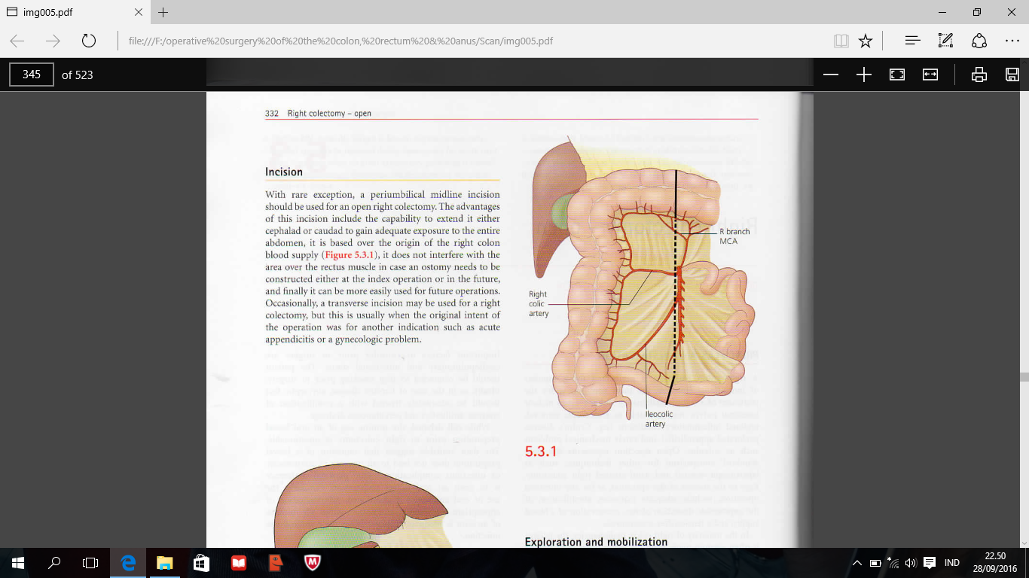
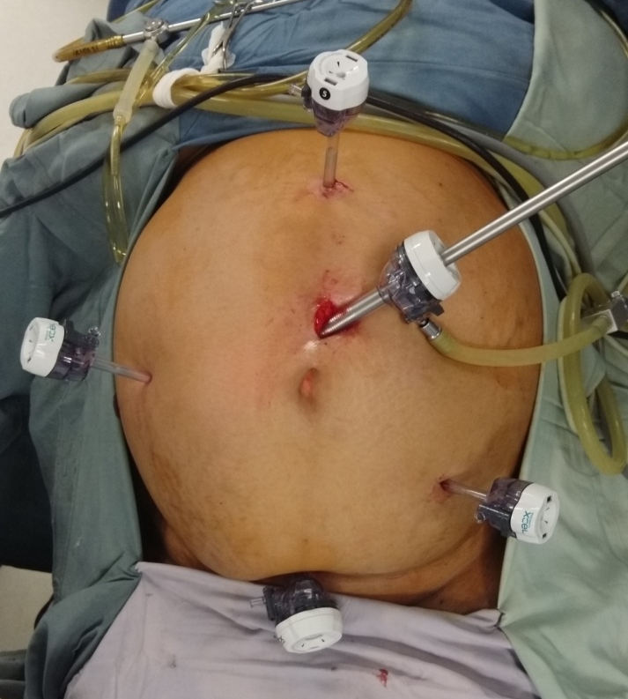
Right Hemicolectomy
remove tumours in THE RIGHT COLON, including the cecum and ascending colon
Extended Right Hemicolectomy
removes all of the transverse colon, may be done to remove tumours in the hepatic flexure or transverse colon

Slide 23
procedure
Mobilization of right colon
Mobilization of transverse colon
Control of mesentery and proximal margin
Creation of ileocolic anastomosis

Slide 24
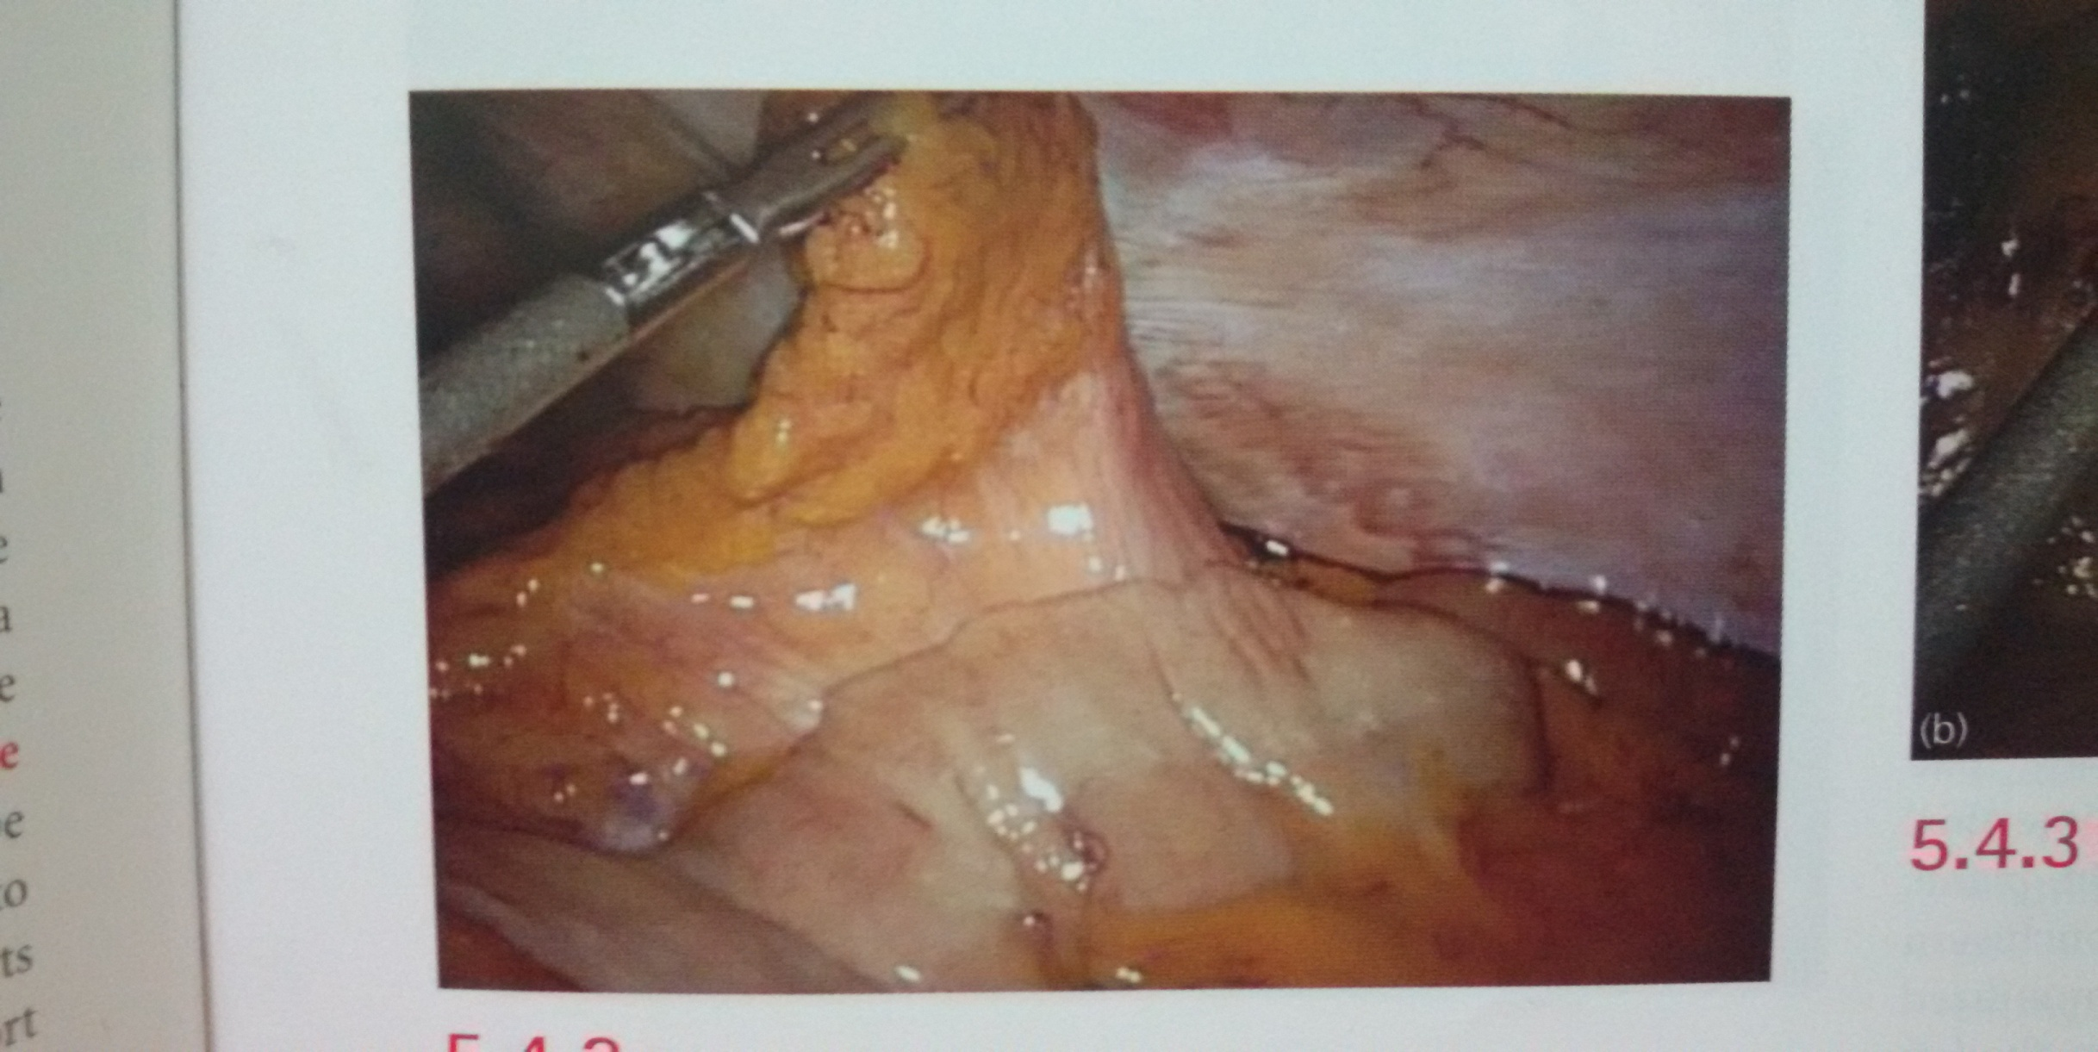
Visualization of right colon → reflecting tAke omentum over the transverse colon

Slide 25
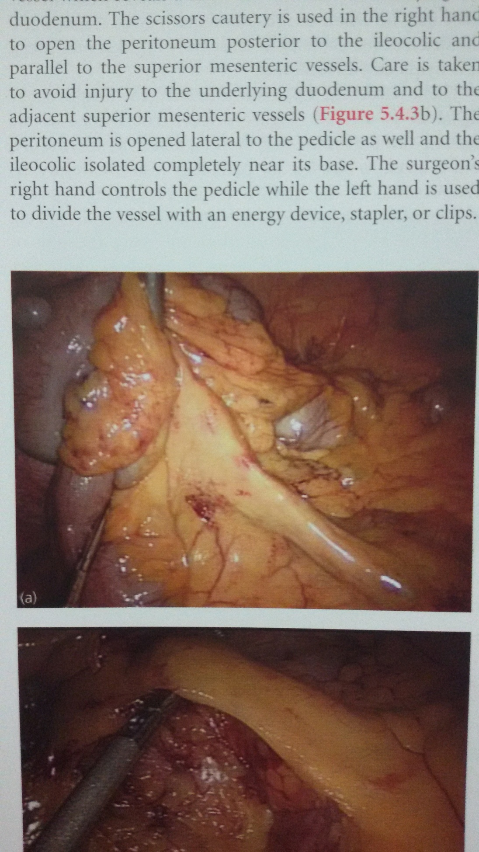
Isolation of ileocolic pedicle
Lifts the mesentry
at the ileocecal junction
IDENTIFYING THE DISTAL ILEOCOLIC PEDICLE WHICH IS HANDED TO THE ASISSTANT AND RETRACTED ANTERIORLY, INFERIORLY, AND LATERALLY

Slide 26
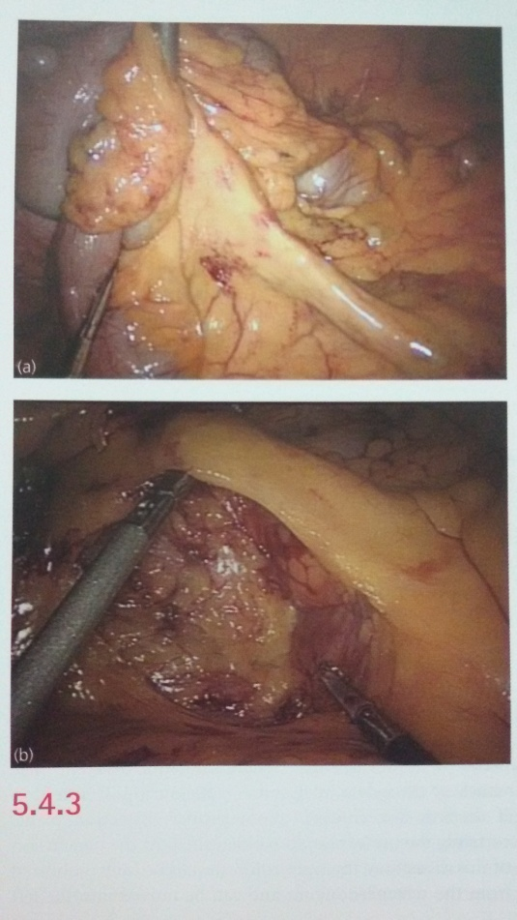
Open the peritoneum posterior to the ileocolic
& parallel to the superior mesentric vessels
The peritoneum is opened lateral to pedicle as well and ileocolic isolated completely near its base

Slide 27
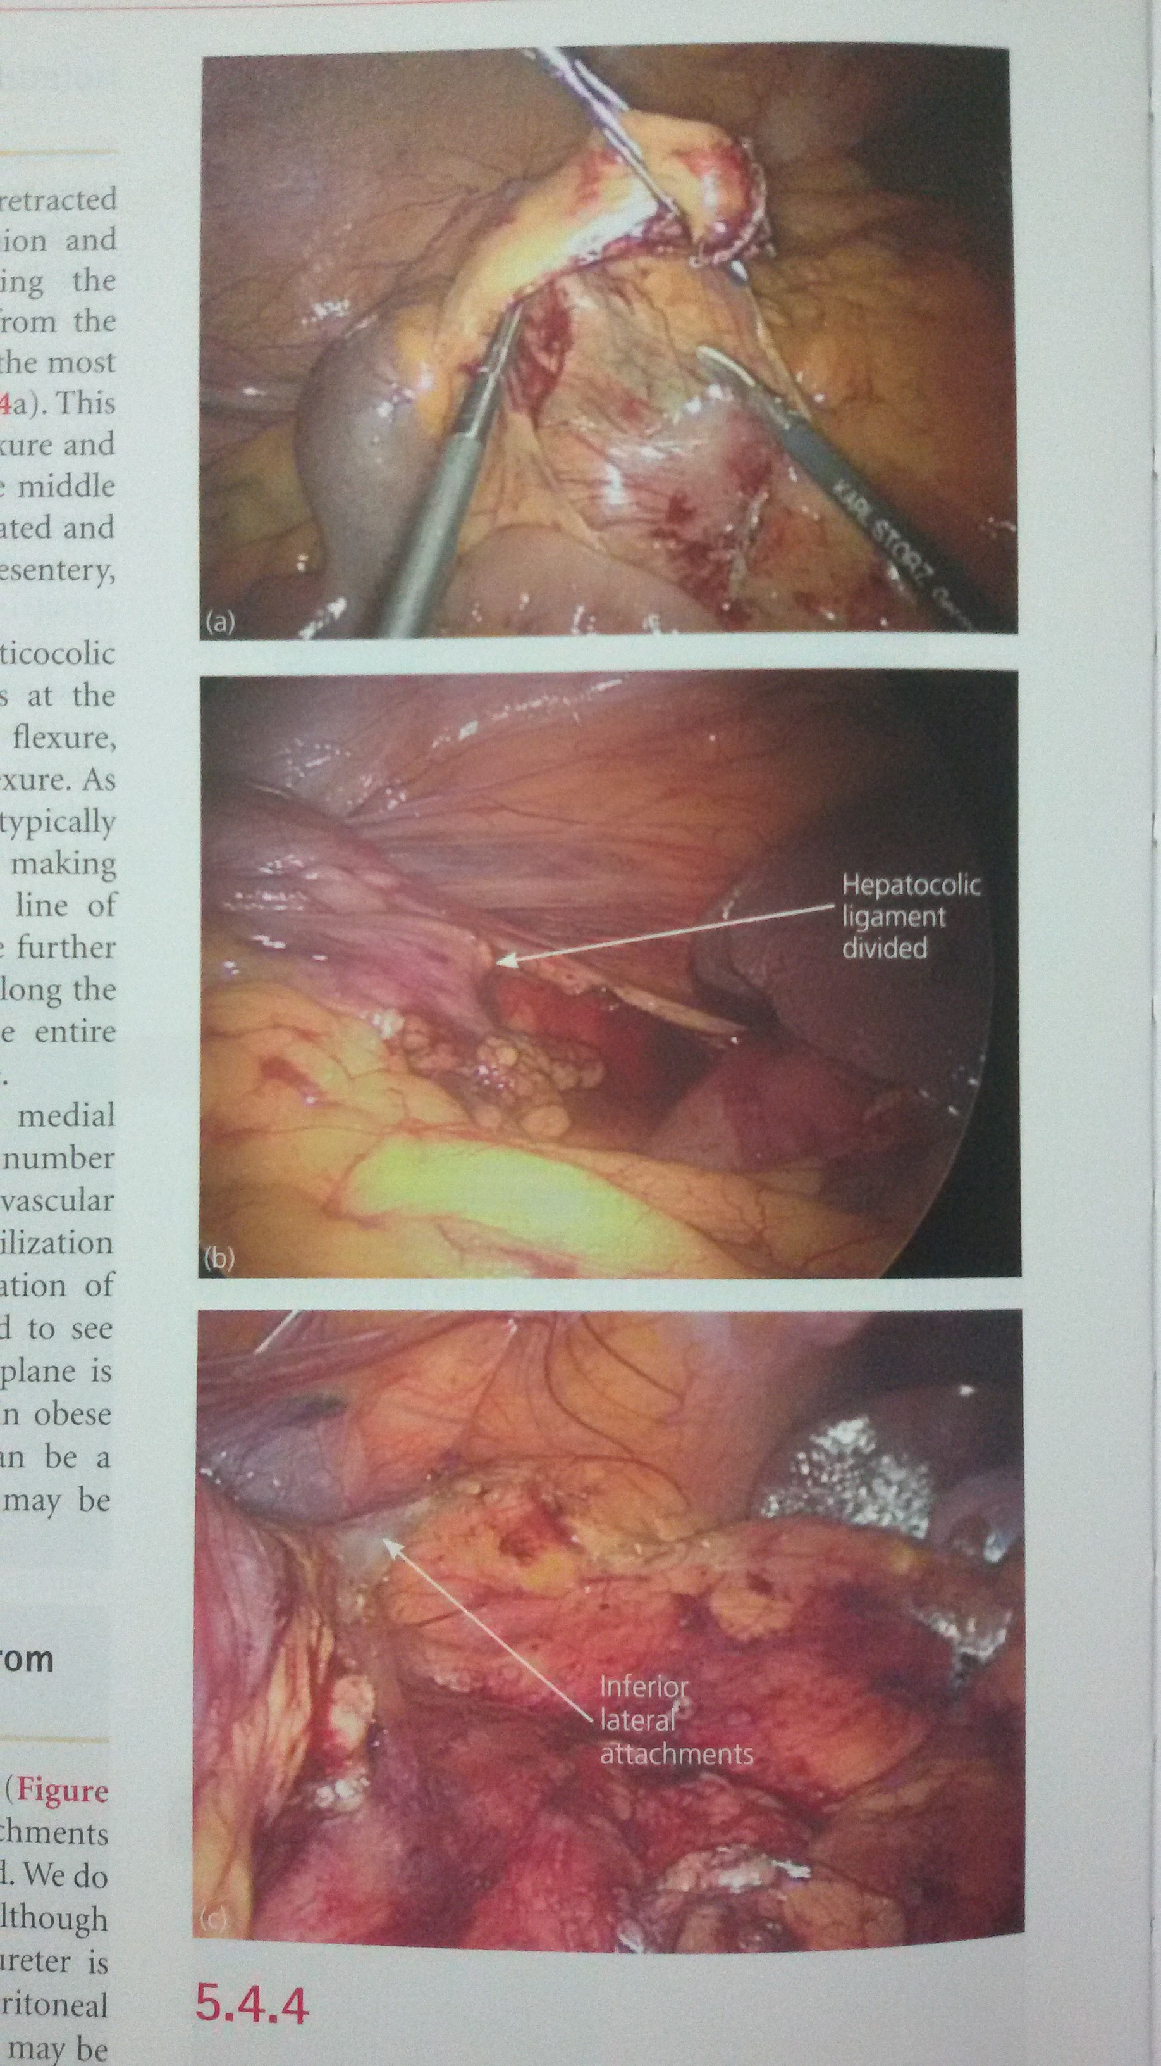
Mobilization of the ascending colon & hepatic flexure
Divided ileocolic pedicle is grasped and retracted anteriorly
Preserving retroperitoneal fascia overlying the kidney & ureter
Mesocolon is dissected
Continus up behind the hepatic flexure and down behind the cecum

Slide 28

Retracting the colon inferiorly →
the hepaticocolic ligament is divided
Medial to lateral approach along the line of toldt straightforward
Heading inferiorly along the ascending colon
white line of Toldt → the fusion of colic mesentery with the posterior peritoneum

Slide 29
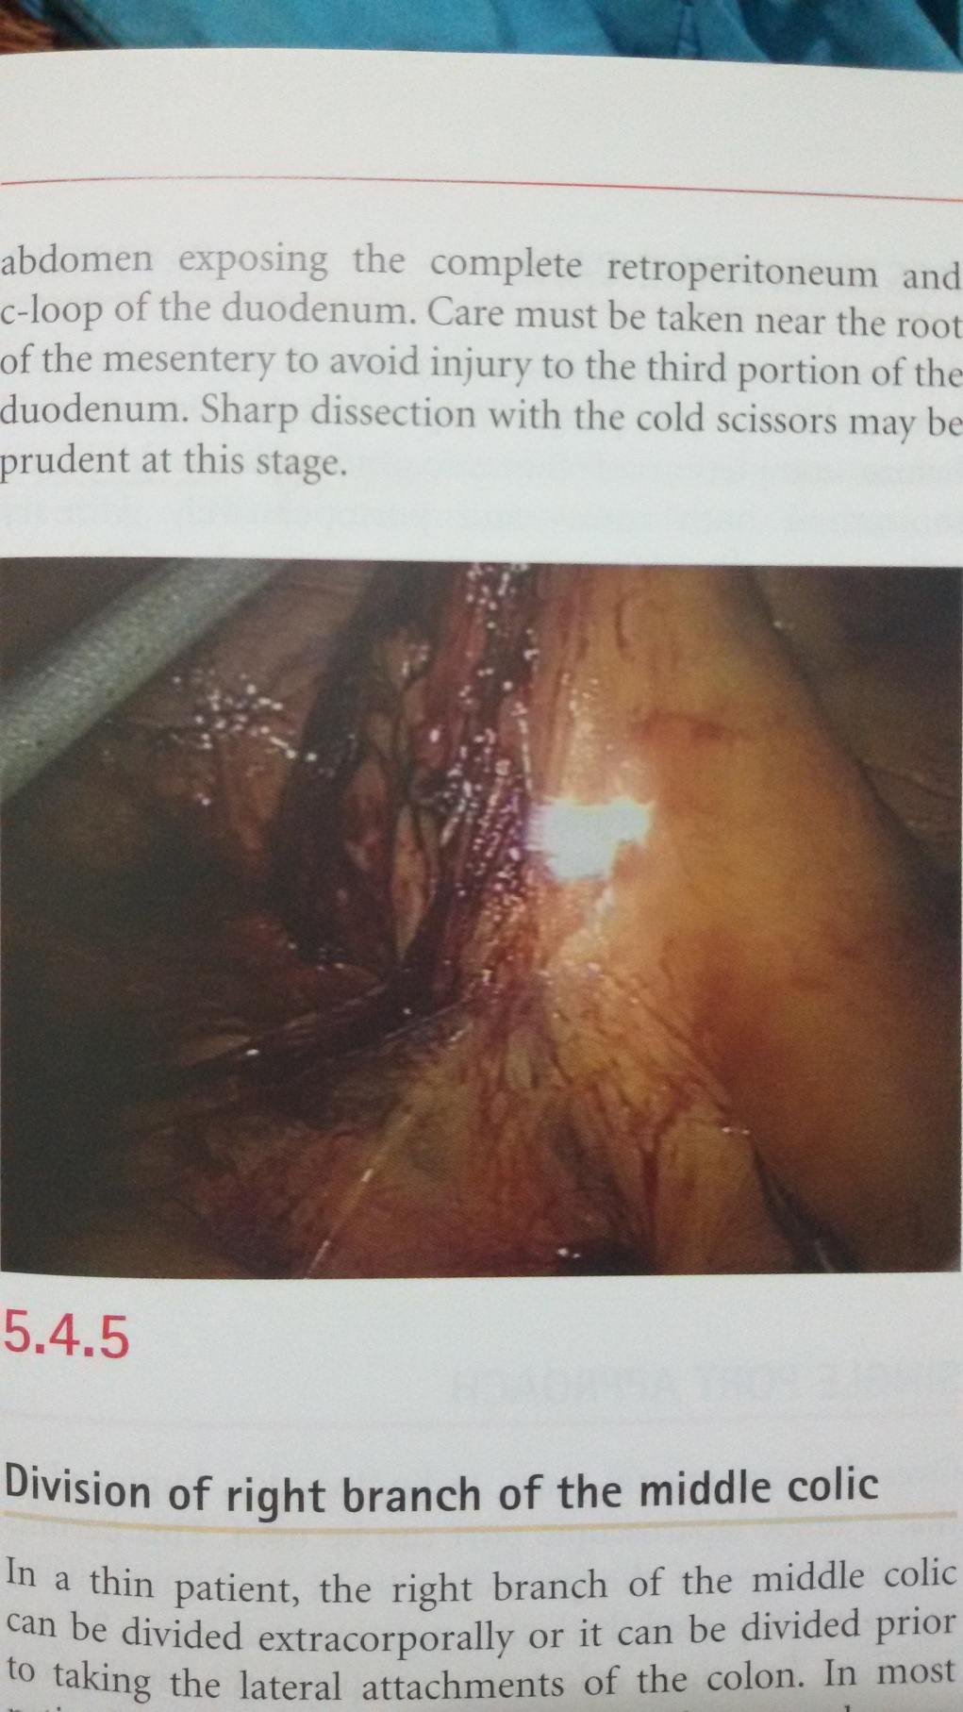
mobilization of small bowel mesentery from the retroperitoneum
Cecum is retracted cephalad and anteriorly
The remaining small bowel mesenteric attachment and any lateral attachment of colon are divided
Ureter → identified → coursing over the iliac vessels at the pelvic inlet
Right colon should be fully mobilized from retroperitoneum and can be moved into the left abdomen → expose the complete retroperitoneum and c-loop duodenum

Slide 30
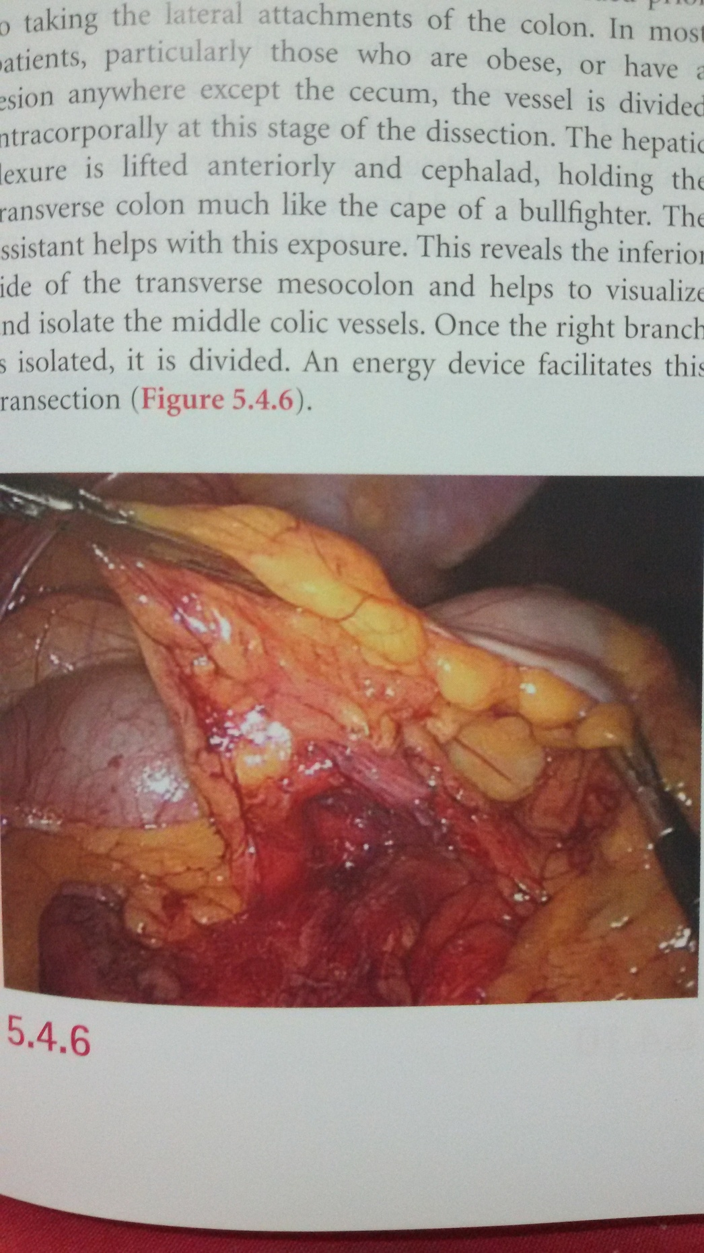
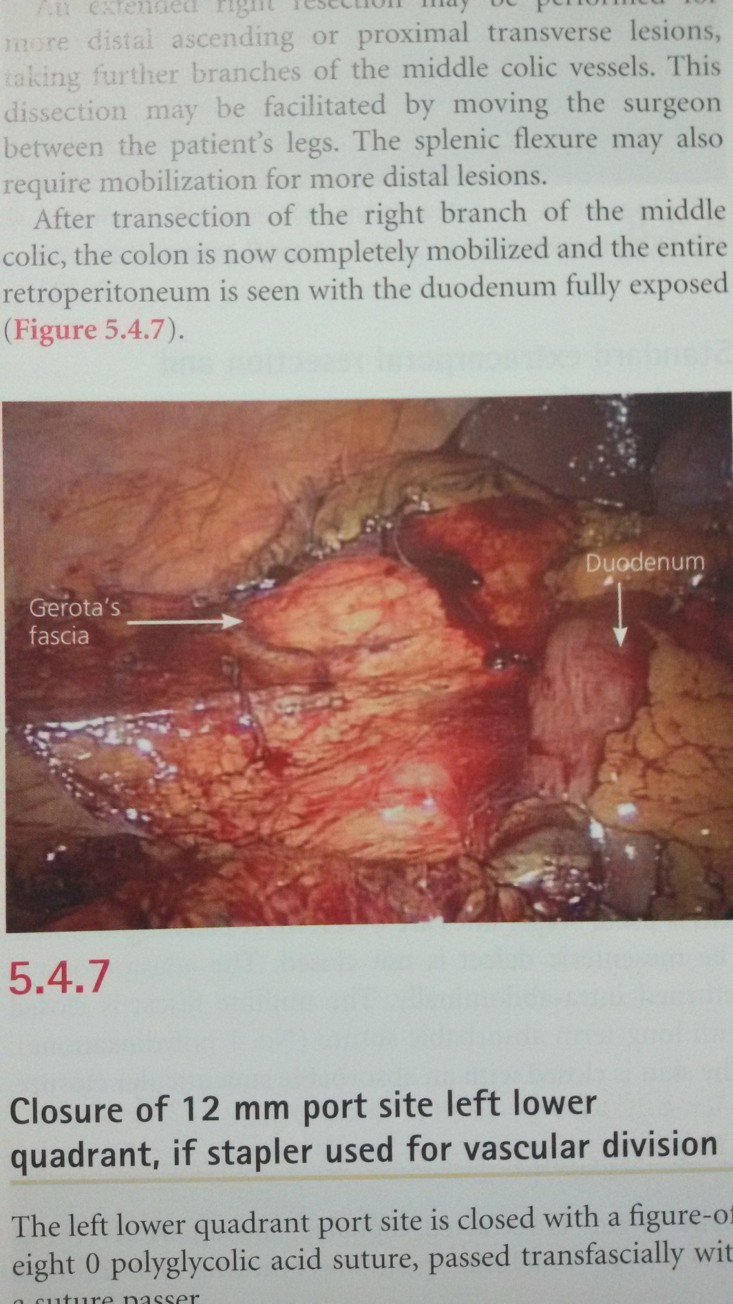
Division of right branch of the middle colic
Right branch is isolated → divided → facilitates this transection
Transection of the right branch of the middle colic → colon is now completely mobilized and entire retroperitoneum is seen with duodenum fully exposed

Slide 31
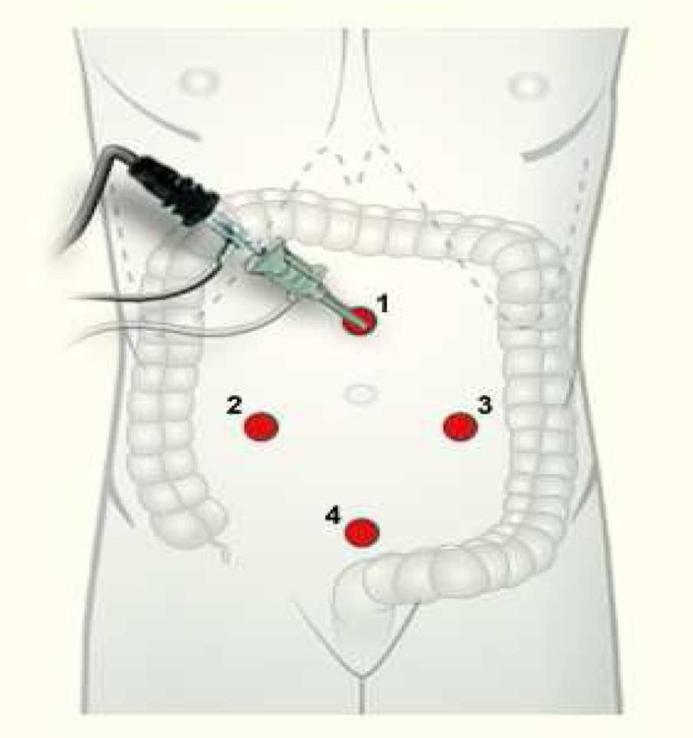
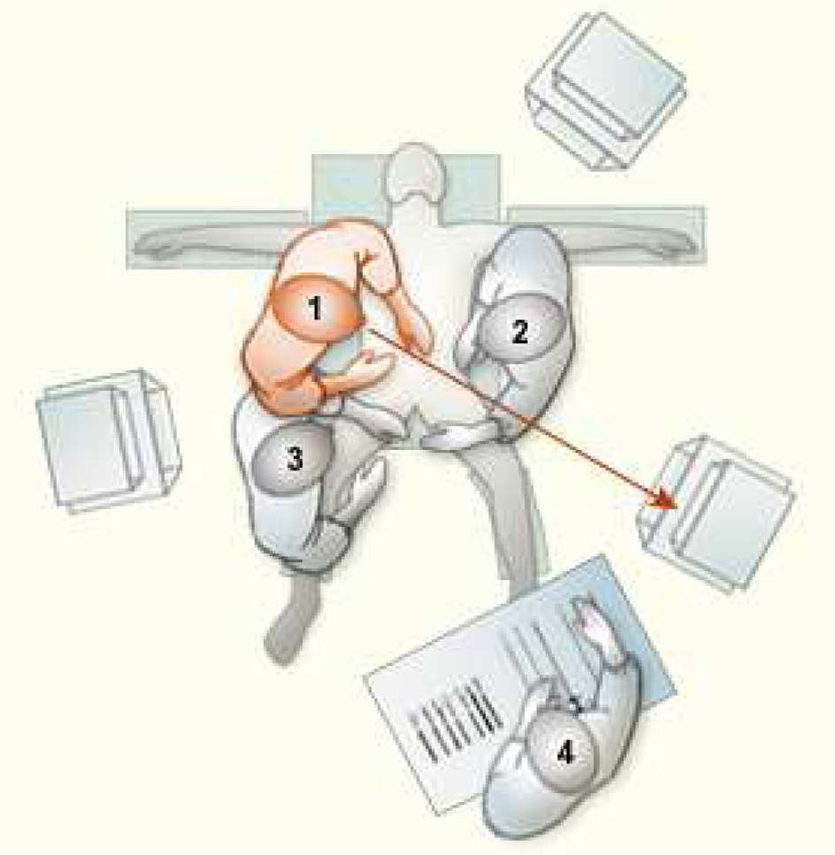
Left hemicolectomy
Mobilization of sigmoid colon
Mobilization of descending colon
Mobilization of splenic flexure
Endostapling, exteorization of specimen and construction of anastomosis

Slide 32
THANK YOU

