Slide 1
About OMICS Group
OMICS Group International is an amalgamation of Open Access publications and worldwide international science conferences and events. Established in the year 2007 with the sole aim of making the information on Sciences and technology ‘Open Access’, OMICS Group publishes 400 online open access scholarly journals in all aspects of Science, Engineering, Management and Technology journals. OMICS Group has been instrumental in taking the knowledge on Science & technology to the doorsteps of ordinary men and women. Research Scholars, Students, Libraries, Educational Institutions, Research centers and the industry are main stakeholders that benefitted greatly from this knowledge dissemination. OMICS Group also organizes 300 International conferences annually across the globe, where knowledge transfer takes place through debates, round table discussions, poster presentations, workshops, symposia and exhibitions.

Slide 2
About OMICS Group Conferences
OMICS Group International is a pioneer and leading science event organizer, which publishes around 400 open access journals and conducts over 300 Medical, Clinical, Engineering, Life Sciences, Pharma scientific conferences all over the globe annually with the support of more than 1000 scientific associations and 30,000 editorial board members and 3.5 million followers to its credit.
OMICS Group has organized 500 conferences, workshops and national symposiums across the major cities including San Francisco, Las Vegas, San Antonio, Omaha, Orlando, Raleigh, Santa Clara, Chicago, Philadelphia, Baltimore, United Kingdom, Valencia, Dubai, Beijing, Hyderabad, Bengaluru and Mumbai.

Slide 3
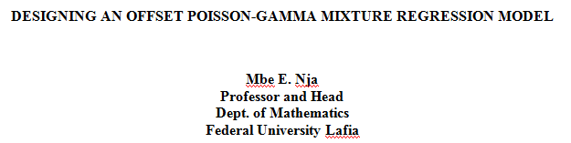

Slide 4
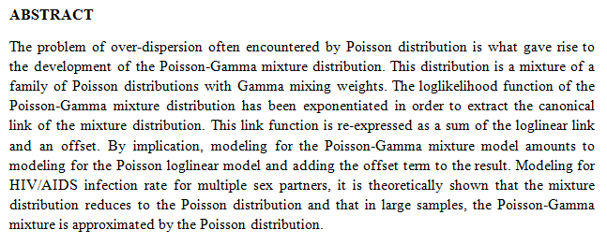

Slide 5
INTRODUCTION
The need to use a Poisson-Gamma mixture distribution arises when the Poisson distribution exhibits over-dispersion. For the Poisson model, the mean and the variance are equal.
If the variance of a Poisson model exceeds its mean, over-dispersion is said to occur. Over-dispersion is indicated if Pearson dispersion is greater than 1 (Hibe, 2007).
The problem with over-dispersion, common to most Poisson models is that it renders the parameter estimates biased. Where over-dispersion is a concern, the alternative models are:

Slide 6
(i) Quasi-Poisson
(ii) Negative Binomial regression
In this paper, we shall consider only the Negative Binomial regression as an alternative to the over-dispersed Poisson model. In designing an offset Poisson-Gamma mixture model, it is logical to use the order listed below:
(i) Poisson distribution
(ii) Gamma distribution
(iii) Poisson-Gamma distribution (Negative Binomial distribution).

Slide 7
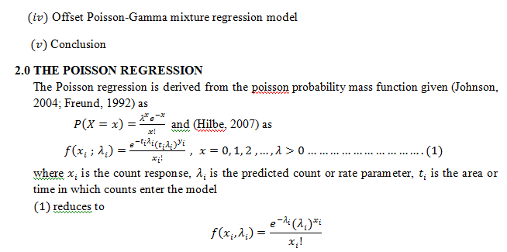

Slide 8
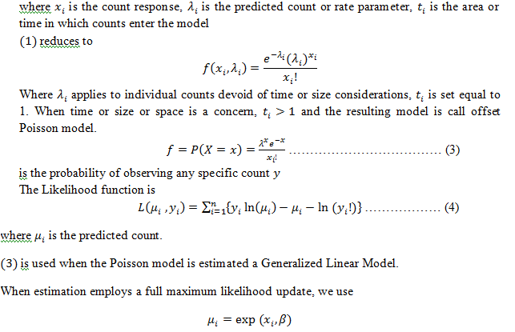

Slide 9
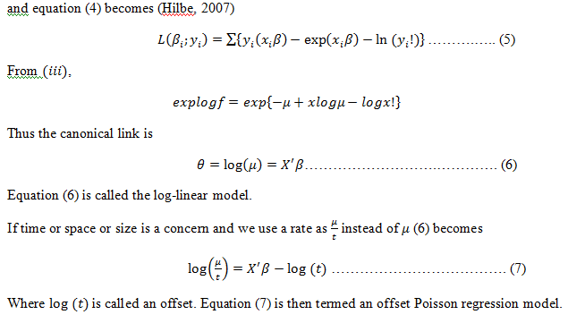

Slide 10
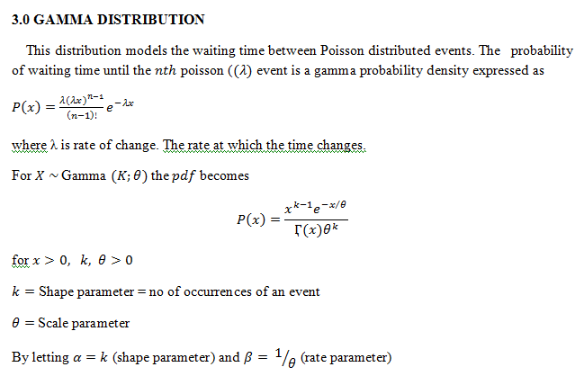

Slide 11
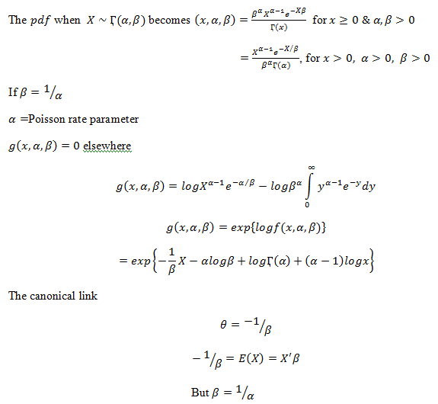

Slide 12
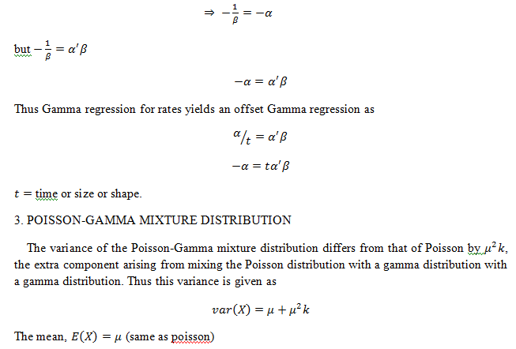

Slide 13
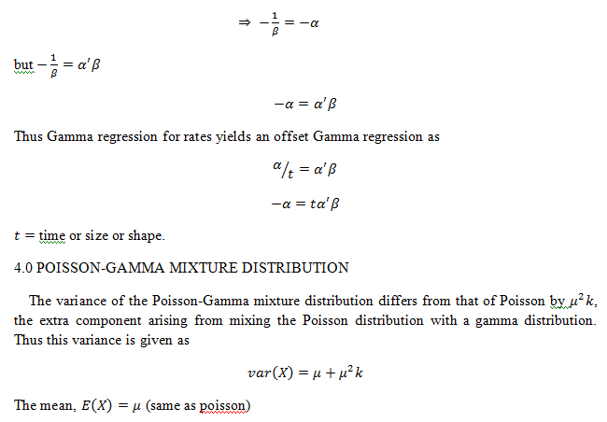

Slide 14
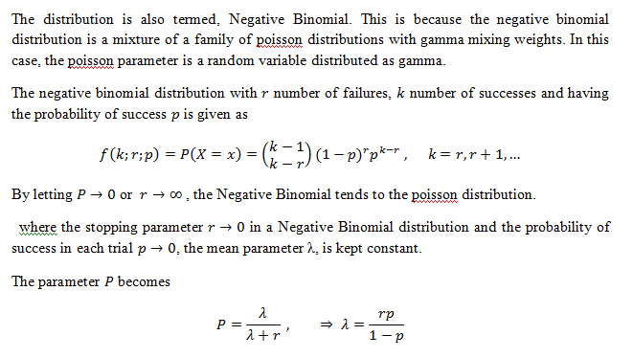

Slide 15
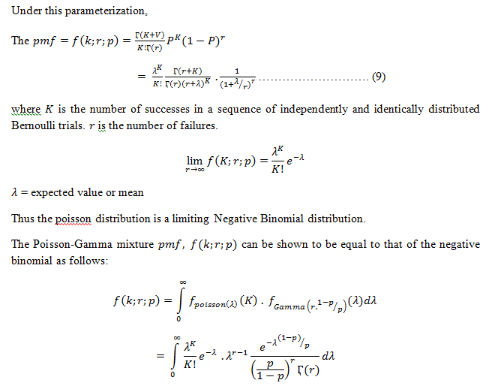

Slide 16
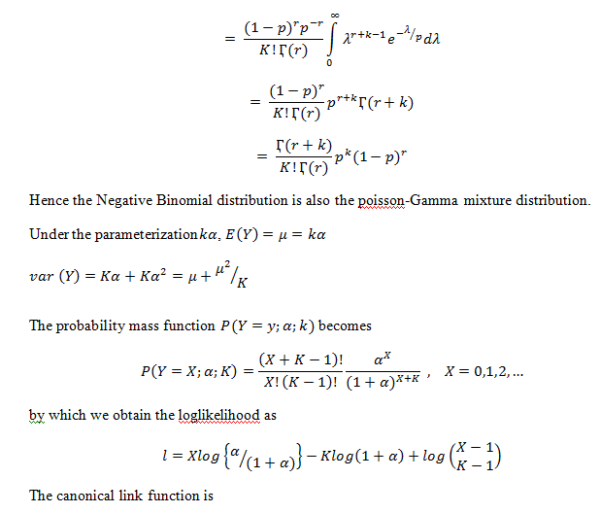

Slide 17
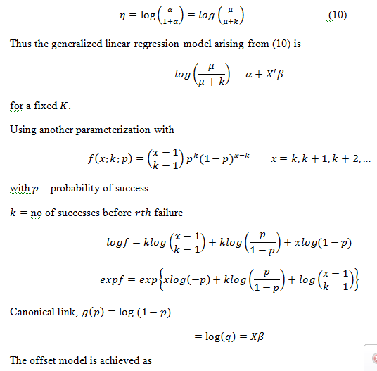

Slide 18
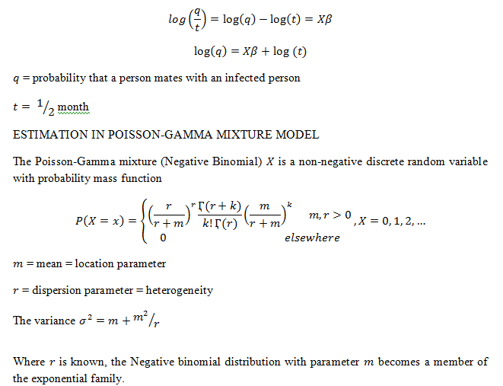

Slide 19
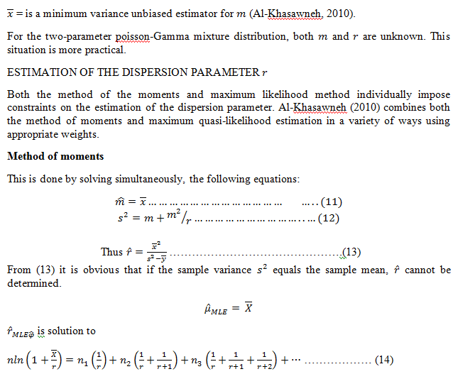

Slide 20
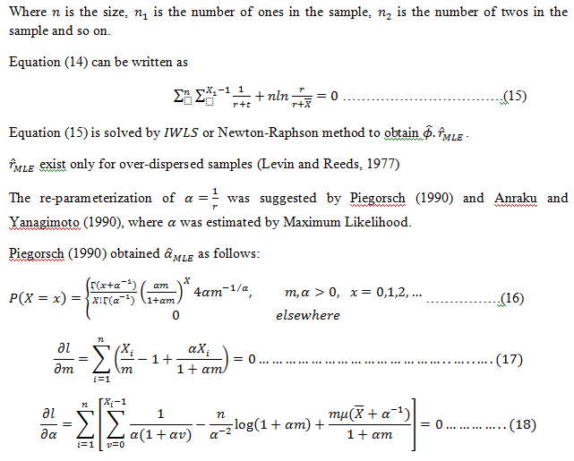

Slide 21
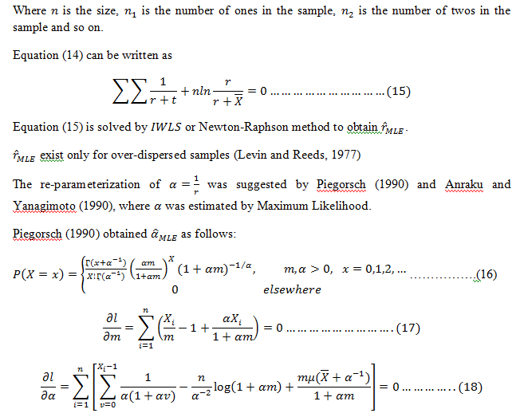

Slide 22
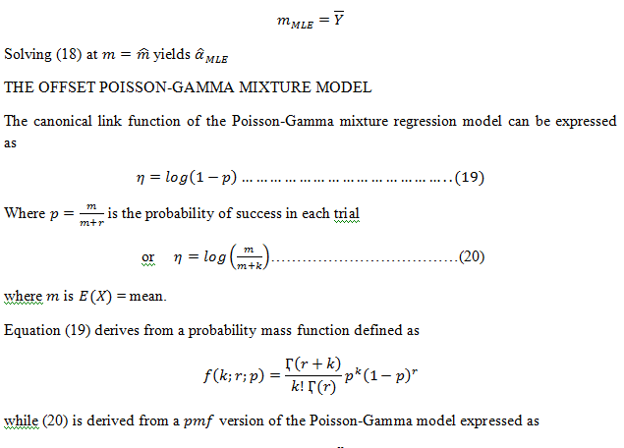

Slide 23
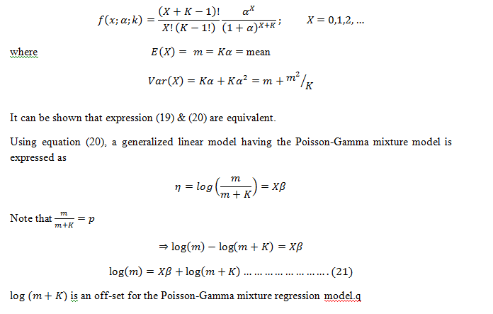

Slide 24
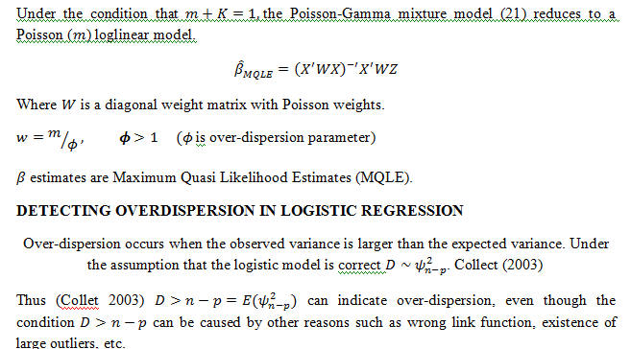

Slide 25
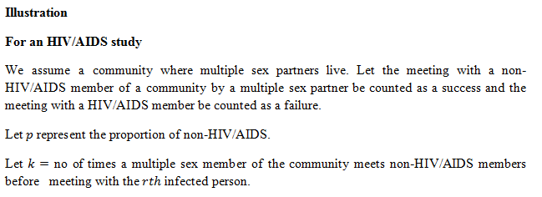

Slide 26
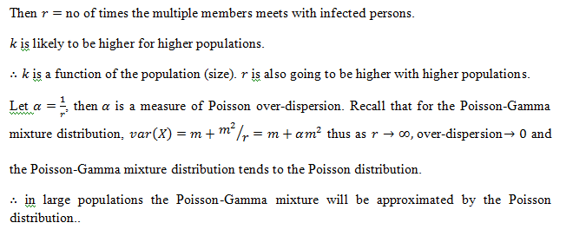

Slide 27
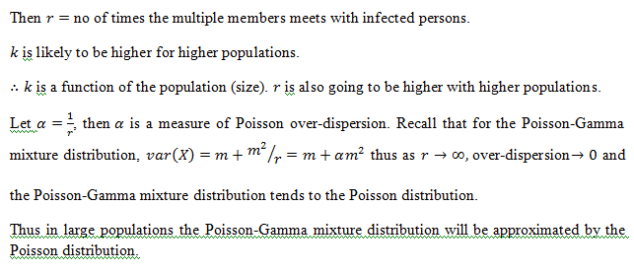

Slide 28
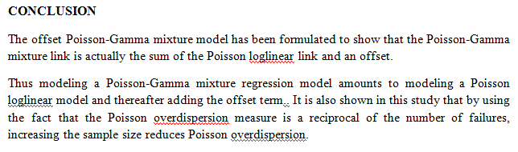

Slide 29
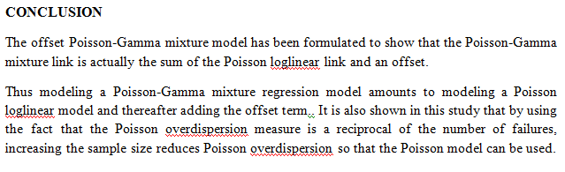

Slide 30
ACKNOWLEDGEMENT
With profound gratitude, I acknowledge
The Federal University Lafia, Nigeria

Slide 31
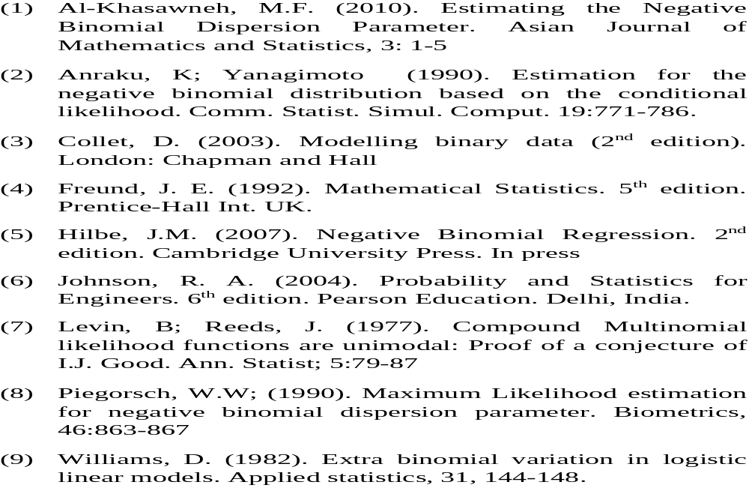
REFERENCES

