Slide 1
Defining the risk factors of cardio-metabolic risk in survivors of childhood brain tumors
M. Constantine Samaan
Associate Professor,
Pediatric Endocrinologist
McMaster Children’s Hospital
McMaster University
Canada

Slide 2
Conflicts of interest
None

Slide 3
Objectives
Review of obesity and type 2 diabetes (T2D) trends in with brain tumor survivors
Review adiposity and its role in T2D
Review of data on adiposity patterns in children with brain tumors
Review interventions to manage adiposity

Slide 4
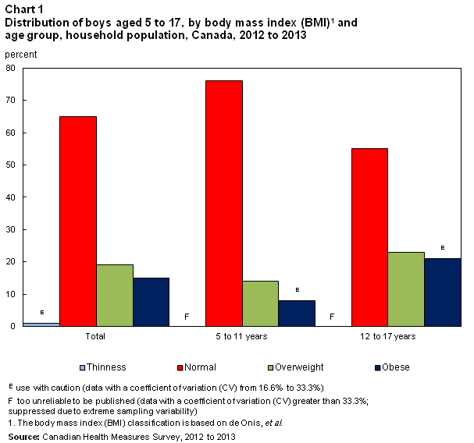
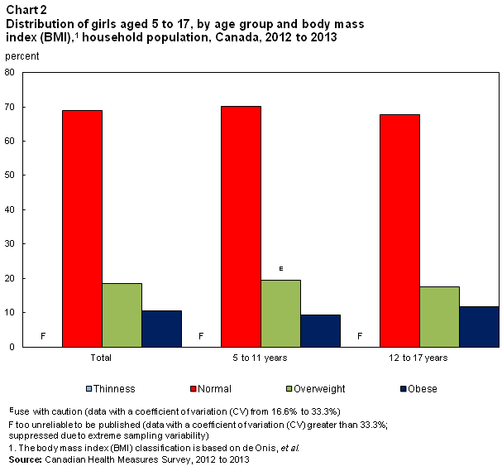
Prevalence of childhood obesity by age group in Canada-2013
Normal
BOYS
GIRLS
OW
Obese
75% of obese children become obese adults
http://www.statcan.gc.ca/pub/82-625-x/2014001/article/14105-eng.htm

Slide 5
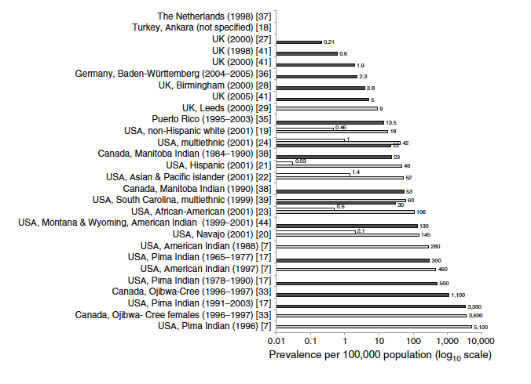
Global prevalence of T2D in children
Farsani SF et al. Diabetologia (2013) 56:1471–1488
Notes:
Fig. 3 Overview of the
reported prevalences of type 2
diabetes per 100,000 children
and/or adolescents (because of
considerable variations in the
observed rates, prevalence data
are graphed on a base 10
logarithmic scale). The
prevalence rates were
calculated for male/female
populations, except for the
prevalence rate of 3,600 per
100,000 which was for Ojibwa-
Cree females. White bars
represent children (0–9 years),
grey bars represent adolescents
(10–19 years) and black bars
represent children and
adolescents (0–19 years)
----- Meeting Notes (15-05-26 22:19) -----
Canada has one of the highest rates of T2D globally, and this is related to the presence of aboriginal population, and many of the ethnic groups that emgirated to Canada from have a higher risk of T2D.

Slide 6
Which groups of children are at risk of developing obesity & T2D?
Certain ethnic groups e.g. Aboriginal, South Asian
Small for gestational age (SGA)
Large for gestational age (LGA) e.g. IOM, IDM
Survivors of childhood cancer & Bone Marrow Transplantation

Slide 7
Pediatric brain tumors in North America
Around 5400 children are diagnosed with a brain tumor annually in Canada/USA
The most common solid tumor in children
The second most common tumor after leukemia
Significant life-long burden of surviving some subtypes

Slide 8
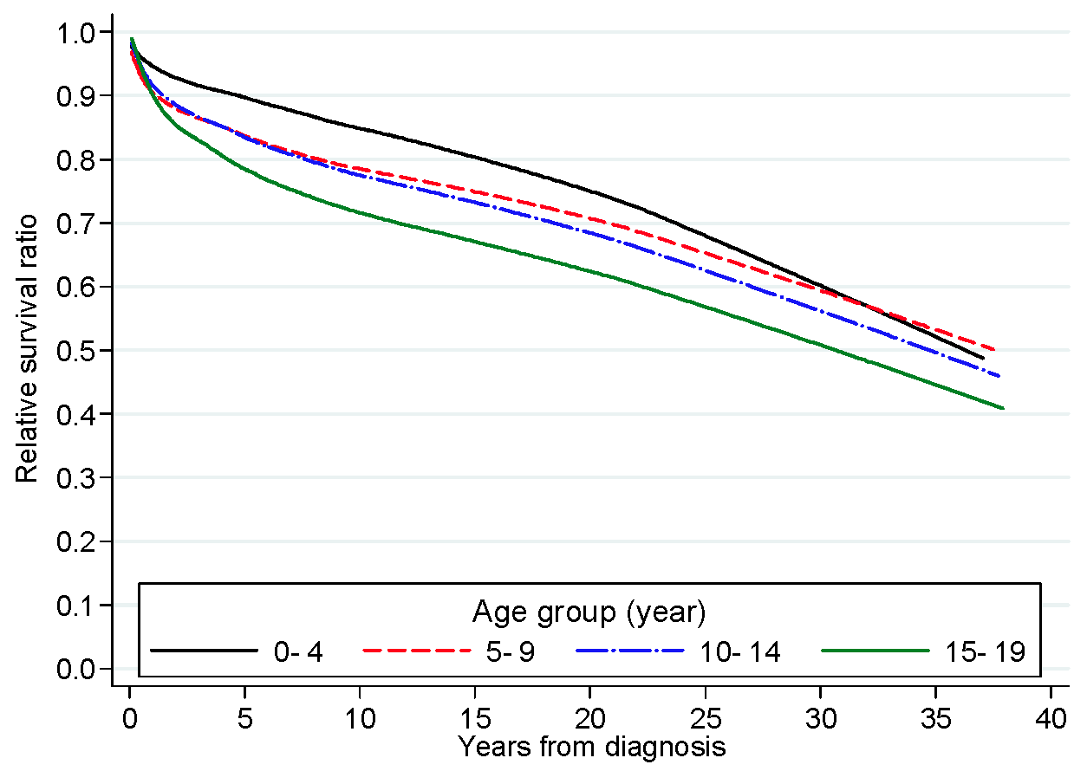
Survival of children diagnosed with astrocytic tumors compared to general population
Samaan et al. Pediatric Blood & Cancer, 62(9):1567-71, 2015

Slide 9
Long-term cause of death in survivors of childhood cancer
Twenty-five years after diagnosis
36.5% of deaths were caused by recurrence
21.3% by second cancers
33.3% by circulatory diseases
Schindler M et al. Int J Cancer. 15; 139(2):322-33, 2016
Notes:
In epidemiology, the standardized mortality ratio or SMR, is a quantity, expressed as either a ratio or percentage quantifying the increase or decrease in mortality of a study cohort with respect to the general population.
In epidemiology, the absolute risk reduction, risk difference or excess risk is the change in risk of a given activity or treatment in relation to a control activity or treatment. It is the inverse of the number needed to treat.

Slide 10
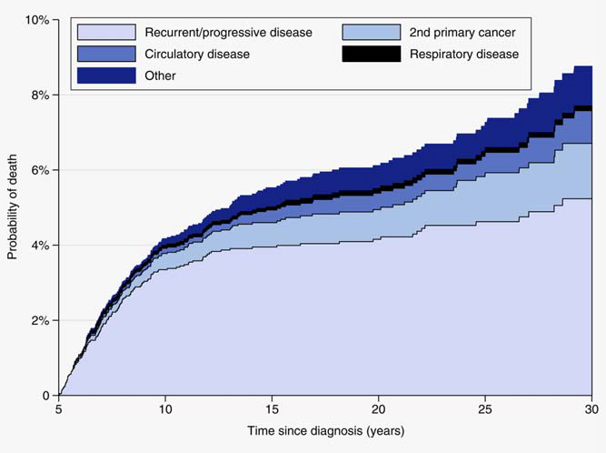
Long-term cause of death in survivors of childhood cancer [risk ratio 1.96 (1.28-3) for BT group]
Schindler M et al. Int J Cancer. 15; 139(2):322-33, 2016

Slide 11
SCBT are at higher risk of stroke than controls
-The rate of late-occurring stroke for brain tumor survivors was 267.6 per 100,000 person-years (95% CI, 206.8 to 339.2).
-The RR of stroke for brain tumor survivors compared with the sibling comparison group was 29.0 (95% CI, 13.8 to 60.6; P < .0001).
-Mean cranial radiation therapy (CRT) dose of ≥ 30 Gy was associated with an increased risk in a dose-dependent fashion, with the highest risk after doses of ≥ 50 Gy CRT
Bowers DC. JCO November 20, 2006 vol. 24(33): 5277-5282

Slide 12
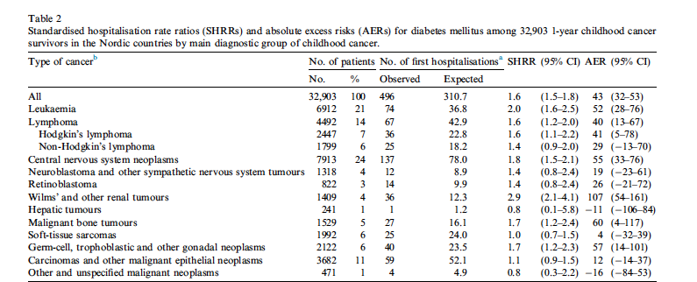
SCBT have increased risk of diabetes
SCBT n=7913, median follow-up 10 years, 1-yr survival included
Holmqvist A S et al. Euro J cancer. 50, 1169-1175, 2014

Slide 13
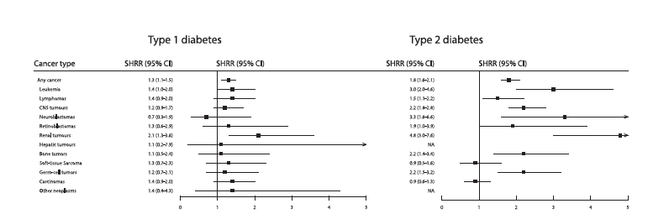
SCBT are at risk of developing T2D
SCBT n=7913, median follow-up 10 years, 1-yr survival included
Holmqvist A S et al. Euro J cancer. 50, 1169-1175, 2014

Slide 14
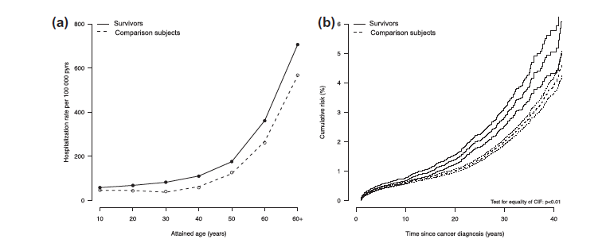
The risk of diabetes rises progressively with age and time since diagnosis
Holmqvist A S et al. Euro J cancer. 50, 1169-1175, 2014

Slide 15
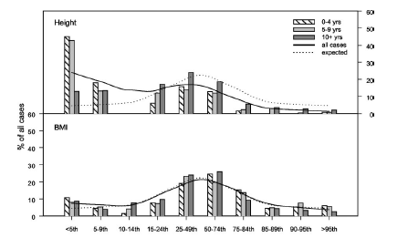
SCBT are shorter and have BMI similar to population controls
Percentile for height & BMI
Gurney J. et al. JCEM, 88(10):4731-4739, 2003

Slide 16
Questions
Do survivors of childhood brain tumors, when compared to non-cancer controls, have higher adiposity than controls?
Can adiposity be specifically altered with interventions to mitigate future cardiometabolic risk?

Slide 17
Adiposity
The condition of having an excess body fat that may be present in and outside the adipose tissue

Slide 18
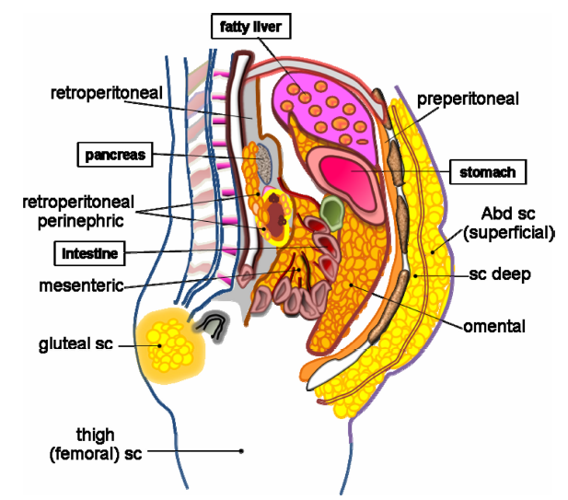
Not all fat depots are created equal: Adipose depots in humans differ in metabolic profiles
Pericardial
Epicardial
Intermyocellular
Lee, MJ et al. Mol Aspects Med. 34(1): 1-11, 2013

Slide 19
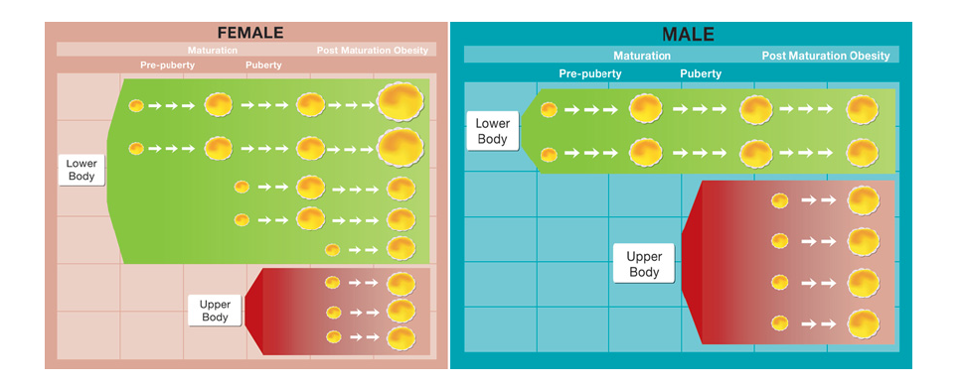
Adipose tissue development in males & females: Not the same tale
Smith, J et al. Clin Sci. 110, 1-9, 2006
Notes:
In prepubertal females, adipocytes are small. Increases in both size and number occur as adipose tissue mass expands during puberty. This expansion occurs pri-marily in the lower body. Thus, overall, there is low transmembrane FA ﬂux. In post-maturation obesity (adult-onset) both lower-body and upper-body adipocytes increase in size in order to accommodate the increased storage requirements. This increases the triacylglycerol synthetic and hydrolytic capacity of the adipose tissue increasing FA ﬂux to the liver and apoB secretion. Adipose tissue in prepubertal males is similar to prepubertal females. During puberty, there is little expansion in adipose tissue mass. With post-maturation obesity, the upper-body adipocytes increase in number and in size, leading to transmembrane FA ﬂux and thus to the increased secretion of apoB.

Slide 20
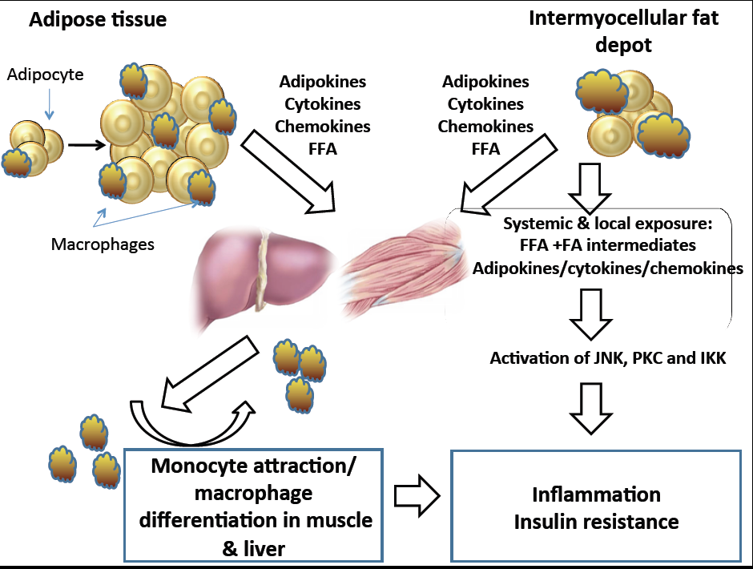
Samaan, MC. Diabetology & Metabolic Syndrome, 2011
Notes:
Figure 1: The model for macrophage-metabolic interactions in obesity. Adipose tissue expansion in obesity results in an inflammatory state characterized by production of adipokines, cytokines, and chemokines. This is also associated with free fatty acid [FFA] release via increased lipolysis. Activation of resident adipose tissue macrophages leads to secretion of inflammatory cytokines and chemokines; this will lead to attraction of monocytes that differentiate to macrophages. Fatty acids and cytokines spill into circulation, and get to metabolic tissues including skeletal muscle and liver. In addition, the expansion of the intermyocellular fat depot also attracts macrophages, and this is associated with secretion of pro-inflammatory cytokines, chemokines and FFA release that occur locally. The exposure of muscle to cytokines, chemokines and fatty acids from systemic and local sources triggers an inflammatory response characterized by activation of inflammatory pathways, upregulation of gene expression, and synthesis and secretion of inflammatory cytokines and chemokines. The attracted macrophages will in turn secrete inflammatory molecules, which signal through inflammatory pathways propagating this inflammatory response and resulting in muscle inflammation and insulin resistance. JNK=c-jun amino terminal kinase; PKC= protein kinase C; IKK=IκB kinase.

Slide 21
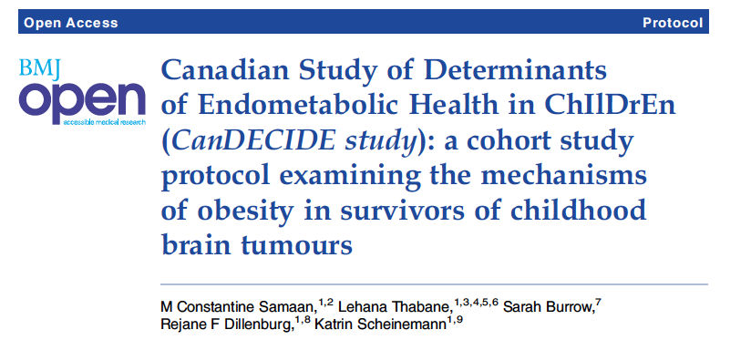
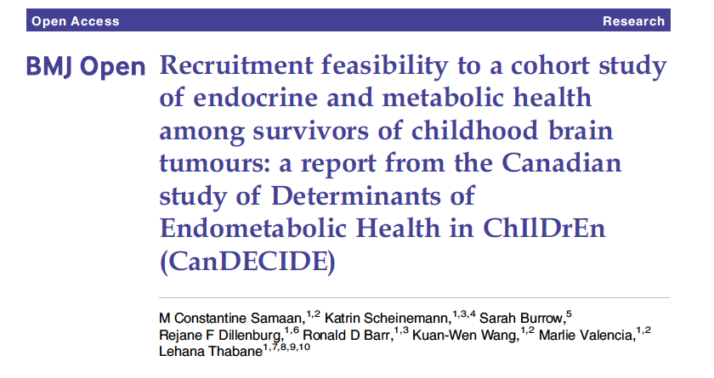

Slide 22
CanDECIDE
Cohort study, cases and non-cancer controls
Primary hypothesis: Obese SCBT have more enhanced inflammation compared to lean survivors and non-cancer controls
Secondary hypothesis: The enhanced inflammatory response seen in obese SCBT is mediated via individual and lifestyle factors

Slide 23
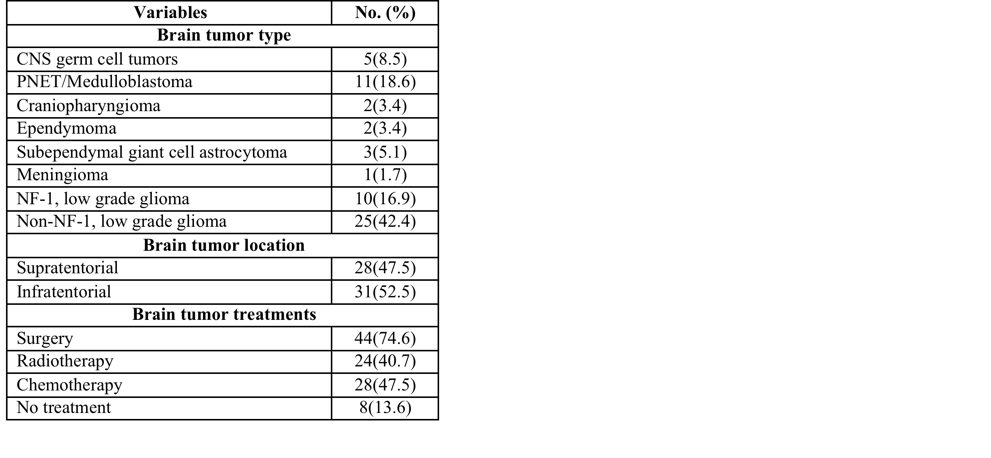
Tumor subtypes & treatment in CanDECIDE study

Slide 24
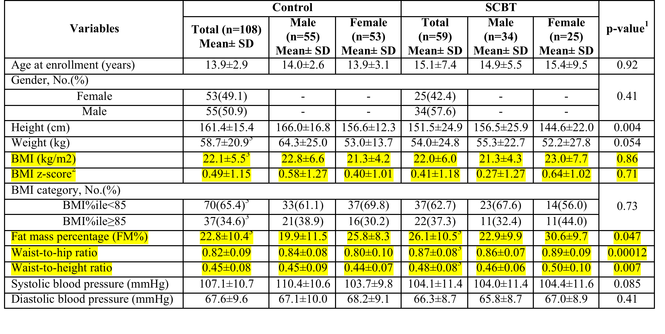
SCBT have higher central adiposity than non-cancer controls
Wang KW et al. manuscript prepared for submission

Slide 25
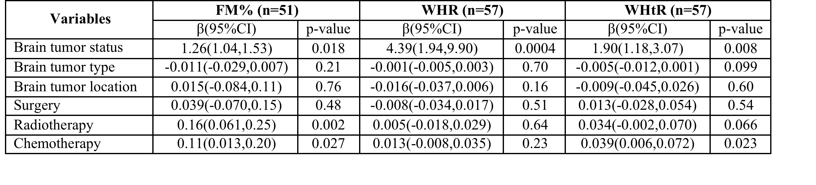
Brain tumor status, radio- and chemotherapy are associated with enhanced adiposity in children with brain tumors

Slide 26
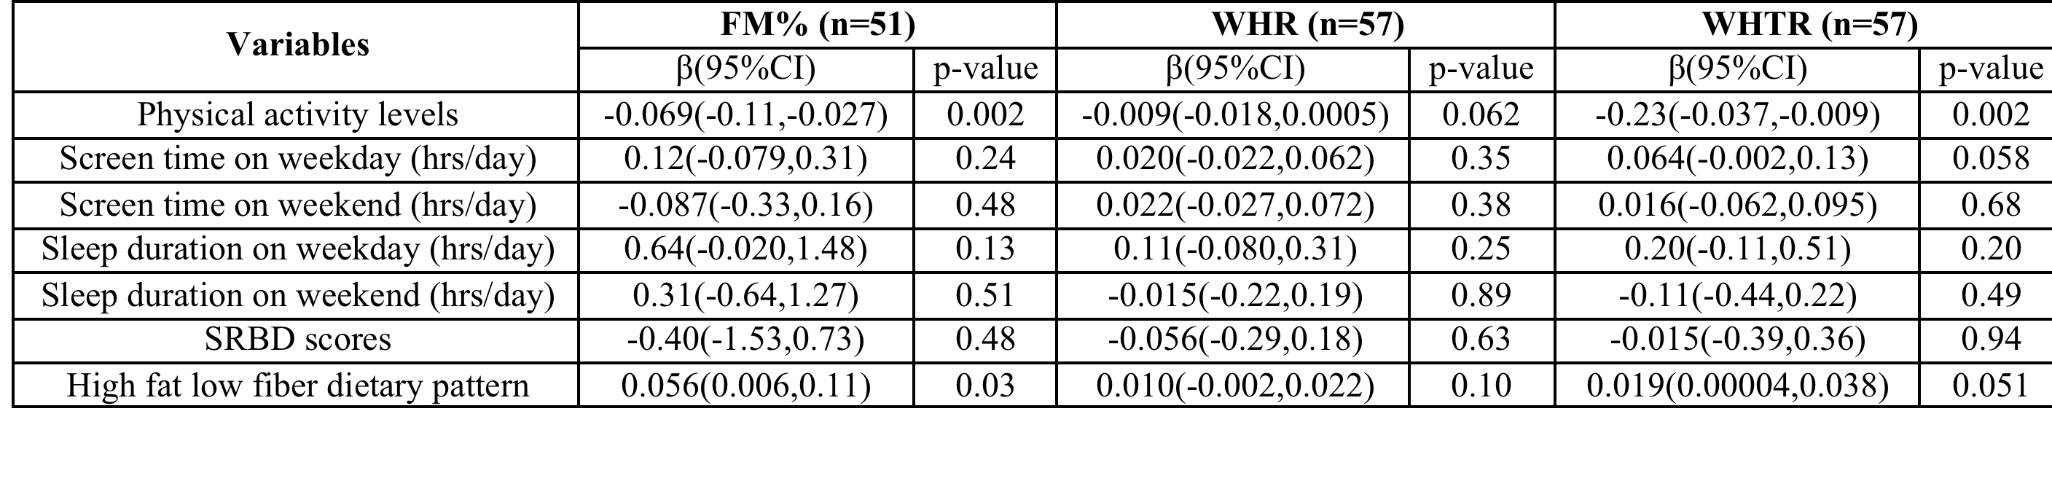
Physical inactivity and a diet high in fat drive adiposity in SCBT

Slide 27
Adiposity in Survivors of childhood brain tumors is likely polygenic
Parental/system overprotection
Altered energy intake
Reduced mobility and physical activity
Treatment e.g. radiotherapy of tail of pancreas
Hypothalamic-pituitary damage
Pituitary hormone deficiencies
Sleep problems
Vision problems
Imbalance and pain
Mental health issues
Medications e.g. antidepressants
Lusting R et al. JCEM, 2003

Slide 28
Question
Can excess adiposity be managed/prevented?

Slide 29
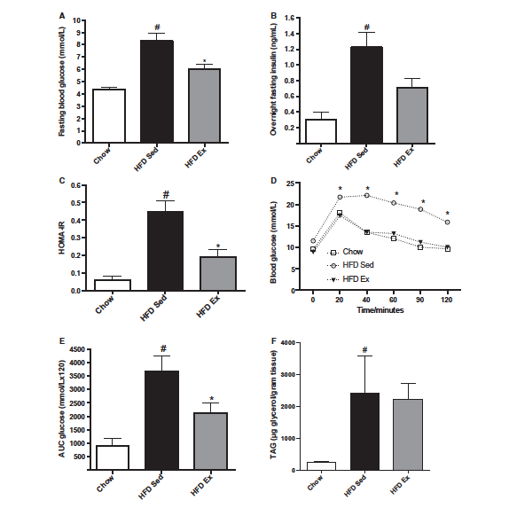
Improvement of dysglycemia in HFD with endurance exercise in mice
Samaan, M.C. et al. Physiological Reports, 2014
Notes:
HFD LEAD TO DYSGLYCEMIA.
ON OGTT, HFD EX MICE HAD A RESPONSE SIMILAR TO CHOW FED MICE DESPITE HIGHER ADIPOSITY

Slide 30
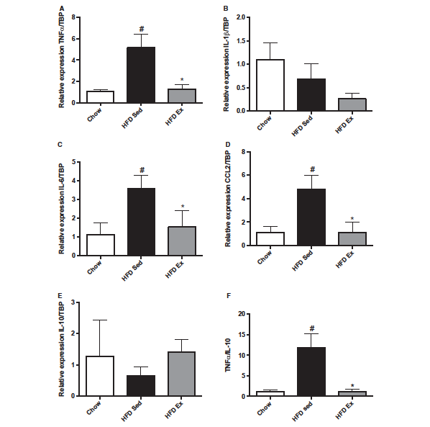
HFD enhanced muscle inflammation that was reduced with exercise (qPCR)
TNFα
IL-1β
IL-6
CCL2
IL-10
TNFα/IL-10
Samaan, M.C. et al. Physiological Reports, 2014
Notes:
WE ASKED WHETHER THIS RESPONSE IS RELATED TO ALTERATION IN MUSCLE INFLAMMATION.
QRTPCR DEONSTRATED THAT THERE IS UPREGULATION OF SEVERAL INF MARKERS IN MUSCLE WITH HFD THAT GO LOWER WITH EXERCISE

Slide 31
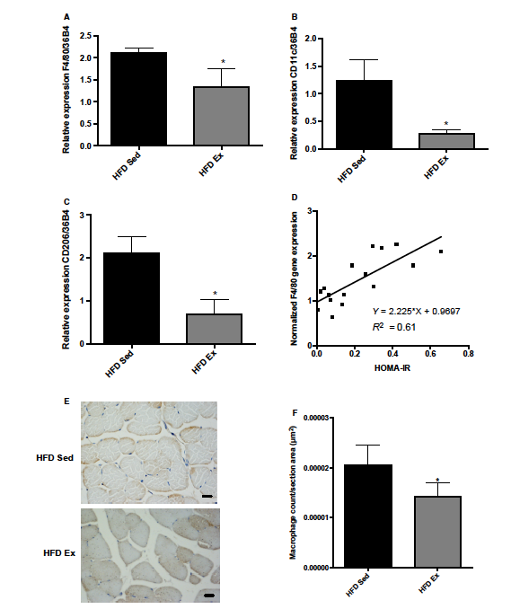
Endurance exercise lowers muscle macrophage content
F4/80
CD11c= inflammatory
macrophages
Muscle F4/80 &
HOMA-IR
CD206= resident macrophages
Samaan, M.C. et al. Physiological Reports, 2014

Slide 32
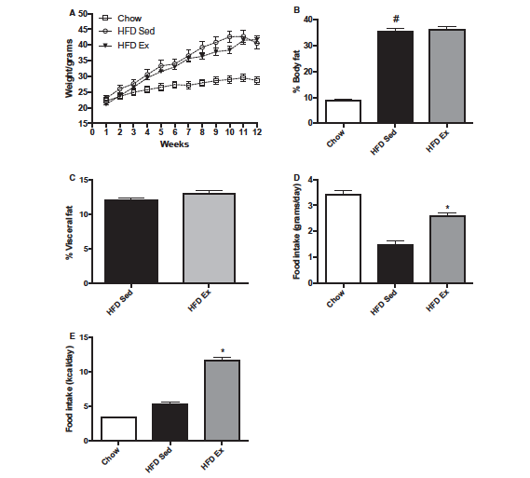
HFD Sedentary and HFD Exercised mice have similar adiposity
HFD 12/52
45% Fat
Total adiposity
Visceral adiposity
Samaan, M.C. et al. Physiological Reports, 2014
Notes:
HFD EX MICE CONTINUED TO GAIN WEIGHT SIMILAR TO HFD SED MICE.
THEIR TOTAL AND VISCERAL ADIPOSITY DID NOT CHANGE WITH EXERCISE.

Slide 33
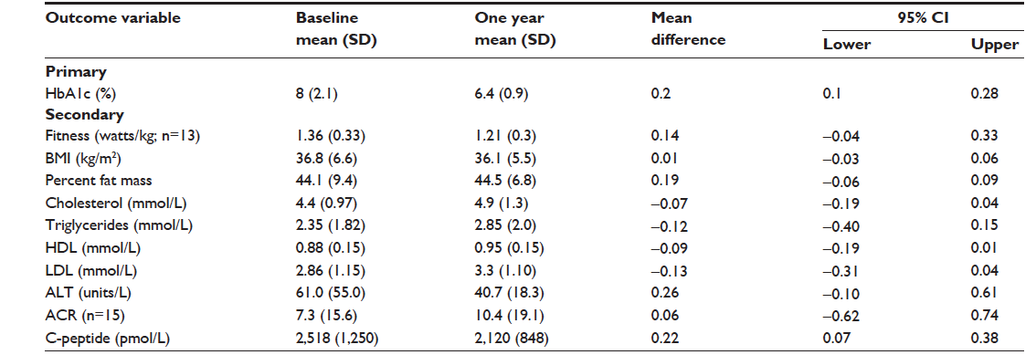
Metformin therapy does not impact adiposity in children with type 2 diabetes
Samaan MC et al. JMDH, 2014:7, p 321-331

Slide 34
Lack of interventions to treat and prevent obesity in SCBT
The effectiveness of interventions to treat obesity in survivors of childhood brain tumors: A systematic review protocol
Wang K.W et al. Systematic Reviews, 5:101. 2016

Slide 35
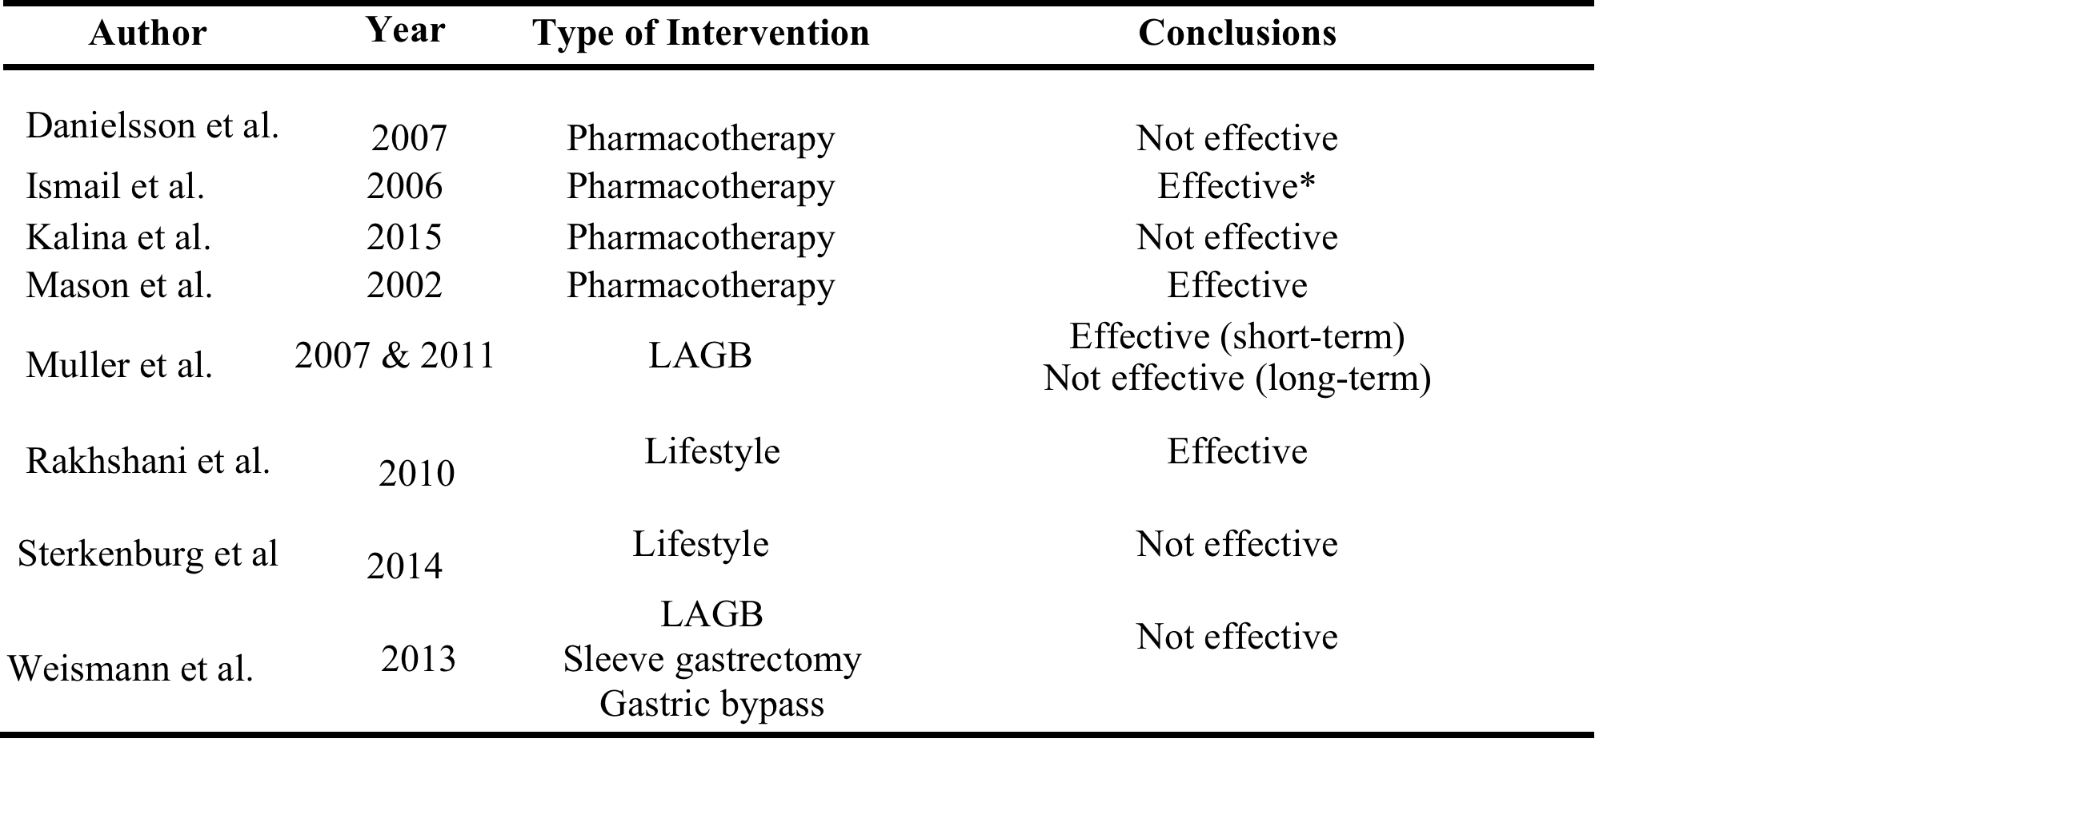
Lack of interventions to treat and prevent adiposity in SCBT
Ismail: dexamphetamine, n=9/12 CP, 7-63/12, reduced BMI SDS 0.7M/0.44 F
Mason: Dextroamphetamine, n=5 CP, 24/12, reduced rate of weight gain but BMI 32 ± 2.8 vs 31 ± 3.3
Rakhshani: LSI, n=39, 3-41/12, effective in changing %BMI change/year but not BMI SDS, slowed weight gain.
Wang et. Al. Manuscript under preparation

Slide 36
Conclusions
SCBT are at an increased risk of T2D
Adiposity is an important driver of T2D in the general population, and this may also be the case in SCBT
SCBT have more total and central adiposity than controls. BMI will miss these patients.
Currently there are no interventions to target adiposity in SCBT

Slide 37
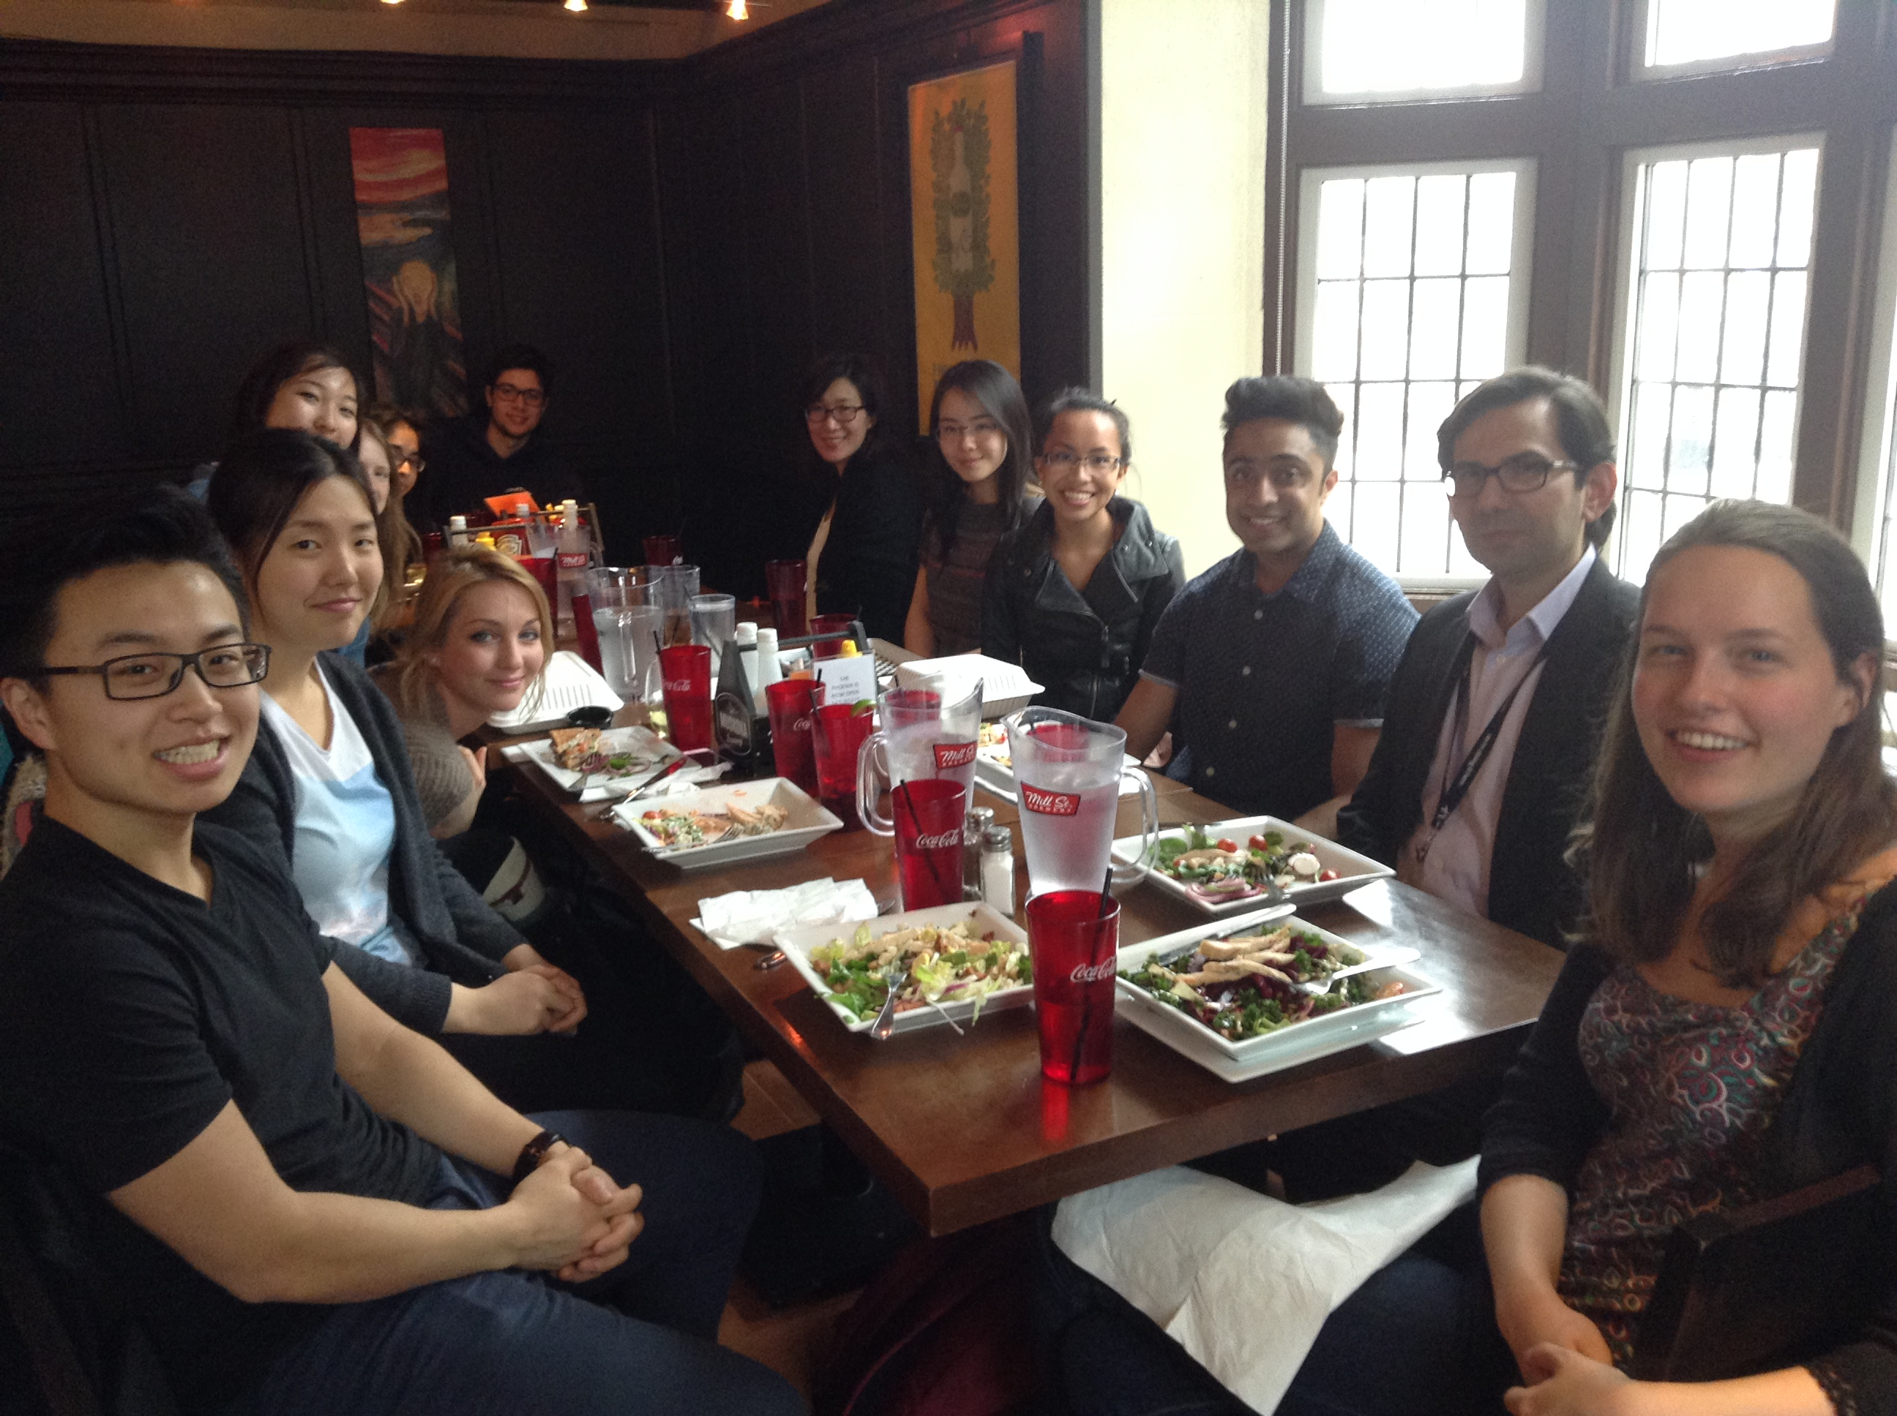

Slide 38
Acknowledgments
Translational Immunometabolism Research Group
Katherine Wang
Marlie Valencia
Pauline Chang
Madeleine Bondy
Mohak Malik
Reha Kumar
Kate Lebedeva
Ting Cai
Nicole Falzone
Billy Sun
Rod Rassekh (UBC)
Donna Johnston (CHEO)
Shayna Zelcer (UWO)
Raymond Kim (PMH)
Laboratory team:
Vivian Leong
Ishan Aditya
Erin Fu
Srikesh Rudrapatna
Collaborators
Sonia Anand
Mark Tarnopolsky
Lehana Thabane
Gregory Steinberg
Steve Arora
Katrin Scheinemann
Adam Fleming
Ronald Barr
Vicky Breakey
Carol Portwine

Slide 39




Funding support

Slide 40
Thank you
Questions?
samaanc@mcmaster.ca

