Slide 1

6th World Congress on Biotechnology
New Delhi, India-2015
BIOPURIFICATION SYSTEM FOR A PESTICIDES MIXTURE DEGRADATION
MC.Diez,¹N. Millahueque, ²F. Gallardo
¹Chemical Engineering Department, ²Chemical Sciences and Natural Resource Department.
³Environmental Biotechnology Center-BIOREN
Universidad de La Frontera, PO Box 54D, Temuco Chile. cristina.diez@ufrontera.cl
.

Slide 2

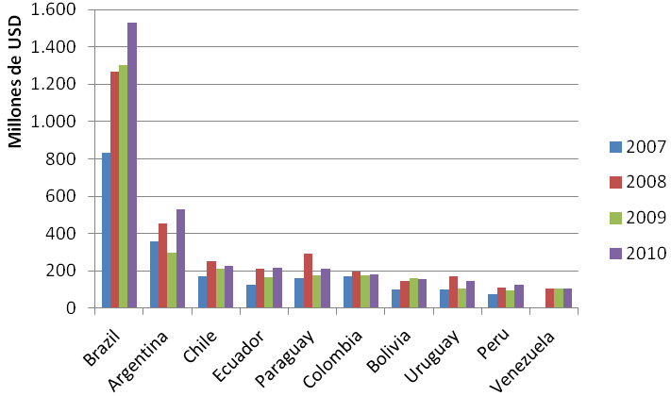
PESTICIDES CONSUMPTION IN SOUTH AMERICA
Source: www.trademap.org
Chile import approximately 50,000 Tons of pesticides per year
(SAG 2012)

Slide 3
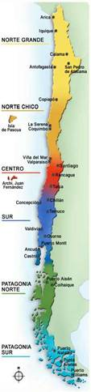
PESTICIDES DETECTED IN SOME PLACES IN CHILE
Place | Detected pesticides | Levels | Sample | Ref.
Aconcagua River | Lindane, diazinon, oxifluorphen, dicofol, azinfos-methyl, metabenzotiazuron, lenacil , diflubenzuron, atrazine | 0.1-1.12 μg/L | Water | Baéz et al. (1996)
Traiguen River | Simazine, 2,4-D, pichloram, hexazinone, carbendazim | 0.2-9.7 μg/L | Water | Palma et al. (2004)
San Pedro lake Lleu-Lleu, Icalma | Heptachlor, aldrin, endrin, pp´-DDT, pp'-DDE, pp'-DDD | 1.68-0.89 ng/g | Sediments | Barra et al. (2001)
Chillan River | Heptaclor, endrin, endosulfan, metoxichlor | 35-58 ng/L | Water | Cooman et al. (2005)
Limari River basin | 2,4 D, Aldicarb, atrazine + N-dealkyl metabolites, captan, carbofuran, chlorothalonil, cyanazine, dimethoate, diclofop-methyl, parathion, pentachlorophenol, simazine, trifularine | 1-0.05 μg/L | Water | DGA (2004)
Nuble Region | Aldrin, DDT, Dieldrin |  | Soil | Henriquez et al. (2006)
EU: 0.1 μg/L for 1 pesticide and 0.5 μg/L for overall pesticides, in water.
(Diez , MC. 2010)

Slide 4
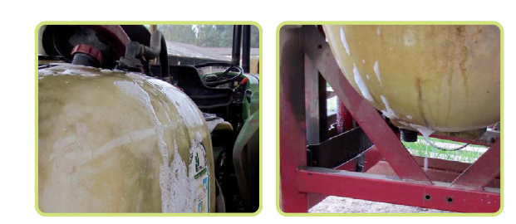
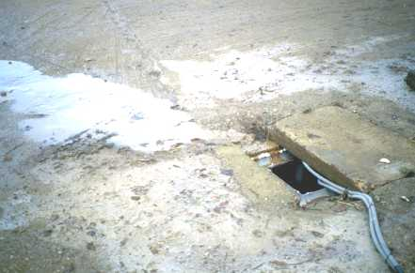
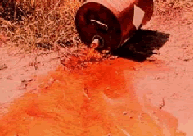
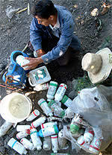
CONTAMINATION BY PESTICIDES
PROBLEM: CONTAMINATION
Intensive Agriculture
Fruits culture
Environment
Impacts
Overflow
Pesticides Consumption
Inadequate Handling
Spills
Point-Source Contamination
Handling
Contamination of Soil and Water

Slide 5
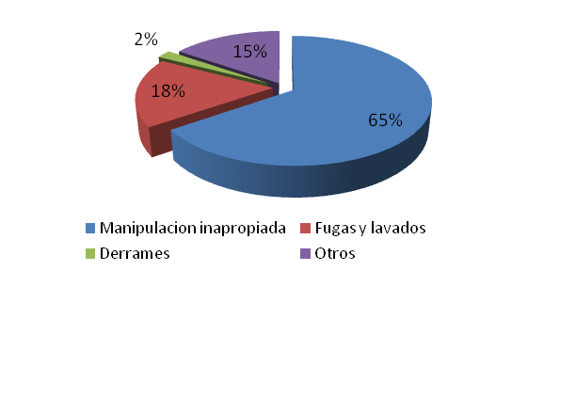
POINT-SOURCE CONTAMINATION
50-90% of the pesticides found in water fonts come from point-source contamination
Pesticide
1g of
active ingredient
1 dm²
1 g/dm² = 1 ton/ha
0.1 µg/L
10,000 m³ water
Handling
Washes
Spillage
Others
Castillo et al., 2008

Slide 6
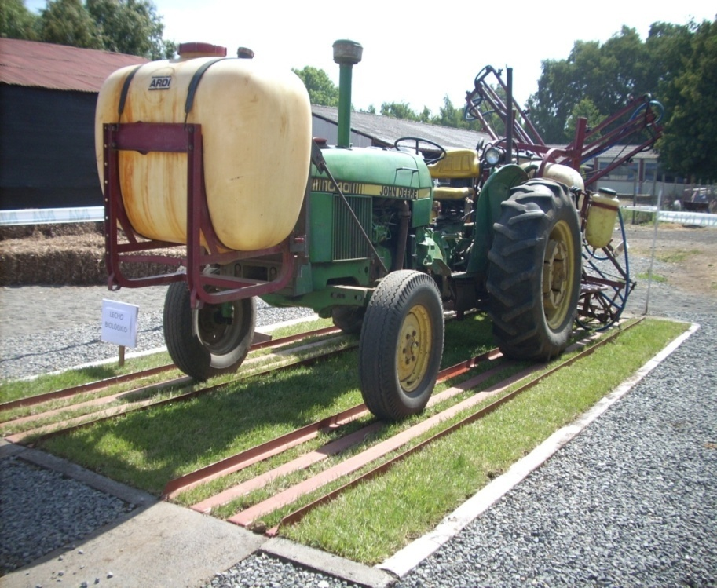
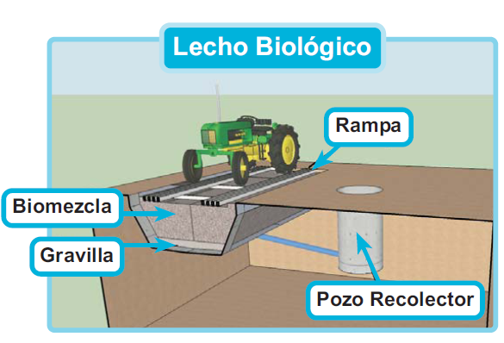
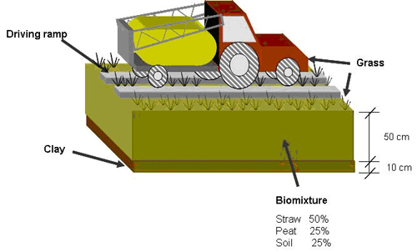
SOLUTION TO AVOID POINT-SOURCE CONTAMINATION
BIOBED
Biobed technology is based on the adsorption and degradation potential of organic biomix composed of top soil (25%), peat (25%) and straw (50%), and the grass layer.
Biobed
Ramp
www.lechosbiologicos.cl
Biomix
Gravel or clay
Collection well
Diez et al., 2013
6

Slide 7
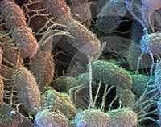
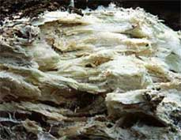
IMPORTANCE OF THE COMPONENTS OF BIOBEDS
Clay Low permeability and high sorption capacity.
Increase the pesticide retention time in the biobed.
Soil Provides sorption capacity and acts as an inoculum of microorganisms.
Soils with low organic matter content and sandy texture are associated with leaching of pesticides.
Straw Provides nutrients for the microorganisms (white-rot fungi), which produce ligninolytic enzymes catalysing the degradation of a broad spectrum of chemicals.
Peat Contributes to sorption capacity, moisture control, and also abiotic degradation of pesticides.
Helps to maintain aerobic conditions and humidity.
Grass: Maintains optimal level of temperature for microbial activity, regulates the moisture in the bed and is an indicator of pesticide spillage.
Rhizospheric degradation of pesticides.
Enzymes
LiP
MnP
Laccase

Slide 8
FACTORS AFFECTING PESTICIDES DEGRADATION IN BIOBED
Type of soil
Peat availability
Lignocellulosic material availability
Organic matter and nutrients (N, P, K)
C/N ratio (> 30) , pH < 6
Components of biomix
Suitable conditions for lignin degrading fungi as WRF
Water solubility
Adsorption Coefficient (K_{oc})
Chemical structure
Pesticides characteristics

Slide 9
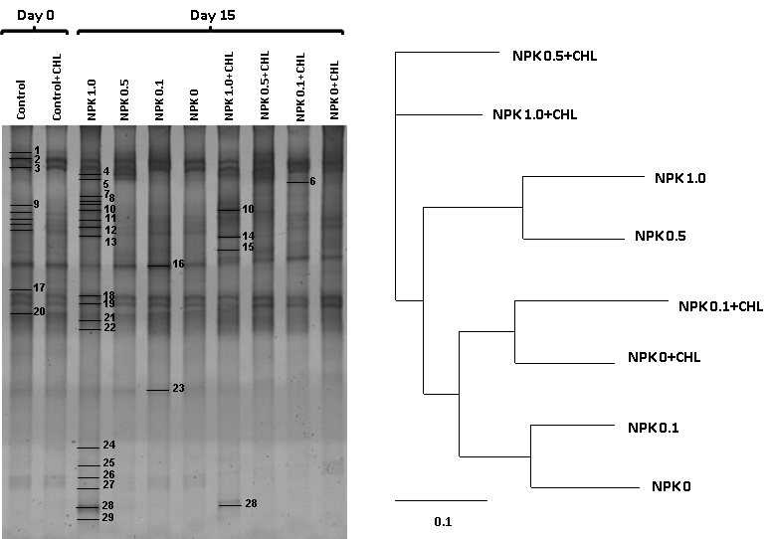
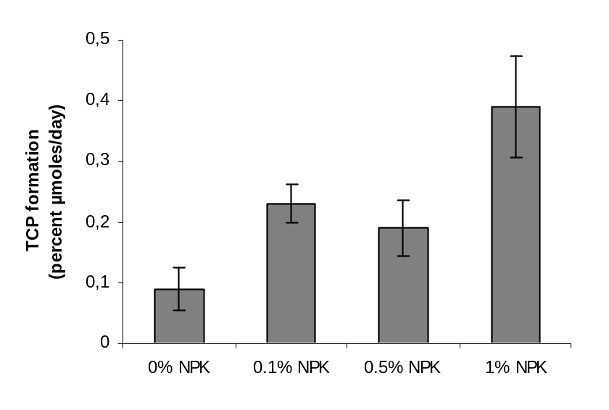
NPK ADDITION. MICROBIAL DIVERSITY EVALUATION
a
b
TCP accumulation in a biobed biostimulated with NPK fertilizer after 40 days of incubation. (Initial chlorpyrifos conc. 160 mg kg-1)
DGGE banding pattern (a) and clustering representation (b) of the bacterial 16S rRNA genes amplified with the primers sets EUBf933- GC/ EUBr1387
NPK concentration of 0.5 and 1.0%, modified the bacterial community and affected TCP (3,5,6-trichloro-2-pyridinol) degradation (Tortella et al., 2010)

Slide 10
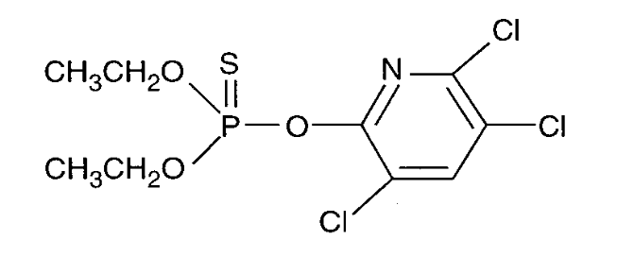
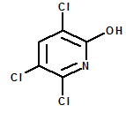
CHLORPYRIFOS AND METABOLITE CHARACTERISTICS
Principal metabolite
Chlorpyrifos
(O,O-Diethyl-O-(3,5,6-trichloro-2-pyridyl) phosphorothioate)
TCP
(3,5,6-trichloro-2-pyridinol )
Chlorpyrifos TCP
Water Solubility (mg/L) 1.4 80.9
Adsorption Coefficient (Koc) 6000 149
Aerobic Soil Half-Life (days) 7-15 52
GUS Index 0.15 (low) 2.9 (high)
GUS <1.8 Low probability of lixiviation

Slide 11
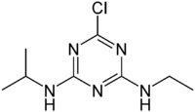
ATRAZINE CHARACTERISTICS
Degradation products
Deisopropylatrazine (DIA)
Deethylatrazine (DEA)
Hydroxiatrazine (HA)
Atrazine
Atrazine
Water Solubility (mg/L) 33
Adsorption Coefficient (Koc) 40-155
Aerobic Soil Half-Life (days) 35-50
GUS Index 3.3 (high)
GUS >1.8 High probability of lixiviation

Slide 12
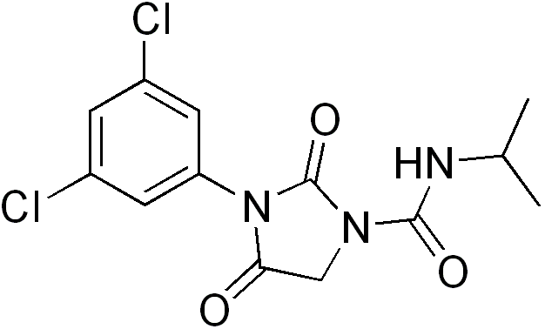
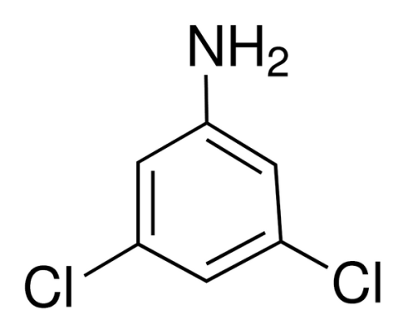
IPRODIONE CHARACTERISTICS
Principal metabolite
Iprodione
3-(3,5-dichlorofenil)-N-isopropil-2,4-dioxoimidazolidine-1-carboxamide
3,5 DCA
3,5-dichloroaniline
Iprodione 3,5 DCA
Water Solubilidad (mg/L) 13,9 600
Adsorption Coefficient (Koc) 370-700
Aerobic Soil Half-Life (days) 42-80 215-319
GUS Index 2,7 (high)
GUS >1.8 High probability of lixiviation

Slide 13
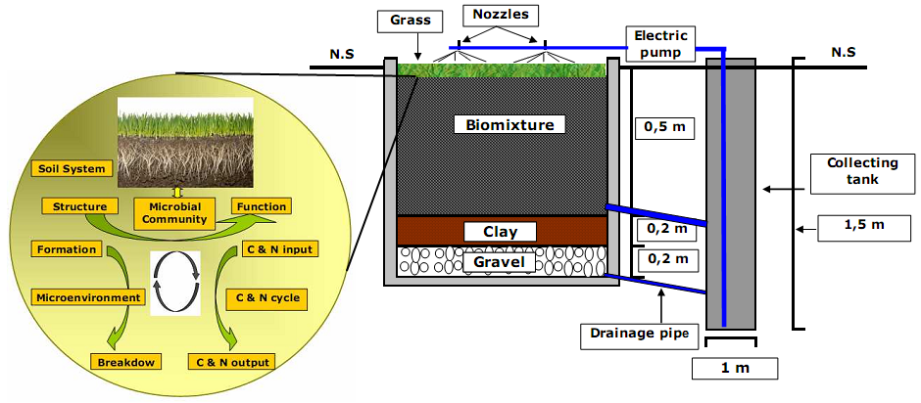
CASE OF STUDY - RHIZOSPHERIC EFFECT

Slide 14
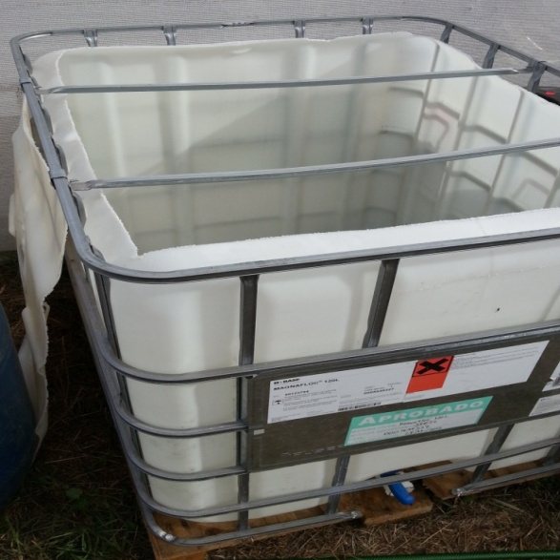
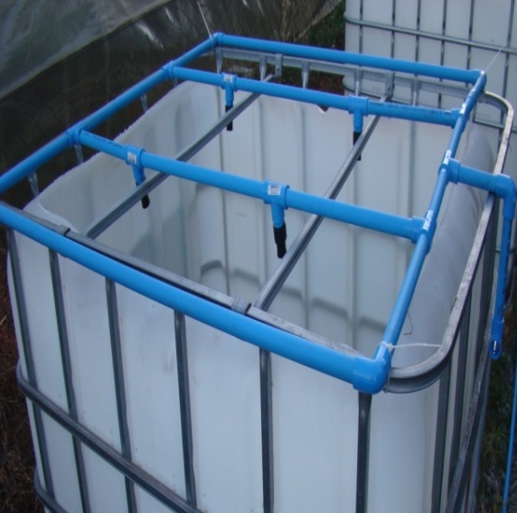
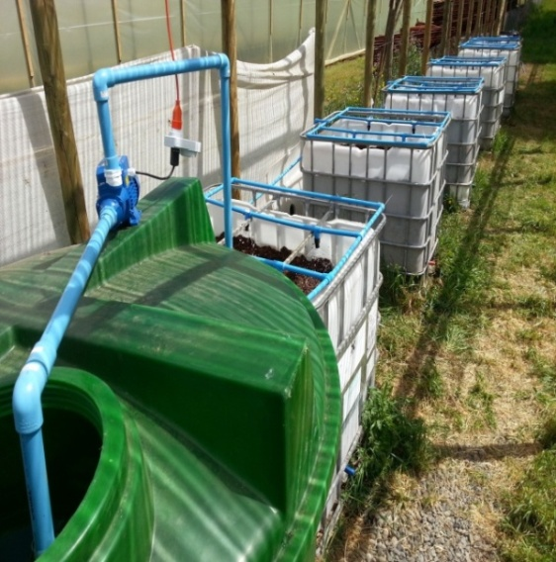
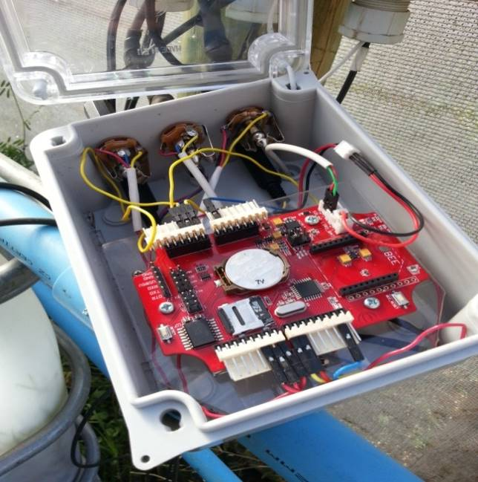
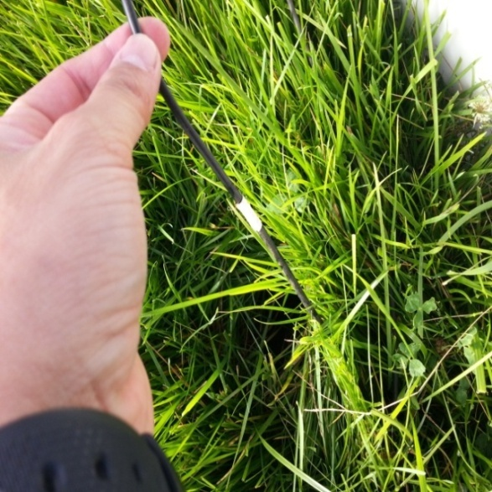
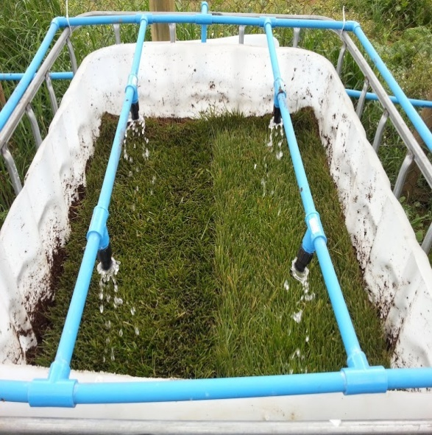
BIOPURIFICACION SYSTEM INSTALLATION
Units of 1m³ with and without vegetal cover + control without pesticides

Slide 15
ASSAY CONDITIONS
BIOMIXTURE
Trumao Soil, Wheat Straw, Peat
(1:2:1 %v), 60% WHC
EVALUATIONS
0 to 60 days
Pesticides and Metabolites
PESTICIDES (35 mg a.i./kg each)
Atrazine
Chlorpyrifos (484 mg L⁻¹ each)
Iprodione
Peroxidase and Dehydrogenase
COMERCIAL VEGETAL COVER
(Festuca sp and Lolium perenne)
Organic Acids
HYDRAULIC LOAD
1.2 L/day
Temperature and Humidity

Slide 16
RESIDUAL PESTICIDES AND METABOLITES
L1
Pesticides and metabolites concentrations in the biomix after 60 days at three depth of biobed. L1, with pesticides and vegetal cover; L2, with pesticides without vegetal cover.

Slide 17
DEHYDROGENASE ACTIVITY
Dehydrogenase activity in biomix . L1, with pesticides and vegetal cover; L2, with pesticides without vegetal cover; L3, without pesticides with vegetal cover; L4, without both pesticides and vegetal cover. A (15 cm), B (35 cm) and C (55 cm).

Slide 18
PHENOLOXIDASE ACTIVITY
Phenoloxidase activity in biomix. L1, with pesticides and vegetal cover; L2, with pesticides without vegetal cover; L3, without pesticides with vegetal cover; L4, without both pesticides and vegetal cover. A (15 cm), B (35 cm) and C (55 cm).

Slide 19
ORGANIC ACIDS EXUDATION
Organic acids extracted from the rhizosphere after 60 days at 15 cm biobed depth. L1, with pesticides and vegetal cover and L3, with vegetal cover without pesticides.

Slide 20
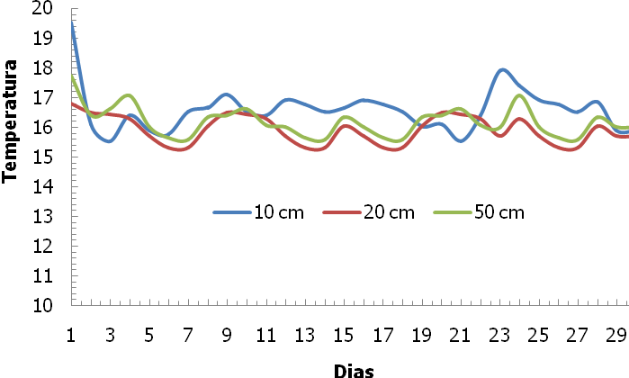
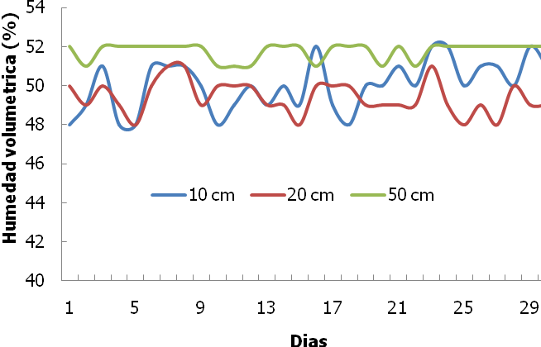
TEMPERATURE AND HUMIDITY RECORD

Slide 21
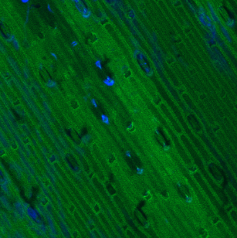
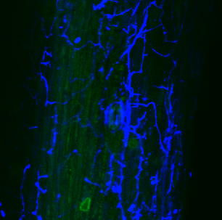
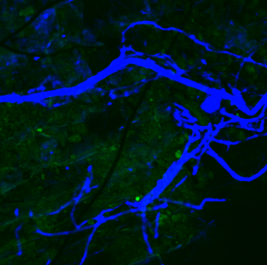
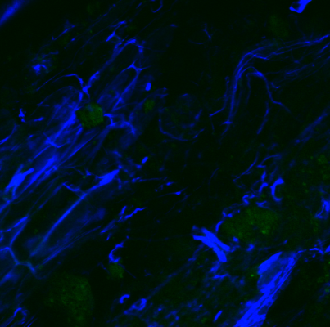
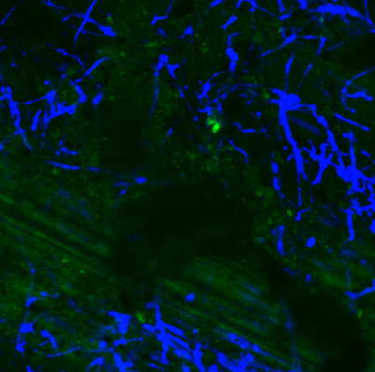
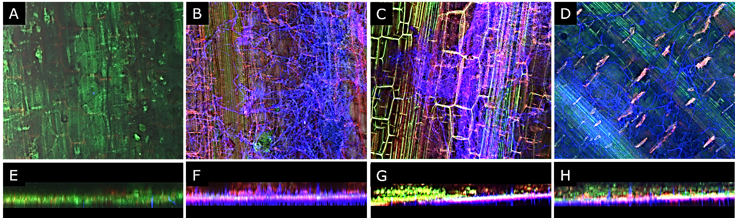
CLSM OF WHEAT STRAW OF BIOMIX
A
B
C
D
E
Confocal laser scanning micrographs (CLSM) of wheat straw. A, wheat straw at initial time (0 day); B, wheat straw for L1 biomix; C, wheat straw for L2 biomix; D, wheat straw for L3 biomix; E, wheat straw for L4 biomix. Micrographs B, C, D and E were taken after 60 days of operation.
Confocal laser scanning microscopy (CLSM) images of colonization and lignocellulosic component degradation by WRF. Lignin (green channel), cellulose (red channel) and fungal mycelium (blue channel).

Slide 22
MAIN CONCLUSIONS
The degradation of the pesticides was high (>95%) and was highest in biobeds with vegetal cover (L1).
At the hydraulic load used (1.2 L d⁻¹), no pesticide residues were obtained in lixiviates of the biobeds system (L1 and L2)
Dehydrogenase activity was similar in all treatments except in biobed without both pesticides and vegetal cover, where low values were obtained (L4).
Contrarily, phenoloxide activity was highest in biobed without both pesticides and vegetal cover (L4).
Oxalic, malic and succinic acids exudation were highest at the first 15 days in contaminated biobed with vegetal cover (L1), instead of, citric acid was highest in uncontaminated biobed (L3).

Slide 23

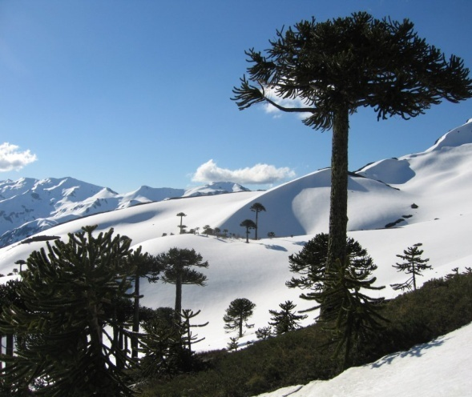
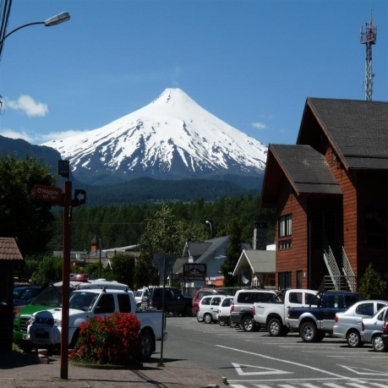
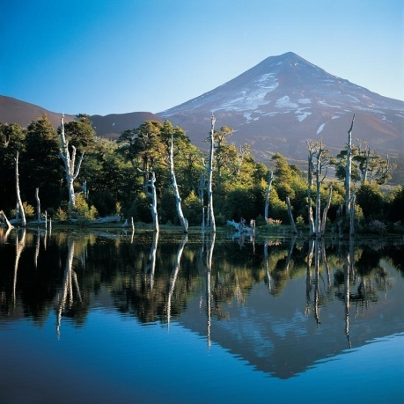
THANKS YOU
Acknowledgements: Financed by FONDECYT 1120963 and CONICYT/FONDAP/15130015 projects
www.lechosbiologicos.cl
www.bioren.cl
La Araucania, South of Chile

Slide 24
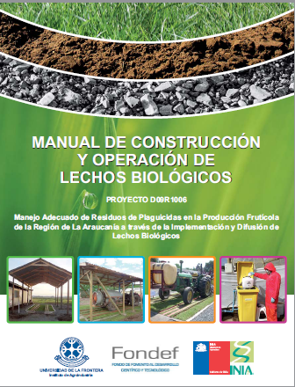

DIFUSSION MATERIALS

Slide 25
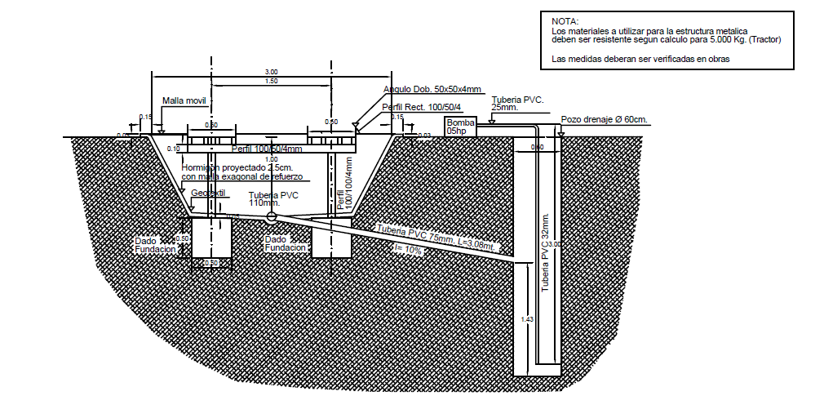
BIOBED CONSTRUCTION

