Slide 1
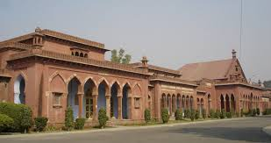
Prevalence of overweight and obesity and their correlates- A cross sectional study among medical students of India
M. Athar Ansari,
Professor, Department of Community Medicine, J.N. Medical College, A.M.U., Aligarh (India)-202002
atharansari777@rediffmail.com

Slide 2
Introduction
Obesity - Long-Term Positive Energy Balance
One of today's most important 'Public Health Problems’
'Global Epidemic' and also one of today's most neglected Public Health Problems
India: Double Burden of Disease

Slide 3
Overweight and obesity - rapidly increasing in countries like India
Under nutrition due to Poverty- 30 % in BPL group
Over nutrition and Obesity --- 5-7% MIG and HIG Urban area
Most productive workforce of the country

Slide 4
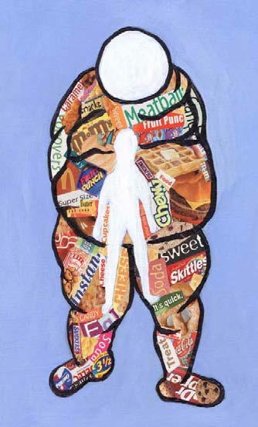
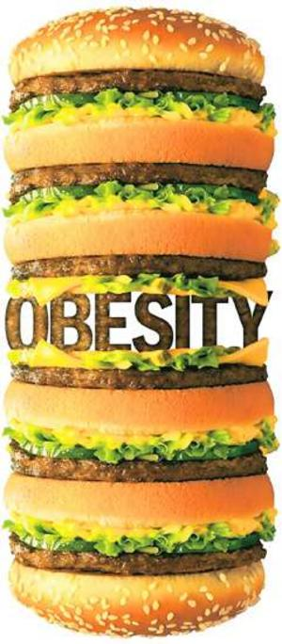
Obesity and Mortality
Morbidly obese individuals (more than 200% ideal body weight) - -twelve fold increase in mortality
Obesity and Diabetes
As many as 80% of patients with type-2 diabetes mellitus are obese

Slide 5
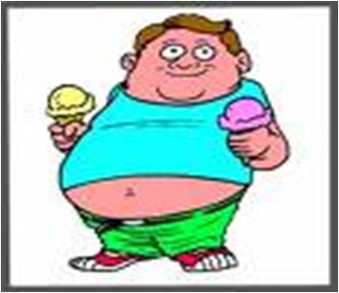
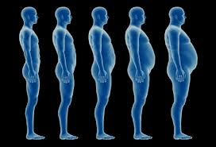
Mild obesity -- Two fold risk of Diabetes
Moderate obesity -- Five fold risk of Diabetes
Severe obesity -- Ten fold risk of Diabetes

Slide 6
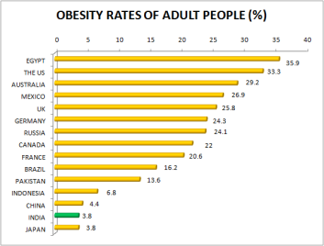
World Scenario
http://datajourno.in/tag/obesity/ (accessed on 17.02.2016

Slide 7
Globally 1/6 adults - obese
Nearly 2.8 million individuals die each year due to overweight or obesity.
(World Health Organization (WHO). World Health Statistics 2. 2012. Geneva: WHO; 2012. Available from: http://www.who.int/gho/publications/world_health_statistics/EN_WHS2012_Full.pdf, accessed on 17.02.2016)

Slide 8
Indian Scenario
Under-nutrition due to poverty which dominated in the past, is being rapidly replaced by obesity
(World Health Organization (WHO). Global health risks: 5. mortality and burden of disease attributable to selected major risks. Geneva: Switzerland, WHO; 2009. Available from: http://www.who.int/healthinfo/global_burden_disease/GlobalHealthRisks_report_full.pdf, accessed on February 17, 2016).

Slide 9
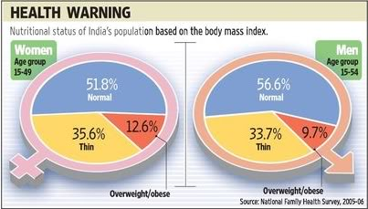

Slide 10
Objectives
To find out the prevalence of overweight and obesity in medical students.
To determine certain correlates of overweight and obesity.

Slide 11
Materials and Methods
Cross-sectional study - carried out from January, 2014 to December, 2014.
Participants - medical students posted in the Department of Community Medicine during 3rd to 5th semesters under Rural Health Posting.
Total number of participants - 240 comprising of 150 male and 90 female students.

Slide 12
A pretested questionnaire was given to them and complete personal details, dietary habits were noted down followed by examination.
Body Mass Index (BMI) was used to categorize the students into underweight, normal, overweight and obese groups.
A BMI of <18.5 Kg/ m² was taken as cut off point for under weight.
Overweight and Obese were taken at the level of 23 Kg/ m² and 25 Kg/m² and above respectively.
24 hour recall
Global physical activity questionnaire

Slide 13
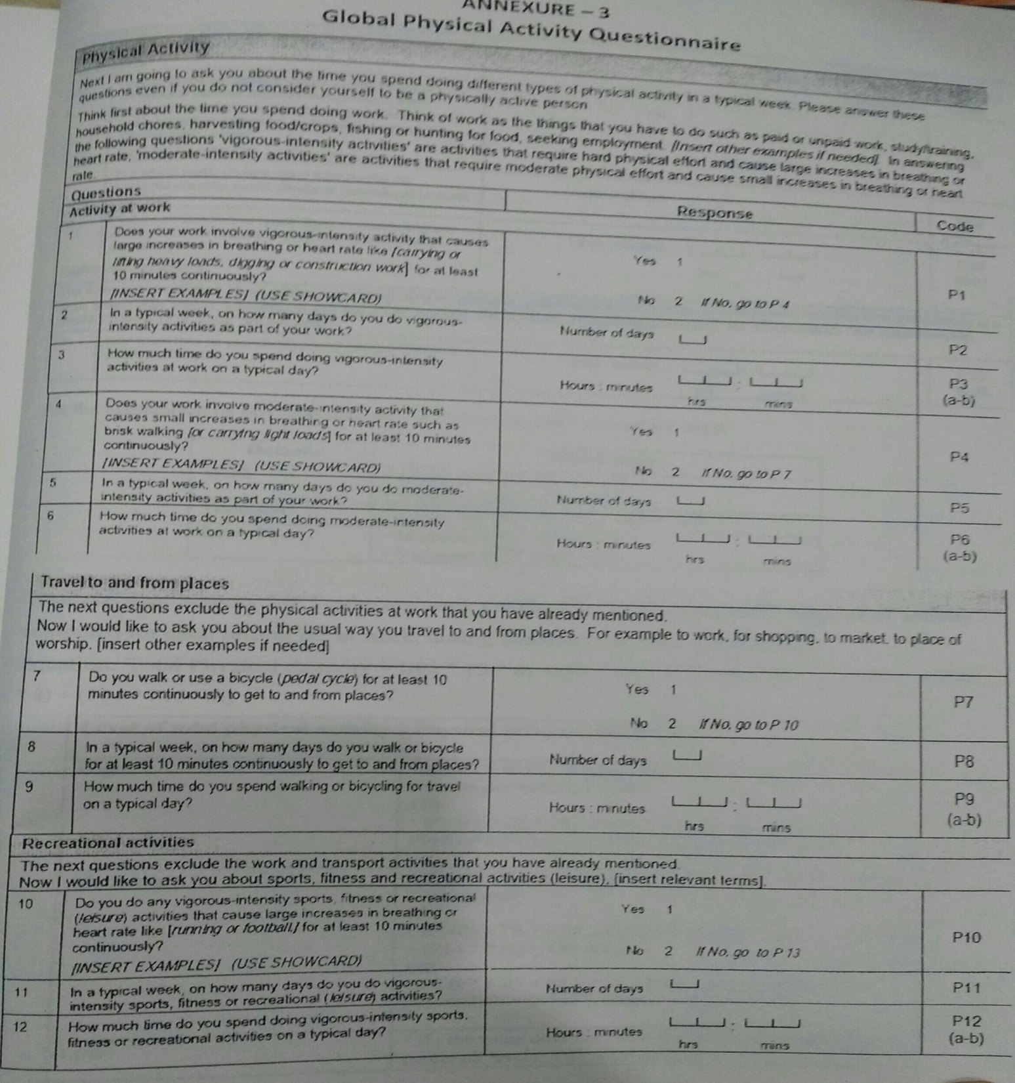

Slide 14
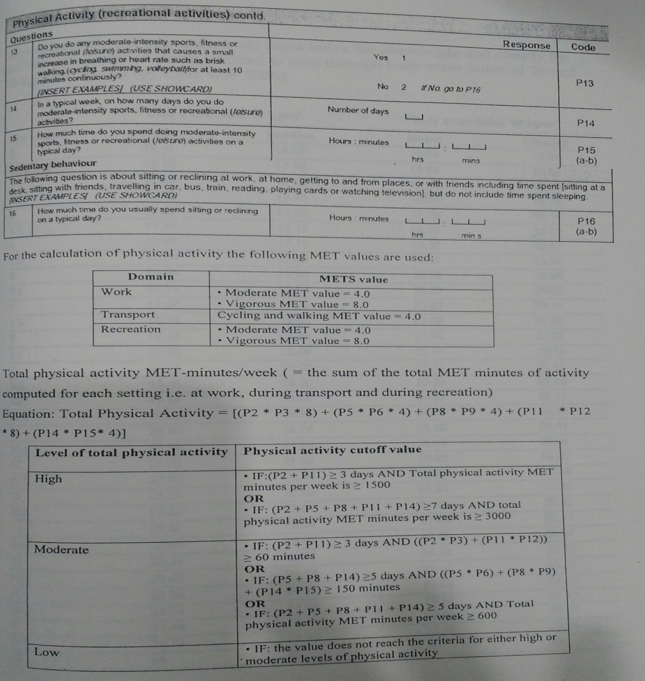

Slide 15
Goyal et al (2010), Aggarwal et al (2008)

Slide 16
Religion
Bharti et al et al (2008)

Slide 17
Calorie Intake
%
Bharti et al et al (2008), Mozaffari et al (2007)

Slide 18
Calorie Intake
%
Goyal et al (2010)

Slide 19
Physical Activity
%
Jafar et al et al (2008), Laxamaiah et al (2007), Anjana et al (2014)

Slide 20
Physical Activity
%
Rauner et al (2013), Shah et at (2013)

Slide 21
Conclusions
There is urgent need for prevention of obesity and its risk factors among college students.
These findings have enormous significance for developing societies emerging from poverty and continuing to bear the double burden of both form of malnutrition in their populations.
Dietary patterns of urban children being influenced by their socio-economic status and the frequency of eating out.
Promoting healthy eating in schools.
Encouraging outdoor sports.
IEC

Slide 22
References
Aggarwal T, Bhatia RC, Singh D, Sobti PC. Prevalence of obesity and overweight in affluent adolescents from Ludhiana, Punjab. Indian Pediatrics 2008;45(6):500-502.
Anjana RM, Pradeepa R et al. Physical activity and inactivity patterns in India – results from the ICMR-INDIAB study (Phase-1) [ICMR-INDIAB-5]. International Journal of Behavioral Nutrition and Physical Activity 2014;11:26.
Bharti DR, Deshmukh PR, Garg BS. Correlates of overweight and obesity among school children of Wardha City, Central India, Indian Journal of Medical Research 2008;127:539-543.
Goyal RK, ShahVN, SabooBD et al. Prevalence of Overweight and Obesity in Indian Adolescent School Going Children : Its Relationship with Socioeconomic Status and Associated Lifestyle Factors. Journal of Association of Physician of India 2010;58:151-158.

Slide 23
5. Jafar TH, Qadri Z, Islam, M, Hatcher J, Bhutta ZA, Chaturvedi N. Rise in childhood obesity with persistently high rates of undernutrition among urban school-aged Indo-Asian children. Archives of disease in childhood 2008;93(5):373-8.
6. Laxmaiah A, Nagalla B, Vijayaraghavan K, Nair M. Factors Affecting Prevalence of Overweight Among 12- to 17-year-old Urban Adolescents in Hyderabad, India. OBESITY 2007;15(6):1384-1390.
7. Mozaffari H, Nabaei B. Obesity and related risk factors. Indian Journal of Pediatrics 2007;74:265-67.
8. Rauner A, Mess F, Woll A. The relationship between physical activity, physical fitness and overweight in adolescents: a systematic review of studies published in or after 2000. BMC Pediatrics 2013;13:19.
9. Shah JS, Patel PK, Patel B. Determinants of overweight and obesity among school children in Mehsana District, India. Annals of Tropical Medicine and Public Health 2013;6(4):408-412.

Slide 24


