Slide 1
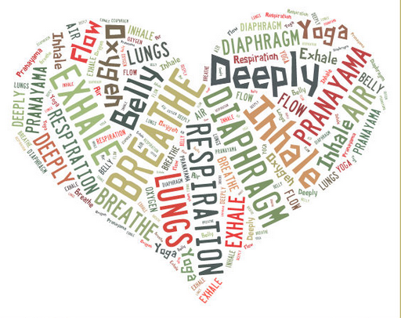
PHYSIOLOGICAL COHERENCE
MOUTH BREATHING AND BIOFEEDBACK
Dr Lynette Wallace BDS Hons (Syd)
Notes:
Good afternoon my name is Dr Lynette Wallace I have a dental practice in the Southern Highlands of NSW
Today I would like to show you how I’ve integrated biofeedback into my practice and the benefits it has for the patients.

Slide 2
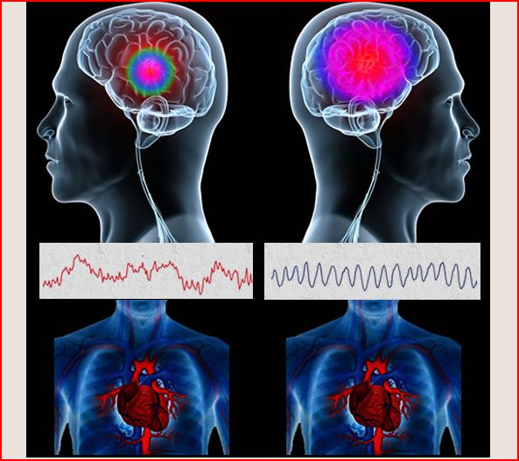
Breathing Well Program at PlanetSmiles
- dedicated to awareness of nasal breathing and its impact on the developing bite and its multisystem effect on heart function, brain function and the immune system.
Notes:
At my practice, we are using these programs as an adjunct to orthopaedic and orthodontic treatment.
We find it helps compliance with orthopaedic appliances.
One of the key benefits to using biofeedback is that the patient can see the multiple effects that breathing has on the body in real time.
It shows the relationship between breathing, heartrate and emotions
the patient can experiment with different breathing patterns and emotions to play various games.
Kids are already familiar with computers so it is relating to kids in their language and on their terms.

Slide 3
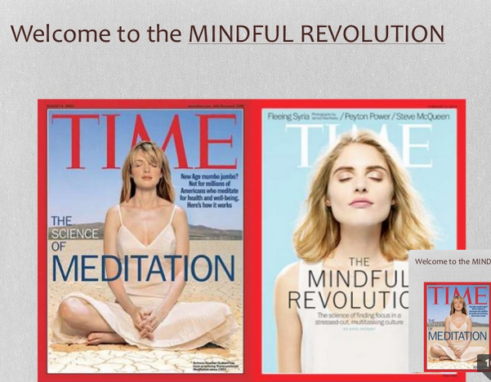
Its time for change.
Instead of thinking outside the box,
Turn your attention to the inside.
Notes:
We are beginning to realise that one of the key ways to keep our bodies healthy and optimise development is to start with the breathe.

Slide 4
Outline of Presentation
2 main Biofeedback programs used in our surgery
How they work,
Analysis of the data
Case presentation and follow up four years later

Slide 5
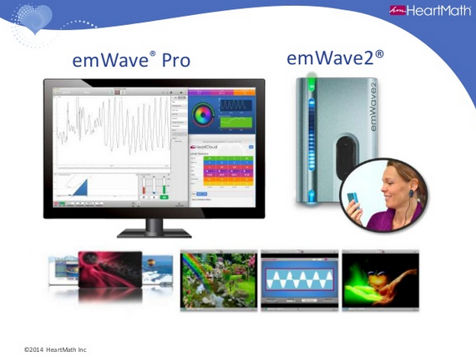
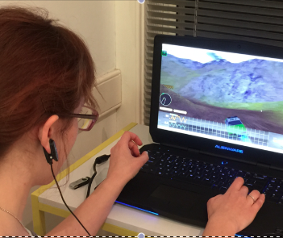
Notes:
Software breathing techniques focus on stabilising beathing,
Which shifts the heart rhythm and shifts to a positive emotional state.
This creates a favourable cascade of neural biochemical and hormonal events .
This benefist the entire body and mind.

Slide 6
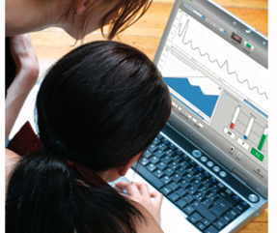
Physiological Coherence, Mouthbreathing and Biofeedback
  Can breathing techniques be learnt through biofeedback video games and how can they be used as an adjunct in dentistry?
Notes:
So the question I would like to explore is “Can breathing techniques be learnt through biofeedback video games?

Slide 7
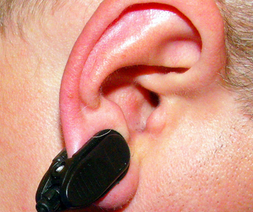
What is Biofeedback? Biofeedback is a technique that trains people to improve their health by controlling certain bodily processes that normally happen involuntarily. In our case breathing. Electrodes are attached to your earlobe that measure the processes and are displayed on a monitor. With training you can learn to change your breathing rhythms to adjust to nasal breathing.
Notes:
So what is biofeedback? The use of electronic monitoring of a normally automatic bodily function in order to train someone to acquire voluntary control of that function.
Biofeedback is being used globally by medical professionals, cardiologists, treatment for ADHD, schools, large companies such as Cathay Pacific, accounting firms, Australian Army and the Federal Police Force.

Slide 8
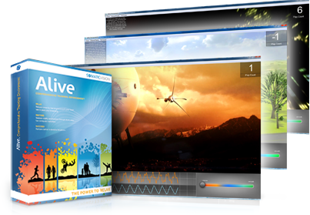
Brave New World
Video Games that Teach You to Relax
Wild Divine and Somatic Vision pioneer fun and engaging Video games.
These focus on stress-reduction as a primary health objective.
Notes:
Our team has been using two main programs with the patients.
The Wild Divine and Somatic Vision/Heart Math emwave program.
There is a wide variety of games which allows them to use the power of their breathing to progress through the games rather than by physically moving the mouse

Slide 9
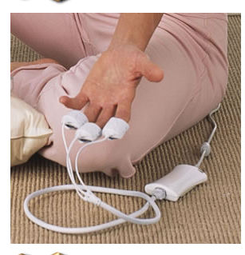

Notes:
The Journey to Wild Divine is promoted by Health Gurus Andrew Weil and Deepak Chopra. It’s a platform for guided meditation and stress reduction. Players control the gameplay with their own minds. Technically the finger sensors or IOM control the game,
in practical terms it acts similar to your mouse or joystick, as a connection between you and your computer. For example, if something requires you to move your mouse left on the screen, in Wild Divine you need to relax your muscle and calm down to move left. It picks up your body’s extremely subtle signals of emotion, calm, stress, tension and happiness, and lets you progress in the game dependent on your ability to control yourself.
It uses the physiological measurements – heart rate coherence and skin sweat.

Slide 10
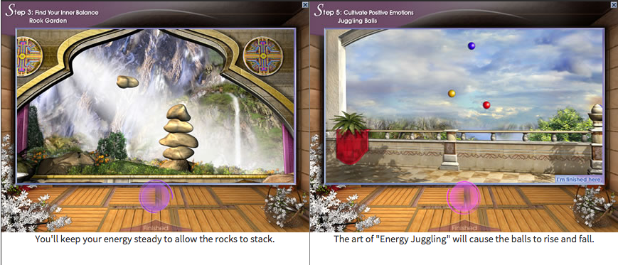
Notes:
Here are a few of the screens used in the wild divine game
In the first you’ll keep your breathing steady to allow the rocks to stack
The second trains you in the art of energy juggling which cause the balls to rise and fall.

Slide 11
Biofeedback and ADHD
Aust. Journal of Educational & Developmental Psychology Vol 8 2008; p72-84
Amon & Campbell
“Can children with AD/HD learn relaxation and breathing techiques through biofeedback video games?”
The Wild Divine has shown potential in teaching breathing and relaxation techniques to reduce disruptive behaviours in children with ADHD.
Notes:
The Journey to Wild Divine has been used as a research tool by Amon & Campbell from the University of Newcastle.
They found it to show a lot of potential in teaching breathing and relaxation techniques to reduce the disruptive behaviours in children with ADHD.

Slide 12
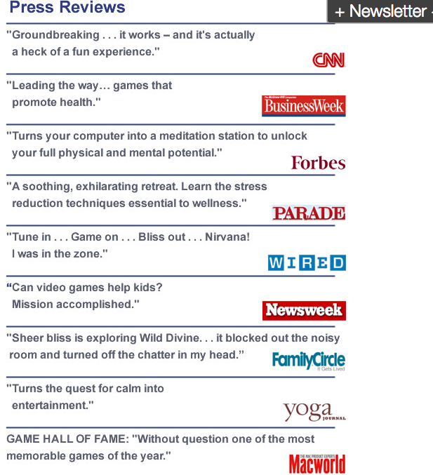
Notes:
It gets 5 star reviews
CNN – ground breaking, it works and is a heck of a fun experience
Newsweek – can video games help kids? Mission accomplished
Yoga magazine says it turns the quest for calm into entertainment

Slide 13
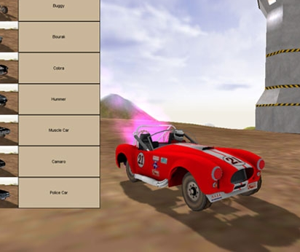
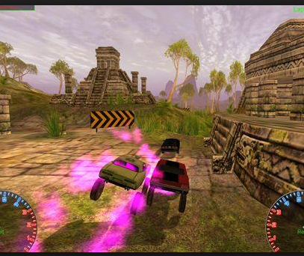
Gaming for health
Notes:
The other programme we use is by Somatic Vision. The developer worked with the French Ministry of Defence and the Israeli Defence Department.
Its targeted at high pressure executives, veterans, harried parents and children.

Slide 14

Notes:
Science is realising that breathing holds the key to finding focus in our stressed out multi-tasking culture
Governments and multi million dollar corporations invest a lot of time training their employees in these techniques, as the programs are geared to bring quick results, rapidly improve and sustain performance.
They provide a significant return on investment on a number of levels.
2007 Journal of the American Medical Association reported that “Workplace stress is as bad for your heart as smoking and high cholesterol”

Slide 15
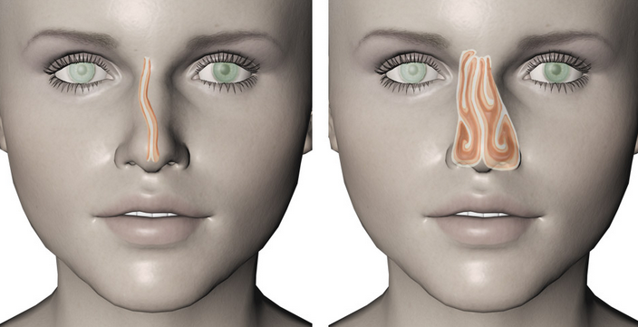
Physiology behind the programmes
When the heart and the brain are in sync there is physiological coherence.
Rhythmic breathing is only possible with nose breathing due to pH regulations of the body.
Notes:
Breathing patterns modulate the hearts rhythm. The heart is in sync with the brain and the whole nervous system by simply breathing slowly and regularly.

Slide 16
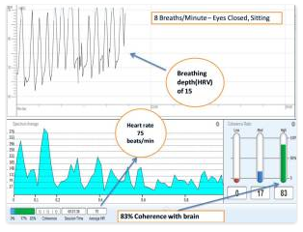
Respiration aids Circulation
Regular breathing causes the heart rate to synchronise to the breath.
Respiration aids in circulation
This facilitates venous flow during inhalation and arterial flow during exhalation
Notes:
Neurocardiology scientists have discovered that the heart possesses its own intrinsic nervous system – a network of nerves so functionally sophisticated as to earn the description of a heart brain. This gives the heart the ability to independently sense, process information, make decisions and even to demonstrate a type of learning and memory. Not only is it intelligent, but research has also revealed that the heart is a hormonal gland, Oxytocin is one of these known as the “love” or “bonding hormone”.
Science has only just begun to understand the effects of the electromagnetic fields produced by the heart. There is evidence that the information contained in the hearts powerful field may play a vital synchronizing role in the human body.

Slide 17
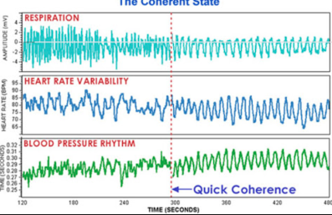
Coherence: A state of optimal function
Notes:
Both ANS synchronise along with a number of different bodily systems to the heart rhythm.
HeartMath research has demonstrated that different patterns of heart activity have distinct effects on cognitive and emotional function.
During stress and negative emotions when the heart rhythm pattern is erratic and disordered, the corresponding pattern of neural signals travelling from the heart to the brain inhibits higher cognitive functions. This limits our ability to think clearly, remember, learn, reason and make effective decisions
This may explain why we act impulsively during stress.
In contrast a more ordered and stable pattern of the heart’s input to the brain during positive emotional states has the opposite effect, it facilitates cognitive function and reinforces positive feelings and emotional stability

Slide 18
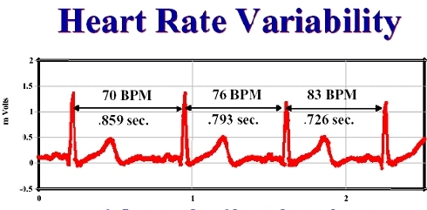
The Science
  The heart’s rhythm changes beat to beat.
  The naturally occuring beat-to-beat variation in heart rate is called heart rate variability (HRV)
Notes:
The time interval between heart beats varies
Why is HRV important?
HRV is an indicator of physiological resilience and behavioural flexibility
It is also used as an indicator of biological aging. A low HRV is associated with an increased risk of future health problems and associated with premature mortality.
Low HRV is observed in individuals with a wide range of diseases and disorders.

Slide 19
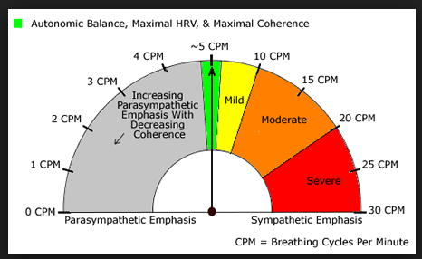
Notes:
This diagram shows how the frequency of breathing harnesses the parasympathetic or sympathetic nervous systems. So in analysing the HRV we can look at the function and balance in the autonomic nervous system.

Slide 20
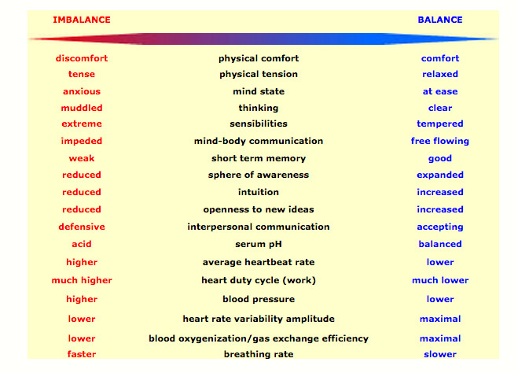
Symptoms
The Subtle relationship between Breathing, Circulation, Autonomic Governance and Heart Rate
Notes:
So just by looking at symptoms it is possible to see if there is autonomic balance or not and if imbalanced which side is dominant.
For example physical tension is tense in imbalance
Serum pH is acidic in imbalance and blood pressure is higher.

Slide 21
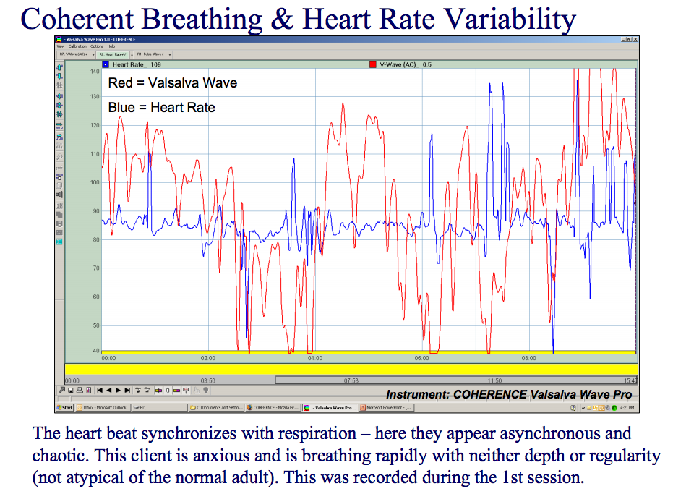

HRV – Irritated Frustrated Angry
Notes:
The HRV also reflects our emotional state. The heart literally beats out different messages with every pulse.
This is what HRV looks like when we are irritated and frustrated – it appears asynchronous and chaotic, the patient is anxious and breathing without depth and regularlity.

Slide 22
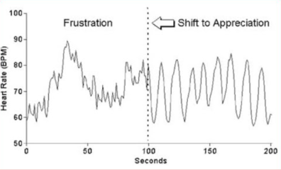
HRV and Negative Emotions
Notes:
Emotional stress gives rise to irregular erratic heart rhythm patterns which are incoherent.
This pattern indicates that the signals produced by the two branches of the ANS are out of sync with each other.

Slide 23

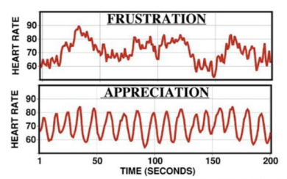
HRV and Positive Emotions
Notes:
Positive emotions excite the system at its resonant frequency and enable rhythmic breathing to emerge and be maintained naturally in sync with the persons natural heart rhythms without any conscious mental focus on breathing.
Appreciation, joy care and love produce highly ordered, smooth harmonious heart rhythm patterns – ie Coherent Heart Rhythm patterns.
The ANS is synchronised and the body’s systems operate with increased efficiency and harmony.

Slide 24
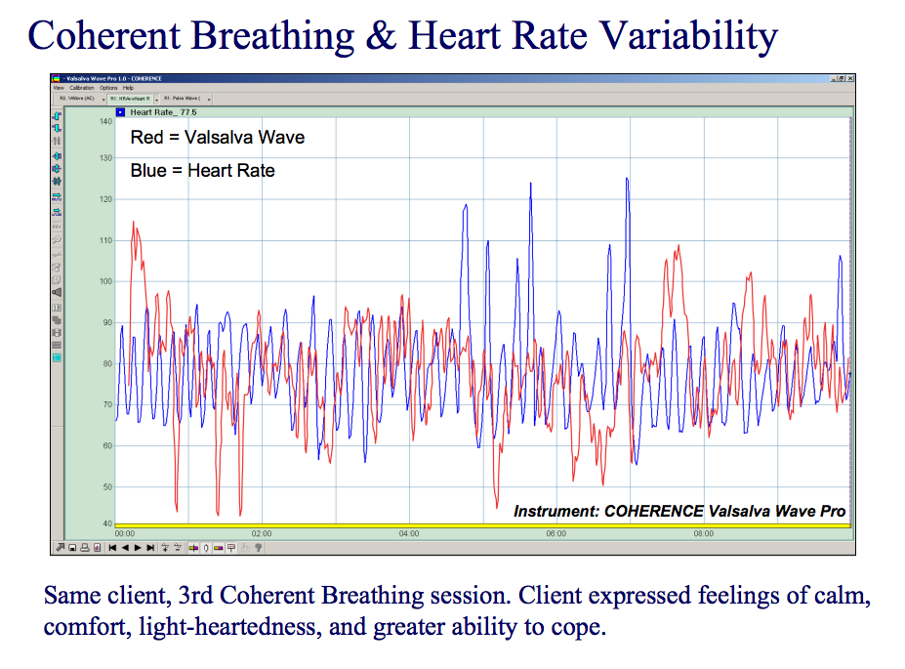

HRV – Feeling Good
Notes:
When composed and feeling good the heart beats out a different message and feelings of calm, comfort and greater ability to cope are expressed.

Slide 25
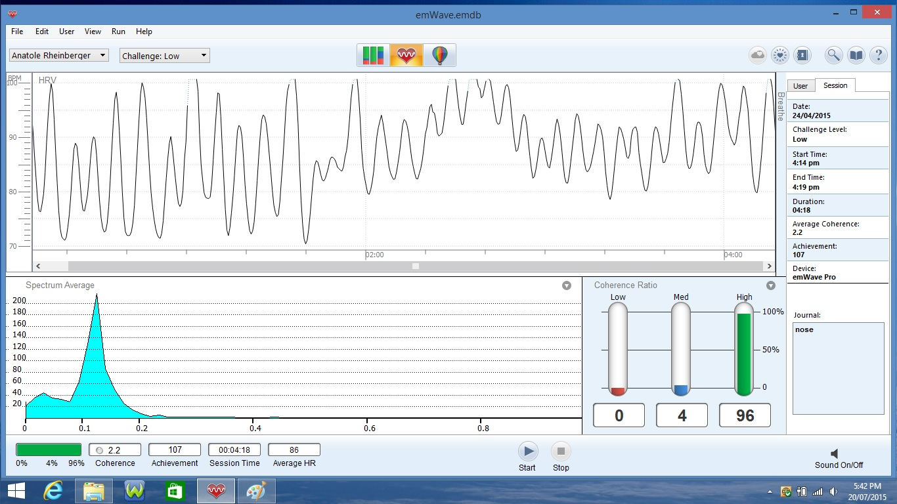
Power Spectral Density (PSD)
Notes:
For these reasons we would like to look at autonomic system balance with the The Power Spectral Density
This is a mathematical transformation of HRV, it helps distinguish sympathetic from parasympathetic regulation of the Sino Atrial node.

Slide 26
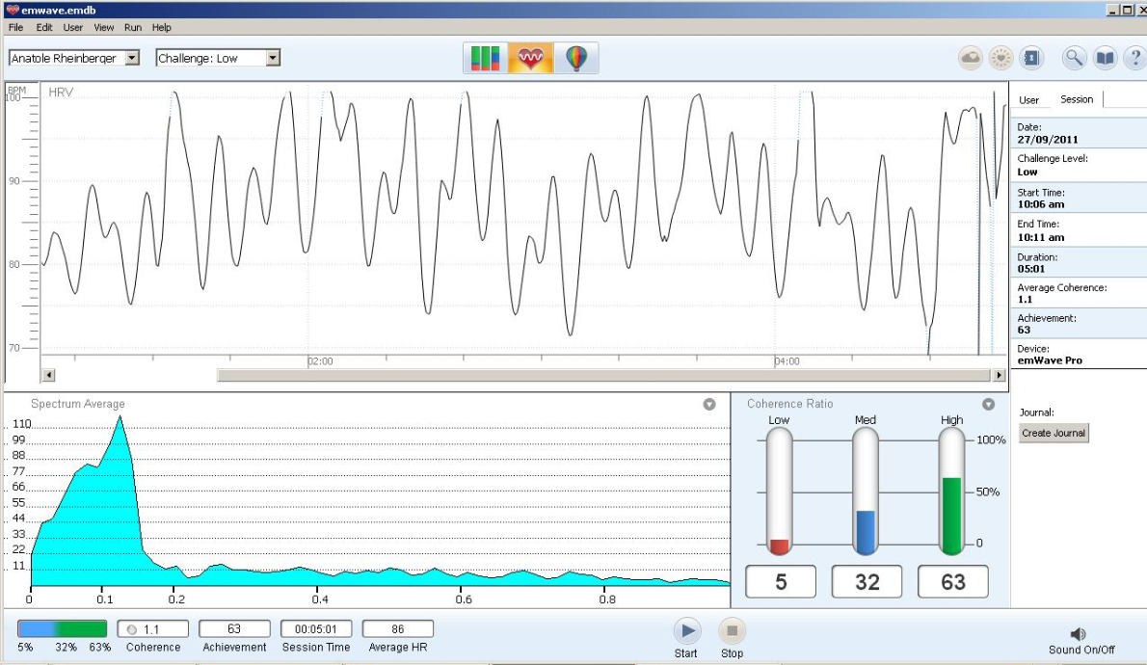
Notes:
HRV and PSD analyses have been used to monitor a variety of pathologic states and to predict mortality after Myocardial infarction and congestive heart failure
It has also been used in coronary angiography to determine the risk of rejection after cardiac transplantation. HRV and PSD are also being ussed in psychological illnesses including major depression and panic disorders

Slide 27
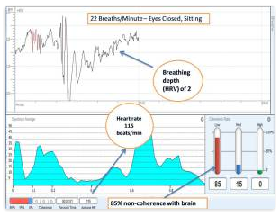
BIOFEEDBACK ANALYSIS
Notes:
So now we will go over what the biofeedback Analysis screen looks like
Records the pulse
Records the heart rate rhythm
Coherence level, coherence ratio

Slide 28
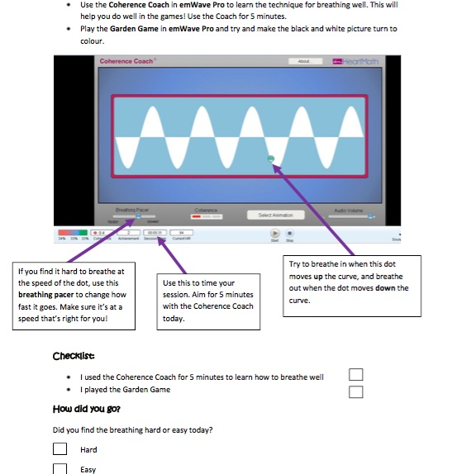
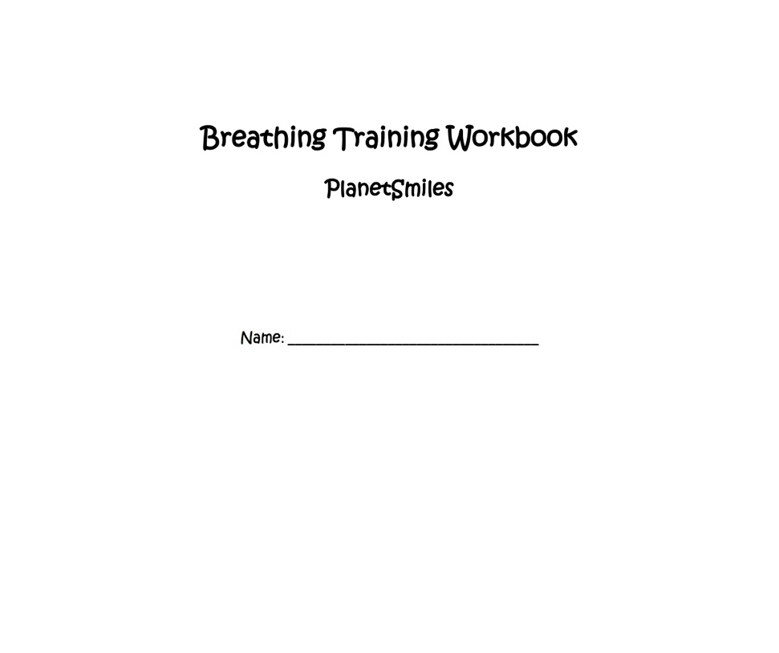
Notes:
Lets talk about the breathing training workbook we have developed with the software to use with our patients.
The first thing the patients work with is a breathing pacer called a coherence coach. They can adjust the breathing pacer to match their breathing speed.
They learn to pace their breathing until they get a green light on the screen which means there is high coherence, there is a red light for low coherence and a blue light for medium coherence.

Slide 29
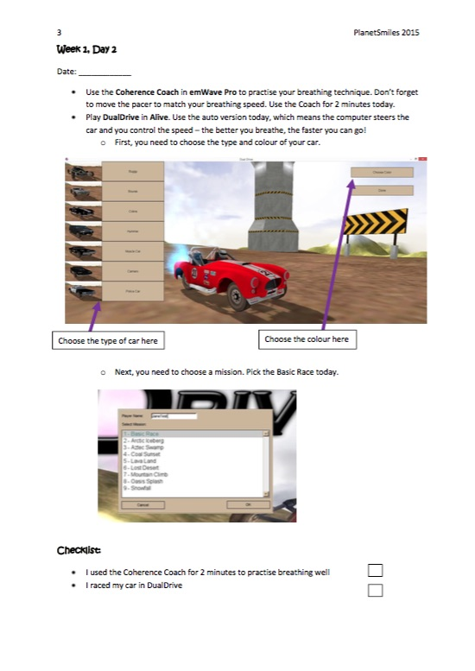
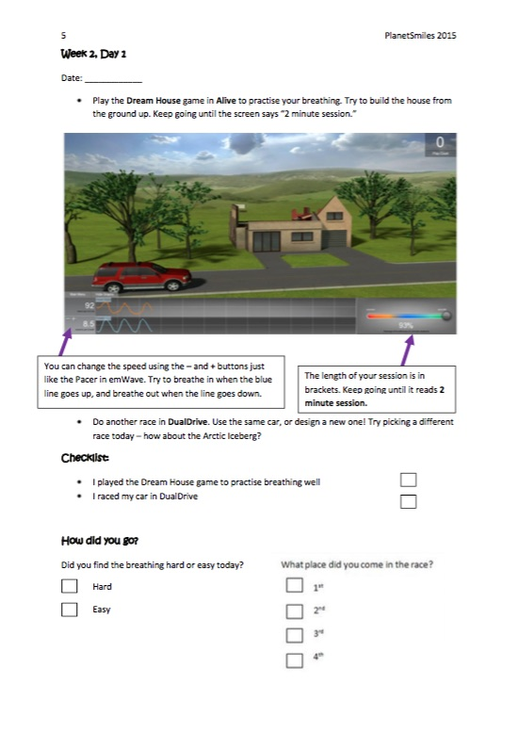
Notes:
From there they progress on to play car games, the computer steers the car and they control the speed, the better they breathe the faster they go.
Dream house builds the house from the ground up

Slide 30
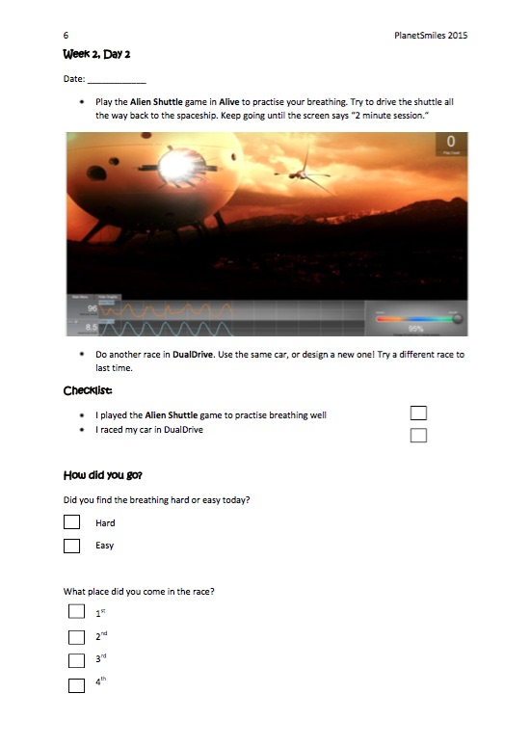
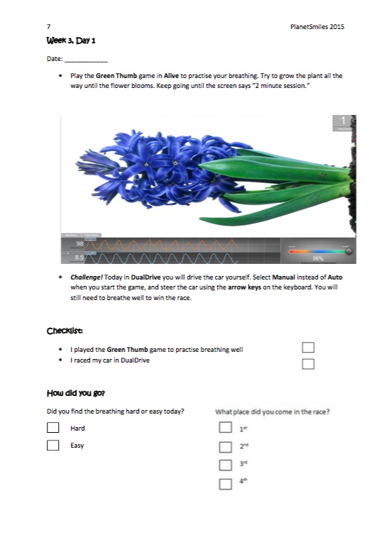
Notes:
Here they drive the shuttle all the way back to the space ship
On the right you grow a plant all the way until the flower blooms

Slide 31
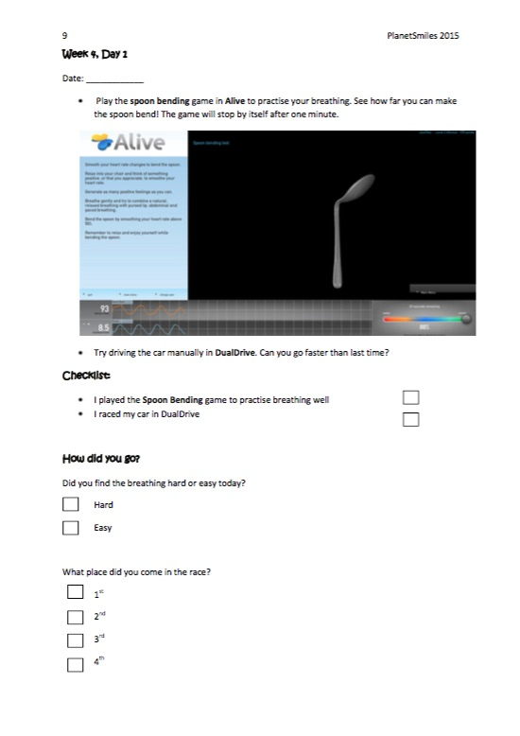
Notes:
By this stage you should be pretty good And practice coherent breathing to see how far you can make the spoon bend.

Slide 32
emWave Program for Biofeedback
  emWave works on the basis of “sessions”. The principle features of emWave appear when you run a session.
Record your pulse
Record and view your heart rhythm
View your coherence level
View your coherence ratio
View accumulated coherence score
Run the Coherence Coach
Play the emWave games

Slide 33
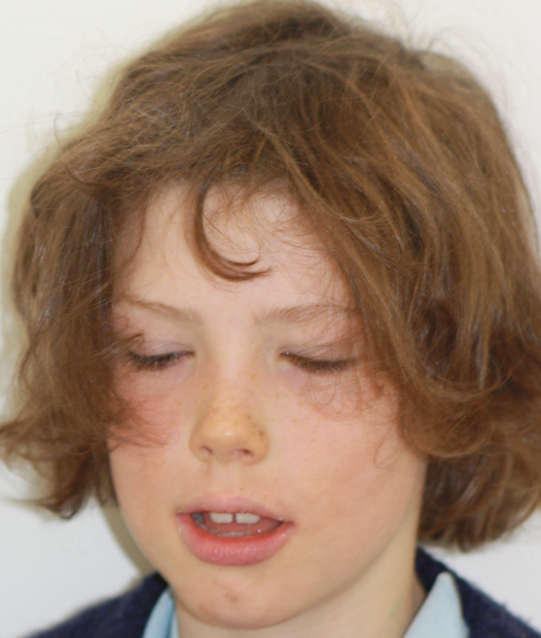
Case Study
Initial Signs and Symptoms | 8 yr
Mouth breathing Allergies Blocked nose Frequent respiratory infections Poor concentration Tension/anxiety Fatigue Disrupted sleep Dark circles under eyes Dry and chapped lips Noisy breathing

Slide 34
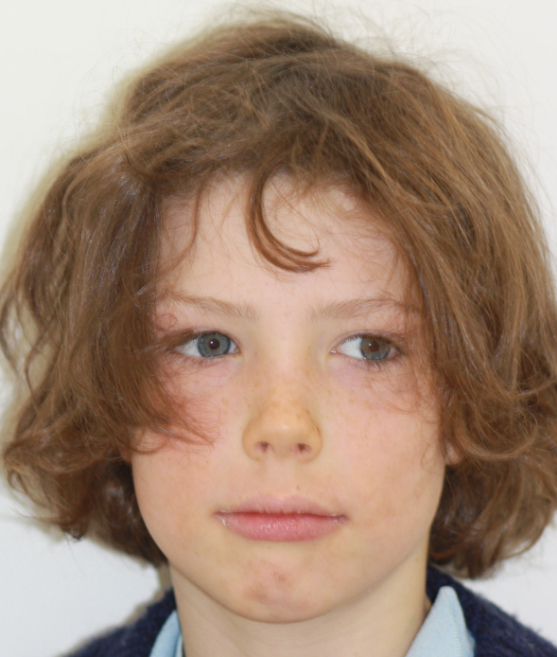
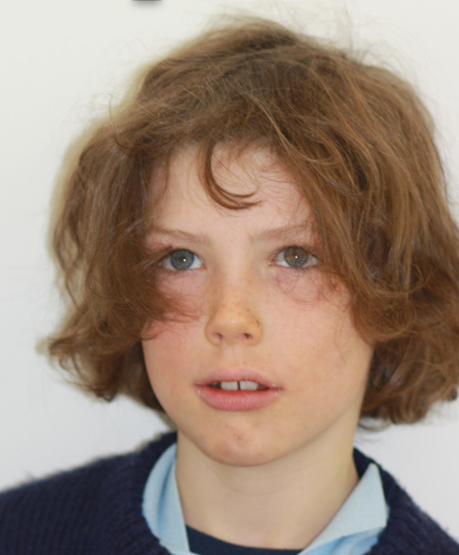

Slide 35
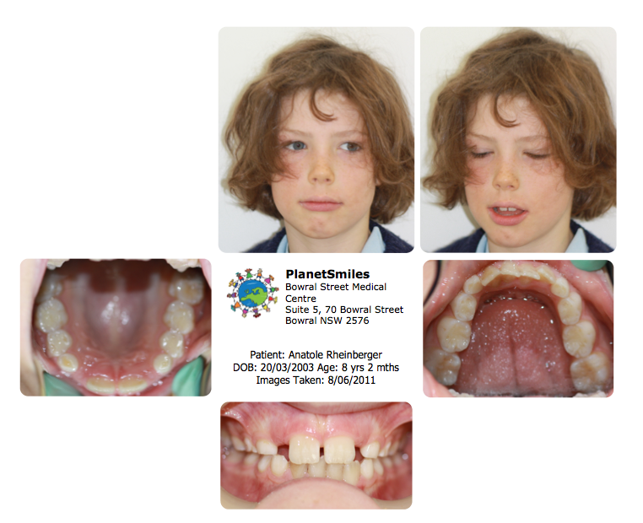

Slide 36
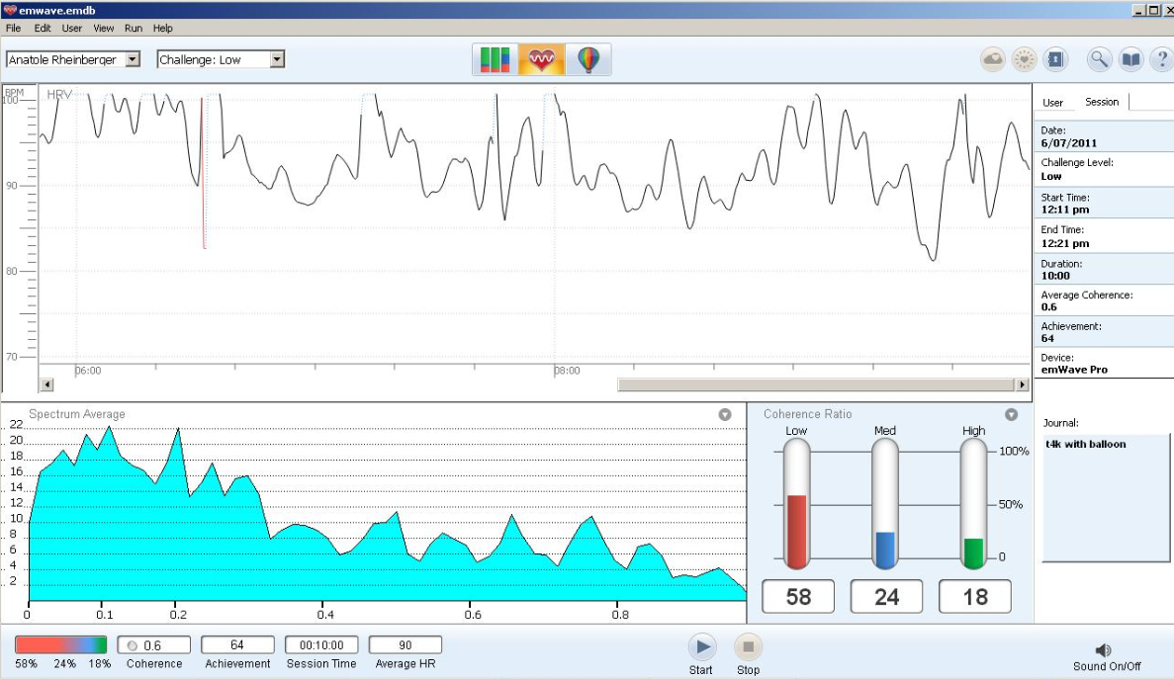
Notes:
Here is one of his first coherence graphs which show an erratic chaotic breathing pattern, low coherence ratios and a sympathetically dominated autonomic nervous system in the Power spectral density

Slide 37
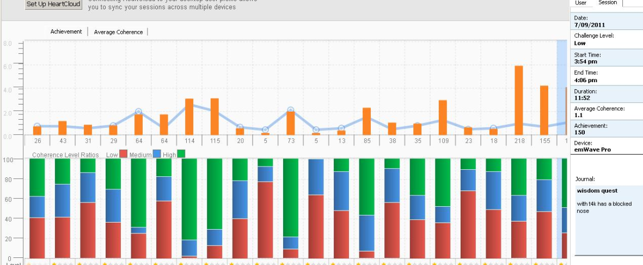
Notes:
Here we are viewing his accumulated coherence scores,
In these graphs the more green and blue we see and the less red is a good thing
He came in twice a week for about 20 mins a session, which was supervised by the reception staff,
Some weeks he skipped due to nasal infections etc.

Slide 38
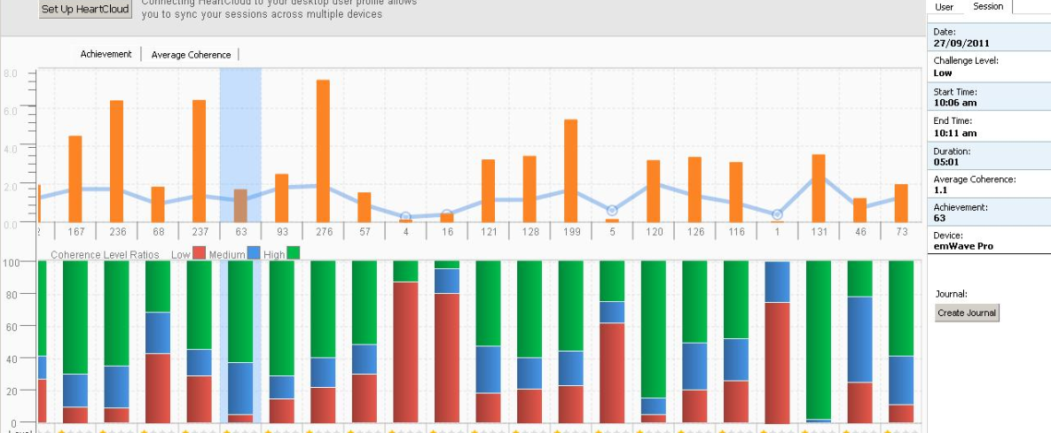

Slide 39
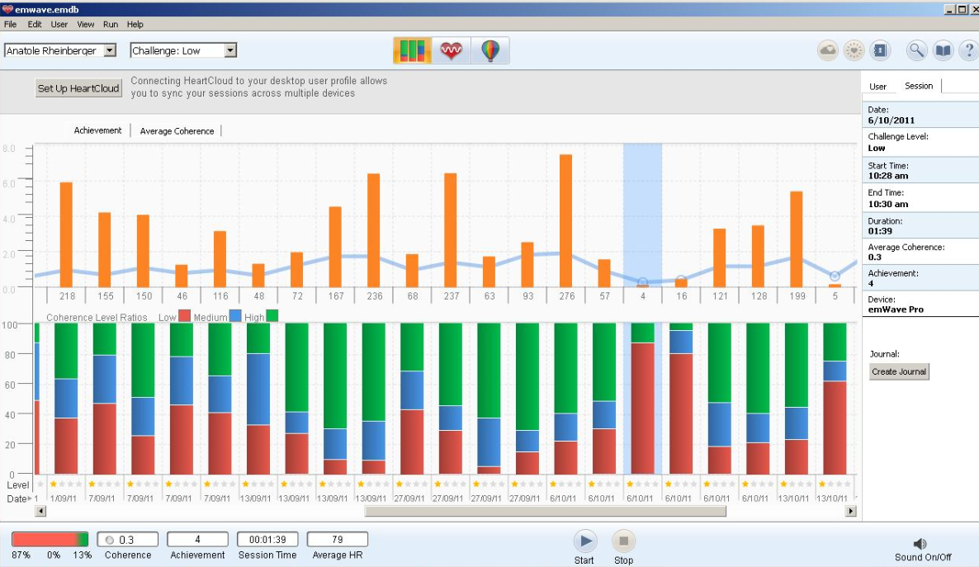

Slide 40
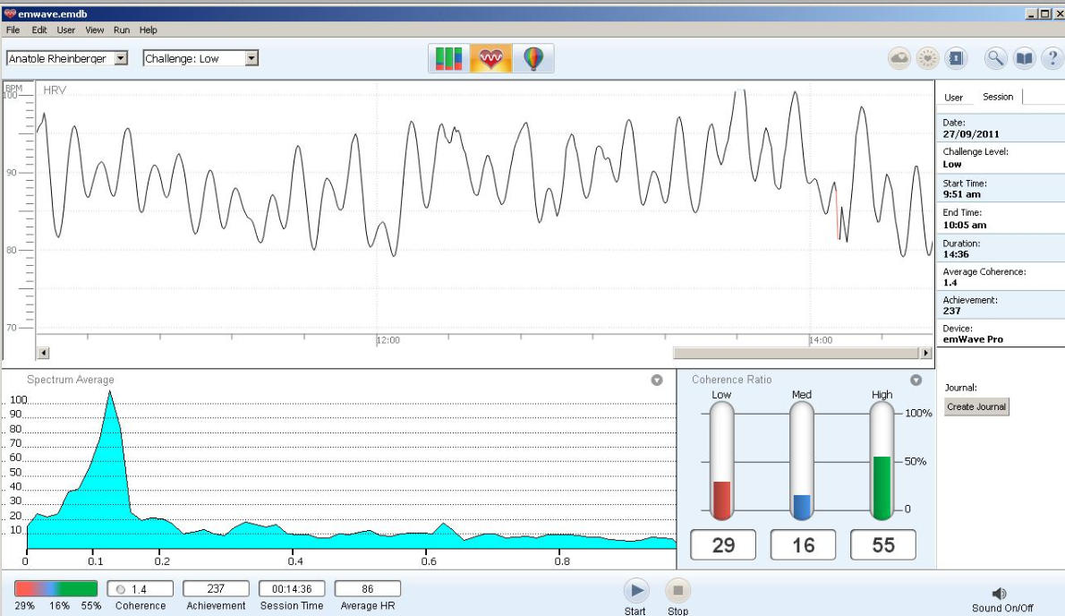

Slide 41
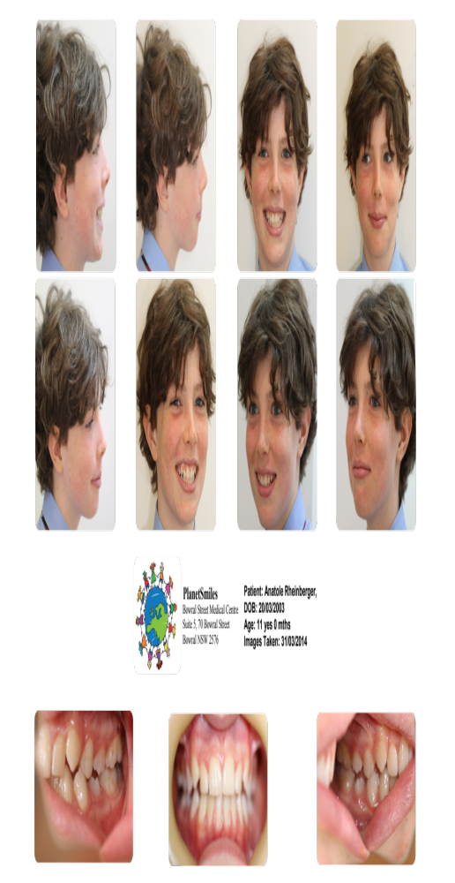
Case Study – 3 years later
Notes:
And he started looking more alert and more focused and happier

Slide 42
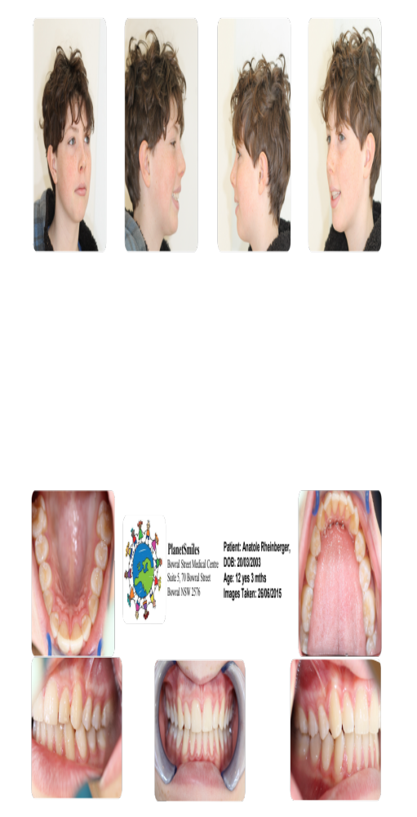
4 years later
Notes:
Less allergies, exhibited mainly nasal breathing, more alert and more focused.

Slide 43
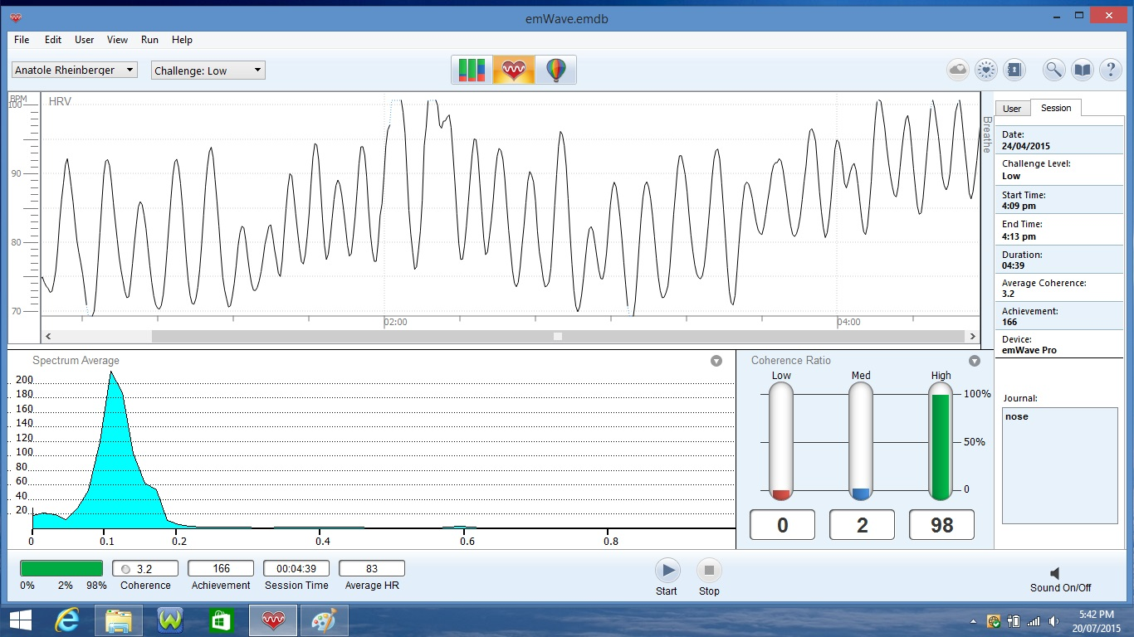

Slide 45
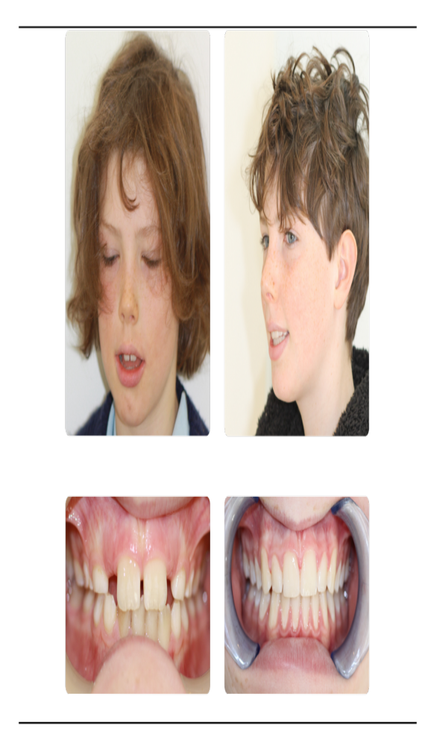
Notes:
So yes biofeedback programes can be very effective in teaching new breathing techniques which can lead to more healthy development and productive behaviours.

Slide 46
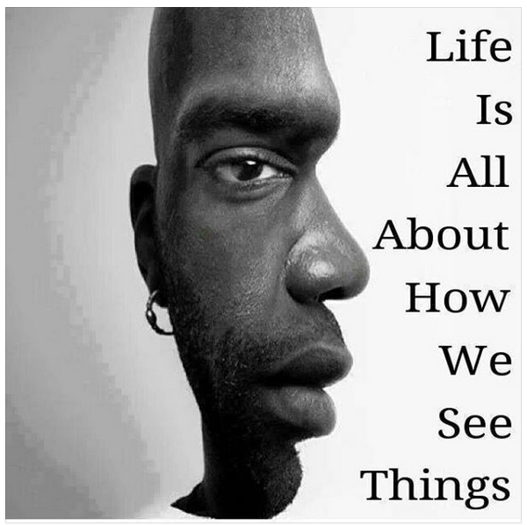

Dr Lynette Wallace BDS Hons Syd
info@planetsmiles.com.au

