Slide 1
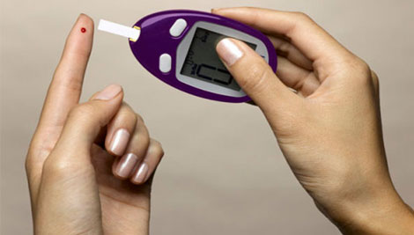


Diabetes Specific Psychological Distress in Type 2 Diabetes Mellitus, using the PAID scale
Dr Lydiya Thomas, Dr Hesarghatta Shyamasunder Asha
Dr Raja Edwin Amalraj, Mr Prakash R
Dr Prakash Abraham, Prof Nihal Thomas

Slide 2
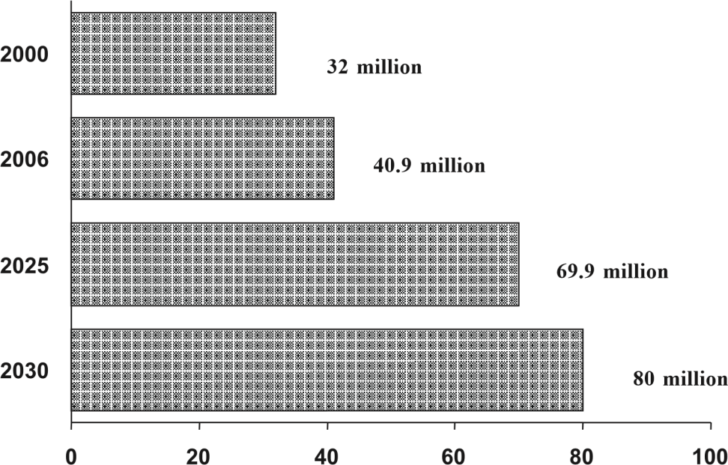
INTRODUCTION
Diabetes is an important public health challenge¹
More pronounced in India – Type 2 (90%)²
Focus of treatment on lifestyle and pharmacological methods
However studies also identified a significant association between psychological distress and diabetes
Number of diabetic subjects (million) in India²
World Health Organisation (WHO). Diabetes Fact sheet N0312. 2013. Available at: http://www.who.int/mediacentre/factsheets/fs312/en/. [online]. Accessed on 31/08/2014.
Mohan V, Sandeep S, Deepa R, Shah B, Varghese C. Epidemiology of type 2 diabetes: Indian scenario. Indian J Med Res 2007 Mar;125(3):217-230.

Slide 3
Diabetes Specific Psychological Distress (DSPD)
The burden of self-care and pharmacological therapy
  → overwhelm or burn-out patients³
Adjustment to the disease associated with
  → anger, guilt, frustration, denial and loneliness⁴
The potential influence of diabetes on life-expectancy and the impact of long-term complications
  → fear and depression³
Lloyd CE, Pouwer F, Hermanns N, ed. Screening for Depression and Other Psychological Problems in Diabetes: A Practical Guide. London: Springer-Verlag; 2013.
Polonsky WH. Understanding and Assessing Diabetes-Specific Quality of Life. Diabetes Spectr. 2000;13(1):36.
Notes:
especially with insulin injections
Various negative emotions
aggravate feelings of
These responses are classified as ‘Diabetes-specific Psychological Distress (DSPD). It’s a separate entity from general emotional distress

Slide 4
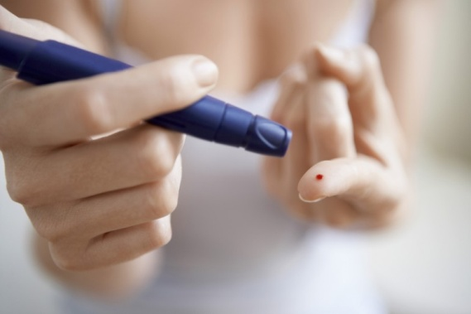
DSPD
Prevalence: 18-52%³
Specific to diabetes
Associated with depression, reduced QoL, poor diabetes self-care and impaired glycaemic control
Earlier diagnosis and treatment known to improve outcome
Holistic/ patient-centred model of care
National recommendations suggests screening using questionnaires⁵
Lloyd CE, Pouwer F, Hermanns N, ed. Screening for Depression and Other Psychological Problems in Diabetes: A Practical Guide. London: Springer-Verlag; 2013.
Kalra S, Sridhar GR, Balhara YPS. et al. National recommendations: Psychosocial management of diabetes in India. Indian J Endo and Meta 2013 May;17(3):376-380

Slide 5
PROBLEM AREAS IN DIABETES (PAID)
Well-validated, easy-to-administer, 20-item scale
Uses a five-point Likert scale
Shown to correlate strongly with DSPD
Welch G, Weinger K, Anderson B, Polonsky WH. Responsiveness of the Problem Areas In Diabetes (PAID) questionnaire. Diabet Med. 2003;20(1):69-72.
Notes:
Modern means of measuring QoL involves self-reported questionnaires
PAID measures DSPD. Developed in Boston, USA

Slide 6
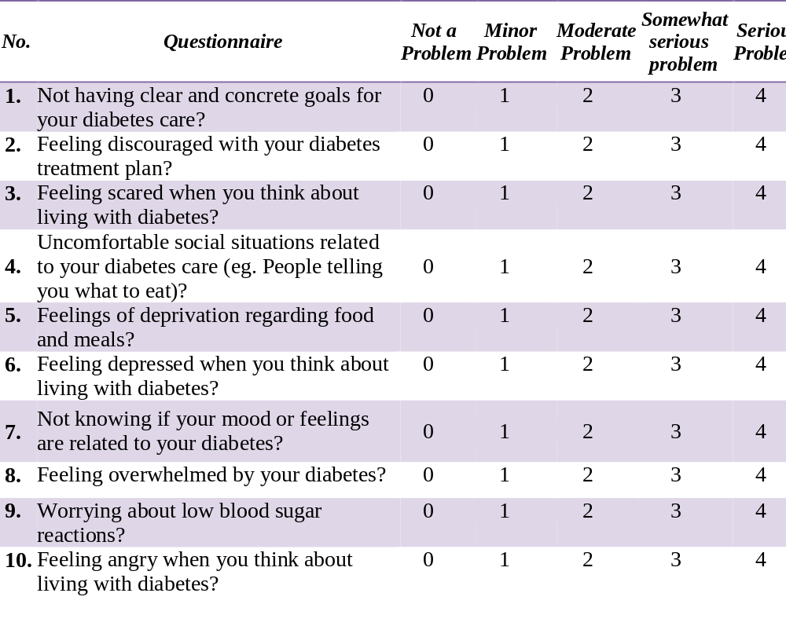

Slide 7
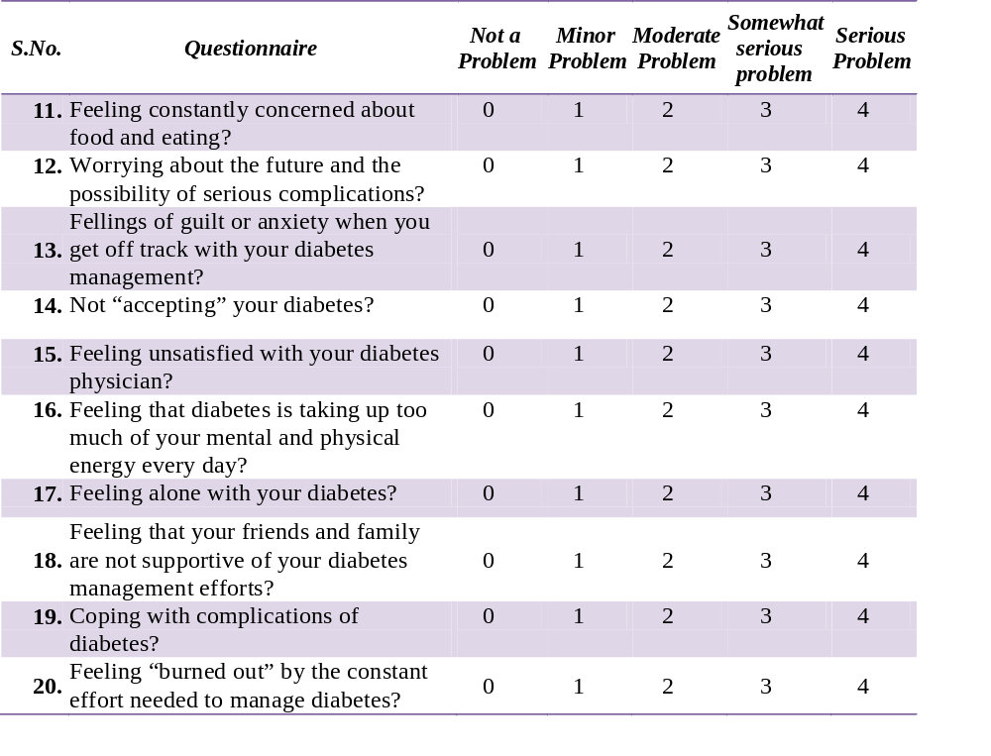
SCORING
  Ranges from 0-100
  Summing 0-4 responses to 20 PAID items & multiplying the sum by 1.25
  Score of ≥ 40 denotes elevated levels of distress

Slide 8
AIMS
Primary aim
  To establish the prevalence of DSPD among type 2 diabetes outpatients at a south Indian tertiary hospital, using the PAID questionnaire.
Secondary aims
  To study the relationship between socio-demographic factors and the level of diabetes-specific psychological distress.
  To explore the level of acceptance of PAID scale by the Indian subjects.

Slide 9
METHODS
Cross-sectional single centre study
Setting
  Christian Medical College, Vellore, Tamil Nadu, India
  7th Jan – 11th Feb 2015
Subjects
  T2DM patients, aged >18ys, attending the diabetes outpatient dept
Ethics
  Approved by the Institutional Review Board (IRB) and Ethics committee of CMC
Notes:
Outpatient dept of endocrine, diabetes and metabolism

Slide 10
DATA COLLECTION
Informed consent obtained
Two sets of questionnaires
  PAID
    - Available in two languages (English & Tamil)
  2) Satisfactory questionnaire
  – Socio-demographic and clinical characteristics
  – Acceptance of PAID
Notes:
Tamil – local language
Approached eligible participants whilst waiting
Details of study were explained
Takes ~15mins to complete

Slide 11
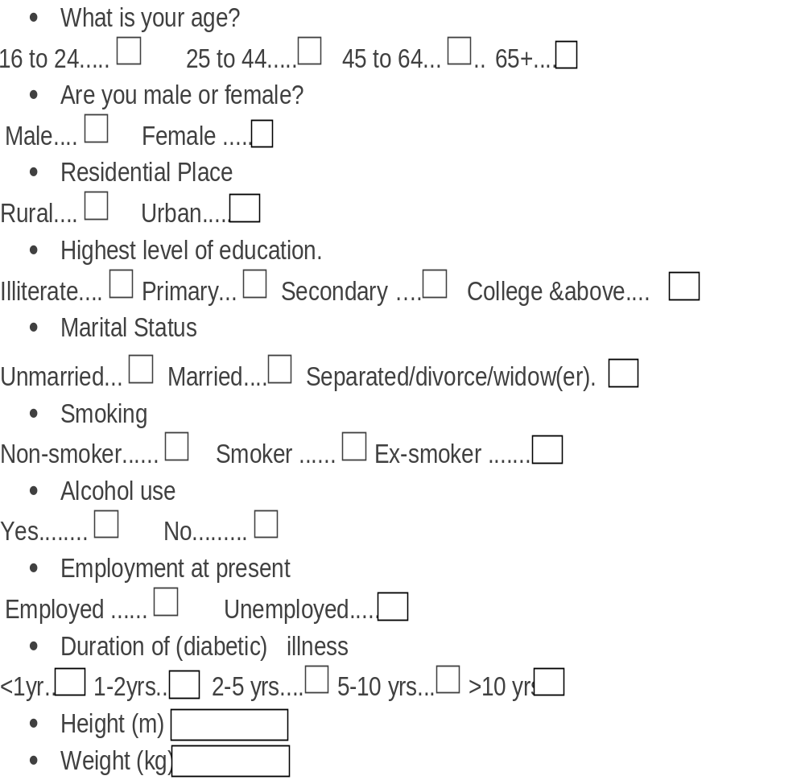
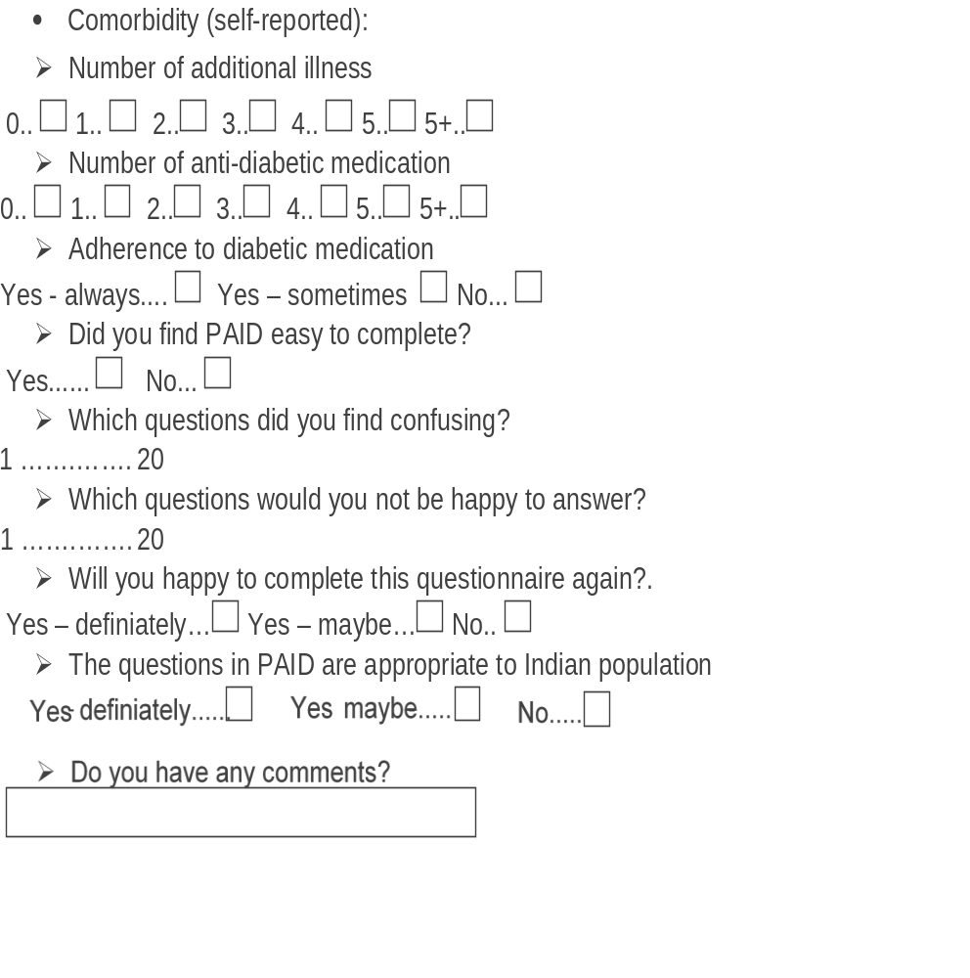

Slide 12

DATA ANALYSIS
  Epidata Software
  Stata 13.1

Slide 13
RESULTS
Demographics
  253 questionnaires were completed
    Male : Female = 157 : 96
    61.3% were aged between 45 to 64
    50.2% had T2DM for >10yrs
    70.0% reported one or more complications
Notes:
154 Tamil, 99 English
62.1% males & 37.9% females

Slide 14
  Self-reported complications of diabetes 177/253 (70.0%)
Notes:
reported one or more complications
Neuropathy (42.7%) commnest

Slide 15
PREVALENCE OF DSPD
The PAID score ranged between 12.5 – 45.0
One-third of the patients had greater level of psychological distress (Score ≥40: 83/253, 32.8%)
All 20 items on PAID were scored as a serious problem (score=4)

Slide 16
Line graph: frequency in which the 20 PAID items were scored as a
serious problem

Slide 17
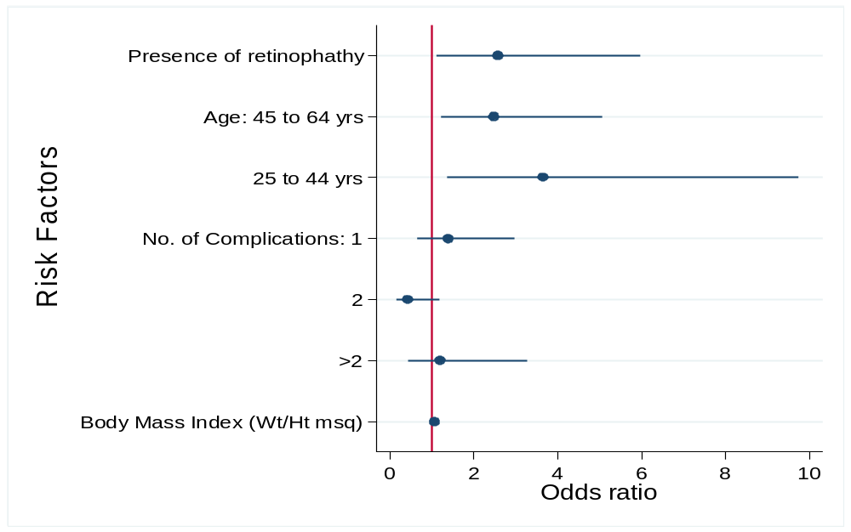
Adjusted OR and Its 95% CI from multiple logistic regression
P = 0.032
P = 0.009
P = 0.010
Notes:
Explain here that those aged bet 25 – 44 yrs were 3.6x more likely to have DSPD
However other interesting points to high light are: Gender/educational, employment and marital status and duration of diabetes was not statistically significant
Also, regardless of the duration of diabetes or any socio-demographic factors, 1/3rd of the individuals showed evidence of DSPD.

Slide 18
Adjusted OR and Its 95% CI from multiple logistic regression
Statistically Insignificant
Gender
Educational, employment & marital status
Duration of diabetes
Regardless of the duration of diabetes → 1/3rd had DSPD
Notes:
Explain here that those aged bet 25 – 44 yrs were 3.6x more likely to have DSPD
However other interesting points to high light are: Gender/educational, employment and marital status and duration of diabetes was not statistically significant
Also, regardless of the duration of diabetes or any socio-demographic factors, 1/3rd of the individuals showed evidence of DSPD.

Slide 19
Acceptance of PAID
Notes:
>90% found PAID easy to complete
84.6% willing to do it again
Majority (83%) suggested that PAID was appropriate for the Indian population

Slide 20
discussion
First study to use PAID in India
Worrying about future complications, anger, guilt, depression and feeling overwhelmed by diabetes were key problems noted
PAID
  easy to administer
  Acceptable
  Helps identify concerns of individual patients
  Individual concerns can be specifically addressed during counselling sessions
Limitation: Effect of intervention not studied
Notes:
Worrying about future complications and issues relating to emotional feelings in diabetes (anger, depressed, guilty, overwhelmed, scared etc)

Slide 21

conclusion
1/3 of patients with diabetes have significant psychological distress
PAID easy to administer and acceptable
Further longitudinal studies to assess the effect of interventions are recommended
Notes:
Known to improve outcomes
?Minor changes on wording

Slide 22
THANK YOU

