Slide 1
Resolving terahertz spectral mixtures using the blind source separation approach
a method to study the dehydration kinetics

Slide 2
Presentation outline
Problem statement
The blind source separation (BSS)
Dehydration studies
Possible applications

Slide 3
Presentation outline
Problem statement
The blind source separation (BSS)
Dehydration studies
Possible applications

Slide 4
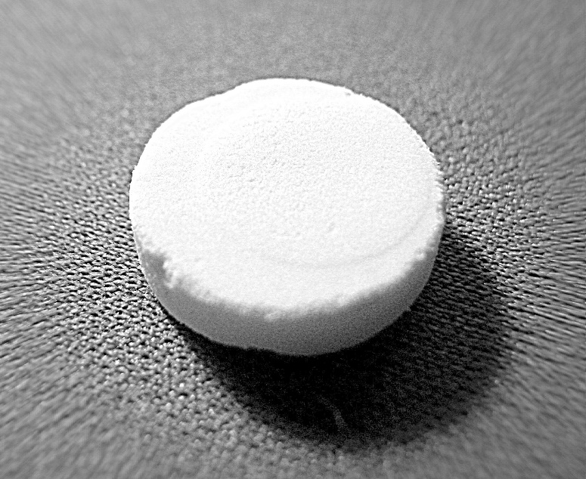
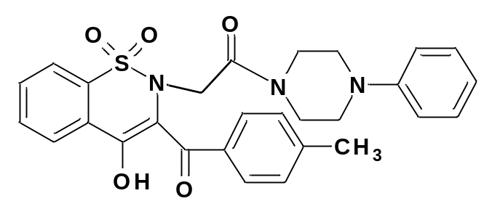
Problem statement
Polymorphic and pseudo-polymorphic phase transitons
Change in physical and chemical properties of the API
?
Well known example: chloramphenicol palmitate
Possibility of reduced shell life
More expensive drugs

Slide 5

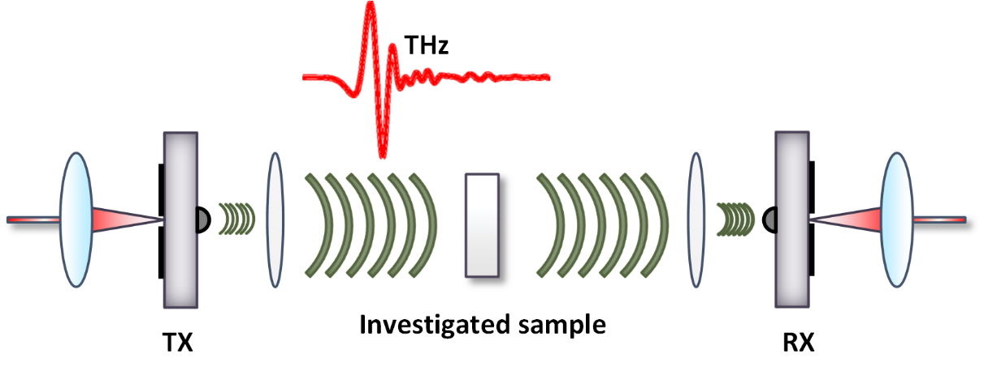
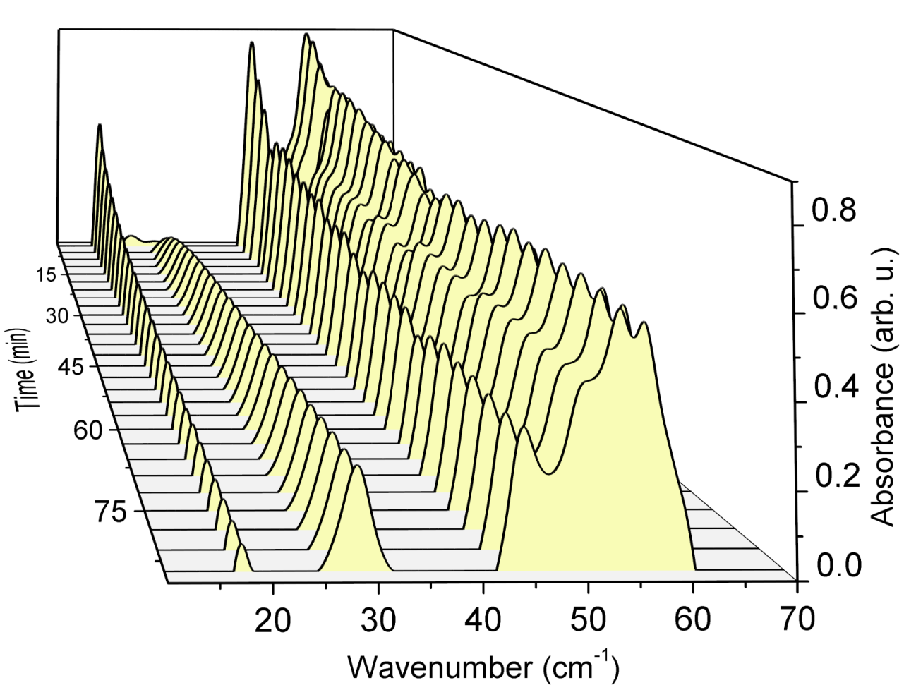
Terahertz spectroscopy

Slide 6
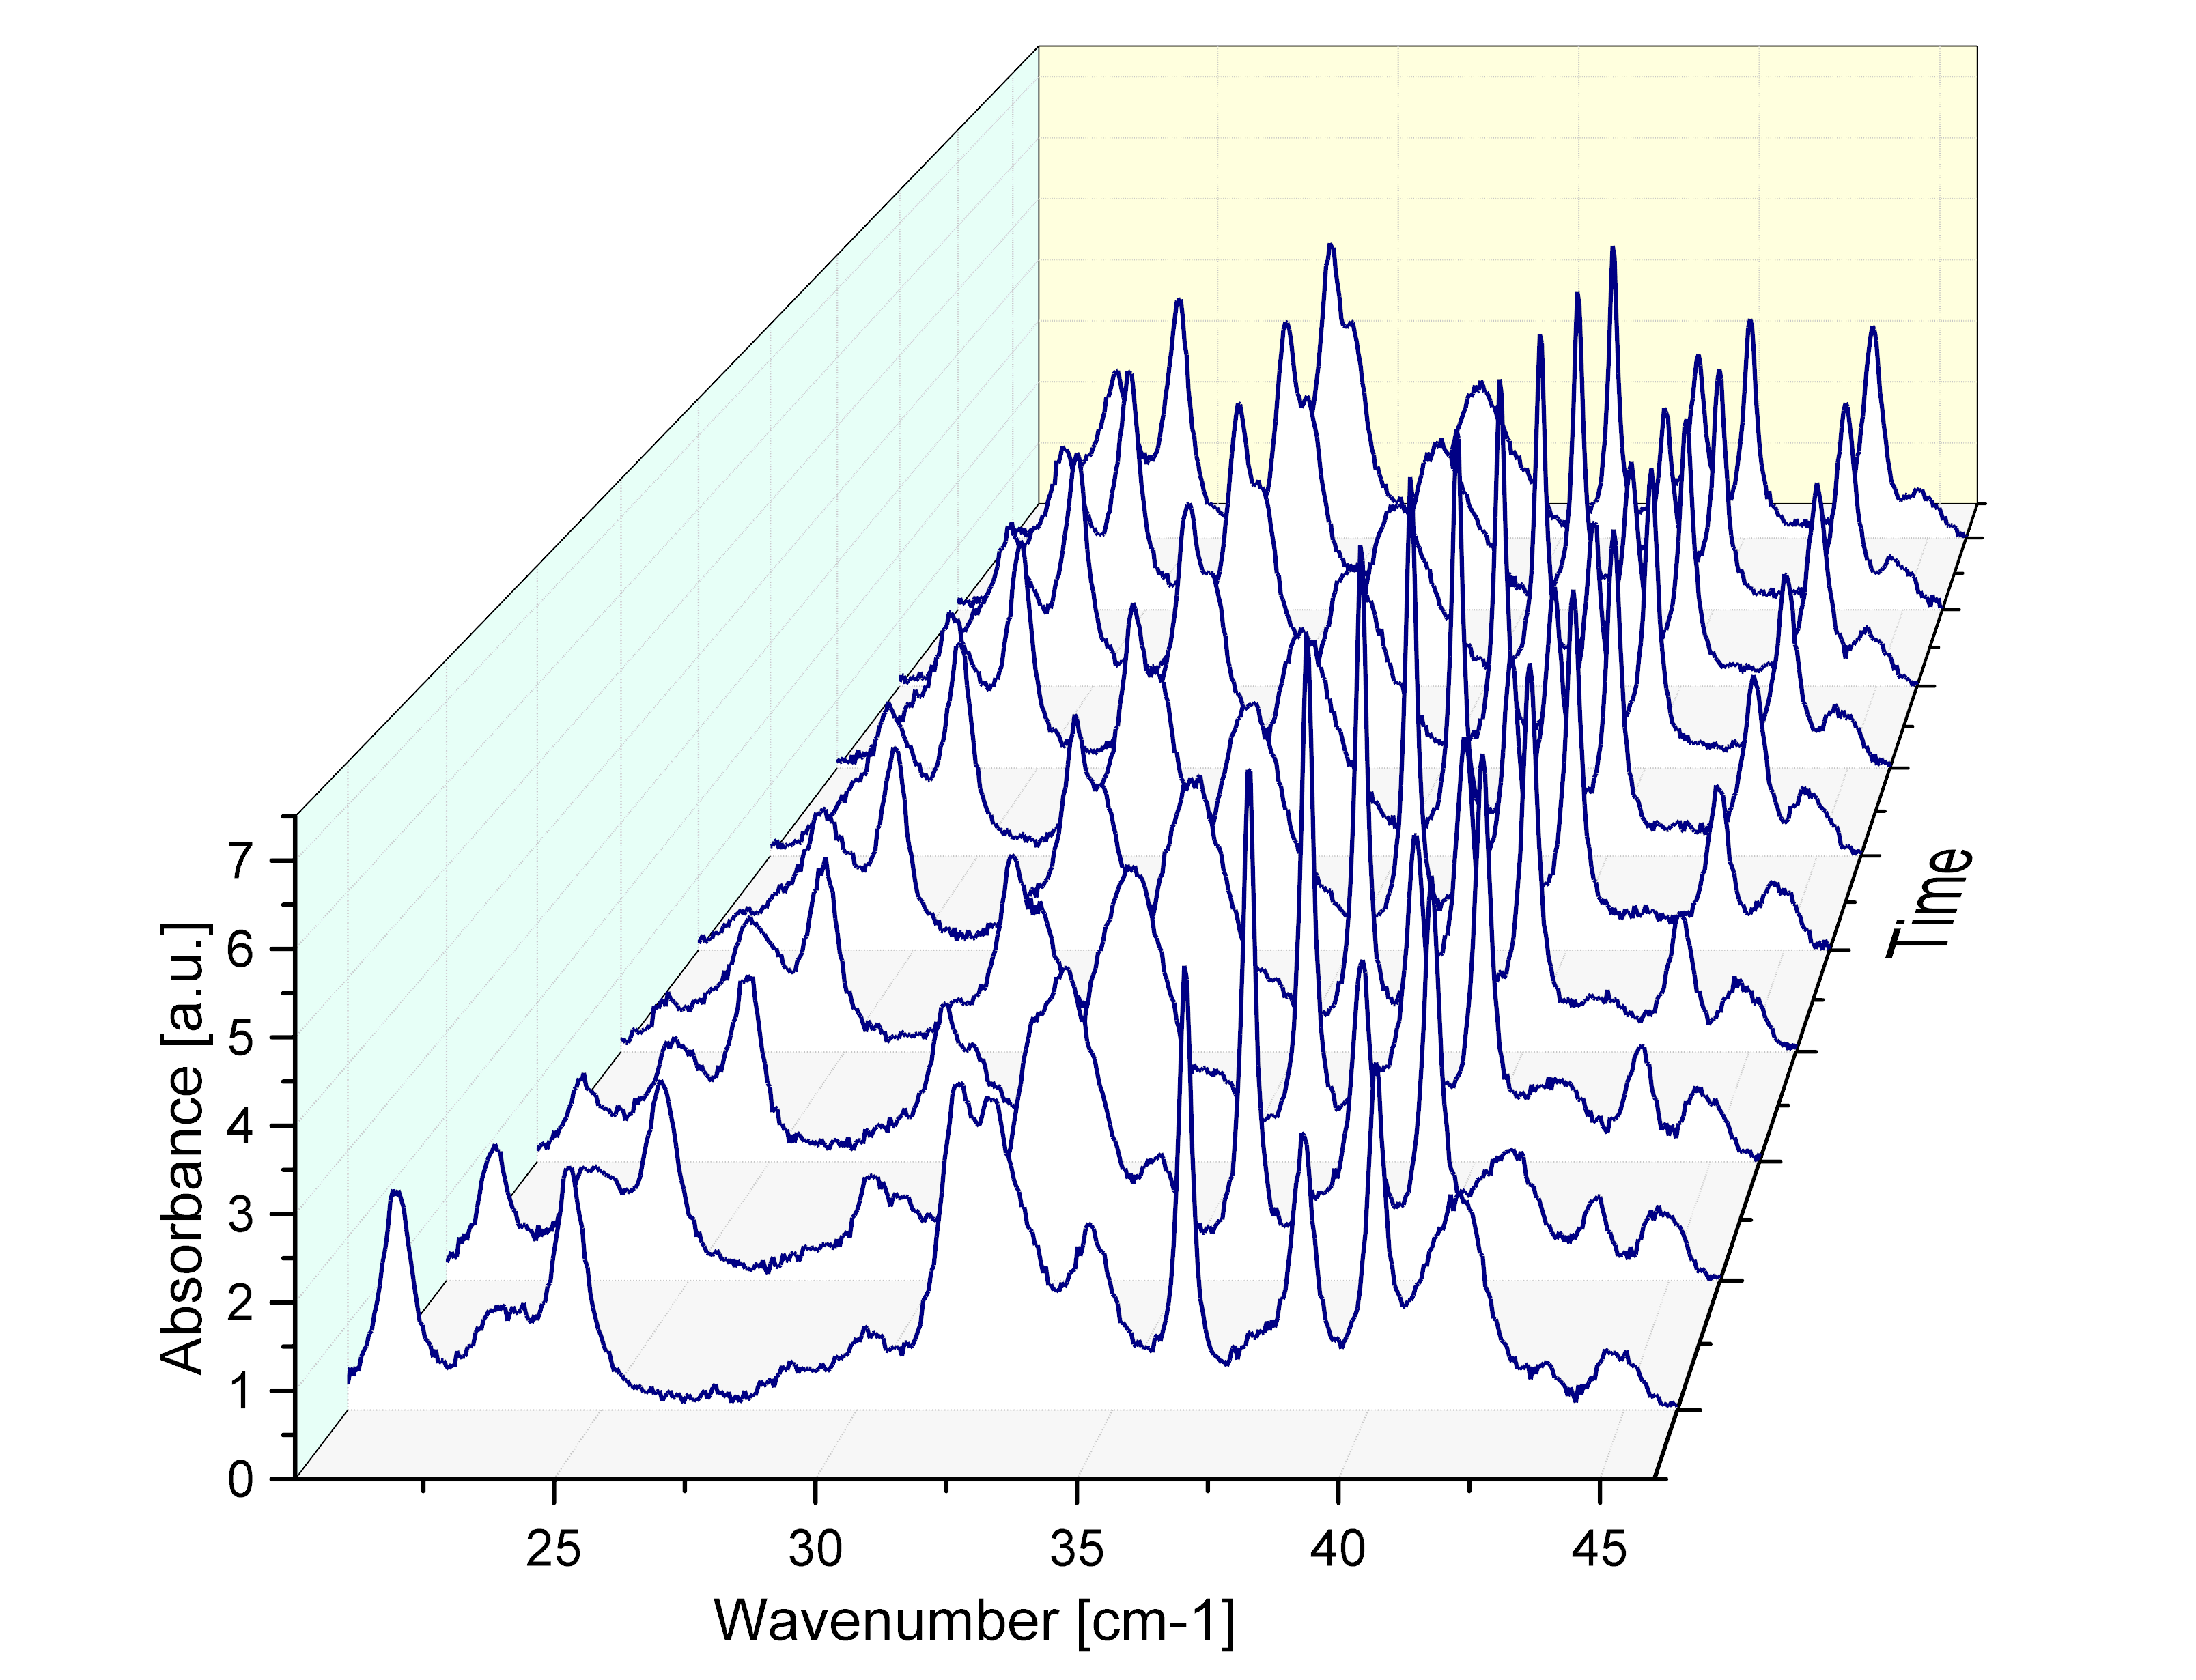

Spectral mixture
?

Slide 7
Presentation outline
Problem statement
The blind source separation (BSS)
Dehydration studies
Possible applications

Slide 8
Presentation outline
Problem statement
The blind source separation (BSS)
Dehydration studies
Possible applications

Slide 9
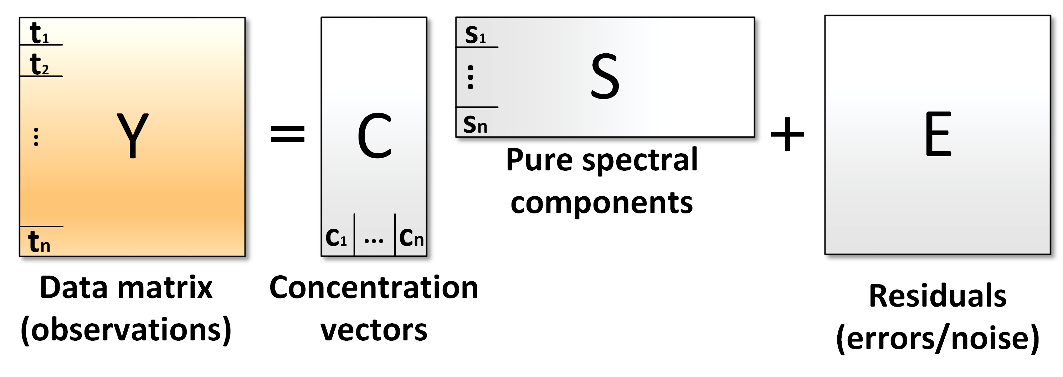
Blind source separation
Known
Unknown
Unknown
Unknown
Iterative character
Sample the multidimensional PDF with the parameters
dependent on the estimation error
N. Dobigeon, S. Moussaoui, J.-Y. Tourneret and C. Carteret, “Bayesian separation of spectral sources under non-negativity and full additivity constraints,” Signal Processing, vol. 89 (12), pp. 2657-2669, 2009.

Slide 10

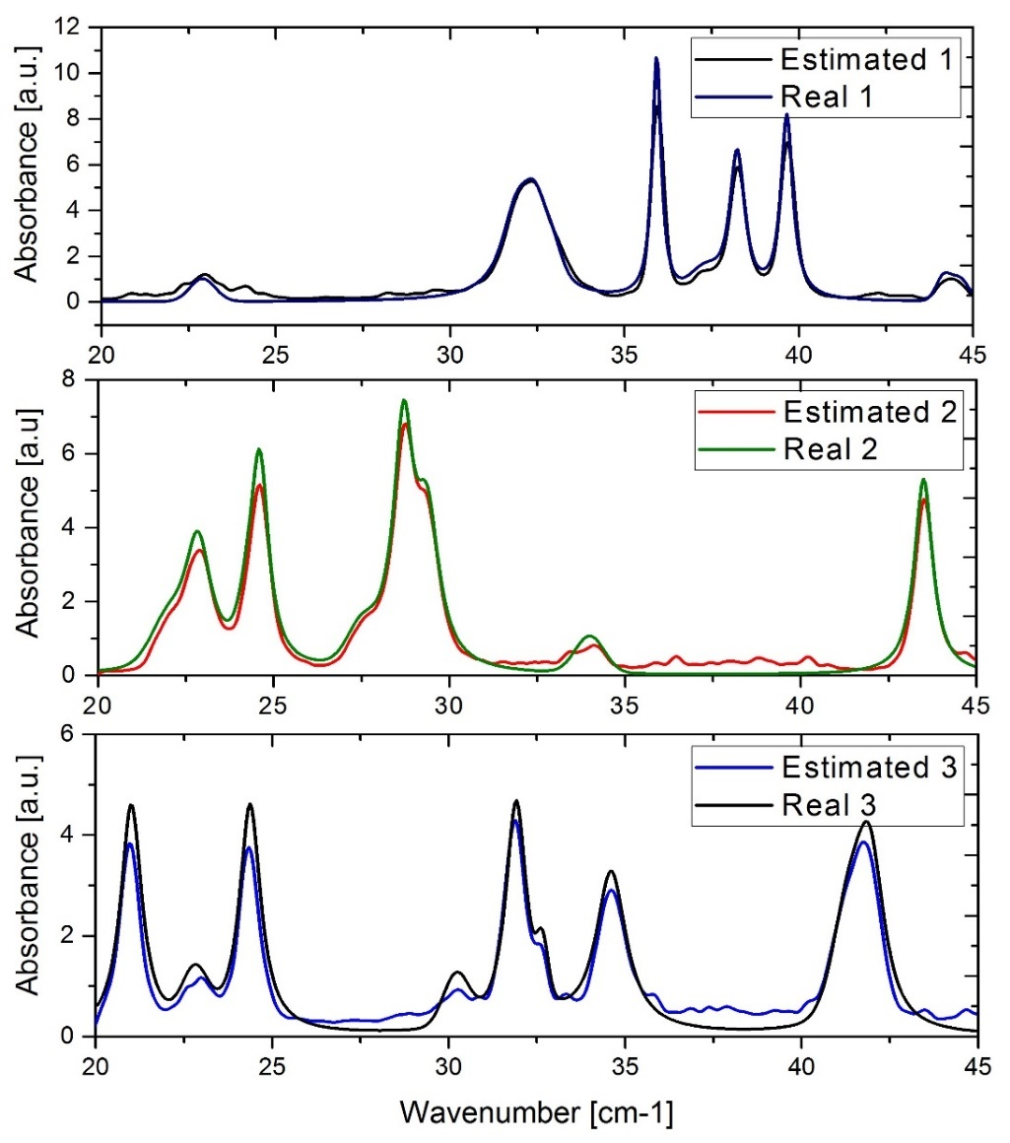
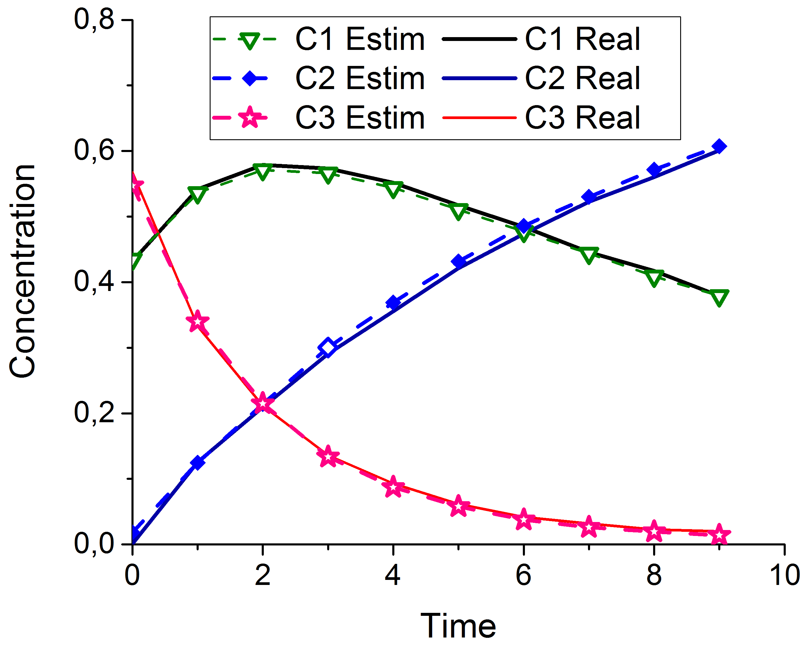
Results of deconvolution
Percentage accuracy!

Slide 11

Results of deconvolution
Unknown
Known
Unknown
=
×
L. A. Sterczewski, M. P. Grzelczak, K. Nowak, B. Szlachetko, and E. F. Plinski, “Bayesian separation algorithm of THz spectral sources applied to D-glucose monohydrate dehydration kinetics,” Chemical Physics Letters, vol. 644, pp. 45–50, 2016.

Slide 12
Presentation outline
Problem statement
The blind source separation (BSS)
Dehydration studies
Possible applications

Slide 13
Presentation outline
Problem statement
The blind source separation (BSS)
Dehydration studies
Possible applications

Slide 14
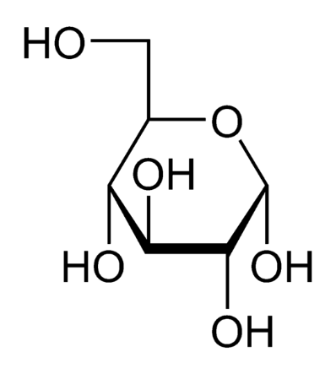

α-D-Glucose dehydration
Hydrate
Dehydrate
t>40°C
H₂O
Objective: Determine the concentration profile in time

Slide 15
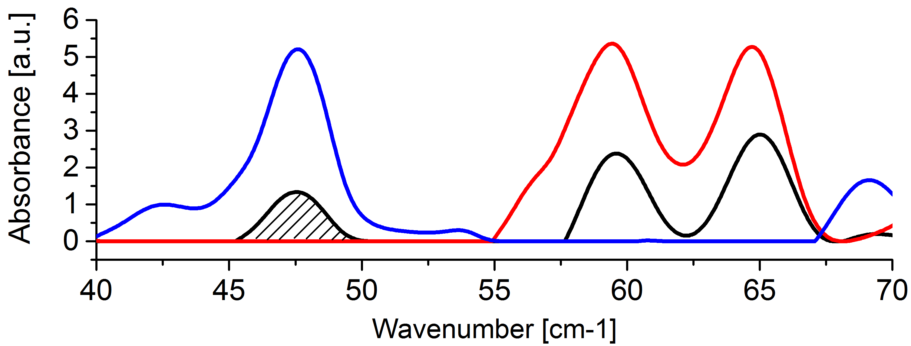
α-D-Glucose dehydration
[1]: 1.19 - 1.56 THz band (2006)
(39.6 – 52.0 cm⁻¹), inspiration of work
Hydrate
Dehydrate
BSS Method : full band

Slide 16
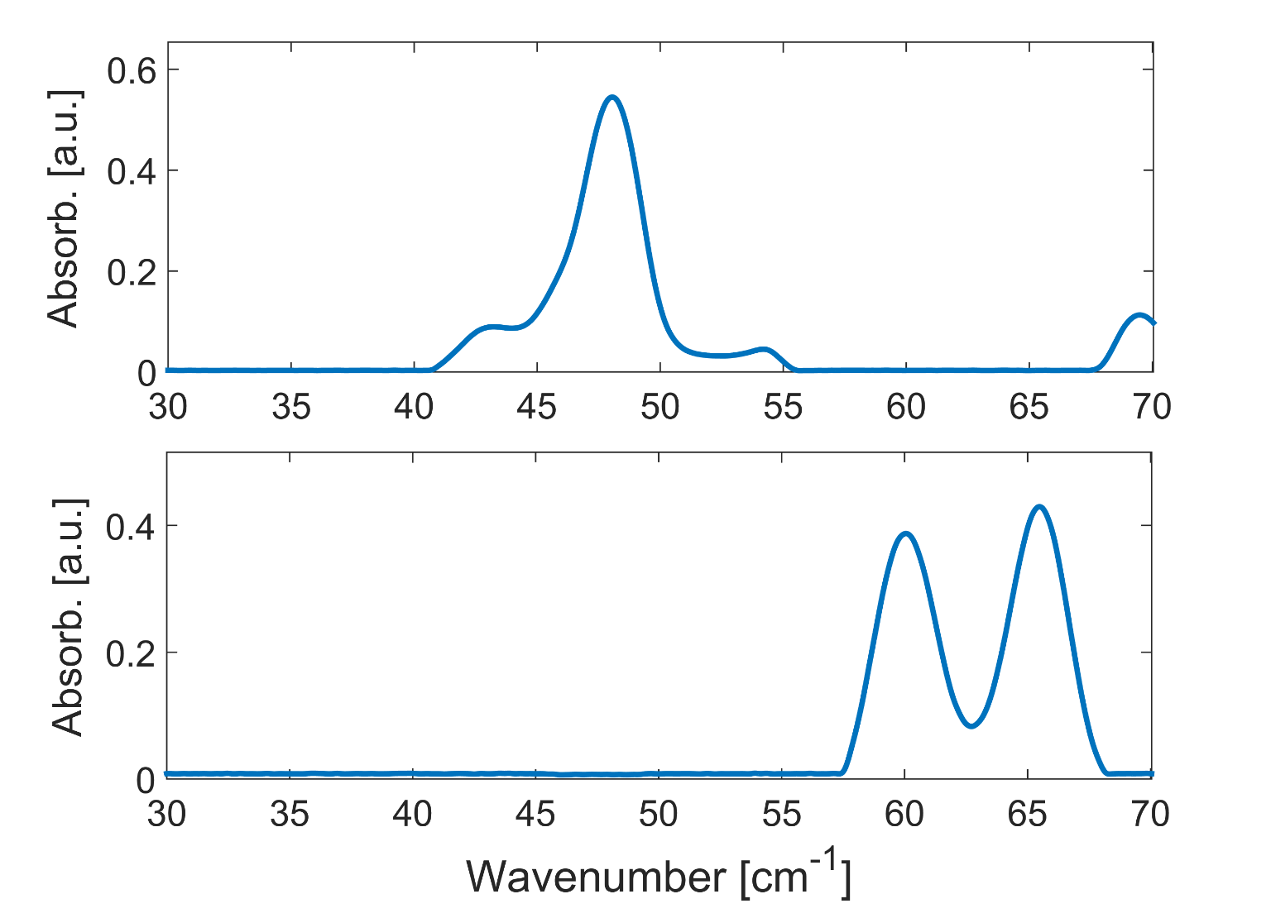
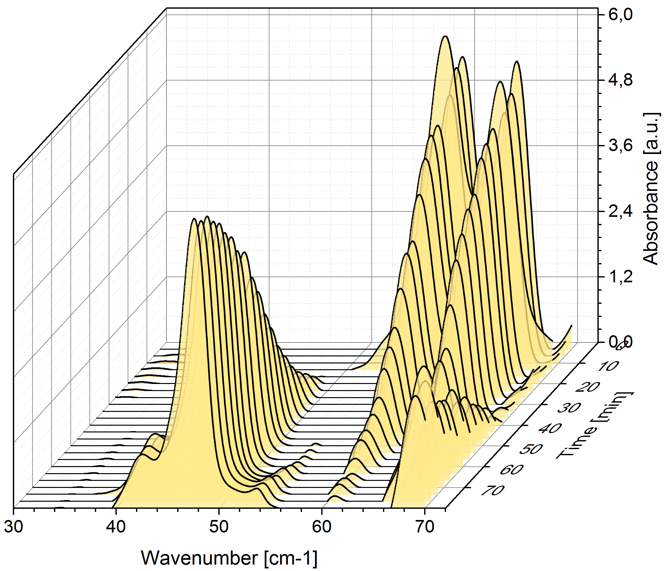
Glucose dehydration at 46°C
Dehydrated glucose
Hydrated glucose

Slide 17
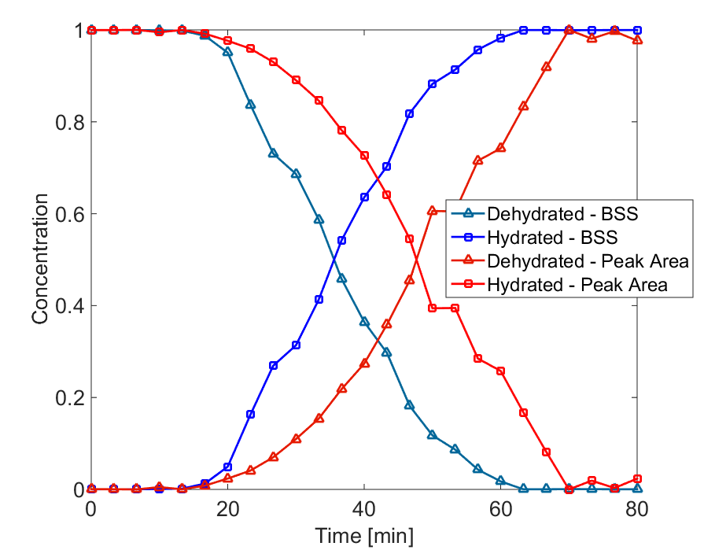
Comparison of methods: BSS vs PA
BSS algorithm yields a conclusion that
the dehydration is completed sooner

Slide 18
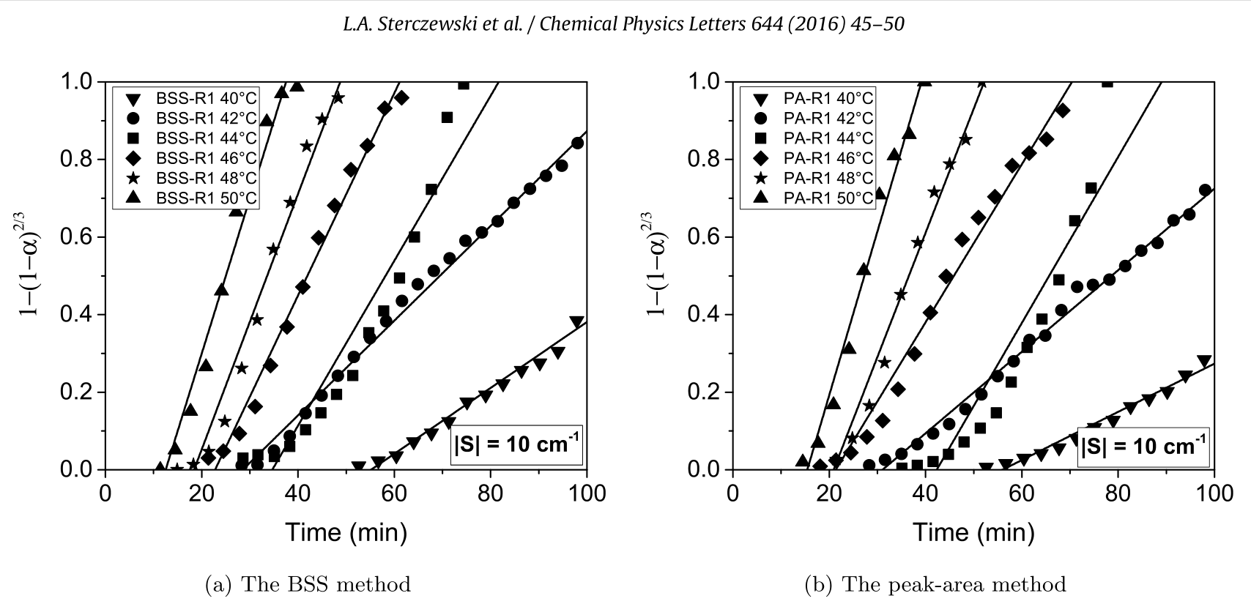
Comparison of methods: BSS vs PA

Slide 19
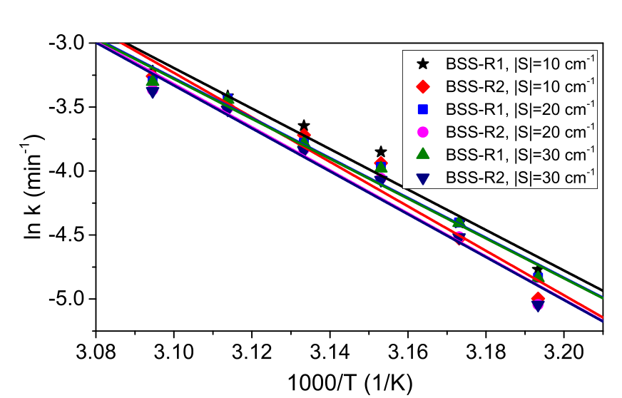
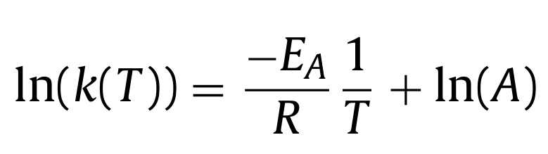

Arrhenius plot
Arrhenius plot-ready form:
131.6 kJ mol⁻¹
L. A. Sterczewski, M. P. Grzelczak, K. Nowak, B. Szlachetko, and E. F. Plinski, “Bayesian separation algorithm of THz spectral sources applied to D-glucose monohydrate dehydration kinetics,” Chemical Physics Letters, vol. 644, pp. 45–50, 2016.

Slide 20
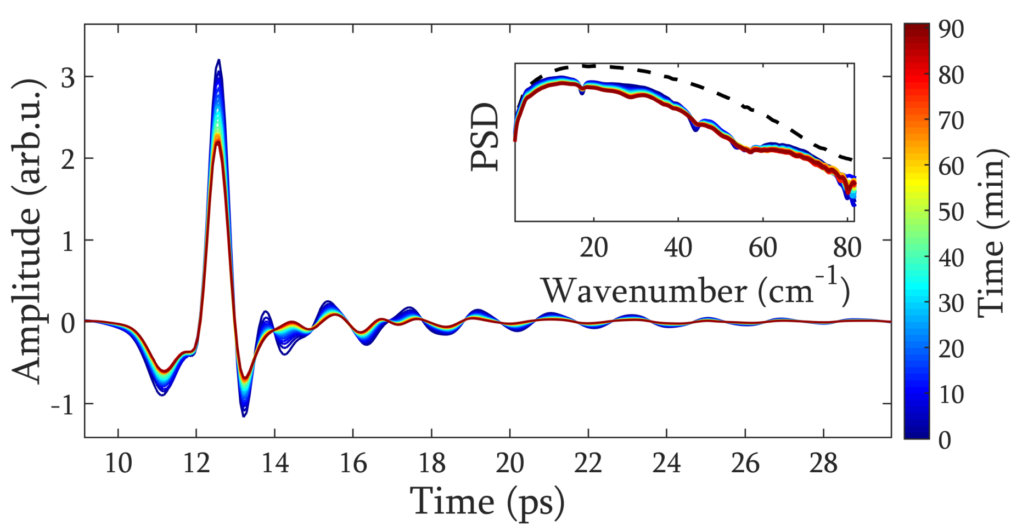
α-D-Lactose dehydration
L. A. Sterczewski, M. P. Grzelczak, and E. F. Plinski, “Heating system of pellet samples integrated with terahertz spectrometer,” Review of Scientific Instruments, vol. 87, no. 1, p. 13106, Jan. 2016.

Slide 21
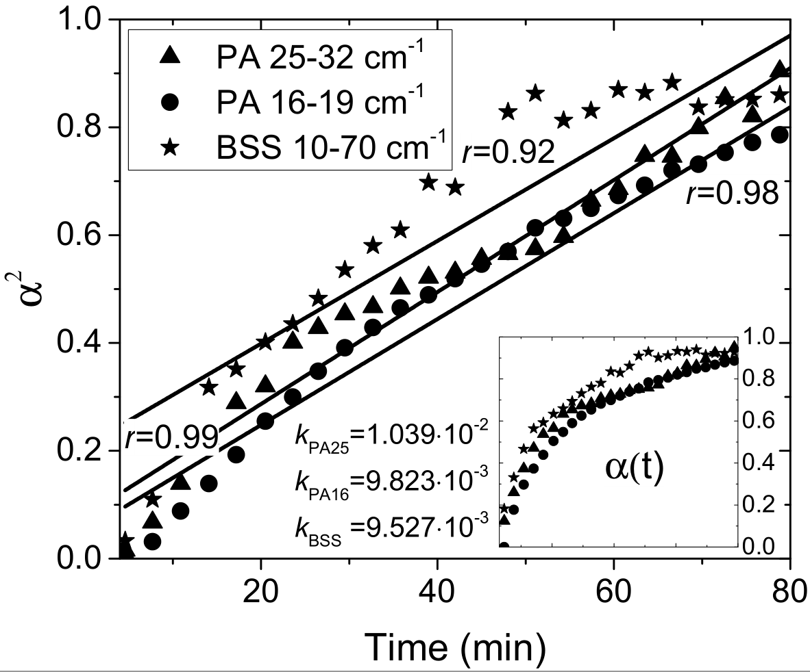
α-D-Lactose dehydration
L. A. Sterczewski, M. P. Grzelczak, and E. F. Plinski, “Heating system of pellet samples integrated with terahertz spectrometer,” Review of Scientific Instruments, vol. 87, no. 1, p. 13106, Jan. 2016.

Slide 22
Presentation outline
Problem statement
The blind source separation (BSS)
Dehydration studies
Possible applications

Slide 23
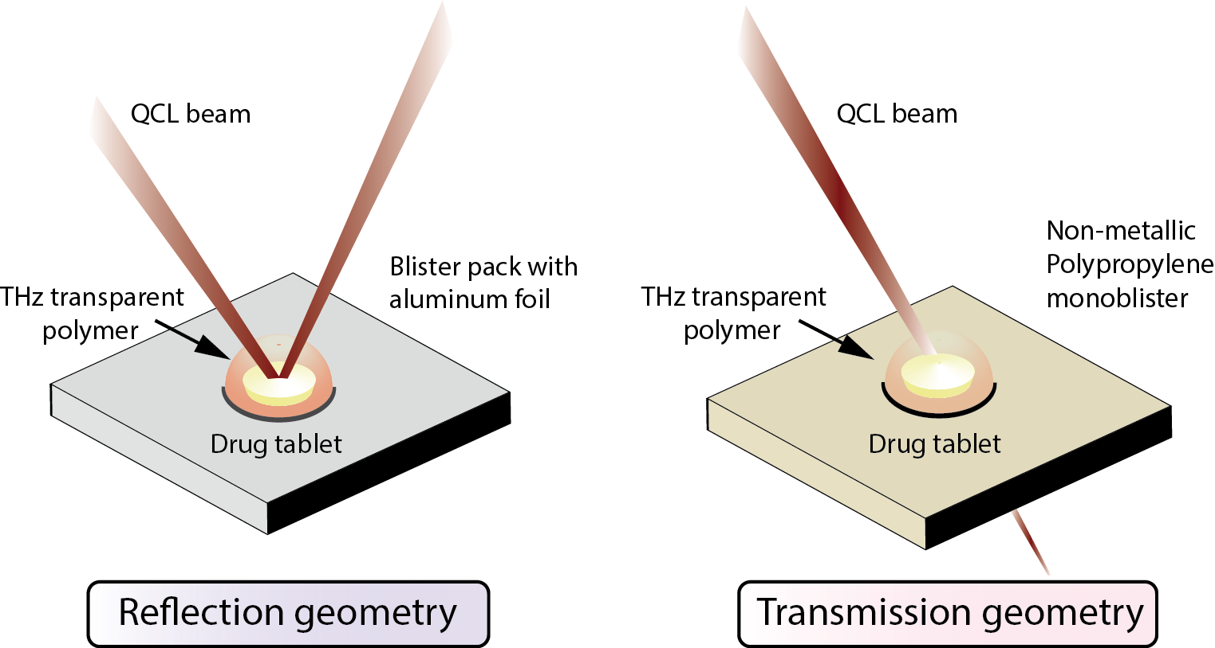
Reaction kinetics in native packaging

Slide 24
BSS – Pros and Cons
Not sensitive to overlapping peaks
Possible estimation of multiple compounds
Use of the full band
Less sensitive to spectral artifacts
More precise
Sophisticated implementation
Computational complexity
Does not work when no evolution is present

Slide 25
Thank you!

