Slide 1
Cover title Segoe UI 36 pt. Gray:
R: 109
G: 110
B: 112
Date title Segoe UI 16 pt.
MARALFALFA
SYNERGIES WITH BIOGAS PLANTS AND POTENTIAL AS BIOENERGY AND BIOREFINERY CROP
Luis Puchades Rufino
Agricultural Engineer
Director Ludan Renewable Energy España S.L.
Vice-president Spanish Biogas Association
August 26, 2015

Slide 2
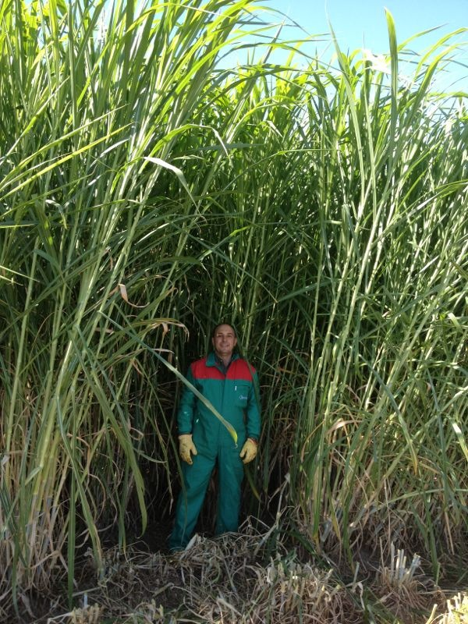
MARALFALFA DESCRIPTION
Maralfalfa (Pennisetum spp.) is a crop originated in South America, with different theories about its origin. It is not a GMO.
It belongs to the Pennisetum genus, from the Poaceae family. Pennisetum is a widespread genus of plants in the grass family, native to tropical and warm temperate regions of the world.
Maralfalfa is a fast growing grass, being considered one of the promising feed grasses of the world.

Slide 3
MARALFALFA DESCRIPTION
In several countries, it is being implemented the use of tropical grasses related to the Elephant Grass (Pennisetum purpureum (Schum)), that have the characteristics of having an extraordinary potential of biomass generation. Amongst them can be found Taiwan, King Grass, Napier, or the recently introduced OM-22, CT-115 and Maralfalfa.
Such cultivars of P. purpureum are widely used in the tropics, but there is also an important lack of scientific studies about its bioenergy potential, especially in the areas of bioethanol and biogas.
Our results show that the crop has the potential to become of the most popular energy crops in the world, as can overproduce most of the most popular energy crops worldwide: corn, sorghum, beet and sugar cane.

Slide 4
MARALFALFA DESCRIPTION
Ludan has been developing over the last years a detailed study in Maralfalfa and other Pennisetum cultivars implemented in Spain, with the following objectives:
Define its productivity and adaptation in Spain.
Check the resistance to cold weather. Winter survival
Check on a technical levels the costs of cultivations
Define the potential of the crop as energy crop
Study the synergies in the use of the digestates of the existing biogas plants
Evaluate the overall economical and environmental sustainability of the crop

Slide 5
BIOMASS PRODUCTIVITY
It is important to define that the biomass productivity of a certain crop depends not only on its genetic potential, but also from the external inputs. The amount of environmental resources will determine the productivity of pastures and crops (Valentine I, Mathew C, 1.999).
Therefore, the comparison shown below has only limited value, as the results are taken from different places under different cultivation processes.
Crop | Productivity (t FM/ha) | Dry matter content | Productivity (t DM/ha) | Reference
Maize silage | 74,63 | 33,50% | 25,00 | Pioneer cathalogue
Maize silage | 60,00 | 34,70% | 20,82 | University of Tennessee
Sorghum silage | 84,32 | 28,9% | 24,36 | INTA Paraná
Sorghum grain | 56,22 | 34,6% | 19,47 | INTA Paraná
Fodder Beet. Mammoth Long Red | 95,70 | 14% | 13,40 | Washington State University
Fodder Beet. Red Globe | 83,39 | 14,50% | 12,09 | Washington State University
Sugar Beet. Shepard | 54,50 | 22,50% | 12,26 | Washington State University
Sugar Beet. White Klein | 38,64 | 24,60% | 9,51 | Washington State University
Maralfalfa | 235,00 | 19,30% | 45,30 | Own research

Slide 6
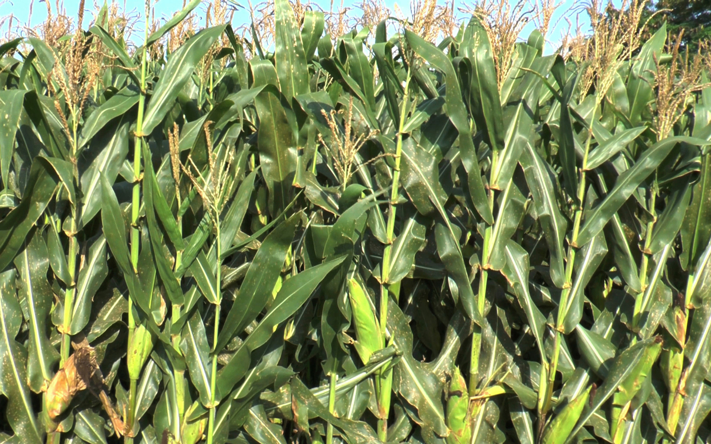
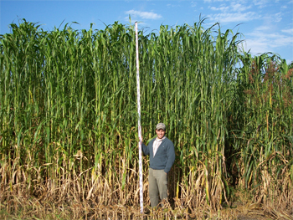
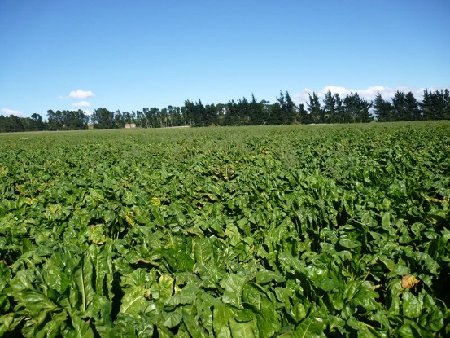
BIOMASS PRODUCTIVITY
Up to 30% more potential without winter

Slide 7
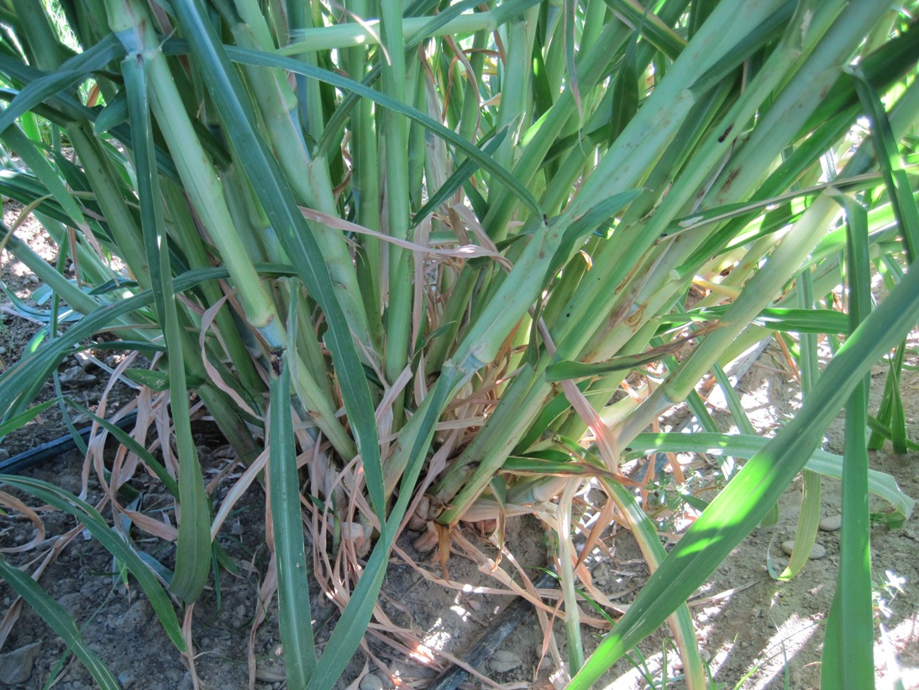
BIOMASS PRODUCTIVITY
Keys for success:
Regrown
Development of radicular systems. Winter survival
Plagues relative resistance
Rusticity
Efficiency in the absorption of nutrients
Temperature

Slide 8
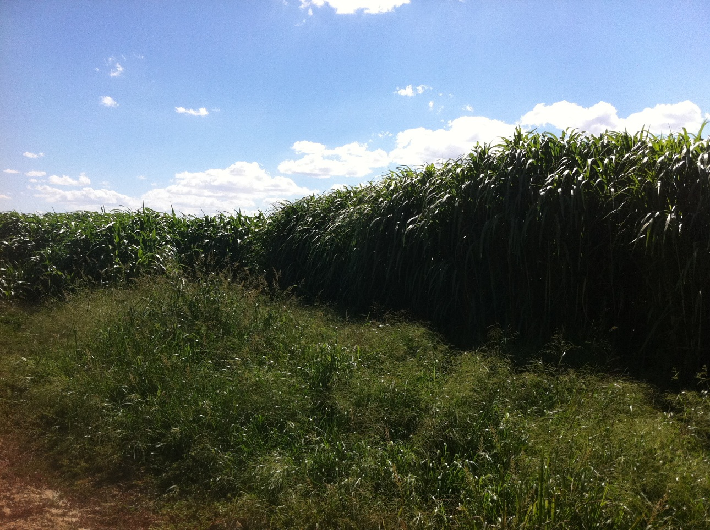
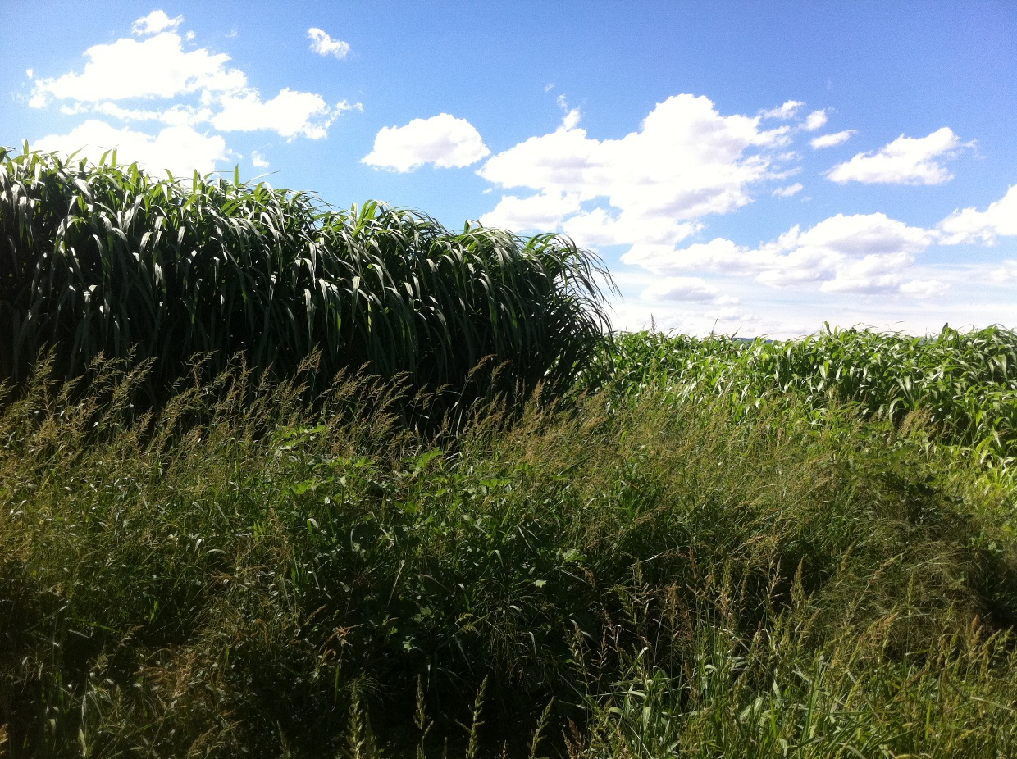
TESTS IN EXTREMADURA
Sorghum.
Maralfalfa
Corn.
Tests held in Extremadura during 2014, combinig Maralfalfa, corn and sorghum.

Slide 9
TESTS IN EXTREMADURA
Duration | April 2014 - November 2014
Fertilization | 250 kg N per hectare (150 kg Urea, 52 tons of digestate)
Irrigation | 6.000 m³ water per hectare
Rainfall during period | 425 mm
Crop | Productivity (t FM/ha) | Dry matter content | Productivity (t DM/ha) | Harvests
Sorghum | 85,80 | 29,40% | 25,23 | 1
Corn | 65,40 | 34,70% | 22,69 | 1
Maralfalfa | 235,30 | 19,3% | 45,30 | 2
Tests held in Extremadura during 2014, combinig Maralfalfa, corn and sorghum.

Slide 10
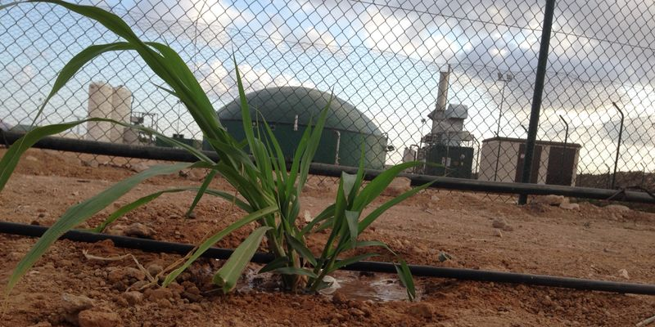
TESTS IN OTHER PARTS OF SPAIN
Place | Vall d´Uixó (Castellón)
 | Los Alcázares (Murcia)
Planting frame | Two canes parallel. 75 cm between rows
Place | Date | Nitrogen fertlization (kg N/ha)
 |  | 80 | 170 | 350
Vall d´Uixó | 15th August | 18,1 | 22,5 | 25,1
 | 1st december | 19,3 | 21,3 | 27,4
Los Alcázares | 15th August | 16,3 | 21,8 | 24,1
 | 1st december | 19,4 | 23,5 | 24,5
Biomass generation (tDM/ha)
Fertilization (N/ha)

Slide 11
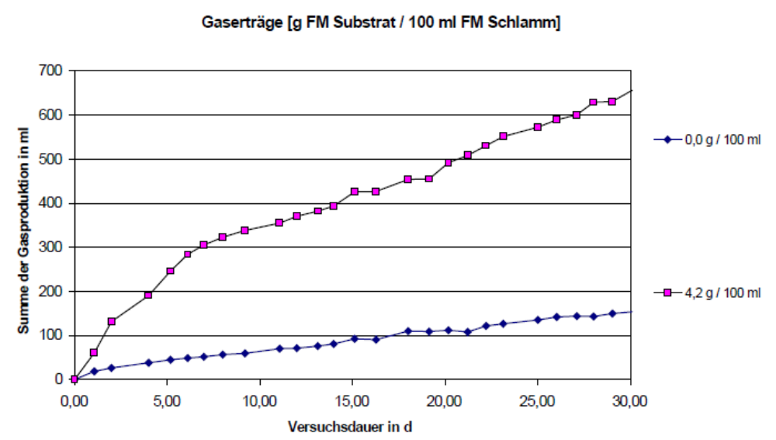
BIOGAS PRODUCTION TESTS
The batch test is a discontinuous test in which organic substrates or co-substrates are subjected to fermentation under defined anaerobic conditions.
Maralfalfa is suitable for biogas production, just like most vegetables. The biogas production is around 570 l of biogas per kg of VS, with a methane content around 60%.

Slide 12
BIOGAS PRODUCTION TESTS
Parameter | Dimensions | Mesophilic
Loading
Reactor volume | l | 5,48
Daily input | Kg/d | 1,4
Retention time | d | 39,2
Organic load | Kg oDM/m³d | 5,98
Fermenter output
Dry Matter | % | 12,96
Loss on ignition | % DM | 71,42
Organic Dry Matter | % | 9,23
Ph |  | 7,51
Organic acids | mg/l | 1.144
Ammonium-N | mg/l | 1.380
Parameter | Dimensions | Mesophilic
Biogas
Gas production | m_{n}³/(m³d) | 3,422
Gas yield | m_{n}³/kg oDM | 0,577
Gas yield | m_{n}³/kg FM | 0,132
Methane content | Vol % | 56,900
Methane yield oDM | m_{n}³ CH₄/kg oDM | 328

Slide 13
CONCLUSIONS ON BIOENERGY POTENTIAL
Combining the biomass yields with the biogas potential, it can be seen that Maralfalfa has very interesting possibilities as bioenergy crop.
The results obtained for biogas probably can be obtained similarly with ethanol, as they are both biological anaerobic digestions.
Up to 30% more potential without winter

Slide 14
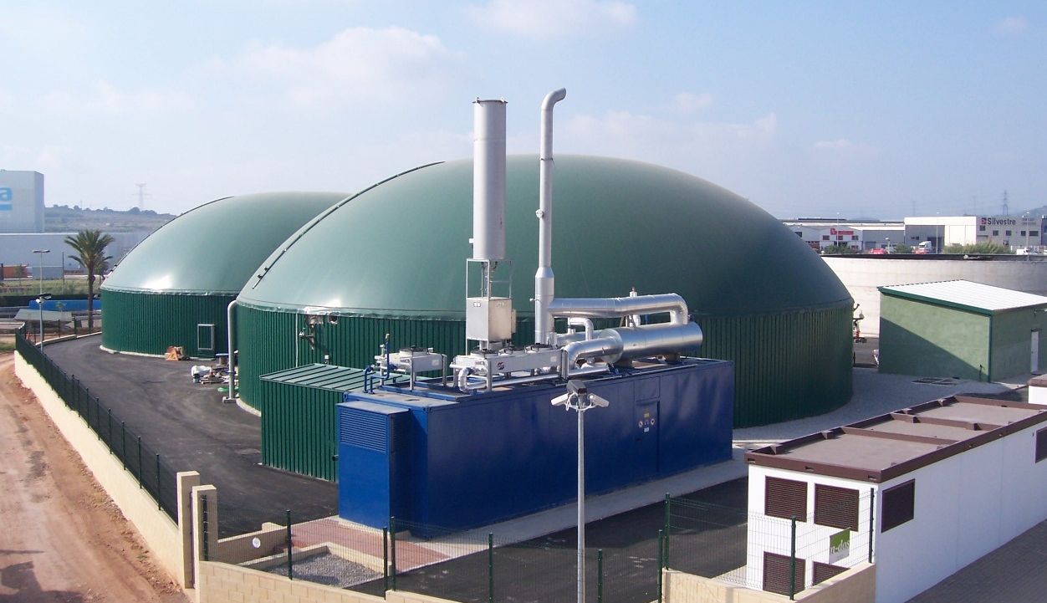
INTEGRATION WITH BIOGAS SYSTEMS
It has been reported that one of the main limitations of the production of grasses is the availability of nutrients.
Large biomass productions tend to extract enormous amounts of nutrients and organic matter from the soil.
Taking Maralfalfa as reference, a production of 200 tons per hectare, with 18% DM and protein content of 14%, will lead a production of 5 tons of CP per hectare. Using a protein factor of 6.25 (CP/Total Nitrogen), shows an extraction of 800 kg of Nitrogen per hectare.
Therefore Nitrogen availability becomes one of the main limiting factors to sustain large biomass productions, especially on the long term.

Slide 15
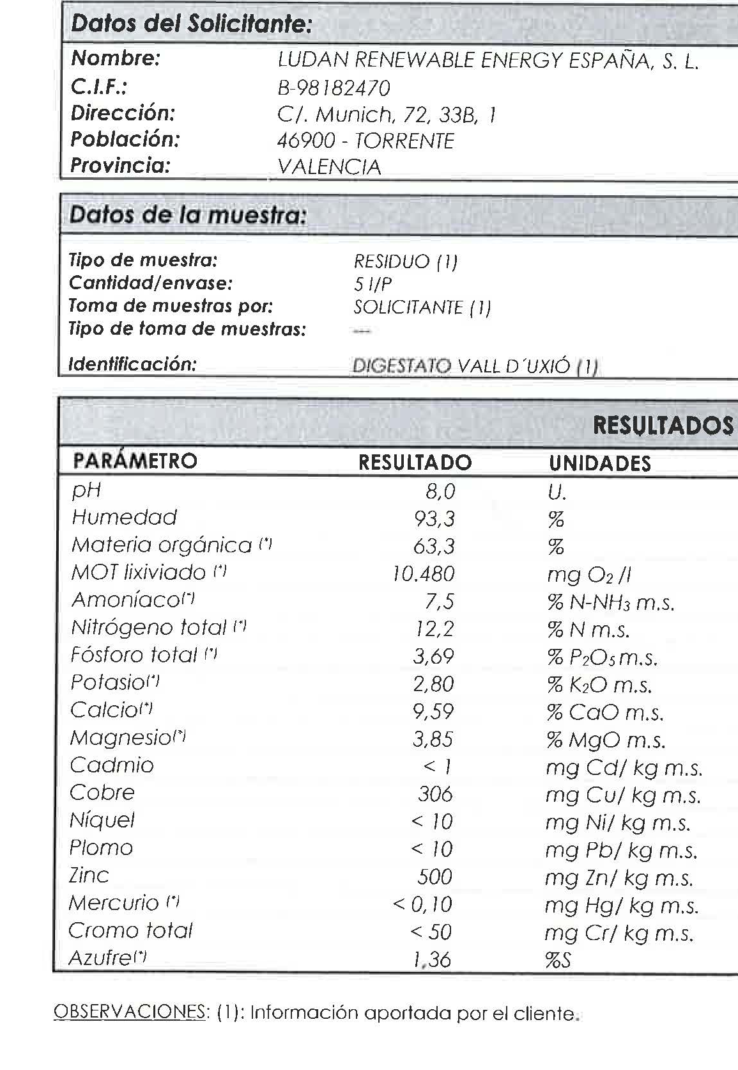
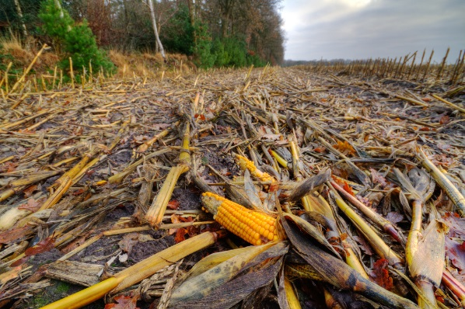
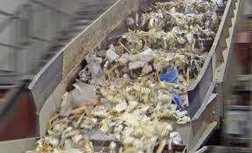
INTEGRATION WITH BIOGAS SYSTEMS
Organic input material such crop wastes, foodstuff remnants, sludge from food industries, slaughterhouse wastes and manure are fed into the biogas plant digester. All those products are quite rich in nitrogen.
The anaerobic digestion process generates a substance called digestates comprised of water + organic matter + nutrients. These digestates serve as plant fertilizer enhancing plant growth, as they provide nutrients, organic matter and other benefits.

Slide 16
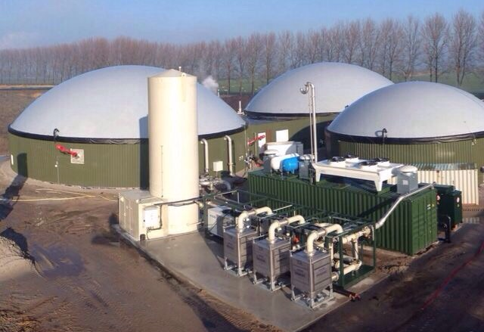
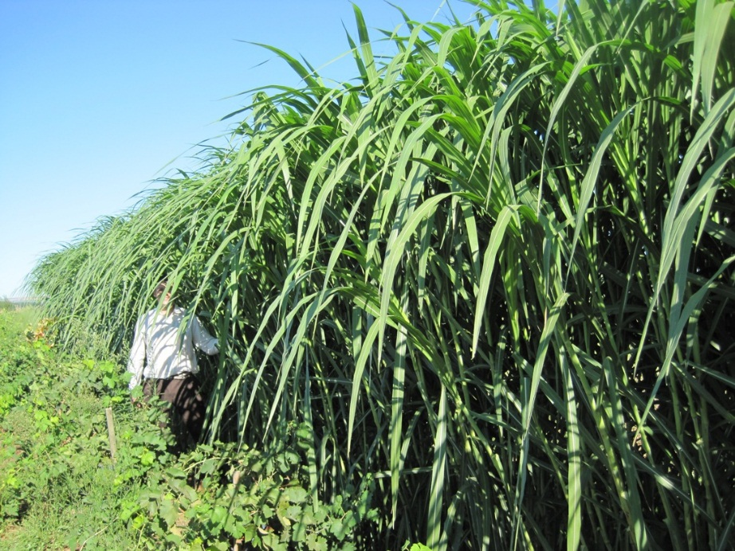
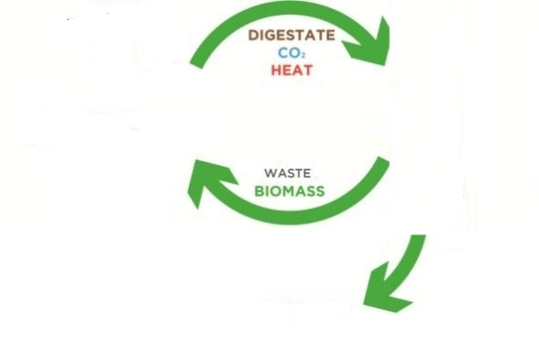
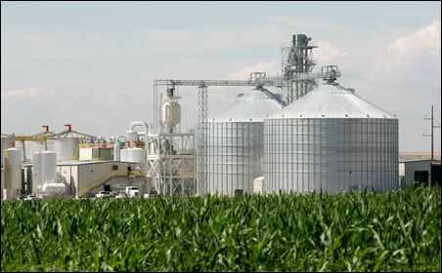
INTEGRATION WITH BIOGAS SYSTEMS

Slide 17
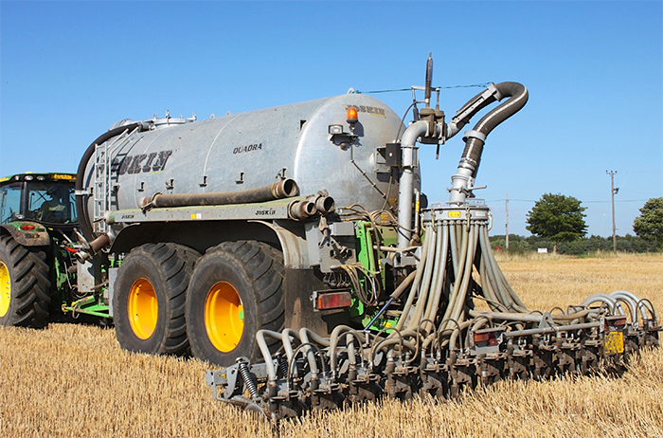
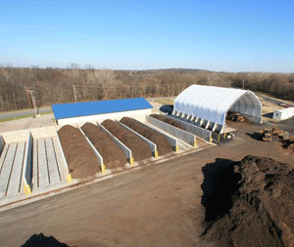
INTEGRATION WITH BIOGAS SYSTEMS

Slide 18
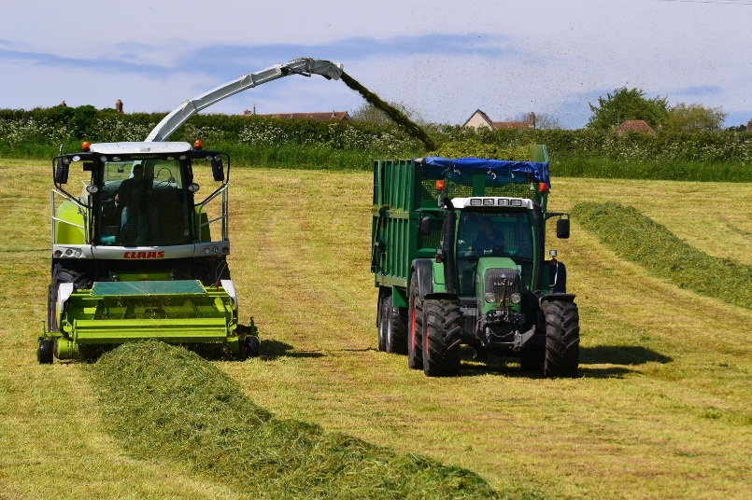
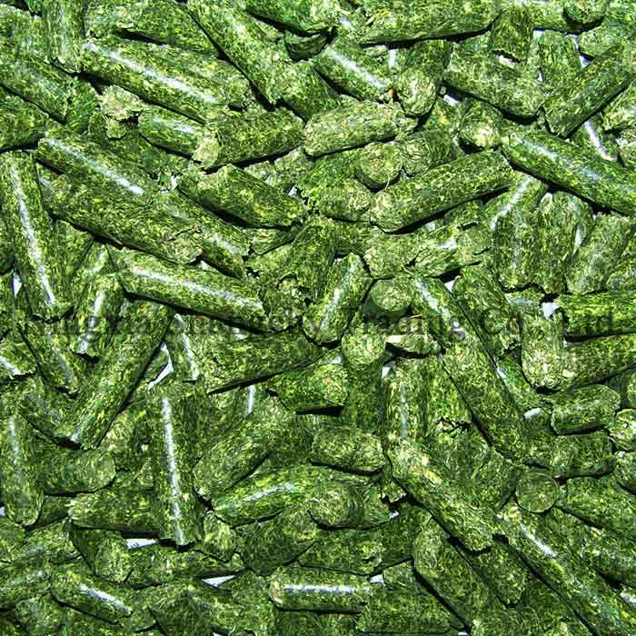
BIOREFINERY CONCEPT
The production of energy and food/feed based products from the same raw materials, or in the same installation, is one of the keys of success of the industry.
The characteristics of Marafalfa crop make it an ideal candidate for this approach. Its levels of crude protein and digestibility make it a product with similar characteristics to Alfalfa.
Therefore it combines a huge energy potential (production of large amounts of digestible carbohydrates) with good nutrient characteristics (digestibility, protein content).
Recent studies in the Polytechnic University of Valencia (2015), using material provided by Ludan Renewable Energy, confirm this statement.

Slide 19
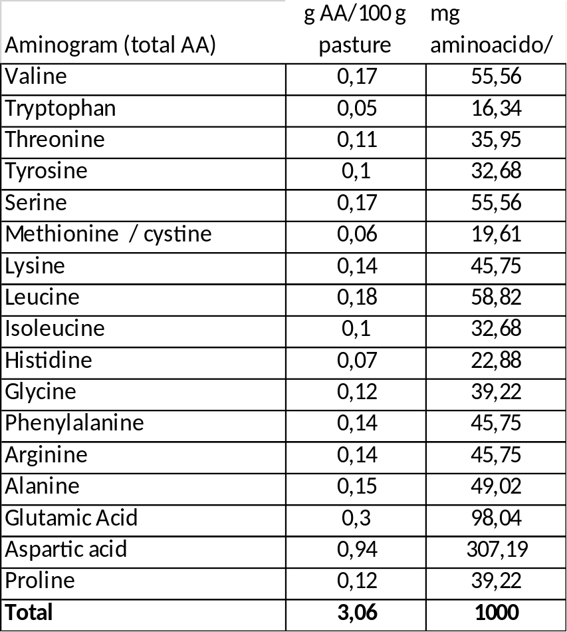
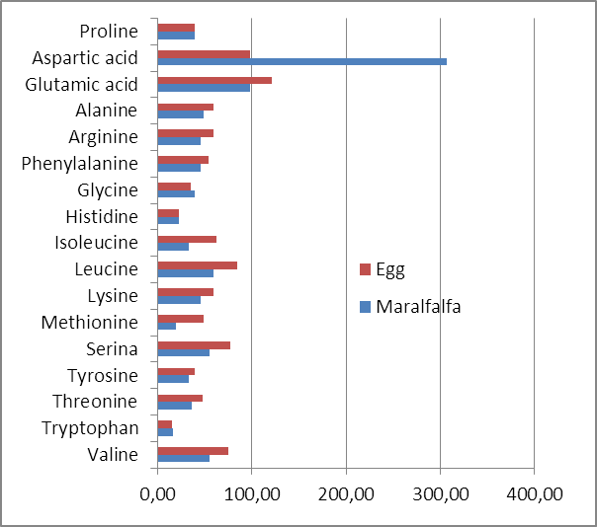
BIOREFINERY CONCEPT

Slide 20
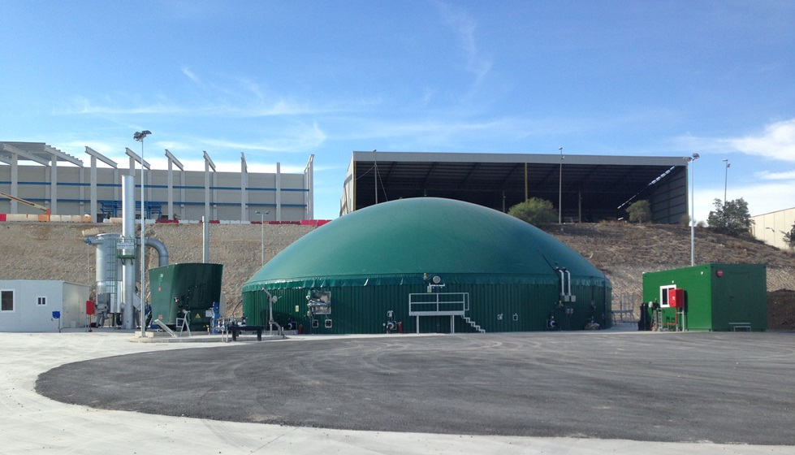
BIOREFINERY CONCEPT
Maralfalfa is rich in all the essential aminoacids, its digestibility is acceptable and is very palatable for animals.
The base of the product is very good to be used in a combine bioenergy + feed production process. There are several processes of biorefinery where Maralfalfa can have a relevant role:
Production of feed pellets from a combined CHP unit
Bioethanol production and use as DDG
Extraction of protein concentrate previous to anaerobic digestion
Advanced extraction forms

