Slide 1
The response of HMSC-bm, SaOS-2 and imunocompetent cells to calcium phosphate doped alginate coatings on titanium surfaces.
Lucie Himmlova¹, Dana Kubies², Jirina Bartova¹, Marta Vandrovcova³, Elena Filova³
¹ School of Dental Medicine, General University Hospital in Prague, First Faculty of Medicine,
Charles University, Prague, Czech Republic
² Institute of Macromolecular Chemistry, Academy of Sciences of the Czech Republic, Prague, Czech Republic
³ Institute of Physiology, Academy of Sciences of the Czech Republic, Prague, Czech Republic
Notes:
Dear mr chairman, thank you for introducing my presentation. NEBO : me
Dear ladies, dear gentlemen
I would like to present here our study dealing with biological coatings on titanium implants intended for load bearing implants directly bonded to the bone.
Dear ladies, dear gentlemen
It is great opportunity to me to present here our study. This study deals with biological coatings on titanium implants, which are intended for direct bone bonding for load bearing implants.
NEBO : which are intended for load bearing implants directly bonded to the bone. Like big joints as hips, knees, shoulders or for dental implants, epithesis fixers, etc.
Dear ladies, dear gentlemen
It gives me great pleasure to contribute to this conference. Our study deals with biological coatings on titanium implants intended for direct bone bonding of load bearing implants, like big joints as hips, knees, shoulders or for dental implants, epithesis fixers, etc.
Vážené dámy, vážení pánové,
Je to skvělá příležitost pro mě prezentovat zde naše studie zabývající se biologickými povlaky na titanových implantátů, které jsou určeny k přímé kosti lepení na nosné implantáty

Slide 2
AIM OF THE STUDY
to elaborate the methodology for preparing alginate hydrogel layers doped with HAP or β-TCP immobilized onto Ti surface
to test the biological properties of each surface treatment by determining cytokine production of cells that are involved in implant wound healing
to compare this "cytokine profiles" of different cell types to determine the suitability of chosen types of cells for this type of evaluation
Notes:
The study has 3 aims:
to elaborate the methodology for preparing alginate hydrogel layers doped with hydroxyapatite (Ti/ALG/HAP) or b-tricalcium phosphate (Ti/ALG/TCP) immobilized onto titanium (Ti) surfaces , especially/mainly from point of view how to immobilize (anchor) the hydrogel layer onto titanium
The next aim was
- to test the biological properties of each surface treatment by determining cytokine production of cells cultivated on each type of hydrogel layer. For this testing we chose HMSC-bm, which represent stem cells, which according environment cann change to osteoblasts or osteoclast cells, immunocompetent cells recruited from buffy coat and connective tissue cell line SaOS-2. All these cells are involved in implant wound healing.
The last one aim was
to compare this "cytokine profile" to check the applicability of used cell types.
It is well known fact, that the release of calcium and phosphate ions into the interface around bone embedded implants may improve the bone healing and to speed up, accelerate,
Human mesenchymal stem cells derived from the bone marrow (HMSC-bm), imunocompetent (mononuclear) cells obtained from buffy coat and connective tissue cell lines SaOS-2 were used for testing of alginate hydrogel layers doped with hydroxyapatite (Ti/ALG/HAP) or b-tricalcium phosphate (Ti/ALG/TCP) immobilized onto titanium (Ti) surfaces.
2

Slide 3
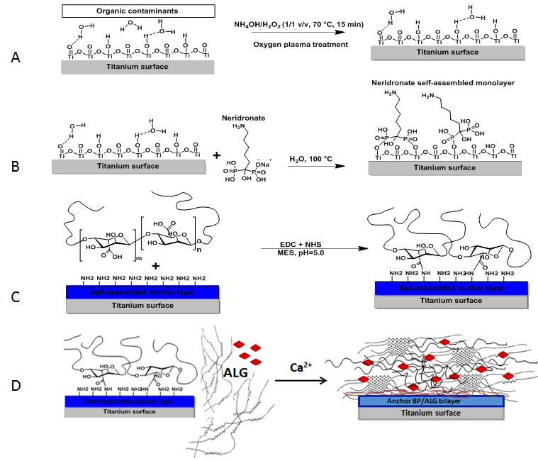
SURFACE PREPARATION
Cleaning and activating proces of Ti surfaces: removal of contamination + introduction of active hydroxyl groups on Ti surface.
Covalent immobilization of the coupling bisphosphonate layer (Neridronate) via specific reactions between phosphonate and hydroxyl groups on Ti surface.
Covalent immobilization of the anchor thin alginate layer using NH₂ groups via EDC/NHS chemistry.
Deposition of alginate/HAP or alginate/TCP hydrogel layers, cross-linked with 1M CaCl₂
Notes:
As I told, the main task was to immobilize-anchor the alginate hydrogel layer onto titanium surface.
The surface preparation starts with the cleaning and activating process of titanium surfaces using alkaline phyrania (mixture of hydroxyamonium, hydroxy peroxide and water ) to introduce increased content of OH groups. These OH groups serve for the covalent immobilization of the bisphosphonate layer, as you can see in the figure B (performed in water conditions at 100 C). The bisphosphonate layer offers amine groups for subsequent covalent immobilization of the anchor alginate thin layer Via EDC/NHS chemistry – reaction between NH2 and COOH groups of alginate (5 nm thickness). Then, the final upper composite alginate hydrogel layered containing calcium phosphates crosslinked with 1M CaCl₂ was deposited
Poté na nich byl imobilizován neridronát, pak navázána kotvící alginátová vrstva a nakonec bylo provedeno síťování vytvořené alginátové vrstvy.
3

Slide 4
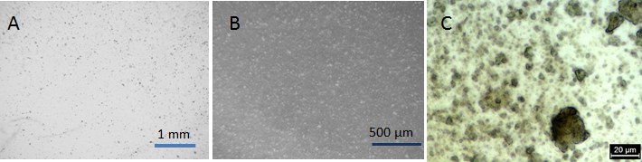
SURFACE MORPHOLOGY
Morphology of the ALG/HAP hydrogel layer on the real Ti surface in a swollen state (light microscopy)
A, B) at different magnifications (objects = particles of anorganic phase disperged in alginate hydrogel)
C) 3D-LM microphotography ALG/HAP
Surfaces prepared from 1 % wt ALG solution in water containing 40 % wt of HAP (versus ALG) and cross-linked with 1 M CaCL₂)
Notes:
On this slide, you can see the morphology of the composite hydrogel coating prepared from 1 % wt ALG solution in water containing 40 % wt of HAP (versus ALG) and cross-linked with 1 M CaCL₂) at different magnifications. The observed objects are particles of anorganic phase well disperged in alginate hydrogel
4

Slide 5
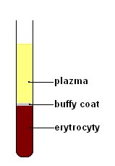
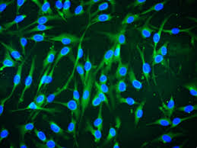
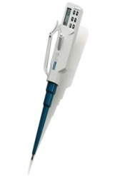

METHODOLOGY OF EXPERIMENT
Substrates:
alginate hydrogel layers doped with:
  hydroxyapatite Ti/ALG/HAP
  β-tricalcium phosphate Ti/ALG/TCP
control surfaces:
  pristine titanium Ti
  pristine alginate ALG
  glass, TCPS
Cells:
mononuclear cells - 10⁸/mL
HMSC - bm - 5.000 cells/cm²
SaOS - 2 - 17.000 cells/cm²
Cultivation (3 and 7 days, at 37⁰C, 5%CO₂)
supernatants
Multiplex analysis (RayBio Human Inflammation Array 3)
Notes:
Ten to the power of eight – deset na osmou
Cells represent immunocompetent cells
Na vzorky byly inokulovány imunokompetentní buňky a SaOS-2 cells.
Imunokompetentní buňky pocházejí z buffy coat (Bílá, neprůhledná vrstva těsně nad erytrocyty, někdy je označována jako buffy coat, je tvořena trombocyty a leukocyty a tvoří asi 1 % z celkového objemu krve) byl získán centrifugací plné krve.
Sediment obsahující buněčnou frakci krve byl zakoupen na ÚHKT.
Gradientovou centrifugací při 600g (podle Boyum 1968) byla získána vrstva bílého prstence, který obsahoval mononukleární buňky.
Kultivace na modelových Ti površích byla prováděna na terčících o průměru 20 mm tloušťce 2 mm z titanu grade 2 s povrchovou úpravou vyvíjených hydrogelových nosičů.
Mononukleární buňky získané gradientovou centrifugací z buffy coat byly naředěny na koncentraci 10⁸/ml a 2 ml buněk byly naneseny na sterilní vzorky předem připravené v kultivačních destičkách.
Vzorky byly kultivovány po dobu 3 a 7mi dnů v termostatu při teplotě 37⁰C a atmosféře s 5% CO₂.
Po kultivaci bylo médium odebráno a hodnoceno multiplexovou metodou RayBio Human Inflammatory Array - sada 3 (array 3), která umožňuje stanovení 40 cytokinů v 1 ml v jednom vzorku na membráně (tab. 1).
Metoda pracuje na principu ELISA, zobrazení spektra cytokinů i proteinů je provedeno pomocí denzity zabarvení jednotlivých bodů na membráně s příslušnými protilátkami (obr. 1).
Stanovení tvorby cytokinů bylo prováděno třetí a sedmý den po kultivaci mononukleárních buněk izolovaných z buffy coat.
Získaná data byla digitalizována a intenzita reakce měřena pomocí obrazové analýzy. Získané výsledné hodnoty vzorků, ve kterých byly supernatanty buněk kultivovaných na terčících s různými povrchy, byly porovnávány s pozitivní a negativní kontrolou
vzorky TPS o průměru 12 mm (plocha 1,8 cm²) a o průměru 28 mm (plocha 9 cm²)
koncentrace inokulační dávky:
5 000 buněk/cm² ve 2 ml media na vzorek o průměru 12 mm
To analyse cytokines produced by respective cells we used proteomic Multiplex analysis RayBio Human Inflammation Array 3)
5

Slide 6
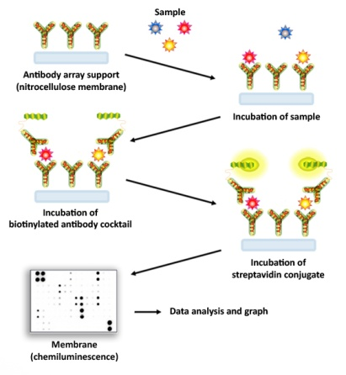
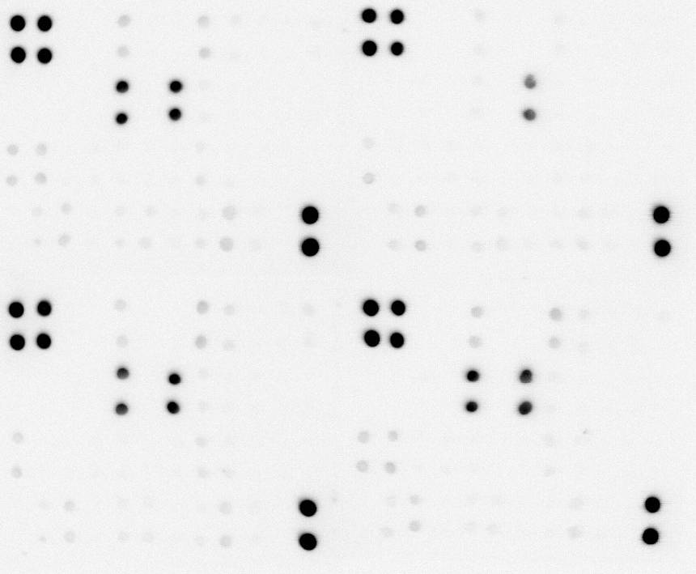
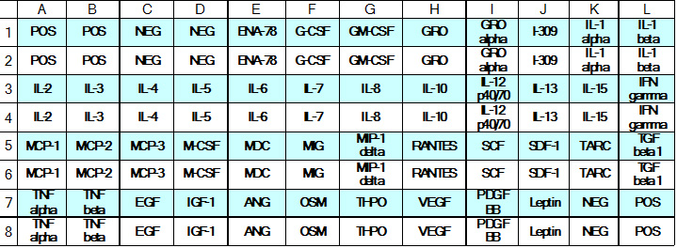
MULTIPLEX ANALYSIS
RayBio HUMAN INFLAMMATION ARRAY 3
screening sandwich-based membrane method
detect of 40 human inflammatory factors/proteins in 1 mL of cell culture media, serum, plasma, etc.
cytokines visualized by chemiluminescent reaction with the respective antibodies
semi-quantitative densitometric evaluation from digital photography of membrane (Fujifilm LAS – 1000, sw AIDA 3.28)
Positive control – colouring 100 %
Negative control – colouring 0 %
Notes:
(the semi-quantitative) screening sandwich-based membrane method
detect of 40 human inflammatory factors/proteins in 1 ml of cell culture media, serum, plasma, etc.
Than react with agent for devedloping chemiluminescent reaction
cytokines (in supernatant produced by cells are) visualized by chemiluminescent reaction with the respective antibodies
semi-qantitative densitometric evaluation from digital photography of membrane
(Fujifilm LAS – 1000, sw AIDA3.28)
http://www.raybiotech.com/c-series-human-inflammation-array-3-4.html
Manual at - http://www.raybiotech.com/files/manual/Antibody-Array/AAH-INF-3.pdf
Na povrchu vhodné membrány o rozměrech cca 1x1cm byly do určitých předem definovaných míst, spotů, navázány protilátky proti jednotlivým stanovovaným chemokinům. Membrána byla následně inkubována se supernatantem vzorku po kultivaci a po promytí byl na povrch membrány aplikován koktejl sekundárních protilátek proti zmíněným chemokinům. Tyto protilátky jsou namířeny proti jiným epitopům na povrchu molekul chemokinů než se kterými reagují primární, na membránu fixované protilátky. Sekundární protilátky byly značeny biotinem. V dalším kroku byl přidán konjugát streptavidin-křenová peroxidáza a nakonec substrát, který po transformaci na barevný produkt vizualizoval navázané stanovované chemokiny.
Vyhodnocení bylo provedeno densitometricky z digitálního fotografického záznamu membrány.
6

Slide 7
RESULTS – HMSC-bm
Cytokine | Material / Cultivation
 | Titanium |  | TCPS
 | 3 days | 7 days | 3 days | 7 days
Eotaxin-2 | 2 | 2 | 2 | 0
IL-10 | 5 | 8 | 5 | 3
IL-16 | 2 | 4 | 3 | 1
IL-3 | 3 | 3 | 3 | 1
IL-6 | 1 | 1 | 1 | 0
IL-8 | 31 | 51 | 48 | 47
IP-10 | 3 | 1 | 3 | 1
M-CSF | 4 | 6 | 5 | 2
MCP-1 | 1 | 6 | 2 | 2
MIP-1b | 9 | 13 | 11 | 8
RANTES | 10 | 15 | 11 | 7
TGF-b1 | 1 | 1 | 1 | 1
TIMP-2 | 2 | 10 | 4 | 9
TNF-a | 3 | 5 | 3 | 1
TNF-b | 3 | 2 | 4 | 1
Averaged values (n=4)
above 20 - rose
above 40 - green
above 70 - yelow
above 100 - red
Cytokines produced at a level close to the negative control were omitted.
Positive control – 100 %
Negative control – 0 %

Slide 8
RESULTS – MONONUCLEAR CELLS
Cytokine | Material / Cultivation
 | Ti/ALG/HAP |  | Ti/ALG/TCP |  | Titanium |  | Ti/ALG
 | 3 days | 7 days | 3 days | 7 days | 3 days | 7 days | 3 days | 7 days
Eotaxin-2 | 8 | 7 | 1 | 2 | 3 | 7 | 1 | 3
GM-CSF | 5 | 6 | 2 | 12 | 5 | 18 | 0 | 1
I-309 | 4 | 9 | 6 | 6 | 3 | 10 | 7 | 7
ICAM-1 | 4 | 5 | 2 | 2 | 2 | 7 | 1 | 3
IL-10 | 5 | 6 | 2 | 2 | 3 | 6 | 1 | 2
IL-16 | 45 | 65 | 23 | 30 | 39 | 50 | 24 | 33
IL-1a | 5 | 5 | 4 | 8 | 9 | 21 | 3 | 4
IL-1b | 4 | 5 | 2 | 5 | 1 | 6 | 2 | 5
IL-3 | 10 | 10 | 3 | 6 | 6 | 7 | 4 | 5
IL-6 | 121 | 127 | 117 | 133 | 75 | 150 | 2 | 46
IL-6sR | 5 | 5 | 3 | 2 | 3 | 5 | 1 | 3
IL-8 | 117 | 121 | 67 | 68 | 111 | 127 | 52 | 79
IP-10 | 27 | 24 | 3 | 8 | 19 | 28 | 8 | 11
M-CSF | 4 | 4 | 1 | 2 | 2 | 6 | 1 | 2
MCP-1 | 94 | 123 | 58 | 77 | 59 | 113 | 54 | 85
MIP-1a | 32 | 47 | 20 | 31 | 26 | 58 | 1 | 9
MIP-1b | 51 | 63 | 58 | 76 | 56 | 82 | 27 | 31
PDGF-BB | 9 | 21 | 4 | 3 | 11 | 24 | 6 | 9
RANTES | 99 | 109 | 85 | 117 | 95 | 117 | 119 | 117
TGF-b1 | 5 | 4 | 1 | 3 | 3 | 4 | 1 | 4
TIMP-2 | 9 | 16 | 4 | 4 | 7 | 23 | 2 | 8
TNF-a | 5 | 10 | 2 | 4 | 8 | 14 | 2 | 5
TNF-b | 41 | 42 | 4 | 12 | 36 | 45 | 7 | 16
sTNFRI | 5 | 5 | 1 | 2 | 3 | 6 | 1 | 3
sTNFRII | 16 | 31 | 5 | 6 | 8 | 23 | 3 | 8
Averaged values (n=4)
above 20 - rose
above 40 - green
above 70 - yelow
above 100 - red
Limits selected with regards to the highest measured value - 150 and absolute values of the negative and positive controls.
Cytokines produced at a level close to the negative control were omitted.
Positive control – 100 %
Negative control – 0 %
Notes:
8

Slide 9
RESULTS – MONONUCLEAR CELLS
Cytokine production higher than 15 % of the positive control
Cytokine | Material / Cultivation
 | Ti/ALG/HAP |  | Ti/ALG/TCP |  | Titanium |  | Ti/ALG
 | 3 days | 7 days | 3 days | 7 days | 3 days | 7 days | 3 days | 7 days
IL-16 | 45 | 65 | 23 | 30 | 39 | 50 | 24 | 33
IL-6 | 121 | 127 | 117 | 133 | 75 | 150 | 2 | 46
IL-8 | 117 | 121 | 67 | 68 | 111 | 127 | 52 | 80
IP-10 | 27 | 24 | 3 | 8 | 19 | 28 | 8 | 11
MCP-1 | 94 | 123 | 58 | 78 | 60 | 113 | 54 | 85
MIP-1a | 32 | 47 | 20 | 31 | 26 | 58 | 1 | 9
MIP-1b | 51 | 63 | 58 | 76 | 56 | 82 | 27 | 31
PDGF-BB | 9 | 22 | 4 | 3 | 11 | 24 | 6 | 9
RANTES | 99 | 109 | 85 | 117 | 95 | 117 | 120 | 117
TNF-b | 41 | 42 | 4 | 12 | 36 | 45 | 7 | 16
TIMP-2 | 9 | 16 | 4 | 4 | 7 | 23 | 2 | 8
Averaged values
above 20 - rose
above 40 - green
above 70 - yelow
above 100 - red
Limits selected with regards to the highest measured value - 150 and absolute values of the negative and positive controls.
Cytokines produced at a level close to the negative control were omitted.
Notes:
9

Slide 10
RESULTS – MONONUCLEAR CELLS
(7 days cultivation )
Titanium
Ti/ALG
Ti/ALG/HAP
Ti/ALG/TCP
Notes:
Titanium induce cells to produce higher dose of cytokines, the alginate hyrogel is less reactive.
When we will compare experimental surfaces, the HAP doped alginate, produce cytokines at similar doses,except Il-8 – the proinflammatory factor and MCP 1, which recruit cells to the site of inflammation.
MIP – 1 (macrophage inflammatory protein)
MCP – 1 (monocyte chemotactic protein 1) recruits monocytes/macrophages, memory T lymphocytes, and natural killer (NK) cells to the sites of inflammation produced by either tissue injury or infection.

Slide 11
RESULTS – SaOS-2 CELLS
Cytokine | Material / Cultivation |  |  |  |  |  |  |  |  | Cytokine | Material / Cultivation
 | Ti/ALG/HAP |  | Ti/ALG/TCP |  | glass |  | Ti/ALG |  |  |  | Ti/ALG/HAP |  | Ti/ALG/TCP |  | glass |  | Ti/ALG
 | 3 days | 7 days | 3 days | 7 days | 3 days | 7 days | 3 days | 7 days |  |  | 3 days | 7 days | 3 days | 7 days | 3 days | 7 days | 3 days | 7 days
Eotaxin | 12 | 15 | 13 | 18 | 4 | 6 | 1 | 2 |  | IL-6 | 1 | 2 | 3 | 4 | 1 | 1 | 0 | 1
Eotaxin-2 | 18 | 21 | 17 | 22 | 6 | 8 | 2 | 2 |  | IL-6sR | 9 | 12 | 12 | 16 | 5 | 7 | 1 | 2
GCSF | 3 | 4 | 2 | 3 | 1 | 1 | 0 | 1 |  | IL-7 | 4 | 6 | 4 | 5 | 2 | 3 | 1 | 1
GM-CSF | 8 | 10 | 9 | 12 | 2 | 3 | 1 | 1 |  | IL-8 | 24 | 29 | 23 | 30 | 12 | 15 | 6 | 9
I-309 | 8 | 10 | 8 | 11 | 4 | 5 | 5 | 7 |  | IP-10 | 30 | 32 | 28 | 34 | 19 | 26 | 8 | 12
ICAM-1 | 13 | 16 | 13 | 17 | 3 | 4 | 1 | 2 |  | M-CSF | 13 | 17 | 14 | 18 | 7 | 9 | 14 | 18
IFN-g | 17 | 22 | 19 | 24 | 7 | 9 | 4 | 6 |  | MCP-1 | 22 | 26 | 28 | 32 | 13 | 18 | 9 | 12
IL-10 | 13 | 16 | 12 | 15 | 5 | 7 | 6 | 8 |  | MCP-2 | 8 | 10 | 7 | 10 | 4 | 5 | 6 | 7
IL-11 | 8 | 10 | 8 | 10 | 2 | 3 | 8 | 10 |  | MIG | 10 | 13 | 9 | 12 | 5 | 6 | 14 | 19
IL-12p40 | 21 | 25 | 22 | 24 | 13 | 17 | 24 | 32 |  | MIP-1a | 21 | 26 | 19 | 25 | 8 | 11 | 30 | 40
IL-12p70 | 21 | 25 | 23 | 27 | 12 | 16 | 27 | 36 |  | MIP-1b | 44 | 46 | 40 | 45 | 25 | 31 | 62 | 70
IL-13 | 2 | 2 | 3 | 4 | 0 | 0 | 1 | 1 |  | MIP-1d | 14 | 17 | 13 | 17 | 3 | 4 | 18 | 25
IL-15 | 5 | 7 | 13 | 17 | 5 | 7 | 1 | 2 |  | PDGF-BB | 8 | 9 | 8 | 11 | 5 | 7 | 8 | 13
IL-16 | 13 | 16 | 13 | 17 | 7 | 10 | 3 | 4 |  | RANTES | 18 | 24 | 34 | 39 | 19 | 24 | 9 | 12
IL-17 | 5 | 7 | 5 | 7 | 3 | 5 | 1 | 1 |  | TGF-b1 | 6 | 7 | 10 | 13 | 6 | 8 | 2 | 1
IL-1a | 16 | 20 | 17 | 22 | 5 | 7 | 23 | 30 |  | TIMP-2 | 75 | 78 | 73 | 83 | 62 | 68 | 109 | 114
IL-1b | 8 | 10 | 14 | 19 | 7 | 9 | 3 | 4 |  | TNF-a | 11 | 14 | 14 | 19 | 9 | 11 | 3 | 4
IL-2 | 8 | 10 | 12 | 16 | 6 | 8 | 2 | 3 |  | TNF-b | 25 | 29 | 31 | 37 | 19 | 25 | 13 | 17
IL-3 | 17 | 20 | 19 | 25 | 12 | 15 | 4 | 5 |  | sTNFRI | 9 | 12 | 13 | 18 | 6 | 9 | 6 | 9
IL-4 | 5 | 6 | 5 | 8 | 3 | 4 | 1 | 1 |  | sTNFRII | 11 | 15 | 9 | 13 | 8 | 10 | 8 | 11
Averaged values
above 20 - rose
above 40 - green
above 70 - yelow
above 100 - red
Limits selected with regards to the highest measured value 114 and absolute values of the negative and positive controls.
Positive control – 100 %
Negative control – 0 %

Slide 12
RESULTS – SaOS-2 CELLS
Cytokine production higher than 15 % of the positive control
Cytokine | Material / Cultivation
 | Ti/ALG/HAP |  | Ti/ALG/TCP |  | glass |  | Ti/ALG
 | 3 days | 7 days | 3 days | 7 days | 3 days | 7 days | 3 days | 7 days
Eotaxin-2 | 18 | 22 | 17 | 22 | 6 | 8 | 2 | 2
IFN-g | 17 | 22 | 18 | 25 | 7 | 10 | 4 | 6
IL-12p40 | 21 | 25 | 23 | 23 | 13 | 17 | 24 | 32
IL-12p70 | 21 | 25 | 23 | 27 | 12 | 16 | 27 | 36
IL-1a | 16 | 20 | 17 | 22 | 5 | 7 | 23 | 30
IL-3 | 17 | 20 | 19 | 25 | 12 | 15 | 4 | 5
IL-8 | 25 | 29 | 23 | 30 | 12 | 15 | 6 | 9
IP-10 | 30 | 33 | 28 | 34 | 19 | 26 | 8 | 12
MCP-1 | 22 | 26 | 28 | 33 | 13 | 18 | 9 | 12
MIP-1a | 22 | 26 | 19 | 25 | 8 | 11 | 30 | 41
MIP-1b | 44 | 46 | 40 | 45 | 25 | 31 | 62 | 70
MIP-1d | 14 | 17 | 13 | 17 | 3 | 4 | 18 | 26
RANTES | 18 | 26 | 34 | 39 | 19 | 25 | 9 | 12
TIMP-2 | 75 | 78 | 73 | 83 | 62 | 68 | 109 | 114
TNF-a | 12 | 14 | 15 | 19 | 9 | 11 | 3 | 4
TNF-b | 26 | 29 | 31 | 37 | 19 | 26 | 13 | 17
Averaged values
above 20 - rose
above 40 - green
above 70 - yelow
above 100 - red
Limits selected with regards to the highest measured value 114 and absolute values of the negative and positive controls.
Notes:
Lidské osteoblasty SaOS je buněčná rakovinná linie
Naměřené hodnoty exprese cytokinů byly zprůměrovány a vyneseny do tabulky
nad 5 růžově,
nad 10 zeleně,
nad 25 žlutě
nad 100 mají červený podklad
Danka navrhuje na
nad 10 - růžově
nad 30 - zeleně
nad 70 - žlutě
nad 100 - červený podklad
Tyto hranice byly zvoleny s ohledem na nejnižší (0) a nejvyšší (149) naměřené hodnoty a absolutní hodnoty negativní a pozitivní kontroly. Cytokiny, které byly buňkami produkovány v množstvích blízkých negativní kontrole a nejsou významné z hlediska vhojení, jsou v tabulce vynechány (menší než cca 5 v průměrech).
12

Slide 13
RESULTS – SaOS-2 CELLS
7 days cultivation
glass
Ti/ALG
Ti/ALG/HAP
Ti/ALG/TCP

Slide 14
PRODUCED CYTOKINES
IL-6 (interleukin 6), pro- and anti-inflammatory cytokine. Stimulate immune response during infection and after trauma, play a role in fighting against infection.
IL-8 (interleukin 8), induces chemotaxis in target cells, primarily neutrophils but also other granulocytes, causing them to migrate toward the site of infection, induces phagocytosis, pro-inflammatory mediator. First pro-inflammatory cytokine in place of healing.
RANTES (Regulated on Activation, Normal T cell Expressed and Secreted), chemotactic for T lymphocytes, eosinophils and stimulate basophils to release of histamine. Recruit leukocytes into inflammatory sites, induces proliferation and activation of certain natural-killer (NK) cells.
MCP–1 (monocyte chemotactic protein 1) recruits monocytes/macrophages, memory T lymphocytes, and natural killer (NK) cells to the sites of inflammation produced by either tissue injury or infection.
Notes:
Rantes (Regulated on Activation, Normal T cell Expressed and Secreted) - chemotactic for T cells, eosinophils, and basophils, and plays an active role in recruiting leukocytes into inflammatory sites.
IL - 8 induces chemotaxis in target cells, primarily neutrophils but also other granulocytes, causing them to migrate toward the site of infection, induces phagocytosis, proinflammatory mediator . První prozánětlivý cytokin v místě boje.
RANTES plays an active role in recruiting leukocytes into inflammatory sites, induces the proliferation and activation of certain natural-killer (NK) cells. chemotaktický pro T lymfocyty, eosinofilyu a stimuluje basofily s uvolnění histaminu.
MCP – 1 regulate migration and infiltration of monocytes/macrophages , memory T lymphocytes, and natural killer (NK) cells.
MIP - 1produced by macrophages that causes local inflammatory responses in vivo, and induces superoxide production by neutrophils in vitro, chemoattractant for natural killer cells, monocytes and a variety of other immune cells. Regulují pohyb monocyto makrofágových buněk a T a B lymfocytů. Podobný účinek vykjazuje i MCP – 1
Il – 16 - factor that could attract activated T cells in humans, it was previously called lymphocyte chemoattractant factor (LCF).[3] Since then, this interleukin has been shown to recruit and activate many other cells expressing the CD4 molecule, including monocytes, eosinophils, and dendritic cells.
is a cytokine that is released by a variety of cells (including lymphocytes and some epithelial cells) that has been characterized as a chemoattractant for certain immune cells expressing the cell surface molecule CD4.
pleiotropic cytokine that functions as a chemoattractant, a modulator of T cell activation, and an inhibitor of HIV replication.
MCP 1 - recruits monocytes, memory T cells, and dendritic cells to the sites of inflammation produced by either tissue injury or infection.

Slide 15
PRODUCED CYTOKINES
MIP–1 (macrophage inflammatory protein), chemotactic and proinflammatory factor, causes local inflammatory responses in vivo, chemoattractant for natural-killer (NK) cells, monocytes and a variety of other immune cells. Regulate migration of monocyte-macrophages and T and B lymphocytes.
IL-16 (interleukin 16), chemoattractant, released by a variety of cells (lymphocytes, some epithelial cells), a modulator of T cell activation, recruit and activate many other cells including monocytes, eosinophils, and dendritic cells.
TIMP–2 (tissue inhibitor of metalloproteinase 2), natural inhibitor of the matrix metalloproteinases involved in degradation of the extracellular matrix, directly suppress the proliferation of endothelial cells. May be critical to the maintenance of tissue homeostasis by inhibiting protease activity in tissues undergoing remodelling of the extracellular matrix.
Notes:
IL - 6 both a pro-inflammatory cytokine and an anti-inflammatory myokine. stimulate immune response during infection and after trauma, plays a role in fighting infection.
IL - 8 induces chemotaxis in target cells, primarily neutrophils but also other granulocytes, causing them to migrate toward the site of infection, induces phagocytosis, proinflammatory mediator . První prozánětlivý cytokin v místě boje.
RANTES plays an active role in recruiting leukocytes into inflammatory sites, induces the proliferation and activation of certain natural-killer (NK) cells. chemotaktický pro T lymfocyty, eosinofilyu a stimuluje basofily s uvolnění histaminu.
MCP – 1 regulate migration and infiltration of monocytes/macrophages , memory T lymphocytes, and natural killer (NK) cells.
MIP - 1produced by macrophages that causes local inflammatory responses in vivo, and induces superoxide production by neutrophils in vitro, chemoattractant for natural killer cells, monocytes and a variety of other immune cells. Regulují pohyb monocyto makrofágových buněk a T a B lymfocytů. Podobný účinek vykjazuje i MCP – 1
Il – 16 - factor that could attract activated T cells in humans, it was previously called lymphocyte chemoattractant factor (LCF).[3] Since then, this interleukin has been shown to recruit and activate many other cells expressing the CD4 molecule, including monocytes, eosinophils, and dendritic cells.
is a cytokine that is released by a variety of cells (including lymphocytes and some epithelial cells) that has been characterized as a chemoattractant for certain immune cells expressing the cell surface molecule CD4.
pleiotropic cytokine that functions as a chemoattractant, a modulator of T cell activation, and an inhibitor of HIV replication.

Slide 16
SUMMARY
Each cell type produced a different spectrum of cytokines:
Mononuclear cells produced preferentially factors of nonspecific immunity (IL-6 and IL-8, RANTES, MCP-1, MIP and IL-16) at doses higher than detected for the positive control of the RayBio array.
The cytokine production declined in the order of Ti/ALG/HAP →Ti → Ti/ALG/TCP → Ti/ALG.
HMSC-bm produced mostly chemokines activating monocytes, granulocytes and neutrophils (IL-8, MIP-1b, RANTES, TIMP-2) and activating predominantly their chemotaxis, but in doses lower than mononuclear cells.
SaOS-2 cells produced the broadest spectrum of cytokines but generally only in the lowest doses and with no significant difference between Ti/ALG/HAP and Ti/ALG/TCP surfaces. The only one exception was the TIMP-2 expressed in a higher extent compared to mononuclear cells and HMSC-bm.
Notes:
Pro SaOS 2:
The only one exception was TIMP-2 expressed in a higher extent compared to mononuclear cells (reached above 75 % of the positive control).
- Oba typy (monocyty a stem cells) buněk produkovaly tyto cytokiny IL-8, MIP-1β, RANTES, v produkci ostatních cytokinů se lišili.
- Spektrum produkovaných cytokinů ukazuje na nastartování reakce přirozené imunity, která spouští zánět.
U linie HMSC-bm byla detekována vyšší produkce chemokinů, které aktivují chemotaxi a aktivaci monocytů, granulocytů, neutrofilů.
Vliv povrchové úpravy je zanedbatelný. – dělaly to HMSC -bm
KAŽDÝ TYP BUNĚK PRODUKOVAL JINÉ SPEKTRUM CYTOKINŮ:
Mononukleární buňky produkovaly přednostně faktory nespecifické imunity (IL-6 a IL-8, MIP, RANTES a MCP-1) v dávkách vyšších než u pozitivní kontroly testu RayBio. Produkce cytokinů klesala v pořadí Ti/ALG/HAP→Ti→Ti/ALG/TCP→ Ti/ALG.
HMSC-bm produkovaly převážně chemokiny aktivující chemotaxi a aktivaci monocytů, granulocytů a neutrofilů, a to v nižší míře než mononukleární buňky. Nižší proliferace HMSC-bm buněk na Ti povrchu oproti TCPS kontrole neovlivňuje produkci cytokinů a chemokinů do supernatantu.
SaOS-2 buňky produkovaly nejširší spektrum cytokinů, ale většinou pouze v nižších dávkách a bez významného rozdílu mezi Ti/ALG/HAP a Ti/ALG/TCP povrchy. Výjimkou byl TIMP-2, který SaOS-2 buňky produkují v nejvyšší míře v porovnání s ostatními sledovanými typy buněk.

Slide 17
CONCLUSION
Immunocompetent (mononuclear) and HMSC-bm (stem) cells produced preferentially factors of nonspecific immunity and showed differences between tested surfaces.
SaOS-2 cells were not sufficiently sensitive for this type of comparison.
To test the systemic inflammatory response induced by the presence of the implant intended for the bone tissue reconstruction or replacement the immunocompetent and HMSC-bm cells should be included into the material biocompatibility investigation.
Notes:
What is the conclusion.
Cytokiny produkované imunokompetentními ukazují rozdíly mezi experimentálními materiály.
Buňky SaOS-2 nejsou pro tento typ porovnání dostatečně citlivé.
Pro testování celkové zánětlivé odpovědi vyvolané přítomností implantátu určeného k rekonstrukci nebo náhradě kostní tkáně v podmínkách in vitro by měly být kromě SaOS-2 buněk využívány i HMSC-bm a mononukleární buňky vzhledem k jejich zmíněné citlivosti na produkci cytokinů.
Porovnání produkovaných cytokinů ukazuje, že imunokompetentní buňky mají širší spektrum reakce na implantační materiál, a tak by měly být využívány k testování zejména bioaktivních materiálů.
To test the systemic inflammatory response induced by the presence of the implant intended for reconstruction or replacement of the bone tissue under in vitro conditions should be besides SaOS-2 cells used also HMSC-bm and mononuclear cells due to their sensitivity to the above mentioned cytokine production.
17

Slide 18
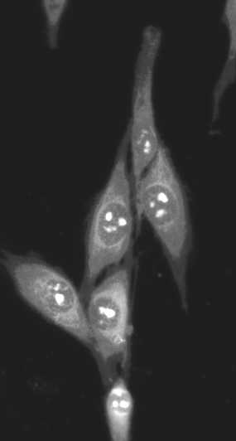
Thank for your attention
The study was supported by research project NT 13297-4 of the Internal Grant Agency, Ministry of Health, Czech Republic and by the European Regional Development Fund (project BIOCEV No. CZ.1.05/1.1.00/02.0109).
Notes:
The study was supported by research project NT 13297-4 of the Internal Grant Agency, Ministry of Health, Czech Republic and by the European Regional Development Fund (project BIOCEV No. CZ.1.05/1.1.00/02.0109).

