Slide 1
Biomedical Application of Zeolites – a Review
Lucie Bacakova, MD, PhD, Assoc. Prof.
Dept. of Biomaterials and Tissue Engineering
Institute of Physiology, Czech Academy of Sciences
Videnska 1083
142 20 Prague 4-Krc
Czech Republic
E-mail: Lucie.Bacakova@fgu.cas.cz
Web site: http://www.fgu.cas.cz/en/

Slide 2
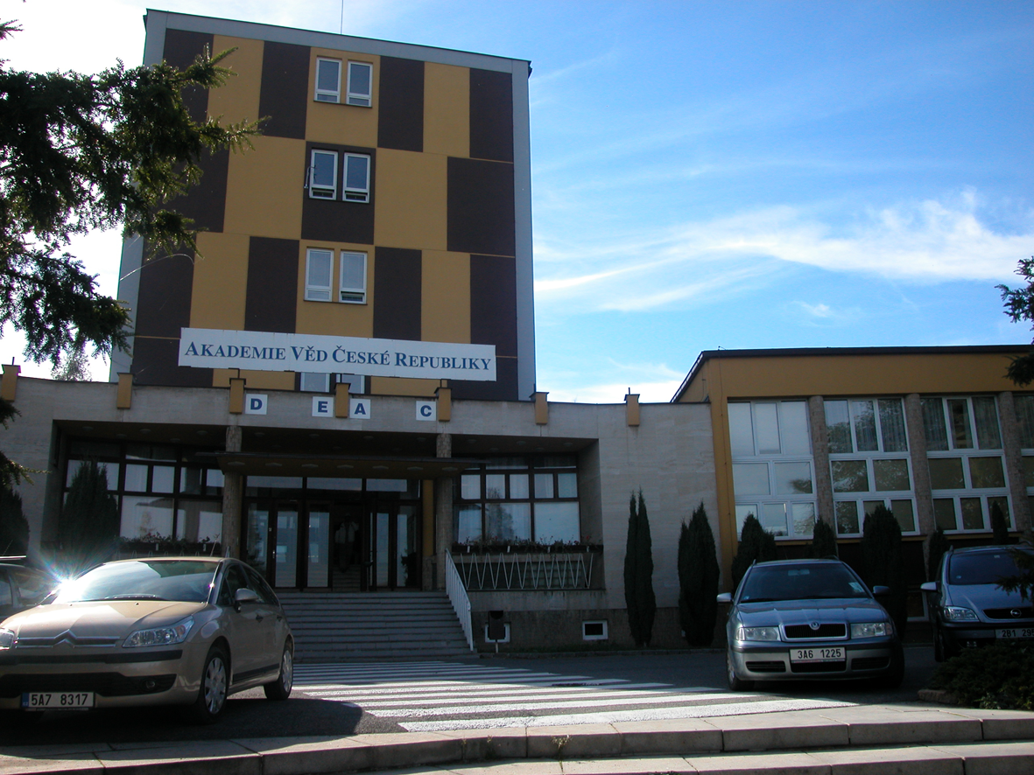
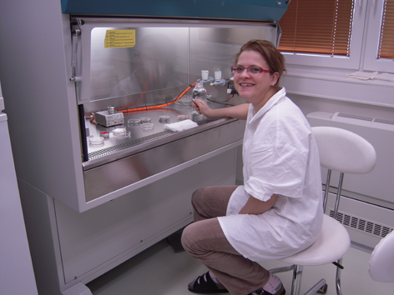
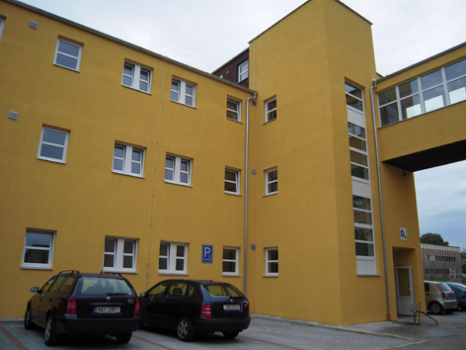
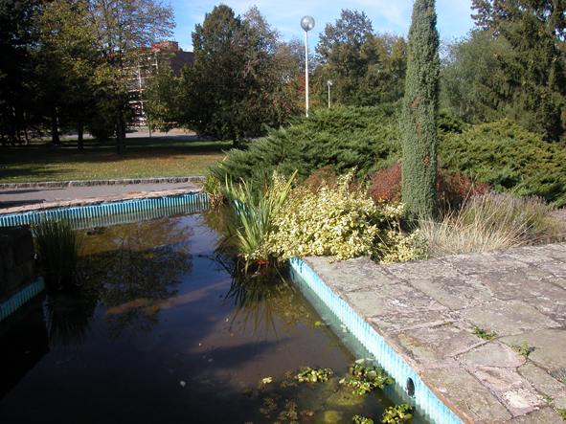

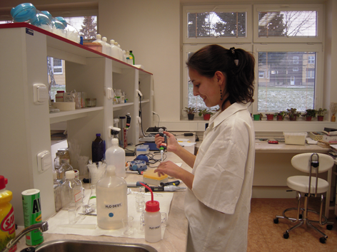
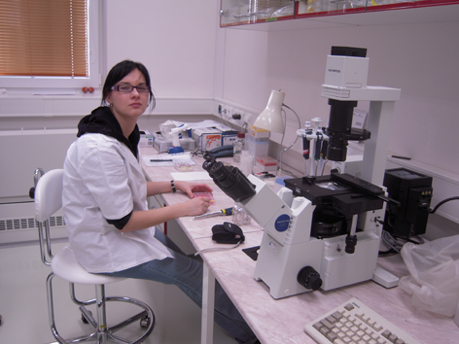
Institute of Physiology, Czech Acad. Sci.
Videnska 1083
142 20 Prague 4-Krc
Czech Republic
Main Building
Tissue Culture Room
New Building with our Lab
Cell Staining & Microscopy
Garden

Slide 3
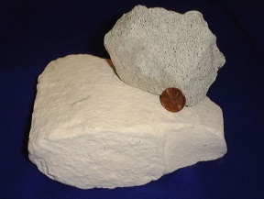
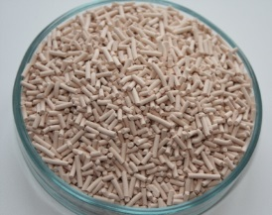
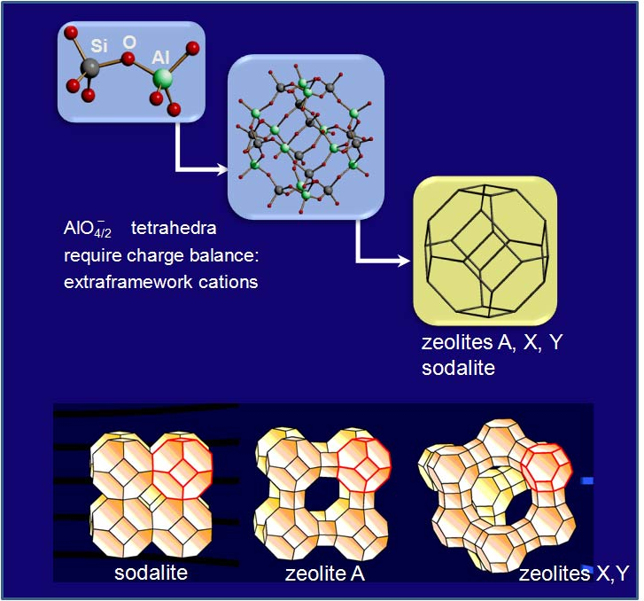
Zeolites - Definition
Zeolites are crystalline porous minerals
  Natural
  Synthetic
Zeolites consist of:
  Si atoms tetrahedrally coordinated by O atoms
  A part of the framework Si atoms may be isomorphously substituted by some other atoms (e. g. Al)
  Si-O tetrahedra form 3D structures with pore size of 4 - 12 Å

Slide 4
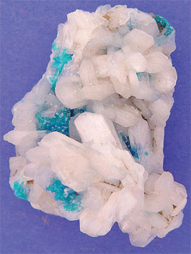
The Term “Zeolites”
Introduced in 1756 by Swedish mineralogist Axel Fredrik Cronsted
  Discovered stilbite
  Observed that upon rapidly heating, this material produced steam from water that had been adsorbed by the material
  Based on this, he called the material zeolite, from the Greek ζέω (zéo̱), meaning "to boil" and λίθος (líthos), meaning "stone"
Cavansite as the bluish mineral on the stilbite matrix. Both are zeolite minerals.
Copyrigt StoneTrust, Inc.; courtesy of ESW Image Bank

Slide 5
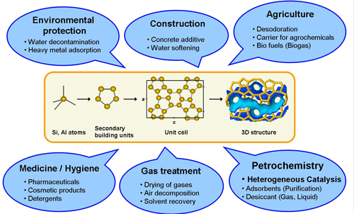
Zeolites as Potent Adsorbents and Ion-Exchangers
Technical and biomedical applications
Water: Removal of ammonium, nitrate, Cu(II), Mn(II), Zn(II), Pb(II)
Air: removal of benzene, toluene and xylene from the polluted air
Radioactivity: Decontamination of water, air and food from (134)Cs, (137)Cs, (90)Sr
Positive effects in veterinary medicine and zootechnology:
Function and microbial flora of the digestive tract
Delivery of metabolically important ions
Strengthening the immunity, improved nutrition status
Drug and gene delivery
Sunscreens, skin whitening
Organism detoxification
Antioxidative, antiapoptotic, antiinflammatory efects
Separation of biomolecules and cells
Construction of biosensors
Tissue engineering
Wound healing
Biomaterial coating
https://www.elitenetzwerk.bayern.de/elitenetzwerk-home/forschungsarbeiten/naturwissenschaften/2009/reitmeier-zeolites/

Slide 6
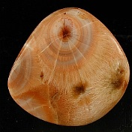
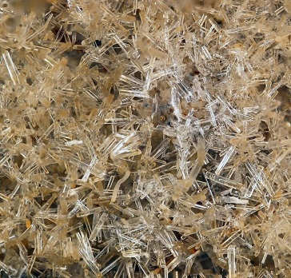
Classification of Zeolites I
Six structural groups of zeolites according Nickel-Strunz classification
Group No. | Group name | Example | Significance, examples of application
09.GA | Zeolites with T5O10 units (T = combined Si and Al) – the fibrous zeolites | Thomsonite | Gemstone
09.GB | Chains of single connected 4-membered rings | Analcime | Antioxidant effects in humans (Dogliotti et al. 2012)
09.GC | Chains of doubly connected 4-membered rings | Phillipsite Zeolite L | Antioxidant effects in humans (Dogliotti et al. 2012) Cell separation (El Gindi et al. 2012); Detection of cancer cells (Greco et al. 2015)
09.GD | Chains of 6-membered rings – tabular zeolites | Faujasite Zeolite Y Ferrierite Erionite | Drug delivery (5-fluorouracil, Vilaça et al. 2013); wound healing (Ninan et al. 2013, 2014, 2015); Studies on endocytosis (Andersson and Eriksson 2007) Antioxidant (Pellegrino et al. 2011) Highly carcinogenic (causing lung cancer and mesothelioma (Ortega-Guerrero et al. 2015)

Slide 7
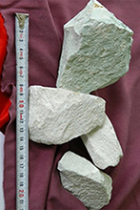
Classification of Zeolites II
09.GE | Chains of T10O20 tetrahedra (T = combined Si and Al) | Clinoptilolite (Hydrated Sodium Potassium Calcium Aluminum Silicate) | Most widely used zeolite: Water and air purification (Huang et al. 2015, Rostami and Jonidi Jafari 2014) Decontamination of radioactivity (Voronina et al. 2015) Detoxification of organisms (Beltcheva et al. 2012, Topashka-Ancheva et al. 2012, Delavarian et al. 2013) Positive effects on nutrition and digestive tract (Wu et al. 2013a,b,c), gastroprotective effects Potgieter et al. 2014) Drug delivery (Diclofenac: de Gennaro et al. 2015, doxorubicin: Khatamian et al. 2016) Antioxidant, antiapoptotic, antiinflammatory activity (Saribeyoglu et al. 2011, Yapislar et al. 2016) Antitumor activity (Pavelić et al. 2001) Construction of biosensors (Soldatkin et al. 2015, Hasheminejad and Nezamzadeh-Ejhieh 2015)
- | Others | ZSM-5 Zeolite A | Drug delivery (gentamycin), antibacterial properties, bone implants (Guo et al. 2014, Kaur et al. 2015) Antimicrobial wound-healing dressings (Neidrauer et al. 2014); antimicrobial coating of bone implants (Chen et al. 2009); inhibition of osteoclasts (Schütze et al. 1995)

Slide 8
Use of Zeolites in Tissue Engineering
Bone tissue engineering
  Scaffolds
  Implant coating
Vascular tissue engineering
  Reservoirs of oxygen, nitric oxide
Skin tissue engineering, wound healing, hemostasis
Positive effects on liver
  Based on the antioxidant effect
Positive effects on nervous system
  Treatment of Alzheimer disease

Slide 9
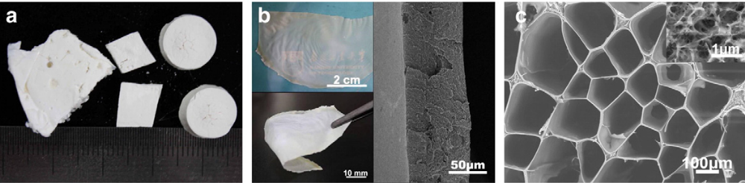
Bone Tissue Engineering: Scaffolds
Zeolite-A/chitosan hybrid composites with zeolite contents of 20-55 wt.%
  Cylinders, plates; pore size 100-300 um
  Hydroxyapatite growth in simulated body fluid
  Antimicrobial activity when incorporated with Ag⁺ ions
Poly(vinylidenefluoride), an electroactive polymer, with zeolite NaY particles (Costa et al. 2013, J Mater Sci Mater Med. 24:395-403.)
  Promoted the growth of human mesenchymal stem cells differentiated into osteoblasts
  No proinflammatory effects
  Yu et al. 2013, Materials Science and Engineering C 33: 3652–3660)

Slide 10
Bone Tissue Engineering: Coatings
Metallic bone implants are often associated with the release of cytotoxic ions; anticorrosive coating is needed
This coating can also improve cell-material interaction and osseointegration
  MFI zeolite coatings prepared by on Ti-6Al-4V alloy
  This coating increased the adhesion and proliferation of mouse embryonic stem cells in vitro on the three-dimensional zeolite microstructure surface compared with a two-dimensional glass surface (Bedi et al. 2009, Acta Biomater. 5(8):3265-71)
  This coating also enhanced osteointegration and promoted bone regeneration after implantation of Ti-6Al-4V in rabbit femoral condylar defects in vivo (Li et al. 2015, Biochem Biophys Res Commun. 1;460:151-6)
Antimicrobial effects of the coatings: direct of mediated by Ag ions

Slide 11
Zeolites for Biomaterial Coating – Our Experience
We prepared defined anticorrosive silicalite nanofilms on
  Si (100) substrate
  AISI-316L stainless steel substrate
We tested the effects of these films on
  the adhesion, growth and viability of human osteoblast-like Saos-2 cells in vitro
These studies were performed in collaboration with Heyrovsky Institute of Physical Chemistry, Czech Acad. Sci., Prague (Dr. Ivan Jirka)

Slide 12
Preparation of Silicalite Nanofilms
Synthesized by the one-step in situ crystallization method
Based on immersion of the substrate into a reaction slurry composed of
  Template: tetrapropyl ammonium cations (TPA⁺)
  Silica source in deionized water (H₂O)
    hydrothermal conditions at elevated temperatures and autogenous pressure
    followed by a cleaning procedure of the freshly synthesized film
      removal of neutral amines, mainly tripropylamine, thermally or by ozonization

Slide 13
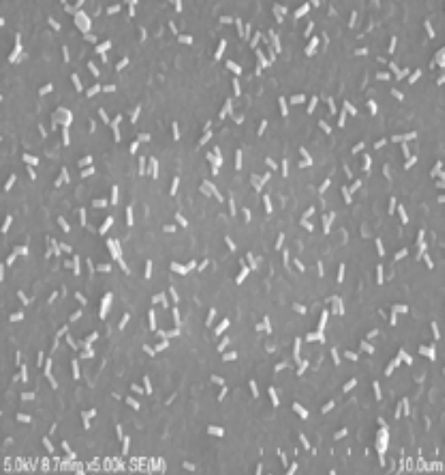
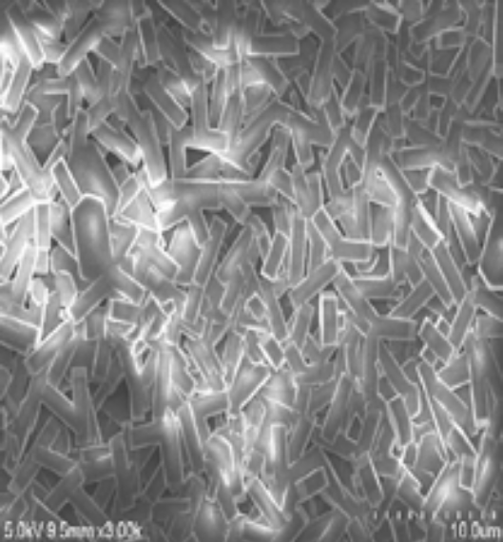
Morphology of Silicalite Nanofilms
Silicalite nanofilm on Si (100) substrate:
  continuous layer of b-oriented crystals covered by isolated a-oriented ones
Silicalite nanofilm on stainless steel:
  highly defective film composed mostly from a-oriented crystals
Ivan Jirka, 2016
100 μm
100 μm

Slide 14
First Set of Experiments
Silicalite nanofilms (SNF) without purification
Water drop contact angle ~70°
Human osteoblast-like Saos-2 cells, day 3 after seeding
SNF on Si (100)
(mainly b-oriented crystals)
SNF on stainless steel
(mainly a-oriented crystals)
Microscopic glass coverslip
Vandrovcova, Jirka, Bacakova 2016
Green: immunofluorescence of vinculin, a protein of focal adhesion plaques
Red: actin cytoskeleton (phalloidin-TRITC), Blue: cell nuclei (DAPI)

Slide 15
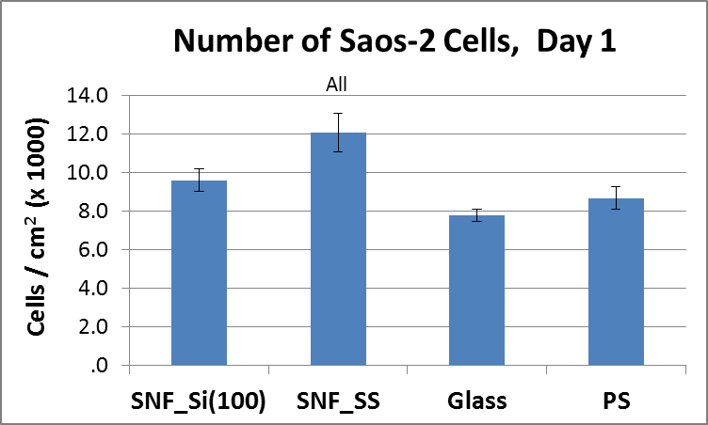
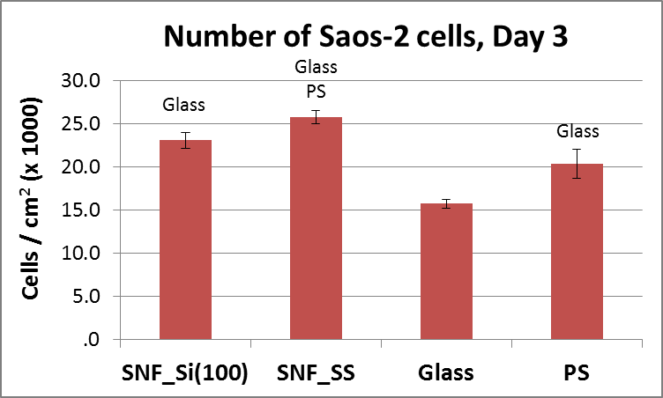
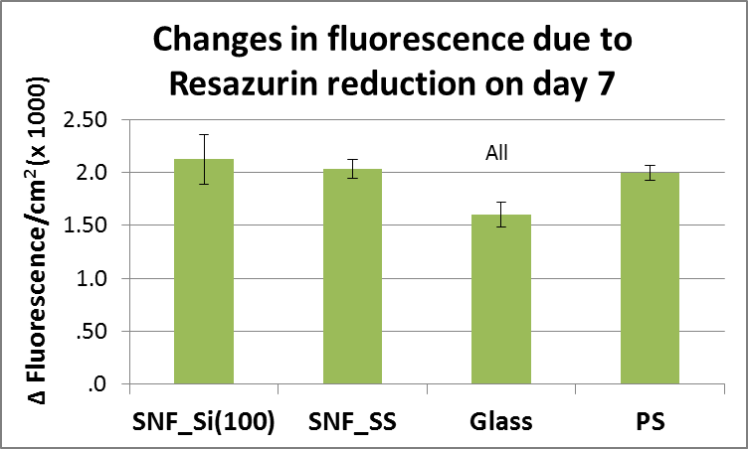
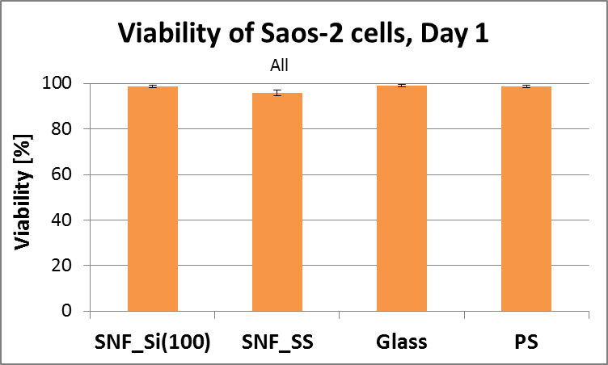
First Set of Experiments – cont.
Silicalite nanofilms without purification
(Water drop contact angle ~70°)
Mean ± S.E.M. from 48-64 measurements
(Resazurin:
Mean ± S.D. from 3-4 meas.)
ANOVA, Student-Newman-Keuls Method
Vandrovcova, Jirka, Bacakova 2016
(Staining with LIVE/DEAD kit (Invitrogen)

Slide 16
Second Set of Experiments
Silicalite nanofilms (SNF) with purification
Water drop contact angle
10° 30°
SNF on Si(100) - ozonization SNF on stainless steel (heat treatment at 300°C)
Green: immunofluorescence of vinculin, a protein of focal adhesion plaques
Red: actin cytoskeleton (phalloidin-TRITC), Blue: cell nuclei (DAPI)
Vandrovcova, Jirka, Bacakova 2016
Si(100)
Stainless steel
Glass

Slide 17
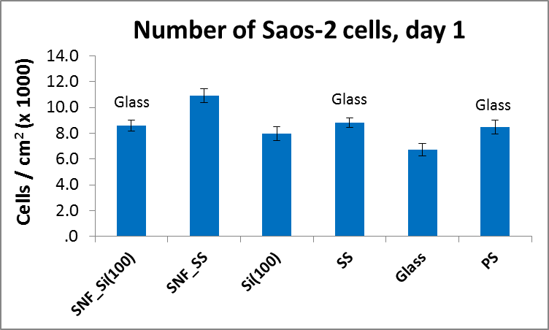
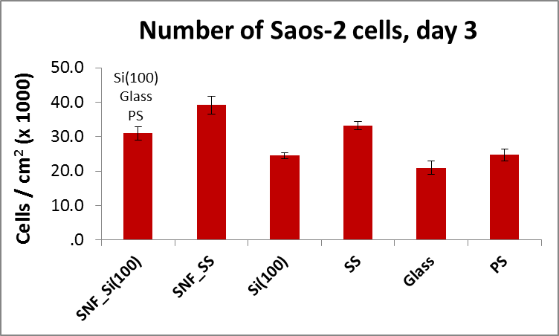
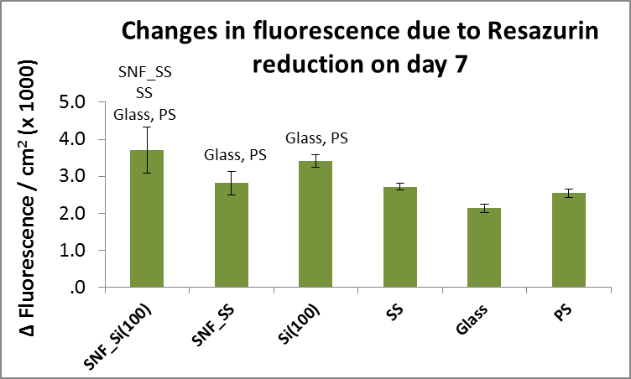
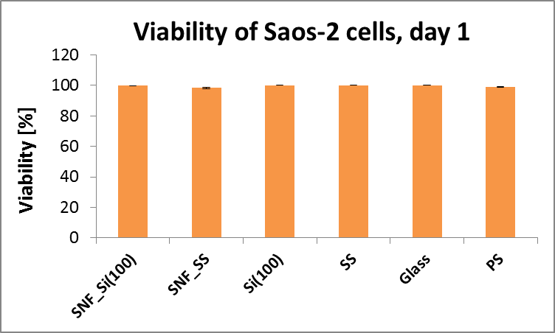
Second Set of Experiments – cont.
Silicalite nanofilms with purification
(SNF_Si: ozonization, WCA ~10°; SNF_SS: heat treatment at 300°C, WCA ~30°)
Mean ± S.E.M. from 48-64 measurements
(Resazurin:
Mean ± S.D. from 3-4 measurements)
ANOVA, Student-Newman-Keuls Method
Vandrovcova, Jirka, Bacakova 2016
(Staining with LIVE/DEAD kit (Invitrogen)

Slide 18
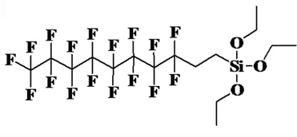
Vascular Tissue Engineering
Zeolites have potential for vascular tissue engineering
  As oxygen reservoirs (Seifu et al. 2011, Acta Biomater 7:3670-8)
    fluorinated zeolite particles were embedded in 3D polyurethane scaffolds
    The proliferation of human coronary artery smooth muscle cells on these scaffolds was significantly greater than on control zeolite-free scaffolds
  As carriers for nitric oxide (van Faassen and Vanin 2006, Nitric Oxide15: 233-240)
    NO is a vasodilator physiologically secreted by vascular endothelial cells
    Zeolite-Y powder functionalized with ferric iron-diethyldithiocarbamate complexes can trap nitric oxide

Slide 19
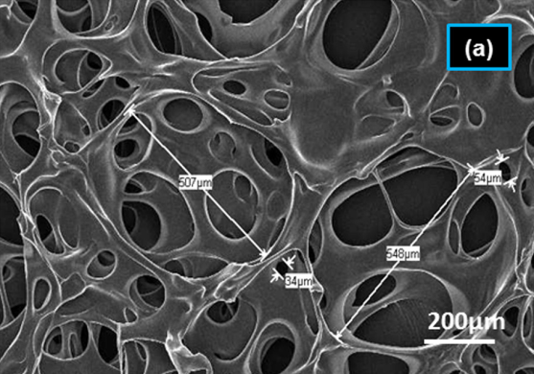
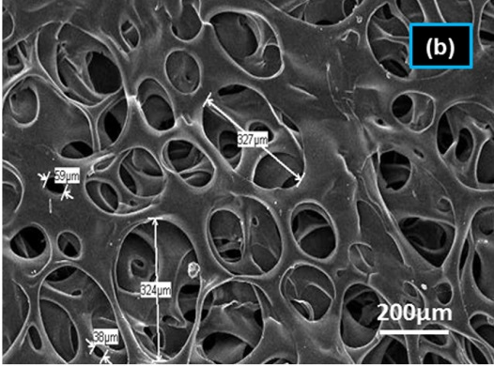
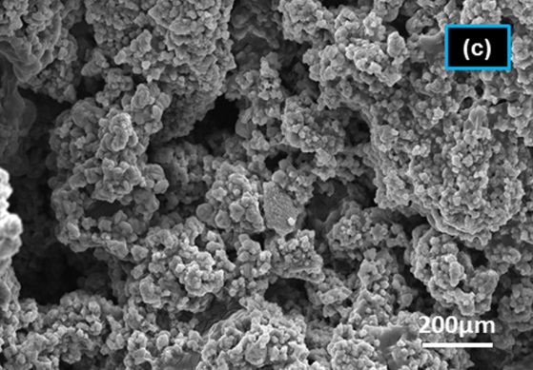
Skin Tissue Engineering
Pectin, gelatin or gelatin-hyaluronan copper-activated faujasite hybrid scaffolds (Ninan et al. 2013, 2014, 2015)
  Highly porous architecture
  Oxygen reservoirs
  Supported viability NIH3T3 fibroblasts in vitro
  Improved skin regeneration in rats in vivo
  Antibacterial activity
Gelatin/zeolite scaffolds (Ninan et al. 2014, Colloids Surf B Biointerfaces 115:244-52)
Pure scaffolds
0.5 w/v.% of faujasite
5 w/v.% of faujasite

Slide 20
Positive Effects of Zeolites on Other Cell and Tissue Types
Protective effect on hepatocytes
  after partial hepatectomy in rats
  during anticancer therapy using doxorubicin
  These effects are based on antioxidant action of zeolites (clinoptilolite) (Saribeyoglu et al. 2011, Asian J Surg. 34:153-157; Yapislar et al. 2016, Biol Trace Elem Res. 170:373-381).
Protective effects on nervous system
  Promising for treatment of Alzheimer's disease
  Increased the activity of antioxidant enzymes
  Reduced amyloid level and plaque load in the mouse brain (Montinaro et al. 2013, Life Sci. 92: 903-910).

Slide 21
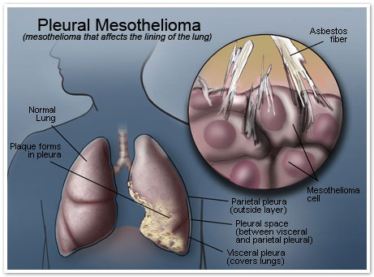
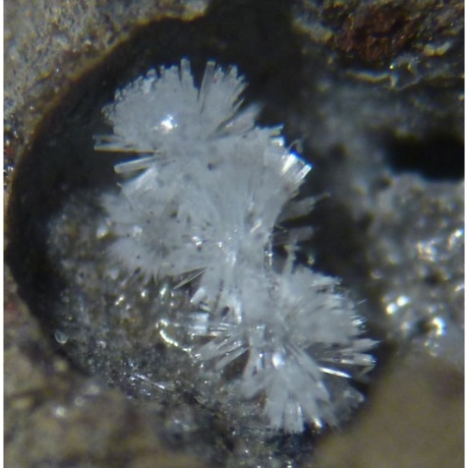
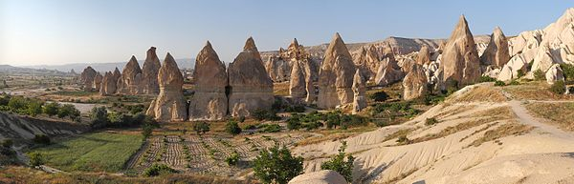
Toxic Zeolites
(Ortega-Guerrero et al. 2015, Occup Environ Med 72:216-218)
Erionite
  naturally occurring fibrous mineral (Turkey, Mexico, USA)
  forms brittle, wool-like fibrous masses in the hollows of rock formations
  similar properties to azbestos
  causes lung cancer and malignant mesothelioma
Fairy Chimneys rock formation in Cappadocia, Turkey

Slide 22
Conclusion
Zeolites are used in or are promising for a wide range of biotechnologies (e.g. drug and gene delivery, construction of biosensors, organism detoxification, antioxidants, tissue engineering, implant coating…….)
Our results showed that silicalite coatings on Si(100) and stainless steel enhanded the adhesion and growth of human osteoblast-like cells
Nevertheless, potential cytotoxicity of some zeolites should be taken into acount
Acknowledgements: This study was supported by the Grant Agency of the Czech Republic (grant No. 16-02681S).

Slide 23

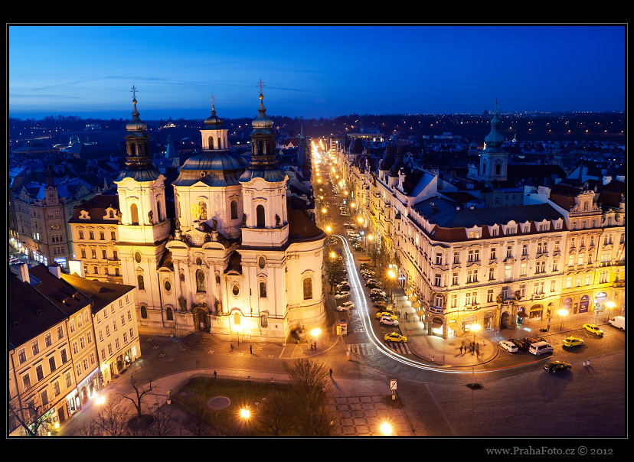

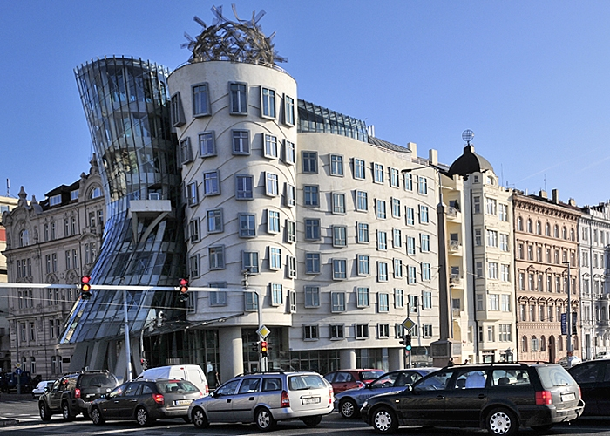
Prague
Thank you very much for your attention!
Charles Bridge, Castle of Prague
Old City Square
Wenceslas Square,
National Museum
„Dancing House“

