Slide 1

Drug-Induced Cardiac Safety in premature infants and neonates
Luana Pesco Koplowitz, MD, PhD, FCP, FFPM
President and Chief Medical & Scientific Officer
DUCK FLATS Pharma
Elbridge, New York, and Stockton, New Jersey USA
Adjunct Assistant Professor of Medicine
University of Delaware School of Medicine, Wilmington, Delaware, USA
University of Miami School of Medicine, Miami, Florida, USA
Department of Clinical Pharmacology
Member of:
FDA Cardiac Safety Research Consortium, International Neonatal Consortium (FDA/EMA/PMDA)

Slide 2
OVERVIEW
This presentation will discuss:
Introduction to Drug-Induced Cardiovascular Safety and Regulatory
Neonatal Physiology and Cardiac Function
Nonclinical Juvenile Models and Limitations
Developmental Cardiac Electrophysiology/Pharmacology
Cardiac Development and Drug Responses

Slide 3
OVERVIEW (Continued)
This presentation will discuss:
CVS Toxicity from Nonclinical Studies by Therapeutic Area
CVS Toxicity from Clinical Studies by Therapeutic Area
Well-Studied Agents (GI Motility): Cisapride
Bioanalytical Assays
Next Steps
Call To Action

Slide 4
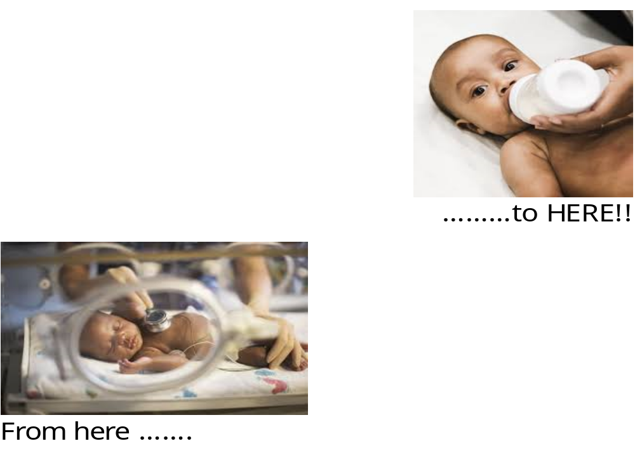
  Cardiac Safety Research Consortium

Slide 5
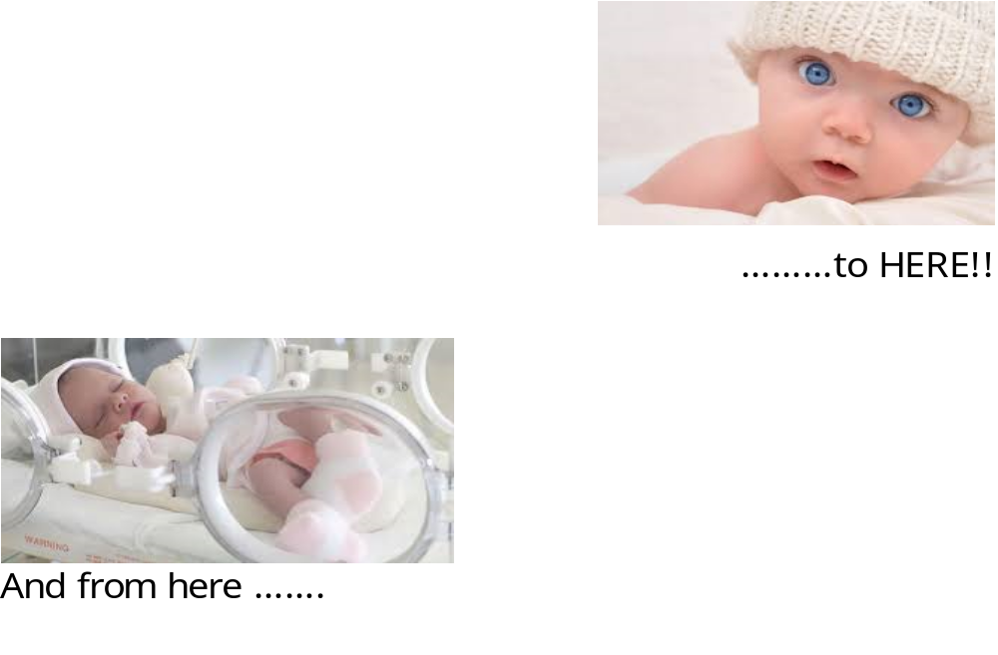
  Cardiac Safety Research Consortium

Slide 6
Introduction to Drug-Induced Cardiovascular Safety and Regulatory
Cardiovascular safety has been a primary focal point of drug development in adult patients over the past few decades, and, guidelines (eg, ICH E14) have been developed to address cardiovascular safety within drug development programs across all therapeutic areas.
However, there are no specific guidelines that address cardiovascular safety secondary to drug administration in the pediatric population.¹

Slide 7
Introduction to Drug-Induced Cardiovascular Safety and Regulatory
Neonatologists are provided with many challenges when treating various diseases in the pediatric patient population, which includes neonates and premature infants.
Drug therapy, an essential component in the treatment of most neonatal disorders, is difficult, at best, due to:
  Limited study and labeling of drugs for neonates
  leading to,
  Off-label use and extrapolation of efficacious dosing based on approved adult doses

Slide 8
Approaches to Drug Development
  Per the FDA, when clinical PK studies in pediatric patients are not feasible, there are situations where interpolation or extrapolation of PK data from existing data in adults may be sufficient.²
  Extrapolation of data to very young pediatric patients, particularly neonates, is rarely credible:
    Significant metabolic differences may exist between this population and older pediatric population or adults which give rise to considerable variability in metabolism and drug disposition.
    This variability may lead to an altered dose-response relationship.

Slide 9
Neonatal Pharmacology
Research has been increasing in the field of neonatal pharmacology.
Knowledge integration through pharmacokinetic modeling (predictive models) may convert neonatal pharmacotherapy from ‘exploratory’ to ‘confirmatory’.
  Illustrated by research projects related to prediction of neonatal renal clearance and glucuronidation.
  Application of these modeling approaches may improve current knowledge of neonatal pathophysiology.

Slide 10
Advancements
Information about cardiovascular safety associated with drug administration in this patient population is minimal, and scattered
Excipients associated with drug delivery methodology or IV solutions can be associated with risk of cardiovascular toxicity in these infants³

Slide 11
Neonatal Physiology and Cardiac Function
  Premature infant and neonate physiology can be considered a ‘moving target’ due to
    Extensive variability in baseline status
    Ongoing fast development and maturation of organ systems and enzymatic pathways
  Ongoing maturation can present a challenge in dosing for this population as they age:
    Patterns of drug absorption/clearance can occur within a period of a few weeks
    Multiple dynamic systems that contribute to physiologic, pharmacologic, toxicologic, and drug ADE effects, that occur concurrently

Slide 12
Neonatal Physiology and Cardiac Function
  After formation of a four-chambered heart, function is dependent on development of innervation, receptors, and coupling of receptor activation to mechanical and electrical actions.
  These anatomic and physiologic changes determine responsiveness of the cardiovascular system to:
    Exogenous drugs
    Endogenous hormones and transmitters

Slide 13
Neonatal Physiology and Cardiac Function
    For this discussion, understanding of the developmental changes in the cardiovascular system is based on data from earlier studies of human fetuses supplemented with data from translational studies in animal models.
      Norepinephrine has been measured in human fetuses as early as 16 weeks^{4,5}
      Ephinephrine is also present at roughly 1/3 of the concentration of norepinephrine
      Adenyl cyclase has been detected in the heart at 12 to
      22 weeks’ gestation⁶
      Contractility starts to increase with a steep slope around 18 weeks, several weeks after adenyl cyclase

Slide 14
Neonatal Physiology and Cardiac Function
    Translation of the innervation and metabolism of cyclic AMP (cAMP) has been studied in the human fetal heart using isoproterenol, a beta adrenergic agonist.⁷
      Study results have demonstrated a slow increase in atrial contractility between 12 and 18 weeks’ gestation that was followed by an approximate 5-fold increase from
      12 to 18 weeks.
      Achievement of similar drug exposure may produce quite different physiologic responses, depending on the stage of gestational development.

Slide 15
Neonatal Physiology and Cardiac Function
    Studies of developmental changes of the heart in immature humans have shown right ventricle systolic pressure doubling from 30 to 60 mmHg between 31 and
    36 weeks’ gestational age.⁸
      Changes responsible for this increase likely represent integration of innervation, receptor changes, and increased efficiency of coupling changes in cAMP to mechanical contractility.
    Assessment of data from studies of cardiac catheterization in developing infants with severe respiratory distress shortly after birth noted that pulmonary arterial pressure can be elevated within 5 hours after birth to between 80 and 85 mmHG in infants with mild or no respiratory distress.

Slide 16
Summary of Neonatal Physiology and Cardiac Function
    Data from studies that have been conducted demonstrate some of the dramatic physiologic changes that occur during the neonatal period.
    These changes challenge the approaches used to study cardiovascular drugs in the older child and adult.
    In the immature developing newborn, the response to similar exposures of drugs will not be the same as that in older children and adults.
    Therefore, careful study and documentation of responses is necessary for correlation with the drug exposure.

Slide 17
Nonclinical Juvenile Models
  Nonclinical models have been used to characterize and better understand the mechanisms responsible for the clinical cardiac toxicity of term neonates and juveniles, and premature neonates and infants.
  Numerous in vitro and in vivo studies, in multiple species and preparations have been published, though little is known about species differences between human and the animal models.
  Translation of these studies is difficult.

Slide 18
Limitations of Nonclinical Juvenile Models
  Challenges facing translational efforts of the data from nonclinical studies include:
    General paucity of information from clinical studies and case reports resulting in a lack of a defined “gold standard” for comparisons with nonclinical results.
    A lack of recognized standard models that would allow for evaluation of reproducibility of findings and model limitations.
    For some studies, minimal effort has been made to match the stage of human development when characterizing particular models, or differences in the level and timing of development, in animals versus humans.

Slide 19
Limitations of Nonclinical Juvenile Models
  Additional limitations include:
    Differences in the pharmacology of drugs in neonates versus juvenile animal models
    Changes in the pharmacokinetics of a drug
    (eg, absorption and clearance) with development
Given the limitations presented, it is not surprising that little is known about drug-induced cardiac toxicities in premature infants and neonates.

Slide 20
Developmental Cardiac Electrophysiology
Some studies of developmental differences at the time of birth and in immature newborns have been conducted. What is known includes, but is not limited to, the following:
  Ion channels in the myocardium of both full term and premature newborns are immature which creates a different configuration of depolarization than that of the adult heart
  The heart and CVS undergo rapid and large changes in function at birth
  These changes in cardiovascular resistance for the right and left ventricle are accompanied by changes in cardiac conduction

Slide 21
Developmental Cardiac Electrophysiology
At the early stages of fetal cardiovascular development
  Innervation is likely to be incomplete
  Enzymes and ion channels may not be fully expressed⁹
  Timing of histaminergic innervation is not well-studied in the developing human heart.
In addition
  Studies have shown slower repolarization than in adults.
  Measurements of ECG at 1 month and 3 months of age showed that both QTc and JTc were significantly longer at 1 month of age compared to at 3 months¹⁰

Slide 22
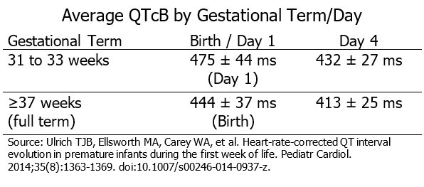
Electrophysiology and Pharmacology
Older studies demonstrated longer intervals of repolarization immediately after birth.
A more recent study noted that infants delivered at earlier gestations had even longer QTcB, as presented in the following table.¹¹

Slide 23
Drug-Induced Arrhythmias
Some medications can slow cardiac repolarization and increase the risk of cardiac arrthymias, in particular the polymorphic ventricular tachycardia, Torsade de Pointes.
The FDA standard for the upper limit of the QT interval, normalized for heart rate, is defined as 450 ms.¹²
  If this standard is applied to newborn medication studies during the first few days after birth, many will be incorrectly identified as affected by long QT syndrome
  More studies are needed of the ECG in at-term newborns to determine a standard during the first 1 to 2 weeks after birth, and in particular, preterm newborns at gestational age as early as 23 to 25 weeks.

Slide 24
In Vitro and In Vivo Animal Models
In vitro studies clearly demonstrate a change in cellular ventricular electrophysiology during and beyond the neonatal period.
  Electrophysiologic changes on the cellular level have been studied using canine cardiac Purkinje fibers.^{13,14}
  Purkinje fibers in normal neonatal (<9 days of age) and
  adult (78±21.2 months) canines demonstrated that
  neonatal fibers had:
    Less negative maximum diastolic potentials
    Lower action potential amplitudes (and shorter durations)
    Lower maximum upstroke velocities

Slide 25
In Vitro and In Vivo Animal Models
Some studies have shown age-related differences in drug effects on the fast-sodium current responsible for the action potential upstroke and conduction through the working myocardium.
  Effects of lidocaine in epicardial tissue demonstrated that neonatal tissue reached a steady-state level of block more rapidly and recovered more slowly as compared to the adult epicardium¹⁵
  Effects of flecainide, a sodium channel blocking drug, produced significant use-dependent reductions in upstroke velocity in adult, but not neonatal, Purkinje fibers¹⁶

Slide 26
In Vitro and In Vivo Animal Models
Age-related differences in drug effects measured using upstroke characteristics may be confounded by differences in the action potential duration across preparations.
Developmental changes in sodium channel gating could possibly influence drug block.
Changes in characteristics of cardiac sodium current with development have been noted and attributed to sympathetic innervation, at least in part.

Slide 27
In Vitro and In Vivo Animal Models
Age-related differences in drug sensitivity have been found to vary across currents in the same preparation.
  Quinidine use: Reduction of peak calcium current was less in neonatal versus adult rabbit ventricular myocytes; possibly related to an age-related increase in peak current density¹⁷ and calcium channel kinetics¹⁸
    Oubain use: Purkinje fibers of neonatal and adult canines elicited prominent acceleration of repolarization and decreases in the resting membrane potential and action potential upstroke;
      Lesser effects were observed in fibers from young dogs
      Minimal effects were observed in neonatal fibers¹⁹

Slide 28
In Vitro and In Vivo Animal Models
Specialized conduction Purkinje fibers represent a small portion of the ventricular mass, and may not necessarily reflect responses of the working ventricular myocardium.
      In general, animal studies show that the positive inotropic response to digoxin in young hearts is probably greater than that in adult hearts²⁰
      In contrast, neonatal Purkinje fibers exhibit decreased sensitivity to digitalis toxicity compared with adults
      Therefore, an infant may better tolerate higher digoxin exposures for therapeutic benefit
      Higher serum digoxin levels (>2 ng/mL) are not associated with greater inotropic effects in pediatric patients, but with greater frequency of toxic effects

Slide 29
Drug Effects and Electrophysiology
Changes in developmental electrophysiology that occur from the first few weeks after birth to adulthood are well-recognized, although not well studied.
However, changes that occur from birth to the first week of life are not well-known or acknowledged. Developmental changes include:
  Heart size
  Relative size and positions of atria and ventricles
  Innervation
  Receptor developments
  Expression of ion channels, cardiac ultrastructure, and cell-to-cell connections

Slide 30
Changes in ECG and Heart Rate
The dynamic nature of electrophysiologic changes is revealed in the range of heart rates and changes that occur with age:²¹
  Neonate heart rates may range from 150 bpm to transient rates up to 230 bpm.
  The normal heart rate increases from birth, reaches a maximum between 30 and 60 days, and then declines back to earlier rates by 6 months. Thereafter, heart rate slowly declines with age.
  These changes complicate the mechanistic nature of drug effects.

Slide 31
Changes in Cellular Electrophysiology
  Prominent changes in the expression and functional characteristics of the cardiac ion channels and currents occur during postnatal development that include:^{22,23,24}
    A more negative resting membrane potential
    Enhanced inward sodium current supporting action potential upstroke
    Altered depolarizing inward currents during action potential plateau
    Enhance outward plateau current to sustain repolarization
  These changes in ion channel development are complex and asynchronous in maturation which has varied effects on drugs.

Slide 32
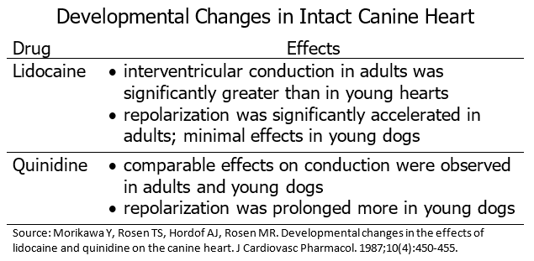
Cardiac Development & Drug Responses
Nonclinical in vitro studies have demonstrated differences in electrophysiologic effects of drugs in neonate, juvenile, and adult cardiac preparations. An example of differences and drug effects is noted in the following table.

Slide 33
Cardiovascular Toxicity from
Nonclinical Studies by Therapeutic Area
Immunology / Oncology / Anti-Inflammatory Drugs
Anti-Microbials
Pulmonary
Gastrointestinal
Formulation Excipients

Slide 34
Immunology/Oncology/ Anti-Inflammatory Drugs
AZT (zidovudine)
Nucleoside reverse transcriptase inhibitor (NRTI)-induced heart damage has been reported in human infants. A study of AZT and AZT/lamivudine (3TC) included observations of mice pups postnatally from Day 4 through Day 28:²⁵
AZT/3TC combination treatment produced greater mtDNA damage than either agent individually
Dexamethasone (DEX)
Glucocorticoid treatment, used in preterm babies to prevent chronic lung disease, causes myocardial hypertrophy and increased myocardial protein content.²⁶ DEX is thought to induce permanent myocardial abnormalities. DEX treatment in rats caused:
A permanent decrease in heart weight
Hypertrophy and early degeneration of cardiomyocytes

Slide 35
Anti-Microbial Drugs
Pulmonary Drugs
Anti-Microbial Drug: Chloramphenicol
Mechanical function and mitochondrial respiration were observed in newborn, isolated perfused pig heart.²⁷ Results of chloramphenicol treatment indicated:
  Acute reductions in pressure development and cardiac output was observed and was accompanied by elevated left atrial filling pressure
Pulmonary Drug: 5,7-dihydroxytryptamine (5,7-DHT)
The medullary 5-HT system has potent effects on heart rate and breathing in adults.²⁸ Treatment of postnatal Day 2 rat pups with 5,7-DHT indicated:
  80% reduction in number of 5-HT-positive neurons in treated animals
  Considerably larger bradycardias during brief apnea (P5/P6 & P10/P12 animals)
  Reduced breathing frequency and ventilation (Ve), but normal Ve relative to metabolic rate (P5/P6 animals)
  More unstable breathing pattern and an enhanced Ve response to moderate hypercapnia (P10/P12 animals)

Slide 36
Gastrointestinal - Cisapride
A study of cisapride-elicited, dose-dependent prolongation of the QT interval in Langendorff perfused rabbit hearts noted the following:²⁹
QT interval was shorter in adult hearts vs newborn rabbit hearts
Greater prolongation of refractoriness of the specialized conduction system in neonate vs adult rabbit
  At the lowest concentration tested in this study, the percent prolongation was greater in newborn versus adult rabbit hearts, which was greater at higher exposures (28% versus 8%, respectively)
  This effect was consistent in reports that described a 2:1 ratio of atrioventricular block in children and not adults³⁰

Slide 37
Formulation Excipients
Perfluorooctane sulfonate (PFOS)
A study of PFOS was conducted in pregnant mice and rats.³¹ Postnatal effects of daily
in utero exposure to PFOS from gestation Day 2 to Day 21 indicated:
  Severly compromised postnatal survival of neonatal mice and rats
  Caused delays in growth and development accompanied by hypothyroxinemia in surviving rat pups

Slide 38
Cardiovascular Toxicity from
Clinical Studies by Therapeutic Area
Cardiovascular
Central Nervous System
Immunology/Oncology
Pulmonary
Formulation Excipients

Slide 39
Cardiovascular
Cardiovascular: Digoxin Therapy
Treatment of low birth weight premature infants with persistent patency of the ductus arteriosus
High incidence of toxicity:
High dosage and variable clearance were postulated as reasons for high incidence of toxicity
Risk associated with digoxin therapy in low birth weight, premature infants with patent ductus arteriosus³²
Treatment of infants with paroxysmal atrial tachycardia at birth
Manifestations of cardiac failure (severe ascites and hydrops)
Atrial flutter, supraventricular tachycardia, Wolff-Parkinson-White (WPW) syndrome³³
Treatment of neonates with congestive heart failure
  Cardiac arrhythmias post administration
  Difficult to establish a precise correlation between the serum digoxin concentration level and the onset of cardiac arrhythmias³⁴

Slide 40
Central Nervous System: Anticonvulsants
Phenytoin (dilantin)
Treatment of seizure activity uncontrolled with phenobarbital alone:
PKs of phenytoin are unpredictable in newborn infants due to delayed absorption, decreased rate of elimination, and dose-dependent nature of phenytoin elimination³⁵
Lidocaine
Treatment of neonatal seizures: post first‑line therapy
Optimal dosing strategy was used based on POP PK modeling and simulation (considered body size and effects of maturation) which minimized the risk of cardiac arrhythmias³⁶

Slide 41
Central Nervous System: Anesthetic Agents
Tetracaine
Treatment - (topical) pain management:
Case of a significant potential adverse event when using topical tetracaine (clinically significant arrhythmia)³⁷
Ropivacaine
Treatment – general anesthesia
Case of accidental caudal injection during sugery resulted in cardiac depression with bradycardia³⁸

Slide 42
Additional Therapeutic Areas
Immunology / Oncology: (Antiretrovirals)
Lopinavir/ritonavir
Treatment of HIV post-birth
  Twin neonates: born prematurely at 32 weeks:
One twin developed complete heart block and dilated cardiomyopathy, and one twin developed bradycardia³⁹
Pulmonary
Theophylline
Treatment of respiratory disorders
  Infant born at 31 weeks:
Supraventricular tachycardia was observed after 3 days of therapy with theophylline
Plasma theophylline concentration measurements may aid in avoiding toxicity⁴⁰

Slide 43
Formulation Excipients
Polysorbate 80
(excipient in amiodarone)
Treatment of supraventricular tachycardia
  Pediatric use:
Rapid development of cardiogenic shock and multiple organ dysfunction⁴¹
Propylene Glycol
  Observations noted include:
Potential for significant toxicity in neonates as accumulation can result in renal/hepatic toxicity⁴²
Exposure is associated with neurotoxicity⁴³

Slide 44
Well-Studied GI Motility Agents: Cisapride
Cardiovascular Effects
Preterm and term neonates with gastroesophageal regurgitation⁴⁴
No ventricular arrhythmias of death
Transient prolonged QTcB; however, no cardiac arrhythmias observed
No clinical significant relationships with plasma concentration, drug exposure, or subject age were observed
Effects on QT Interval
Preterm infants: Prospective, blinded evaluation of ECG measurements (QT, JT, QTc, and JTc) before and after cisapride administration⁴⁵
A higher risk of prolongation of the QTc interval and risk of arrhythmias with greater prematurity
Results from 2 NICU Surveys
Most frequent indication: choking or gagging with associated apnea, bradycardia, and desaturation⁴⁶
Complications/AEs seen when administered in excessive dosages or in combination with drug considered to be a metabolism-inhibitor
Less than 1 in 11,000 NICU admissions reported severe toxicities

Slide 45
Bioanalytical Assays
  Refine sampling techniques and assays (due to limited quantities of blood available for testing)⁴⁷
  Improve dried blood spot (DBS) sampling technique
  Determine best representative matrix (blood, plasma, or serum)
  Continue development and validation of existing blood spot assays tailored to this patient population.
  Application of the internal standard
  Translation of DBS to plasma drug concentration via reference plasma concentrations (and clinical validation)
  Automation of sample handling and analysis

Slide 46
Next Steps
  Exploration and standardization of nonclinical models
  Focus on models more likely to reflect human mechanistic understanding and potential
  Careful and timely documentation and publication of cardiovascular adverse events that occur with drug administration
  Future look at available technologies to improve monitoring of cardiac safety endpoints in premature pediatric population
  Refinement of treatment regimens

Slide 47
Call to Action
  Concerted approach to study drug development in this population with a combined collaboration amongst:
  Academic neonatologists
  Pharmaceutical companies (clinical and nonclinical domains)
  NIH
  Regulators from various countries
  Address missing gaps in the drug development program
  Encourage additional research into the basic science of disease mechanisms in this population (define similarities and differences)

Slide 48
Additional Steps Forward
  Provide an aid to the development process
  Create additional Master Protocols similar to those available from NICHD and the Pediatric Trials Network
  Focus efforts on the premature infant and neonate population as the last “orphan drug indication”
  Potential for exclusivity granted to sponsors pursuing new therapies

Slide 49
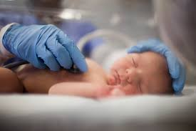
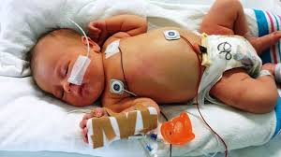
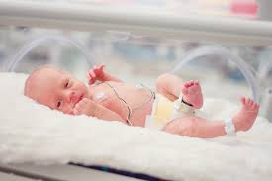
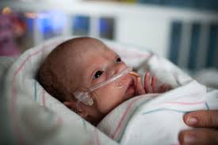
  International Neonatal Consortium (INC)

Slide 50


THANK YOU!
DUCK FLATS Pharma
Elbridge, New York and Stockton, New Jersey
USA

Slide 51
REFERENCES
Ward RM, Lugo RA. Cardiovascular drugs for the newborn. Clin Perinatol. 2005;32(4):979-997, x. doi:10.1016/j.clp.2005.09.013.
General Clinical Pharmacology Considerations for Pediatric Studies for Drugs and Biological Products - ucm425885.pdf. https://www.fda.gov/downloads/drugs/guidances/ucm425885.pdf. Accessed May 31, 2017.
Ward RM, Lugo RA. Drug therapy in the newborn. In: Avery GB, MacDonald MG, Mullett MD, Seshia MMK, Ovid Technologies I. Avery’s Neonatology: Pathophysiology & Management of the Newborn. 6th ed. Philadelphia, PA: Lippincott Williams & Wilkins; 2005.
Greenberg RE, Lind J. Catecholamines in tissues of the human fetus. Pediatrics. 1961;27:904-911.
Papageorghiou AT, Kennedy SH, Salomon LJ, et al. International standards for early fetal size and pregnancy dating based on ultrasound measurement of crown-rump length in the first trimester of pregnancy. Ultrasound Obstet Gynecol. 2014;44(6):641-648. doi:10.1002/uog.13448.
Coltart DJ, Davies GM, Gillibrand IM, Hamer J. Adenyl cyclase activity in the developing human foetal heart. J Physiol. 1972;225(2):38P-40P.
Coltart DJ, Spilker BA. Development of human foetal inotropic responses to catecholamines. Experientia. 1972;28(5):525-526.
Rudolph AM, Drorbaugh JE, Auld PA, et al. Studies on the circulation in the neonatal period. The circulation in the respiratory distress syndrome. Pediatrics. 1961;27:551-566.
Pickoff AS. Developmental electrophysiology in the fetus and newborn. In: Polin RA, Fox W, Abman SH, eds. Fetal and Neonatal Physiology . 4th Edition. 2011. https://www.elsevier.com/books/fetal-and-neonatal-physiology/polin/978-1-4160-3479-7. Accessed June 2, 2017.
Ariagno RL, Mirmiran M, Adams MM, Saporito AG, Dubin AM, Baldwin RB. Effect of position on sleep, heart rate variability, and QT interval in preterm infants at 1 and 3 months’ corrected age. Pediatrics. 2003;111(3):622-625.
Ulrich TJB, Ellsworth MA, Carey WA, et al. Heart-rate-corrected QT interval evolution in premature infants during the first week of life. Pediatr Cardiol. 2014;35(8):1363-1369. doi:10.1007/s00246-014-0937-z.

Slide 52
REFERENCES
E14 Clinical Evaluation of QT/QTc Interval Prolongation and Proarrhythmic Potential for Non-Antiarrhythmic Drugs - UCM073161.pdf. https://www.fda.gov/downloads/Drugs/GuidanceComplianceRegulatoryInformation/Guidances/UCM073161.pdf. Accessed June 2, 2017.
Rosen MR, Hordof AJ, Hodess AB, Verosky M, Vulliemoz Y. Ouabain-induced changes in electrophysiologic properties of neonatal, young and adult canine cardiac Purkinje Fibers. J Pharmacol Exp Ther. 1975;194(1):255-263.
Reder RF, Miura DS, Danilo P, Rosen MR. The electrophysiological properties of normal neonatal and adult canine cardiac Purkinje fibers. Circ Res. 1981;48(5):658-668.
Jeck CD, Rosen MR. Use-dependent effects of lidocaine in neonatal and adult ventricular myocardium. J Pharmacol Exp Ther. 1990;255(2):738-743.
Yabek SM, Kato R, Ikeda N, Singh BN. Effects of flecainide on the cellular electrophysiology of neonatal and adult cardiac fibers. Am Heart J. 1987;113(1):70-76.
Wetzel GT, Chen F, Klitzner TS. L- and T-type calcium channels in acutely isolated neonatal and adult cardiac myocytes. Pediatr Res. 1991;30(1):89-94. doi:10.1203/00006450-199107000-00018.
Wetzel GT, Chen F, Klitzner TS. Ca2+ channel kinetics in acutely isolated fetal, neonatal, and adult rabbit cardiac myocytes. Circ Res. 1993;72(5):1065-1074.
Rosen MR, Hordof AJ, Hodess AB, Verosky M, Vulliemoz Y. Ouabain-induced changes in electrophysiologic properties of neonatal, young and adult canine cardiac Purkinje Fibers. J Pharmacol Exp Ther. 1975;194(1):255-263
Park MK. Use of digoxin in infants and children, with specific emphasis on dosage. J Pediatr. 1986;108(6):871-877.
Schwartz PJ, Garson A, Paul T, et al. Guidelines for the interpretation of the neonatal electrocardiogram. A task force of the European Society of Cardiology. Eur Heart J. 2002;23(17):1329-1344.
Nerbonne JM. Regulation of voltage-gated K+ channel expression in the developing mammalian myocardium. J Neurobiol. 1998;37(1):37-59.

Slide 53
REFERENCES
Obreztchikova MN, Sosunov EA, Plotnikov A, et al. Developmental changes in IKr and IKs contribute to age-related expression of dofetilide effects on repolarization and proarrhythmia. Cardiovasc Res. 2003;59(2):339-350.
Pickoff AS. Developmental electrophysiology in the fetus and newborn. In: Polin RA, Fox W, Abman SH, eds. Fetal and Neonatal Physiology . 4th Edition. 2011. https://www.elsevier.com/books/fetal-and-neonatal-physiology/polin/978-1-4160-3479-7. Accessed June 2, 2017
Chan SSL, Santos JH, Meyer JN, et al. Mitochondrial toxicity in hearts of CD-1 mice following perinatal exposure to AZT, 3TC, or AZT/3TC in combination. Environ Mol Mutagen. 2007;48(3-4):190-200. doi:10.1002/em.20191.
de Vries WB, van der Leij FR, Bakker JM, et al. Alterations in adult rat heart after neonatal dexamethasone therapy. Pediatr Res. 2002;52(6):900-906. doi:10.1203/00006450-200212000-00015.
Werner JC, Whitman V, Schuler HG, et al. Acute myocardial effects of chloramphenicol in newborn pigs: a possible insight into the gray baby syndrome. J Infect Dis. 1985;152(2):344-350.
Cummings KJ, Commons KG, Fan KC, Li A, Nattie EE. Severe spontaneous bradycardia associated with respiratory disruptions in rat pups with fewer brain stem 5-HT neurons. Am J Physiol Regul Integr Comp Physiol. 2009;296(6):R1783-1796. doi:10.1152/ajpregu.00122.2009.
Wu M-H, Su M-J, Sun SS-M. Age-related differences in the direct cardiac effects of cisapride: narrower safety range in the hearts of young rabbits. Pediatr Res. 2003;53(3):493-499. doi:10.1203/01.PDR.0000050122.67091.1D.
Lewin MB, Bryant RM, Fenrich AL, Grifka RG. Cisapride-induced long QT interval. J Pediatr. 1996;128(2):279-281.
Lau C, Thibodeaux JR, Hanson RG, et al. Exposure to perfluorooctane sulfonate during pregnancy in rat and mouse. II: postnatal evaluation. Toxicol Sci Off J Soc Toxicol. 2003;74(2):382-392. doi:10.1093/toxsci/kfg122.
Berman W, Dubynsky O, Whitman V, Friedman Z, Maisels MJ. Digoxin therapy in low-birth-weight infants with patent ductus arteriosus. J Pediatr. 1978;93(4):652-655.

Slide 54
REFERENCES
Radford DJ, Izukawa T, Rowe RD. Congenital paroxysmal atrial tachycardia. Arch Dis Child. 1976;51(8):613-617.
Larese RJ, Mirkin BL. Kinetics of digoxin absorption and relation of serum levels to cardiac arrhythmias in children. Clin Pharmacol Ther. 1974;15(4):387-396.
Wiriyathian S, Kaojarern S, Rosenfeld CR. Dilantin toxicity in a preterm infant: persistent bradycardia and lethargy. J Pediatr. 1982;100(1):146-149.
van den Broek MPH, Huitema ADR, van Hasselt JGC, et al. Lidocaine (lignocaine) dosing regimen based upon a population pharmacokinetic model for preterm and term neonates with seizures. Clin Pharmacokinet. 2011;50(7):461-469. doi:10.2165/11589160-000000000-00000.
Maulidi H, McNair C, Seller N, et al. Arrhythmia associated with tetracaine in an extremely low birth weight premature infant. Pediatrics. 2012;130(6):e1704-1707. doi:10.1542/peds.2011-1743.
Hübler M, Gäbler R, Ehm B, Oertel R, Gama de Abreu M, Koch T. Successful resuscitation following ropivacaine-induced systemic toxicity in a neonate. Anaesthesia. 2010;65(11):1137-1140. doi:10.1111/j.1365-2044.2010.06449.x.
McArthur MA, Kalu SU, Foulks AR, Aly AM, Jain SK, Patel JA. Twin preterm neonates with cardiac toxicity related to lopinavir/ritonavir therapy. Pediatr Infect Dis J. 2009;28(12):1127-1129. doi:10.1097/INF.0b013e3181acd17e.
Loughnan PM, Mc Namara JM. Paroxysmal supraventricular tachycardia during theophylline therapy in a premature infant. J Pediatr. 1978;92(6):1016-1018.
Masi S, de Cléty SC, Anslot C, Detaille T. Acute amiodarone toxicity due to an administration error: could excipient be responsible? Br J Clin Pharmacol. 2009;67(6):691-693. doi:10.1111/j.1365-2125.2008.03323.x.
Allegaert K, Vanhaesebrouck S, Kulo A, et al. Prospective assessment of short-term propylene glycol tolerance in neonates. Arch Dis Child. 2010;95(12):1054-1058. doi:10.1136/adc.2010.190330.

Slide 55
REFERENCES
Whittaker A, Currie AE, Turner MA, Field DJ, Mulla H, Pandya HC. Toxic additives in medication for preterm infants. Arch Dis Child Fetal Neonatal Ed. 2009;94(4):F236-240. doi:10.1136/adc.2008.146035.
Berul CI, Ward RM, Kearns GL, Kerstens PK, van den Ouweland FA. Electrocardiographic observations in premature and term infants on cisapride therapy. Paediatr Perinat Drug Ther. 2006;7(2):77-88.
Dubin A, Kikkert M, Mirmiran M, Ariagno R. Cisapride associated with QTc prolongation in very low birth weight preterm infants. Pediatrics. 2001;107(6):1313-1316.
Ward RM, Lemons JA, Molteni RA. Cisapride: a survey of the frequency of use and adverse events in premature newborns. Pediatrics. 1999;103(2):469-472.
McDade TW, Williams S, Snodgrass JJ. What a drop can do: dried blood spots as a minimally invasive method for integrating biomarkers into population-based research. Demography. 2007;44(4):899-925.

