Slide 1
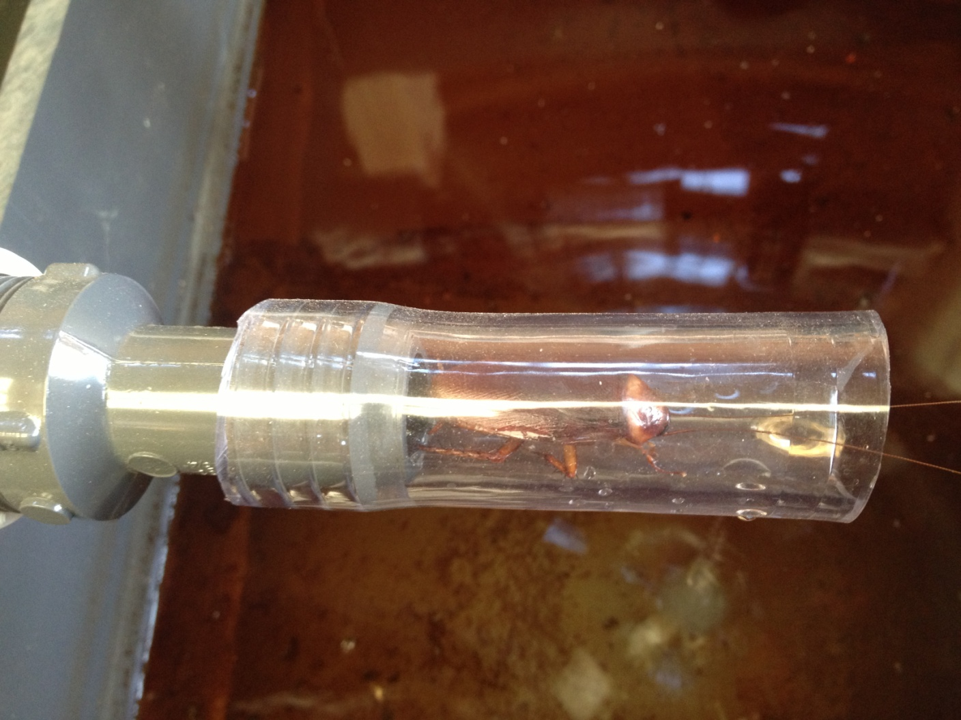

Slide 2
Denitrifying Bioreactor
Midwestern Cornbelt Nutrient Sequestration: Fine Tuning Treatment Technology
Lu Zhang, Joe Magner
May 29th, 2014

Slide 3
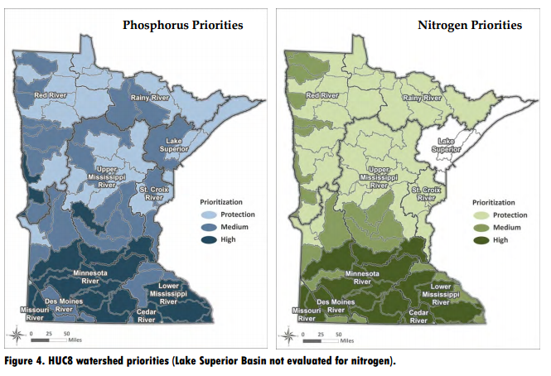

Nutrient Reduction Strategy

Slide 4
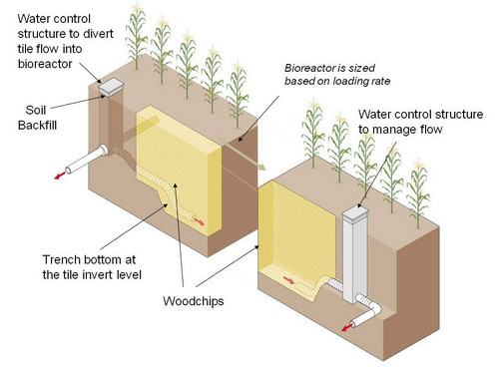
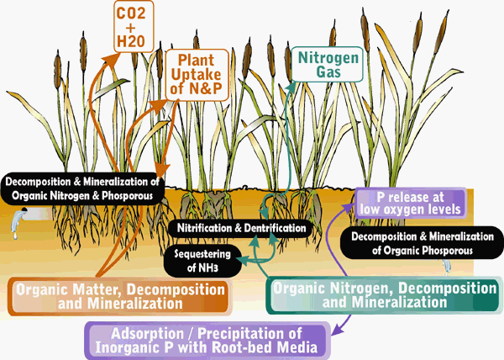
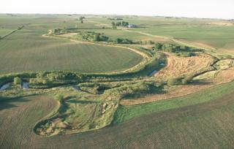
Denitrification Overview
NO₃⁻
NO₂⁻
NO
N₂O
N₂

Slide 5
Why Bioreactor
Subsurface flow
Relatively consistent nitrate concentration over a drainage season at a given site
Biostimulation
High reduction rate
Space

Slide 6
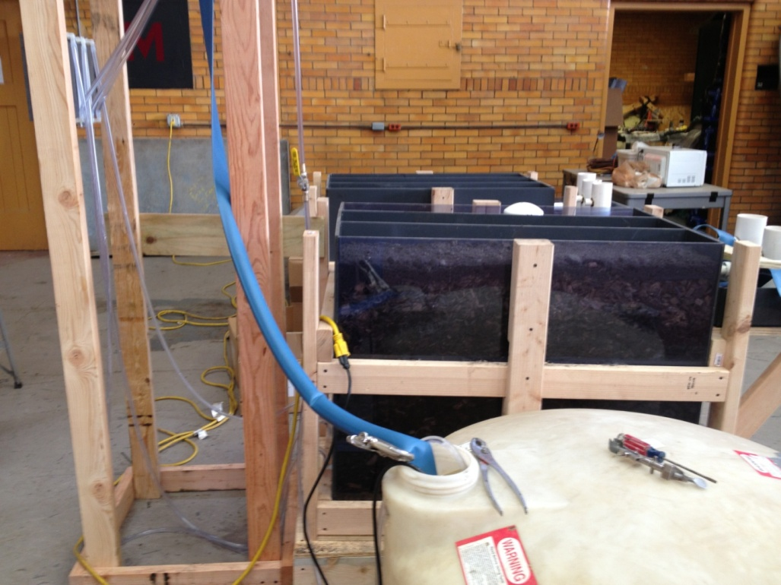
Lab Study
Design Schematic
The two bioreactors simulate horizontal flow in the field with a length to width ratio of 14:7.
The size of each bioreactor is 0.98m (L) * 0.2m (W) * 0.67m (H).
One has transparent sides to provide view of the inside. Both sides are covered with tarp to prevent light effect on microbial growth.
Each chamber has two baffles inside to guide the flow. Water enters from the bottom on one side and comes out from the top on the other side.
Soil from the field site (mostly Clarion-Storden loams) is used to seal the top. When water is running, the soil on top is always saturated providing anaerobic condition inside.
Nutrient water is prepared in the storage tank and pumped into the overhead tank. Six flow meters are used to control the flow rate in each chamber.
PVC containers are used to catch outflow for nitrate probe uses.

Slide 7
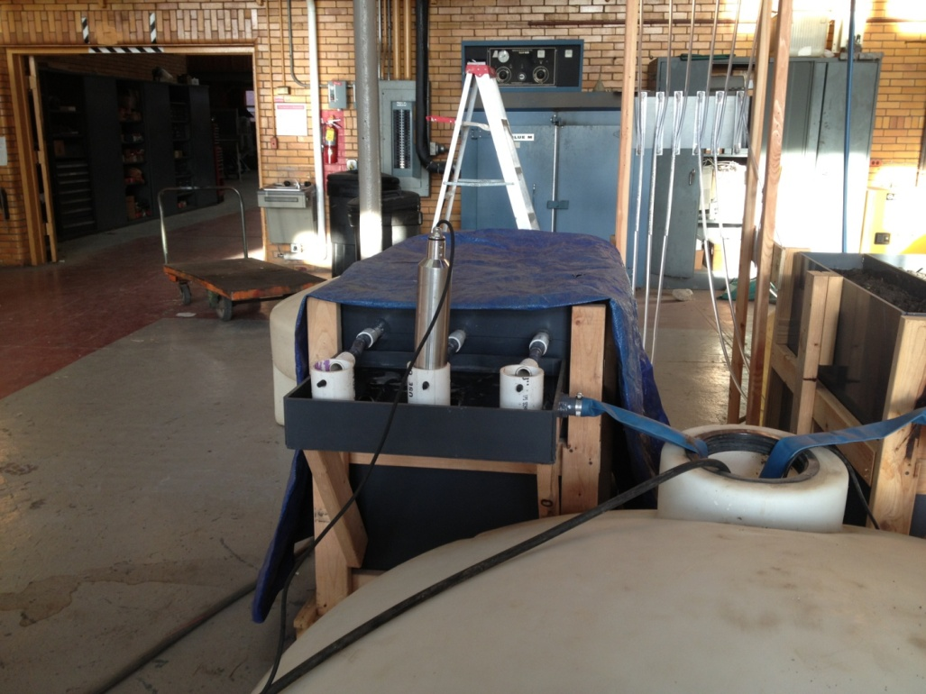
Lab Study
Design Components
Variables
Alternative C sources: food source for denitrifying bacteria
  Woodchips- mix of hardwood
  Biochar- “caramelized woodchips”
  Corn cob
Residence time
  24 and 8-hour
Controlled factors
Nitrate concentration: 21±1 ppm
Temperature: T is around room temperature
Processes competing for available C: oxygen availability

Slide 8
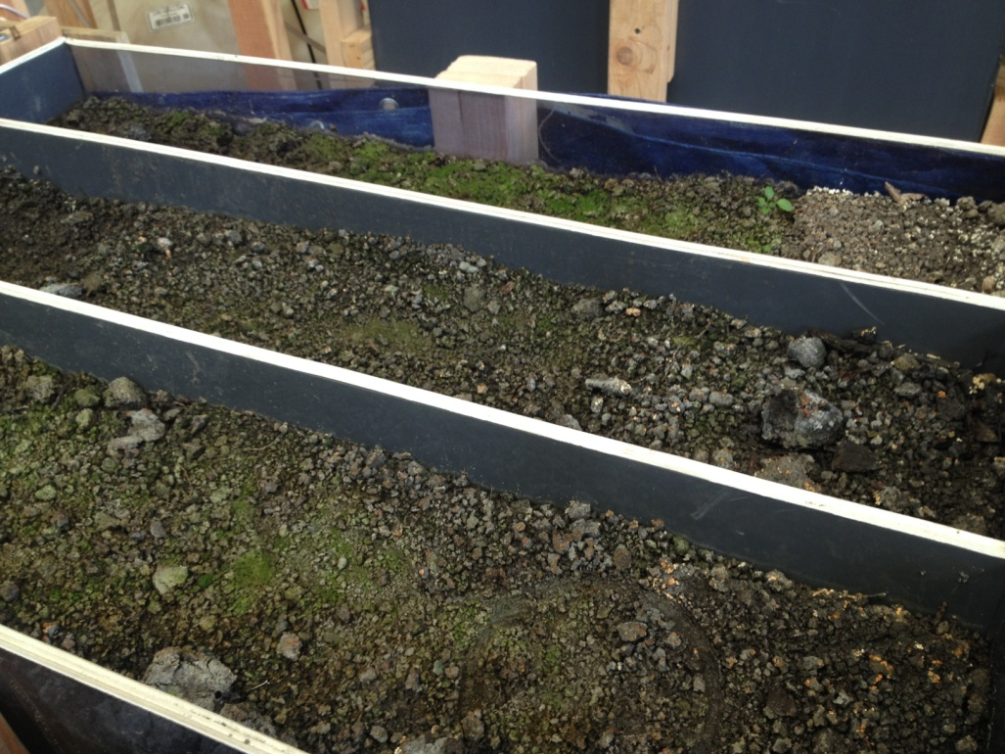
Lab Study
Research Method
Nutrient removal is evaluated by nitrate reduction and phosphorus reduction. Nitrate is measured on a daily-base. Phosphorus is measured every three days.
Nitrous oxide production will be measured to determine the effect on greenhouse gases emission.
The in-situ residence time will be determined by bromide tracer.
Residence time is designed to be 24 hours (50ml/min flow rate) for the first 3 months and 8 hours (150 ml/min) for the next 2 months.

Slide 9
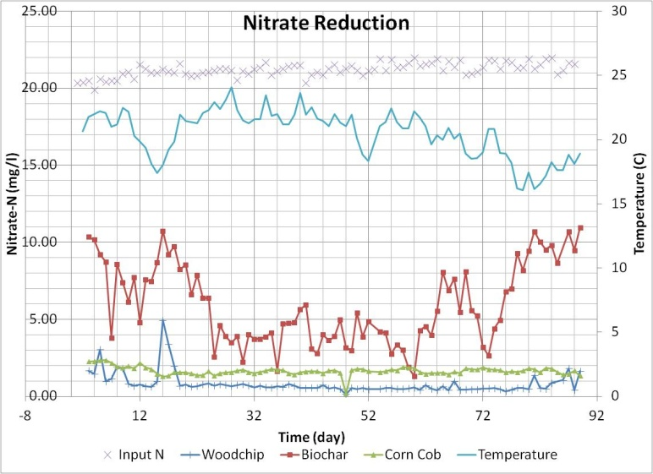
Lab Study- 24 hr result

Slide 10
Lab Study- 24 hr result

Slide 11
Lab Study- 24 hr result

Slide 12
Lab Study- 24 hr result

Slide 13
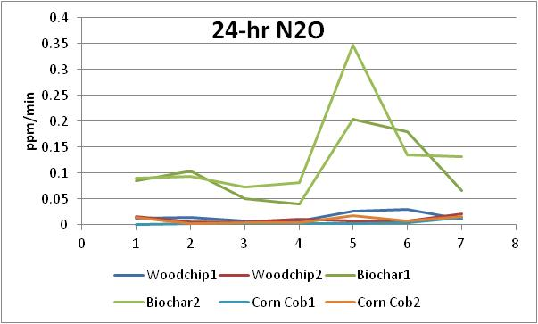
Lab Study- 24 hr result

Slide 14
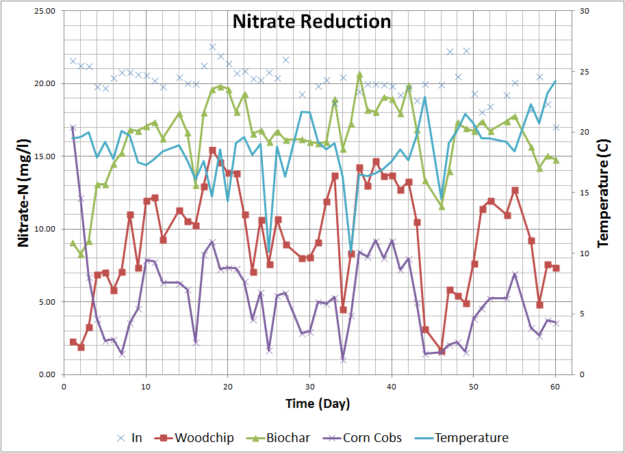
Lab Study- 8 hr result

Slide 15
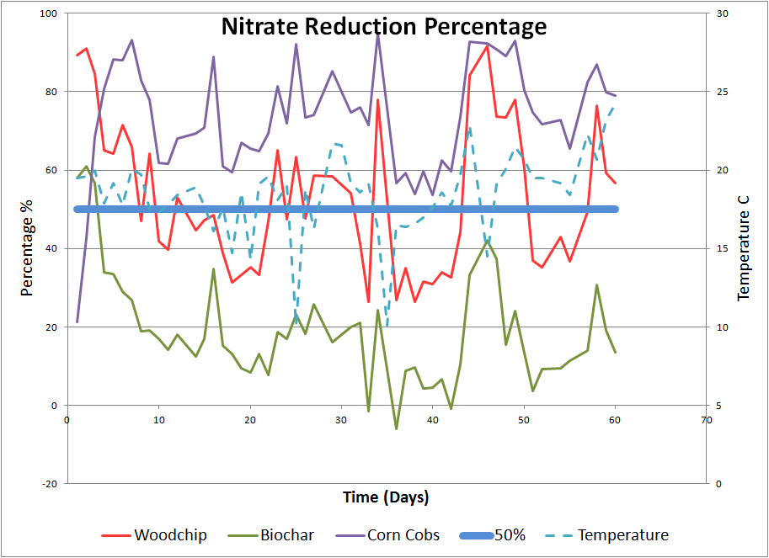
Lab Study- 8 hr result

Slide 16
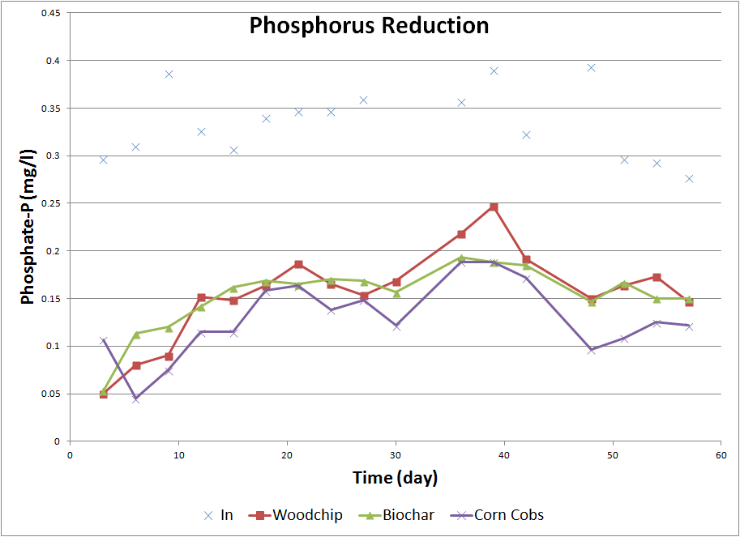
Lab Study- 8 hr result

Slide 17
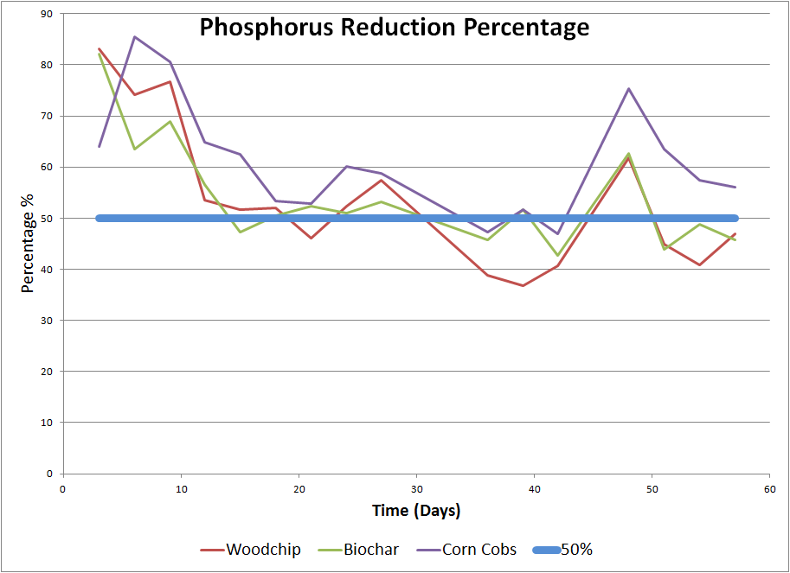
Lab Study- 8 hr result

Slide 18
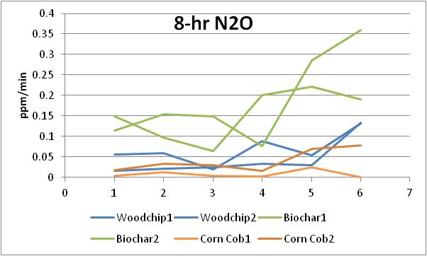
Lab Study- 8 hr result

Slide 19
Summary
Woodchip: nitrate removal
Biochar: orthophosphate removal, N2O, longevity
Corn Cob: environmental resilience

Slide 20
Questions?

