Slide 1
Traditional or Modern Bioenergy: which developing countries can mostly benefit?
Luís Cortez cortez@unicamp.br
5th World Bioenergy Congress and Expo
Madrid, Spain June 29-30th 2017

Slide 2
DisclaiMer
Any opinions, findings, and conclusions or recommendations expressed in this material are those of the authors and do not necessarily reflect the views of the neither funding nor participating institutions.

Slide 3
Hypothesis
Contrarily to what many researchers believe, modern bioenergy presents the essential features to meet needs of developing countries improving food & fuel securities, and social benefits.

Slide 4
Bioenergy
is the single largest renewable energy source today, providing nearly 9% of world primary energy production.
however, traditional bioenergy (TB) still plays an important role being responsible for 47% of total renewable energy use in 2015 (REN21, 2017), but with substantial reduction projection for 20% in 2040 (IEA, 2015).
depending on the way bioenergy is produced or extracted from nature, the “renewable” label doesn´t necessarily applies.
as much as 25% of TB can´t be considered as renewable Goldemberg and Coelho (2004).

Slide 5
Facts about Traditional Bioenergy
In 2013, one in three people worldwide has relied traditional use of solid biomass for cooking. In Africa, the dependence achieves two in three African, and eight in ten in Sub-Saharan region. In India, a population similar to that of the European Union and the United States lives without clean cooking facilities (IEA, 2015);
In 2012, 7 million premature deaths worldwide were attributed to indoor and outdoor air pollution (WHO, 2015), where 4.26 million were attributed for household air pollution, affecting 0.5 million children and 1.8 million women, mainly in Asia and Africa;
The depletion of forest cover in large scale is not attributed to the use of biomass for cooking, however the wood exploration may cause local/regional deforestation, land degradation, air pollution and several biodiversity impacts (IEA, 2006);
Fuelwood collection is a time-consuming and exhausting task, mainly for women and children. In Sub-Saharan region, up to 11 kilometers are travelled and around 20 and 38 kg of wood are loaded for women and children daily. Serious long-term physical damage and limiting of opportunities (education and income-generating activities) are the major losses (IEA, 2006).

Slide 6
Estimated renewable energy share of global final energy consumption (2015)
Source: REN21, 2017

Slide 7
Where there is TB there is hunger coincidence??
Share of Traditional Biomass in Household Consumption by Countries.
Source: IEA (2007)
Hunger Map. Source: FAO (2015a)

Slide 8
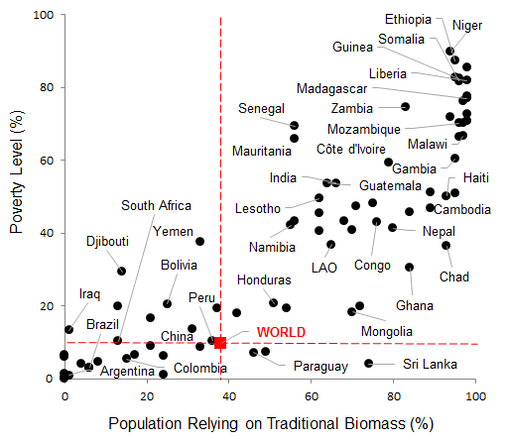
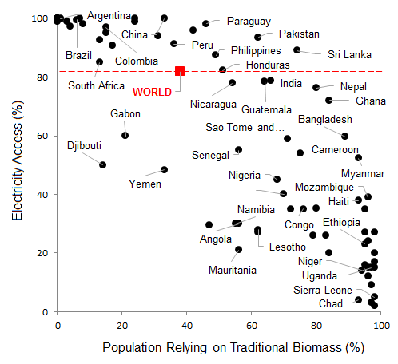
Developing countries: use of TB vs. poverty, undernourishment, electricity access
Source: IEA (2014), UNDP (2014).

Slide 9
traditional bioenergy (TB):
TB is typically used to generate heat used for cooking and heating. TB is usually associated with high losses and can be characterized by:
- Collecting biomass from natural biomass, frequently forests leads to deforestation and reduction of biodiversity;
- Labor and time consuming, often the “collector” has to walk far to get needed biomass, using substantial part of its day collecting fuel wood or even dung;
- Use of women and children labor often implying gender problems;
- Low overall efficiency: combines low efficiency in the collecting operations (pure gathering) and low efficiency in the conversion process. TB is often associated with low agricultural productivity, often derived from wrong crops (e.g. jatropha case), and poor management;
- High health risks combining health risks in the collecting operations (long daily walks, cutting wood, heavy duty) and high health risks in the biomass conversion (biomass population, smoke during combustion causing eyes and lung problems including blindness and asthma);
- TB production often occurs in non-legalized land in areas where land tenure is weak. TB production is often informal, without taxes, marginalizing government intervention.

Slide 10
MODERN bioenergy (TB):
typically found in developed countries, such as US and European countries but also in intermediate economies such as Brazil, Colombia, Argentina and Mexico. In the upstream,
MB uses conventional to modern technologies (systematic production for agricultural practices; use of essential inputs, such as seeds of genetically improved plants, fertilizers, and machinery), often practicing large scale agriculture and based on a highly efficient energy crop such as sugarcane, eucalyptus, corn and sugar beet.
MB, typical products are biofuels, electricity, chemicals, buildings and industry in general.
In the downstream, MB typically uses highly efficient conversion technologies for heat, liquid fuel and electricity production.
MB does not necessarily mean an efficient and sustainable system, good or bad options (e.g. energy crops, technological conversion processes, other) and practices (e.g. agricultural and land use management, co-products/residues treatment and/or disposal, other) may result in environmental/social impacts, waste of resources and time, missing the opportunity to generate income, wealth and eradicate poverty.

Slide 11
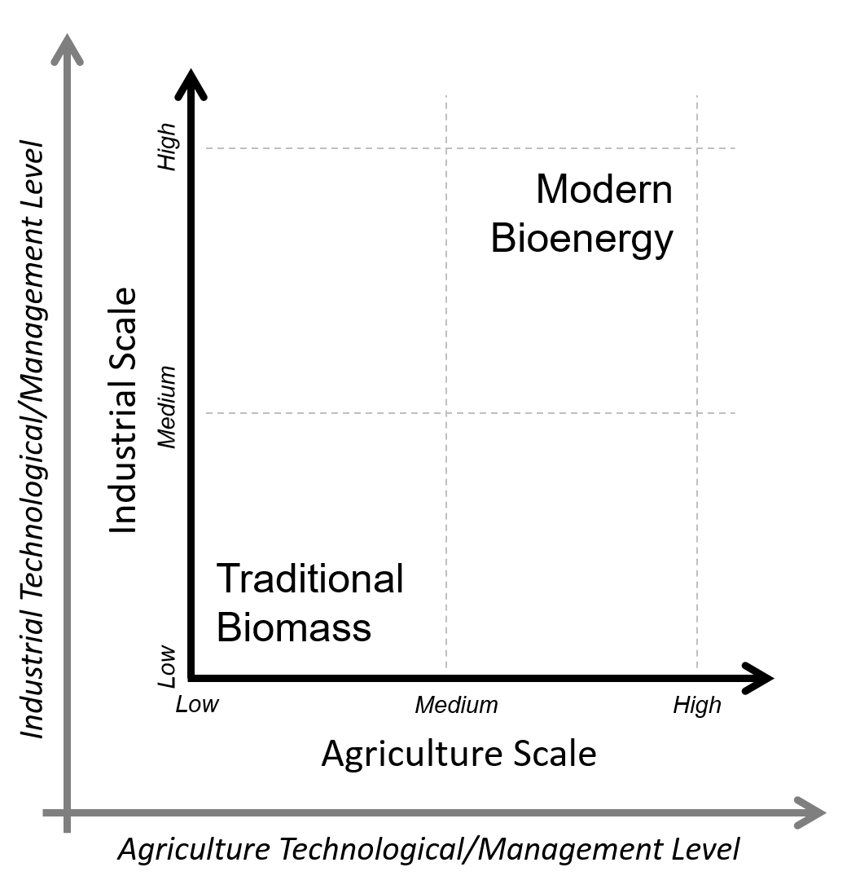
bioenergy systems models according to agriculture and industrial scales and technological/management levels.

Slide 12
  Myths & Facts about TB and MB
Can TB be adapted to perform as MB? How?
- Hybrid systems
- “improved traditional biomass energy technologies (IBTs)”
- InterAmerican Development Bank-IDB “scorecard for sustainable biofuels criteria
FAO Integrated food-energy systems (IFES)
However, intrinsic problems of TB are nor solved!

Slide 13
Myths & Facts about TB and MB
Can small production in few hectares, typically managed by a family to make a living with TB?
- No, the benefits are too low and they are not qualified.
- One important point is that energy needs intrinsically to be produced at low cost, low effort and therefore the revenue obtained in few hectares will not be sufficient to maintain a family or a community.
- This is why, typically, economies of scale tend to favor large scale projects.

Slide 14
Myths & Facts about TB and MB
Is MB always good and TB always bad?
- No, MB can be bad too, but TB to be “good” it needs to be highly subsidized and integrated to an extent that it is difficult to distinguish from MB (e.g. cooperatives). So a cooperative is a way to combine positive aspects of small production and management with large scale MB management.
- TB is often understood as a cultural activity and therefore many organizations do not position against and often protects TB because they don´t want to deal with these issues like sovereignty, self-determination, independence.
- The problem is that these so called “cultural activities” such as wood gathering by women, wood firing cooking in closed environments often brings very bad side effect consequences for women, for health, and other socio-economic aspects bringing the family and the less developed rural societies to a long term imprisonment.

Slide 15
  Why MB is more likely the way to go even in less developed countries?
The main reason why less developed countries need MB rather than TB is that they need to adopt a more professionalized agriculture, go to systematic/progressive improvements only possible in economy of scale.
Another fundamental reason to go to MB is that modern production systems most frequently optimize labor and frees women and children from semi-slave type of activities. MB also tends to reduce production costs and, if done right, tends to reduce negative environmental impacts/re-store biodiversity.
The activities associated with production of MB is, therefore, given to qualified professionals, utilizing machinery when necessary to avoid intensive labor, freeing women, and children to other more noble tasks.
According to FAO “biofuels accounted for the fastest-growing market for agricultural products around the world and was a billion-dollar business. Increasing oil prices in recent years had had devastating effects on many poor countries, some of which spent six times as much on fuel as they did on health. In that regard, the modern form of bioenergy could create great opportunity” (Raswant et al., 2008).

Slide 16
  Correct use of fossil energy in developing countries can displace TB
Many times, the correct use of fossil energy can greatly benefit developing countries. Brazil introduced LPG in both urban and rural areas during the last 5 decades. Until the 50´ies Brazilian energy matrix depended heavily on fuel wood and charcoal. However with the fast urbanization process LPG was introduced changing habits of Brazilian population in nearly all regions, including the Amazon. Today practically all Brazilian territory is covered by LPG distribution system which involves oil companies. This example not only demonstrates that using fossil energy, in its early stages of development, can have positive impacts leading to better living conditions, particularly to the low income population.
Also diesel can be used to slow down deforestation. Diesel has been introduced in the Amazon area for power. Today nearly 10% of all diesel consumed in Brazil is in the Amazon region, helping to protect the forest and giving better living conditions for the population, despite the great logistic difficulties associated with diesel transportation in the region.
Later, when a country starts to improve socio-economic conditions some complementary bio-based fuels can be used, such as bioethanol gel in ethanol cooking stoves. Later MB can be introduced completing the transition to a more affluent society.

Slide 17
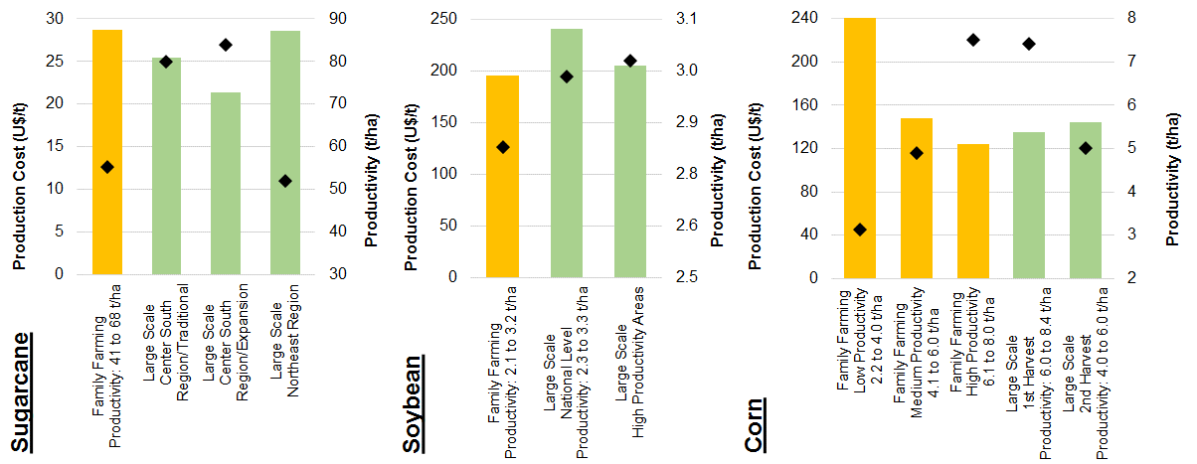
Potential impacts of MB in developing countries: Brazilian case
  Production costs reduction

Slide 18
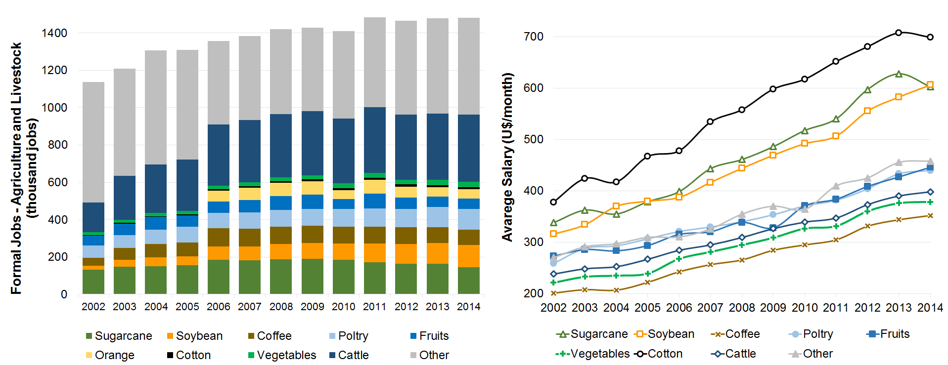
Potential impacts of MB in developing countries: Brazilian case
  Salary and improvements in job quality

Slide 19
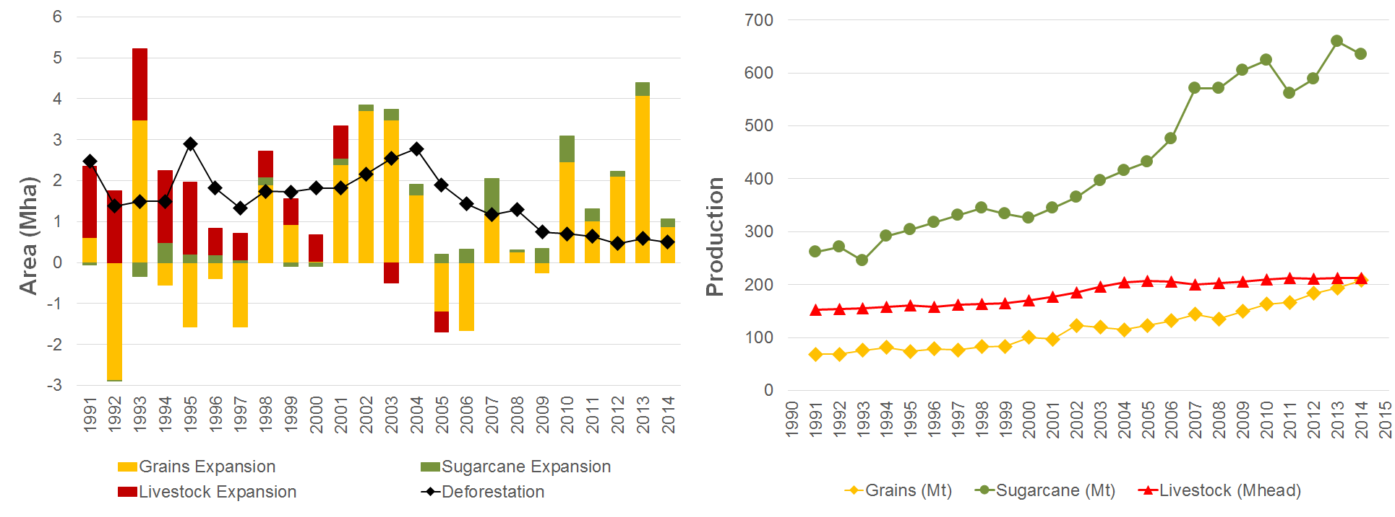
Potential impacts of MB in developing countries: Brazilian case
  Deforestation reduction

Slide 20
The Role of S&T&I in developing modern sustainable bioenergy
Having presented the main arguments in favor of MB compared to TB for developing countries, it is also essential to develop a long-term strategy regarding adequate plant varieties, adequate infrastructure and qualified labor and scientists.
Investments in science and technology development have greatly helped Brazil to improve its agriculture and its energy matrix. With sound R&D investments in agriculture (e.g. Embrapa for soybeans and sugarcane breeding programs: IAC, CTC, Ridesa) (Cortez et al., 2014) notably after 1970 Brazil could implement MB programs and reduce hunger (FAO, 2015b) consequently increasing food (IBGE, 2014) and energy securities (EPE, 2017). The São Paulo Research Foundation (FAPESP) is investing significant amount of resources to improve MB approaching it to the industrialized agriculture concept (BIOEN-FAPESP, 2017).
It is of course questionable how much can be done by S&T to improve TB in developing countries. It seems to be absolutely necessary investments in proper infrastructure (roads, harbors, and also social infrastructure) and production of qualified labor at all levels (workers to operate trucks, agricultural machinery, mills etc.) and of course universities to produce engineers and scientists to build a truly sustainable production system.

Slide 21
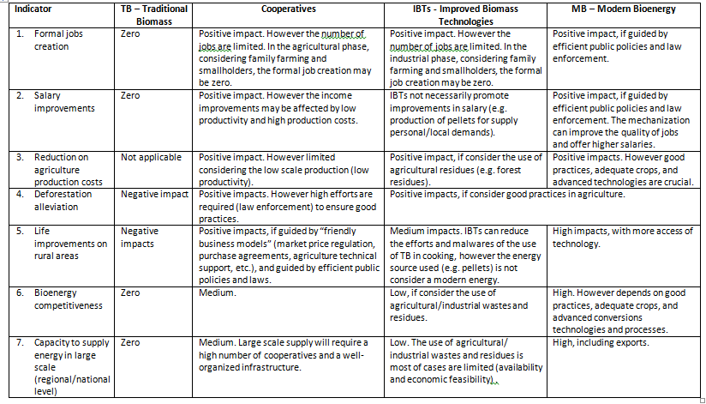
  Comparing social indicators TB, MB and variations

Slide 22
Conclusions
Reconciling food security and energy security goals may represent a very difficult task with TB. Instead, contrarily to what many policy advisors recommend, the best solution, even for less developed countries, is to adopt MB model integrated with food production systems, combined with the introduction of adequate fossil fuel to improve quality of life.
TB is frequently used in less developed countries because of their apparently low cost and lack of available other energy options. However TB true cost is not evident and does not appear as direct short term cost to the user. Since it represents an energy version of traditional agriculture which is based on reproducing natural production environment, pure TB is actually a step back because it intrinsically denies the gains from agriculture revolution.
How can we eliminate poverty? Is it insisting in TB and its consequences?
Conclusion: yes, there is a correlation between hunger and TB use throughout the world. The recommendation of TB to improve food security is going to aggravate the problem. One important issue for less developed countries is to promote development and legalize all civil society transaction, including land tenure issues and formal commercial trade.
If the recommendation for less developed countries is to produce TB, it can be concluded that there will be no surpluses; therefore the exports alternative can be automatically discarded. Also it can be concluded that, since the TB footprint is highly negative (high CO₂ emissions) it doesn´t also contribute to GHG mitigation.
On the other hand the recommendation of MB to less developed countries, utilizing available knowledge, can yield very positive social and economic impacts, helping to introduce these economies in the XXI century.

Slide 23
Acknowledgments
The BIOENERGY CONTRIBUTION OF LATIN AMERICA, CARIBBEAN AND AFRICA TO THE GSB PROJECT – LACAf Project was funded by FAPESP (project number 2012/00282-3) involving participants from several universities, research centers and private sector.

