Slide 1
Discovery of a small molecule inhibitor of Burton’s Tyrosine Kinase (BTK) for autoimmune diseases
3rd International Conference and Exhibition on Clinical & Cellular Immunology (Immunology Summit-2014) Sept 29-Oct 1 2014
Baltimore, USA
Loui Madakamutil, Ph.D

Slide 2
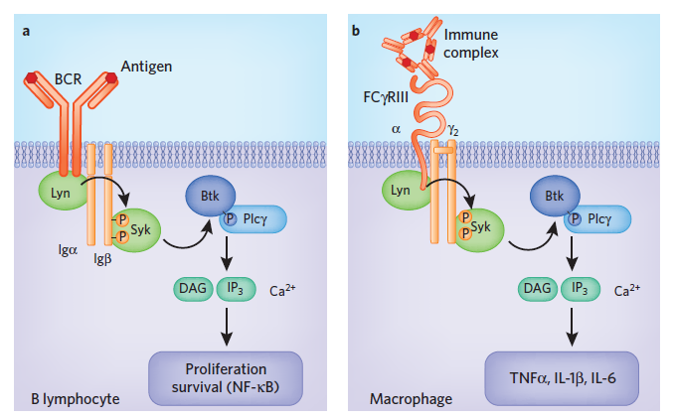
Bruton’s Tyrosine Kinase - Btk
Tec family kinase required for B-cell receptor signaling in B cells and FCγ receptor signaling in myeloid cells
Btk is not expressed in T cells
Aberrant signaling through Btk implicated in the pathogenesis of diffuse large B-cell lymphoma, mantle cell lymphoma and chronic B-cell leukemia
Ibrutinib (PCI32765) recently approved for the treatment of mantle cell lymphoma
Hendrix, Nat Chem Biol. 2011
Kuppers, Nature Rev. Cancer, 2005, 5, 251-62

Slide 3
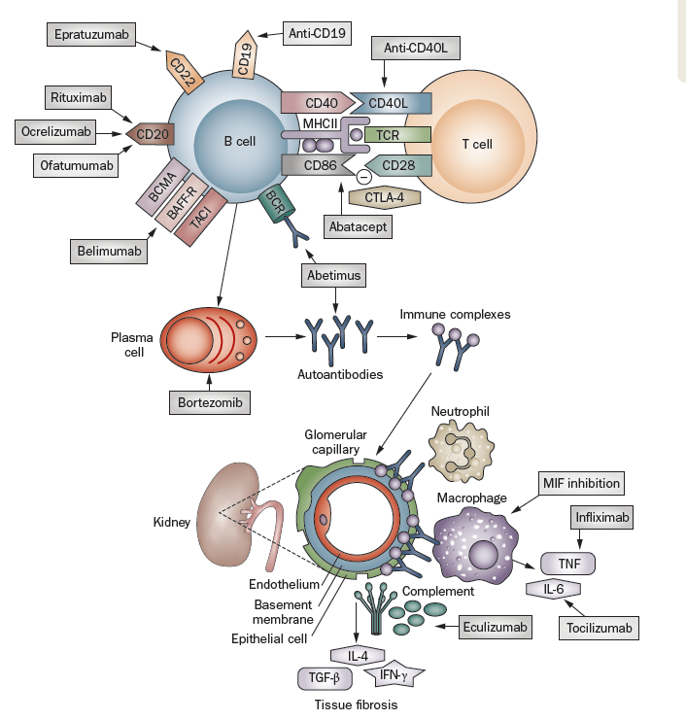
Efficacy and Commercial Opportunity
Efficacy: BTKi >> Belimumab and other single axis biologics.
BTKi has multiple nodes of intervention in SLE pathology
  Immune-modulation
  Prevent tissue damage
  DMARD
  Faster onset due to activity on multiple nodes
Small molecules compartmentalize to organs unlike biologics
Preclinical validation of BTKi for SLE published* – PCI32765
Commercial Opportunity:
Once daily pill >> biologic
BTKi in SLE
pathology
nature reviews rheumatology, volume 6, 2010 pg547

Slide 4
Published Lead Series
Published Btk inhibitor series were either covalent or high molecular weight >500 Da and ligand efficiency ≤ 0.3
Our question: Could a fragment based lead generation approach successfully deliver a reversible BTK inhibitor lead

Slide 5
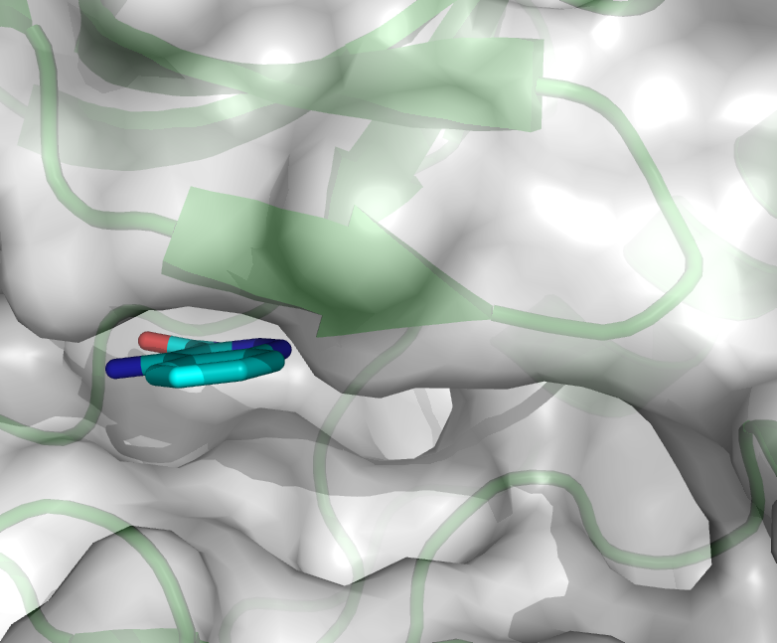
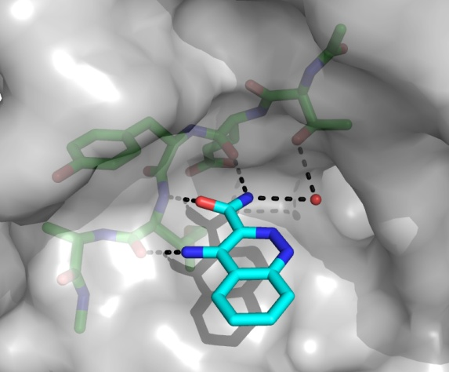
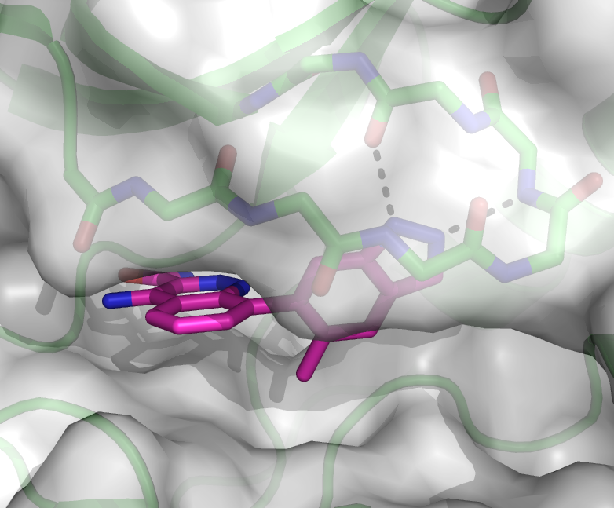
Fragment and Crystal structure based discovery of BTK inhibitor
Compound 9
Fragment Hit
Btk IC₅₀ 3.5 μM
LE 0.53
Mwt 318 Da
LogD 1.8
tPSA 123 Å
pBtk EC₅₀ 28 nM
X-ray Co-crystal Structure – Btk kinase domain
P-Loop
Hinge
Floor
pocket

Slide 6
BTK inhibitor: Pharmacology in vitro
Compound | pBTK | Rat WB B cells | FceR Mast cells | BAFF B cells | FcgR Macrophages
Compound 9 | 42 | 157 | 320 | 733 | 80
PCI-32765 Ibrutinib | 3.1 | 30 | 380 | 300 | 10
Activity in several pathology nodes
  BCR signaling
  FcεR signaling
  BAFF signaling
  FcγR signaling

Slide 7
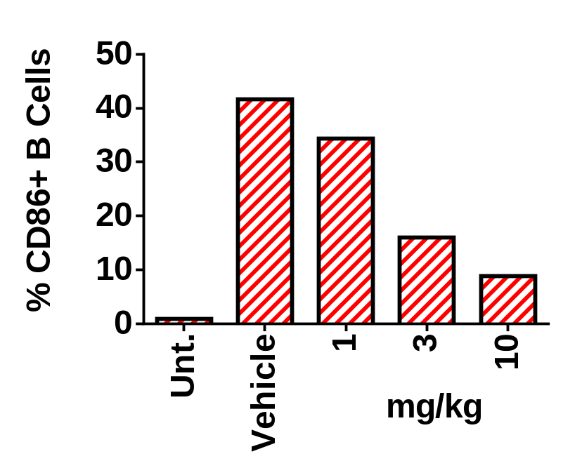
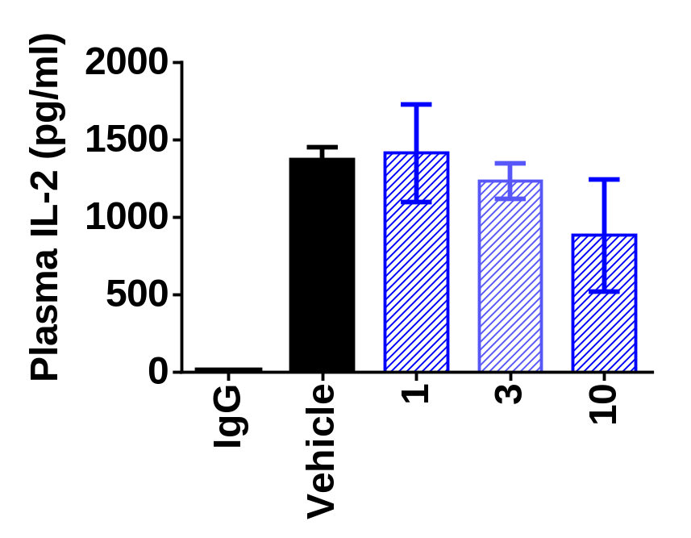
Demonstrates selective activity to B cell and spares T cells

Slide 8
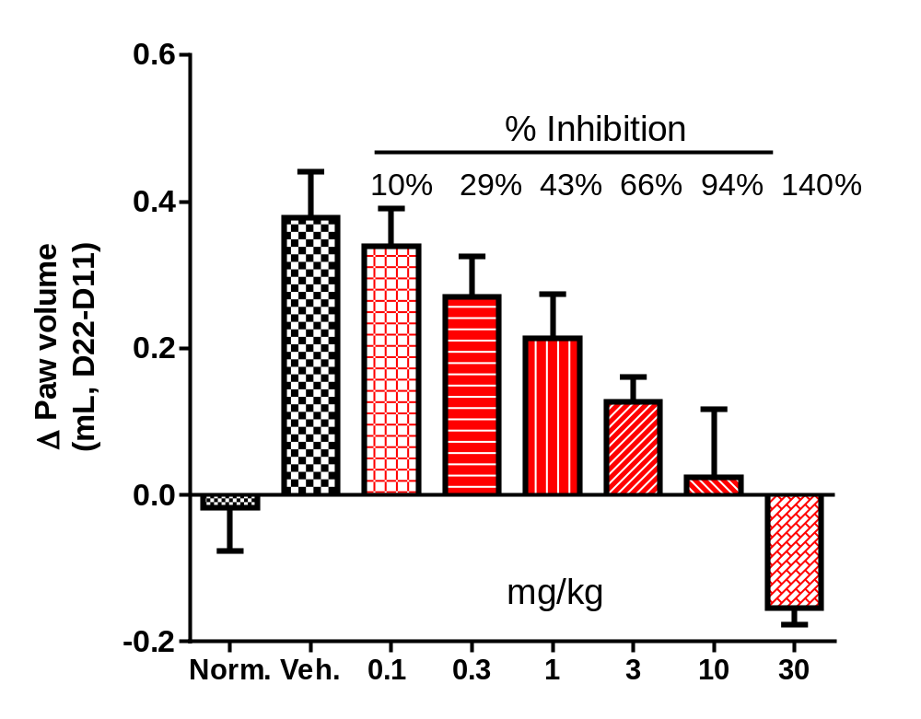
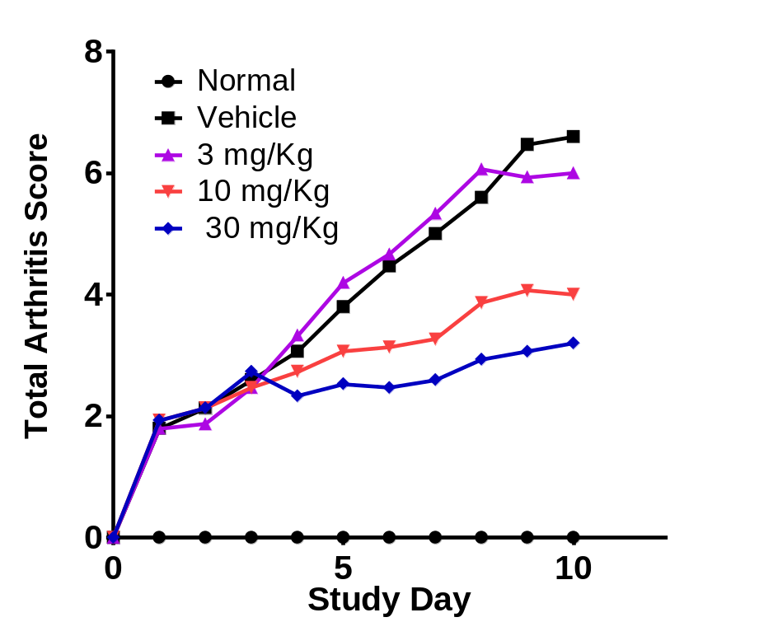
Efficacy in CIA models
Rat CIA
Mouse CIA
D0
D21
D21-24
D24
D34
D0
D7
D11
D12
D16
D19
D21
D22
Immun.
Group
Treatment
Immun.
Group
Treatment

Slide 9
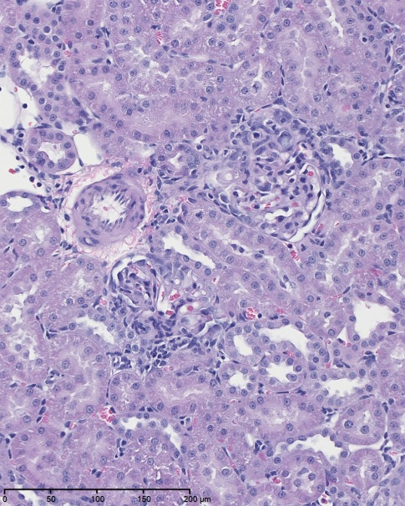
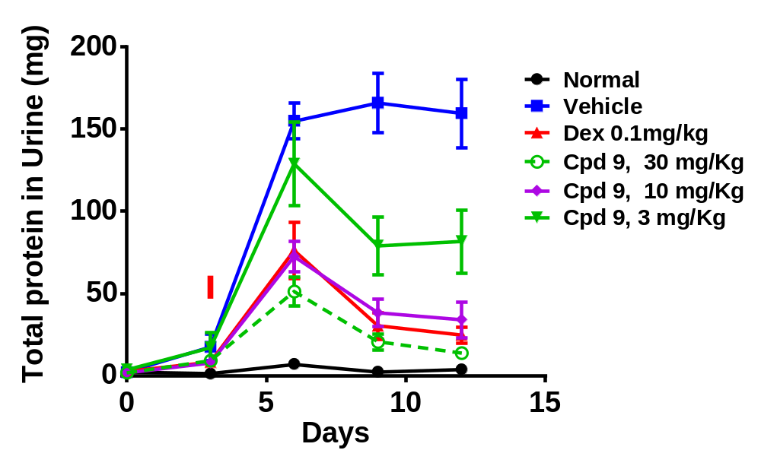
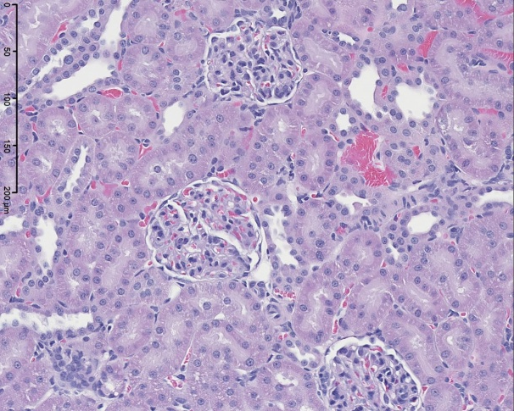
Efficacy in anti-GBM nephritis model
Infiltration of inflammatory cells
Day 1
B35: 30 μg/rat i.v.
B.W. , plasma and urine sampling @ Day 0,4, 6, 9, 12
Dosing start
Day 4
Increased prominence of membrane cells
(loss of Bowman's space)

Slide 10
Summary and Conclusions
Compound 9 was identified as a potent and selective inhibitor of BTK
Compound 9 prevented downstream events mediated by BCR and FcR in vitro. Further it also demonstrates the ability to block BAFF mediated B cell survival
Compound 9 shows no appreciable activity in T cell inhibitory activity
Compound 9 shows potent and dose dependent inhibition of clinical arthritis in CIA models
Compound 9 shows unique activity in the IC mediated kidney damage model
BTK inhibitors are promising approach to treat diseases like RA and nephritis mediated by IC

Slide 11
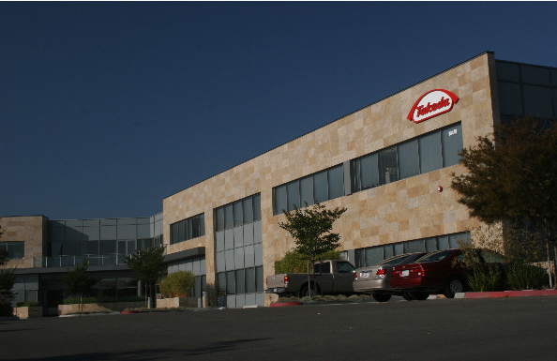
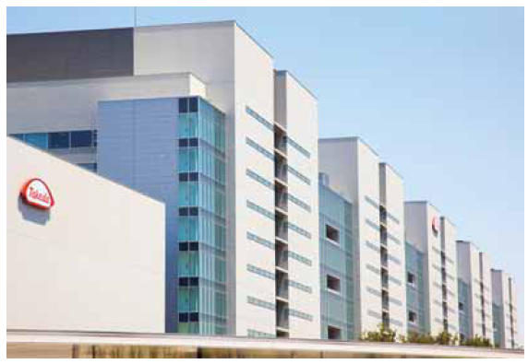
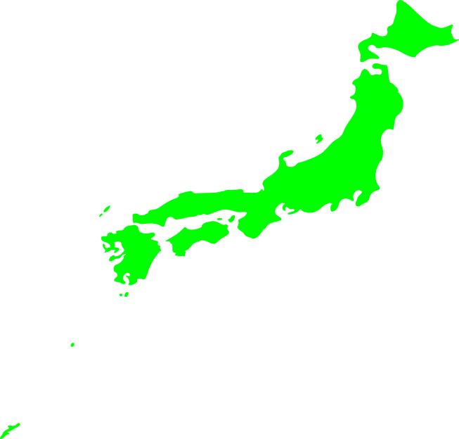
Acknowledgements
Shonan Research Center, Japan
Takeda California, San Diego
Shonan Research Center, Yokohama
Tokyo
Shonan
Enzyme Pharmacology
Ched Grimshaw
Petro Halkowycz
Structural Biology
Doug Dougan
BiChing Sang
Michael Klein
Computational Sciences
Dave Lawson
Experimental Therapeutics
Loui Madakamutil
Jonathan Zalevsky
Keiko Ishigami
Ashleigh Keller
Yoshiki Nakamura
Myra Ng
Corey Wyrick
Cell Pharmacology
Ewan Taylor
Kim Peacock
Joe Russo
Pamela Farrell
Deepika Balakrishna
Analytical Chemistry
Catherine Pham
Haihong Wu
Lu Zeng
CMC
Chunrong Ma
David Provencal
Medicinal Chemistry
Christopher Smith
Mark Sabat
Phong Vu
Nick Scorah
Haixia Wang
DMPK
Ron Xu
Ron Chen
Heather Garcia
Melinda Manuel
Lisa Rahbaek
Jana Yu

