Slide 1
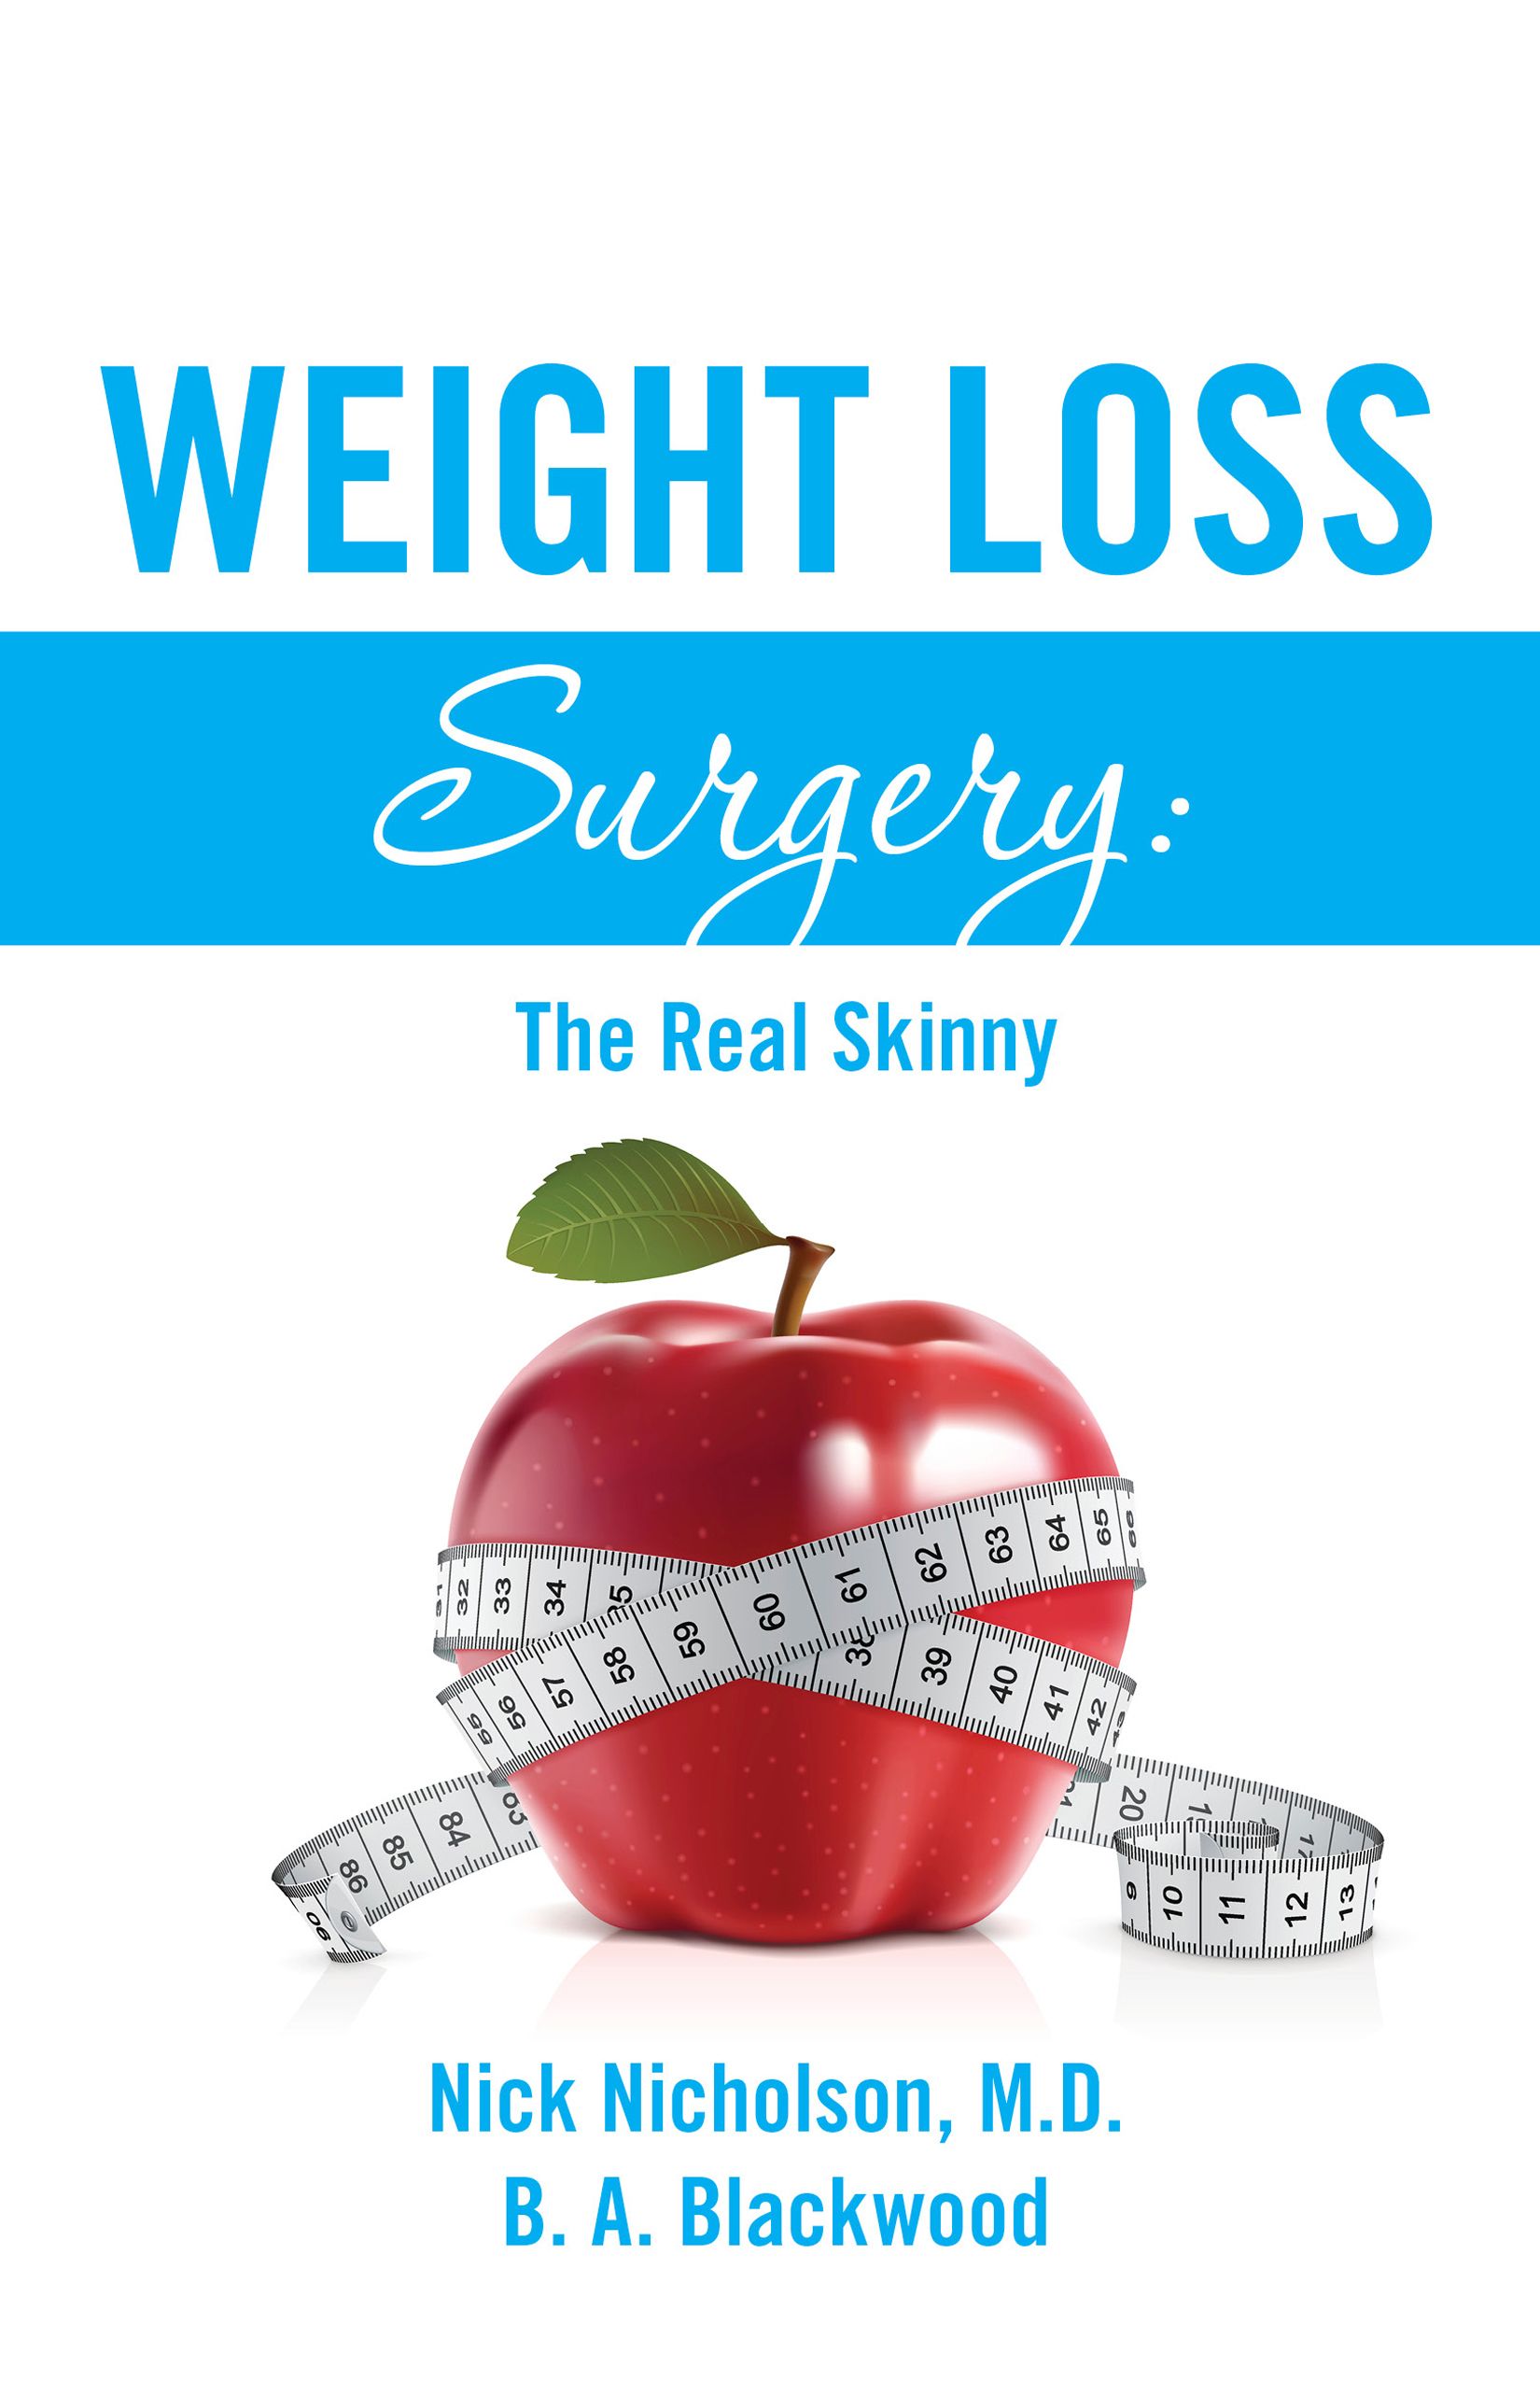
Maintaining Weight Loss After Bariatric Surgery:
A qualitative study
Lori Liebl, PhD, RN, CNE
Assistant Professor of Nursing
University of Wyoming

Slide 2
Weight Loss Maintenance
Within one year of nonsurgical weight loss
  Overweight adults regain ~ 50% of weight lost
  Past 1 year- regain of all or more of the weight lost
Within 2 to 5 years of nonsurgical weight loss
  92% will regain most or more of the weight lost
Within 2 to 5 years of bariatric surgical patients
  20% will regain >50%EWL
  < 5% will regain all of weight loss

Slide 3
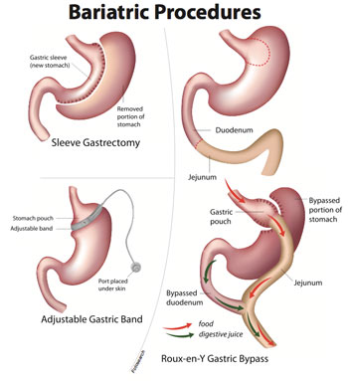
Obesity Treatments: Surgical Types
Roux-en-Y gastric bypass (RYGB)- Criterion Standard
  15.34 reduction in BMI
Laparoscopic sleeve gastrectomy (LSG)
  11.87 reduction in BMI
Laparoscopic adjustable gastric band (LAGB)
  7.05 reduction in BMI

Slide 4
Background
Pre- and post-surgical interventions
  Psychological screening
  Nutrition, behavior, exercise support
    Support groups & exercise classes
Percent & rate of weight regain - estimated 20% of the time
  Within 2 to 5 years

Slide 5
Review of Literature & Gaps
Factors &Traits oriented
  Long-term does not consider bariatric surgical patients (pts)
  Initial weight loss (12 to 18 mo)
  Minimal weight loss maintenance (>24 mo)
  Caucasian females 25 to 55, urban locations
Quantitative:
  Quality of life; self-efficacy r/t behavior changes, self-regulation, self-talk, goal setting, support systems, behaviors.
Qualitative:
  New identity clashing with old
    Loss, shame, anger, frustration, fear, joy, excitement, support systems, coping mechanisms
Behavior change theories – Bandura’s Social Cognitive Theory
  Minimally studied with bariatric surgical pts

Slide 6
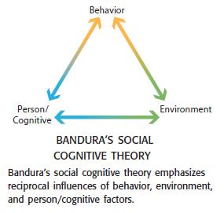
Theoretical Underpinnings
Bandura’s behavioral change theory
  Social Cognitive Theory
  Triadic reciprocal causation model
Broad assumptions used as framework
  Semi-structured interview guide
“open minded yet mindful
of the preconceptions” (Sandelowski 2010,p. 80)
“Lasting change is dependent on reciprocal interaction of intrapersonal, behavioral, and environmental influences…”

Slide 7
Purpose Statement
The purpose of this qualitative descriptive study was to describe the experiences of adults who were successful and those who were unsuccessful at maintaining weight loss AT LEAST 2 YEARS after a bariatric surgery.

Slide 8
Interview Guide
Semi-structured questions were asked to allow the participant to answer and freely discuss their post-surgical experience.
Question Examples:
Prior to surgery, why did you believe your goal weight to be realistic?
Why do you believe you have been able to maintain your weight loss?
Tell me about the lifestyle changes have you made since your surgery?
Tell me about the people who have supported you throughout this journey?
Probing questions were used during the interview in order to keep participants on topic or to help the participant find a place to start or transition.
Probing Question Examples:
Has anyone helped you in your efforts to make these changes?
What makes it difficult to choose healthy diet options?
What type of activities do you do now?
Are you satisfied with your current weight?

Slide 9
Inclusion Criteria
Adult >19 years of age
> 24 months after a laparoscopic Roux-en-Y gastric bypass, laparoscopic sleeve gastrectomy, or laparoscopic adjustable gastric band surgery
Able to speak, read, and understand English
Success defined: > 50% of excessive weight loss (EWL)
Unsuccessful: < 50% of EWL
EWL: (preoperative weight minus postoperative weight) / (preoperative weight minus ideal body weight)
  380 – 250 / 380 – 155 = 57% EWL
Notes:
(Bray et al. 2009)

Slide 10
Recruitment results
20 adults agreed to participate
  14 Successfully maintained weight loss
    3 more recruited – did not participate
  6 Regained weight
    At least 6 more adults were recruited but did not participate

Slide 11
Findings: Successful Participant Interviews
M=82 minutes, between 60 and 117 minutes
Upbeat and very willing to share information
Participant did the majority of speaking, with minimal use of probing questions
Demeanor and outlook on life were positive
Awakened to a new life that came with a healthier weight

Slide 12
Successful Participant Description
Participant | Age | Gender | Race | Marital Status | Education | Employment | Residence
1 | 48 | Female | Cauca | Divorced | College | Part time & Self | Rural
2 | 52 | Male | Asian | Married | College | Full Time | Suburban
3 | 38 | Male | Cauca | Married | S. College | Unemployed | Suburban
4 | 40 | Female | Cauca | Separated | S. College | Unemployed | Suburban
5 | 46 | Female | Hispan | Married | S. College | Part time | Urban
6 | 29 | Female | Cauca | Married | College | Other | Urban
7 | 60 | Female | Cauca | Divorced | College | Unemployed | Rural
8 | 29 | Female | Cauca | Married | College | Other | Suburban
9 | 73 | Male | Cauca | Married | College | Retired | Urban
10 | 40 | Female | Cauca | Divorced | College | Full Time | Suburban
11 | 46 | Female | Cauca | Married | Tech | Full Time | Suburban
12 | 56 | Female | Cauca | Married | Tech | Part time | Rural
13 | 57 | Female | Cauca | Married | College | Retired | Suburban
14 | 43 | Female | Af. Am | Single | College | Full Time | Urban

Slide 13
Successful participant surgical & weight information
Participant | Surgery Type | Months Post-Surgery | Highest Pre-surgical Weight & BMI | Lowest Post-surgical Weight & BMI | Current Weight & BMI | Successful Weight & Ideal Body Weight
1 | RYGB | 30 | 386 / 62.3 | 180 / 29 | 195 / 31.5 | 270 / 144
3 | RYGB | 157 | 412 / 41.7 | 245 / 32.3 | 255 / 33.6 | 293 / 174
5 | RYGB | 39 | 482 / 60.2 | 275 / 34.4 | 295 / 39.6 | 332 / 182
6 | RYGB | 29 | 225/ 38.6 | 110 / 18.9 | 115 / 19.7 | 182 / 138
7 | RYGB | 28 | 256/ 42.6 | 110 / 18.3 | 164 / 27.3 | 199 / 141
8 | RYGB | 129 | 297 / 56.1 | 136 / 25.7 | 136 / 25.7 | 213 / 129
9 | RYGB | 148 | 500 / 91.4 | 235 / 43 | 275 / 50.3 | 316 / 132
10 | RYGB | 52 | 301 / 55 | 118 / 21.6 | 143 / 26.2 | 219 / 137
12 | LAGB | 65 | 300 / 38.5 | 220 / 28.2 | 235 / 30.2 | 248 / 195
14 | RYGB | 46 | 238 / 43.5 | 116 / 21.2 | 131 / 24 | 188 / 137
15 | LAGB | 73 | 225 / 36.3 | 162 / 26.1 | 175 / 28.2 | 185 / 144
16 | LSG | 31 | 248 / 40 | 138 / 22.3 | 189 / 30.5 | 196 / 144
17 | LAGB | 65 | 207 / 37.9 | 115 / 21 | 122 / 22.3 | 170 / 132
18 | LAGB | 79 | 298 / 49.6 | 163 / 27.1 | 195 / 32.4 | 220 / 141

Slide 14
Awakening: Major Themes
Taking My Life Back
New Lease on Life
Without Supportive People Around You, You’re Lost
I Do Not Like Focusing on the Negative
The Void
Food Demons
Finding the Happy
Ripple Effects
“There’s no way I could've lived and enjoyed life in general the way I was then as compared to how I am now.”
“I decided it's my responsibility to take care of it and that's just how it is.”

Slide 15
Taking My Life Back
New Lease on Life
  Energy
  Physical ability
    Family life
  Confidence
  Appreciation
“My goal is to take my life back”
“I cannot be 72 and pass away because I didn't take care of myself. So she was really the reason why I was like ‘Oh my goodness I can't be my mom.”
“To participate more with my kids… to be active in their lives.”
“Life now as I know it, I love life!”
“I wasn't happy, fat, and I'm happy now and it makes a lot of difference in your life emotionally and physically.”
“My oldest daughter now she says ‘Mom stop stealing my pants!’ I love it!”
“If I drop something I enjoy bending over to pick it up because I can.”
“I'd probably still be sleeping 10 to12 hours a day because I didn't have energy or just sitting around the house because I couldn't move, I was so sore. Now, I'm never home.”

Slide 16
Without Supportive People Around You, You’re Lost
  Encouraging
  You’re not alone
  Honest professionals
I Do Not Like Focusing on the Negative
  This is something for me
  Shedding the negative
  Not the support I needed
“Without supportive people around you, you’re lost…I think if I didn't have those people in my life my success would be minimal.”
“I know that they’re gonna be very honest with me and do things not just from a ‘friend’ perspective but from a nursing perspective and from someone who’s been a patient perspective.”
“He didn't really want me to have it. He would say ‘Your fine the way you are’…We’re not together anymore.”
“The boyfriend at the time, who I had been together with for seven years, was not so supportive. I had lost about 100 pounds, and he decided he didn't want to be together anymore.”
“If I was still was with the same old guy, he would be asking if I wanted ice cream at night because he thought that was the way you took care of each other, you fed each other.”

Slide 17
“Those first two or three weeks after surgery it sets in very quickly that you had an addiction and you’re going through detox and its hell.”
The Void
  Food is an addiction
  Filling the void with another addiction
  Center of my life
Food Demons
  Cravings
  Negotiating with food demons
    Distractions
    How, why, and what I eat
  Tuning into your mind and body
“I've been through the gamete of the different things that you can be addicted to.”
“I just have never been big on taking care of myself, it’s always everybody else….I've just never been okay with that. I'm getting ok with that.”
“I had to change my way of thinking. How I eat, why I eat, what I eat.”
“There are times I'll get Magnum ice cream bars and I'll want to eat three of them, right off the bat…That never goes away.”
“I can eat half a burger and throw it away…And before I didn’t eat half of something and throw it away.”
“Surgery doesn't fix everything and you have to always pay attention to it.”

Slide 18
Finding the Happy Weight
Ripple Effects
“Scary weight is 175…168 is happy weight.”
“I feel good about myself. I feel good about my size.”
“I like my weight best at 140, that's where I'm happiest, and I wasn't too skinny, I wasn't too fat, I'm comfortable in that skin.”
“I couldn't believe I was that skinny and I’d still see myself as fat though.”
“Probably about 145 pounds, people said ‘Your face looks a little bit gaunt”
“If I don't eat it, the rest of the family doesn't really get it either.”
“I think they’re probably more conscious about making good choices than they would have been if I had not had the surgery, because I wouldn't have been conscious about it.”
“We don't really do the whole in-house fitness or going to the gym or whatnot. But we go out swimming. We go camping, hiking, a lot of cardio, ride our bikes, stuff like that.”
“With the kids, we want to make sure they are instilled with good healthy values so that they don't have to go through what we did.”

Slide 19
Findings: Unsuccessful Participant Interviews
M=54 minutes, between 40 and 70 minutes
Hesitant to share details
Reserve and a sadness resonated
Multiple probing questions were used to extract information
Somber but hopeful outlook on life
Not ready to give up on their weight loss efforts

Slide 20
Unsuccessful Participant Description
Participant | Age | Gender | Race | Marital Status | Education | Employment | Residence
2 | 62 | Male | Cauca. | Single | Masters | Full Time | Suburban
4 | 54 | Male | Cauca. | Married | S. College | Self | Suburban
11 | 43 | Female | Cauca. | Married | H. School | Self | Suburban
13 | 55 | Male | Cauca. | Divorced | S. College | Other | Urban
19 | 44 | Female | Hispan. | Widowed | S. College | Full Time & Self | Urban
20 | 55 | Female | Cauca. | Married | College | Part Time | Rural

Slide 21
Unsuccessful participant surgical and weight information
Participant | Surgery Type | Months Post-Surgery | Highest Pre-surgical Weight & BMI | Lowest Post-surgical Weight & BMI | Current Weight & BMI | Successful Weight & Ideal Body Weight
2 | RYGB | 87 | 329 / 45.9 | 190 / 26.5 | 269 / 37.5 | 254 / 179
4 | RYGB | 45 | 430 / 55.2 | 260 / 33.4 | 317 / 40.7 | 313 / 195
11 | LSG | 44 | 263 / 39.3 | 165 / 32.8 | 197 / 32.8 | 193 / 150
13 | LAGB | 102 | 496 / 62 | 340 / 42.5 | 445 / 55.6 | 348 / 200
19 | RYGB | 28 | 276 / 44.5 | 207 / 33.4 | 214/ 34.5 | 216 / 155
20 | LAGB | 74 | 298 / 49.6 | 196 / 32.6 | 238 / 39.6 | 224 / 150

Slide 22
Not Giving Up
“I wanted it so bad and I wanted the surgery for so long and I had read all about how it wasn't successful for some people and I said ‘I will not be one of those people’ and two years later I feel like I am one of those people.”
To Be Healthy and Active
Lasting Changes
I Failed the Surgery
I’m Working On It
Support Systems
“The surgery was a success, yes but I failed the surgery”
“Giving up is a big thing. I don't think there's anything they can do to help me change. I have to do it.”

Slide 23
To Be Healthy and Active
Lasting Changes
  What and how much I eat
  The way I eat
  Increase in activity
“I had high cholesterol and was having some knee pains and…my mom has had both of her knees replaced. I didn't wanna end up like her. I just wanted to do what I could to try and be proactive.”
“I couldn't walk to the mailbox…All I did was stay around the house and go to the store and at the store I'd need one of those carts. That was always embarrassing.”
“I’m very aware of what I eat and what I'm doing…I'm more aware of what I'm buying and why I'm buying it.”
“I get out a lot more. I get exercise. I go to the gym and exercise, and I can walk on my paper route…I'm just more active…It’s more fun because I can ride my bike and go to the gym and lift weights, and I can just be more mobile.”
“Now, I am much more focused on three planned meals a day…I used to eat whenever I wanted.”

Slide 24
I Failed the Surgery
  In the beginning
  Sabotaging my stomach
  I’m struggling
    I quit exercising
    Old eating habits resurfaced
      Emotional eating
      Love of food
      Poor food choices
      Mindless eating
      Anger
    Balance
      Social, Work and Home
    The fault is mine
“I feel ashamed, I feel embarrassed that I got the surgery.”
“I'll try something, and I don't just try a couple bites, I usually try like a big piece of something…Then I really do feel sick which makes no sense. That's just stupid.”
“I started dating a guy…and I have changed my diet a lot since he's been in my life.”
“I feel the need to take care of people…I think that hopefully over time I’ll find that right balance.”
“I still choose French fries and the bread on a sandwich instead of getting fruit and a salad...It's all about poor decision-making.”
“It's so hard to have control in so many areas. Right now, I'm struggling with how to change and not lose everything.”
“I'm disgusted and mad…mad at myself.”

Slide 25
I’m Working On It
Support Systems
  Support groups
  Family
  Non-judgmental support
  Health care support
  Co-workers
“I just need to try to forgive myself and say ‘Well I got to do better’ and start over.”
“I go out and look at my motorcycle sitting there…I gotta do something, or I'm gonna end up selling my bike and I'm never gonna be able to get another one.”
“I'm responsible for my own actions. Eating is my own action. If I eat too much lasagna I am responsible for that.”
“I'm gonna prioritize things in my life. I need to make healthy eating and exercise and spending quality time with my kids.”
“I think he was happy that I was losing weight but…he never says anything about my weight or that I didn't look good after I had my surgery or anything.”
“When you're really, really down and then you think ‘I'm going to quit and not do it anymore’ and then you think ‘well what did they tell me in the support group”
“My husband would get on me and say like my plate looks like a man’s plate.”
“I felt a little bit alone.”

Slide 26
Conclusions: Reciprocal Determinism
Previous studies focus – initial weight loss
  Long-term challenges
Reciprocal Determinism: Interaction between intrapersonal, behavioral, and environmental influences
  Individual’s ability to interact, modify, and alter their environment to regulate their behavior
    Successful - identify negative attitudes, influences, and behaviors then modified their environment to support healthy behavior
    Unsuccessful – failed to modify or alter their environment to support healthy behaviors

Slide 27
Discussion: Confirmed & Expanded
Intrapersonal influences
  Self-efficacy to make lasting changes (diet & physical activity (PA))
Behavioral influences
  Self-regulate healthy behaviors (seeking support, dietary, & PA)
  Follow-up meetings, exercise classes
  Coping strategies – disturbed eating patterns
  Overcoming replacement addictions – Support groups (NA, AA, OA)
Environmental influences
  Support systems- seek out models & emulate
  Spousal support – keep positive, eliminate negative

Slide 28
Discussion: Inconsistent
Reciprocal determinism
  Vulnerability, ill-prepared
    “Now I can, so I will” vs. “Now I can, so I should”
  Paradoxical – anger, fear, or frustrations with others perceptions
    Further out, not discussed
Behavioral & Intrapersonal influences
  Motivated to lose weight and make lasting healthy lifestyle choices
  Obtainable realistic goals
  High self-efficacy to make lasting changes

Slide 29
Implications for Practice & Future Research
Therapeutic education & counseling
  Changes in relationships
Communication techniques
  Negativity
Support groups
  Different stages
  Sponsors
Weight fluctuations
  Comfortable and maintainable weight
  Guilt, shame, anger, and frustrations

Slide 30
Questions & Comments
Thank you for your time!

