Slide 1

Novel roles for PKD genes in the reproductive tract and in stromal cells of the kidney
Lois Arend
Johns Hopkins University
Department of Pathology
Lab Members:
Xuguang Nie
Humera Khan

Slide 2
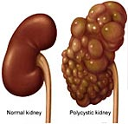
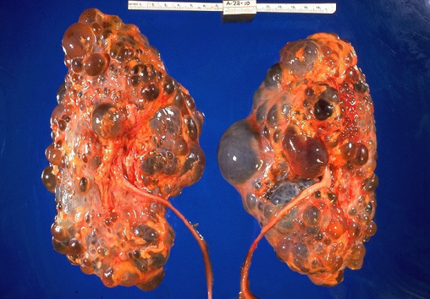
Some facts about Autosomal Dominant Polycystic Kidney Disease (ADPKD)
Epidemiology: Incidence of 1:500 to 1:1000 live births, affecting all ethnicities
Etiology: Pkd1 mutations account for over 85% of ADPKD cases, Pkd2 mutations account for approximately 15% of ADPKD.
Clinical signs: Progressive development of cysts, enlargement of kidneys and progressive loss of renal function
Over half of the cases proceed to end stage renal disease by fifth to sixth decades
Treatment: dialysis and kidney transplantation
Infertility can be a problem
Notes:
ADPKD is one of the most common genetic diseases
The major problem in ADPKD is cyst formation in the kidneys, which gradually disrupts kidneys function and eventually leads to renal failure. The last resort is kidney transplantation for ESRD. This is a huge burden to the society as ADPKD affects 1 in up to 400 people, regardless of genetic background. ADPKD is caused by PKD gene mutations. Infertility can be a problem
Reproductive system abnormalities and infertility in male ADPKD patients are very common and have a higher incidence than in the general population, suggesting that ADPKD genes are required for development or maintenance of the male reproductive system

Slide 3
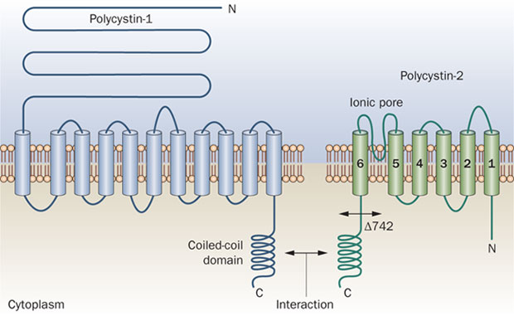
Structures of Polycystin1 and Polycystin2
Notes:
The protein products of ADPKD genes are polycystins, including PC-1 and PC-2.
Polycystin-1 is a glycoprotein which contains a large N-terminal extracellular region, multiple transmembrane domains and a cytoplasmic C-tail. It may function as an integral membrane protein involved in cell-cell/matrix interactions, and may modulate intracellular calcium homoeostasis and other signal-transduction pathways.
Substantial evidence support that PC-2 acts as calcium channel, and PC-1 can regulates the channel activity of PC-2. It is firmly established that PC-1/PC-2 interact at the coiled-coil domains regulating calcium inflow.

Slide 4
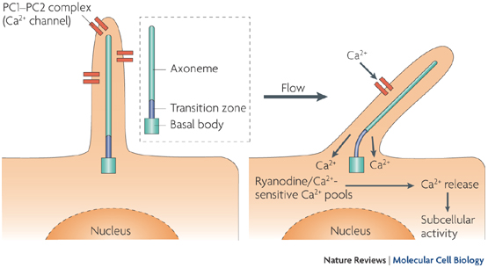
Functions of PCs
Polycystin-2 serves as a calcium channel
Polycystin-1 and polycystin-2 act as complex (interact at the coiled-coil domains) to regulate calcium inflow in many cell types
Mechanosensing role of polycystins in primary cilia of epithelial cells
PC regulated cellular events
Cytoskeleton dynamics
Cell adhesions
Cellular signaling: Wnt signaling, mTOR, et al.
Cell proliferation and apoptosis
Metabolism changes
Notes:
Substantial evidence support that PC-2 acts as calcium channel, and PC-1 can regulates the channel activity of PC-2 via an interaction at the coiled-coil domains regulating calcium inflow.
In a number of epithelial cells, polycystin1/polycystin2 co-exist in the primary cilia and act as mechanosensor, transducing environmental stress signal into cellular molecular cascades by regulating calcium flow.
Polycystin activity regulates a set of cellular processes including cytoskeleton arrangement, cell-cell adhesion, proliferation and apoptosis.

Slide 5
Genetic explanation of ADPKD
The “Second hit” theory: a germline mutation in one allele plus a second hit mutation on the other allele causing loss of heterozygosity in a ADPKD gene initiates cyst formation from a single epithelial cell
Accumulation of mutations throughout lifetime explains slow progression of the disease
Modulators (a “third hit”) might also play a role in variations of the disease
Notes:
The second hit theory is the most accepted genetic explanation of ADPKD. It is proposed that a germline mutation and a second hit mutation in the other PKD allele, causing loss of heterozygosity in an ADPKD gene initiates cyst formation from one single cell.

Slide 6
ADPKD Projects
ADPKD genes (Pkd1 and Pkd2) in male reproductive system development
Mechanisms of cyst development in ADPKD: Although causative roles for ADPKD gene mutations are firmly established, the mechanisms for disease progression and variations remain to be determined.
Notes:
In the first project, we have revealed novel roles of ADPKD genes in male reproductive system development. We found that ADPKD genes are not only required for metanephros development but also for mesonephros development. PKD genes are also required for epididymis development.
In our ongoing project, we are studying mechanism of ADPKD.

Slide 7
ADPKD genes in reproductive tract
ADPKD genes (Pkd1 and Pkd2) in male reproductive system development
  Required for mesonephric development, including epididymis, efferent ducts, testis
  Disruption of Tgf-beta/Bmp and Wnt signaling
Notes:
In the first project, we have revealed novel roles of ADPKD genes in male reproductive system development. We found that ADPKD genes are not only required for metanephros development but also for mesonephros development. PKD genes are also required for epididymis development.

Slide 8
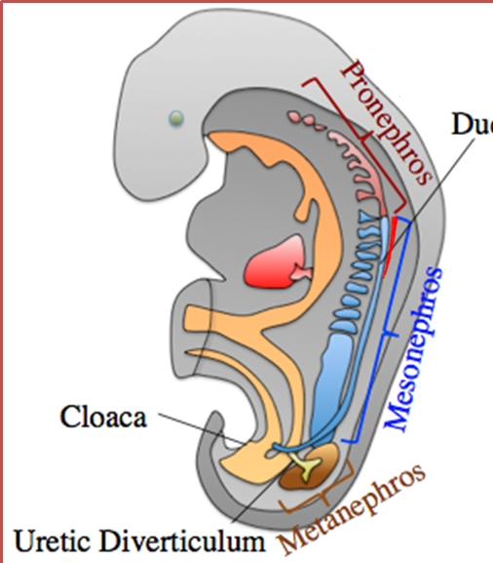
Development of Mesonephros and Gonad
Notes:
Reproductive system is derived from intermediate mesoderm (labeled with red color at the cross section of the early embryos). Initially, an epithelium tube is formed in the IM, that is the Wolffian duct. It extends caudally and give rise to epithelial duct/tubules. These Wolffian ducts derivatives (epithelial duct/ tubules grow out from the Wolffian duct), together with mesoderm mesenchyme, to form pronephro and mesonephros and metanephros. Pronephoros degenerates shortly after being formed, metanephros will form the adult kidneys, mesonephros is related to reproductive organ development.
Mullerian duct is being formed parallel to wolffian duct start from E11.5
Gonadogenesis: the gonadal primordium arises from the thickening of the coelomic epithelium.

Slide 9
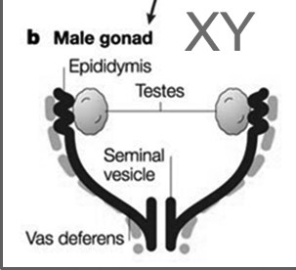
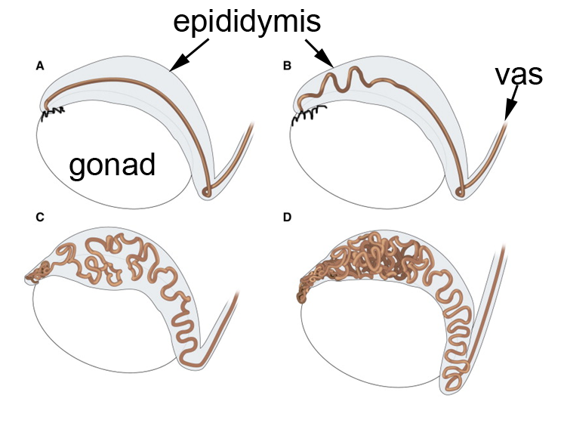
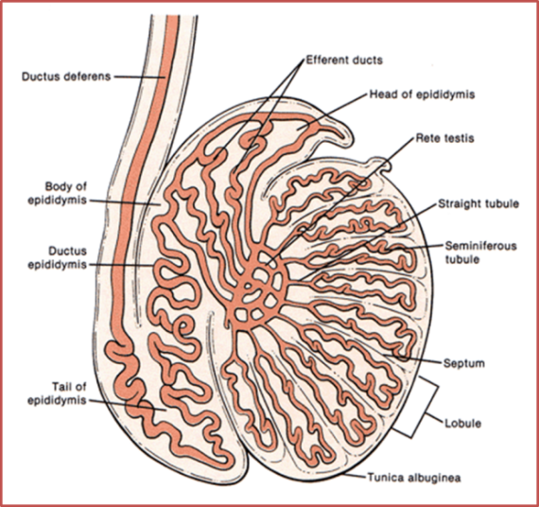
Development of the male reproductive system
Notes:
The efferent ducts (lower), connecting the testis to the epididymis, derive from mesonephric tubule remodeling. Other structures are derived mostly from the
Wolffian duct.
The testes turn down and descend, placing the epididymis on top. The epididymis undergoes coiling to form a long tortuous tube. The interstitial compartment of the gonads is formed mesenchymal cells, some of which differentiate into endothelial cells, peritubular myoid cells, and Leydig cells.
Wolffian duct will make a twist forming two segments: epididymis primordium and vas deferens twist.
The epididymal epithelium will coil and form a lengthy and tortuous tube which is 1 meter long in mice.
Testis development is initiated by establishment of a group of specialized epithelial cells during early gonadogenesis, the Sertoli cells. The interstitial compartment of the male gonad is formed by mesenchymal cells which migrate from the mesonephros during. These mesenchymal cells differentiate into various cell types, including endothelial cells, peritubular myoid cells, and the Leydig cells. The testicular cords, after being formed, continuously grow and convolute, and eventually mature into the seminiferous ducts.

Slide 10
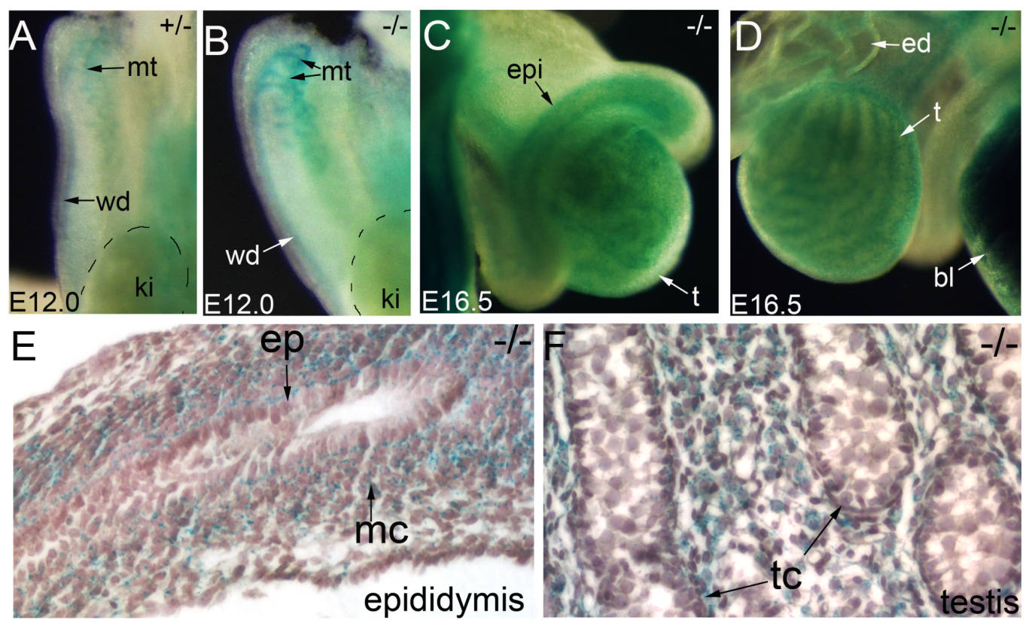
Pkd1 expression in developing male reproductive system
Notes:
We first looked at the constitutive Pkd1 expression. The mice have a LacZ gene inserted in Pkd1 allele. We use homozygous mice because they have two copy of Lacz gen and staining is much stronger than hetero. At E12, Pkd1 is present in epithelium of the Wolffian duct and mesonephric tubules. Later at E16.5 expression shifted more to the mesenchyme of developing epididymis. It is also seen in the testis. Sectioning showed it is abundant in the interstitial cells. Spatiotemporal dynamics of Pkd1 expression suggest that Pkd1 has a role in male gonadal development.

Slide 11
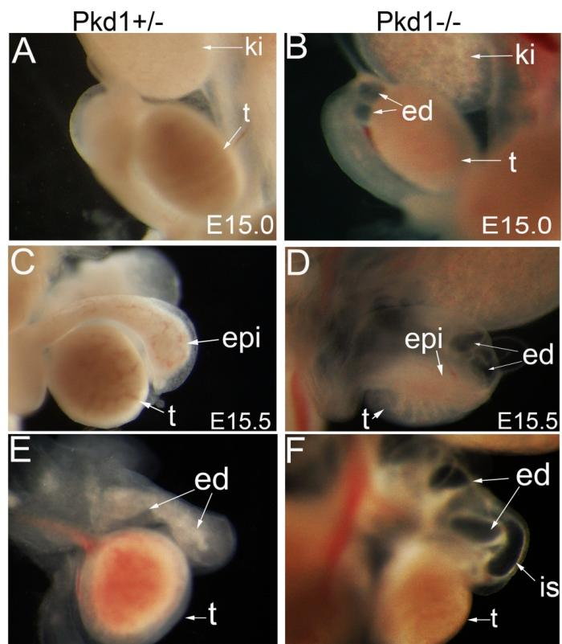
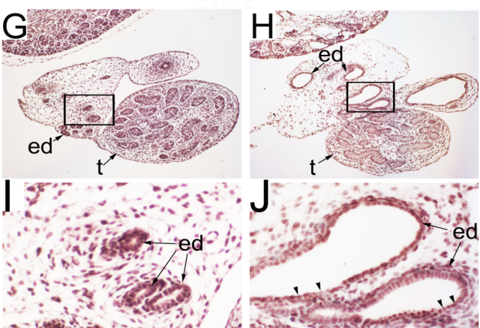
Efferent duct dilation and cystogenesis in Pkd1^{LacZ/LacZ} (Pkd1^{-/-} )mice
Pkd1+/-
Pkd1-/-
E16.5
Nie X, Arend L. Mech Dev 2013
Notes:
Earliest visible defect is cystic dilation of efferent ducts
Majority of Pkd-/- mice died at E15.5-16.5 – multi-system defects, cysts in kidneys and pancreas.
Eff duct dilation in Pkd1-/- mice beginning at E15.0
A&B: E15.0 eff duct dilation
C&D: E15.5
E&F: E16.5 marked dilation of eff ducts
Histology: at E16,5, showing dilated ducts. Flattened epithelial cells.

Slide 12
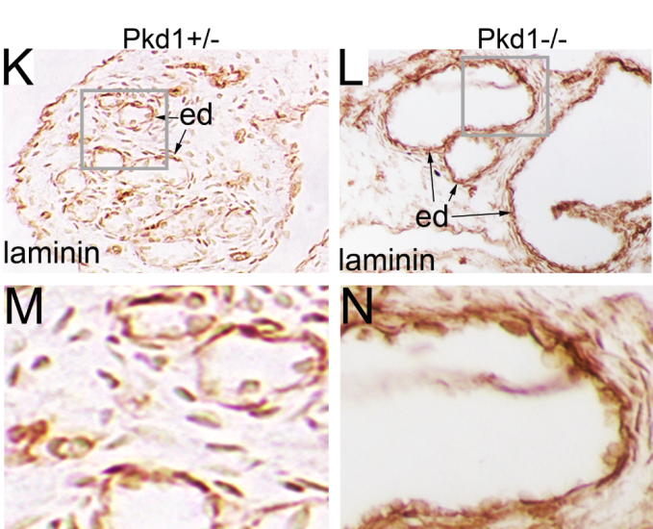
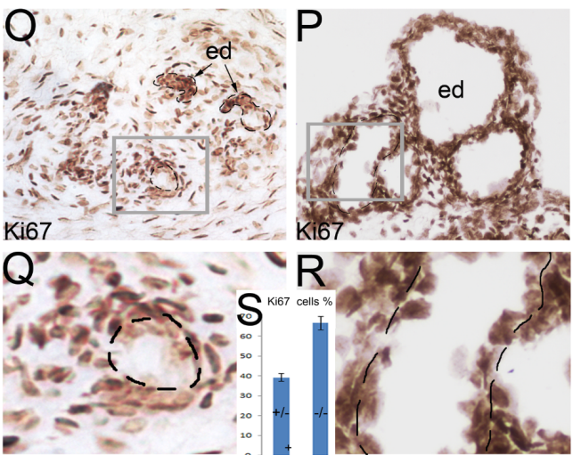
Changes in basement membrane and proliferation rate
Nie X, Arend L. Mech Dev 2013
Notes:
In ADPKD, basement membrane is abnormal. Laminin staining showed thicken and laminated basement membrane in the mutant, suggesting dysregulated ECM formation.
Increased proliferation reflecting rapid expansion of epithelium.
All these observations conforms to findings in renal cysts.

Slide 13
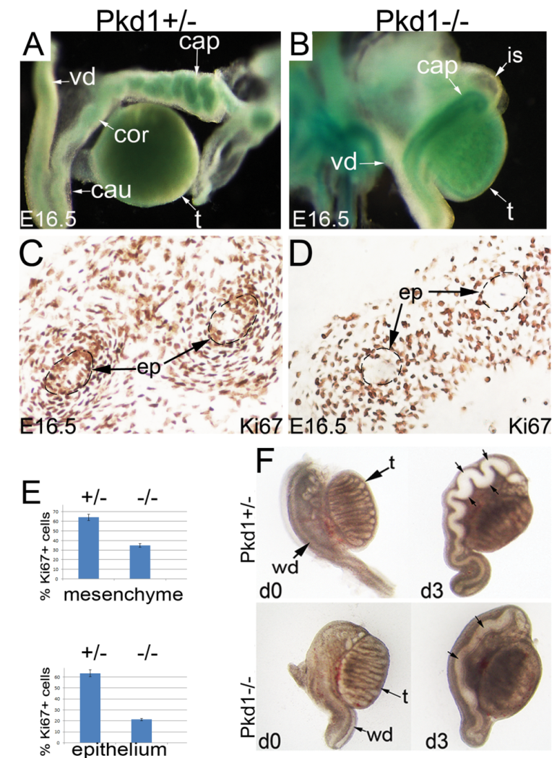
Epididymis defects in Pkd1^{-/-} mice
Lack of coiling
Reduced proliferation
Lack of hormone responsiveness
Notes:
Pkd1 mutant epididymis showed lack of coiling and reduce interstitial cells.
Proliferation is decreased, suggesting that growth and elongation is delayed or arrested in the mutants.
In vitro culture experiments showed that coiling defect is intrinsic, not due to dilation.
Lack of response of epididymis to respond to growth factor stimulating coiling, shows defect in responsiveness of epithelium in the mutant.

Slide 14
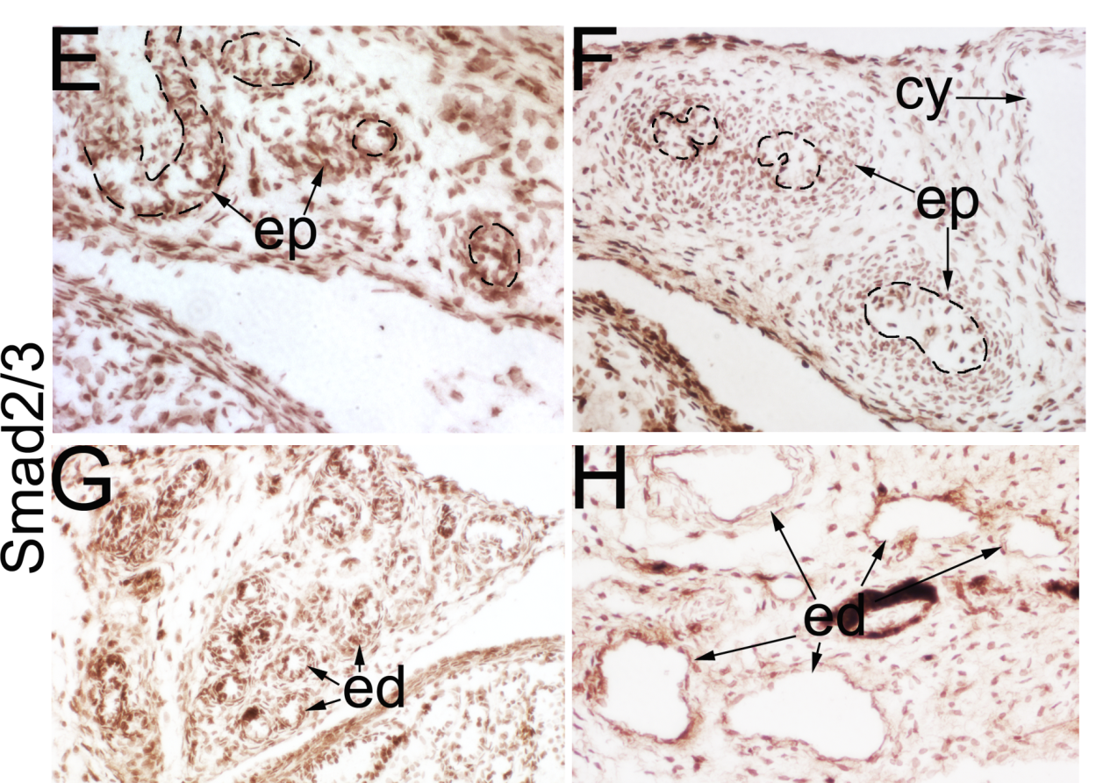
Decreased Tgf-β signaling
Notes:
Tgf-beta/Bmp signaling pathways are impt for ductal system development and maintenance (disrupting signaling leads to loss of coiling DiGiovanni2007 and Tomaszewsi2011)
Smad 2/3 and phospho-Smad 1/5 intracellular mediators of Tgf-B and Bmp, respectively.
Smad2/3: high in epidydimis epithelium of normal, but reduced in mutant. Also reduced in mutant efferent ducts.
Disrupted Tgf-beta signaling in mutant

Slide 15
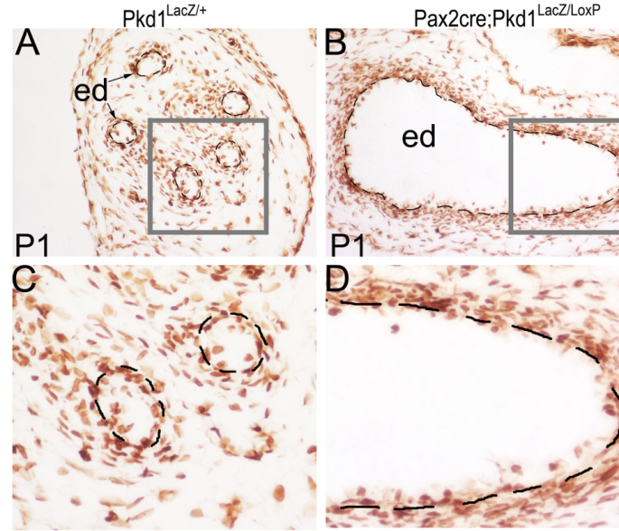
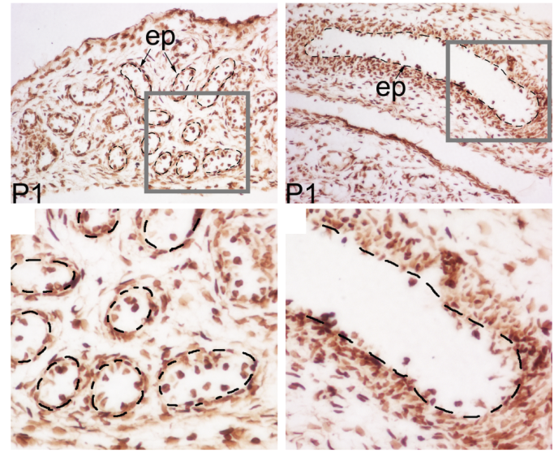
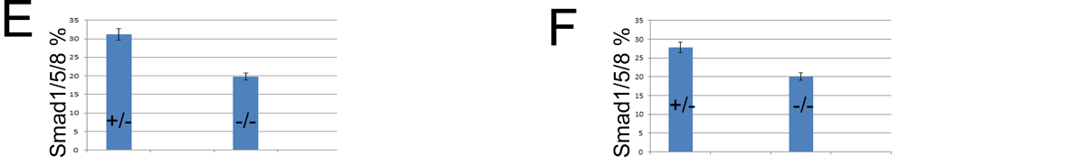
Decreased Bmp signaling
Notes:
Phospho-Smad 1/5 is intracellular mediator of Bmp signaling.
In contrast to Smad2/3, pSmad1/5 is expressed in both mesenchyme and epithelium, and is reduced to a greater extent in the epithelial cells of the mutant in both eff ducts and epididymis.
Suggest a link between PC1 and Tgf-beta/Bmp signaling pathways.

Slide 16
Summary 1
PC-1 deficient mice showed reproductive system defects in males, including:
Efferent duct dilation
Coiling defect and dilation of epididymis
Phenotypic change of epithelium: columnar cells to highly proliferating flattened cells
Abnormal Tgf-β/Bmp signaling
Pkd2 knockout mice show similar features, but also show atypical testicular cords
Notes:
By examining male reproductive system in global and epithelial knockout mice, we found that Pkd1 is critical for reproductive system development. As a result of disrupting Pkd1,
Also looked at PC-2, which had similar expression as PC-1, but also showed high testicular expression, and Pkd2 k/o showed reduced # of testicular cords, reduced mitotic activity, and reduced phospho-Smad2 levels suggesting altered Tgf-beta signaling
Taken together, these findings demonstrate an important role for Pkd genes in male repro tract development and may explain in part the infertility problems in patients with ADPKD, (but not required for early tubulogenesis in the mesonephros)

Slide 17
New insights from genetic engineered mouse models
Conditional inactivation of ADPKD genes in adulthood or late postnatal development only leads to focal cyst formation in mice, failing to model human ADPKD
Cilium ablation or disrupting cilium-dependent calcium inflow, which is regulated by PC-1and PC-2, does not elicit cyst formation in both mice and zebrafish, challenging the “cilium polycystin theory”
Other mechanisms likely contribute to cystogenesis
Notes:
The introduction of inducible gene expression techniques in genetic studies provide a powerful tool for studying gene function and genetics. Recently, several studies using inducible gene knockout system have generated strong evidence to extend our understandings of ADPKD, also, challenged our current theories.
, other than loss of heterozygosity in epithelial cells ,
Made difficult since global deletion of pkd1 leads to embryonic lethality

Slide 18
Stromal compartment in ADPKD
Stromal compartment defects are common in ADPKD patients
-Apoptosis
  -ECM changes, fibrosis, basement membrane thickness
Pkd1 is expressed in undifferentiated
mesenchyme during embryogenesis
Little is known is about functional roles of ADPKD genes in renal stromal compartment
Notes:
Indeed, besides roles in epithelia, ADPKD genes are important for maintenance of a number of non-epithelial tissues. For example, stromal compartment defects are common in ADPKD patients, including fibrosis, basement membrane thickness, and abnormal apoptosis.
During early metanephric development, up to E15.5, Pkd1 expression was seen only in renal vessels and weakly in uninduced and induced mesenchyme (from E13.5), with the ureteric bud, comma, and S-shaped bodies negative (Fig. ​(Fig.22g). This is consistent with the observation that renal development of Pkd1^{del17–21βgeo} −/− embryos was normal until their deaths at E13.5-E14.5. From E15.5 to E18.5, Pkd1 expression was increased dramatically in mesenchymal cells and endothelial cells in the nephrogenic zone and most significantly in the differentiating tubules of the nephron and collecting duct system (Boulter.PNAS.2001)

Slide 19
Does disruption of PKD genes in the stromal compartment initiate cystogenesis?
Notes:
A new hypothesis: PCs are critical for maintenance of the stromal compartment and this function is important for epithelial structural integrity. impairing this function may initiate cyst formation

Slide 20
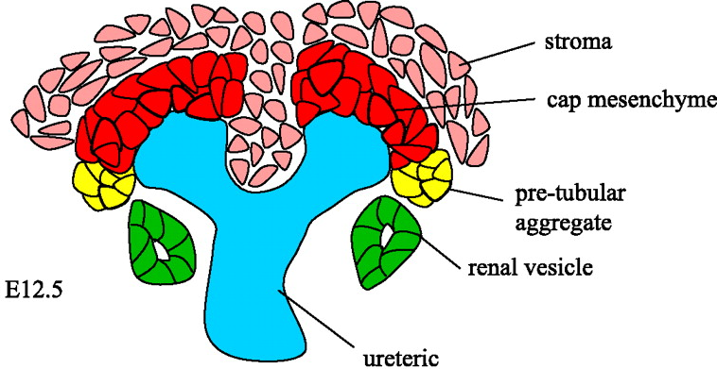
The renal stromal cells
Renal cell lineages during development:
Cap mesenchyme-epithelial cells: tubules and CDs
Endothelial progenitors(hemangioblasts): endothelia of renal vasculature
Stromal cells and Stromal cell derivatives: mesangial cells, interstitial fibroblasts, smooth muscle cells, pericytes
glomerular mesangial stalk, interstitium, vascular wall, smooth muscle
Notes:
The stromal cells are a cell lineage other than the mesenchymal cells that are destined for renal epithelia. Stromal cells differentiate to several cell types, forming a set of supporting structures for the kidney including glomerular mesangial stalk, interstitium, vascular wall, smooth muscles. The stromal compartment is critical for maintaining kidney structural integrity and proper function

Slide 21
Stromal cell-specific deletion of Pkd1
Using Foxd1^{CreEgfp/+} mice to delete ADPKD genes from stromal cell derivatives
Foxd1: a transcription factor regulating stromal cell development in the kidney (non-epithelial cells)
Notes:
To address these issues, we specifically deleted PKD genes from the renal stromal cells using Foxd1-cre mice. Foxd1is a transcription factor regulating stromal cell development in the kidney (non-epithelial cells), first reported in 1996.
Foxd1CreEgfp/+ mice contain a fused Cre-Egfp construct inserted in the Foxd1 domains under the control of Foxd1 promoter.
The Foxd1^{CreEgfp/+} mice have a Cre-Egfp fusion construct inserted downstream of the Foxd1 promoter

Slide 22
Experimental Approaches
Foxd1^{CreEgfp/+} mice (Jackson Lab)
Pkd1^{LacZ/+} mice and Pkd1^{loxp/loxp} mice (Hopkins PKD Core)
Foxd1^{CreEgfp/+};Pkd1^{LacZ/+} double heterozygous mice are fertile and healthy with normal life span. Minor defects exist in the kidneys, including rare cysts, varied tubule dimension
Foxd1^{CreEgfp/+};Pkd1^{LacZ/LoxP} mutant mice
Notes:
Foxd1 knockin mouse, has a fused Cre-Egfp construct inserted in the Foxd1 domain under the control of Foxd1 promoter.
Foxd1, also know as bf-2, is a transcription factor, specifically regulate stromal cell development in the kidney, first reported in 1996.
Foxd1^{CreEgfp/+} Pkd1LacZ/LoxP mutant mice have one null allele of PKD1, similar to human ADPKD subject, and a floxed allele that is only deleted in tissues where Foxd1 is expressed.
The Cre activity specifically targets renal stromal cells and their derivatives
We produced stromal cell-specific deletion of Pkd1 by crossing Foxd1^{CreEgfp/+} mice with Pkd1^{LacZ/+} mice and their offspring were crossed with Pkd1^{LoxP/LoxP} mice
From paper: To inactivate Pkd1 in stromal cell derivatives, we used the Foxd1^{CreEgfp/+} mouse, which contains a fused Cre-Egfp transgene inserted in the Foxd1 locus. We first established Foxd1^{CreEgfp/+};Pkd1^{LacZ/+} double heterozygous mice. Double heterozygous mice were fertile. We then used Foxd1^{CreEgfp/+};Pkd1^{LacZ/+} male mice to cross with Pkd1^{LoxP/LoxP} female mice to produce Foxd1^{CreEgfp/+};Pkd1^{LacZ/LoxP} mutant mice, which contain one null Pkd1 allele and one floxed Pkd1 allele that is disrupted in Foxd1+ cells. Foxd1^{CreEgfp/+};Pkd1^{LacZ/LoxP} mutant mice were found at an expected ratio at an early postnatal stage (14dpp), suggesting that inactivation of Pkd1 using Foxd1^{CreEgfp/+} did not cause embryonic lethality. Mutant mice displayed unique craniofacial features, including dome-shaped heads, short noses and malocclusion (data not shown). Majority of mutant mice survived to adulthood, but a significant number of mutant mice died in early adulthood due to extra-renal problems.

Slide 23
Mutant mice - characteristics
Foxd1^{CreEgfp/+;}Pkd1^{LacZ/LoxP} survived to adulthood
A significant number of mutant mice survived beyond 1 year old now
Altered craniofacial development: domed head, short snout, malocclusion
Infertile
Notes:
Foxd1CreEgfp/+;Pkd1LacZ/LoxP mice survived to adulthood with apparently normal kidney development
-A significant number of mutant mice survived beyond 1 year old now
-Altered craniofacial development: vaulted head, malocclusion
-Infertility

Slide 24
Progressive cyst formation in adulthood
Notes:
The mutant mice displayed progressive cyst formation in adulthood. Both cyst number and cyst area increased as mutant mice aged, modeling clinical course of human ADPKD. BUN levels were higher in mutants when examined at one year old.
Since large amount of renal parenchyma remained and cystogenesis does not proceed in the same speed bilaterally, BUN levels of most of the mutant mice at 1 year old still falls into normal range.

Slide 25
Cyst origins
Notes:
Segmental markers for cyst origin: DBA lectin for collecting ducts (brown) and E-cadherin for proximal tubules (blue). At 6 weeks, most cysts arose from cd. Later, cyst also arose from tubules and glomeruli.

Slide 26
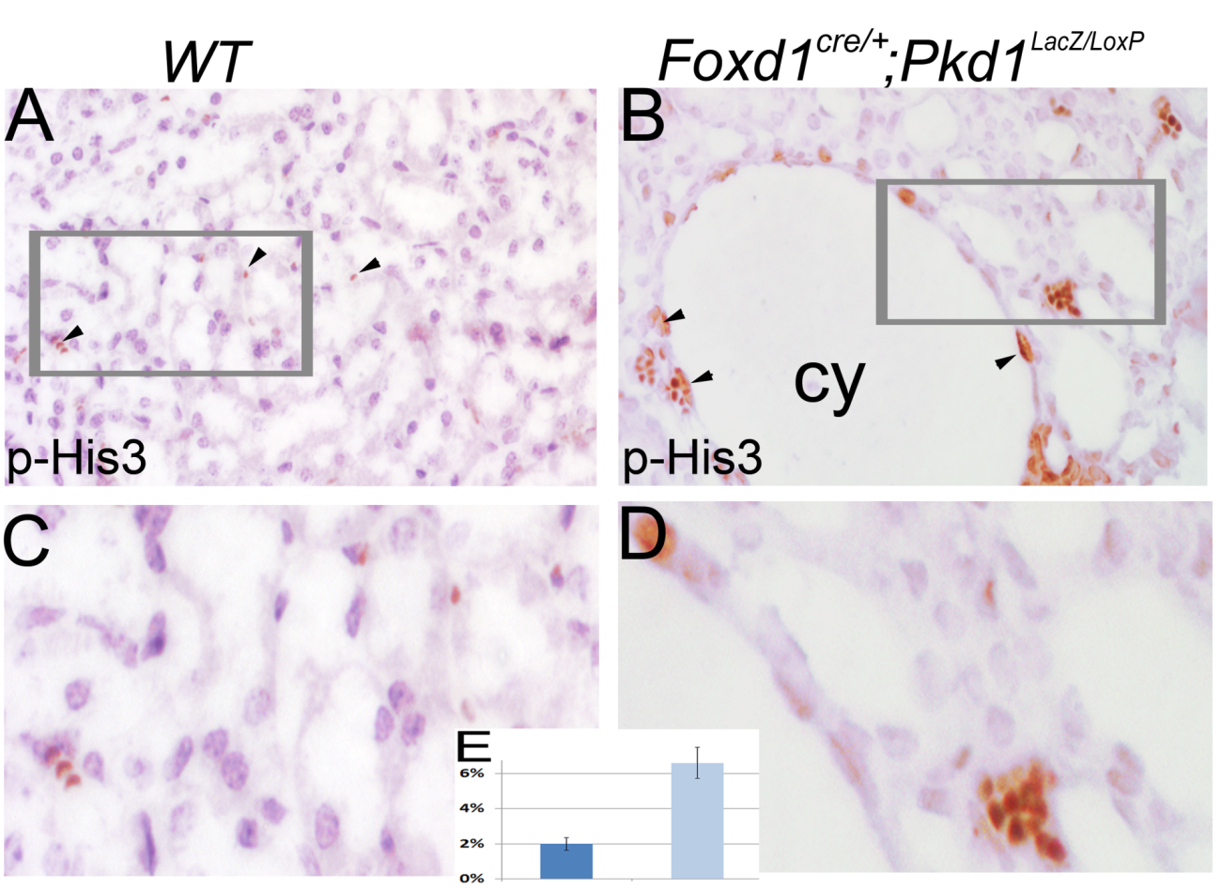
Proliferation-phospho Histone H3
Notes:
As increased proliferation and apoptosis are hallmarks of cellular changes in ADPKD, we therefore performed proliferation and apoptosis assays. Proliferating cells in control adult kidney are very few. By contrast, apoptosis is abundant in mutant.

Slide 27
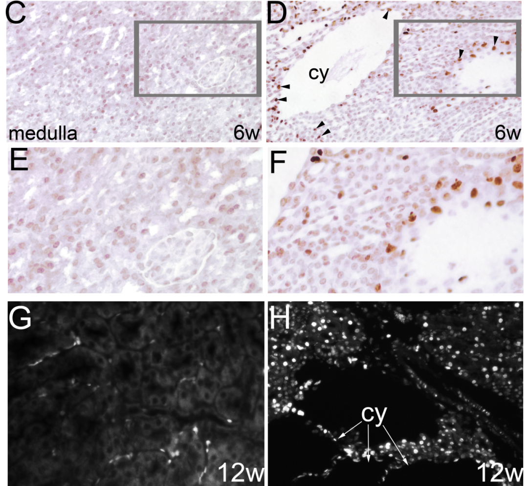
Apoptosis
Notes:
Apoptosis increased as well in the mutant at multiple adult stages

Slide 28
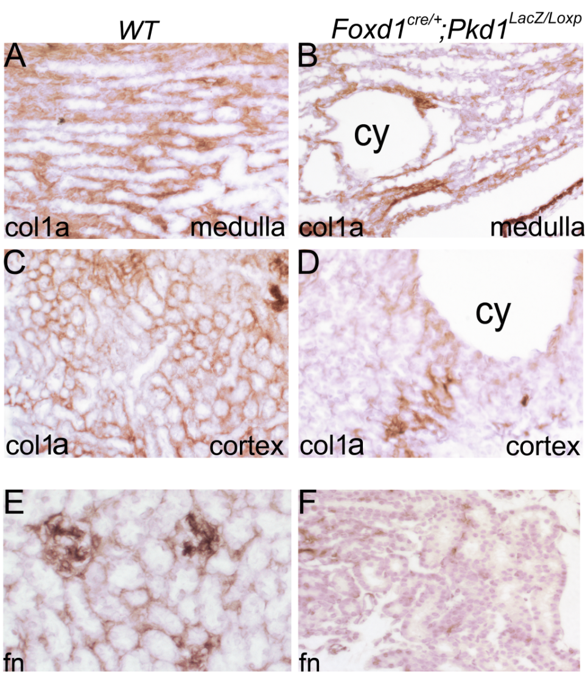
ECM
Decreased ECM components in mutants
Col1a: collagen type 1
fn: fibronectin
Notes:
Stromal cells are responsible for interstitial ECM deposition and maintenance. We detected significant ECM reduction in mutant.

Slide 29
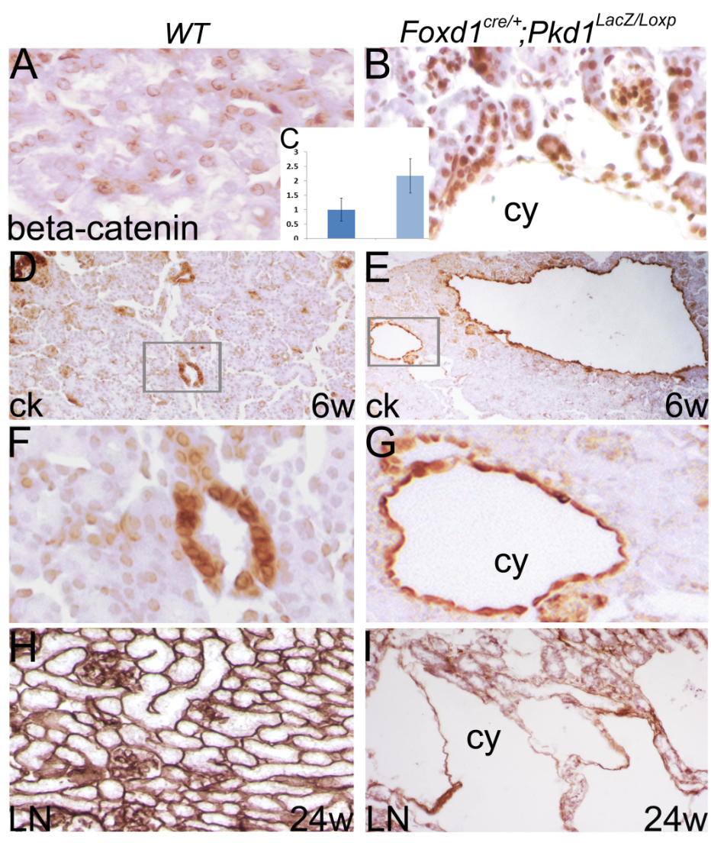
Epithelial changes
-Increased Wnt
- Flat epithelial cells
-Disruption of BM at an advanced stage
Notes:
Changes in the stromal cell compartment elicit epithelial changes, include increased Wnt signaling

Slide 30
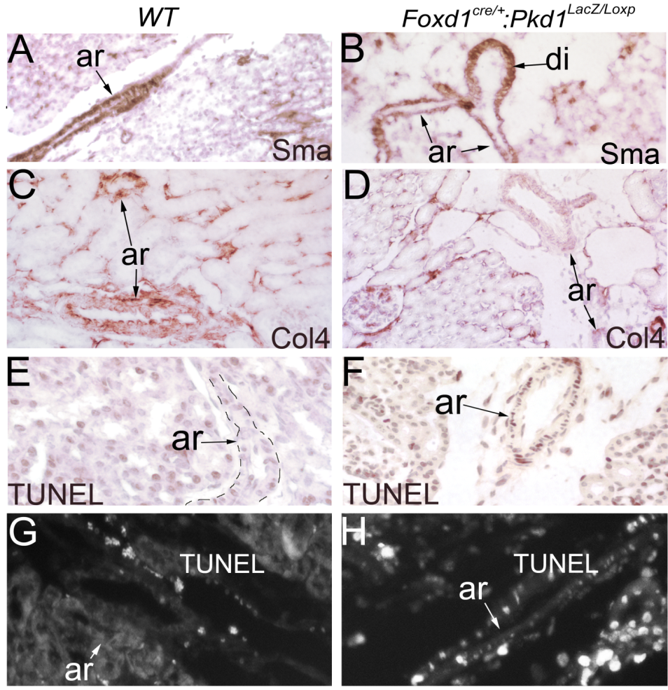
Vascular changes
Notes:
Changes in large vessels: reduced expression of collagen and smooth muscle actin, possible aneurysms, increased apoptosis.

Slide 31
Summary 2
Disruption of Pkd1 in renal stromal cells leads to progressive cystogenesis in adulthood, modeling the clinical course of human ADPKD
Disruption of Pkd1 in renal stromal cells induces a spectrum of cellular and vascular changes seen in ADPKD.
Polycystin deficiency in the stromal compartment might contribute significantly to renal changes of ADPKD.

Slide 32
Acknowledgments
Lillian Goldman Charitable Trust.
NIDDK sponsored Johns Hopkins Polycystic Kidney Disease Research and Clinical Core Center (P30 DK090868).
Notes:
Dr Timothy H. Moran of the Department of Psychiatry and Behavioral Sciences at Johns Hopkins University School of Medicine
Dr Noel Rose at the Department of Pathology at Johns Hopkins University School of Medicine
Dr. Charles Steenbergen at the Deparment of Pathology, Johns Hopkins University School of Medicine

Slide 33
Thanks!

