Slide 1

In vivo bioluminescence, fluorescence, µCT and photoacoustic imaging to noninvasively evaluate pathogenesis, therapeutics and diagnostics in an experimental orthopaedic implant infection
Lloyd S. Miller, M.D., Ph.D.
Johns Hopkins University School of Medicine Department of Dermatology
Division of Infectious Diseases Department of Orthopaedic Surgery

Slide 2
Background
The number of prosthetic joint replacement surgeries performed in the U.S. will increase from 1 million to 4 million per year by 2030.
Prosthetic joint infections occur in ~1% of primary and 3-5% of revisions.
Treatment of these infections involves extensive surgical and medical care, resulting in increased morbidity/mortality and an additional ~$100,000 in medical costs per patient or a national healthcare burden of $1-3 billion annually in the U.S.
The most common etiologic pathogens are staphylococcal species, including MRSA.
A small animal model that uses noninvasive optical imaging may be a valuable system to study the pathogenesis, novel treatments and diagnostic approaches.
Kurtz,S., et al. 2007. Projections of primary and revision hip and knee arthroplasty in the United States from 2005 to 2030. J.Bone Joint Surg.Am. 89:780-785.

Slide 3
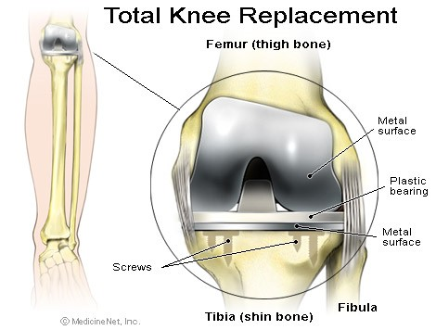
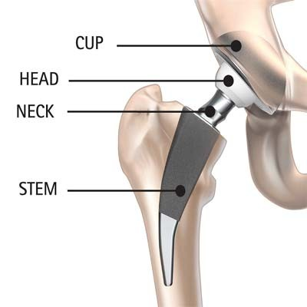
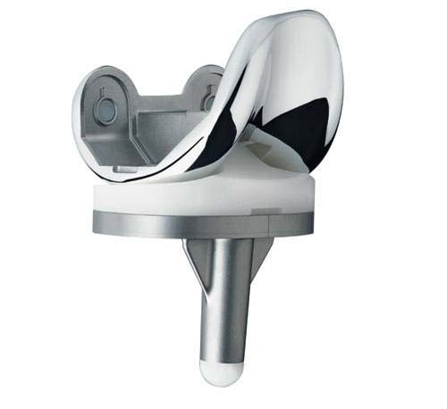
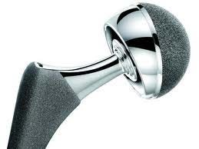
Total Hip Replacement
Total Knee Replacement

Slide 4
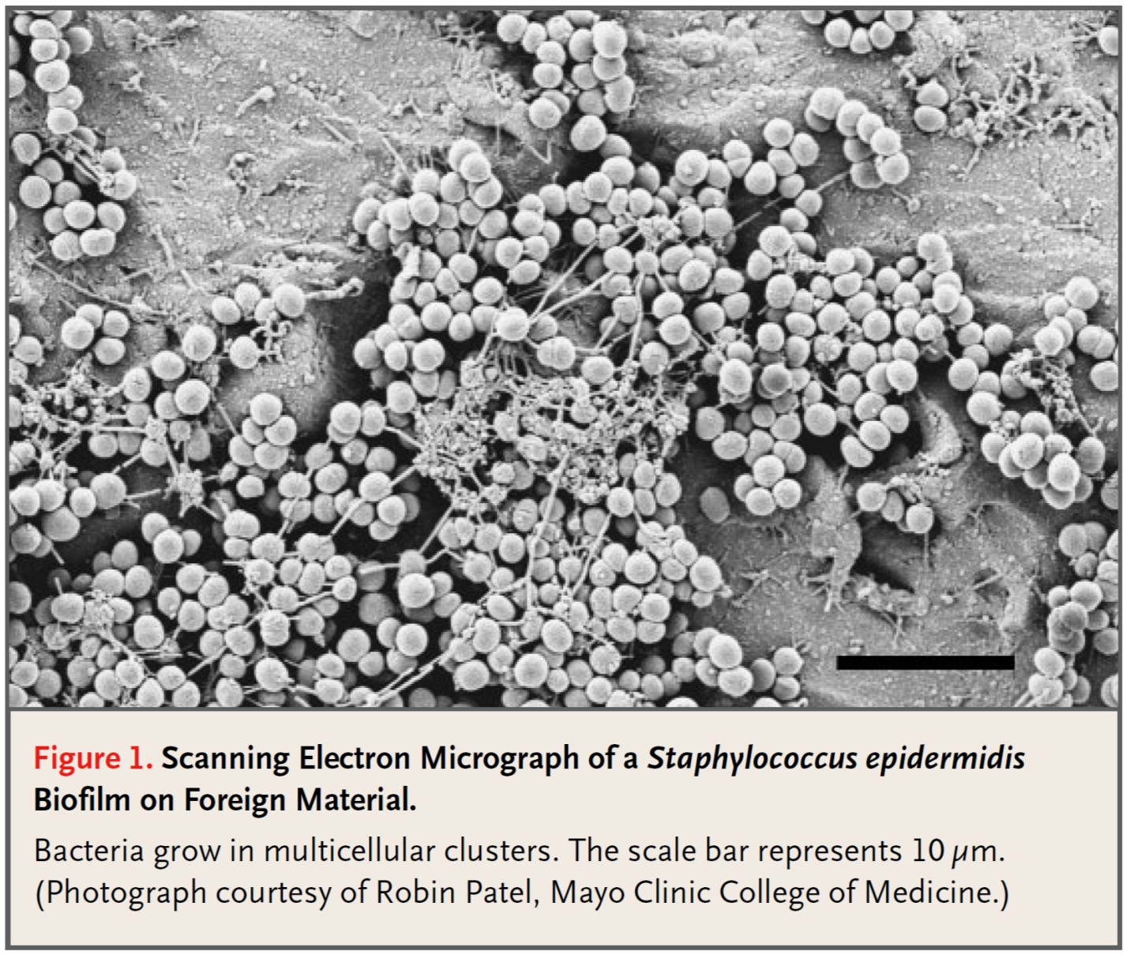
Biofilms form on the surgically implanted materials
Zimmerli, W, et al. 2004. New England Journal of Medicine 351: 1645-1654.

Slide 5
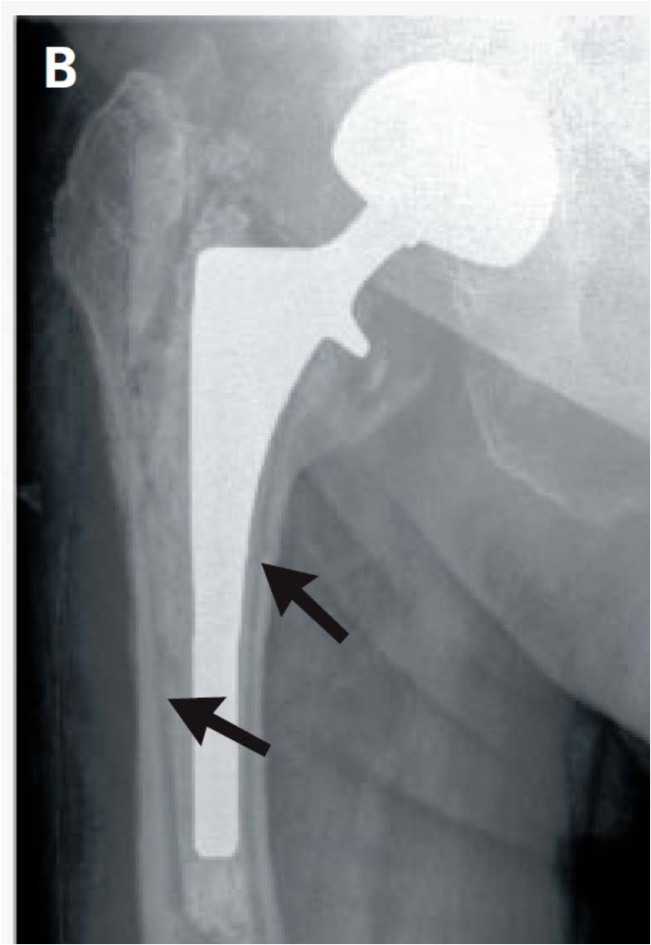
Radiolucent lines seen on X-ray represents periprosthetic osteolysis, which is a hallmark of prosthetic joint infections that leads to implant failure
Darouiche, RO. 2004. New England Journal of Medicine 350: 1422-1429.

Slide 6
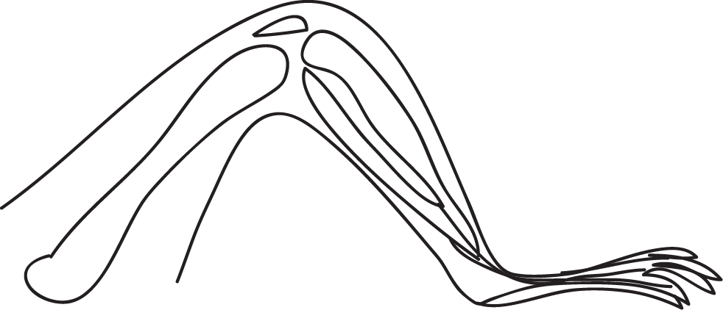
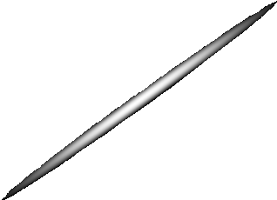
Mouse model of post-arthroplasty joint infection with S. aureus
K-wire
Site of S. aureus inoculation (on pin in knee joint)
Femur

Slide 7
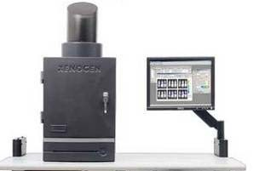
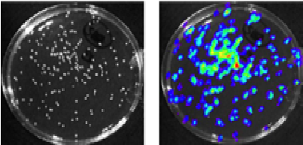

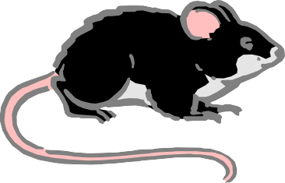
In vivo imaging to measure bacterial burden and neutrophil influx in real-time
(1) Bioluminescent S. aureus
(naturally emits light)
In vivo imaging system was used to detect:
bioluminescence (bacterial burden)
fluorescence (neutrophil infiltration)
(2) Mice are LysEGFP that possess fluorescent neutrophils

Slide 8
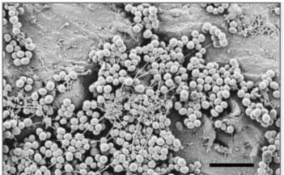


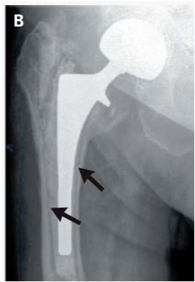
Other endpoints
Biofilm Formation (VP-SEM)
Bacterial CFUs adherent to the implants and within the infected joint tissue
Neutrophil influx (histology and myeloperoxidase (MPO) assays)
Effects of infection on periprosthetic osteolysis (micro-CT imaging)

Slide 9
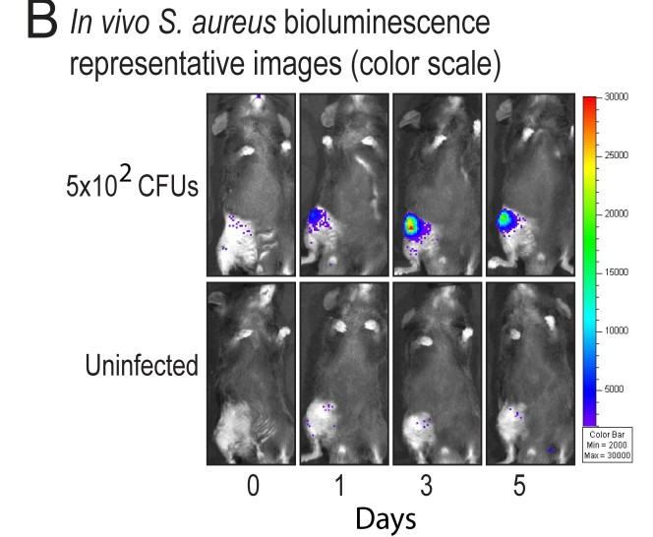
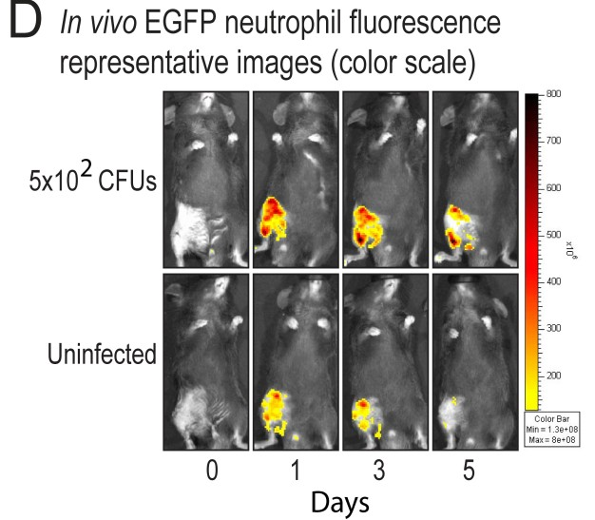
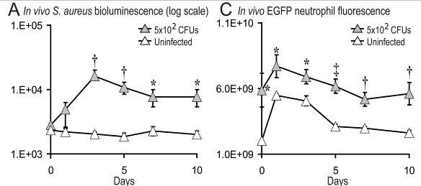
The level of inflammation in the post-operative joints can be measured in real-time by using in vivo fluorescence
imaging of EGFP neutrophil infiltration
Bernthal, NM… Miller, LS. 2010. PLOS ONE 5(9): e12580

Slide 10
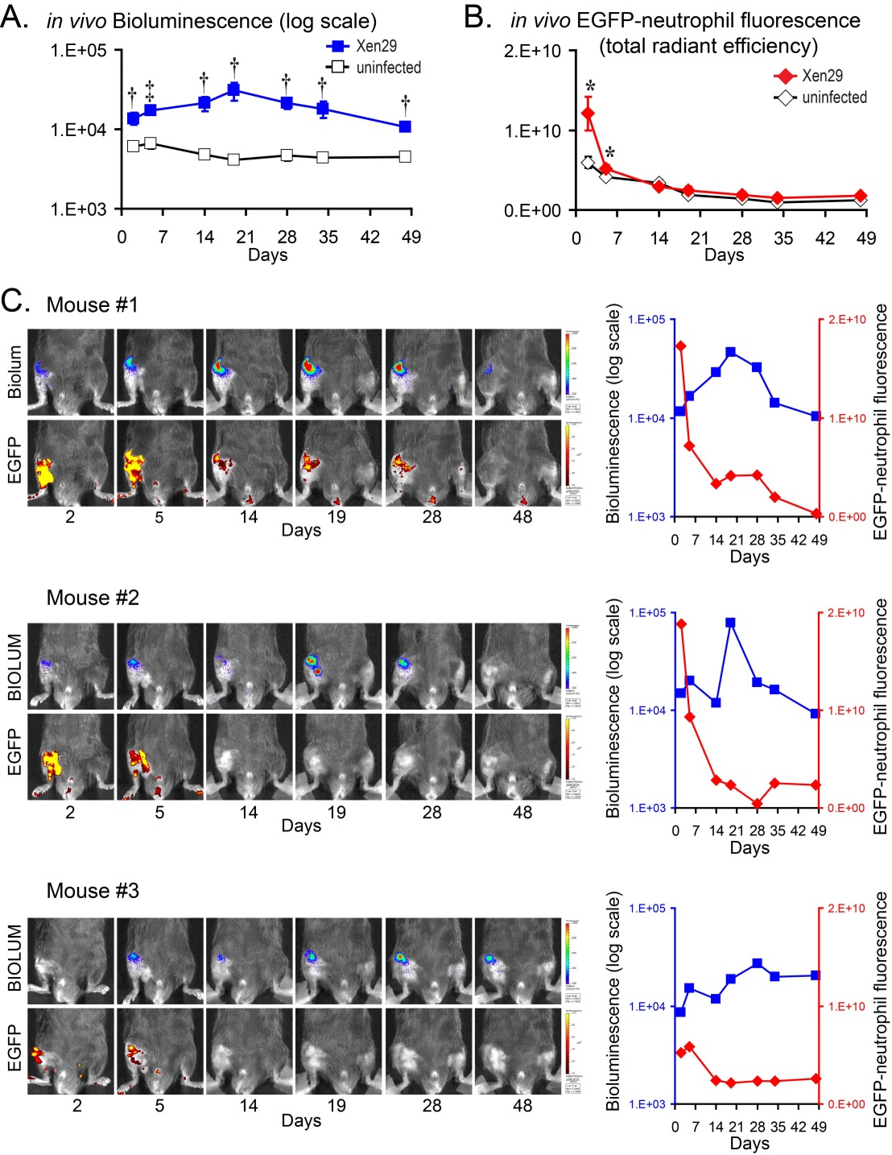
Monitoring differences in individual animals
Niska, JA… Miller, LS. 2012. PLOS ONE 7(10): e47397.

Slide 11
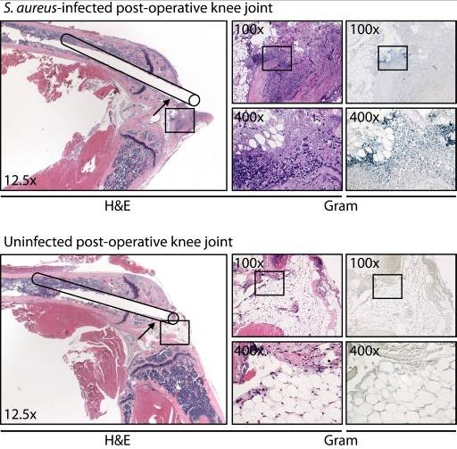
Neutrophils admixed with gram-positive bacteria can be detected in the joint tissue surrounding the implant after
S. aureus infection
H&E
Gram
H&E Gram
Bernthal, NM… Miller, LS. 2010. PLOS ONE 5(9): e12580

Slide 12
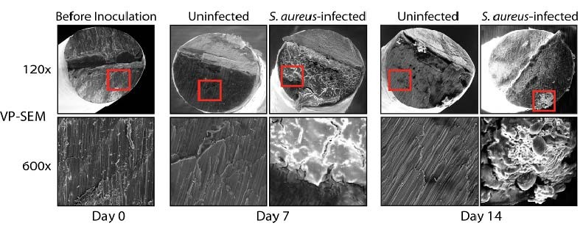


Biofilm formation was readily observed on the metallic implants after post-operative S. aureus infection
Bernthal, NM… Miller, LS. 2010. PLOS ONE 5(9): e12580

Slide 13
What is the optimal S. aureus
bioluminescence strain?

Slide 14
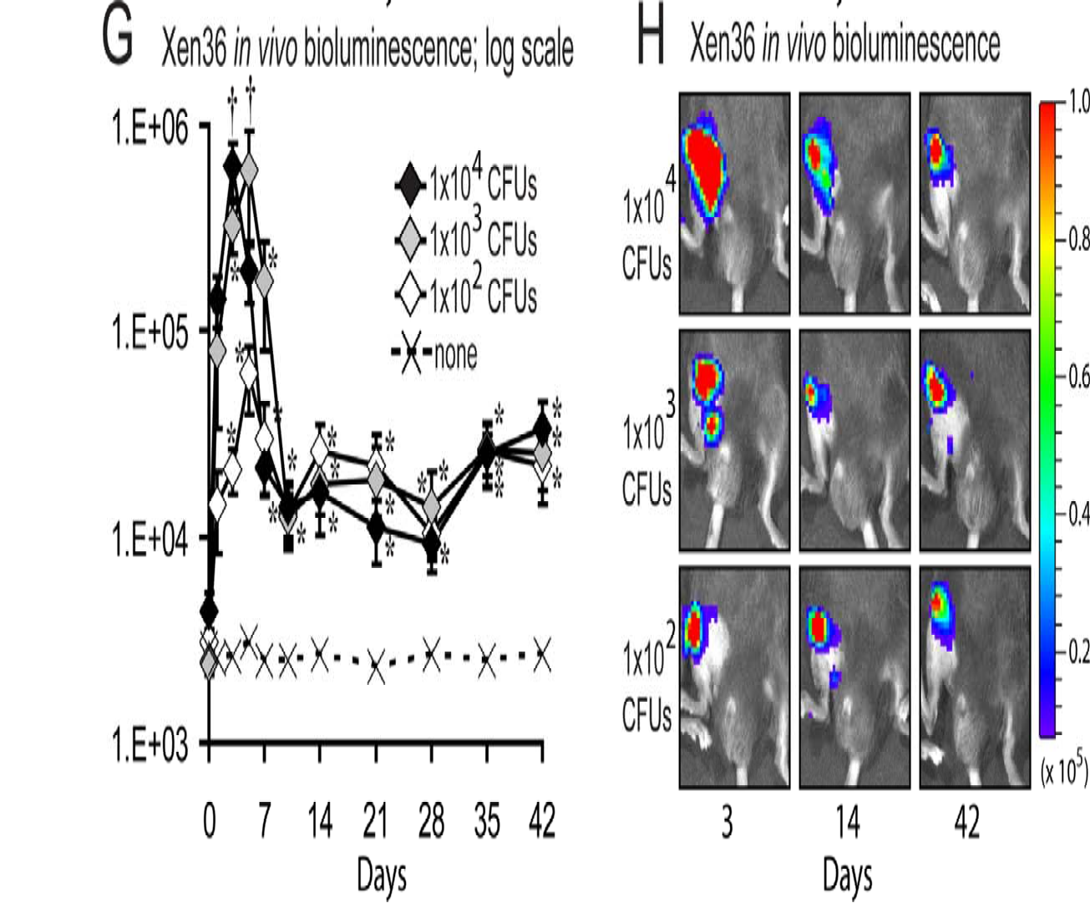
What is the optimal S. aureus bioluminescence strain?
Pribaz, JR… Miller, LS. 2012. Journal of Orthopaedic Research 30: 335-340

Slide 15
Optimal antibiotic therapy

Slide 16
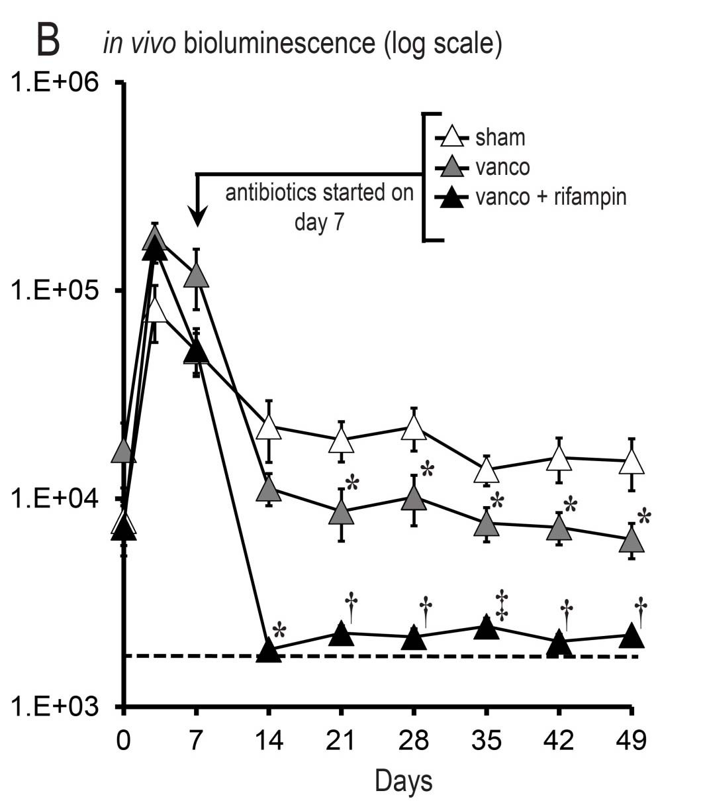
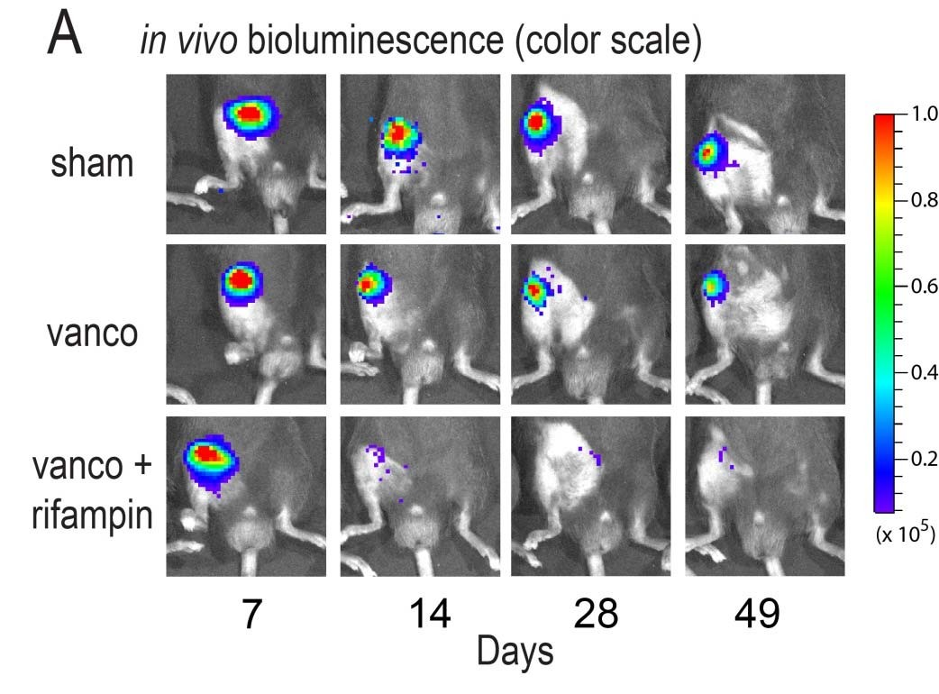
What is the optimal antibiotic therapy against orthopaedic implant infections?
Niska, JA… Miller, LS. 2013. Antimicrobial Agents & Chemotherapy 57(10): 5080-5086

Slide 17
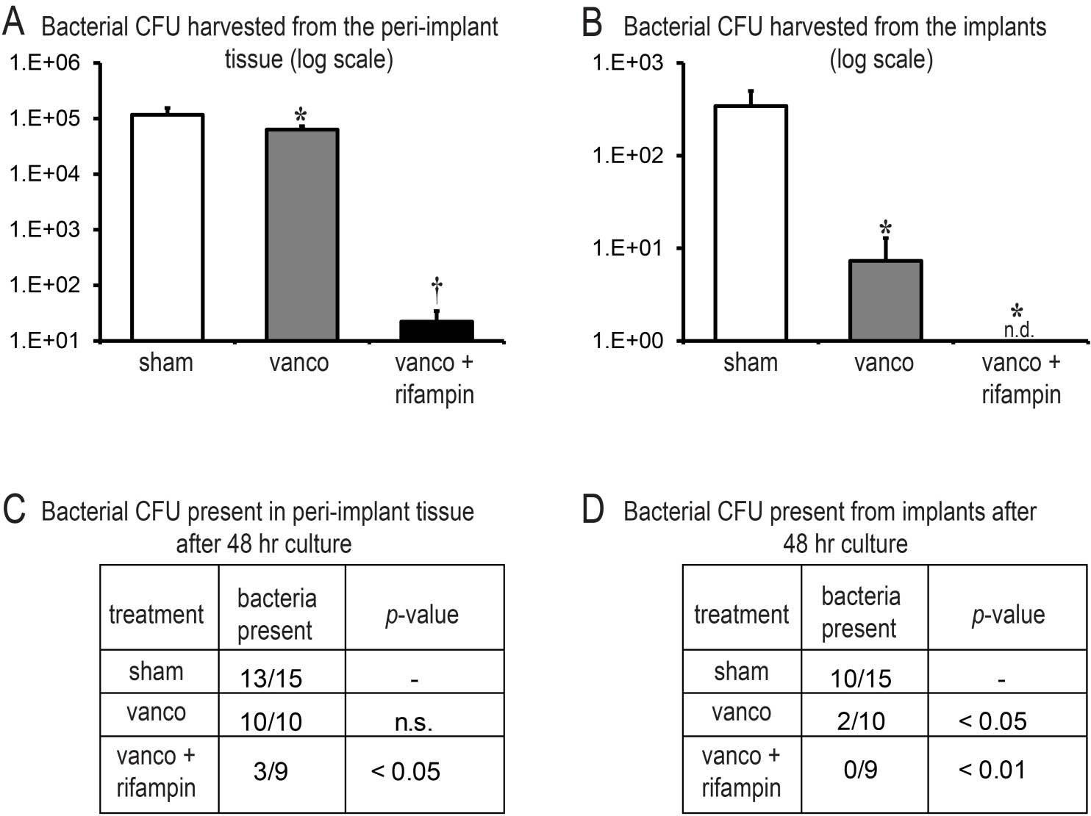
What is the optimal antibiotic therapy against orthopaedic implant infections?
Niska, JA… Miller, LS. 2013. Antimicrobial Agents & Chemotherapy 57(10): 5080-5086

Slide 18
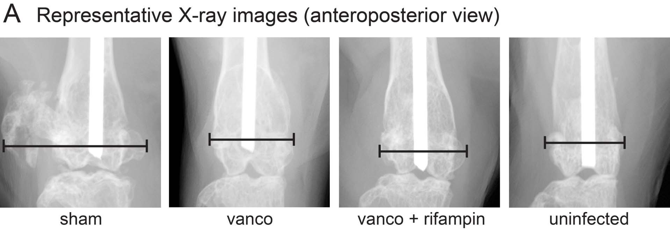
What is the optimal antibiotic therapy against orthopaedic implant infections?
Niska, JA… Miller, LS. 2013. Antimicrobial Agents & Chemotherapy 57(10): 5080-5086

Slide 19
Bone Implant Interface (periprosthetic ostelolysis)

Slide 20
Radiolucent lines seen on X-ray represents periprosthetic osteolysis, which is a hallmark of prosthetic joint infections that leads to implant failure
Darouiche, RO. 2004. New England Journal of Medicine 350: 1422-1429.

Slide 21
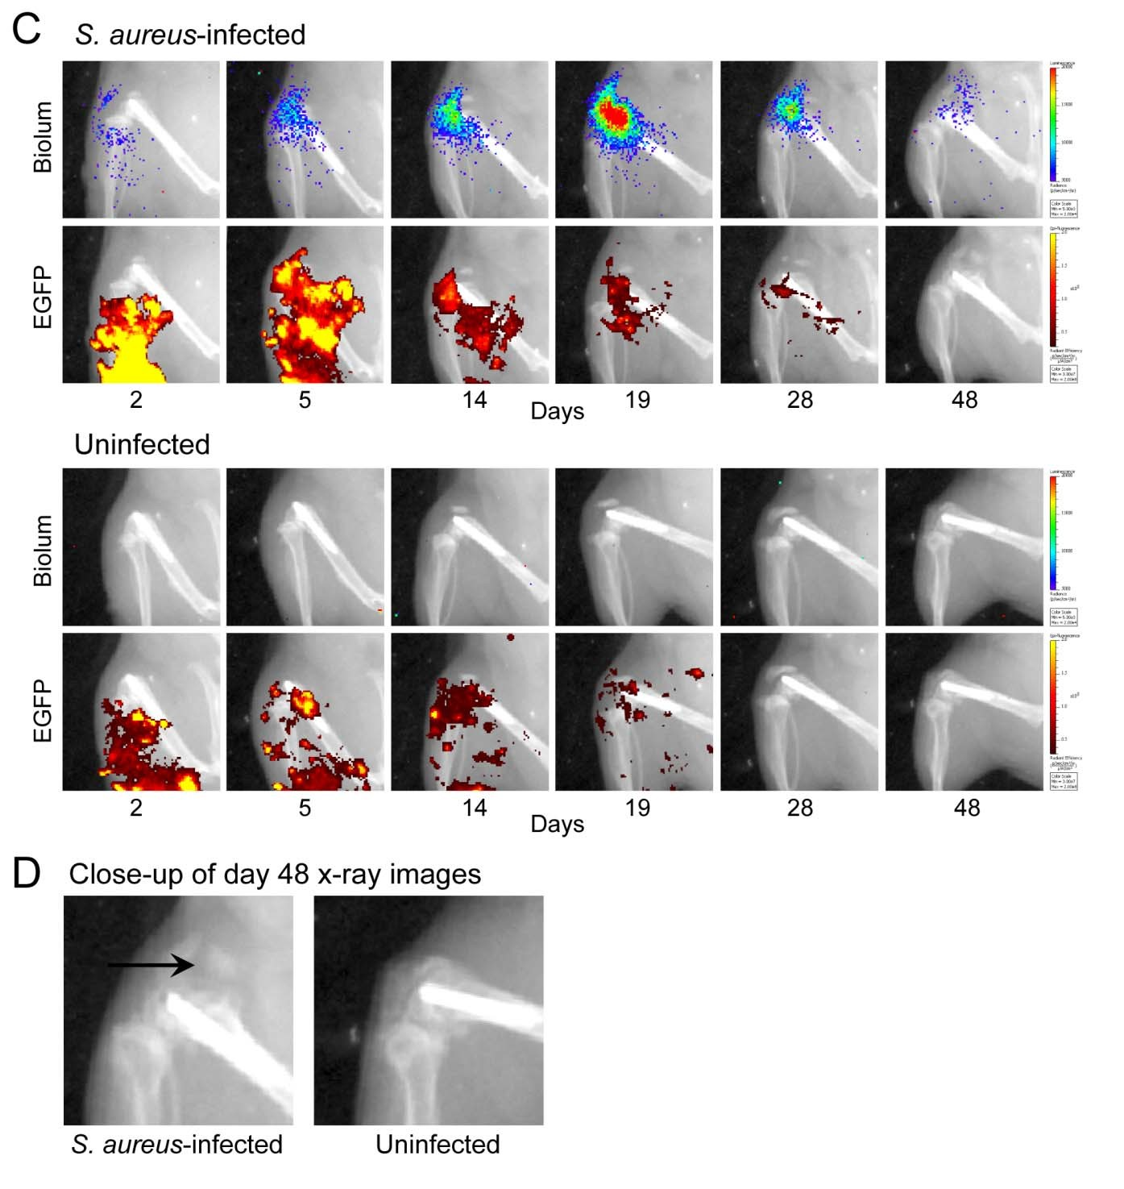
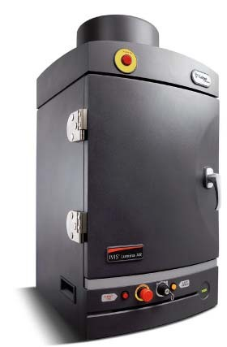
Lumina XR
Niska, JA… Miller, LS. 2012. PLOS ONE 7(10): e47397.

Slide 22
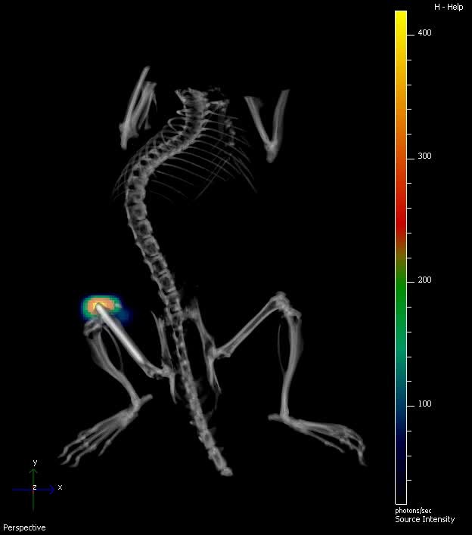
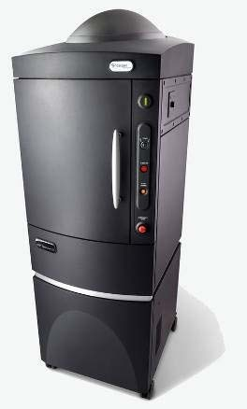
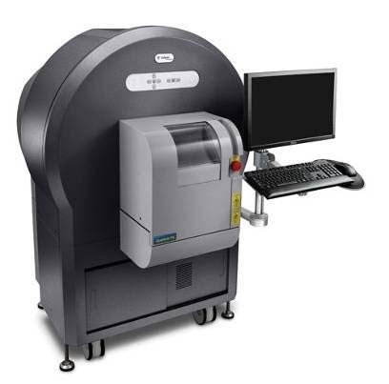
Bioluminescence and μCT overlay to study the bone- implant interface during infection
Spectrum
Quantum FX micro-CT

Slide 23
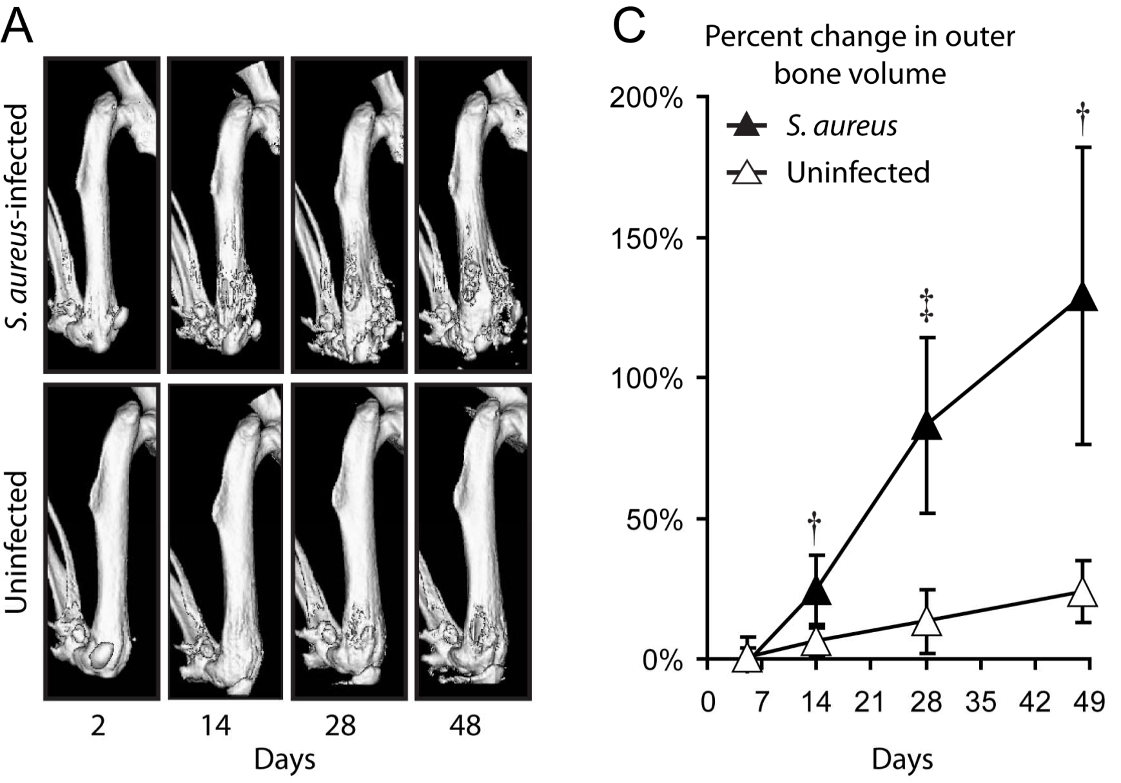
Micro-CT images of the mouse femur post-surgery in the presence and absence of S. aureus infection
Niska, JA… Miller, LS. 2012. PLOS ONE 7(10): e47397.

Slide 24
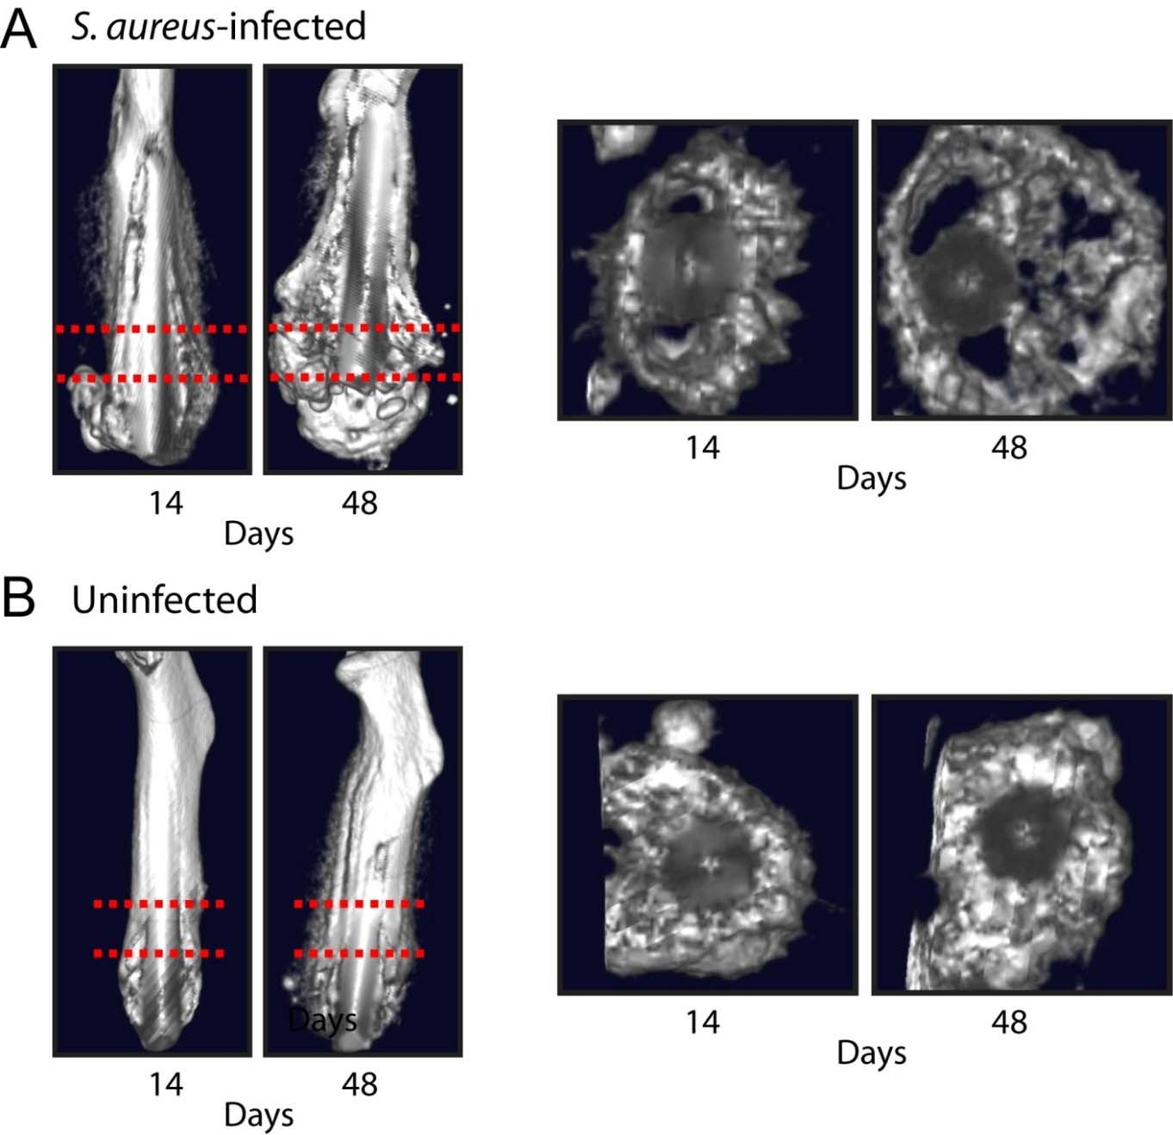
Micro-CT images of the mouse femur post-surgery in the presence and absence of S. aureus infection
Niska, JA… Miller, LS. 2012. PLOS ONE 7(10): e47397.

Slide 25
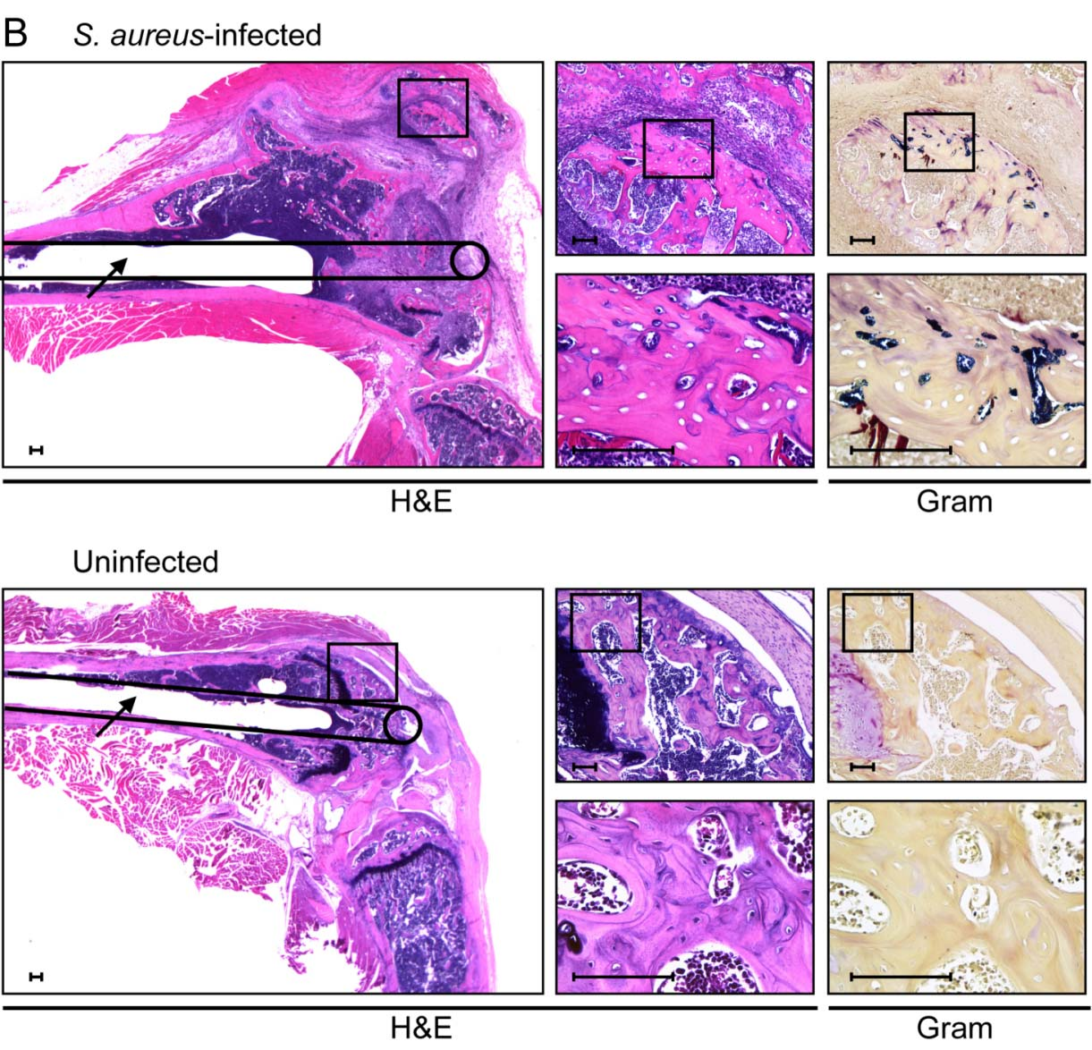
S. aureus infection
Histology at day 48 in the presence and absence of
Niska, JA… Miller, LS. 2012. PLOS ONE 7(10): e47397.

Slide 26
Can photoacoustic imaging be used to diagnose an infection using antibiotic-
ICG fluorescent probes?

Slide 27
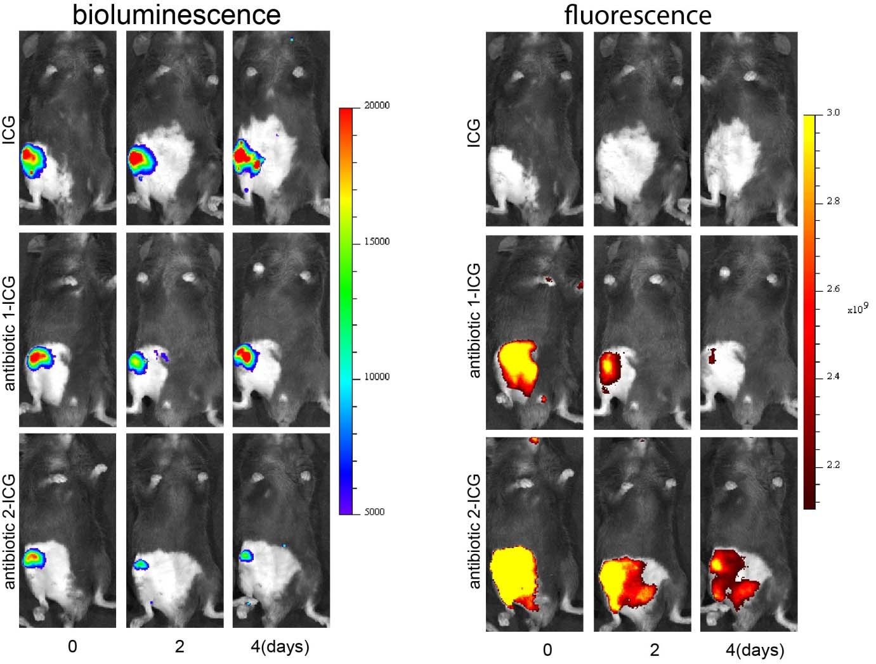
Traditional optical imaging of antibiotic-ICG probes
Two antibiotic-ICG (indocyanine green/cardiogreen) probes were injected 4 hours after inoculation and mice imaged on days 0, 2 and 4.
Unpublished data

Slide 28

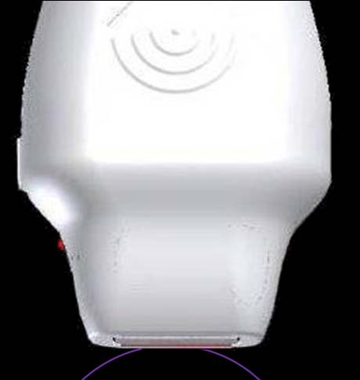





Photoacoustic Imaging
Optical Path
Sound Path
Pulsed Laser Illumination
Acoustic Detection
Optical Absorption
Pressure Waves
Thermo-elastic Expansion

Slide 29

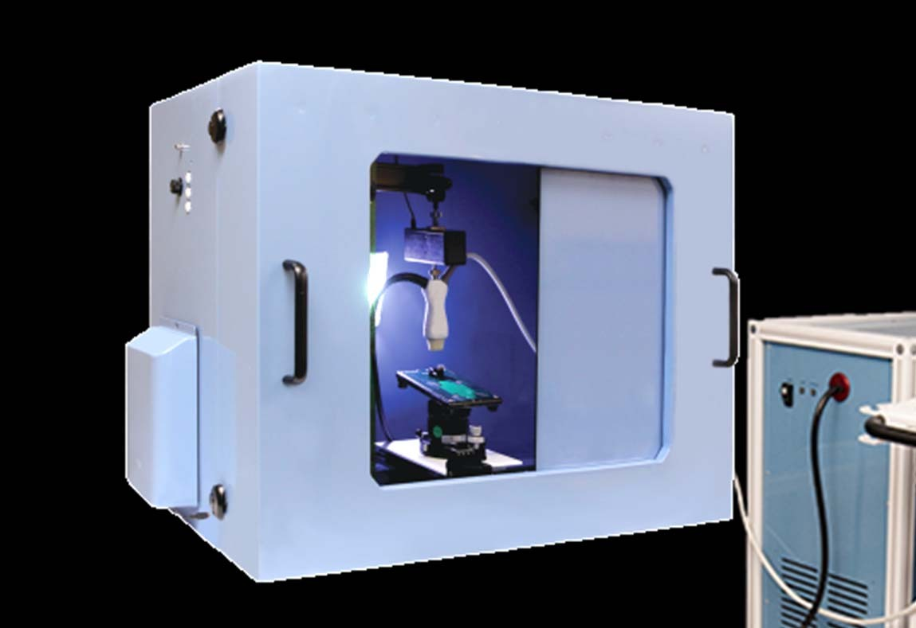
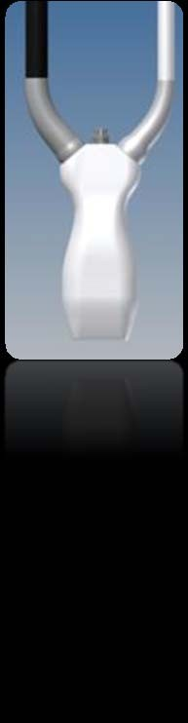

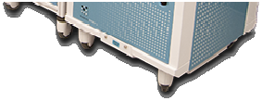
Vevo LAZR System
T
Co-registered real-time PA and US
Doppler and ultrasound contrast modes
2D and 3D
Tunable laser (680 nm – 970)

Slide 30
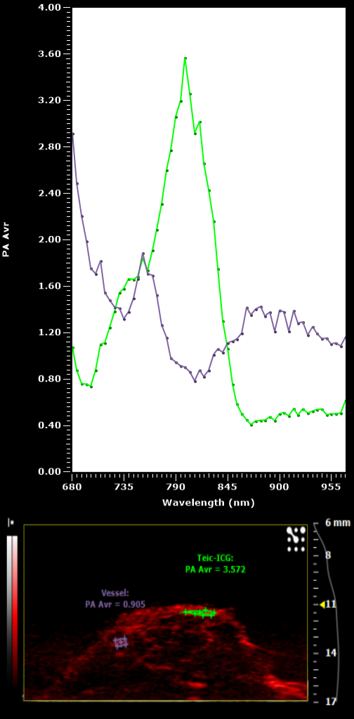
Photoacoustic imaging of S. aureus implant infection
Method of quantification
Wavelength subtraction method used to isolate signal from contrast agents
(Ortho: 800nm – 680nm – 850nm; Intramuscular: 800nm – 680nm – 900nm) based on absorption spectrum of antibiotic-ICG vs blood
ROI drawn to include all tissue within imaging area (hindlimb)
PS (percent signal) = percent of pixels containing signal within the ROI
antibiotic-ICG
Blood

Slide 31
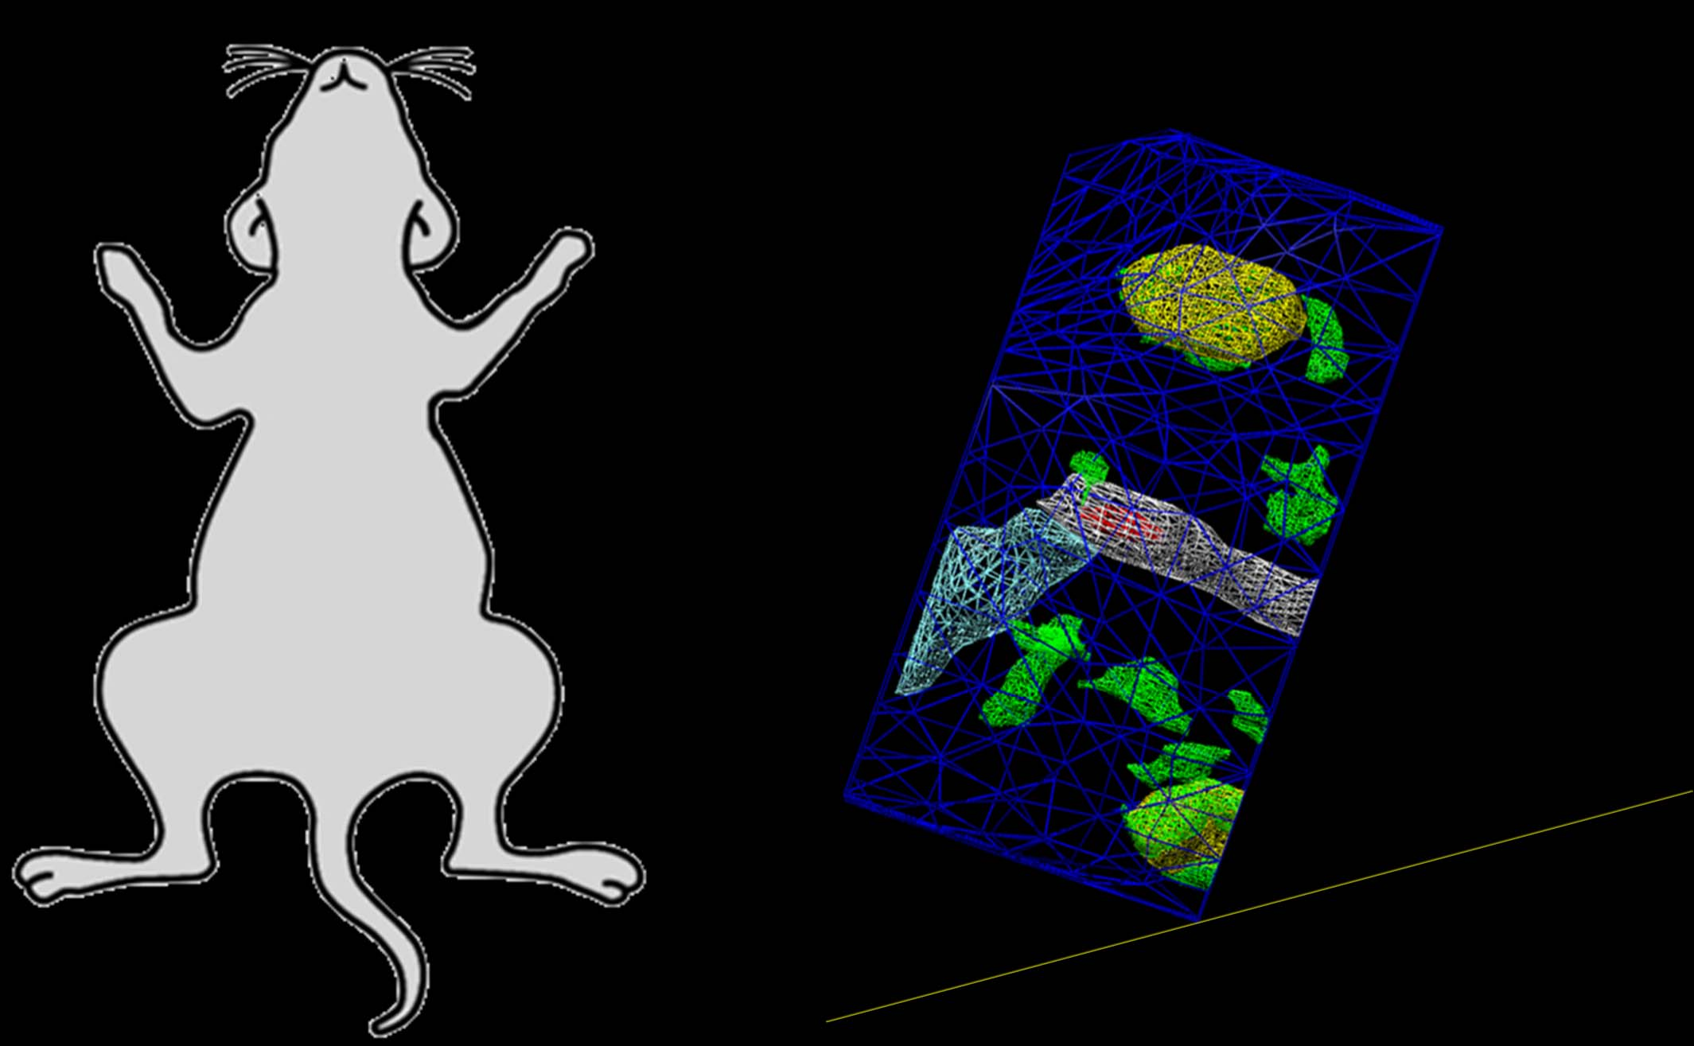
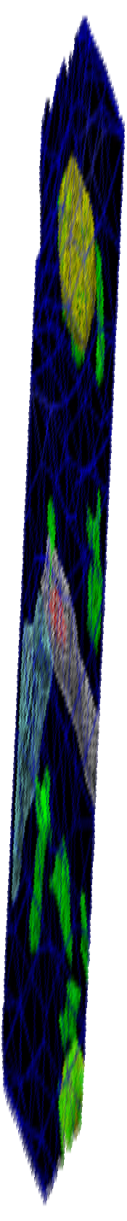
Photoacoustic imaging of S. aureus implant infection
Inguinal lymph node
Femur
Photoacoustic Signal from metal pin
Tibia
Photoacoustic
Signal from
antibiotic-ICG
Popliteal lymph node

Slide 32
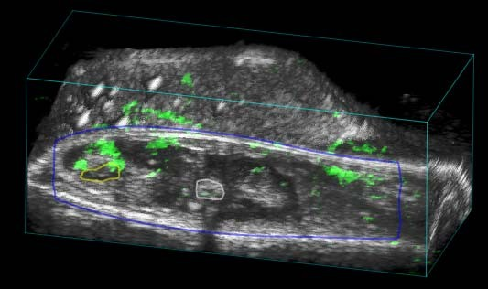
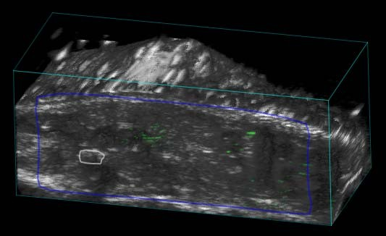
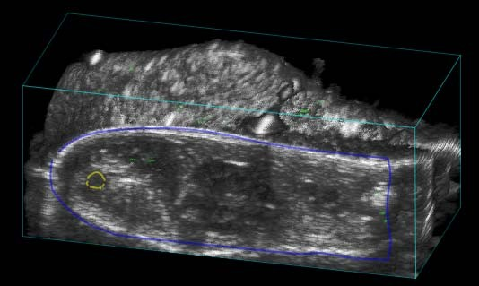
Photoacoustic imaging of S. aureus implant infection
Antibiotic 2-ICG with pin day 4
ICG with pin day 4
Antibiotic 1-ICG with pin day 4

Slide 33
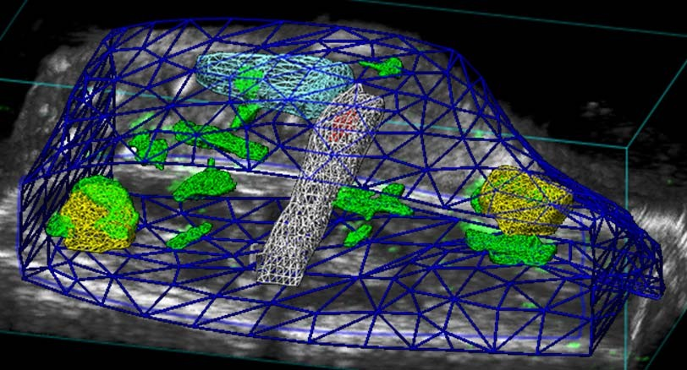
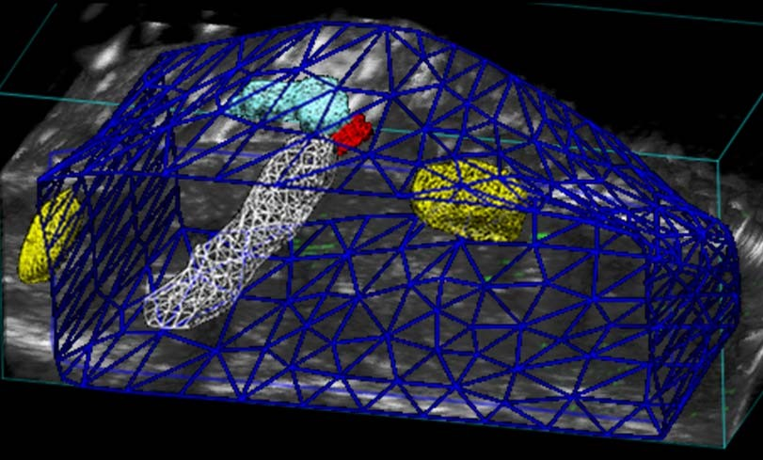
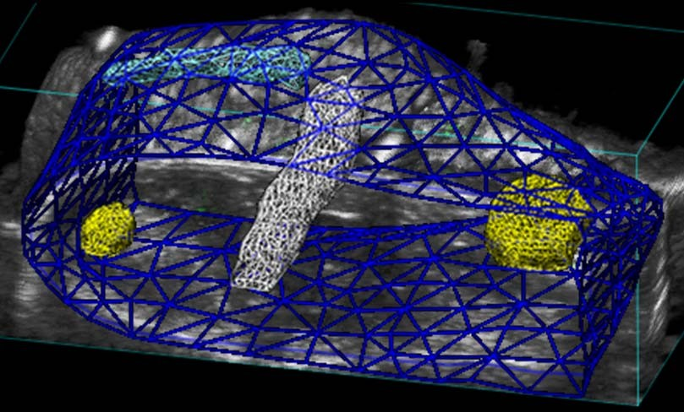
Photoacoustic imaging of S. aureus implant infection
Antibiotic 2-ICG with pin day 4
ICG with pin day 4
Antibiotic 1-ICG with pin day 4

Slide 34
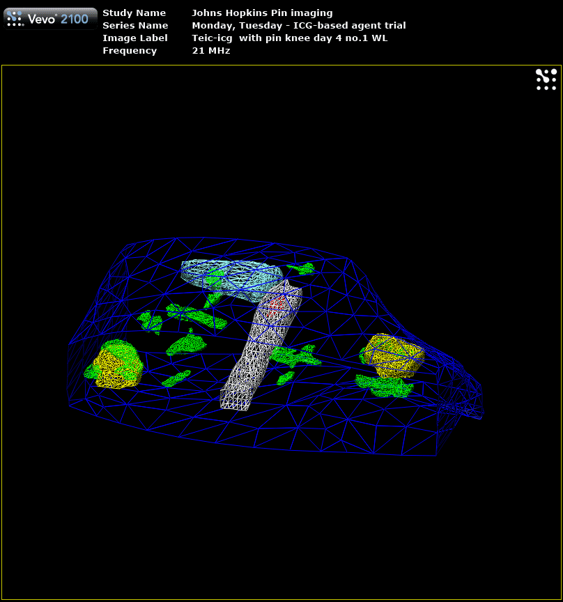
Photoacoustic imaging of S. aureus implant infection
Antibiotic 2-ICG with pin day 4

Slide 35

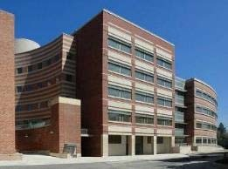

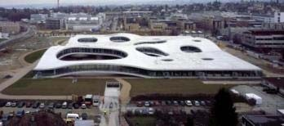








Special Thanks
Elena Dubikovska, PhD Ghyslain Budin, PhD École polytechnique fédérale de Lausanne, Switzerland
Lloyd Miller, MD, PhD Laboratory
Yu Wang
Alyssa Ashbaugh Jonathan Thompson Woo-Shin Kim Jonathan Shahbazian Jared Niska Jonathan Pribaz Alexandra Stavrakis
Johns Hopkins University School of Medicine
Nicholas Bernthal, MD UCLA
Kevin Francis, PhD Brad Taylor, PhD Jeff Meganck, PhD PerkinElmer
Andrew Heinmiller, PhD VisualSonics, Inc.
Gooitzen M van Dam, MD, PhD Jan Maarten van Dijl, PhD University of Groningen, Netherlands
Support

