Slide 1
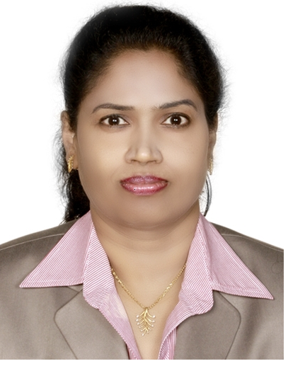
Adult Immunization: challenges and strategies to improve coverage
Presenter
Litty Varghese , RNRM, MSN
Head of Nursing Education
Dept. of Nursing, AHS / SEHA/UAE

Slide 2
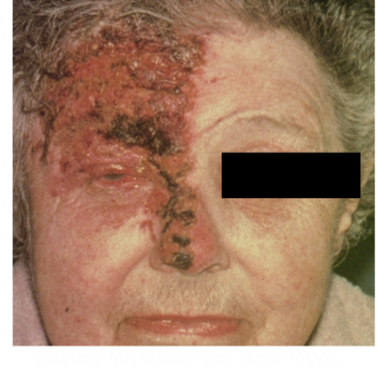

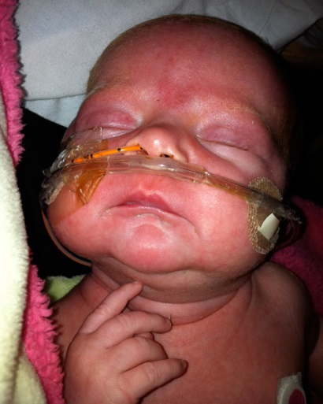
Impact of Vaccine Preventable Diseases in People
Shingles: "I would rather have ten babies than the pain I've endured for the past ten years," says 87-year-old Etta Watson Zukerman of Bethesda, Md., who has lost partial use of her right arm and hand due to nerve damage from postherpetic neuralgia (PHN).
Courtesy MN Oxman San Diego VAMC
Hepatitis B: “One day without warning, my brother, who was 18, woke up with severe pain in his abdomen. When we took him to the doctor, we were told that he and my mother were hepatitis B carriers. My brother passed away a year later. One month after his death, my mother was diagnosed with liver cancer.” Leslie D. Hsu
CDC/ Patricia Walker, M.D., Regions Hospital, MN
Pertussis: Callie stopped breathing again. Family members watched helplessly from behind a glass wall as doctors tried for 45 minutes to revive her. Tragically, Callie could not be saved. She was only 5 weeks old. "We never dreamed we'd lose her," Katie said. "Callie was a more loved, more wanted baby than you'd ever find."
Testimonials from Immunization Action Coalition and CDC websites
CDC website
2
Notes:
INSTRUCTIONS: Persons giving this talk can insert slides or give verbal examples of cases of vaccine preventable illnesses that they have personal experience with. These are examples on the Centers for Disease Control and Prevention website and also the Immunization Action Coalition at immunize.org.
Speakers notes:
These are some personal examples of the impact of illness from some of the vaccine preventable illnesses that I mentioned. [read quotes from slide.]
See additional optional slides for other stories from patients with a vaccine preventable illness.

Slide 3

Meet Dr. William Cochran:
A Pediatric Gastroenterologist
“A Doctor’s Personal Experience with Whooping Cough”
Dr. Cochrane came down with a severe cough where he could not catch his breath and would even pass out.
He coughed so long and hard that he cracked several ribs.
He learned that he had pertussis or “whooping cough”
It took him three months to recover.
“Anyone – doctor, parent, grandparent, caregiver, who comes into contact with infants should be sure they are up to date on their immunizations to spare those too young to be protected through vaccination .”
For Dr. Cochrane’s full story, visit:
http://www.nfid.org/real-stories-real-people/cochran-pertussis.html
Notes:
(Note to speaker: click on the link to familiarize yourself with Dr. Chochrane’s full story)

Slide 4
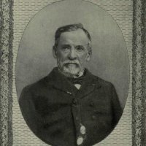
“When meditating over a disease, I never think of finding a remedy for it,
but, instead, a means of prevention.”
Louis Pasteur
Notes:
Louis Pasteur was a French chemist and microbiologist renowned for his discoveries of the principles of vaccination, microbial fermentation and pasteurization

Slide 5
Learning Objectives
At the end of this presentation, the participants will be Able to:
Discuss the importance of Adult vaccination
Brief Adult immunization coverage rates
Discuss HAAD adult immunization practice standards
Brief Barriers and opportunities in adult immunization
Notes:
In this presentation, I will describe the burden of vaccine-preventable diseases in the United States, the adult immunization schedule as recommended by the Advisory Committee on Immunization Practices (ACIP), current low immunization coverage rates among adults, and barriers and opportunities to improving adult immunizations. I will discuss the standards for adult immunization practice (“standards”) that was published in the Public Health Reports in February 2014. Then I will identify adult immunization priorities and strategies by health departments to improve adult immunizations. These priorities and strategies were recently developed by the National Adult Immunization Coordinators’ Partnership.

Slide 6

Ten Great Public Health Achievements 1900 - 1991
Vaccination
Motor vehicle safety
Safer workplaces
Control of infectious diseases
Decline in deaths from coronary heart disease and stroke
Safer and healthier foods
Healthier mothers and babies
Family planning
Fluoridation of drinking water
Recognition of tobacco use as a health hazard
Immunization:
  Saved more lives in the last 50 years than any other health intervention
  Immunization is the single most cost-effective health investment, making it the cornerstone of efforts to promote health²
MMWR, December 24, 1999
2. Canadian Coalition for Immunization Awareness & Promotion. 2005
Notes:
Mar 27, 2014 - India has been certified polio-free by the World Health Organization
The country was once considered the most complex challenge to achieving global polio eradication

Slide 7
Introduction
As the UAE grows in economic prosperity and in providing quality care, there shall be greater stress on the two aspects of good quality health care.
Provision of appropriate, evidence-based care for acute illnesses,
emphasis on preventive care.

Slide 8
Background
Vaccines are considered as one of the greatest public health achievements of the last century for their role in
  Eradicating smallpox
  Controlling polio, measles, mumps, rubella and other infectious diseases
Despite their effectiveness in preventing and eradicating disease, substantial gaps in vaccine uptake persist
Good News – Vaccination rates for young children are high
Bad News – Vaccination rates remain well below established Healthy People 2020 targets for many vaccines recommended for adults.
Understanding why our patients respond with “No thanks!” rather than “Of course!” when we offer vaccinations and effectively communicating the risks and benefits of vaccination are important parts of this effort.
Notes:
Reference for final Bullet –
Brown MT, Lora AM, Anderson MC, and Sinsky CA. Resolving patients vaccination uncertainty: Going from “No Thanks! To “Of Course!.” Family Practice Management.2014. www.aafp.org/fpm.

Slide 9
Why adult vaccinations?
Immunity wanes over time.
As we age, we become more susceptible to serious diseases caused by common infections, such as shingles, flu & pneumonia.
This results in otherwise preventable morbidity & mortality.
  Excess hospitalization
  Diminished quality of life (post-herpetic neuralgia)
  Missed work
  Medical complications

Slide 10
Recommended Adult Vaccines
Vaccines are an important part of optimizing health of the vaccinated person, and preventing infections in others
Example: Vaccination against influenza and pertussis reduces the risk in the person vaccinated and also prevent someone from spreading these diseases
Notes:
Vaccines are important for optimizing health, for protecting the person vaccinated, and also preventing the spread of illness to others.
E.g. Vaccination against influenza and pertussis reduces the risk in the person vaccinated and also prevents someone from spreading these diseases.

Slide 11
Vaccination of Pregnant Women: Two-For-One
Influenza vaccination of pregnant women¹
  Reduce risk of influenza illness in pregnant women
  Reduce risk of influenza illness, fevers and influenza hospitalizations in infants during first 6 months of life
  Vaccinate with inactivated flu vaccine (not live vaccine) during pregnancy
Tdap vaccination of pregnant women
  Vaccinate in 3rd trimester to transfer antibody to infant prior to birth
  Prevents pertussis in mom and protects infant
    Tdap vaccination during pregnancy estimated to be 93% effective in preventing pertussis in infants <4 months old²
Pregnant women should NOT receive any live vaccines (e.g. live influenza vaccine, MMR, varicella or shingles vaccines)
CDC. Prevention and Control of Seasonal Influenza: Recommendations of the ACIP – U.S., 2014-15 Influenza Season. MMWR 2014; 63(32); 691-697.
Dabrera G, et al. Case-control study to estimate the effectiveness of maternal pertussis vaccination in protecting newborn infants in England and Wales, 2012-2013. Clin Infect Dis. 2015; 60 (3): 333-337.
Notes:
As I mentioned in the prior slide, vaccination of pregnant women is an important way to decrease the risk of illness in the mother and also the infant during the first 6 months of life.
[READ SLIDE ABOVE]

Slide 12
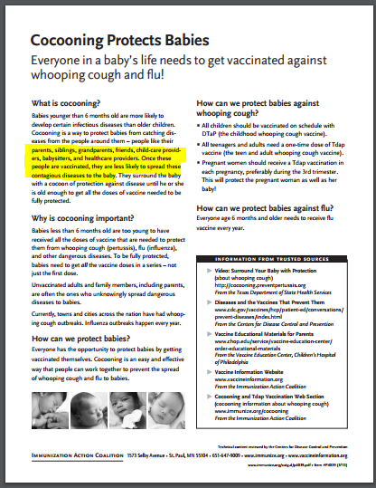

Slide 13
CDC. Non-influenza vaccination coverage among adults: United States, 2012. MMWR Morb Mortal Wkly Rep. 2014;63 (5):95-102.
Vaccination Coverage in Adults*
*NOTE: Children’s vaccination coverage is about 90%.
Vaccine | 2012 Coverage | Health People 2020
Tdap (ages 19-64) | 12.5% (Healthcare workers (26.8%) | −
Herpes zoster | 15.8% | 30%
HPV Women ages 19-26 > 1 Men ages 19-26 > 1 | 29.5% < 3% | −
Pneumococcal Ages 19-64 Age > 65 | 20.1% 62.3% | 60% 90%
Hepatitis B High risk, ages 19-49 Ages 19-59 with diabetes Healthcare professionals | 42% 22.8% 63.8 | 90% − −
Hepatitis A (ages 19-49) | 10.7% | −
Influenza > 6 m of age 65 y of age Pregnant women Healthcare providers | 42.8% 68.6% 47% 72% | 80% 80% 90%
Notes:
Need to Update to 2012 data!

Slide 14
Gaps in Vaccine Utilization and American Healthcare
Financial burden of vaccine-preventable diseases among adults – 10 billion annually
Public health burden is equally heavy
  Annually on average, 50,000 adults die from vaccine-preventable diseases or their complications*
  These figures would be greatly reduced with vaccinations
* National Foundation for Infectious Disease. Facts about immunization. August 2009. Available at: http://www.nfid.org/publications/factsheets/adultfact.pdf
Notes:
Polio and measles could be eliminated from this planet just as smallpox was by the year 1979. However, the recent outbreaks of these two devastating and preventable diseases in areas where they had been previously eradicated, such as parts of Africa and the Middle East, highlight the need for increasing our vaccination rates in order to improve the health of our patients and communities.

Slide 15
Hepatitis B Vaccination (≥3 doses) for
Adults Living with Diabetes, 2010–2013
Coverage rate (%)
2010
2011
2012
2013
2010
2011
2012
2013
Age
Source: National Health Interview Surveys
Notes:
Adults living with diabetes should get the hepatitis B vaccine. How are they doing? Not very well. Younger adults with diabetes are doing better than older adults but, at under 30% coverage, there’s a lot of room for improvement.

Slide 16


Adult Immunization Rates Still Low
2013
2012
2011
2013
2012
2011
2013
2012
2011
2013
2012
2011
Coverage rate (%)
Source: National Health Interview Surveys
: Healthy People 2020 target
Notes:
Even the good news seen in the previous slide is dampened when we compare them to the lack of progress in comparable measures. For example, the increasing trend we’re seeing for HPV vaccination for young women is coupled with the very, very low HPV vaccination coverage for young men. The encouraging news that Tdap coverage for healthcare workers rate is increasing is tempered by their stagnant hepatitis B coverage rate.

Slide 17
Influenza Vaccination Coverage Among Adults
2011-12, 2012-13, and 2013-14 Seasons, United States
Group | 2011-12 (%) | 2012-13 (%) | 2013-14 (%)* | Difference (%)
Persons > 18 yrs | 38.8 | 41.5 | 42.4 | 3.6
Persons 18-49 yrs, all | 28.6 | 31.1 | 32.3 | 3.7
Persons 18-49 yrs, high risk | 36.8 | 39.8 | 38.7 | 1.9
Persons 50-64 yrs | 42.7 | 45.1 | 45.3 | 2.6
Persons ≥ 65 yrs | 64.9 | 66.2 | 65.0 | 0.1
* Estimates of the percentage of people vaccinated are based on interviews conducted beginning September (BRFSS) or October (NIS) 2013 through June 2014 and reported vaccinations from July 2013 through May 2014. For California, BRFSS interview data were only available for September-December 2013 and thus estimates for persons ≥18 years only reflect vaccinations during July-November 2013. For Mississippi, sample size was insufficient from interviews conducted April-June 2014 to estimate vaccinations past the end of February, 2014 for persons ≥18 years.
http://www.cdc.gov/flu/fluvaxview/index.htm
Notes:
Looking at the influenza vaccination coverage rates among adults over a recent 3-year period, we see that there have been small increases among younger adults. But the vaccination rate for adults 65 and older, though they have a higher coverage rate than younger adults, hardly changed over the three influenza seasons.

Slide 18
Reasons for Low Adult Immunization Rates
Adults not aware of vaccines they need
Healthcare providers for adults busy and often unaware
Not all providers stock all vaccines for adults
Adults frequently see multiple providers, so vaccine history recordkeeping difficult
Reimbursement for vaccines confusing, unclear
Notes:
So why are immunization rates for adults so low? These are a several major reasons. One, adults are often not aware of which vaccines they need as adults. Two, Their healthcare providers are busy and have competing priorities. This, coupled with patients often not knowing that they need vaccines and frequently reporting incomplete vaccination history, make providers feel that they are in a difficult position to discuss vaccines routinely with their adult patients. Three, not all providers stock all vaccines that adults need. Four, adult patients see multiple providers because of their need for specialists, insurance coverage, or frequent moves. A consequence of that is that their medical history, specifically immunization history, is often scattered and incomplete. And lastly the reimbursement mechanism for vaccine services can be confusing for providers as well as patients.

Slide 19
Adult vaccination challenges
Immunizing adults is a more complicated undertaking than is immunizing children.
Vaccination recommendations for adults depend on a person's age, occupation, health status, and behavior (e.g., sexual activity and drug use).
This requires physicians and nurses to establish procedures to identify persons who are eligible, often from long lists of qualifying conditions, in contrast to childhood immunization, in which all are offered vaccine unless there are contraindications.
Reference: Plotkins, S. et al, Immunization in the United States. Vaccines 2008:1479-1510.
Notes:
Physicians often question whether it is worthwhile to vaccinate older adults if the desirable immune response cannot be achieved.¹
It should be strongly emphasized that unlike childhood vaccines that frequently prevent clinical illness altogether, most adult vaccines do not prevent illness but lessen the severity of a given infection.²
And are therefore bringing significant value and translate in meaningful gains.
Increasing morbidity & mortality from natural infection translate into an increased burden form individual disease as we age!

Slide 20
Barriers
Organizational
Sociological
Operational
Notes:
We can organize barriers to immunizations to one of three categories - as noted on this slide

Slide 21
Barrier
(Organizational – Competing Demands)
Limited time during office visits to address medical problems and routine health maintenance
Forget (or choose not to discuss) immunizations during sick visits
Unlike childhood vaccinations (based primarily on age and vaccination history), decisions about adult vaccinations often must take into account comorbid medical conditions

Slide 22
Barrier
(Sociological – Low patient health literacy)
Poor communication can contribute to rejection of vaccinations and dissatisfaction with care
Such poor communication often results from a belief by the health professional that vaccine refusal arises from ignorance, which can simply be addressed by persuading or providing more information
Such an approach is counter-productive because it fails to account for the complexity of reasons underpinning vaccine refusal and may even result in a backfire effect
Tailor messages on the basis of particular reasons for declination
Lewandowsky S, Ecker UKH, Seifer CM, Schwarz N, and Cook J. Misinformation and its correction: continued influence and successful debiasing. Psychological Science in the Public Interest. 2012; 13:106-131

Slide 23
What Do We Hear?
What Do We Hear?
Patient | Response
“I can fight infection naturally – with good nutrition and hygiene.” | …and if you get it – there is no effective treatment for measles, mumps, or polio.
“My doctor didn’t recommend it.” | …nursing staff advise, physician then advises (I have had mine!).
“You gave me a flu shot and now I have the flu.” | …use the term “flu” only to describe an influenza infection, not a viral illness causing the common cold. Average patient suffers from 3-4 colds annually, is not unexpected that they might develop symptoms of a cold within weeks of an influenza vaccination – inappropriately attributed to the flu shot.
“It will make me or my child sick.” | In 2010, The Lancet retracted the now infamous 1998 article by Andrew Wakefield that described an erroneous association between MMR (measles, mumps, and rubella) vaccine and autism. Suspicion still abounds.

Slide 24
What Do We Hear?
Patient | Response
“Someone I respect recommended against it.” | A key way patients receive and share antivaccination information is through social media, such as Facebook, Twitter, or blogs. You can use your own social media accounts to offset that content with information favoring immunization. Here are some of the more trustworthy websites: • http://www.immunize.org • http://www.familydoctor.org • http://www.acponline.org • http://www.aap.org • http://www.medlineplus.gov • http://www.cdc.gov/vaccines/hcp/vis/index.html
“It’s a conspiracy.” | Historical unethical research practices and a source of mistrust toward physicians in some minority communities. e.g., Tuskegee experiment
“There is little threat of disease anymore.” | The CDC has a website (http://www.cdc. gov/vaccines/vac-gen/why.htm) aimed at parents, explaining the necessity to continue immunizing against diseases that are close to but not completely eradicated.
Notes:
“There is little threat of disease anymore.” Americans took 61 million trips outside the country in 2009 (almost 30 million overseas), and there were an estimated one billion international tourist arrivals worldwide in 2012.

Slide 25
Barriers
Operational
  Not stocking all recommended vaccines
  Lack of standing orders
  Lack of tracking systems (Immunization registries)
    Leads to under- and over-vaccination
Notes:
Immunization registries provide a way for health care professionals to keep track of vaccinations. At Denver Health, for example, an integrated health system in Colorado, an electronic immunization registry that was initially used only for children was expanded to include adults in 2002. Anytime a vaccine is given, whether in the hospital, at a specialty clinic, or at a primary care office, this information is entered into the registry. This has helped clinicians avoid redundant vaccinations , find immunization history easily, and track immunization rates efficiently. The registry also allows for clinic-specific tracking of immunization rates. All 50 states have developed their own immunization registries. Although most include persons of all ages, the registries are used primarily for children's records. These registries should be expanded to include more data for adults as is happening in Colorado and Washington. This would allow a patient’s data to be accessible even if she moves to another city and would give practices without EMR access to Web-based immunization registry technology.

Slide 26

What are Standards for
Adult Immunization Practice?
All providers, including those who don’t provide vaccine services, have role in ensuring patients up-to-date on vaccines
Call to action for ALL healthcare professionals to:
  Assess immunization status of all patients at every clinical encounter
  Strongly recommend vaccines that patients need
  Administer needed vaccines or refer to a provider who can immunize
  Document vaccines received by patients in state vaccine registries
www.cdc.gov/vaccines/hcp/patient-ed/adults/for-practice/standards/index.html
www.cdc.gov/vaccines/hcp/patient-ed/adults/for-patients/index.html
□ Assess
□ Recommend
□ Administer or Refer
□ Document
Notes:
Again, the National Adult Immunization Coordinators’ Partnership developed Strategies for Health Departments to Increase Adult Immunizations based on the standards fro adult immunization practice.
The standards for adult immunization practice is a call to action for healthcare professionals to ensure that their adult patients are up-to-date on vaccines regardless of whether they provide vaccine services. The standards is made up of four components: (1) assess immunization status of all adult patients at every clinical encounter, (2) strongly recommend vaccines that they need, (3) administer the needed vaccines or refer the patient to a provider who does, and (4) document vaccines received by patients in state vaccine registries or IIS.
Health department programs that see patients are a part of this call to action. There’s clearly an important role that healthcare providers in STD, TB, HIV, mental health, chronic disease, and other clinics and services have in ensuring that their adult patients receive the vaccines they need.

Slide 27
General Principles
Successful dialogue
  Take time to LISTEN
  Solicit and welcome questions
  Keep the language simple and uniform
  Clear cohesive voice of vaccine safety
  Keep the conversation going
Every visit is an opportunity for primary prevention
Trust develops when patients identify both competence and caring in their physician

Slide 28
Organizations Supporting Standards for Adult Immunization Practice
Association of Immunization Managers (AIM)
National Association of County & City Health Officials (NACCHO)
Association of State & Territorial Health Officials (ASTHO)
Centers for Disease Control and Prevention (CDC)
American Academy of Pediatrics (AAP)
American Academy of Physician Assistants (AAPA)
American Academy of Family Physicians (AAFP)
American College of Obstetricians and Gynecologists (ACOG)
American College of Physicians (ACP)
American Pharmacists Association (APhA)
Immunization Action Coalition (IAC)
Infectious Diseases Society of America (IDSA)
National Foundation for Infectious Diseases (NFID)
Others
To add your organization to those supporting the standards, go to…
http://www.izsummitpartners.org/support-adult-standards/
Notes:
The standards have been formally supported by a wide range of organizations, including NACCHO, ASTHO, and [highlight organizations that are most pertinent to your audience]. To formally support the standards, go to: http://www.izsummitpartners.org/support-adult-standards/.

Slide 29
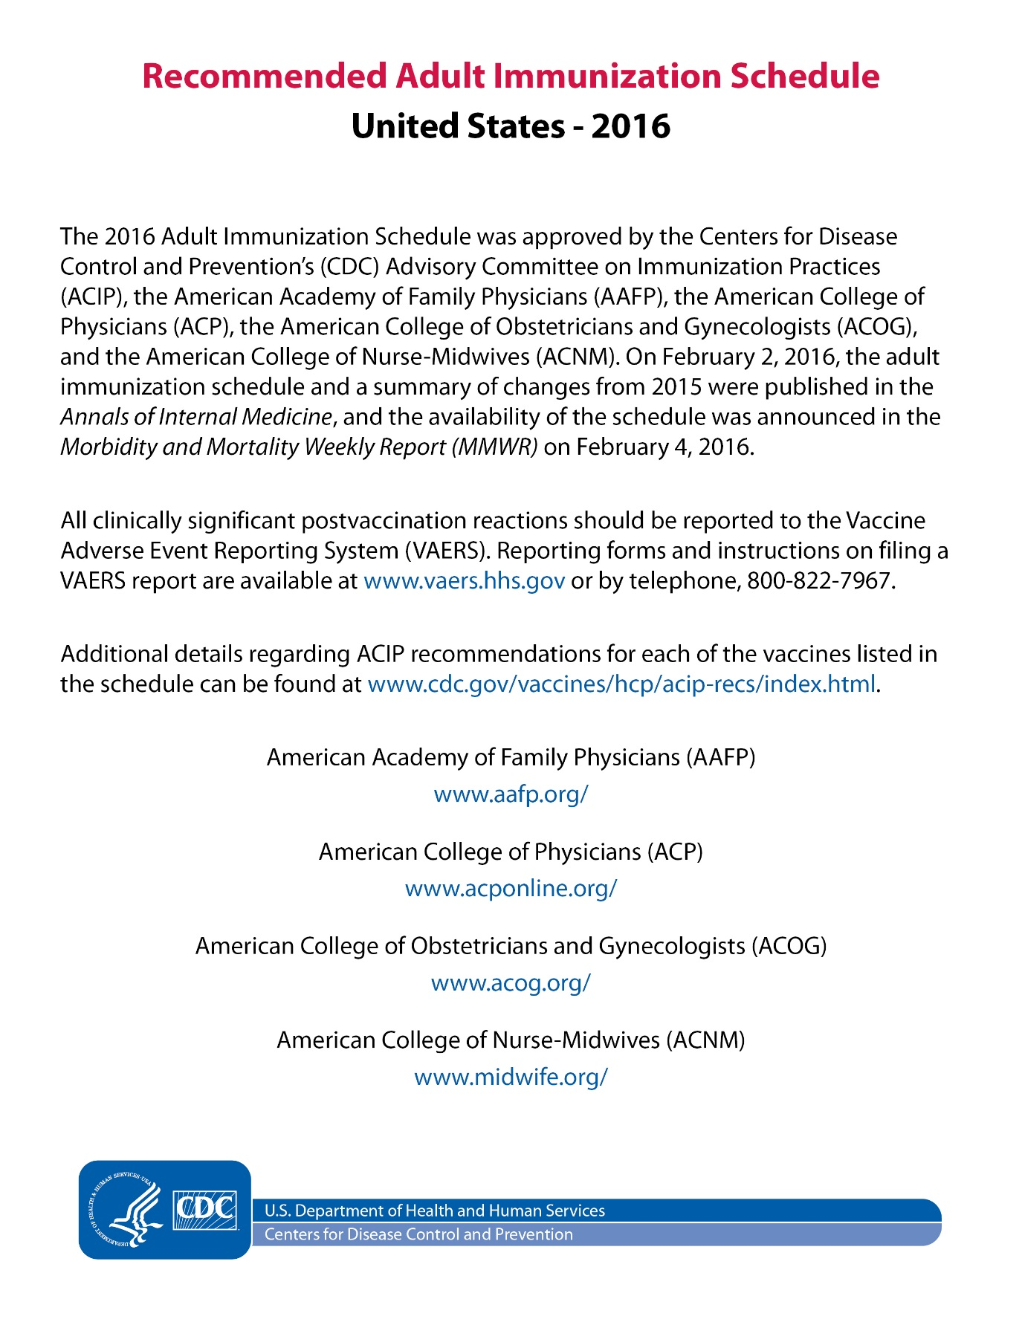

Slide 30
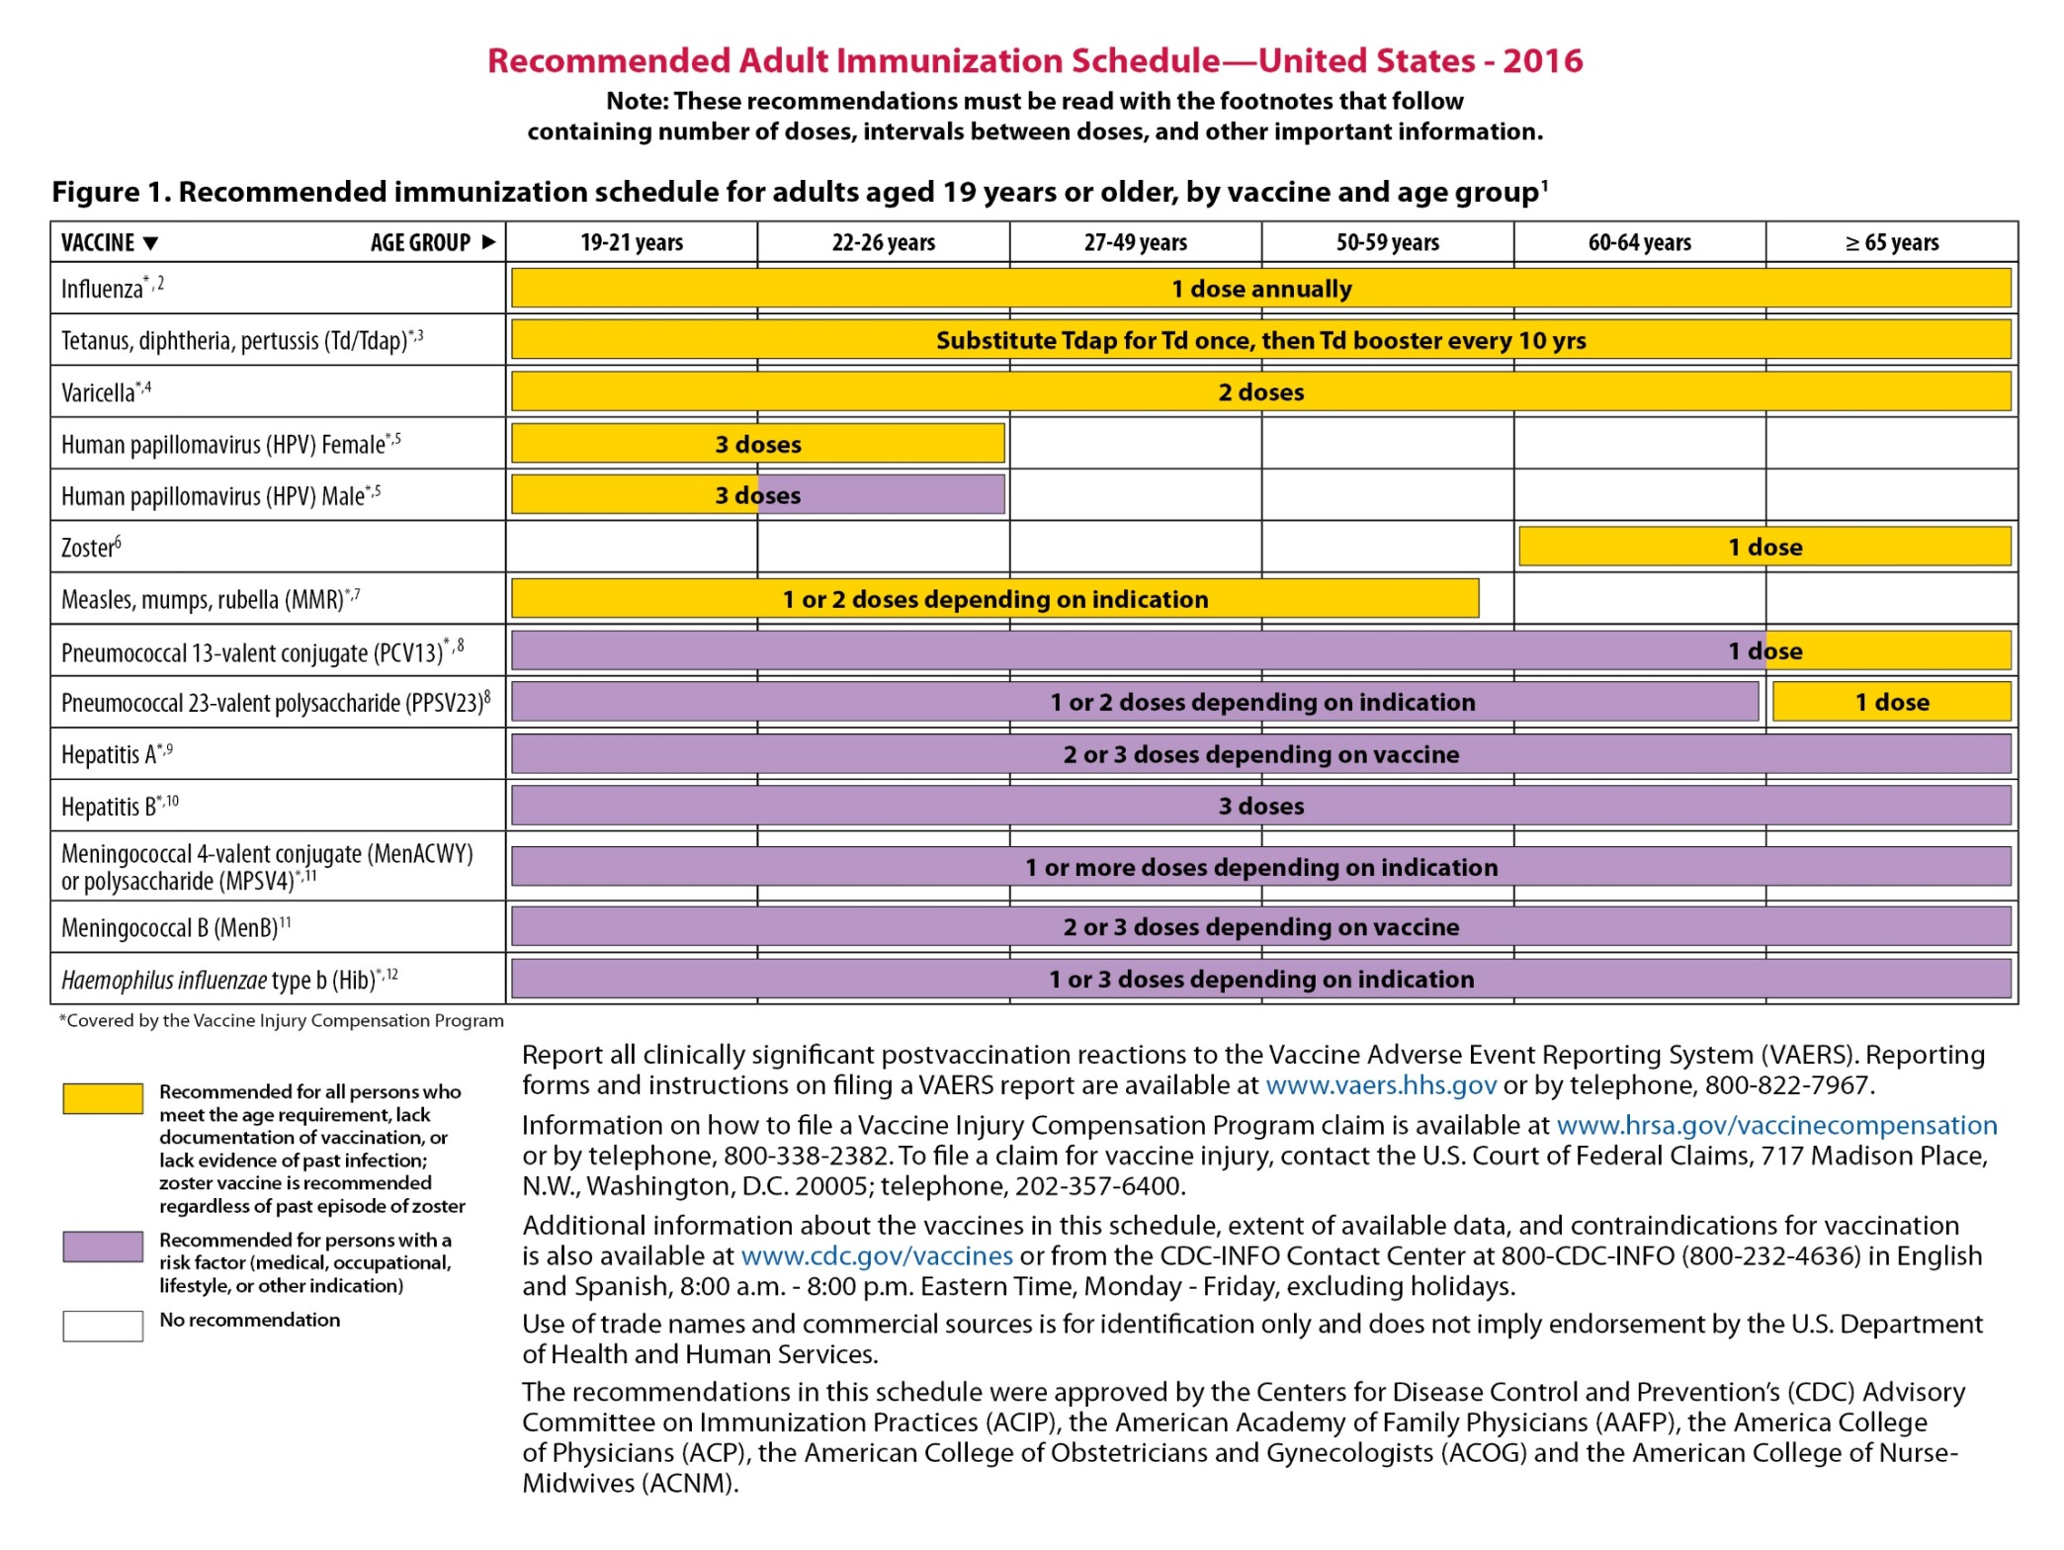

Slide 31
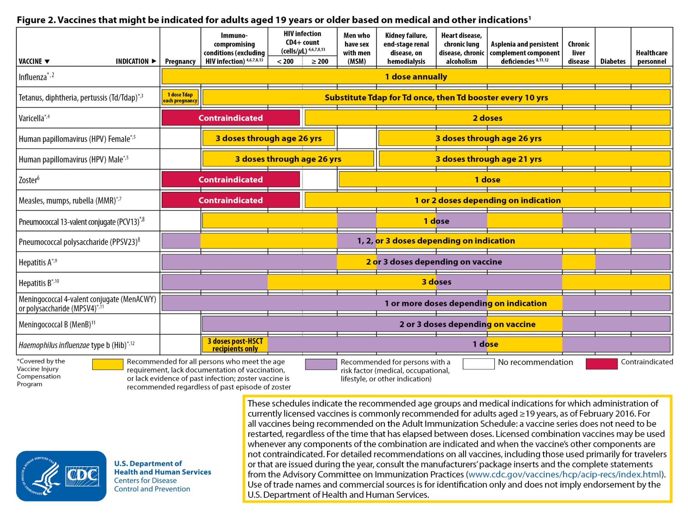

Slide 32
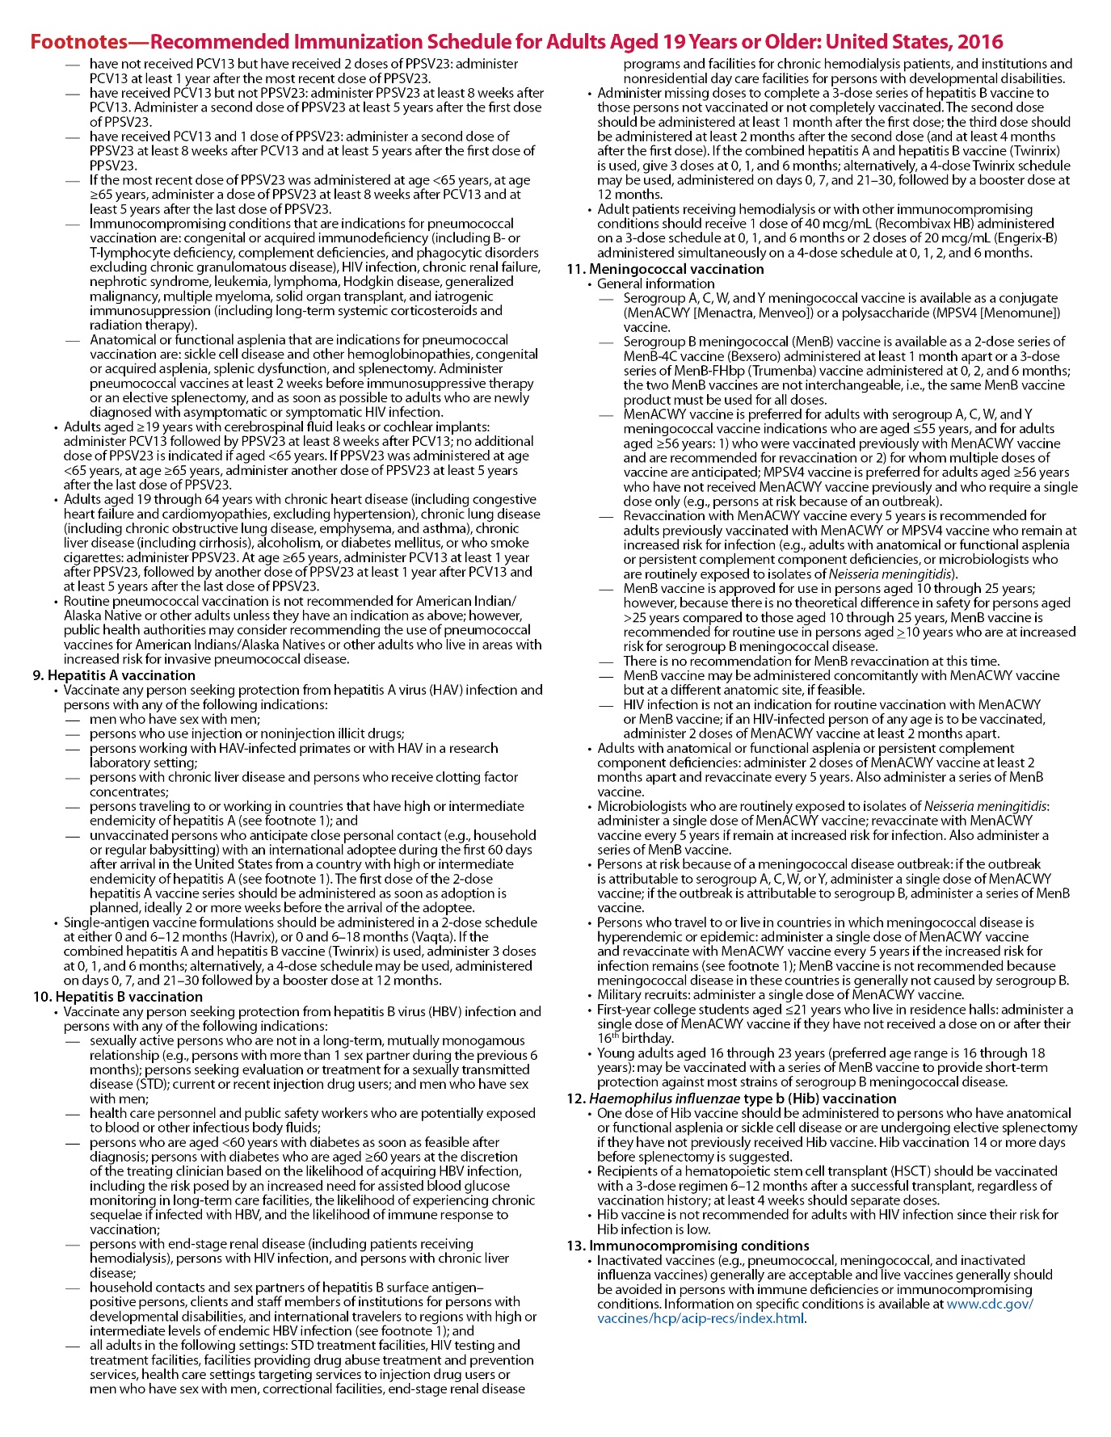

Slide 33
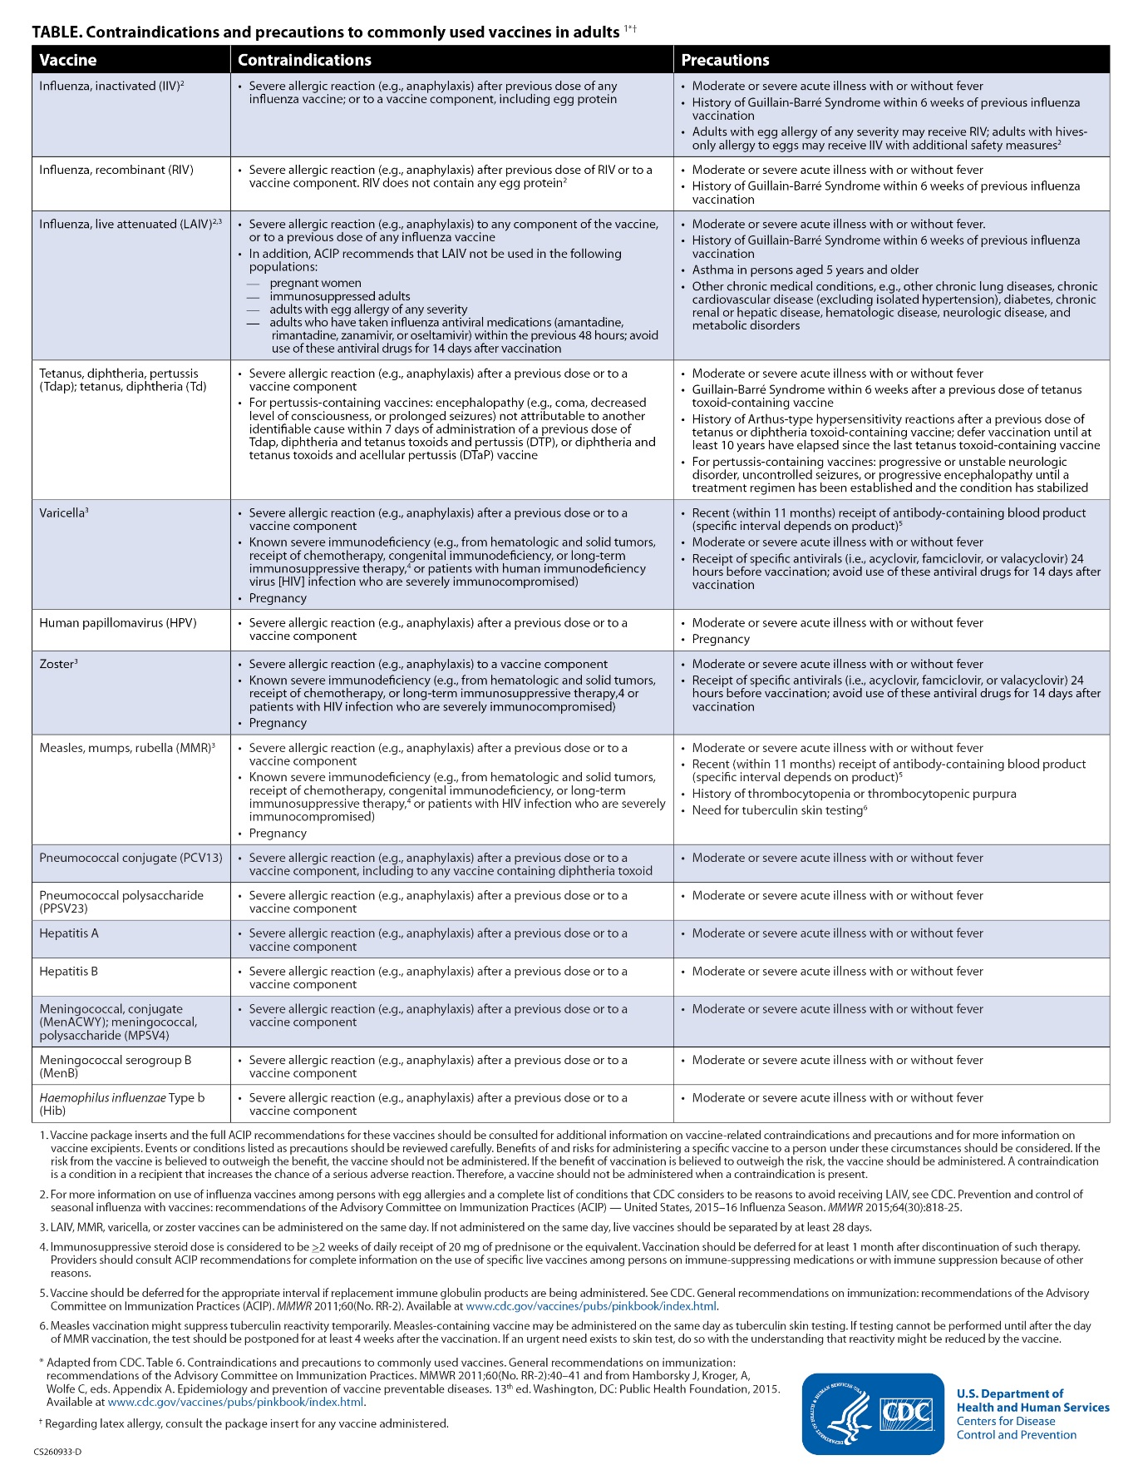

Slide 34


Types of vaccine provided by HAAD
Types of vaccines provided by Health Authority of Abu Dhabi:
Adult vaccine
Travelers vaccine
Hajj and Umrah vaccine
Child vaccine
School health vaccine

Slide 35
Types of vaccines for adults at risk:
Seasonal influenza (flu)
Pneumococcal polysaccharide 23 valent
Pneumococcal Congugate 13 valent
Haemophilus influenza type b (Hib)
Hepatitis A,B
Measles, Mumps,Rubella (MMR)
Rubella
Meningococcal ACWY135
Rabies
Tetanus,diphtheria, pertussis (Tdap)
Tetanus Toxoid (TT)
Varicella
Yellow fever
Typhoid

Slide 36
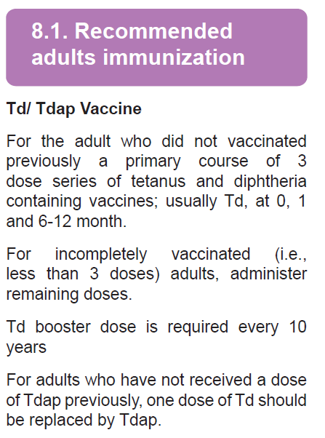
HAAD, MOH, DHA adult immunization guidelines

Slide 37
Vaccine | Indication | Schedule
Tetanus Toxoid (TT) | Post tetanus-prone wound | Single dose as booster

Slide 38
Vaccine | Indication | Schedule
Varicella | All unvaccinated healthcare professionals who have no serologic proof of immunity, prior vaccination, or history of varicella disease or herpes zoster Contacts of a case which are defined as people who have: Direct face to face contact with a symptomatic patient Shared confined space in close proximity for a prolonged period of time, such as > 1hour, with a symptomatic patient or Direct contact with respiratory, oral, or nasal secretions from a symptomatic patient | -Two doses, 4-8 weeks apart -Provide Varicella vaccine within three days , maximum is five days after exposure to chickenpox case

Slide 39
Vaccine | Indication | Schedule
Measles mumps, rubella (MMR) | Premarital Program in case of unavailability of Rubella vaccine Contacts of a case | Two doses, 4 weeks apart

Slide 40
Vaccine | Indication | Schedule
Seasonal Influenza (Flu) | Hajj and Umrah pilgrims All Adults ≥ 65years < 65 years Adults at high risk which include the following :  immunocompromising conditions  Diabetes  Chronic cardiovascular disease (except hypertension)  Chronic lung disease(including Asthma)  Chronic alcoholism  Asplenia (including elective splenectomy and persistent complement component deficiencies)  Chronic liver disease  Kidney failure ,end stage renal disease, recipients of hemodialysis  chronic alcoholism, smoking | Single dose every year, using annual recommended vaccine formulation

Slide 41
Vaccine | Indication | Schedule
Haemophilus influenzae type b (Hib) | The high risk group which include the following if they have not previously received Hib vaccine sickle cell disease leukemia HIV infection who have had a splenectomy | Single dose if they have not previously received Hib vaccine.

Slide 42
Vaccine | Indication | Schedule
Hepatitis B | IV Drug user Household contacts of Hepatitis B cases/chronic carries Post exposure immunoprophylaxis Patients with chronic liver disease Person beginning hemodialysis Diabetes Mellitus type 1 and 2 up to age of 59 Years Contacts of a case include: Household members Sexual contacts Medical staff exposed to oral or respiratory secretions | Three doses at, 0, 1,6 months

Slide 43
Vaccine | Indication | Schedule
Hepatitis A | Patients with Chronic liver disease Persons who receive clotting factor concentrates Outbreak control Contacts of a case include : A person living in the same household as the index case or regularly sharing food or toilet facilities with the index case during the infectious period. include extended family members who frequently visit the household and child-minders and their families. A person who has regularly eaten food prepared by the index case during the infectious period, or who ate food prepared by the index case on a single occasion during the infectious period if there is concern about the hygiene practices of the index case or if the index case had diarrhea at the time of food preparation. Sexual contacts The post exposure efficacy of hepatitis A vaccine is based on its use within 14 days of first symptom onset in the index case. | Two Doses 6-12 months apart The post exposure efficacy of hepatitis A vaccine is based on its use within 14 days of first symptom onset in the index case

Slide 44
Meningococcal ACWY135 | Schedule
Hajj and Umrah pilgrims Travelers to countries in meningitis belt Asplenia (including elective splenectomy and persistent complement component deficiencies) Microbiologists who are routinely exposed to isolates of N. meningitidis. Close contacts | -Meningococcal conjugate vaccine quadrivalent is preferred for adults with any of the preceding indications who are 55 years old and younger; (55 & ↓) meningococcal polysaccharide vaccine is preferred for adults 56 years and older (56 7 ↑ ) -Single dose every 3 years for meningococcal poly saccharide quadrivalent -Administer 2 doses of meningococcal conjugate vaccine quadrivalent at least - 2 months apart to adults with functional asplenia or persistent complement deficiencies. -Administer a single dose of meningococcal vaccine to microbiologists routinely exposed to isolates of Neisseria meningitidis, and persons who travel to countries in which meningococcal disease is hyper endemic or epidemic. -Revaccination with meningococcal conjugate every 5 years is recommended for adults previously vaccinated with quadrivalent conjugate or polysaccharide who remain at increased risk for infection

Slide 45
Vaccine | Indication | Schedule
Pneumococcal polysaccharide 23 Valent | All Adults ≥ 65years without a history of Pneumococcal polysaccharide 23 Valent vaccination Adults < 65 years at high risk which include the following : immunocompromising conditions Diabetes Chronic Cardiovascular disease(except hypertension) Sickle cell anemia Chronic lung disease include asthma Chronic alcoholism Asplenia Chronic liver disease Kidney failure ,end stage renal disease, recipients of hemodialysis | Single dose for persons vaccinated at or after age 65 years The second dose required 5 years after the first dose for persons received vaccine <65 years of age for any indication
Notes:
Persons with asthma are twice as likely to suffer from invasive
pneumococcal disease compared with those without asthma

Slide 46
Rabies | Persons with rabies-prone animal bite Persons in high-risk occupational groups, such as veterinarians and their staff, animal handlers, rabies researchers, and certain laboratory workers Travelers to high risk area (traveler who likely to get in contact with domestic animals particularly dogs and other rabies vectors) | - Pre-exposure: 3 doses at 0, 7, and 28 days, with periodic booster at 1 and 5 years. - Post-exposure: Previously unvaccinated people should receive 5 doses at 0, 3, 7, and 14 and 28 days, category III if not previously vaccinated needs HRIG in addition to the vaccine on 0 day, for specific conditions use 4 doses schedule 2-1-1 ( refer to 7.13). • Previously vaccinated people should receive two doses at 0 and 3 days

Slide 47
Healthcare
Professionals Vaccination
Recommendation

Slide 48

Healthcare Professionals Vaccination Recommendation
Vaccine | Recommendation
Hepatitis B | Give three dose series (0, 1, 6 months) by intramuscular injection. Obtain anti-HBs serologic testing 1–2 months after the third dose.
Influenza | Give One dose of inactivated influenza vaccine annually By intramuscular injection.
Measles, mumps, rubella (MMR) | Give two doses of MMR to healthcare professionals without serologic evidence of immunity or prior vaccination, 4 weeks apart by subcutaneous injection.
HCP Vaccination Recommendation

Slide 49
Vaccine | Recommendation
Varicella | For healthcare professionals who have no serologic proof of immunity, prior vaccination, or history of varicella disease; give 2 doses of varicella vaccine, 4 weeks apart by subcutaneous injection.
Tetanus, Diphtheria , Pertussis (Tdap) | Give a one-time dose of Tdap to healthcare professionals who have not received Tdap previously by intramuscular injection. Give Td boosters every 10 years thereafter.
Meningococcal | Give one dose to microbiologists who are routinely exposed to isolates of N. meningitidis. Give Menactra (Meningococcal Conjugate ACYW-135)by intramuscular injection for adults who are 55 years old and younger and Mencevax (Polysaccharide Meningococcal ACYW135) by subcutaneous injection for adults 56 years and older.
HCP Vaccination Recommendation

Slide 50
Opportunities for Adult Immunization
Adults not aware of vaccines they need… but most patients will accept vaccines if recommended by trusted healthcare provider
Healthcare providers for adults are busy and have competing priorities… but healthcare providers think immunizations are important for their patients
Not all providers stock all vaccines for adults… but access to vaccines is increasing
Adults frequently see multiple providers and recordkeeping is difficult… but state vaccine registries include adult immunizations
Notes:
Where there are challenges, there are opportunities. I mentioned that adults are often not aware of which vaccines they need. But if they become aware and if their healthcare provider recommends that they get the needed vaccine, they will accept the recommendation. In addition, while healthcare providers are busy and have competing priorities, they believe that vaccines are important for their adult patients. At the intersection where the patients are receptive to provider recommendations and providers believing that vaccines for adults are important, we have an opportunity to deliver improved immunization services to adults.
I noted that not all providers stock all vaccines for adults. However, increasingly we have convenient access points for vaccines for adults. An increasing number of pharmacies are vaccine service providers. Vaccines may also be available at the workplace, schools, and other nontraditional venues.
Lastly, immunization recordkeeping for adults is difficult because records can be scattered and no single provider may be keeping track. But each state has a vaccine registry that providers can submit and access adult vaccination records. For [state], the vaccine registry is called [state immunization information system]. [Describe features of IIS, e.g., reminders.]

Slide 51
Vaccination Coverage by Provider Recommendation and/or Offer
Influenza vaccination before and during pregnancy overall and by provider recommendation and offer* for influenza vaccination among women pregnant anytime between October 2012 -January 2013, Internet Panel Survey, 2012-13 Influenza Season
*Women who didn't visit a provider since August 2012 (n=27) or women who didn't know whether they received provider recommendation or offer (n=55) were excluded from this analysis.
Notes:
A key strategy to increase immunization coverage for adults is ensuring that healthcare providers make a strong recommendation to their adult patients to get vaccinated. Research shows that the provider recommendation is a key factor in pregnant women, and other adults, getting the flu vaccine and other vaccines. An example of the impact of provider recommendation is this survey of pregnant women. This example also demonstrates the importance of providers vaccinating at the time of the recommendation.
In this survey, about half of the pregnant women received the influenza vaccine as recommended overall, as represented by the black bar on left. Focusing our attention to the red bars, we see that the influenza vaccine coverage rate was 70% among pregnant women who received a provider recommendation and offer of the flu vaccine. When the vaccine was recommended, but vaccination was not offered, the coverage was substantially lower at 46%. Without a recommendation or offer, coverage was far lower at 16%. This vaccination pattern was found in all demographic and other subgroups, even among women who have negative attitudes toward the influenza vaccination, again demonstrating the importance of the provider recommendation.

Slide 52
Indian Health Service
Leveraging Technology Data
Notes:
What they were able to accomplish through E.H.R. prompts and through provider reminders was much higher vaccination rates than the national average.

Slide 53
Strategies for Health Departments to Improve Adult Immunizations
Determine community needs and vaccination capacity
Identify and address barriers to adult vaccination
Provide outreach and education to providers and the public
Distribute patient and provider education materials.
Develop and maintain partnerships with key stakeholders
www.izsummitpartners.org/wp-content/uploads/2014/09/adult-tips.pdf
Notes:
The National Adult Immunization Coordinators’ Partnership identified 4 key strategies to improve adult immunizations. They are: (1) determine community needs and vaccination capacity, (2) identify and address barriers to adult vaccination, (3) provide outreach and education to providers and the public, and (4) develop and maintain partnerships with key stakeholders. I will discuss each of these strategies in the following slides.

Slide 54
Intervention
Delivery
Bring vaccines to where people are
Make vaccination a front-end priority, rather than an afterthought, and appropriately delegate authority

Slide 55
Intervention
Implications for Practice
Use of standing order programs for vaccination – systematic approach
  Empower personnel to administer immunizations without a provider order
  State Immunization Registries
Assessment of practice level vaccination rates with feedback to staff members
Widely accepted practice management resources
  ICD-10 codes tied to computerized algorithm/rule for vaccine eligibility (better than broad categories of chronic diseases in normal paper standing orders)
Implementing reminder-recall systems
  Recall and reminder systems have resulted in increases of up to 20% in rates of vaccination against
    Hepatitis B
    Tetanus
    Influenza
    Pneumococcal disease

Slide 56
Identify and Address Barriers to Adult Immunization
Develop reminder/recall system
Use of standing order programs for vaccination – systematic approach
Audit level vaccination coverage with feedback to staff members
www.izsummitpartners.org/wp-content/uploads/2014/09/adult-tips.pdf
Notes:
The second strategy is to identify and address barriers to adult immunization.

Slide 58
Average 39.6%

Slide 59
Interventions
Vaccine Education Programs
Utilize published immunization resources
National Association of County & City Health Officials
  www.naccho.org/topics/HPDP/immunization/
Association of State and Territorial Health Officials
  www.astho.org/Programs/Immunization/
Association of Immunization Managers
  www.immunizationmanagers.org/
American Immunization Registry Association
  www.immregistries.org/
Centers for Disease Control and Prevention (CDC)
  www.cdc.gov/vaccines/hcp/adults
  www.cdc.gov/vaccines/adults/index.html
Immunization Action Coalition (IAC)
  www.immunize.org/
National Foundation for Infectious Diseases (NFID)
  www.adultvaccination.org/
American College of Physicians
  http://immunization.acponline.org/

Slide 60
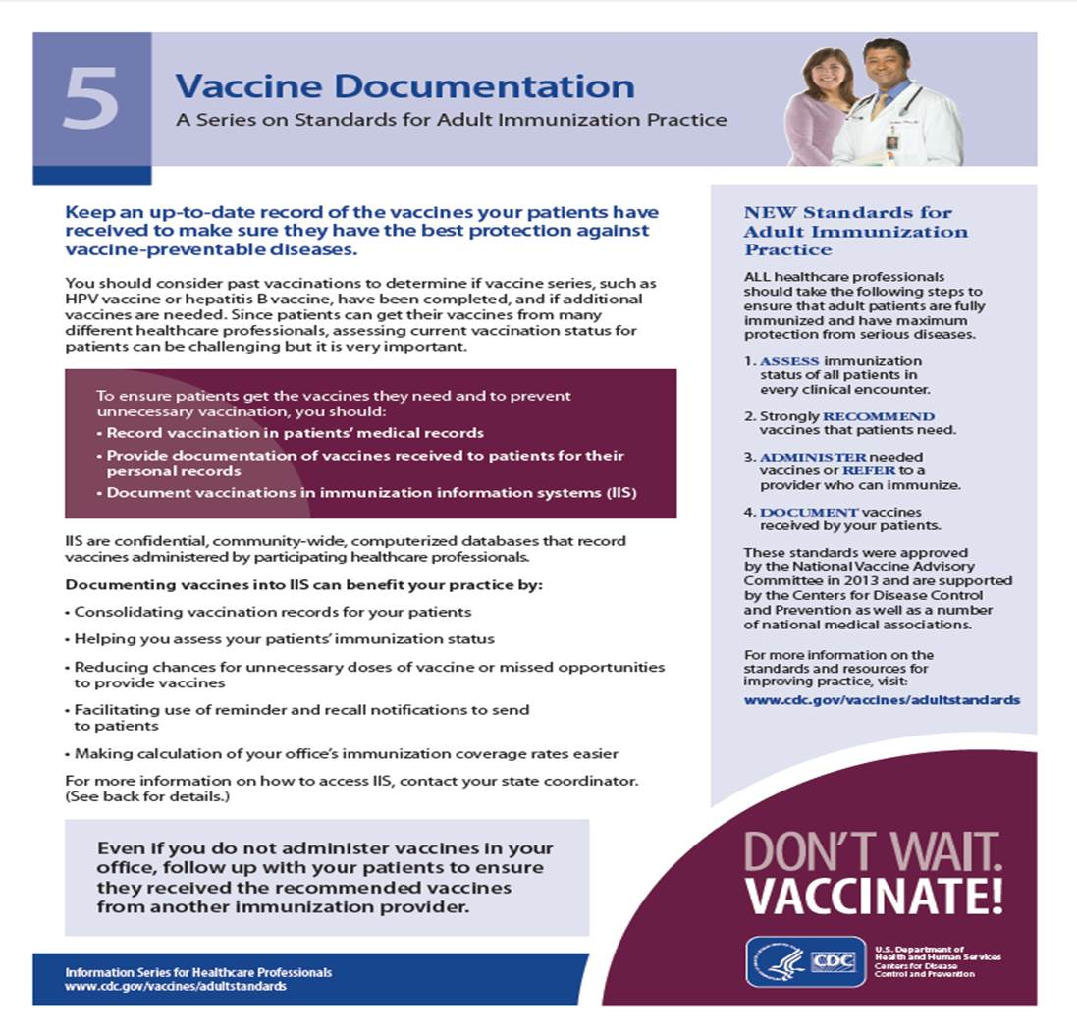
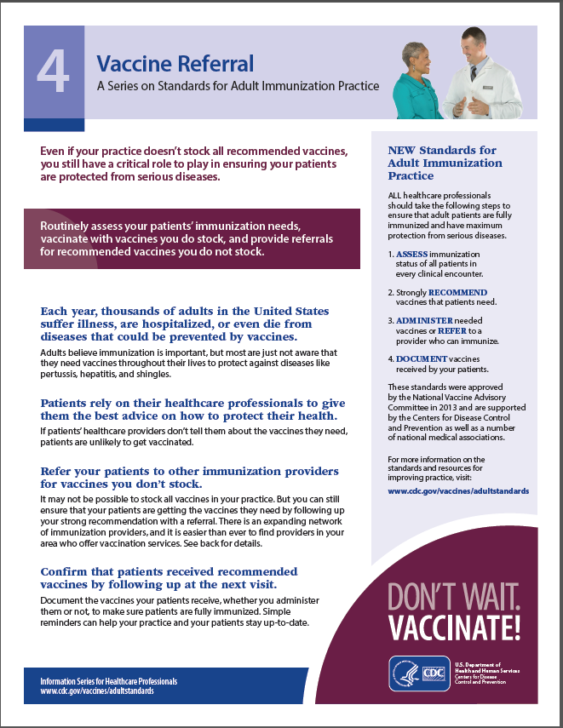
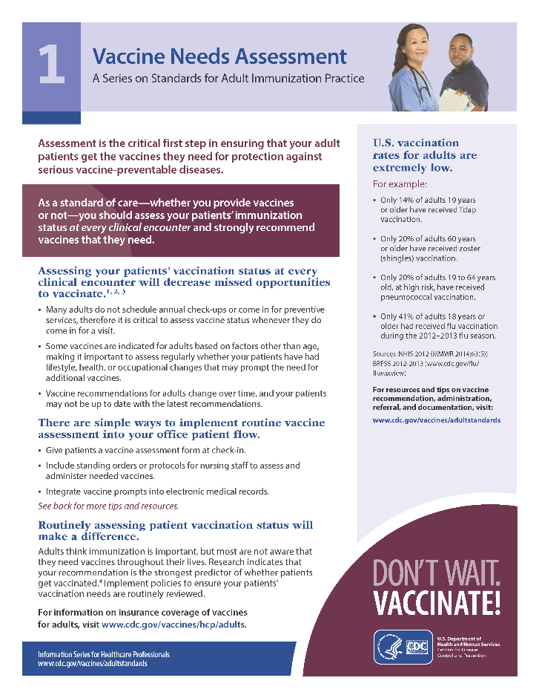
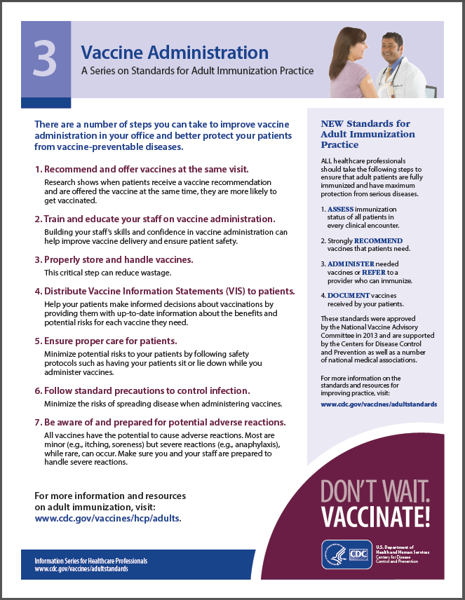
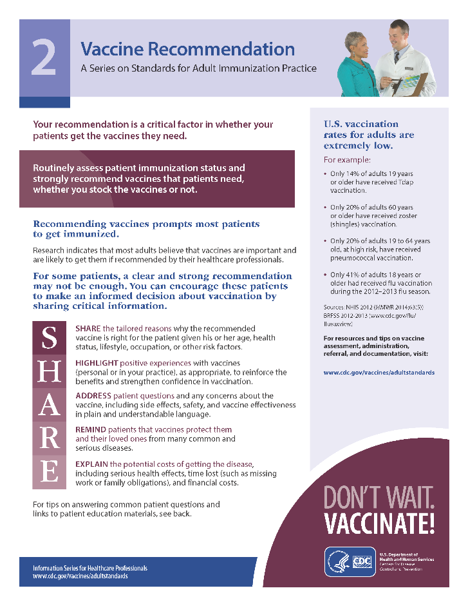
Series for Healthcare Providers on Implementing Standards
www.cdc.gov/vaccines/AdultStandards
Notes:
There are also other resources on the CDC website to help providers with implementation of the standards.

Slide 61
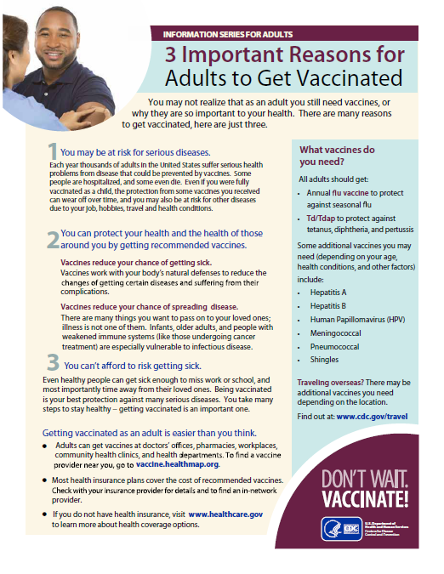
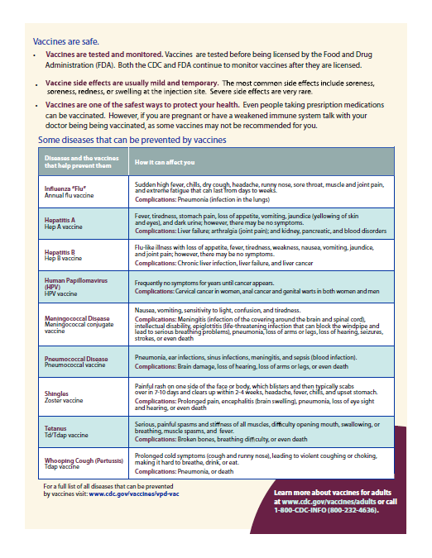
Patient Education Materials - Handouts
Notes:
And CDC also has a number of patient education handouts that can be downloaded free of charge.

Slide 62
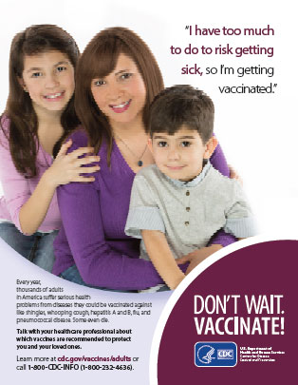
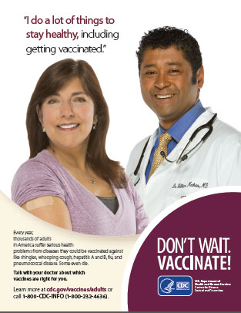
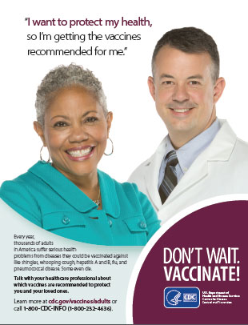
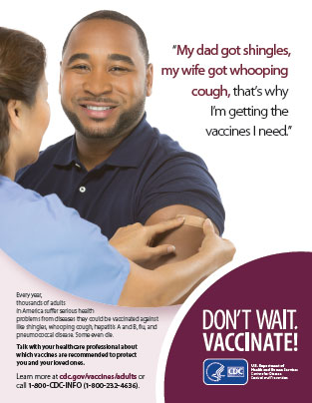
Patient Education Materials - Posters
www.cdc.gov/vaccines/hcp/patient-ed/adults/for-patients/adults-all.html
Notes:
CDC also has some posters as well that are free to providers.

Slide 63

Summary
Health dept. role in promoting the adult immunization
The four components of the standards are:
assess immunization status of all adult patients at every clinical encounter,
strongly recommend vaccines they need,
administer the needed vaccines or refer the patient to a provider who can, and
document vaccines received by the patient in the state vaccine registry.
Notes:
To routinize adult immunization in clinical settings, health departments have a critical role in promoting the adult immunization practice standards. The four components of the standards are: assess immunization status of all adult patients at every clinical encounter, strongly recommend vaccines they need, administer the needed vaccines or refer the patient to a provider who can, and document vaccines received by the patient in the state vaccine registry.

Slide 64
Summary
Immunization does not stop at childhood
Prevention of infection by immunization is a lifelong process
Health Care Practitioners need to Empower, Educate, Advocate and Recommend particularly for Adult vaccination.

Slide 65
YES, We have to:
Clinicians must educate themselves on applicable adult vaccines so they can make valid recommendations to patients

Slide 66
References
References
National Immunization Guidelines - Ministry of Health, Health Authority - Abu Dhabi, Dubai Health Authority, Chapter 8, Adult Immunization (pages 81-90)
Vaccination of Adults at high rusk od infectioes diseases, Circular No. ( CEO 37 / 12 ), July 26th 2012
Christina M. Hillson, Joshua H. Barash, and Edward M. Buchanan; Adult Vaccination; Primary Care: Clinics in Office Practice, 2011-12-01, Volume 38, Issue 4, Pages 611-632; Copyright © © 2011 Elsevier Inc.
Carolyn B. Bridges, MD,1 Laura P. Hurley, MD, MPH,2,3 Walter W. Williams, MD, MPH,1; Aparna Ramakrishnan, MA, MSW,4 Anna K. Dean, MPH,1,5 Amy V. Groom, MPH1; Meeting the Challenges of Immunizing Adults; accessed September 2015

Slide 67
References
5. Jessica L. MacLeod, APRN; Adult & Gerontology Nurse Practitioner (AGNP); The Evolving World of Adult Vaccines, New Indications; VT Immunization Conference; October 28, 2011
6. Thomas G. Irons, MD, Professor of Pediatrics, The Brody School of Medicine at East Carolina University, Greenville, North Carolina; Barriers to Adult Immunizations
Getting from “No!” to “Yes!”; accessed September 2015

Slide 68
Resources
National Association of County & City Health Officials
  www.naccho.org/topics/HPDP/immunization/
Association of State and Territorial Health Officials
  www.astho.org/Programs/Immunization/
Association of Immunization Managers
  www.immunizationmanagers.org/
American Immunization Registry Association
  www.immregistries.org/
Centers for Disease Control and Prevention (CDC)
  www.cdc.gov/vaccines/hcp/adults
  www.cdc.gov/vaccines/adults/index.html
Immunization Action Coalition (IAC)
  www.immunize.org/
National Foundation for Infectious Diseases (NFID)
  www.adultvaccination.org/
American College of Physicians
  http://immunization.acponline.org/
Notes:
There are many available resources to promote adult immunizations. A few are listed here. [Add state and local resources.]

Slide 69

“Let’s start afresh today,
and do the good things we didn’t do yesterday,
let’s vaccinate all our adult patients’
whenever it is indicated”
Litty Varghese

Slide 70
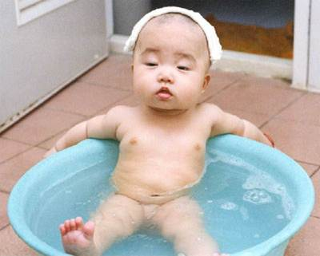
You can contact me for further assistance in vaccination
^{litty_varghese@hotmail.com}
Notes:
“Let’s start afresh today, and do the good things we didn’t do yesterday, let’s vaccinate all our adult patients’ whenever it is indicated”
Litty Varghese

