Slide 1
Optimizing Multimodal Interfaces for Speech Systems in the Automobile
Lisa Falkson
Lead Voice UX Designer
lisa.falkson@nextev.com

Slide 2
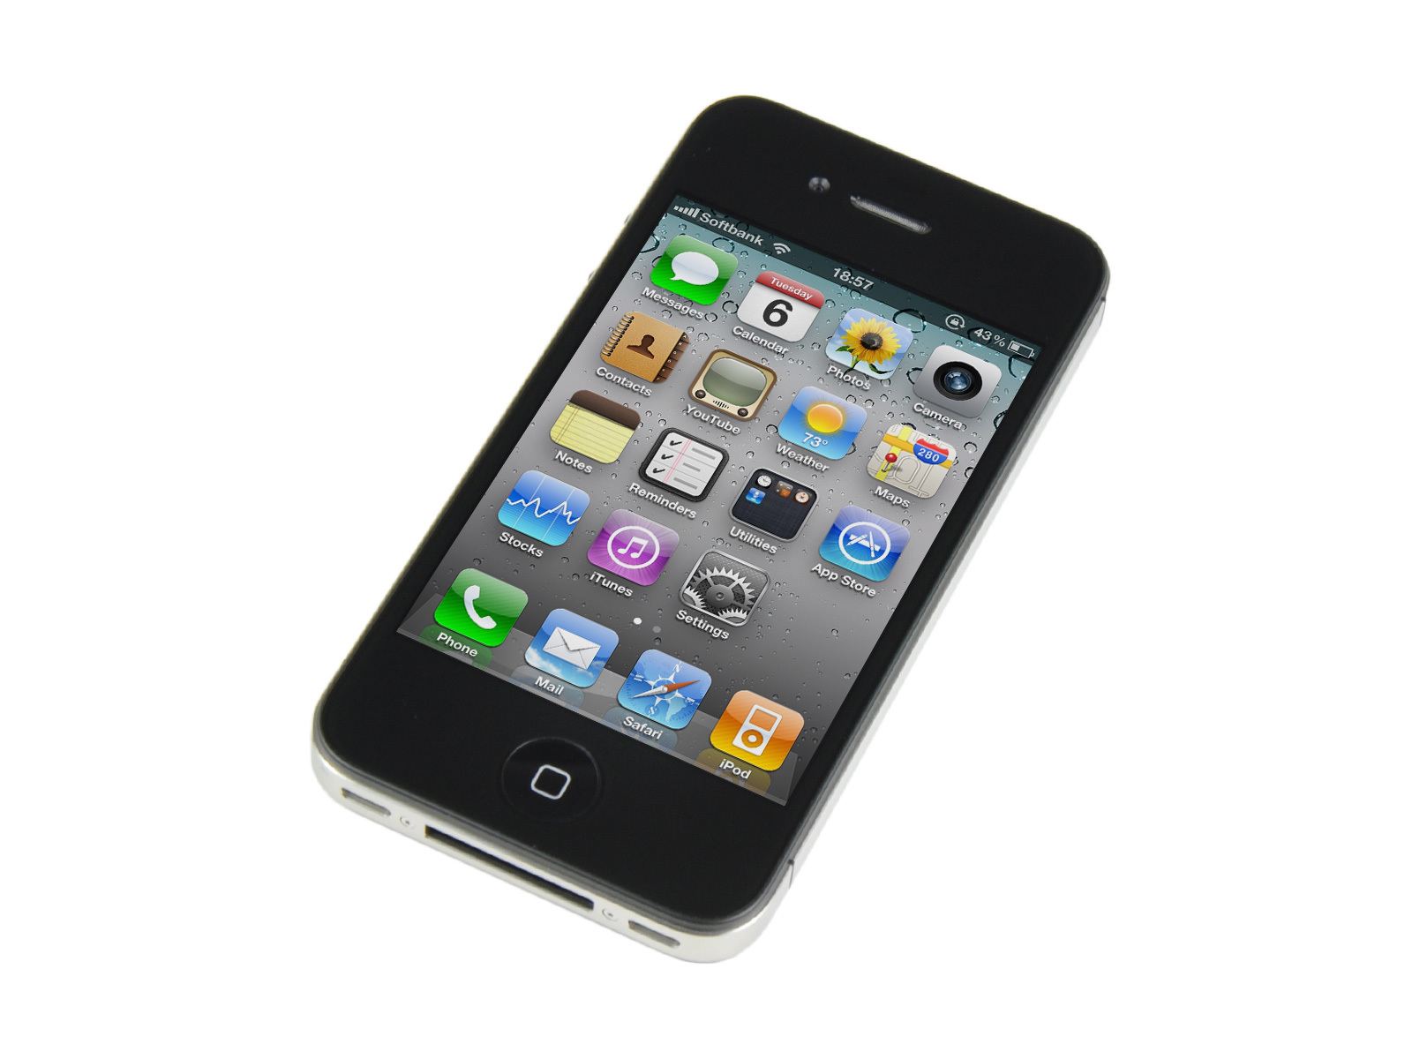
The Problem
In 2013, 3,154 people were killed in vehicle crashes involving distracted drivers¹
10% of drivers under 20 were reported as distracted at time of crash
At any given daylight moment, approximately 660K drivers are using cell phones or electronic devices while driving (since 2010)
Engaging in visual-manual subtasks increases risk of crash by 3X
¹ Distraction.gov, US Government Website for Distracted Driving

Slide 3
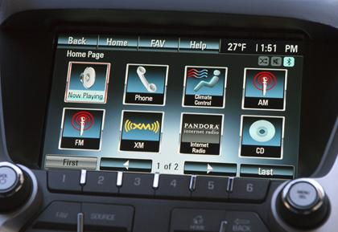
Speech systems in the automobile
Becoming prolific
Motivated by safety (handsfree), to avoid mobile phone use
Generally designed by automotive companies, not speech experts
  Notoriously difficult to use
  User interface mimics mobile phone
  Often out-of-date by launch

Slide 4
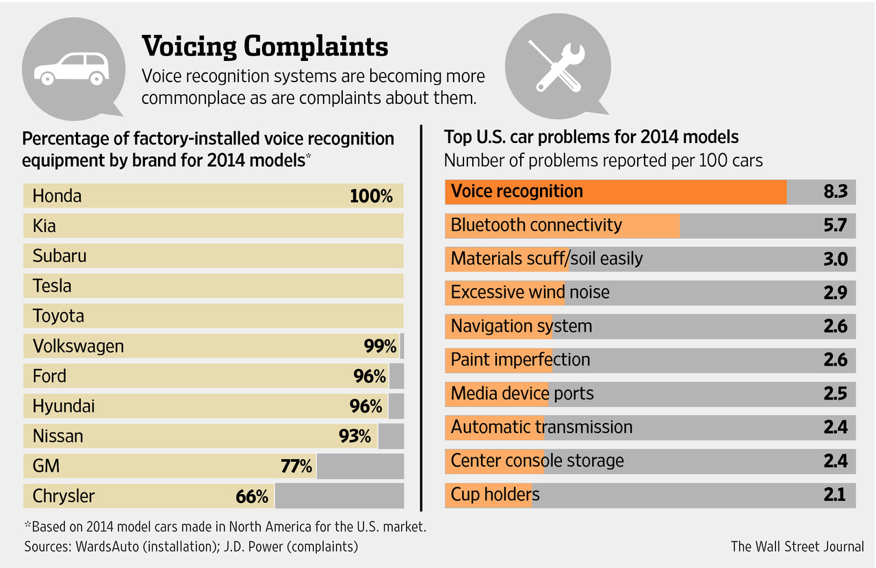
The Price of Popularity

Slide 5
Evaluation of Current Systems¹
The good…
Large, easy-to-read fonts
Easy pairing with smartphone
Big images/buttons, large screen
Intuitive voice prompts
And the bad
Cryptic images/hieroglyphics
Small font text
Tightly packed buttons
“Demanding” voice command procedures
¹ Consumer Reports, “Brand-by-brand guide to car infotainment”

Slide 6
The Design Challenge
NHTSA (National Highway Traffic Safety Administration) guidelines:
  Glance time of 2s or less (per glance)
  Cumulative time spent glancing away for a single task: 12s
  All device functions can be performed with one hand
Drivers need to be focused on main task of driving, not manipulating their infotainment system

Slide 7
What is good multimodal design?
“The advantage of multiple input modalities is increased usability: the weaknesses of one modality are offset by the strengths of another.”¹
¹ Source: wikipedia

Slide 8
Use each modality for its best purpose
Voice input for address or POI is faster and easier than typing
Speech input can understand a variety of requests at top level (no nested menus required)
Speech output via TTS provides eyes-free delivery of information
Maps cannot be conveyed via speech; however turn-by-turn directions can be spoken

Slide 9
So… What should it look like?
Large, readable fonts
Easy tap targets
No cryptic graphics/icons
Simple, clean graphics and layout
No deep nested menus
Large, easy-to-read (and expandable) maps

Slide 10
And… What should it sound like?
All functions available at top-level menu
Non-verbal (earcon) audio to trigger input response
Short, concise prompts
Verbal output in TTS
  Pre-recorded speech not necessary
Spoken and displayed text should match
>2 choices presented one-by-one so each one can be heard
Naturally worded inputs should be understood by ASR and NLU

Slide 11
Takeaways
Keep it simple
Coordinate TTS and on-screen display
Minimize glance time (per input, and overall per task)
Use each modality to its best advantage
Notes:
By this, I mean it should be simple both visually and in the speech interaction. No small buttons and text, or cryptic graphics. The TTS prompts should be short and to the point. This should not be a “chatty” but merely straightforward and informative
TTS and on-screen text should support each other, not conflict. When they are out of sync, that is distracting to the user
As per NHTSA guidelines, and for overall safety.
Similar to using a mouse for selecting a window, or a pen for drawing, or a keyboard for typing. Each modality has its strength, and should be utilized for its greatest benefits

Slide 12

Contact me!
lisa.falkson@nextev.com
Twitter:@LisaFalkson
https://www.linkedin.com/in/lisafalkson

