Slide 1
Cell differentiation and differentiation therapy in neuroblastoma
Liqin Du, MD, PhD
Department of Chemistry and Biochemistry
Texas State University
USA

Slide 2
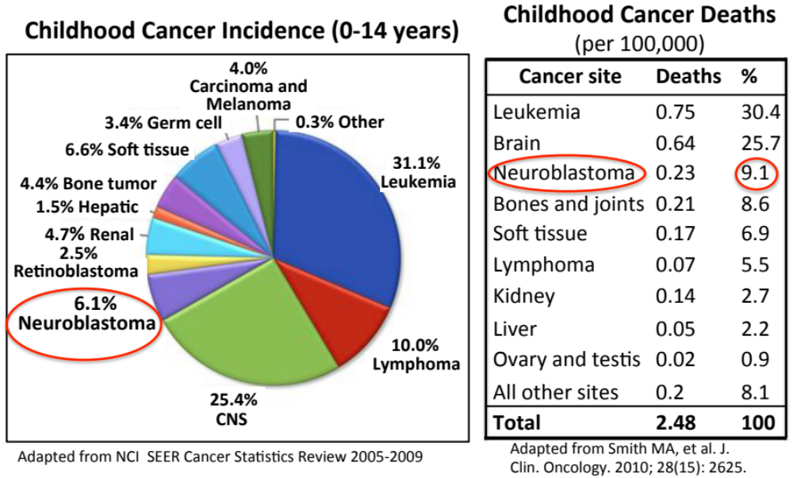
Neuroblastoma is the 3rd most lethal childhood cancer

Slide 3
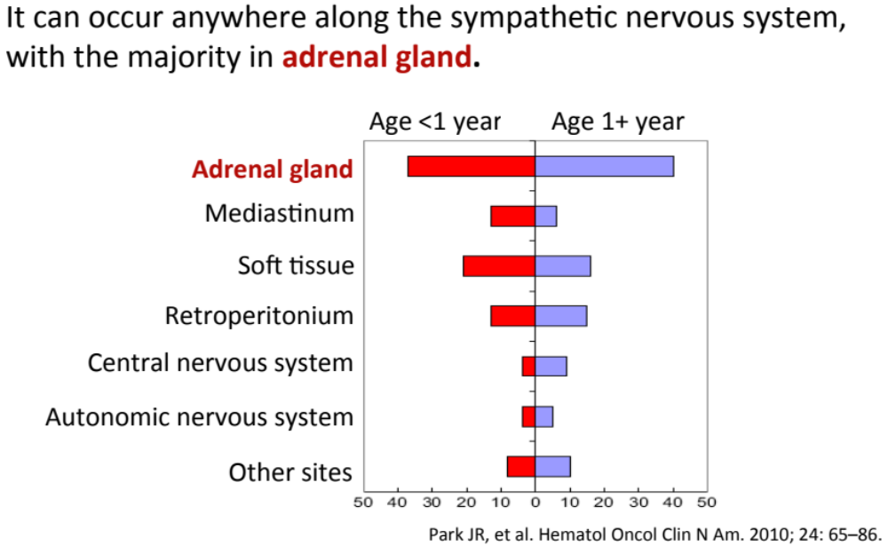
Neuroblastoma is originated from neural crest cells

Slide 4

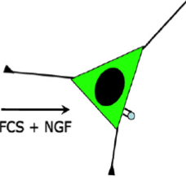


Cell differentiation in neuroblastoma
Neuroblastoma arises from neural crest precursor cells that fail to complete the process of differentiation.
Terminal differentiation of neuroblastoma cells can be induced by differentiation agents.
Differentiation agents have been applied in neuroblastoma therapy.
Neural crest precursor cells
Neuroblastoma cells
Differentiated
cells
Differentiation
agents
Tumor growth arrest
Differentiation defects
Differentiation therapy
Neuro
Differentiation
Neuro
Neurite
outgrowth
Normal
neurons

Slide 5
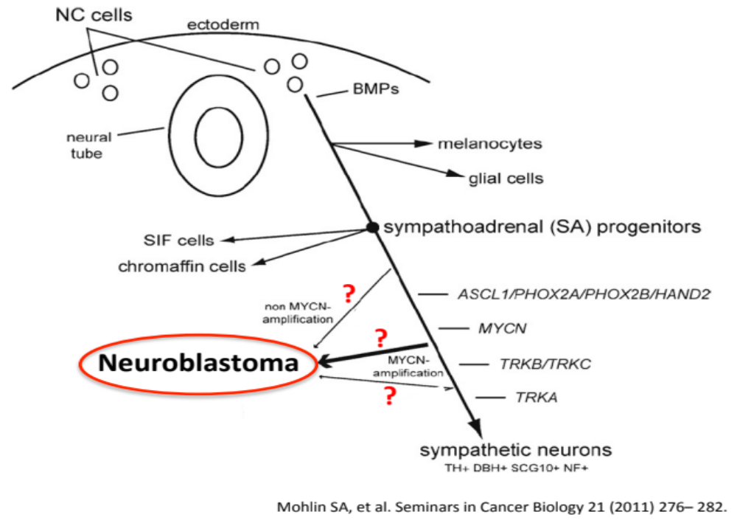
Cell differentiation in neuroblastoma is a complex, poorly understood process

Slide 6
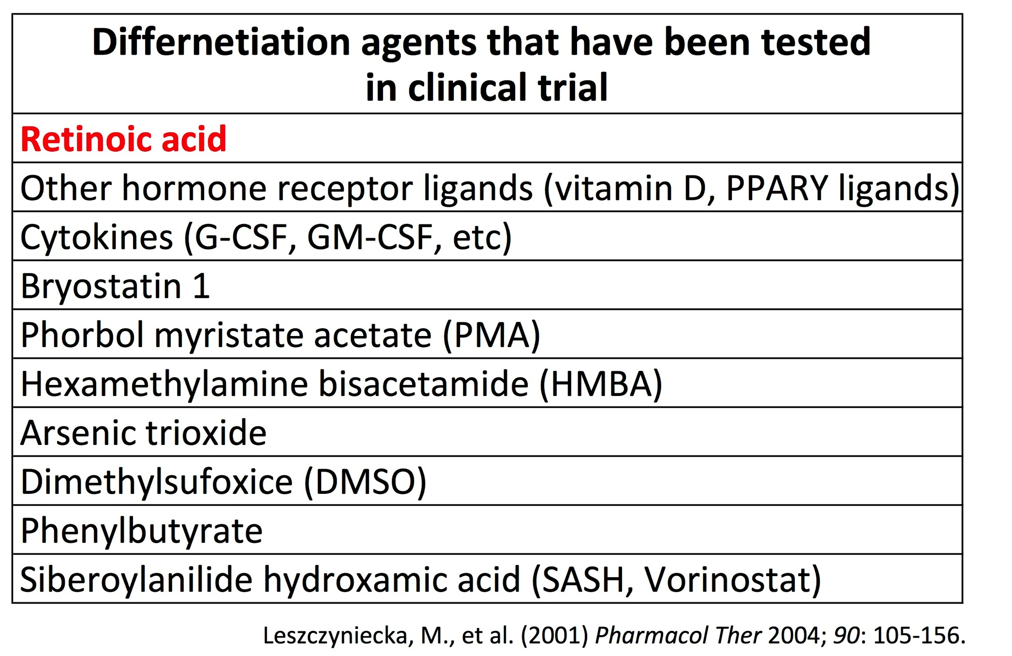
A limited number of differentiation agents are available for clinical application

Slide 7
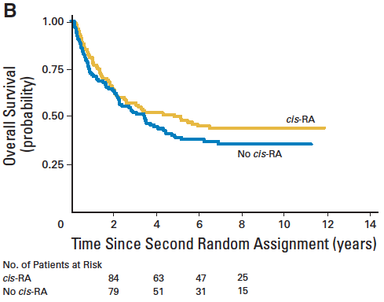
Differentiation agent Cis-retinoic acid (RA) is the standard of care for high-risk neuroblastoma
Differentiation therapy in neuroblastoma
P= 0.0006
Overall survival
RA
No RA
Years
Years
Matthy KK, et al. J Clin Oncol. 2009; 27(7):1007-1013.
Resistance to RA is common. More than 50% of the treated patients still develop recurrence.
There is still lack of alternative differentiation agents to treat the resistant patients.
Discovery of new differentiation agents has been very slow…

Slide 8
Research goal and approach
Goal:
To identify more effective differentiation agents for treating neuroblastoma.
Approach:
Develop a High-Content Screen to directly identify differentiation-inducing molecules (drugs or drug targets), based on quantification of neurite outgrowth − the morphological differentiation marker.

Slide 9
High-Content Screening (HCS)
Definition: is a method to identify substances that alter the visual phenotype of a cell in a high-throughput manner.
General principle: is a combination of cell biology with automated microscopy and robotic handling.
Readouts: cell morphology, protein localization, cell cycle distribution, etc.

Slide 10
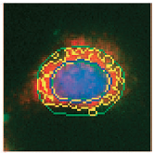

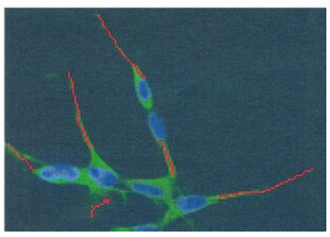
High-Content Screening (HCS)
Currently developed HCS approaches are mostly based on fluorescence signal associated with cells
Localization
Apoptosis
Neurite
Signal sensitivity is an issue

Slide 11
Discovery of new differentiation agents has been very slow because of the lack of high-throughput screening approaches
A more sensitive quantification approach is needed for high-throughput identification of new differentiation agents.

Slide 12
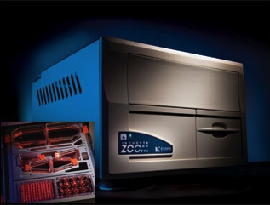
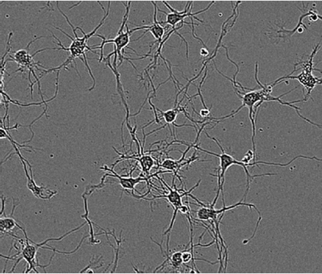
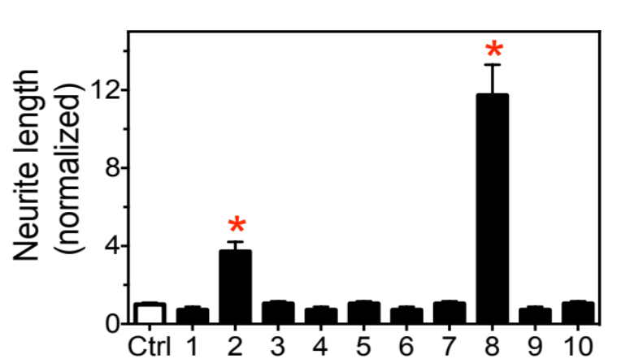
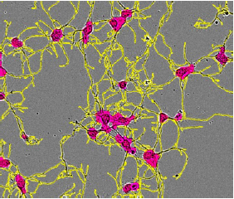
An approach of quantifying neurite outgrowth based on phase-contrast live cell images
Detect Phase-contrast images
Define neurites and cell bodies
Calculate relative neurite length
Relative neurite length
Neurite
Samples
Cell body area
Relative neurite length=neurite length/cell body areas

Slide 13
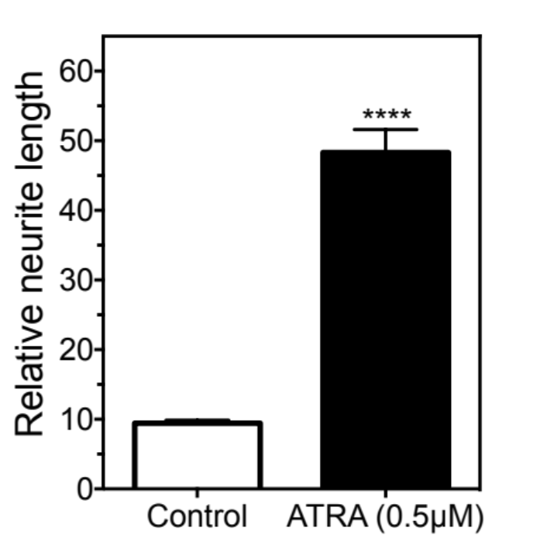
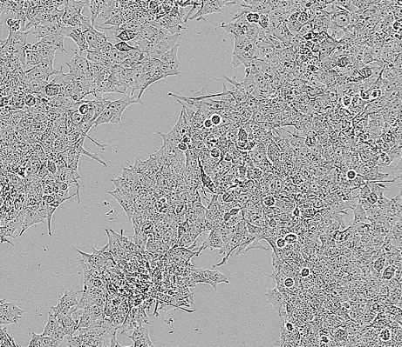
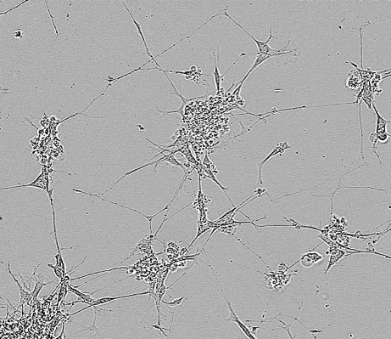
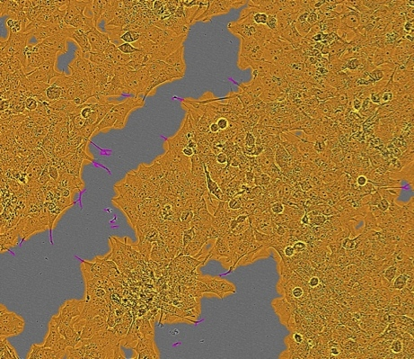
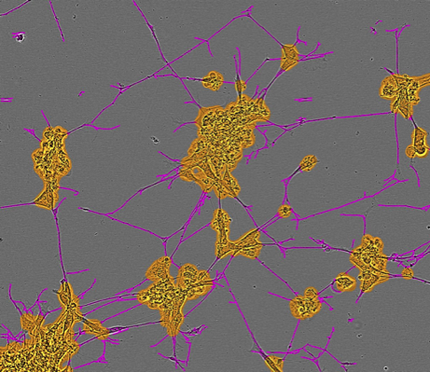
Results
Neurite outgrowth is quantifiable in neuroblastoma cell line BE(2)-C cells
Control
ATRA (0.5μM)
Neurite length
(per cell body area)
ATRA, All-Trans Retinoic Acid
Cell body
Neurite
Zhao, et al. Oncotarget. 2014; 5(9): 2499-2512.

Slide 14
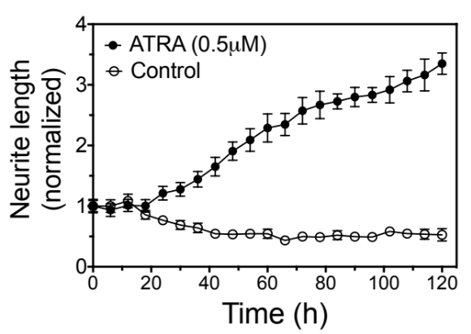



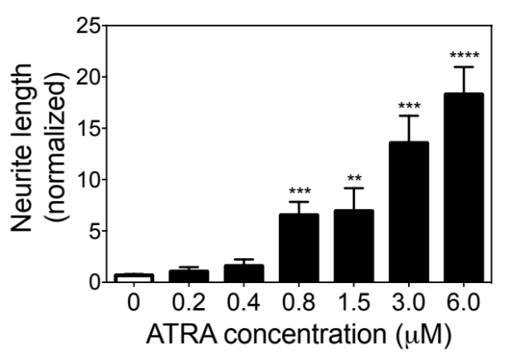
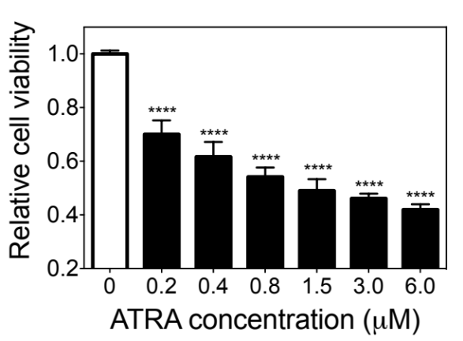
Results
Neurite outgrowth reflects the efficacy of the differentiation-inducing agent in BE(2)-C cells
A
C
ATRA (μM) | 0 | 0.8 | 1.5 | 3 | 6
GAP43
Differentiation markers
NSE
GADPH
GAP43: Growth Associated Protein 43
NSE: Neuron Specific Enolase
B
D
Zhao, et al. Oncotarget. 2014; 5(9): 2499-2512.

Slide 15
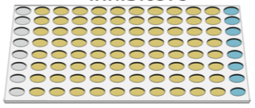

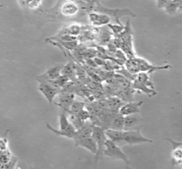
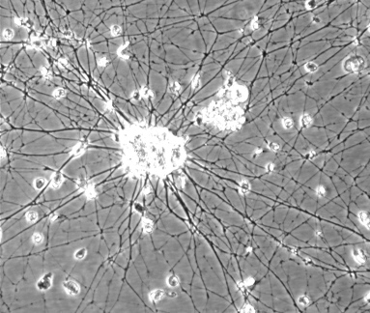

The HCS protocol of neurite outgrowth
(1) Library arrayed
in 96-well plates
(one-well one-molecule)
(2) Cell treatment
X3
Negative Ctrl
Positive Ctrl
Positive Hit
(3) Live cell
imaging
Undifferentiated
Differentiated
Differentiated
3-5 days of culture
(4) Analysis
Observe and calculate neurite outgrowth
Identify candidates that induce neurite outgrowth

Slide 16
Outline
High-Content Screening for differentiation-inducing agents
Drugs & targets
Natural products
Synthetic compounds
Drugs
microRNAs
Drugs/Drug targets for differentiation therapy

Slide 17

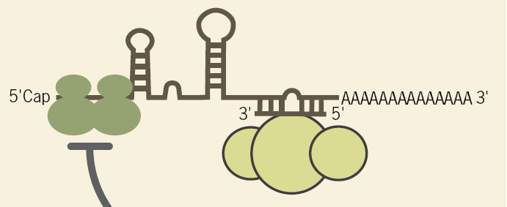
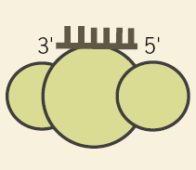
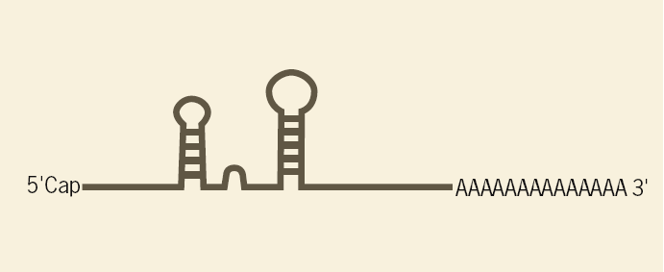
miRNAs as therapeutic agents/targets
miRNA mimic
precursor
miRNA duplex
Targeted oncogene
mimic
miRNA target gene
RISC
miRNA inhibitor
inhibitor
Targeted tumor suppressor gene
RISC
Notes:
Modification of images from David Bumcrot, Muthiah Manoharan, Victor Koteliansky & Dinah W Y Sah (2006) RNAi therapeutics: a potential new class of pharmaceutical drugs. Nature Chemical Biology 2:711 - 719.

Slide 18
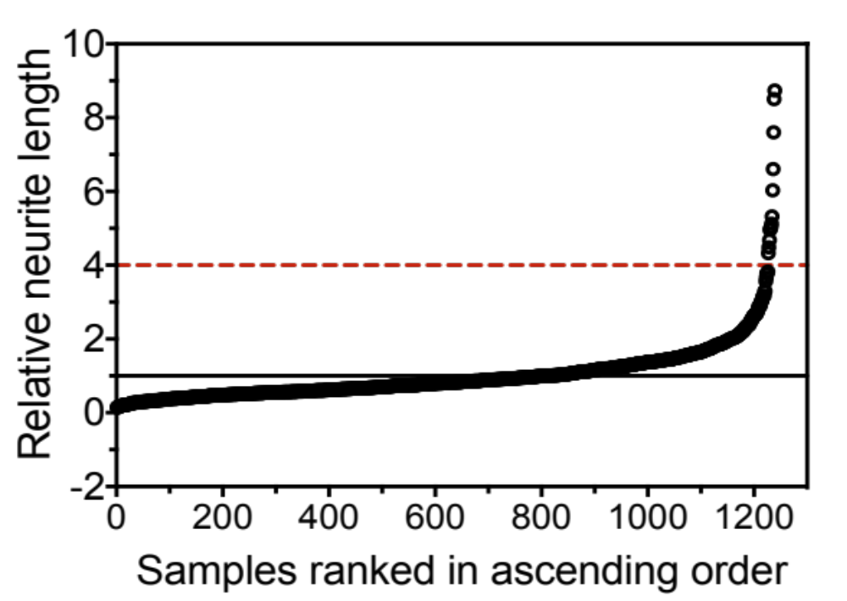
Results
HCS identifies differentiation-inducing miRNA mimics in BE(2)-C cells
Neurite length fold change
(relative to library mean)
Retinoic acid (5μM)
(25nM miRNA mimics)
Zhao, et al. Oncotarget. 2014; 5(9): 2499-2512.

Slide 19
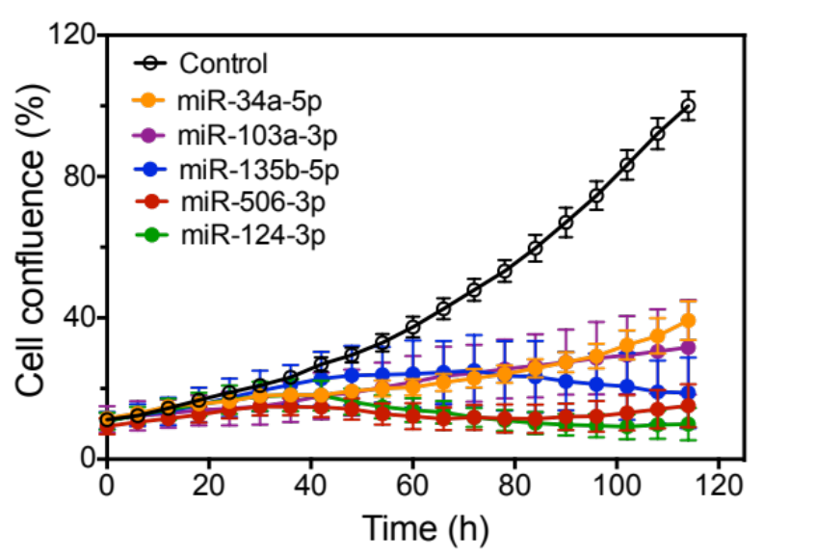



Results
miRNA-induced neurite outgrowth is coupled with expression of differentiation markers and cell growth arrest
GAP43
NSE
Calnexin
Control
miR-124-3p
miR-34a-5p
miR-135b-5p
miR-103a-3p
miR-506-3p
Zhao, et al. Oncotarget. 2014; 5(9): 2499-2512.

Slide 20
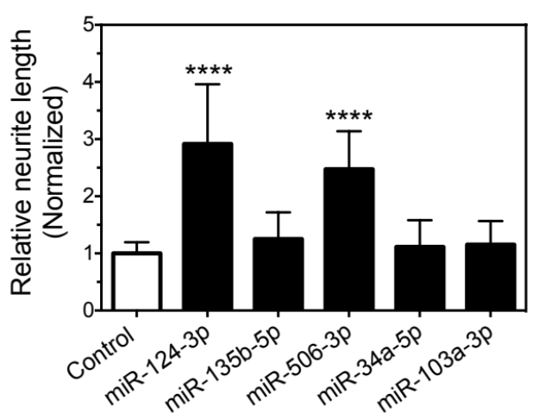
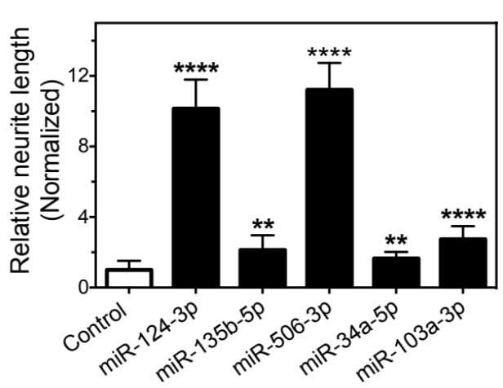
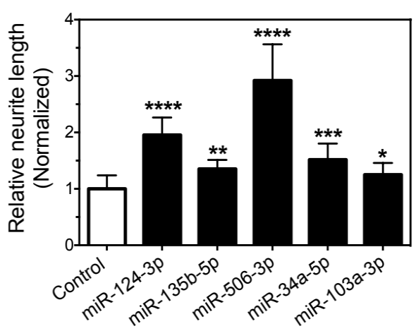
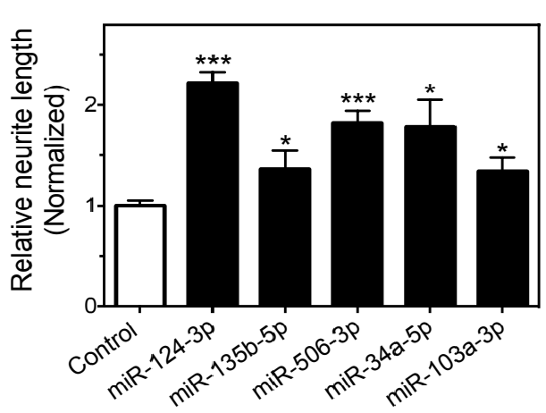
Results
miR-506-3p are functional in both RA-sensitive and -resistant cell lines
NGP
KELLY
Neurite length
(Normalized)
Neurite length
(Normalized)
Sensitivity to RA
Cell line | IC₅₀ (μM)
NGP | 4.37 (S)
KELLY | 45.60 (R)
SKNBE | 65.31 (R)
LAN6 | 98.40 (R)
SKNBE
LAN6
S, Sensitive
Neurite length
(Normalized)
Neurite length
(Normalized)
R, Resistant
Zhao, et al. Oncotarget. 2014; 5(9): 2499-2512.

Slide 21
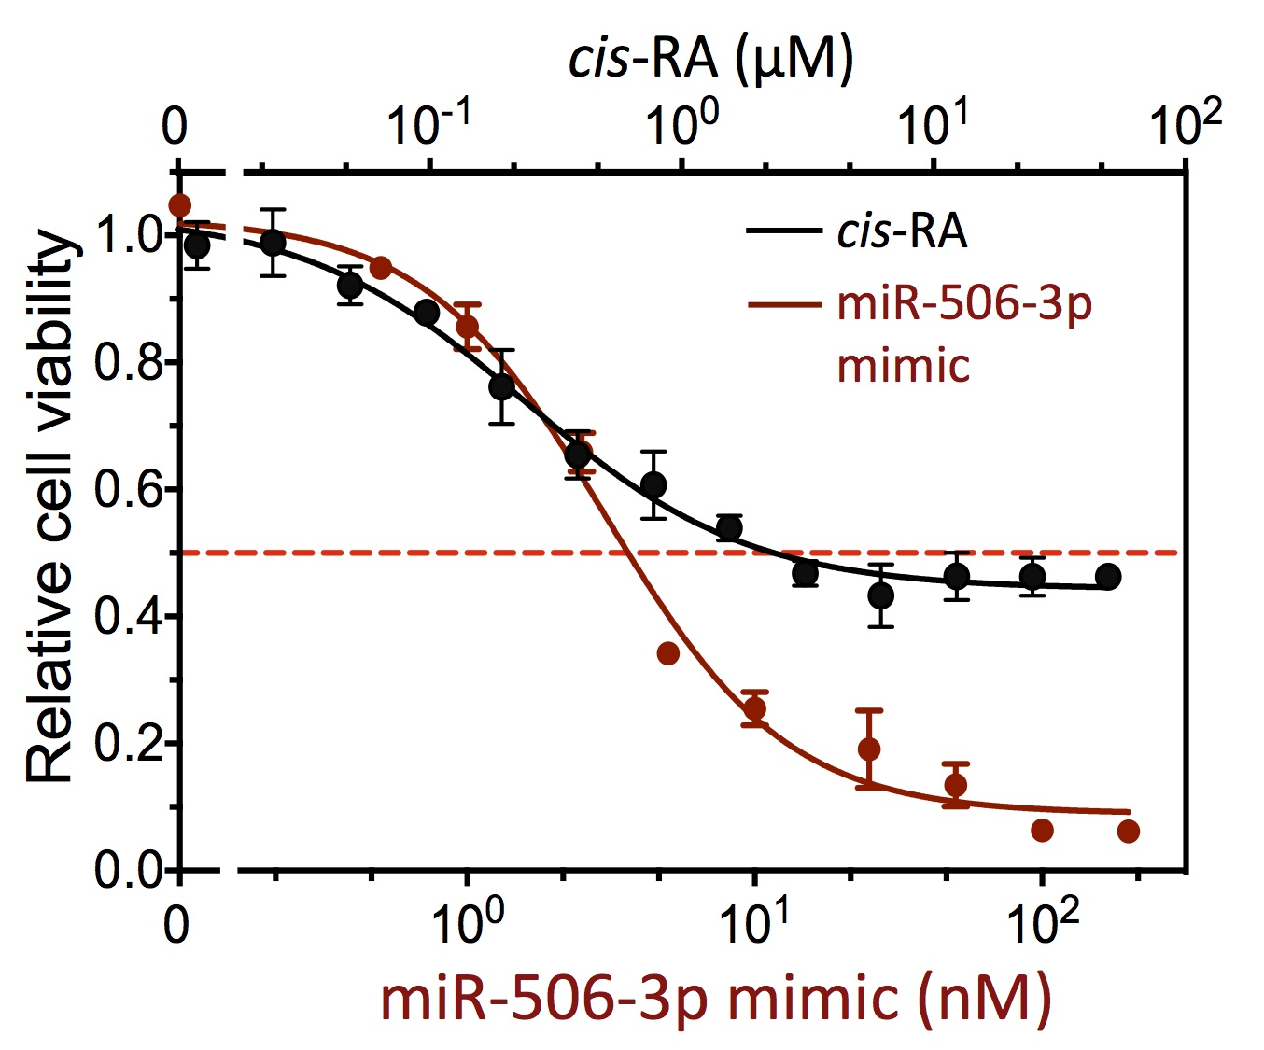
Results
miR-506-3p is much more effective in reducing cell survival than RA in BE(2)-C cells
RA (μM)
RA
Zhao, et al. Oncotarget. 2014; 5(9): 2499-2512.

Slide 22
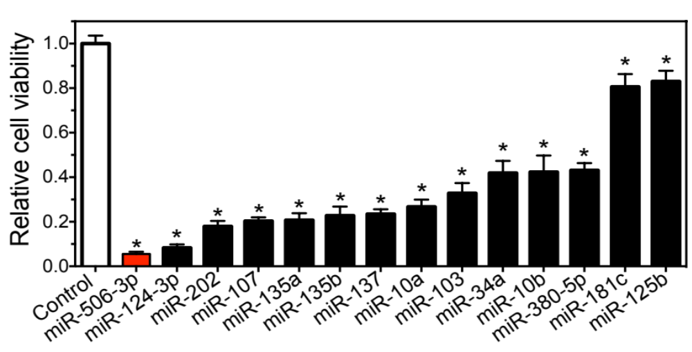
Results
miR-506-3p is more potent in reducing cell survival than other tumor suppressive miRNAs identified in neuroblastoma
*, BE(2)-C cells were transfected with 25nM miRNA mimics or control oligo for 4 days.

Slide 23
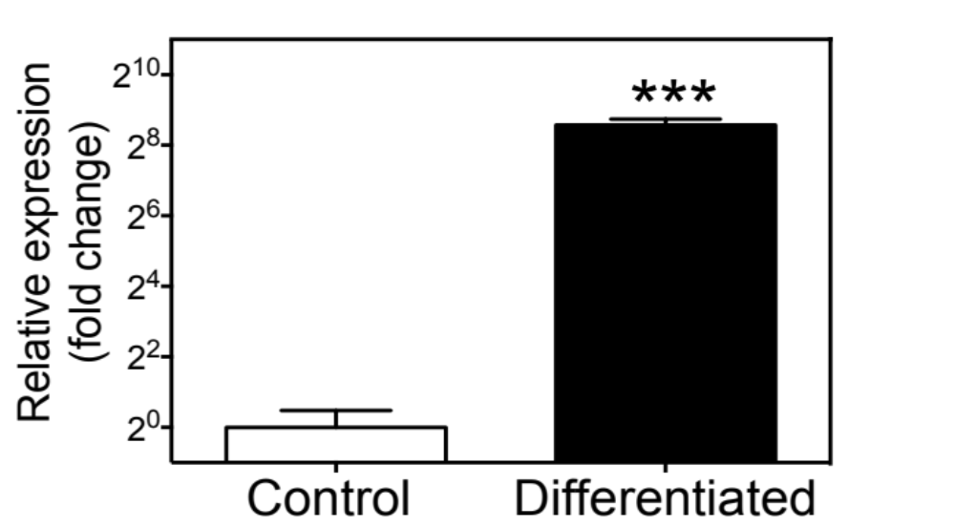
Q: miR-506-3p in neuroblastoma tumorigenesis?
Endogenous miR-506-3p levels are dramatically increased in differentiated BE(2)-C cells
It suggests that the expression of endogenous miR-506-3p in undifferentiated neuroblastoma cells is significantly suppressed.
Zhao, et al. Oncotarget. 2014; 5(9): 2499-2512.

Slide 24
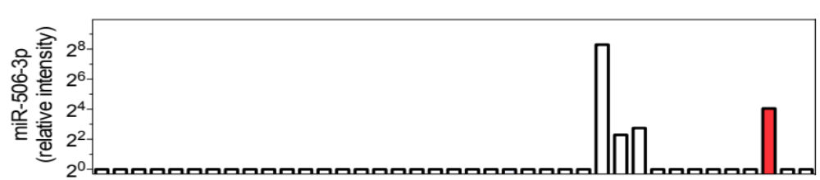
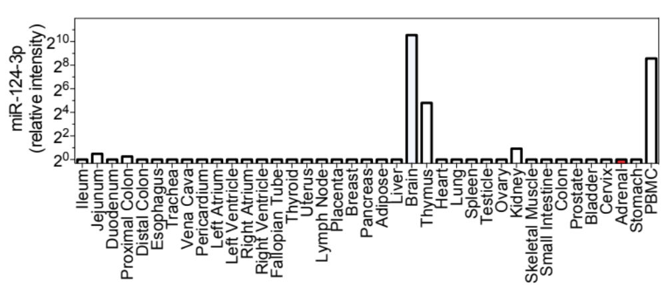
Q: miR-506-3p in neuroblastoma tumorigenesis?
miR-506-3p is expressed in adrenal gland in a tissue-specific manner
It suggests that the repression of miR-506-3p expression in neural crest cells may play an important role in neuroblastoma development.
Liang Y, et al. BMC Genomics 2007, 8:166.

Slide 25
Summary
miR-506-3p mimic is a potent and highly effective inducer of neuroblastoma cell differentiation - the therapeutic potential.
The repression of endogenous miR-506 expression in undifferentiated neuroblastoma cells further support the therapeutic potential of miR-506-3p mimic.

Slide 26
Outline
High-Content Screening for differentiation-inducing agents
Drugs & targets
Natural products
Synthetic compounds
Drugs
microRNAs
Drugs/Drug targets for differentiation therapy

Slide 27
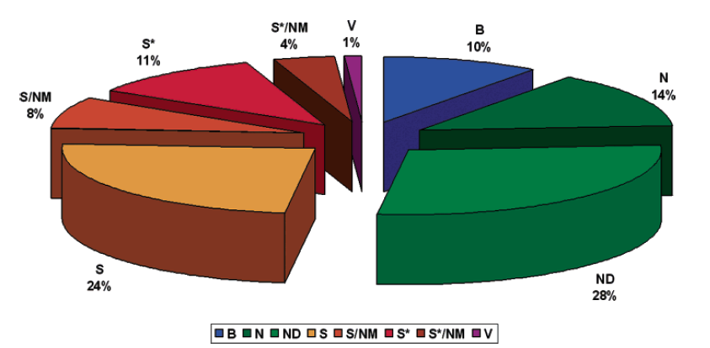
Natural products as a source of anti-cancer drugs
S*/NM
10%
V
1%
B
10%
B, Biological
N, Natural product.
ND, Derived/modified from a natural product.
NM, Natural product mimic.
S, Totally synthetic drug
S*, Synthetic, but the pharmacophore was from a natural product.
V, Vaccine.
S*
11%
N
14%
S/NM
8%
S
24%
ND
28%
Newman DJ, et al. J. Nat. Prod. 2007, 70, 461-477.
The discovery of new differentiation agents from natural products has been slow ...

Slide 28

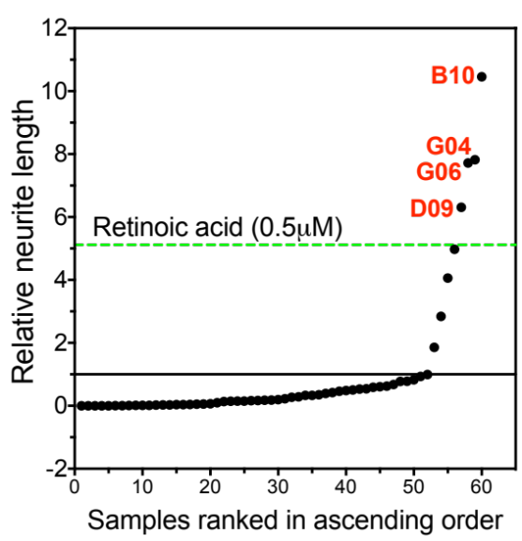
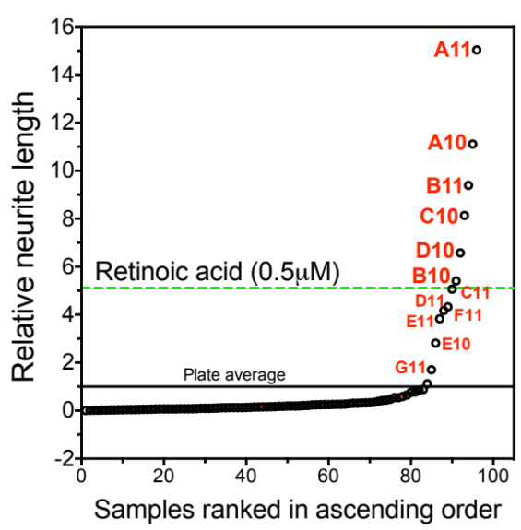
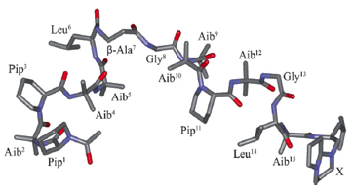
Results
HCS screen of natural products derived from the Great Lakes fungi
Crude extracts
Fractionation
Compounds
G04, G06, G09
Compound X
Collaboration with Dr. Susan Mooberry at UT Health Science Center and Dr. Robert Cichewicz at University of Oklahoma

Slide 29
Outline
High-Content Screening for differentiation-inducing agents
Drugs & targets
Natural products
Synthetic compounds
Drugs
microRNAs
Drugs/Drug targets for differentiation therapy

Slide 30
Acknowledgements
Du Lab
Zhenze Zhao, PhD
Daniel Hernandez
Michaela Sousares
Veronica Partridge
Spencer Shelton
Former members:
Adam Kosti
Derek Sung
Univ. of Texas Health Science Center at San Antonio
Susan Mooberry, PhD
April Risinger, Andrew Robles
Alexander Pertsemlidis, PhD
Xiuye Ma, Xiaojie Yu
Yindong Chen, PhD
Tzu-Hung Hsiao, Yuanhang Liu,
Harry Chen
Univ. of Oklahoma
Robert Cichewicz, PhD
Lin Du, Jarrod B. King
DoD PRMRP Discovery Award (Du)
IIMS/CTSA Pilot Award (Du)
R01 (Mooberry, Cichewicz)
Bank of American Shelby Rae Tengg Foundation ( Du)
Texas State University Startup(Du)

