Slide 1
About OMICS Group
OMICS Group International is an amalgamation of Open Access publications and worldwide international science conferences and events. Established in the year 2007 with the sole aim of making the information on Sciences and technology ‘Open Access’, OMICS Group publishes 400 online open access scholarly journals in all aspects of Science, Engineering, Management and Technology journals. OMICS Group has been instrumental in taking the knowledge on Science & technology to the doorsteps of ordinary men and women. Research Scholars, Students, Libraries, Educational Institutions, Research centers and the industry are main stakeholders that benefitted greatly from this knowledge dissemination. OMICS Group also organizes 300 International conferences annually across the globe, where knowledge transfer takes place through debates, round table discussions, poster presentations, workshops, symposia and exhibitions.

Slide 2
About OMICS Group Conferences
OMICS Group International is a pioneer and leading science event organizer, which publishes around 400 open access journals and conducts over 300 Medical, Clinical, Engineering, Life Sciences, Phrama scientific conferences all over the globe annually with the support of more than 1000 scientific associations and 30,000 editorial board members and 3.5 million followers to its credit.
OMICS Group has organized 500 conferences, workshops and national symposiums across the major cities including San Francisco, Las Vegas, San Antonio, Omaha, Orlando, Raleigh, Santa Clara, Chicago, Philadelphia, Baltimore, United Kingdom, Valencia, Dubai, Beijing, Hyderabad, Bengaluru and Mumbai.

Slide 3


Virulence and Transmission of Bacteria Inducing Tooth Decay
Ling Zhan
University of California, San Francisco

Slide 4
What is Dental Caries?
Dental caries is tooth decay
Specific bacteria (mutans streptococci and lactobacilli …) on the tooth surface metabolize fermentable carbohydrates and generate acids as waste products
Acids diffuse into the tooth and dissolve mineral

Slide 5
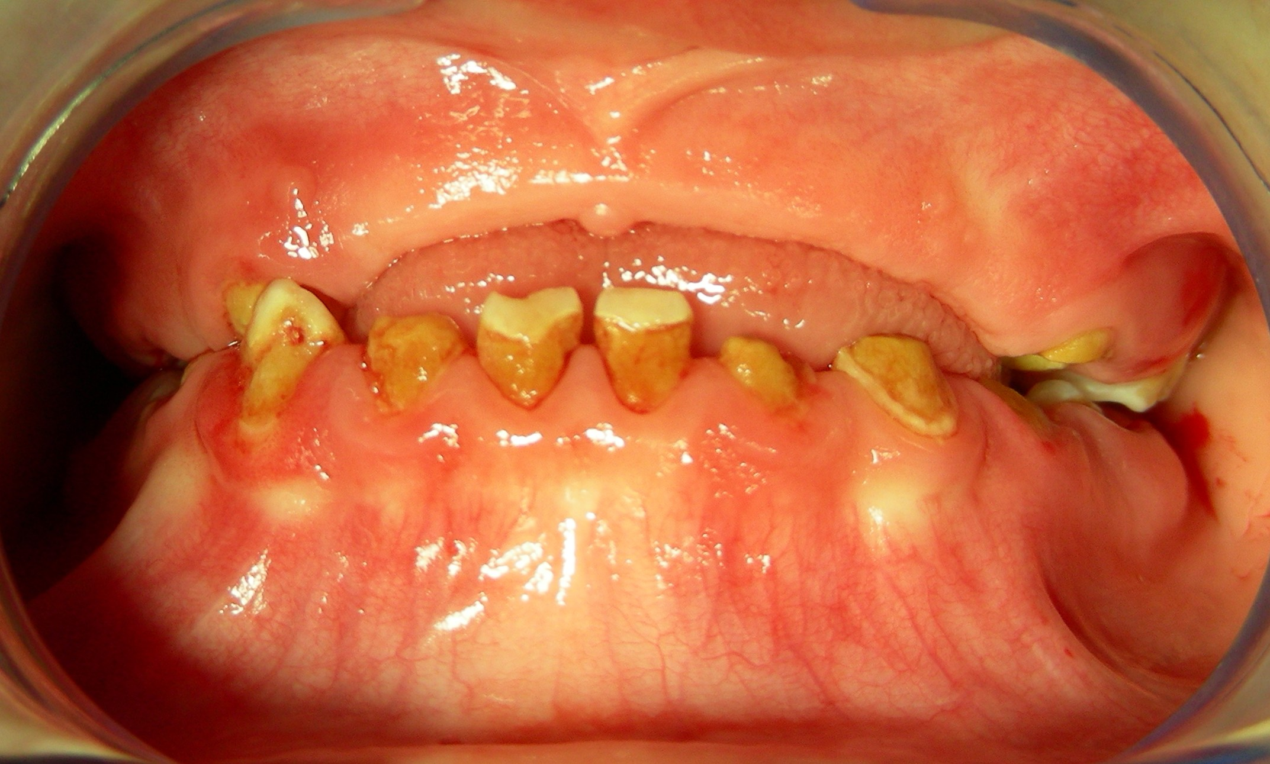
Dental Caries is the most prevalent chronic infectious disease in children in the U. S.
Dental caries affects
  28% of 2-5 yrs old
  49% of 6-11 yrs old
15% children accounts for 85% of total decay
Cost of treating caries under GA- $15-20K/visit
Annual cost to treat dental caries is $4.5 billion in the U.S.
Notes:
what is dental caries. Dental caries is tooth decay
I hope this picture is not too disturbing but it illustrates common patients we see daily under general anesthesia as a pediatric dentist.
This is the mouth of a two year old girl whose teeth were decaying away while erupting. In the surgery, we could only save two of her baby teeth. Meaning that she will have no teeth for chewing until she is 6-7 year old when her permanent teeth erupt.
Dental caries is the most prevalent chronic infectious disease in children in the US.
It affects 28% of 2-5 yo and 49% of 6-11 yo
More over, because it is an infectious disease, drilling and filling do not cure dental decay, 40-50…
Cost of……GA
Annual cost of …

Slide 6
Tooth Decay: Transmissible Infectious Disease
Mutans streptococci (MS) - major cariogenic bacteria
Birth – 2 years: critical time for MS transmission
MS can be transmitted from caregivers, siblings or playmates who the child have close contact with
Children with early MS colonization- 4 times more likely to develop tooth decay
Routine fillings can not reduce MS levels and prevent future tooth decay
Notes:
We can not emphasis enough that dental caries is a transmissible infectious disease.
MS is the major ca…., over 99% of children with dental decay have moderate to high levels of MS infection
MS can be Transmitted…
Children with early…..before age 2 are 4 times…
Certain virulence factors of MS, such as antimicrobial protein to help them fighting competitive bacteria in oral cavity are related to development of SECC and transmission of Mutans streptococci
These facts may help to explain why the distribution of dental decay is highly skewed that 15%......

Slide 7
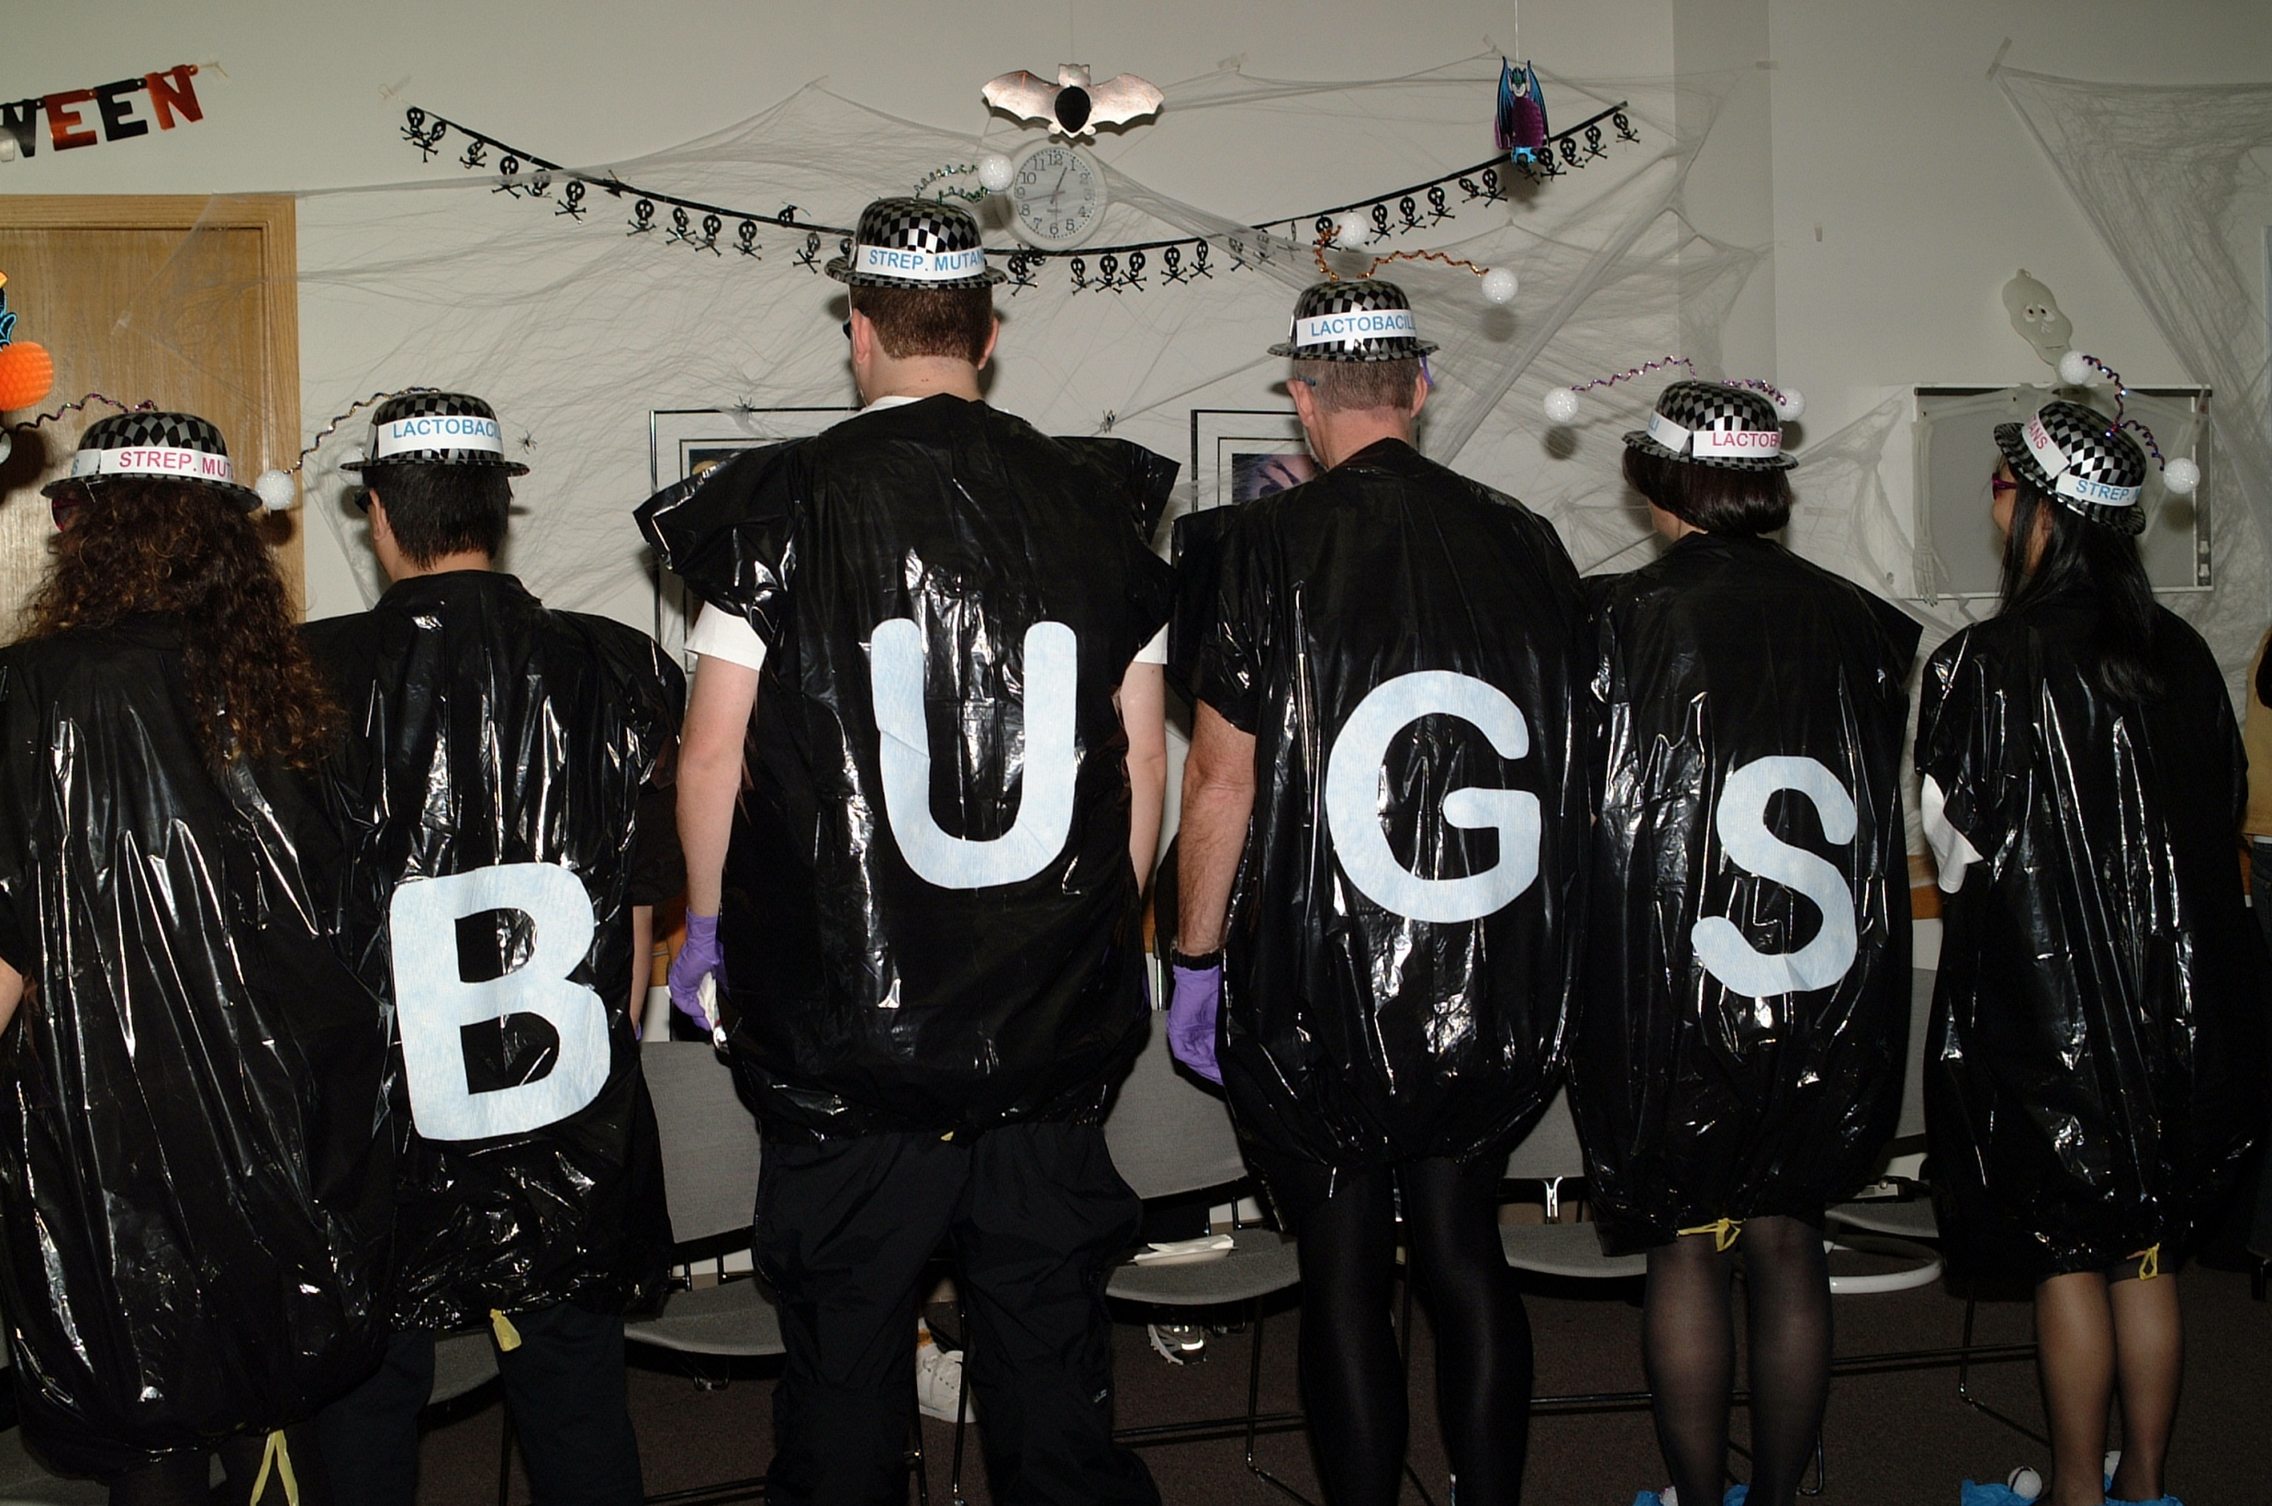
What to do to break the chain and reduce the infection?

Slide 8
Factors related to maternal transmission of mutans streptococci in high-risk children-pilot study.
Zhan L, Tan S, Den Besten P, Featherstone JD, and Hoover CI.
Pediatr Dent. 2012;34(4):e86-91

Slide 9
10 Mother-Child pairs recruited
Mother:≥ 1 carious lesion Child: 2-5 years old
Salivary MS enumeration on MSSB plates
10 MS colonies isolated from each subject
AP-PCR to verifytransmission of MS
Transmitted strains
Non- transmitted strains
Biofilm assay
Mutacin assay
Biofilm assay
Mutacin assay
Notes:
In the study

Slide 10
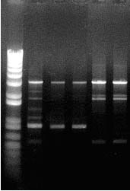
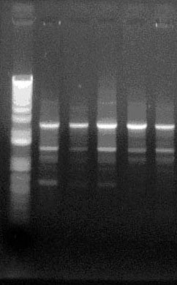
Determination of Different Strains
AP-PCR results for mother-child pair #4
Primer OPA-05
Primer OPA-13
Mother
Child
Mother
Child
DNA ladder
DNA ladder
1 2 3 4 5
1 2 3 4 5
Transmitted strain
Transmitted strain

Slide 11
Result
Only 7 out of 36 genotypes (20%) from mother transmitted to children
Only only 40% of the young children had MS genotypes from their mothers
60% of children had no MS from their mothers
90% of children had MS from other sources.

Slide 12
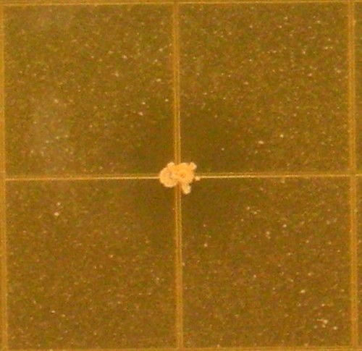
Mutacin Activity Assay
MS isolates
Inhibition zone
Reference Strains
S. sanguinis 10556
S. gordonii 10558
S. mutans25175
S. sobrinus 6715
Notes:
The mutacin activities of MS were evaluated in the previous study using an overlay method with 4 reference strains that are s. gordonii s. mutans, s. sanguinis, and s.sobrinus.
You can see in this picture an example of the overlay method, the MS of interest was inoculated in the center of the plate and allowed to grow for 48 hours.
Then another layer of culture medium containing bacteria, either of these 4 strains was overlaid and allowed to grow for 48 hours
If the MS of interest produced mutacin, an inhibition zone would be observed.
The mutacin activity of each tested MS genotype against the four reference bacteria was evaluated by measuring the radius of inhibition zone.
S. sobrinus, S. mutans, S. gordonii, S. sanguinis
S. Gordonii and S. sanguis

Slide 13
MutancinFormation and Transmission of MS
p=.45 P=.42 P=.09 P<.05
Transmitted MS strains produced significantly more mutacin against S. sobrinus (p<0.05).

Slide 14
Full Genomic Sequencing study on MS from children with ECC or caries Free
(Ling Zhan, Michael Fischbach, Mohamed AbouDonia and Joe DeRisi)
High-throughput Illumina sequencing on MS from children with severe ECC or with no caries
Data analyzed by PRICE system
100% of MS full genomes are covered

Slide 15
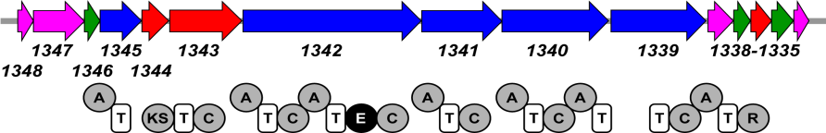
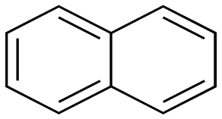
Approach
67 clinical strains (ECC and Caries-free)
Functional assays
Bioinformatics
Illumina
Sequencing
(2 lanes)
Chemistry
Functional Data
Biosynthetic gene clusters
Small molecules

Slide 16
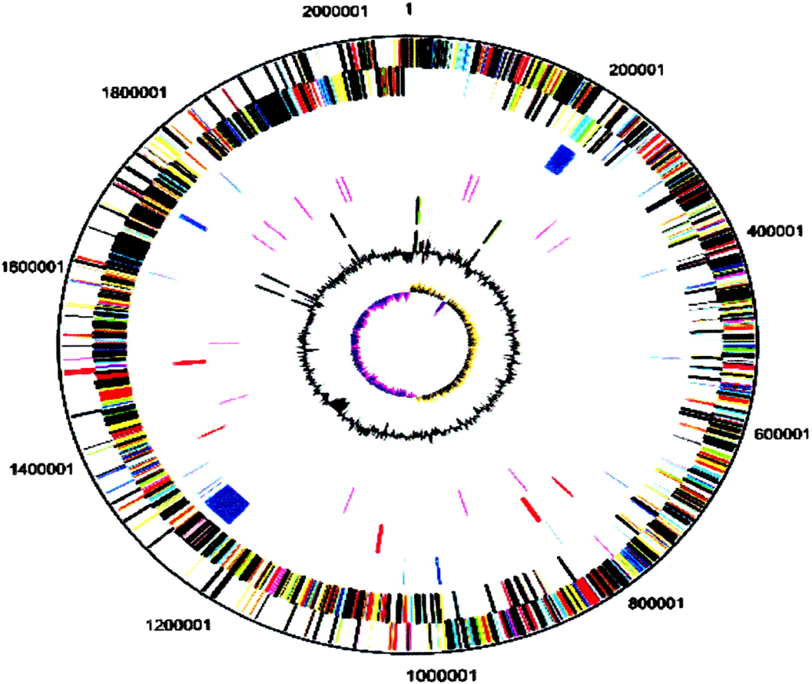
Genomes of S. mutans isolatesare virtually identical except for islands harboring biosynthetic gene clusters for small molecules
S. mutans UA159 genome
A5
A2
A7
A3
A9
A8
A6
A1
A4

Slide 17
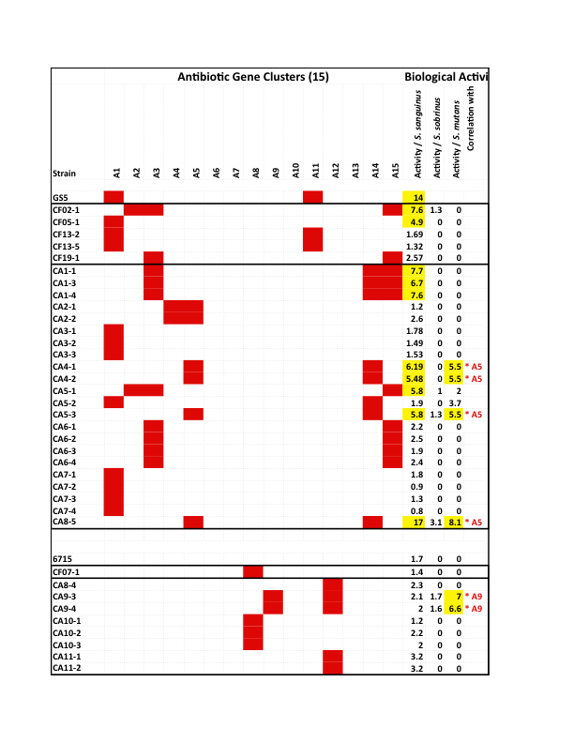
Antibiotic Peptide Cluster of MS by Genomic Sequencing from Children with/without Caries
S. sobrinus
S. mutans
ECC
ECC
CF

Slide 18
Biosynthetic Genes in Transmitted and
Non-transmitted MS
*
A10 gene significantly related to non-transmission (P=.02).
Notes:
Here are the results.
The first aim of current study is to investigate whether mutacin genes are related to the transmission of MS. If it is related to transmission, we would expect differences in the presence of the gene in transmitted and non-transmitted bacteria group.
This chart shows the presence of 10 mutacin genes in transmitted and non transmitted MS.
The vertical axis is the percentage of the presence of each gene in the bacteria.
Along Horizontal axis listed 10 different genes.
Blue bar stands for non-transmitted MS group, while red bar stands for the transmitted MS group.
No thio 2 gene was found in either of the tested MS group.
These 2 genes showed at the same percentage in both groups.
The presence of these 3 genes were slightly higher in the transmitted MS group but the differences were not statistically significant.
The presence of these 3 genes were higher in the non-transmitted MS group but it was not significantly different.
The MutK8 gene presents in about half of non-transmitted MS but not at all in transmitted group. The difference is statistically significant.
This result indicates that mutk8 may be related to transmission of MS.
Presence of MutK8 gene was significantly related to non-transmission of SM (Fisherexacttest, P=.02).

Slide 19
Results
Not all maternal MS genotypes were transmitted
Mutacin production may related the transmission
Further study needed to investigate the function of biosynthetic genes in MS transmission

Slide 20
Multi-generational colonization by mutans streptococci in early childhood caries
J. Rahman, JDB Featherstone, L. Zhan, & C.I. Hoover
Determine the multi-generational transmission of MS in ECC families where grandmothers provide significant childcare (≥20 hours/week)
10 grandmother-mother-child triads recruited
10 MS isolates collected from each subjects
MS transmission studied by AP-PCR to determine the extent of multi-generational transmission of MS

Slide 22
Patterns and rates of MS transmission
Transmission Pattern | #/total groups | %
G-M-C | 1/9 | 11%
G-M | 1/9 | 11%
M-C | 3/10 | 30%
G-C | 4/9 | 44%

Slide 23
Conclusion
Demonstrated multigenerational transmission mode of MS in ECC families
Support more broadly based family-oriented strategies are needed to reduce MS transmission and the incidence of ECC.

Slide 24
Genotypic Diversity and Horizontal Transmission of Mutans Streptococci in Children Aged 5-6 Years.
S Domejean, L Zhan, JD Featherstone et al.
Horizontal transmission of MS was studied in a cohort of 95 5-6 yr old kindergarten children in 3 Bay-Area schools.
J. Dent. Res. 2010

Slide 25
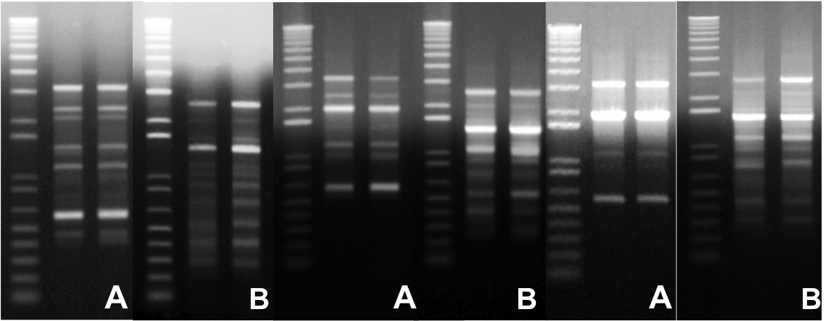
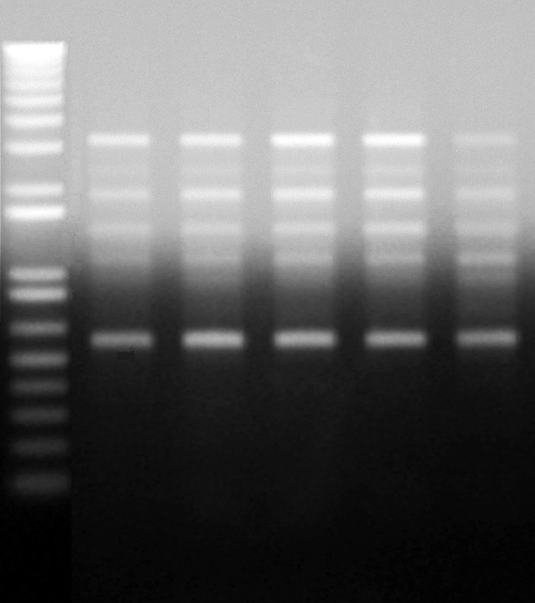
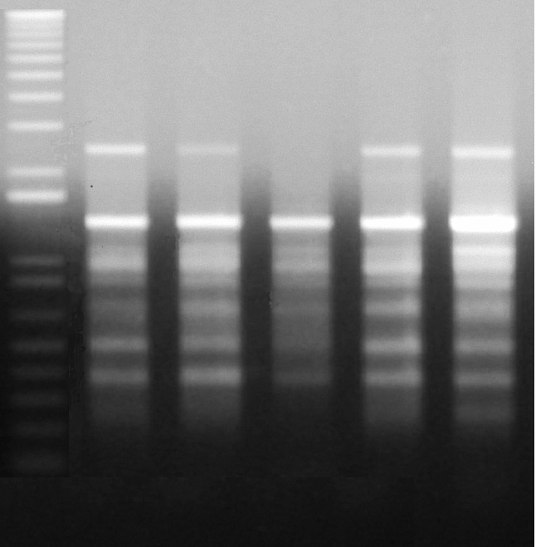
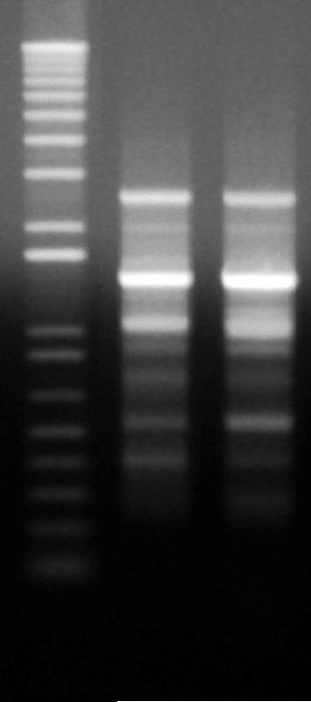
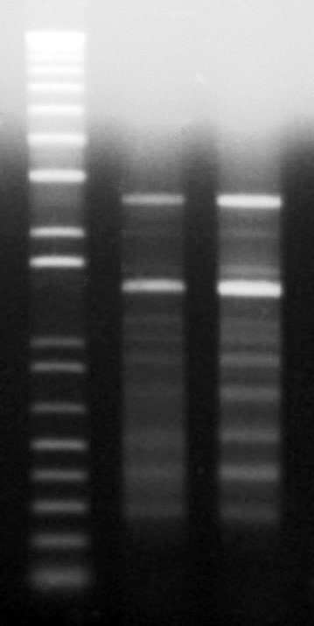
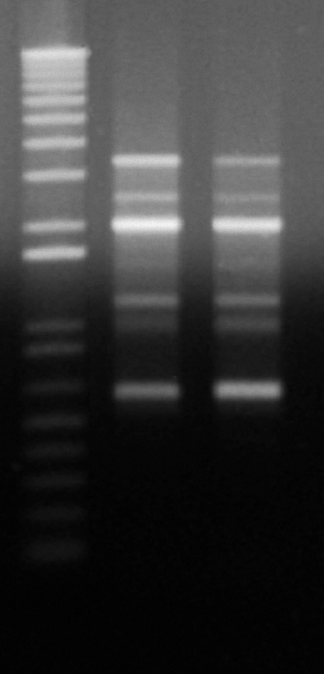
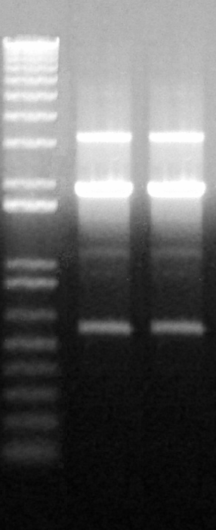
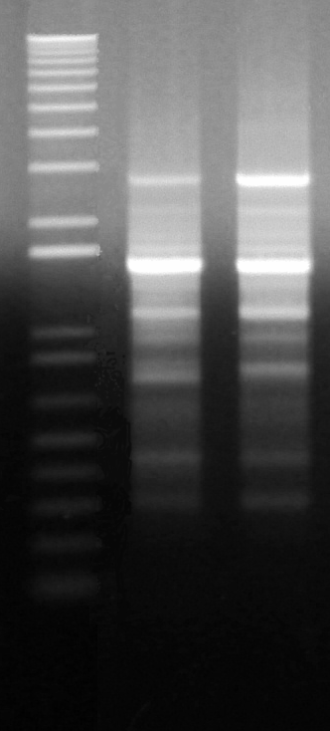
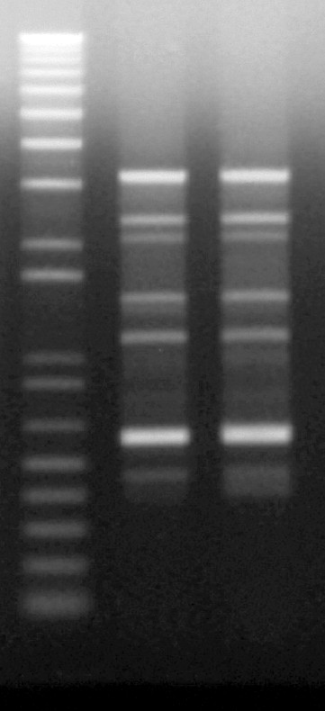
AP-PCR pattens of 3 pairs of subjects sharing S. mutans strains
Pair 1
Pair 2
Pair 3
A. primer OPA 05 B. primer OPA 13
A
B
Pair 1
Pair 1
Pair 1
Pair 2
Pair 2
Pair 2
Pair 3
Pair 3
Pair 3
Pair 1
Pair 1
Pair 1
Pair 2
Pair 2
Pair 2
Pair 3
Pair 3
Pair 3
Pair 1
Pair 1
Pair 2
Pair 2
Pair 3
Pair 1
Pair 2
Pair 3
Pair 3
Pair 1
Pair 2
Pair 3
Pair 1
Pair 2
Pair 3
Pair 1
Pair 2
Pair 3
Pair 1
Pair 2
Pair 3
Pair 1
Pair 2
Pair 3
Pair 1
Pair 2
Pair 3
A
A
A
A
A
A
A
A
A
A
A
B
A
B
B
B
B
B
B
B
B
B
B
A
B
A
A
A
A
A
A
A
B
A
B
B
B
B
B
B
B
A
B
A
A
A
A
B
A
B
B
B
B
A
A
A
B
A
B
A
B
A
B
A
B
A
B
A
B
Figure 2. AP-PCR gel of 3 pairs of subjects sharing S. mutans strains
A. primer OPA 05 B. primer OPA 13
A
B
A
B
A
B
Figure 2. AP-PCR gel of 3 pairs of subjects sharing S. mutans strains
A. primer OPA 05 B. primer OPA 13
A
B
A
B
A
B
A
B
A
B
A
B
B
B
B
Figure 2. AP-PCR gel of 3 pairs of subjects sharing S. mutans strains
A. primer OPA 05 B. primer OPA 13
Figure 2. AP-PCR gel of 3 pairs of subjects sharing S. mutans strains
A. primer OPA 05 B. primer OPA 13
Figure 2. AP-PCR gel of 3 pairs of subjects sharing S. mutans strains
A. primer OPA 05 B. primer OPA 13
Figure 2. AP-PCR gel of 3 pairs of subjects sharing S. mutans strains
A. primer OPA 05 B. primer OPA 13
Figure 2. AP-PCR gel of 3 pairs of subjects sharing S. mutans strains
A. primer OPA 05 B. primer OPA 13
Figure 2. AP-PCR gel of 3 pairs of subjects sharing S. mutans strains
A. primer OPA 05 B. primer OPA 13

Slide 26
Conclusion
Pair 1
Pair 2
Pair 3
A
A
B
A
B
B
The presence of matching genotypes of S. mutans in 3 pairs of children indicates horizontal transmission of this species between kindergarten children.

Slide 27
Mother, father, or other care givers
Vertical transmission
Mutans Streptococci (MS)
Primary teeth
MS
Intimate playmates
Spouse or partner
Horizontal transmission
Permanent teeth
MS

Slide 28
Caries is a Transmissible Infection
We Need to Break the Chain
Bacteria Testing and Antibacterial Therapy

Slide 29
Let Us Meet Again
We welcome you all to our future conferences of OMICS Group International
Please Visit:
www.omicsgroup.com
www.conferenceseries.com

