Slide 1
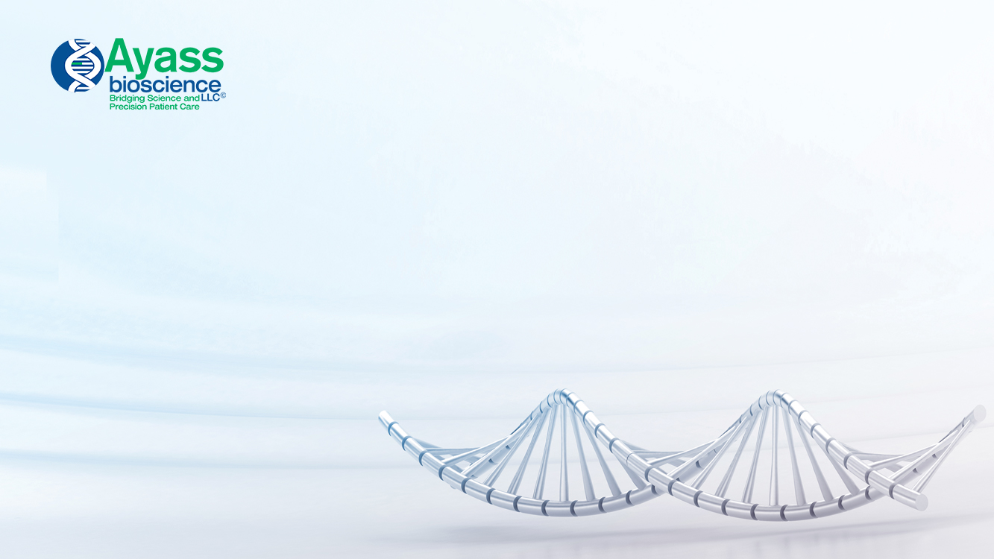
Genetics in Oncology,
Lina Abi Mosleh, PhD
8501 Wade Blvd, Building 9
Frisco, TX 75034
Office: (800)-778-9460
Cell: (325) 260- 1077
Fax: (972) 668- 6720
www.AyassBioScience.com

Slide 2
‘Bridging Science And Precision Patient Care’
Ayass Bioscience, Inc. is an innovative clinical laboratory and healthcare center that offers leading-edge testing.

Slide 3
Goals
Provide Early Detection of disease.
2. Provide Monitoring Protocol of disease progression / remission
The above mentioned goals are neither new, nor exclusive to Ayass Bioscience.
We transform assays intended for ‘research use’ into CLIA compliant LDT assays.

Slide 4
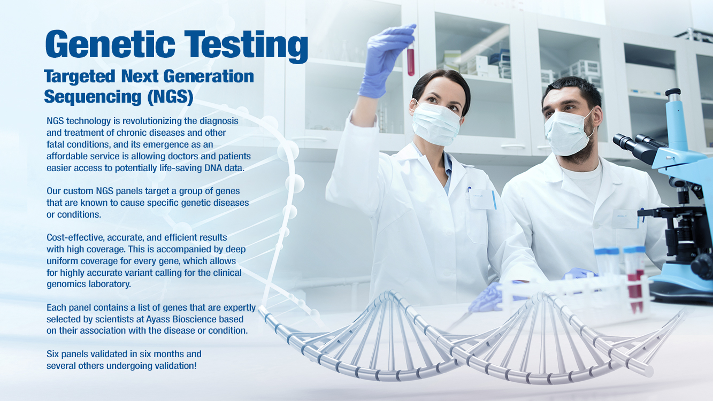

Slide 5
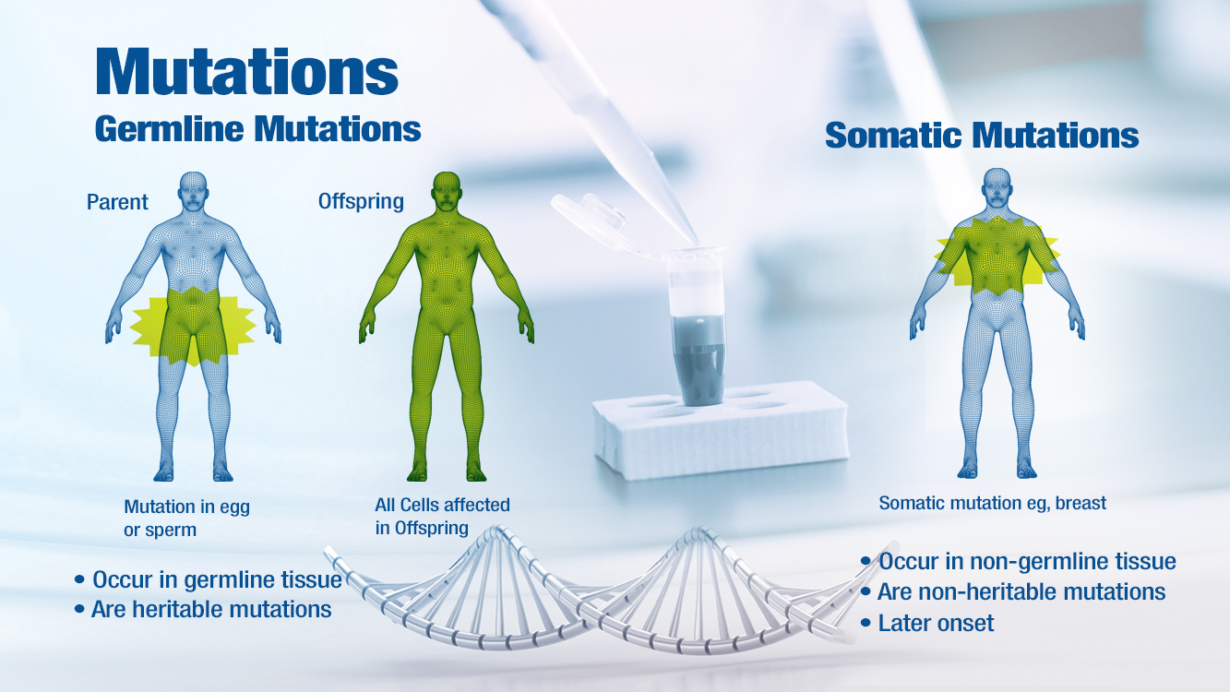

Slide 6
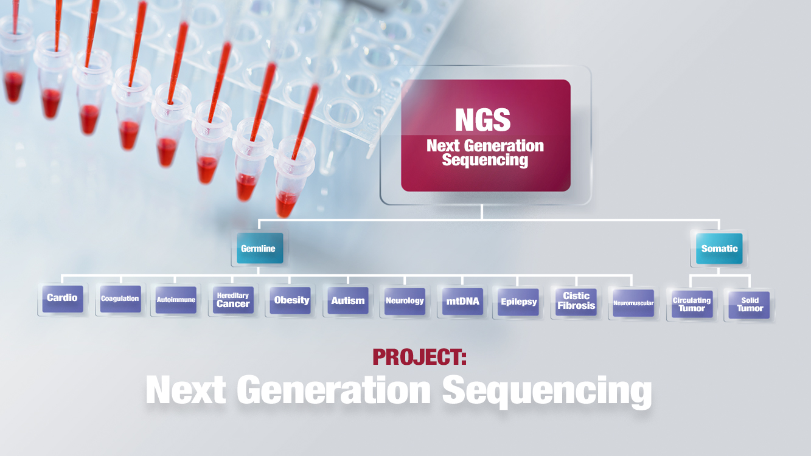

Slide 7
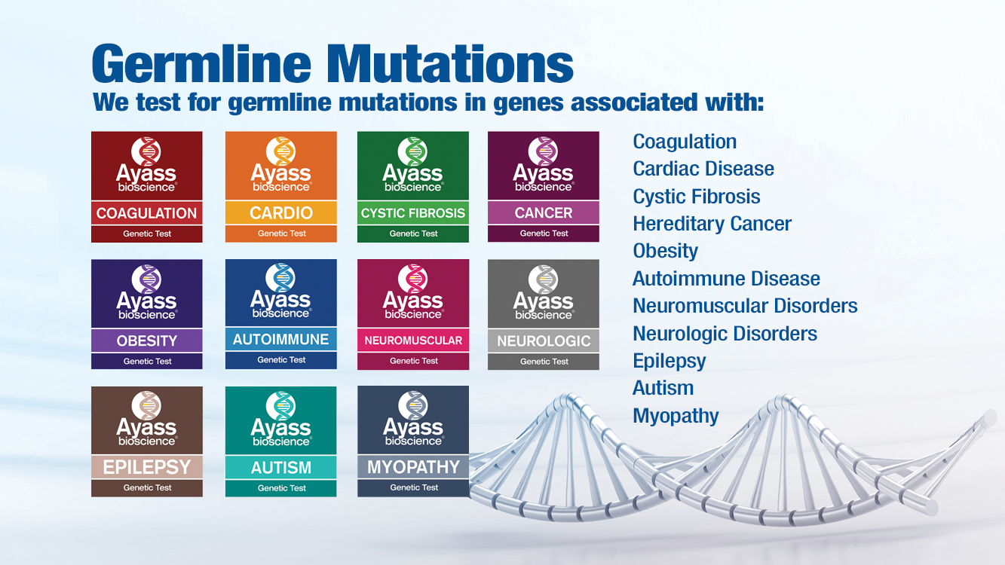

Slide 8
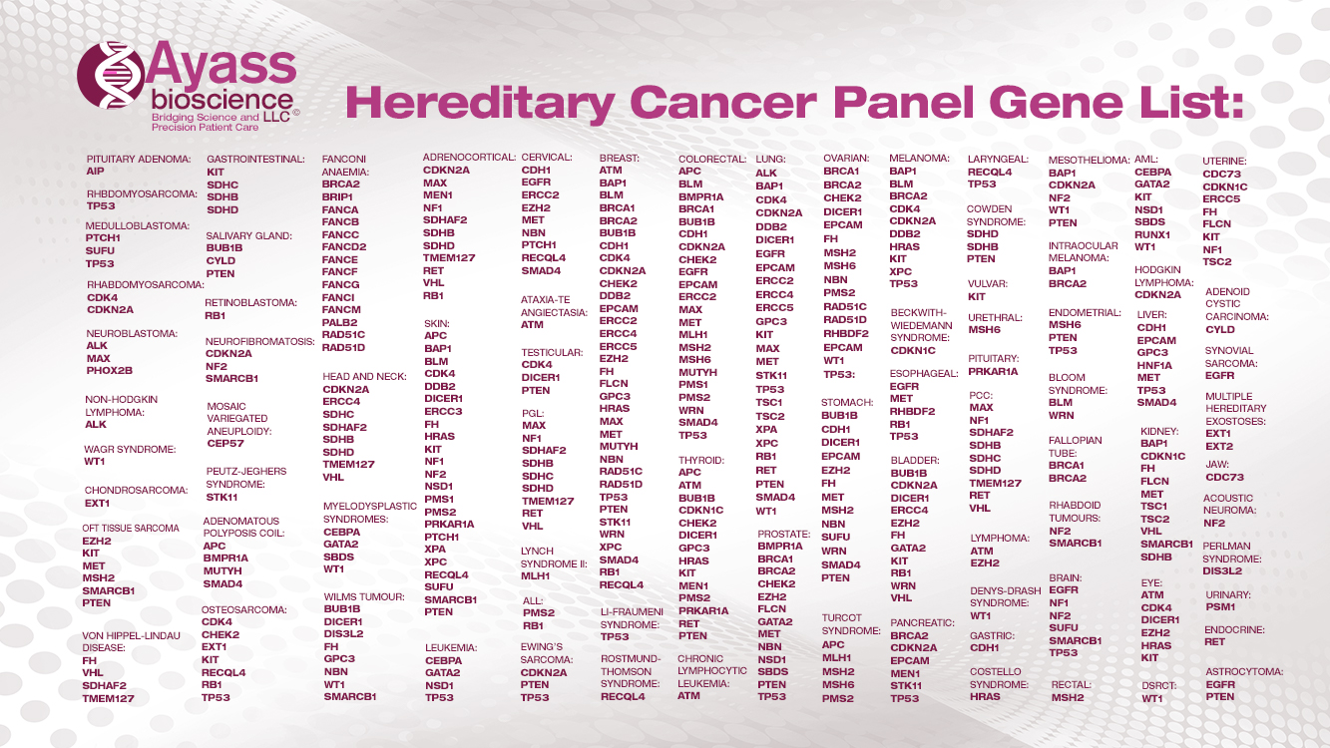

Slide 9
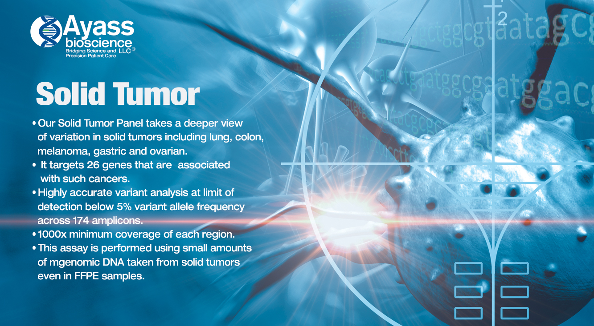

Slide 10
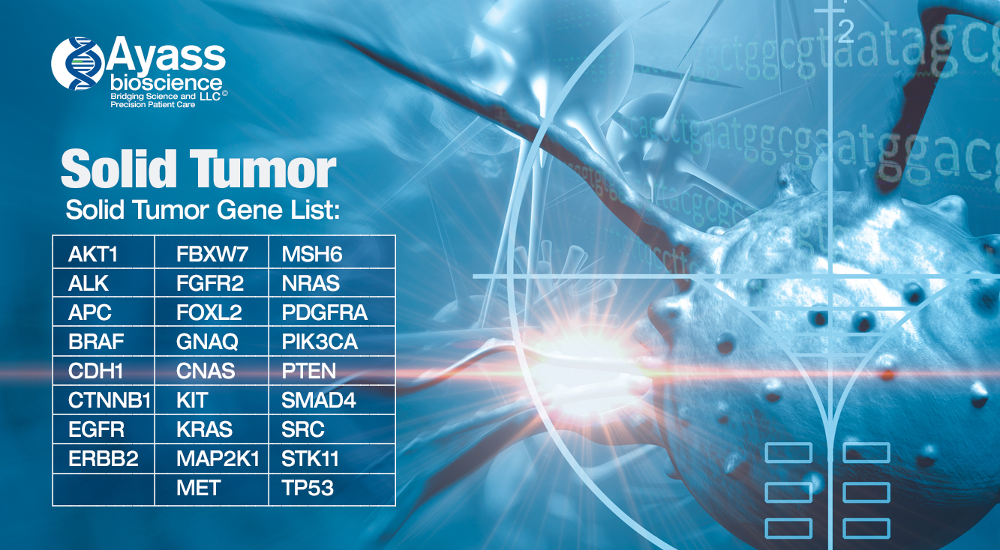

Slide 11

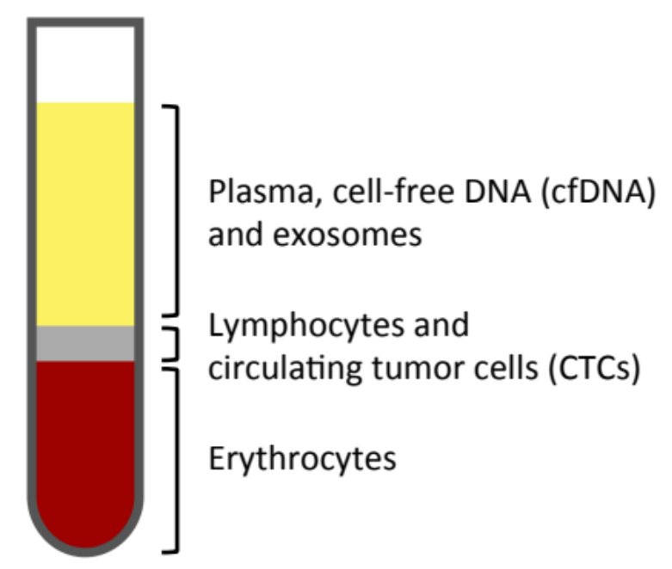
Somatic Mutations
Cell-free DNA (cfDNA): Fragmented genomic DNA released by normal cellular processes (e,g., apoptosis, necrosis, secretion).
Circulating tumor DNA (ctDNA): Highly fragmented (~150bp) DNA that originates from tumor cells.
Cell-free RNA (cfRNA): Released into circulation via exosomes.
Circulating tumor cells (CTCs): Late-stage metastatic tumor cells that enter circulation. CTC cells are rare and their density ranges from 5 to 50 cells per 7.5mL of blood.

Slide 12
Somatic Mutations
Cell-free DNA (cfDNA): Fragmented genomic DNA released by normal cellular processes (e,g., apoptosis, necrosis, secretion).
Circulating tumor DNA (ctDNA): Highly fragmented (~150bp) DNA that originates from tumor cells.
Cell-free RNA (cfRNA): Released into circulation via exosomes.
Circulating tumor cells (CTCs): Late-stage metastatic tumor cells that enter circulation. CTC cells are rare and their density ranges from 5 to 50 cells per 7.5mL of blood.

Slide 13
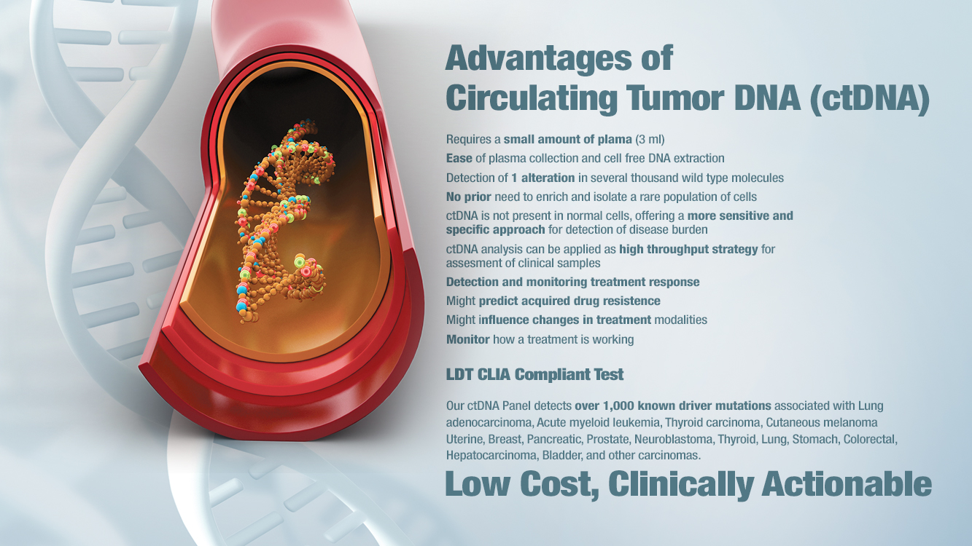

Slide 14
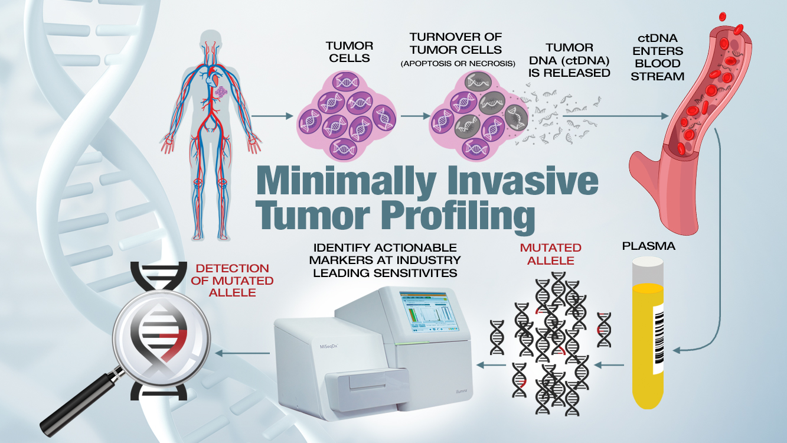

Slide 15
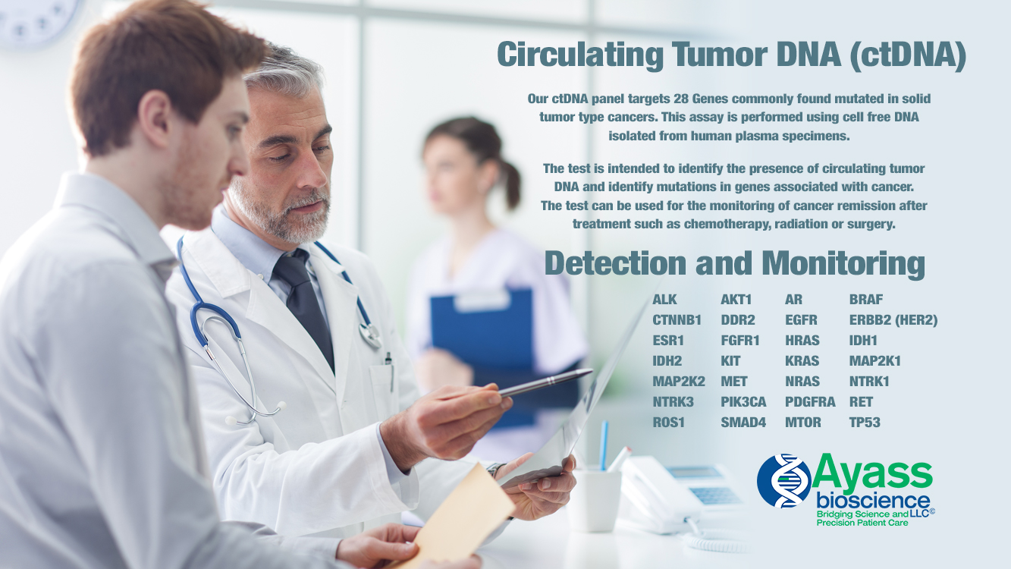

Slide 16
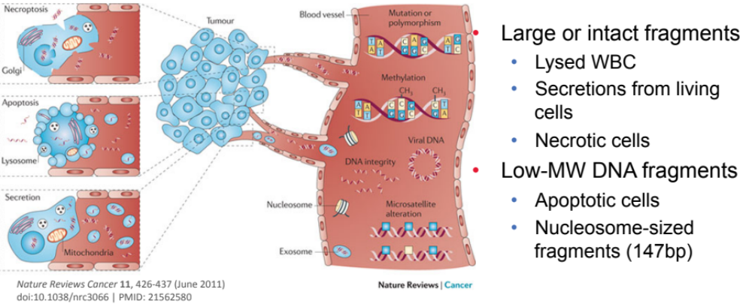
Sources of cfDNA
Large or intact fragments:
Lysed WBC
Secretions from living cells
Necrotic cells
Low-MW DNA fragments:
Apoptotic cells
Nucleosome-sized fragments (147bp)

Slide 17
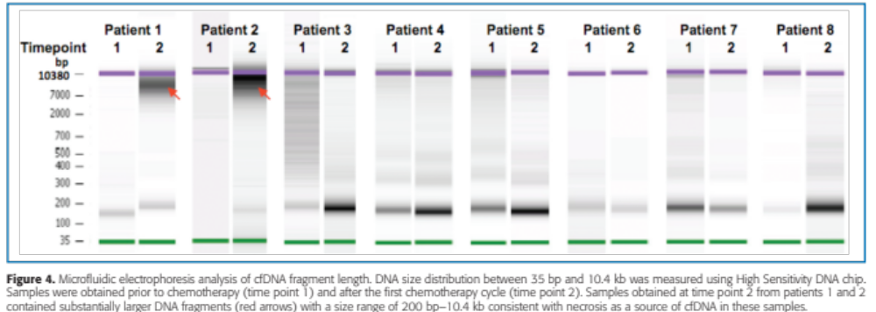
Sources of cfDNA
Cells undergoing apoptosis or necrosis produce different size fragments
• Large fragments from necrotic/lysed cells
• Small fragments derived from apoptosis
We target these fragments (ctDNA)
Kwee et. al., Clinical and Translational Science · February 2012

Slide 18
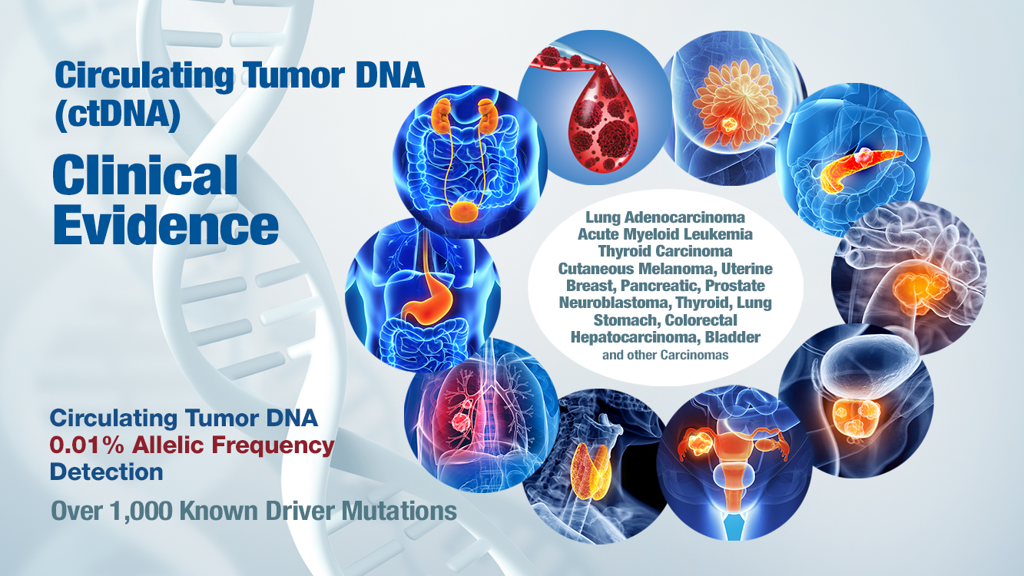

Slide 19
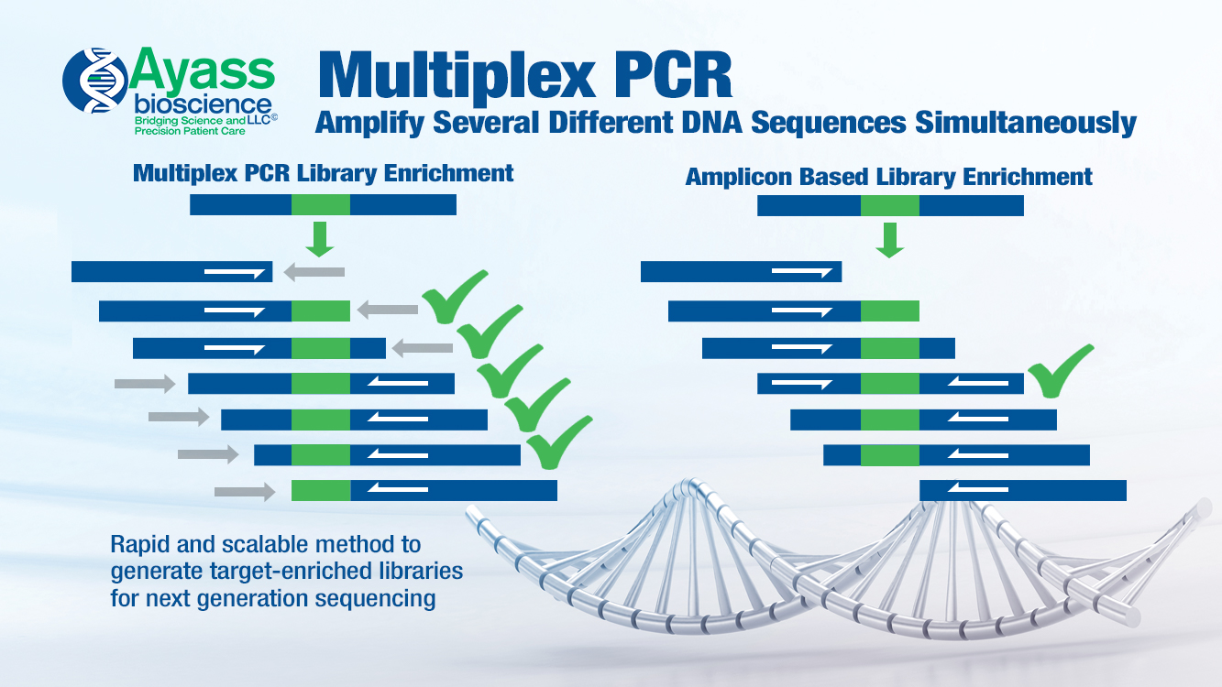

Slide 20
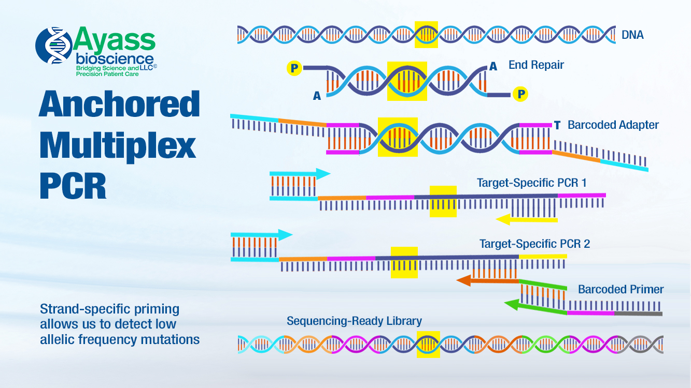

Slide 21
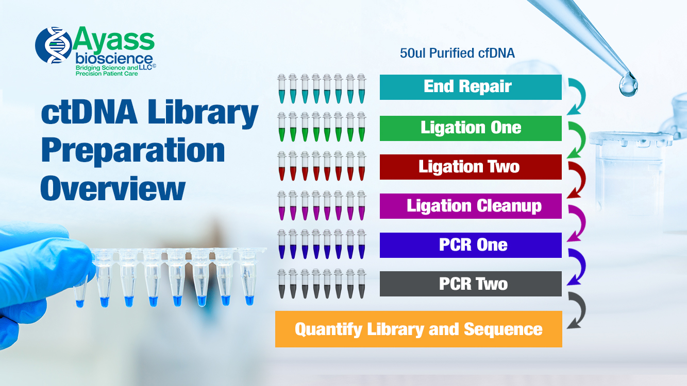

Slide 22
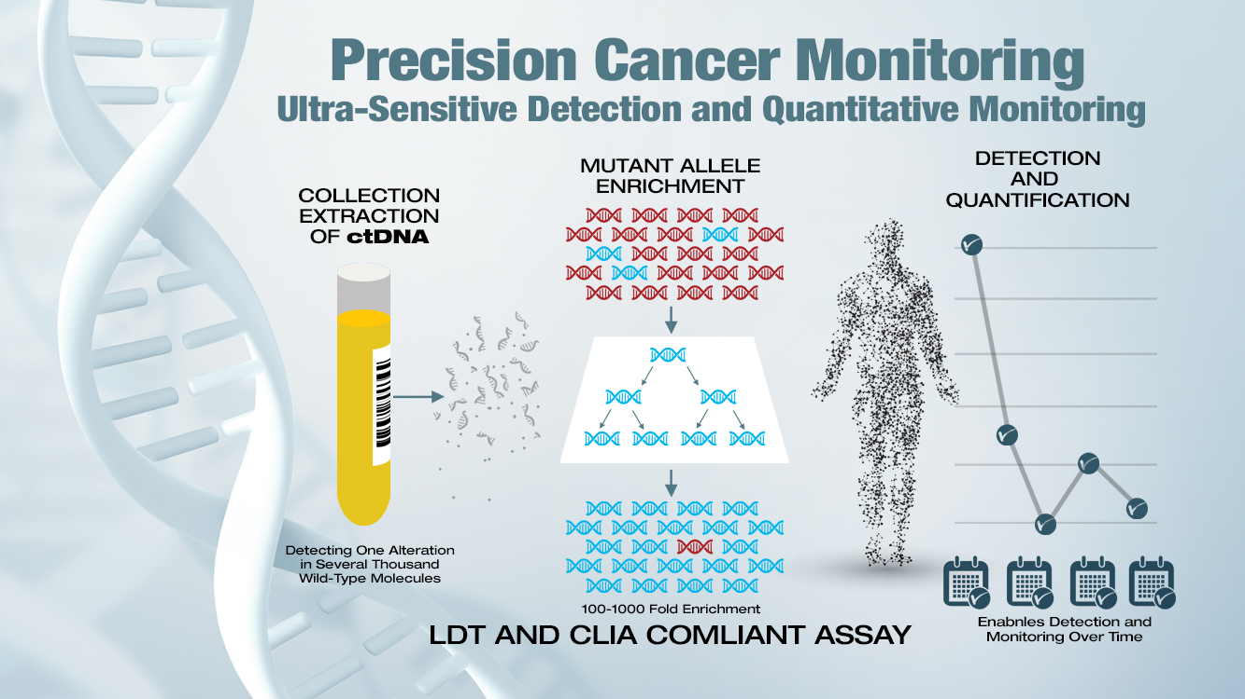

Slide 23
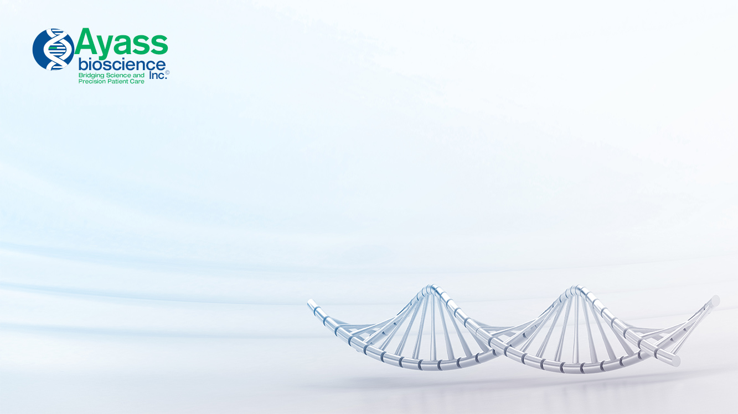

Bridging Everything Together
Background:
  Family history of papillary thyroid carcinoma
What We Know:
  Symptoms are usually not detected in early stages
  Higher incidence rates in females
  Positive family history increases risk 3X-6X
  Progression of cancer becomes more aggressive (Undifferentiated thyroid tumors are the most aggressive and lethal human cancer)

Slide 24

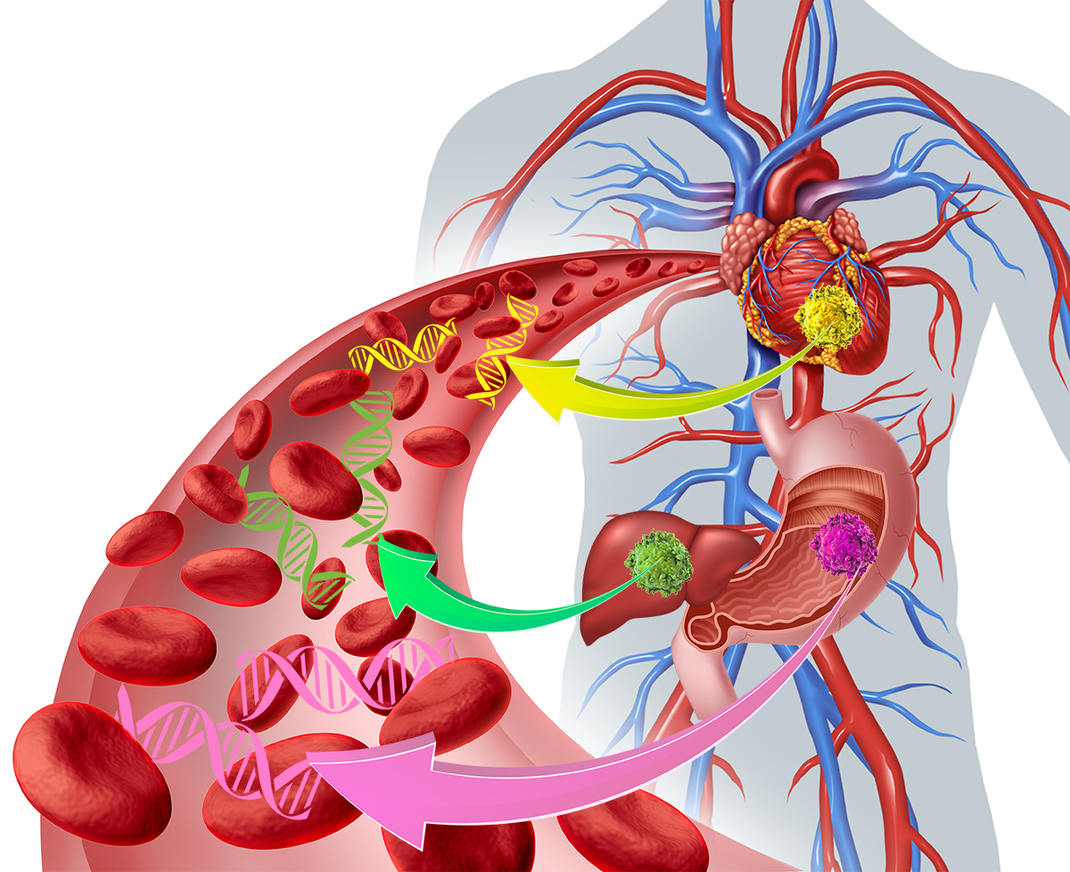
Synopsis of Patient Care Plan
Hereditary cancer panel
Yearly screenings of circulating tumor DNA
Yearly screening of protein biomarkers in plasma
ctDNA
*Multiple Points of Measurement

Slide 25

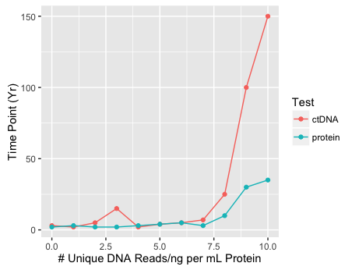
7:14720331
BRAF
V600E
Pathogenic
**Gained mutations in P13K and AKT
Tanaka, et al. 2015. Thyroid Cancer: Molecular Pathogenesis, Tyrosine Kinase Inhibitors, and Other New Therapies. The American Journal of Hematology/Oncology. 11(4):5-9.

Slide 27
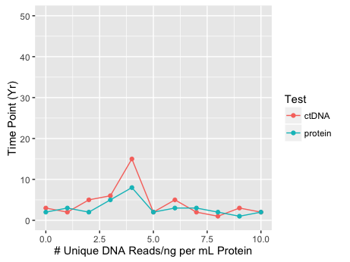
Benefits of Early Diagnosis and Continued Monitoring
Early treatment has a high cure rate
Recurrent thyroid cancer is very aggressive, early detection is vital to outcome
Begin another round of treatment

Slide 28
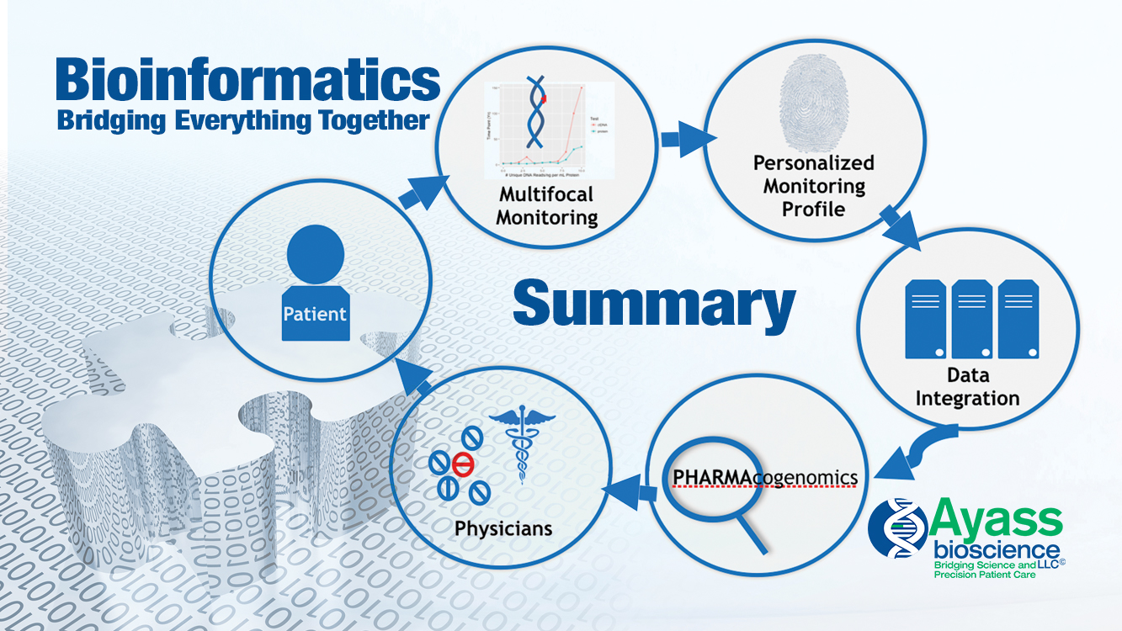

Slide 29
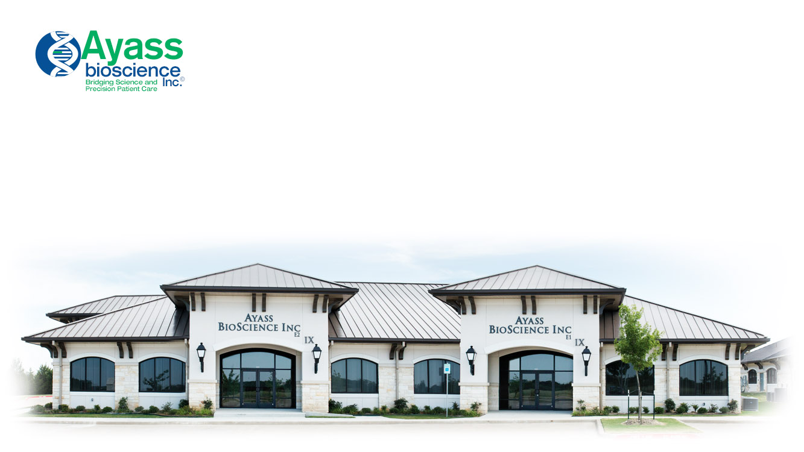

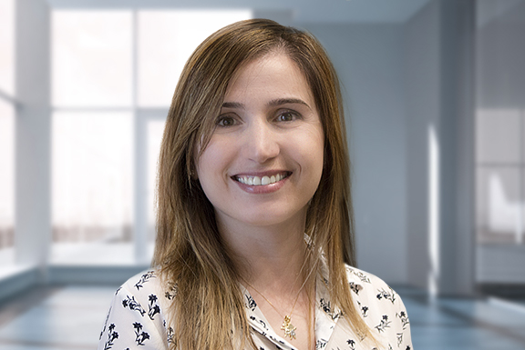
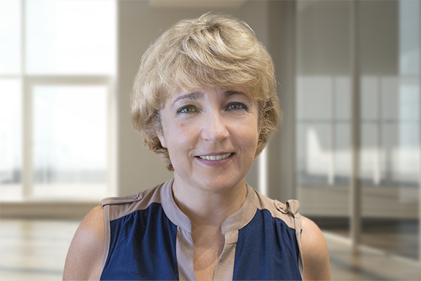
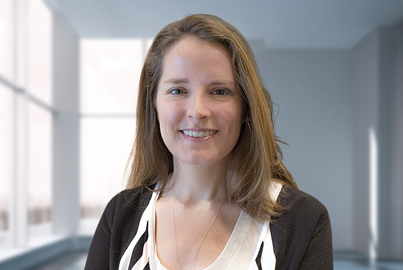
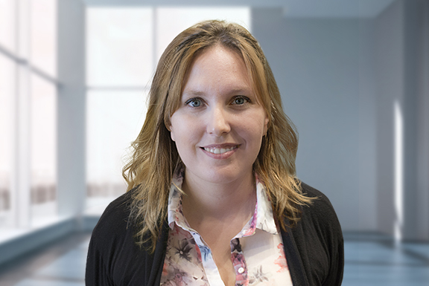
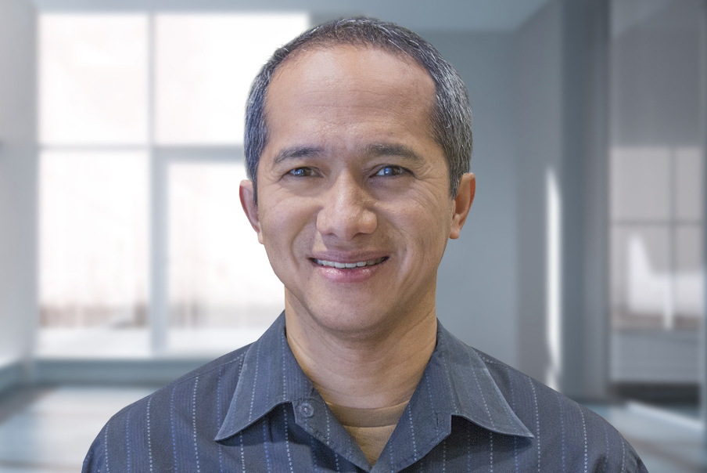
The Genetic Testing Scientific Team
Mohamad Ayass, MD
President
Lina Abi Mosleh, Ph.D.
Principal Scientist
Natalya Griko, Ph.D.
Molecular Biology Scientist
Ashlyn Campbell, M.S.
Bioinformatician
Milica Milivojevic, M.S.
Molecular Biologist
Angelo Josue M. Lubag Jr., Ph.D.
Molecular Biology Scientist

Slide 30
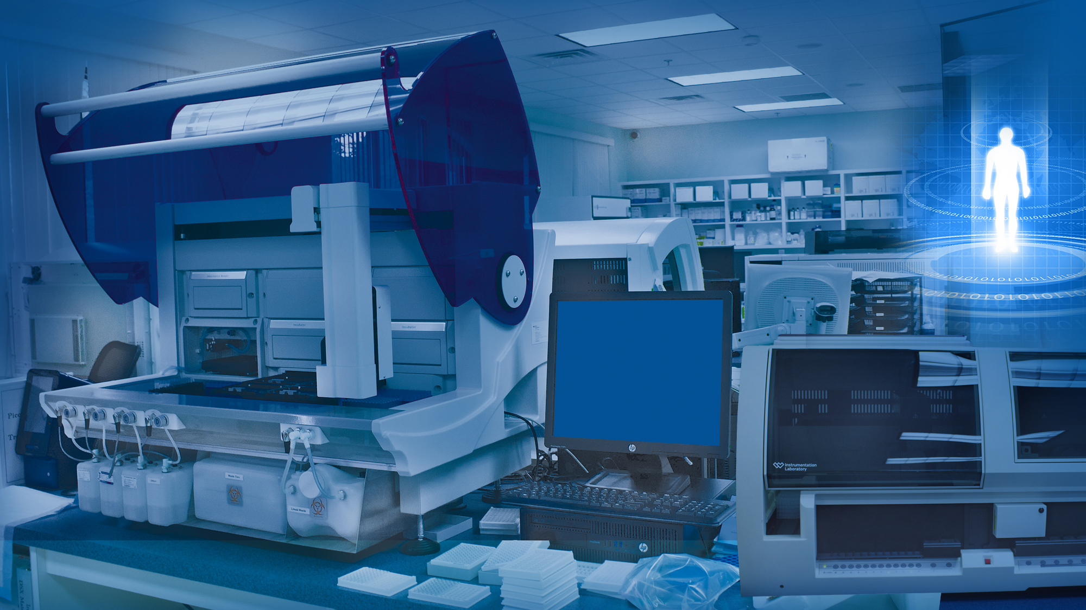
Clinical Testing

