Slide 1
About OMICS Group
OMICS Group International is an amalgamation of Open Access publications and worldwide international science conferences and events. Established in the year 2007 with the sole aim of making the information on Sciences and technology ‘Open Access’, OMICS Group publishes 400 online open access scholarly journals in all aspects of Science, Engineering, Management and Technology journals. OMICS Group has been instrumental in taking the knowledge on Science & technology to the doorsteps of ordinary men and women. Research Scholars, Students, Libraries, Educational Institutions, Research centers and the industry are main stakeholders that benefitted greatly from this knowledge dissemination. OMICS Group also organizes 300 International conferences annually across the globe, where knowledge transfer takes place through debates, round table discussions, poster presentations, workshops, symposia and exhibitions.

Slide 2
About OMICS Group Conferences
OMICS Group International is a pioneer and leading science event organizer, which publishes around 400 open access journals and conducts over 300 Medical, Clinical, Engineering, Life Sciences, Pharma scientific conferences all over the globe annually with the support of more than 1000 scientific associations and 30,000 editorial board members and 3.5 million followers to its credit.
OMICS Group has organized 500 conferences, workshops and national symposiums across the major cities including San Francisco, Las Vegas, San Antonio, Omaha, Orlando, Raleigh, Santa Clara, Chicago, Philadelphia, Baltimore, United Kingdom, Valencia, Dubai, Beijing, Hyderabad, Bengaluru and Mumbai.

Slide 3
Statistical Analysis Using RNA-Seq Data from 726 Individual Drosophila
Yanzhu Lin
Lab of Systems Genetics
NHLBI, NIH
10/21/2014

Slide 4
















Drosophila Genetic Reference Panel (DGRP)
Natural Raleigh Population
20 generations of inbreeding
Mackay et al., Nature, 2012; Huang et al., Genome Research, 2014

Slide 5
Measure gene expression via RNA-Seq
in individual flies
in 3 identical
environments
Environment 1
Environment 2
Environment 3
=
=
229
320
352
370
563
630
703
761
in 16 DGRP
genotypes
787
790
804
812
822
850
900
93
in 8 individuals
of both sexes
M
M
M
M
F
F
F
F
M
M
M
M
F
F
F
F
3 X 16 X 2 X 8 = 768 flies in total !

Slide 6
Comprehensive analysis strategy examines
normalization methods, filtering, and models
Raw sequence reads
Raw data quality control
Workflow 1
Workflow 2
Normalize data
Estimate distribution
Filter data
Filter data
Normalize data
Estimate distribution
Fit models; test hypotheses

Slide 7
Raw data quality control
Raw sequence reads
Raw sequence reads
Raw data quality control
Raw data quality control
Verify at least 2.5 M unique mapped reads per fly
Verify sex of each fly
Verify genotype of each fly
Eliminate genes having zero read counts in all flies
Workflow 1
Workflow 2
Normalize data
Estimate distribution
Filter data
Filter data
Normalize data
Estimate distribution
Fit models; test hypotheses

Slide 8
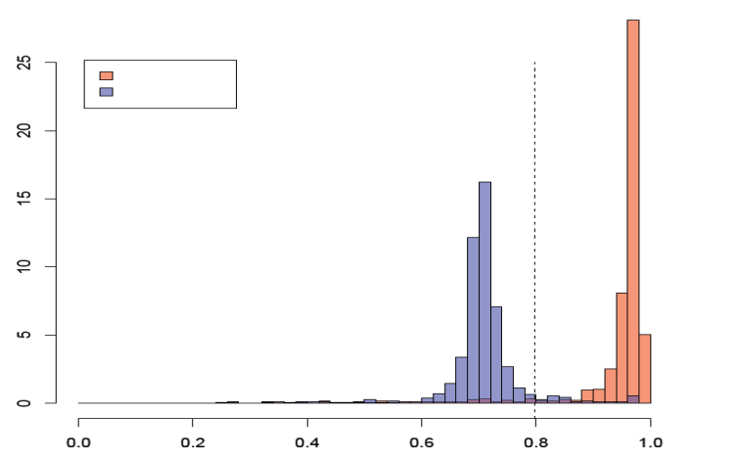
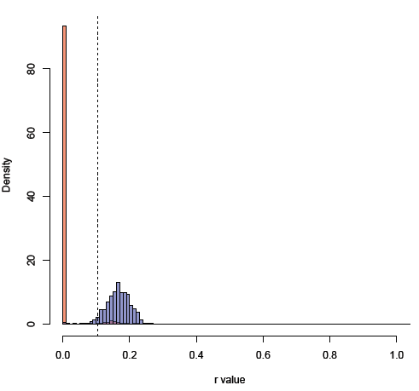

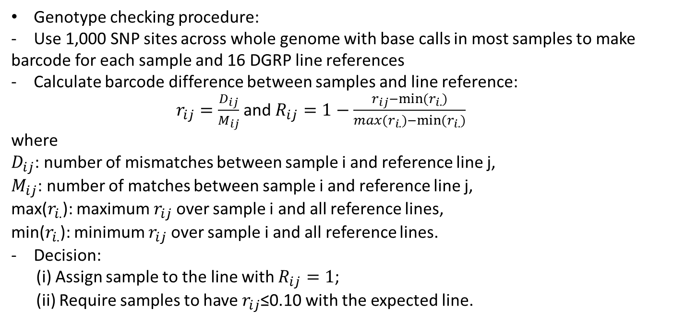
Verify sex and genotype of each fly
Sex checking procedure:
Female/male standard;
Calculate Spearman
correlation of gene expression
of each run and both sex standards
Cutoff: 0.79
0.79
Same sex
Diff. sex
Density
Spearman’s Correlation
Genotype checking procedure:
Use 1,000 SNP sites across whole genome with base calls in most samples to make
barcode for each sample and 16 DGRP line references
Calculate barcode difference between samples and line reference:
$r_{ij}=\frac{D_{ij}}{M_{ij}}$ and $R_{ij}=1−\frac{r_{ij}−min⁡(r_{i.})}{{max(r}_{i.})−min⁡(r_{i.})}$
where
$D_{ij}$: number of mismatches between sample i and reference line j,
$M_{ij}$: number of matches between sample i and reference line j,
max($r_{i.}$): maximum $r_{ij}$ over sample i and all reference lines,
min($r_{i.}$): minimum $r_{ij}$ over sample i and all reference lines.
Decision:
(i) Assign sample to the line with $R_{ij}=1$;
(ii) Require samples to have $r_{ij}$≤0.10 with the expected line.
0.10
With expected line ref.
With unexpected line ref.

Slide 9
Raw data quality control summary
768 flies
Fail due to sample preparation (3)
Fail due to library preparation (5)
Sample quality control
Fail to meet the 2.5M total
unique mapped reads (6)
Fail due to sex checking (11*)
Fail due to genotype checking (18*)
726 flies (17142 FBGNs)
493 FBGNs with zero read count across all samples
726 flies (16649 FBGNs) remaining in further studies
Note*: one fly fails due to both sex and genotype checking

Slide 10
Comprehensive analysis strategy examines
normalization methods, filtering, and models
Raw sequence reads
Raw data quality control
Workflow 1
Workflow 2
Normalize data
Estimate distribution
Filter data
Data
Preprocessing
Filter data
Normalize data
Estimate distribution
Fit models; test hypotheses

Slide 11
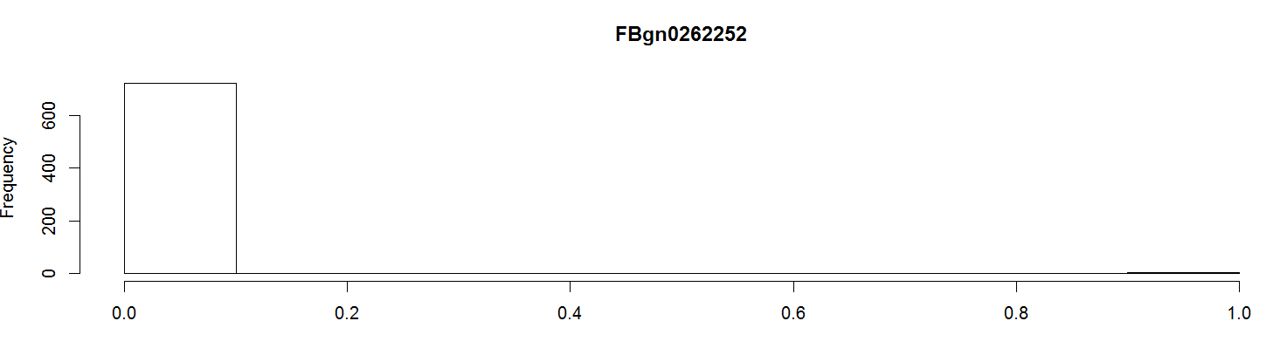
Why normalize the data?
Why Filtering?
4
Read counts
RNA-Seq data has biases
Influence of sequencing depth
Dependence on gene length
Differences on the counts distribution among samples
Normalization is a process designed to identify and correct technical biases removing the least possible biological signal. This step is technology and platform-dependent.
Between-sample normalization
Normalization enables comparisons of fragments (genes) from different samples.

Slide 12
Normalization methods
Methods based on distribution adjustment
Assumption : read counts are proportional to expression level and sequencing depth
Total number of reads: TC (Marioni et al. 2008)
Quantile: Q (Robinson and Smyth 2008)
Upper Quartile: UQ (Bullard et al. 2010)
Median
Method taking gene length into account
Reads Per KiloBase Per Million Mapped: RPKM (Mortazavi et al. 2008)
Methods based on the effective library size concept
- Trimmed Mean of M-values: TMM (Robinson et al. 2010)
- DESeq: (Anders and Huber 2010)

Slide 13
Data preprocessing
Raw sequence reads
Refine raw data
Verify at least 2.5 M unique mapped reads per fly
Verify genotype of each fly
Verify sex of each fly
Eliminate genes having zero read counts in all flies
Workflow 1
Workflow 2
Normalize data
Total counts (TC)
Upper quartile (UQ)
Median (Med)
Quantile (Q)
Reads /kilobase of million mapped (RPKM)
Trimmed Mean of M-values (TMM)
DESeq normalization
Raw counts (RC)
Estimate distribution parameter
Estimate dispersion for negative binomial
distribution (DESeq/edgeR packages)
- Calculate log₂ for normal distribution
Filter data
-Eliminate genes with reads from all flies
below low expression threshold
Normalize data
Total counts (TC)
Upper quartile (UQ)
Median (Med)
Quantile (Q)
Reads /kilobase of million mapped (RPKM)
Trimmed Mean of M-values (TMM)
DESeq normalization
Raw counts (RC)
Estimate distribution parameter
Estimate dispersion for negative binomial
distribution (DESeq/edgeR packages)
- Calculate log₂ for normal distribution
Filter data
Eliminate genes with reads from all flies
below low expression threshold

Slide 14
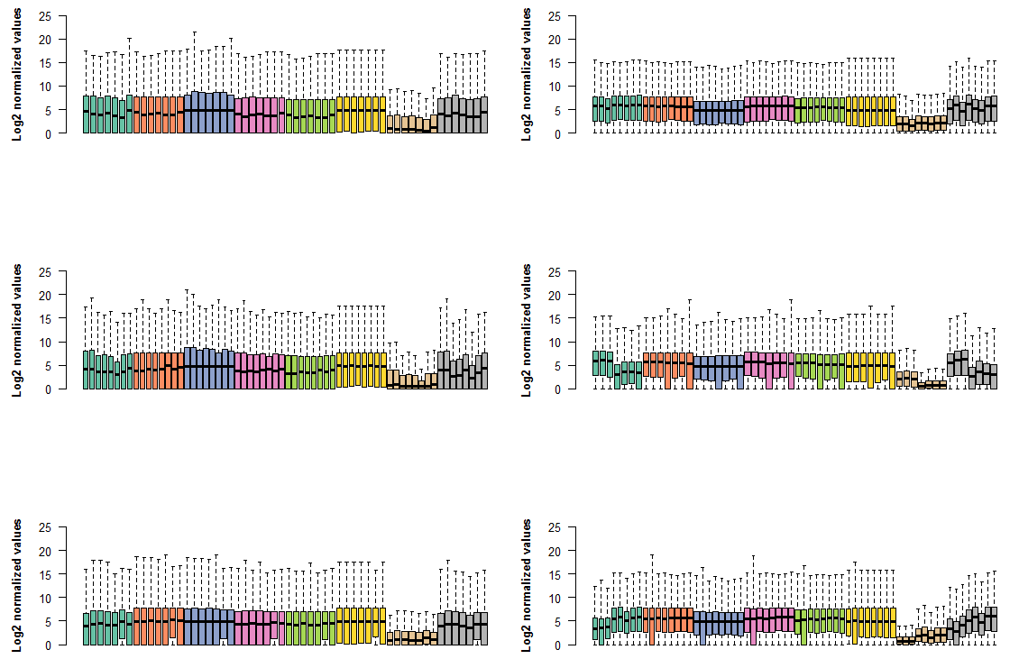
Line: RAL 630
Female & Environment 1
Male & Environment 1
TC
UQ
Med
TMM
DESeq
Q
RPKM
RC
TC
UQ
Med
TMM
DESeq
Q
RPKM
RC
Female & Environment 2
Male & Environment 2
TC
UQ
Med
TMM
DESeq
Q
RPKM
RC
TC
UQ
Med
TMM
DESeq
Q
RPKM
RC
Female & Environment 3
Male & Environment 3
TC
UQ
Med
TMM
DESeq
Q
RPKM
RC
TC
UQ
Med
TMM
DESeq
Q
RPKM
RC

Slide 15
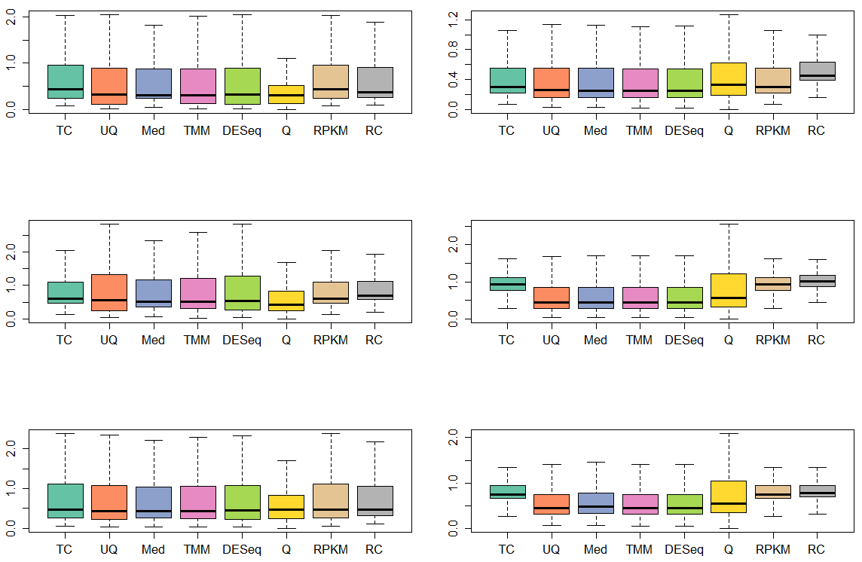
CV for RAL630
Female & Environment 1
Male & Environment 1
Female & Environment 2
Male & Environment 2
Female & Environment 3
Male & Environment 3

Slide 16
Estimate data distribution
ANOVA model
  Requires data to be normally distributed
  Take the ln of normalized counts to get normal distribution
Generalized linear models
  Requires data to have a negative binomial distribution
  y_{ij} ~ NB(µ_{ij}, σ_{ij}²)
  Need to estimate φ_{ij}, the dispersion parameter, for each gene, where
  σ_{ij}² = µ_{ij} (1 + φ_{ij}µ_{ij})

Slide 17
Raw sequence reads
Refine raw data
Verify at least 2.5 M unique mapped reads per fly
Verify genotype of each fly
Verify sex of each fly
Eliminate genes having zero read counts in all flies
Workflow 1
Workflow 2
Normalize data
Total counts (TC)
Upper quartile (UQ)
Median (Med)
Trimmed Mean of M-values (TMM)
DESeq normalization
Quantile (Q)
Reads /kilobase of million mapped (RPKM)
Raw counts (RC)
Estimate distribution
Estimate dispersion for negative binomial
distribution (DESeq/edgeR packages)
- Calculate log₂ for normal distribution
Filter data
-Eliminate genes with reads from all flies
below low expression threshold
Normalize data
Total counts (TC)
Upper quartile (UQ)
Median (Med)
Trimmed Mean of M-values (TMM)
DESeq normalization
Quantile (Q)
Reads /kilobase of million mapped (RPKM)
Raw counts (RC)
Estimate distribution
Estimate dispersion for negative binomial
distribution (DESeq/edgeR packages)
- Calculate log₂ for normal distribution
Filter data
Eliminate genes with reads from all flies
below low expression threshold
Fit models; test hypotheses
DESeq R package
edgeR package
ANOVA (SAS)

Slide 18
Gene expression statistical models and software
3-way analysis model includes the following factors:
Genotype + Sex + Environment + Genotype×Environment + Genotype×Sex +
Sex×Environment + Genotype×Environment×Sex
Where Genotype = DGRP line (16)
Environment = Environment 1, 2, or 3
Sex = Male or Female
Software | Data distribution | Model Type | Test type
DESeq | Negative binomial | Generalized linear model | Log likelihood
edgeR | Negative binomial | Generalized linear model | Log likelihood
SAS | Normal (ln transformed of normalized read counts data) | ANOVA | F test

Slide 19
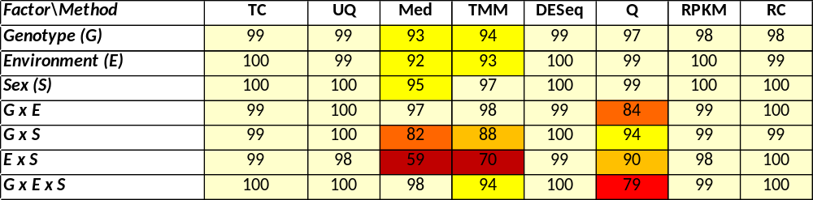
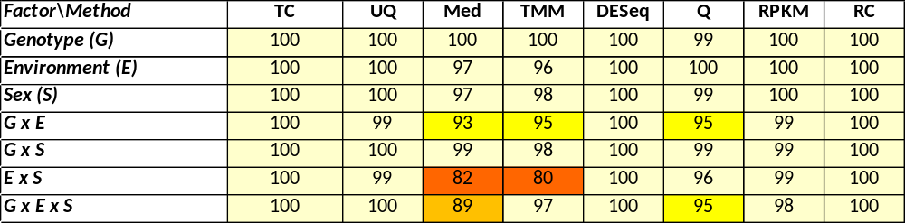
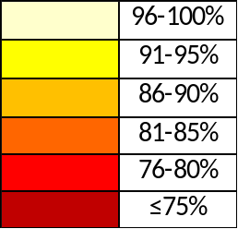
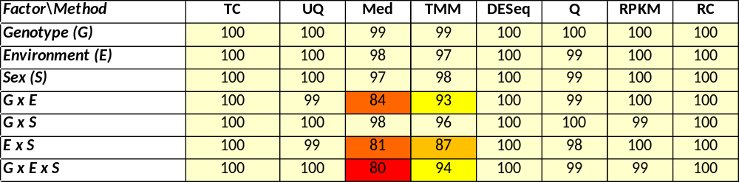
Results using Median, TMM, and Q normalization
are sensitive to filtering strategy
DESeq
edgeR
ln&ANOVA
% significant genes overlapping between Workflow 1 and Workflow 2

Slide 20
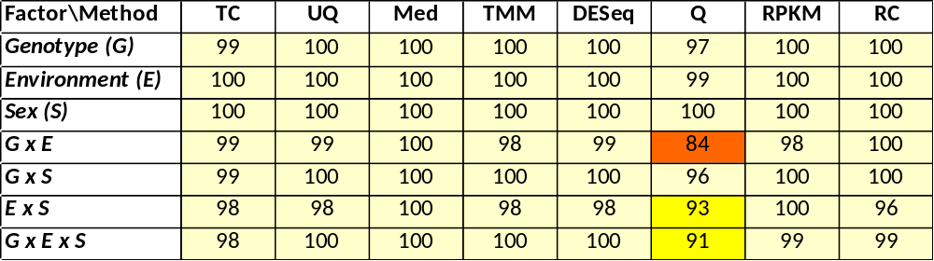
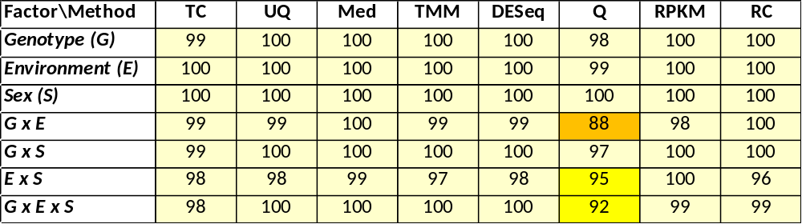

Results using DESeq and edgeR are quite similar
except for Q normalization
Workflow 1
Workflow 2
No filtering
% significant genes overlapping between DESeq and edgeR
Notes:
shown in the dispersion plots as well for Q

Slide 21
Data analysis summary
DESeq-normalized, DESeq software, Workflow 1
DESeq normalization is the best fit to our data
  TC and RPKM do not improve data distribution
  Q normalization can increase variance
  Med, TMM, and Q are sensitive to filtering strategy
  UQ may result in increased false positives (Dillies et al., Briefings in Bioinformatics, 2012)
DESeq and edgeR software perform similarly; DESeq runs faster when fitting multiple models
P-values from the analysis are not impacted by the filtering strategy when Workflow 1 is used
  FDRs need to be re-estimated if filtering strategy changes

Slide 22
Acknowledgements
NHLBI
NIDDK
SBC Lab of Systems Genetics
  Susan Harbison
  Yazmin Serrano Negron
  Amanda Lobell
  Rachel Kaspari
  Shailesh Kumar
DNA Sequencing and Genomics Core
  Jun Zhu
LCBD Developmental Genomics Section
  Brian Oliver
  ZhenXia Chen
  Kseniya Golovnina
  Hina Sultana
  Haiwang Yang
Sequencing Core
  Harold Smith

