Slide 1

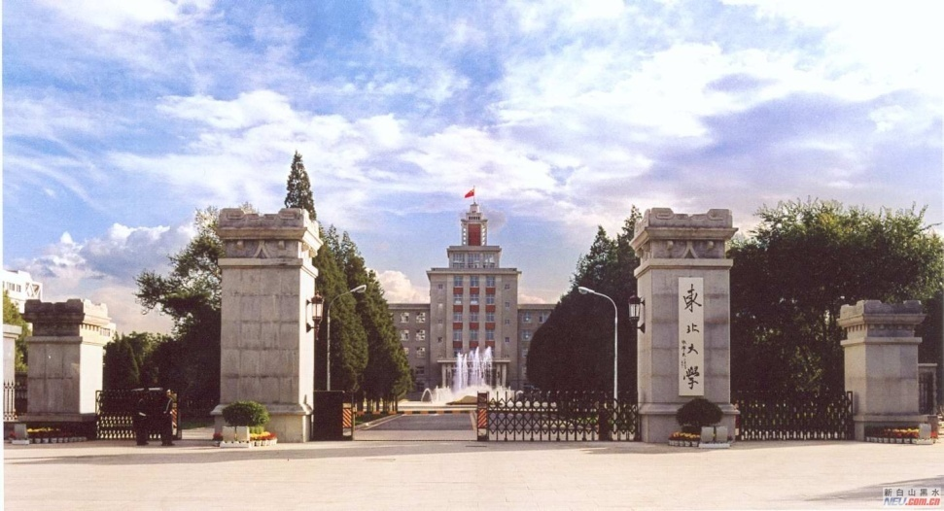

Materials Science 2016
September 12-14, 2016 Atlanta, Georgia
Microstructures and Mechanical Properties
of Low C Medium Mn Steel Plates
Linxiu DU, Jun HU, Hongyan WU, Guodong WANG
(The State Key Lab. of Rolling Technology and Automation,
Northeastern University, Shenyang 110004, P. R. China)
Email: dulx@ral.neu.edu.cn
1

Slide 2
Contents
Introduction
Composition and Process
Microstructure and Mechanical Properties
Industrial Test
Summary
2

Slide 3
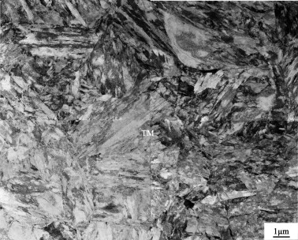
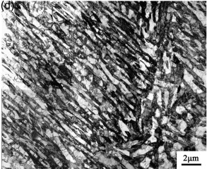
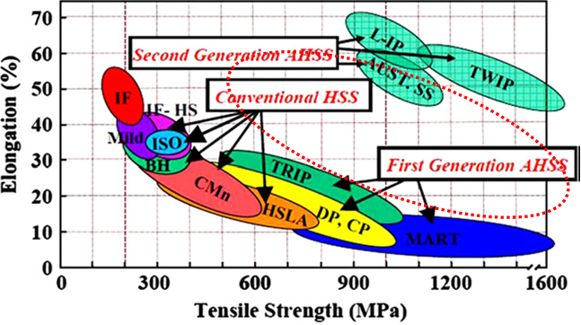
Introduction
Low C - Medium Mn steel is one of the research highlights
Low carbon(0.2%C) Medium Mn(5-8%Mn) are being developed as third generation advanced high strength steel (AHSS).
The hot-rolled strip steel with martensite microstructure was intercritical annealed in the ferrite-austenite region.
Metastable austenite was stabilized at room temperature because the austenite become highly enriched in Mn during the annealing process.
The high strength of 700~1600MPa was attributed to fine microstructured strengthening, and the good elongation of 20~60% was due to the TRIP effect of austenite.
Tempered-martensite
Reverse austenite
Martensite
Strength and elongation of AHSS
3

Slide 4
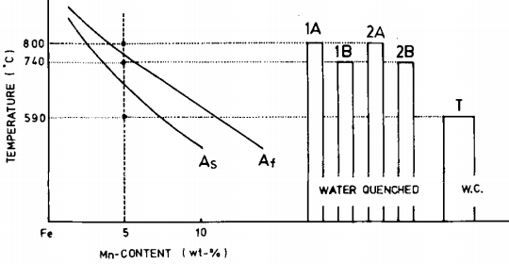
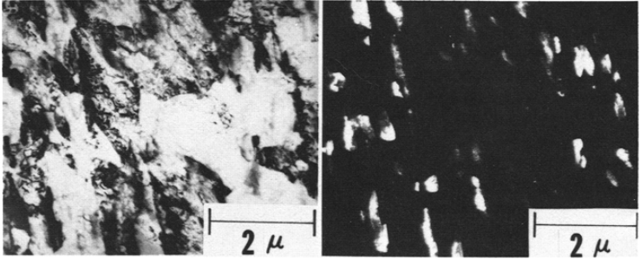
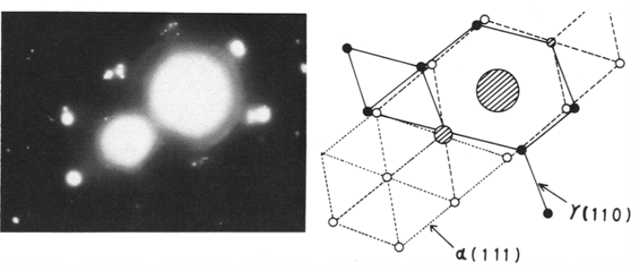
Introduction
Medium Mn steel can also obtain excellent toughness
Niikura and Morris conducted multi-stage quenching and inter-critical temper heat treatment on 0.04C-5Mn-0.2Mo steel.
Yield strength 497MPa
Tensile strength 669MPa
Elongation 41.3%
Impact energy at -196℃ 190J
The good properties are attributed to a symbiotic influence between the grain refinement treatment and the introduction of thermally stable retained austenite during tempering
4

Slide 5


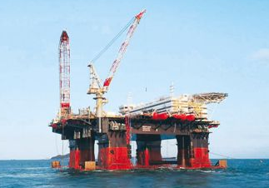
Introduction
Above works inspire us to have an idea to produce medium Mn plates with large thickness, for solving the problems in the production of high toughness heavy plates at present:
Microstructural inhomogeneity along the thickness direction
High cost due to addition of expensive alloying elements, such as Ni, Mo and Cr
Poor weldability due to high carbon equivalent
High yield ratio
Complicated production procedure of multi-stage quenching and tempering
Is it possible to produce Medium Mn steel plates?
5

Slide 6
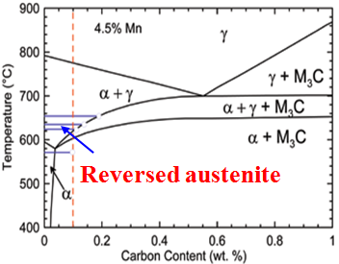
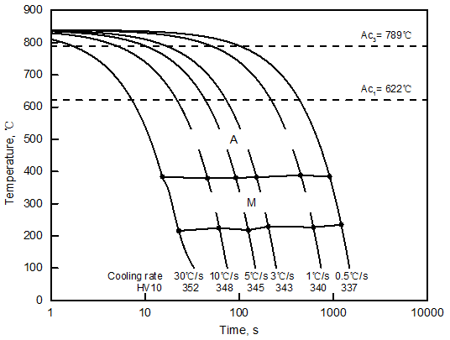
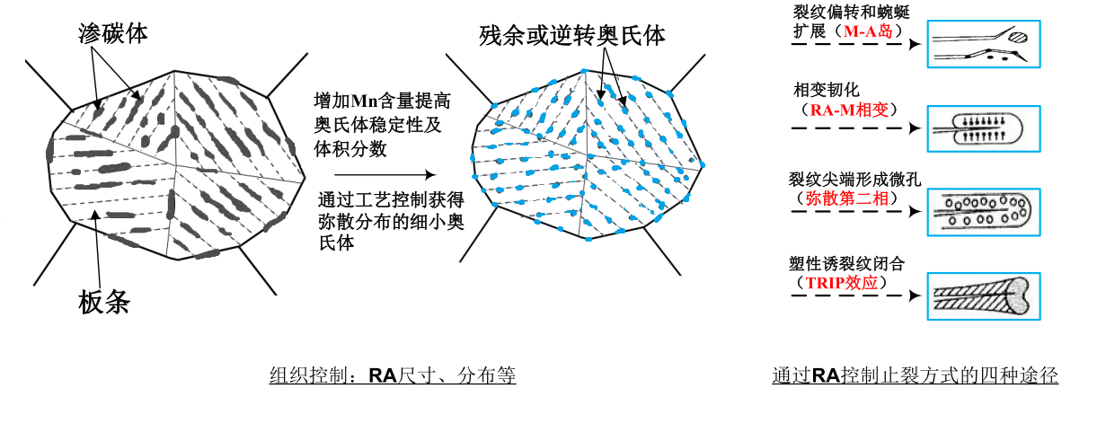
Composition and Process
Composition: 0.04-0.1C and 4-6 wt.% Mn
Alloying with medium Mn was to enhance hardenability and improve the homogeneity of microstructure and mechanical properties throughout the thickness of the heavy steel plate. Austenite was stabilized by Mn enrichment.
CCT
Austenite
Fe-C phase diagram of 4.5%Mn. (From M.J. Merwin. Iron & steel Technology, Oct. 2008)
Martensite could be formed at cooling rate from 0.5-30 ℃/s
Low carbon design was preferred from the view point of weldability and reduced cementite content.
Cu, Ni, and Cr were added to enhance corrosion resistance
6

Slide 7
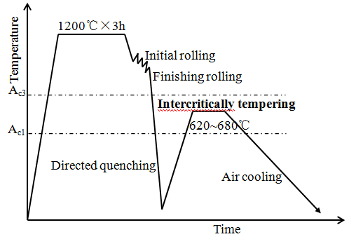
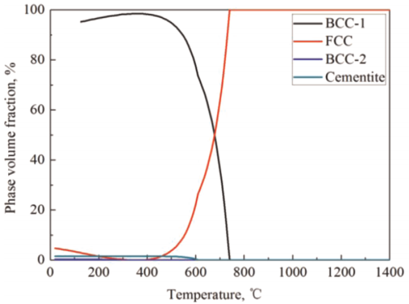
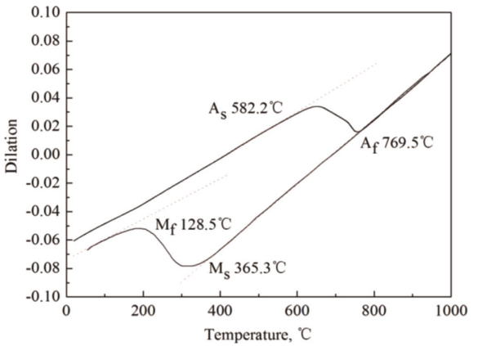
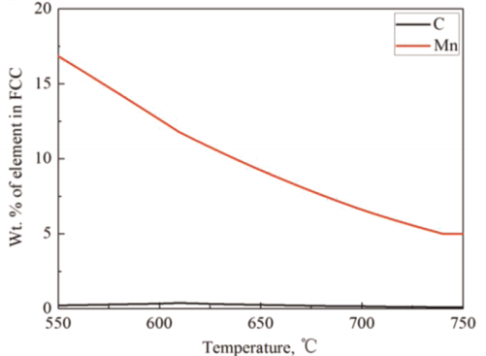
Composition and Processes
TMCP Process: DQ+Tempering
The steel slab was heated to 1200ºC for 3h, and then hot-rolled to a plate of ~120 mm thickness.
The plate was directly water-quenched to room temperature using accelerated cooling system.
The water-quenched plates were tempered at temperature of 620~680ºC for 10~30min.
Tempering in this region
Austenite
Mn
Austenite was formed during inter-critical tempering
Amount of element in fcc
7

Slide 8
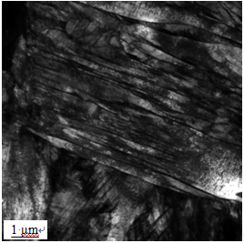
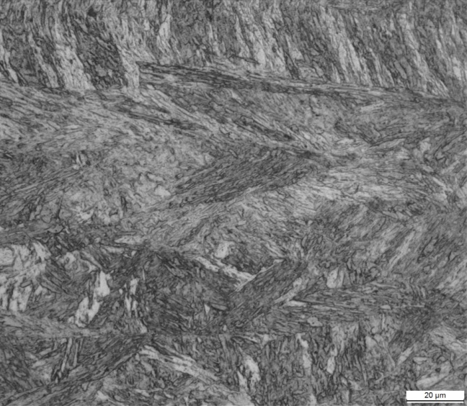
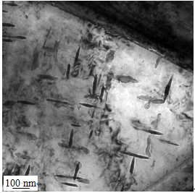
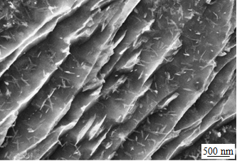
Microstructures and properties
Water-quenched microstructure after hot-rolled
TEM
OM
Fine martensite laths with high fraction of dislocations
TEM
SEM
Fine needle-shaped cementite in martensite laths
8

Slide 9
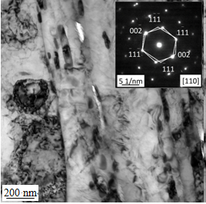
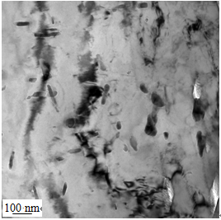
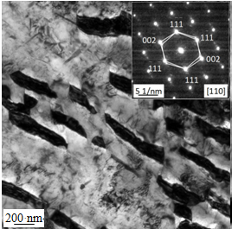
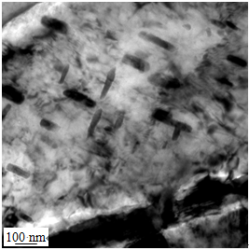
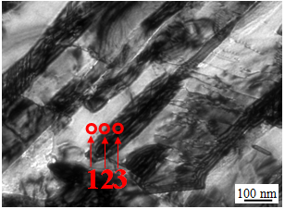
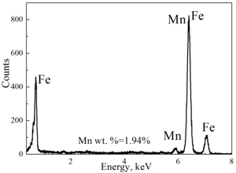
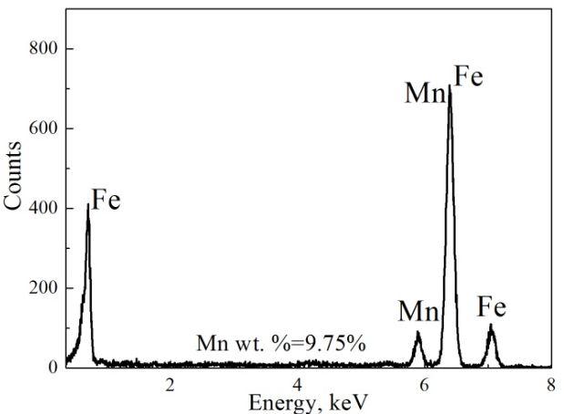
Microstructures and properties
Tempered microstructure: effect of tempering time
Tempering at 650℃ for 10min
Tempering at 650℃ for 30min
Volume fraction of austenite increased with time, and cementite was gradually dissolved.
Mn partitioning during inter-critically tempering
1.94%Mn
Ferrite
9.75%Mn
Austenite
Reversed austenite was stabilized by highly Mn enrichment.
9

Slide 10
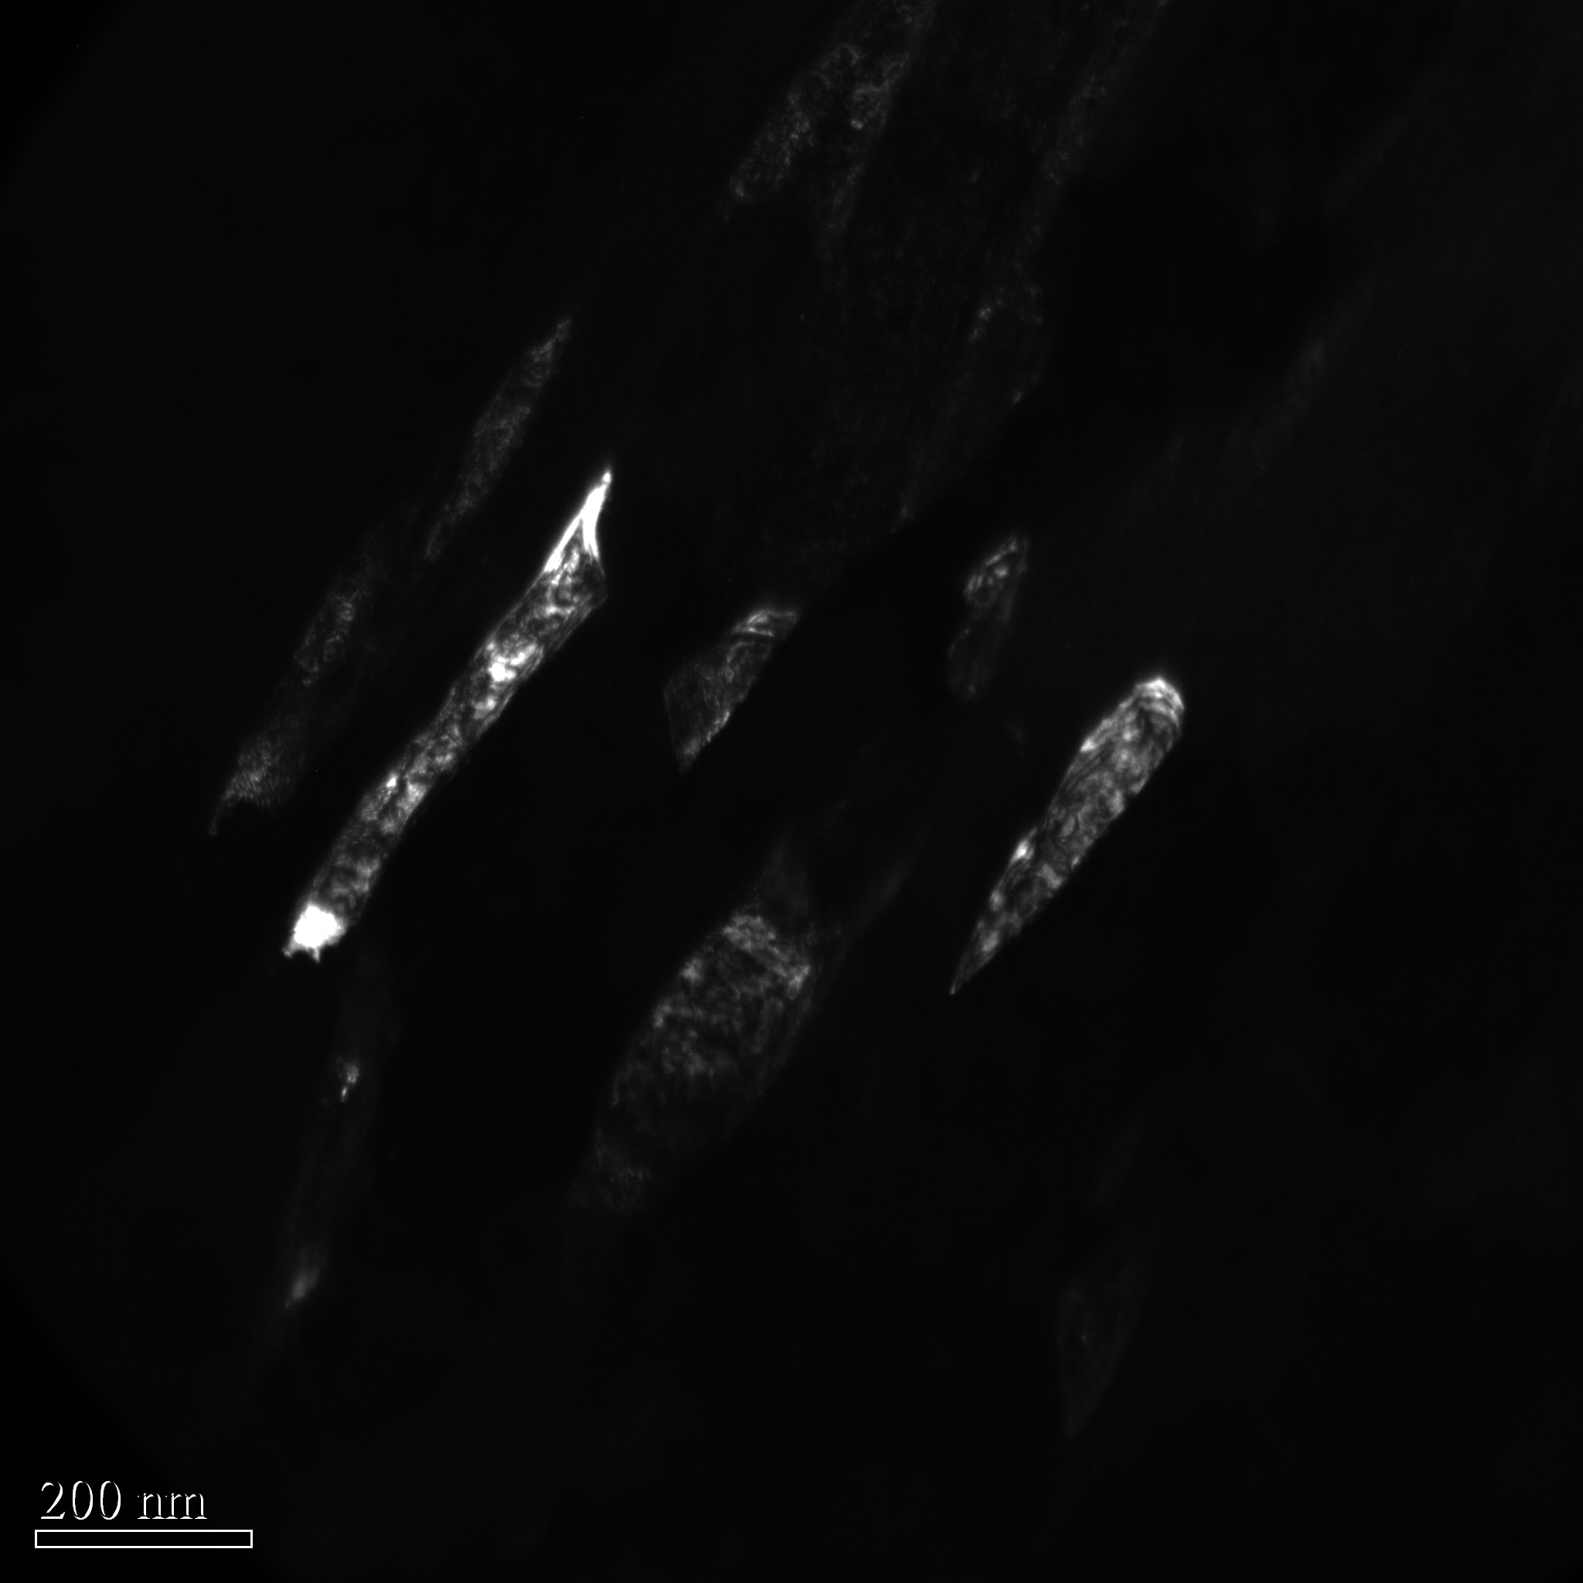
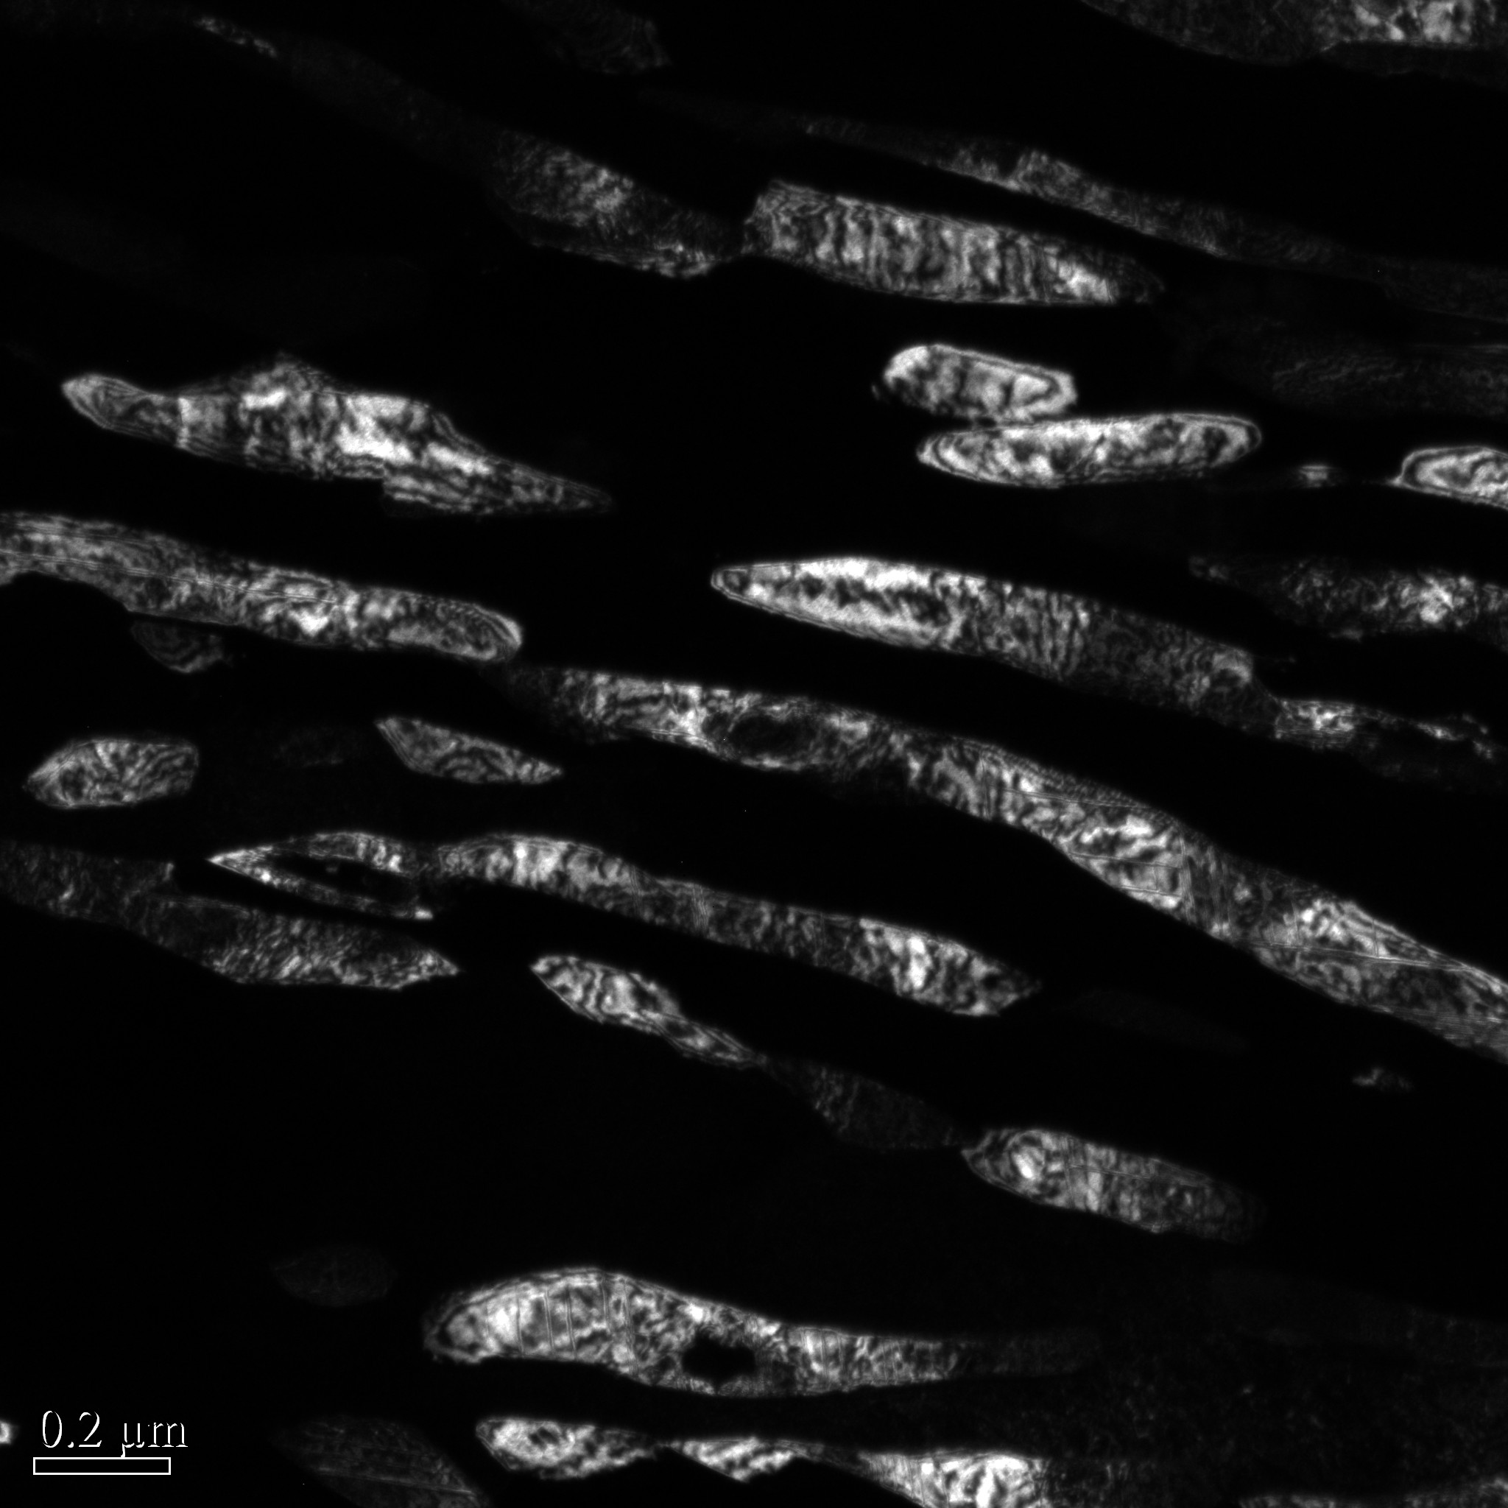
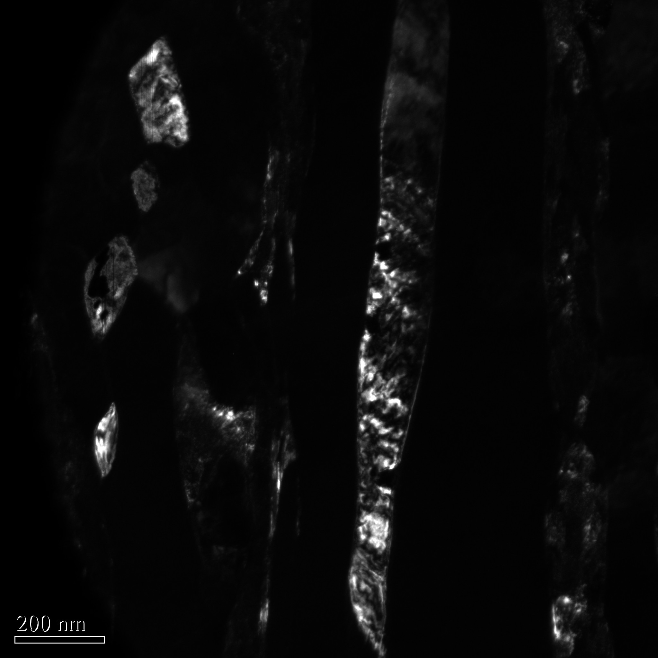
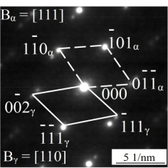
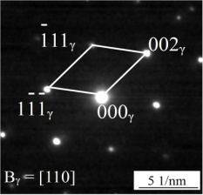
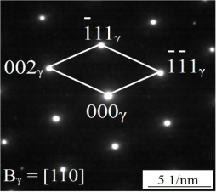
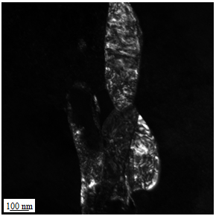
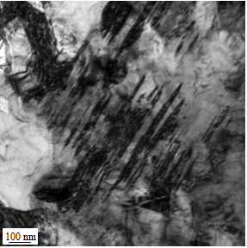
Microstructures and properties
Tempered microstructure: effect of tempering temperature
10.4%
22.2%
28.7%
Tempering at 620℃
Tempering at 650℃
Tempering at 680℃
As increase in tempering temperature, the volume fraction of austenite was increased.
As tempering at 680℃
At room temperature,
some austenite grains were less stable due to weak Mn enrichment, resulted in the formation of twin martensite.
Tempering at 680℃
10

Slide 11
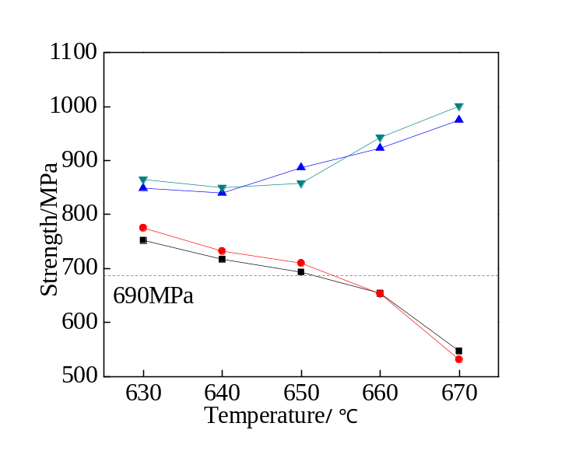
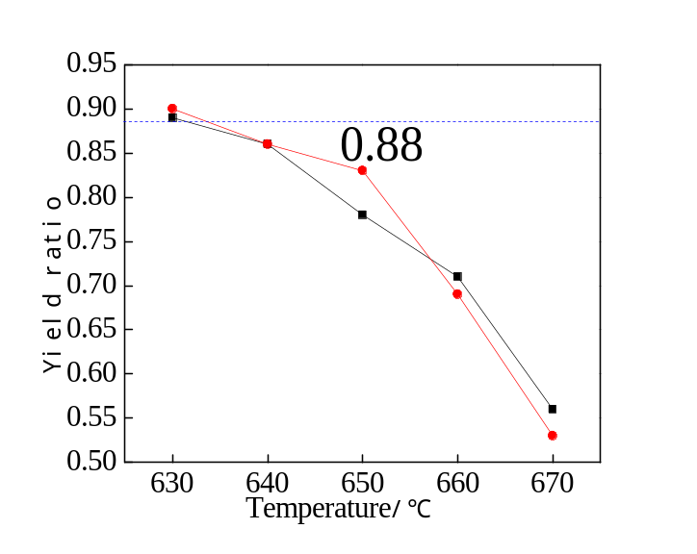
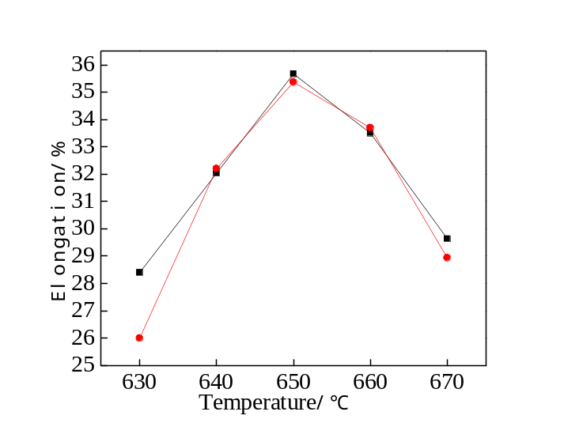
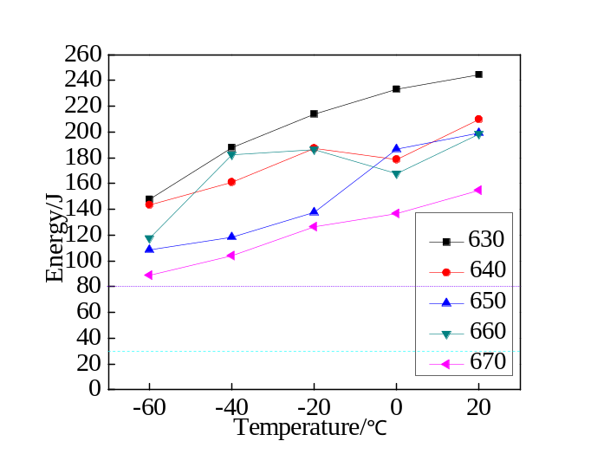
Microstructures and properties
Mechanical properties: effect of tempering temperature
Tensile strength
Yield strength
Yield strength decreased with temperature
Tensile strength increased due to TRIP effect
Yield ratio decreased with temperature
Because of decreased stability of austenite
-60℃
11
Elongation first increased an then decreased
Impact energy decreased with temperature

Slide 12
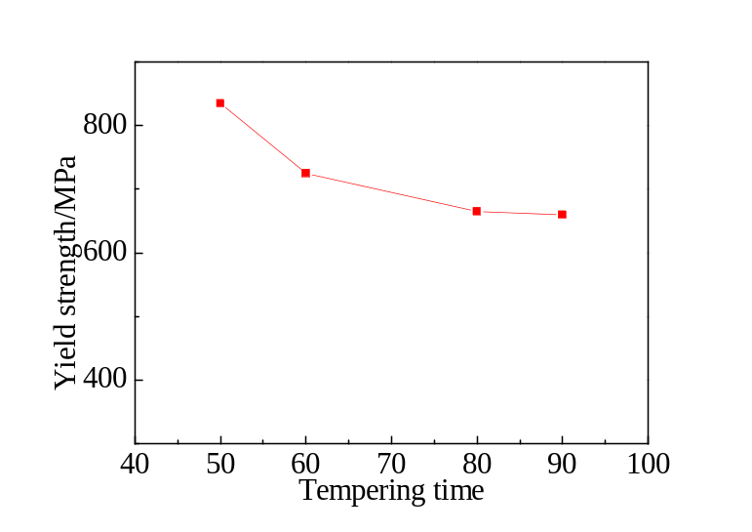
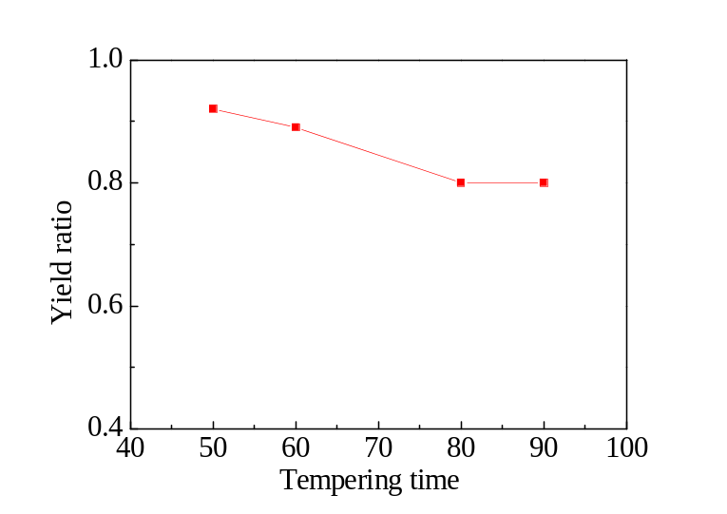
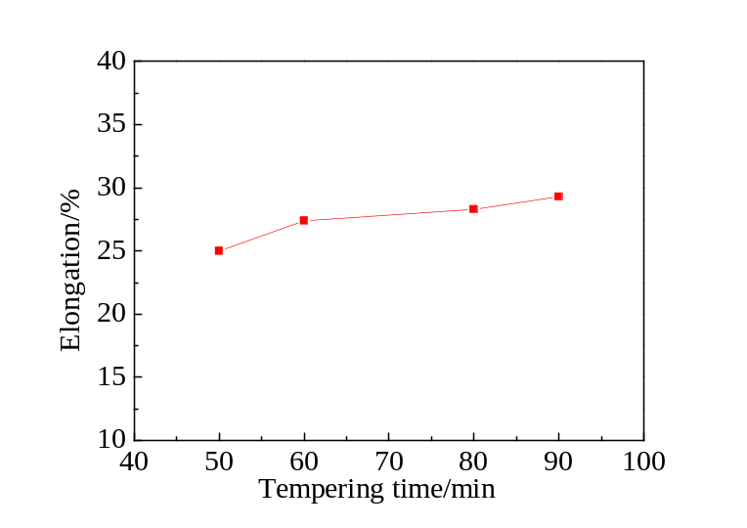
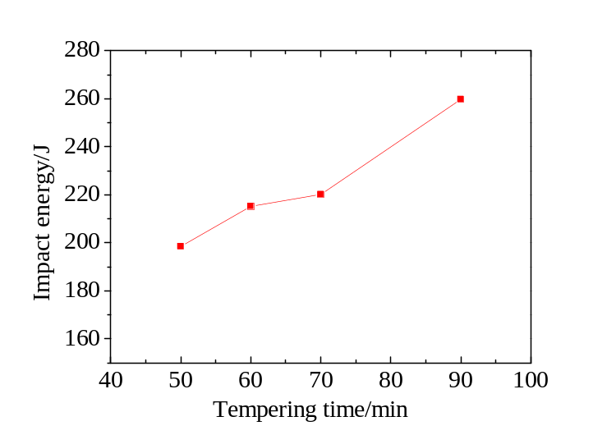
Microstructures and properties
Mechanical properties: effect of tempering time at 650℃
Yield strength decreased with time
Yield ratio decreased with time
20℃
Elongation increased with time
Impact energy increased with time
12

Slide 13
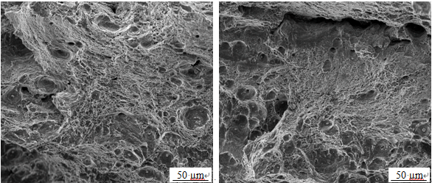
Microstructures and properties
Typical heavy steel
Chemical composition: 0.1C-5Mn
Steel plate thickness: 80 mm
Tempering procedure: 650℃ for 30min
Tensile properties
Steel Number | Yield strength /MPa | Tensile strength /MPa | Elongation /% | Reduction in area /% | Yield ratio
1/2 thickness | 770 | 875 | 25.0 | 65.4 | 0.88
1/4 thickness | 772 | 880 | 27.5 | 63.6 | 0.88
Charpy impact energy
Steel number | 20ºC | 0ºC | -20ºC | -40ºC | -60ºC
1/2 thickness | 209 | 189 | 184 | 179 | 165
1/4 thickness | 213 | 190 | 180 | 185 | 168
1/2
Dimple fractures
1/4
Excellent microstructure and properties homogeneity along thickness was obtained. Impact fractures consisted of dimples.
13

Slide 14
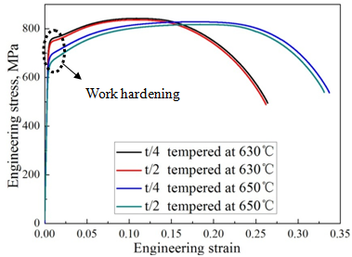
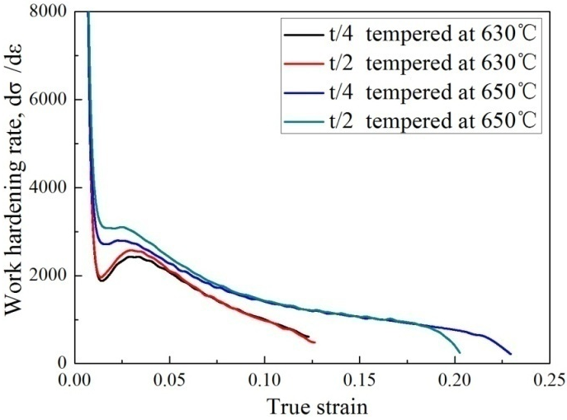
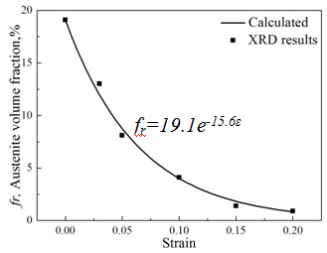
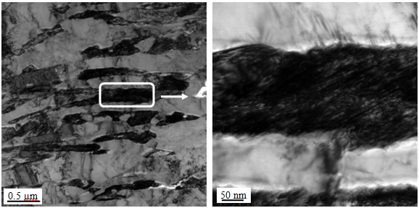
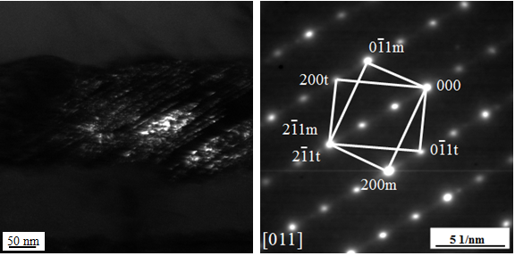
Microstructures and properties
TRIP effects improved ductility and toughness
Stress-strain curves
Work hardening rate curves
Volume fraction of austenite
Austenite transformed to martensite as straining, and toughness and ductility were improved.
Twin-type martensite formed under 0.05 tensile strain
14

Slide 15
Microstructures and properties
Some of above works have been published:
Jun Hu, LinXiu Du, GuoSheng Sun, Hui Xie, R.D.K. Misra. The determining role of reversed austenite in enhancing toughness of a novel ultra-low carbon medium manganese high strength steel. Scripta Materialia, 2015, 104: 87-90.
Jun Hu, LinXiu Du, H. Liu, G.S. Sun, H. Xie, H.L. Yi, R.D.K. Misra. Structure-mechanical property relationship in a low-C medium-Mn ultrahigh strength heavy plate steel with austenite-martensite submicro-laminate structure. Materials Science and Engineering A, 2015,647: 144-151.
15

Slide 16
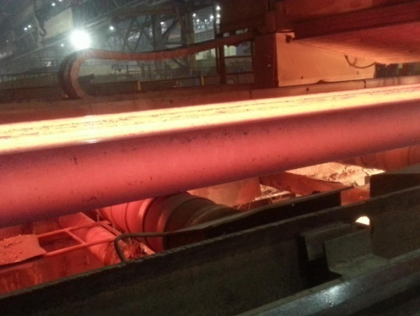
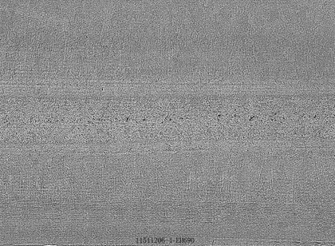


Industrial tests
Continuous casting slab and macroscopic examination
C and Mn content along thickness
Thickness | C/% | Mn/%
1/2 | 0.08 | 5.63
1/4 | 0.07 | 5.43
1/8 | 0.07 | 5.57
1/16 | 0.07 | 5.49
The quality of slab is very good. No serious segregation was found.
The plate subjected to controlled rolling and controlled cooling
Low carbon medium Mn heavy plate steel has been successfully fabricated in two steel factories, and the high yield strength ≥690MPa, excellent impact toughness at -60℃ ≥120J, and low yield ratio ≤0.88 were obtained. Moreover, the impact energy at -60℃ was ≥100J after 5% straining ageing.
16

Slide 17

Industrial tests
Good weldability
Welding seam
Fusion line
Coarse
grain
Fine
grain
Mixed
grain
Base
metal
Impact energy at welding joints
Notch location | Welding seam | Fusion line | Fusion line +1mm | Fusion line +2mm | Fusion line +3mm | Fusion line +5mm | Fusion line +7mm
Impact energy at -40℃/J | 103 | 86 | 61 | 103 | 148 | 120 | 140
Without using the pre-heating and the heat treatment after welding, the welding joints has good impact toughness and high strength.
17

Slide 18
Summary
Medium Mn can significantly increase the hardenability, and the fine martensite can be formed throughout the thickness of heavy steel plate during water quenching.
Some austenite can be formed during inter-critically tempering, so the sub-micron laminated martensite-austenite structure was obtained.
Fine tempered martenite laths greatly increased the yield strength, and the improvement in ductility and low temperature toughness is attributed to the TRIP effect of high fraction of reversed austenite.
Low carbon medium Mn steel plates has been successfully fabricated in steel factories, and good combination of high strength, good toughness, and excellent weldability were obtained.
18

Slide 19

Materials Science 2016
September 12-14, 2016 Atlanta, Georgia
Thanks for your attention!
19

