Slide 1
Estrogen and anti-androgen Induced Penile Mal-development
Lilian Okumu
Tuskegee University, Tuskegee, AL, USA

Slide 2
Background
Endocrine disrupting chemicals interfere hormonal balance; present in the environment e.g. in cosmetics, medical instruments and agriculture

Slide 3
Background
Synthetic: diethylstilbestrol (DES), Ethinyl estradiol (EE)
Phytoestrogens: Plant origin isoflavones (genistein, daidzen)
Environmental: Bisphenol A (BPA), Methoxychlor (MXC), Pthalates

Slide 4
Background
DES daughters have higher incidence of vaginal cancer; sons: testicular cancer and hypospadias
BPA causes prostate hypertrophy and precancerous growth
MXC causes lower fertility in females
EE: More than two million women continue to take contraceptive pills during the first trimester of pregnancy

Slide 5
Background: effects on wildlife
Alligators from Lake Apopka (FL) contaminated with industrial estrogenic contaminants have smaller phallus and reduced fertility.
Turtles from Mody Pond (MA) contaminated with xenobiotics have impaired reproductive functions.
Fish from some rivers in the USA and Europe contaminated with oral contraceptives are feminized.

Slide 6
Summary of background
It is well-established that perinatal exposure to estrogenic compounds (endocrine disruptors) has permanent deleterious effect on the development of reproductive organs in both humans and wildlife.
However, mechanisms underlying these reproductive disorders are not well-understood.

Slide 7
Experimental design
Chemicals: DES (diethylstilbestrol), estradiol valerate (EV), or ethinyl estradiol (EE). All three compounds caused similar mal-developments
Animals: Neonatal rats and mice
Treatment: 10ng-10µg/day/pup, 1-6 postnatal days, sc
Tissue collection: Ages at day 7, 12, 18, 28, 41, or adulthood.
Analyses: hormone assays, gene expression (micro array and Q-RT-PCR), WB

Slide 8
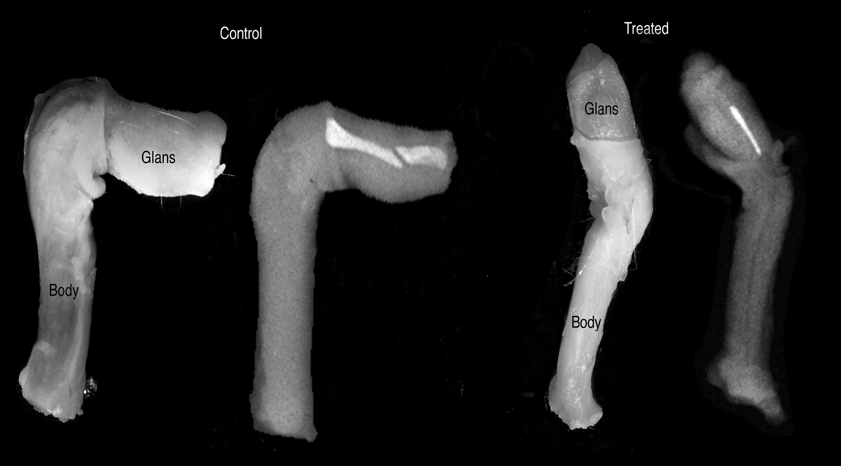
Study-1: Estrogen-induced mal-development of the penis
Goyal et al. (2004) Reproductive Toxicology 18:265-274

Slide 9
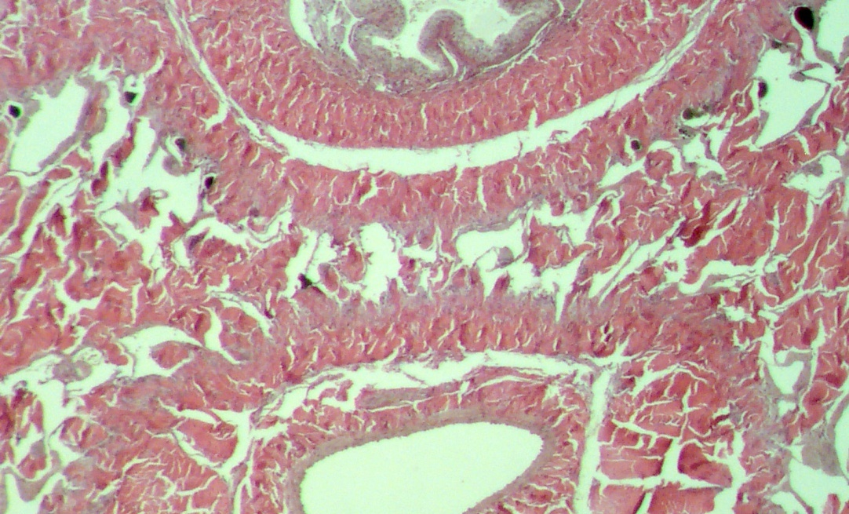
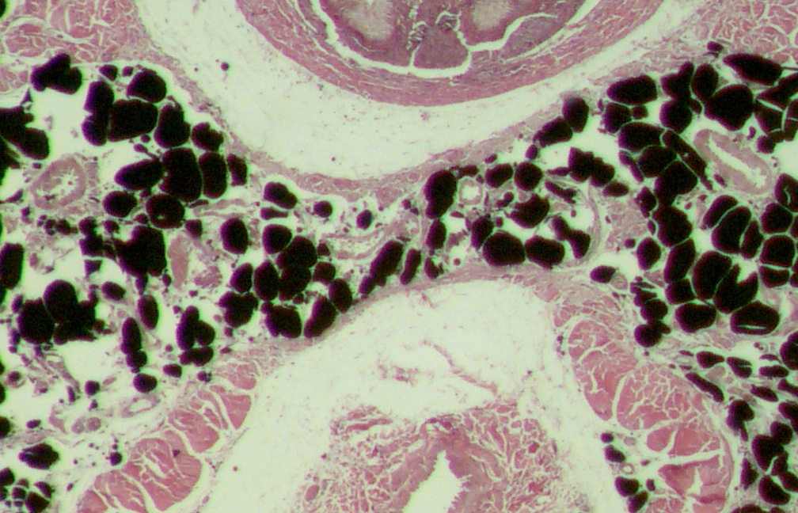
Study-1: Estrogen-induced accumulation of fat cells and loss of smooth muscle cells
Control
DES
Goyal et al. (2004) Reproductive Toxicology 18:265-274

Slide 10
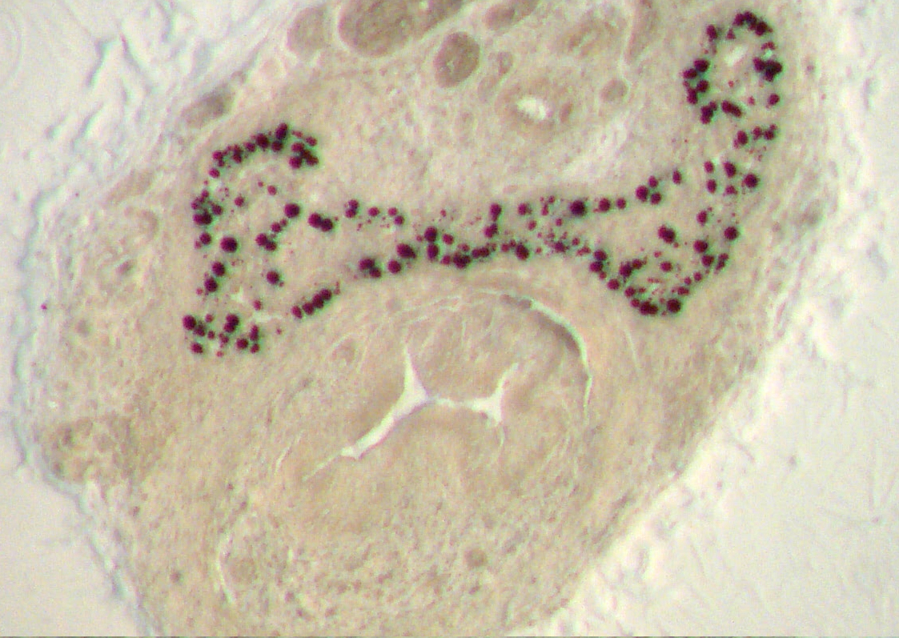
Study-1: Estrogen-induced accumulation of fat cells occurs in the corpora cavernosa, but not in the corpus spongiosus
Corpora Cavernosa
Corpus Spongiosus
Goyal et al. (2004) Biology of Reproduction 18:265-274

Slide 11
Study-2: Estrogen-induced penile mal-development is dose-dependent:
Neonatal Exposure to ethinyl estradiol (EE), female contraceptive, at a dose of 100 ng (0.01 mg/kg) or higher results in infertility and malformation of penis in 100% of the treated rats
Mathews et al. (2009) Toxicological Sciences 112:331-343, Okumu et al, in preparation

Slide 12
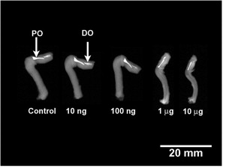
Study-2: Radiographs of the penis treated with different doses of EE
Ethinyl Estradiol
Mathews et al. (2009) Toxicological Sciences 112:331-343

Slide 13
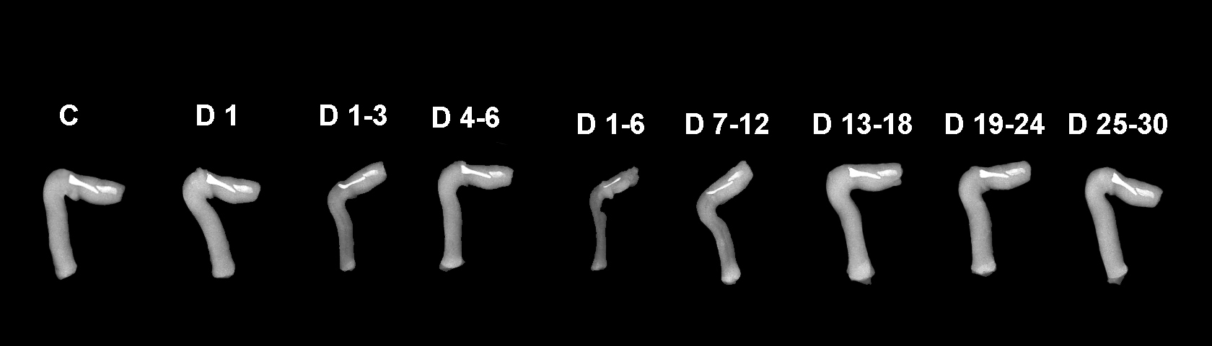
Study-3: Estrogen-induced penile mal-development is dependent upon estrogen exposure during critical period of development
Goyal et al. (2005) Toxicological Sciences 87:242-254

Slide 14
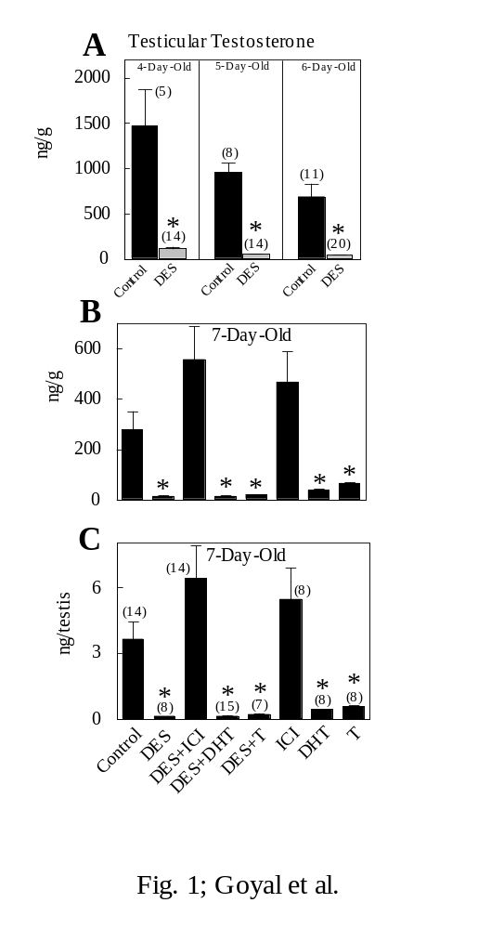
Study-4: Estrogen-induced penile mal-development is associated with lower intra-testicular T Surge (typical for rodents from gestation day 17 to postnatal days 7-10)
Goyal et al. (2009) Biology of Reproduction 81:242-254

Slide 15
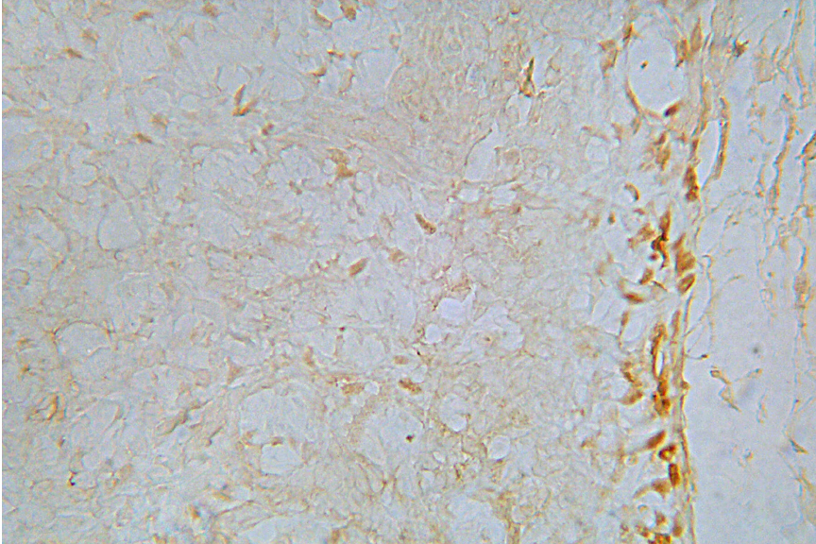
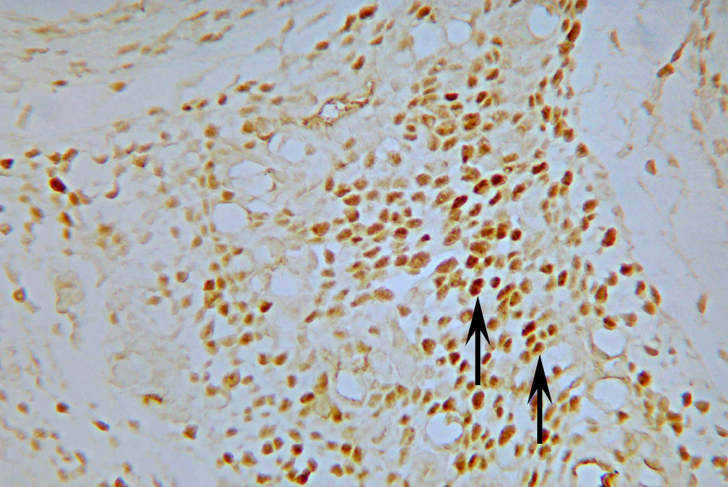
Study-5: Estrogen-induced penile mal-development is associated with ERα up-regulation
Control
DES
Goyal et al (2004) Biology of Reproduction 70:284-297
Goyal et al (2007) Reproduction 134:199-208

Slide 16
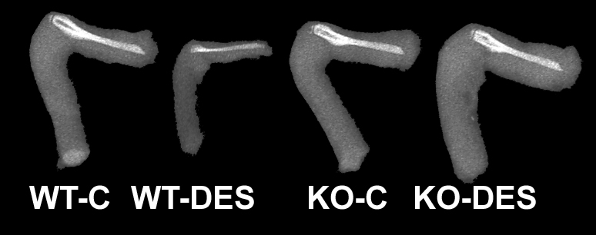
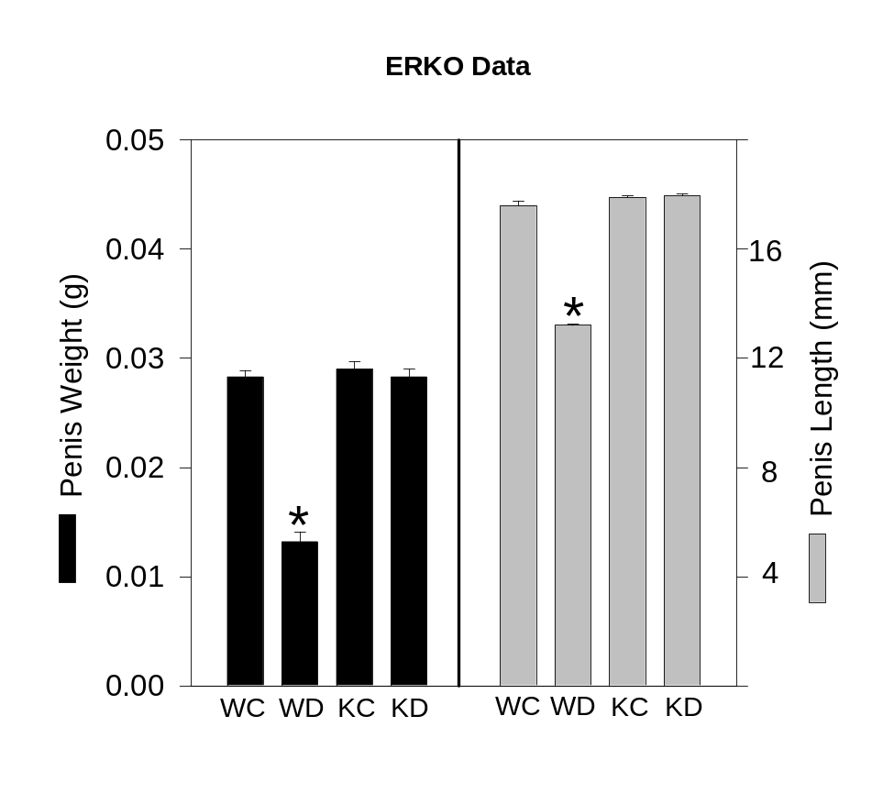
Study-6: ERα presence is essential for estrogen-induced penile mal-development
Goyal et al (2007) Reproduction 133:1057-1067

Slide 17
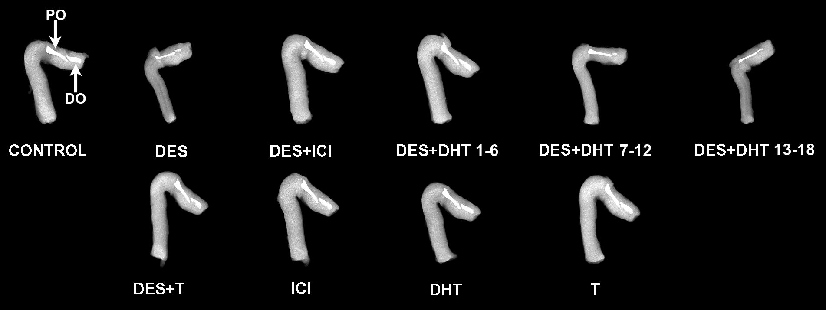
Study-7: Estrogen-induced penile mal-development is mitigated by ER antagonist ICI 182780 and AR agonist DHT or testosterone (T)
Goyal et al. (2009) Biology Reproduction 81:242-254

Slide 18
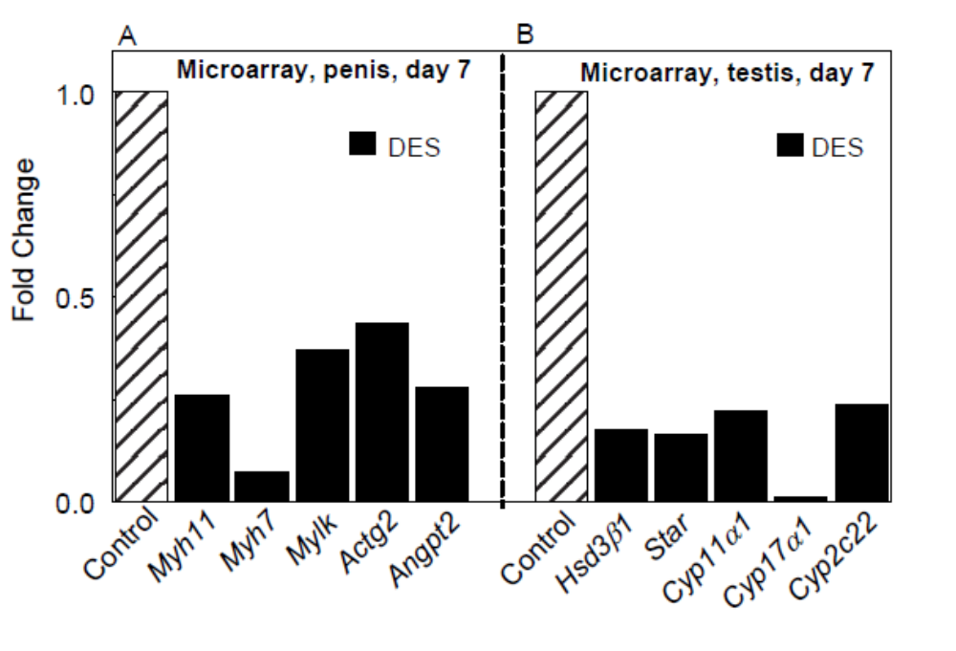
Studies-9&10: Estrogen induced penile mal-development is characterized by down-regulation of smooth muscle cell markers in the penis and steroidogenic enzymes in the testis
Okumu et al., 2012

Slide 19
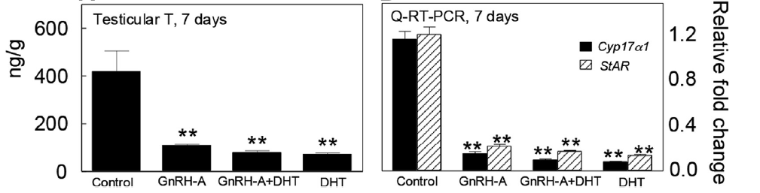
Study-9: similar to estrogen, GnRH antagonist antide (GnRH-A) supressed intratesticular testosterone surge and mRNA for steroidogenic enzymes
Okumu et al., 2014

Slide 20
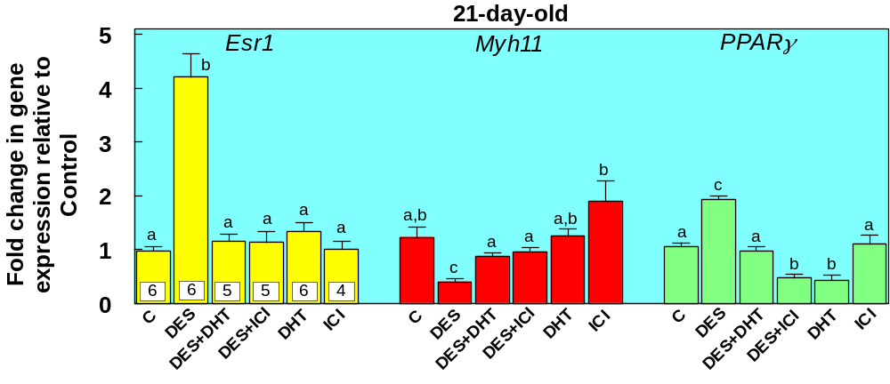
Estrogen up-regulates Esr1 and Pparγ mRNA and down-regulates Myh11 mRNA and these alterations are Mitigated by Estrogen Receptor Antagonist ICI and DHT
Okumu et al., 2012

Slide 21
Both estrogen and GnRH-A treatment induced similar effects in the penis
b
a
a,c
a,c
a,c
a,c
b
b,d
a
c

Slide 22
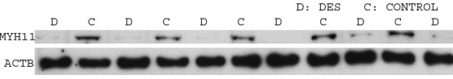
MYH11 protein expression in the penis
***

Slide 23
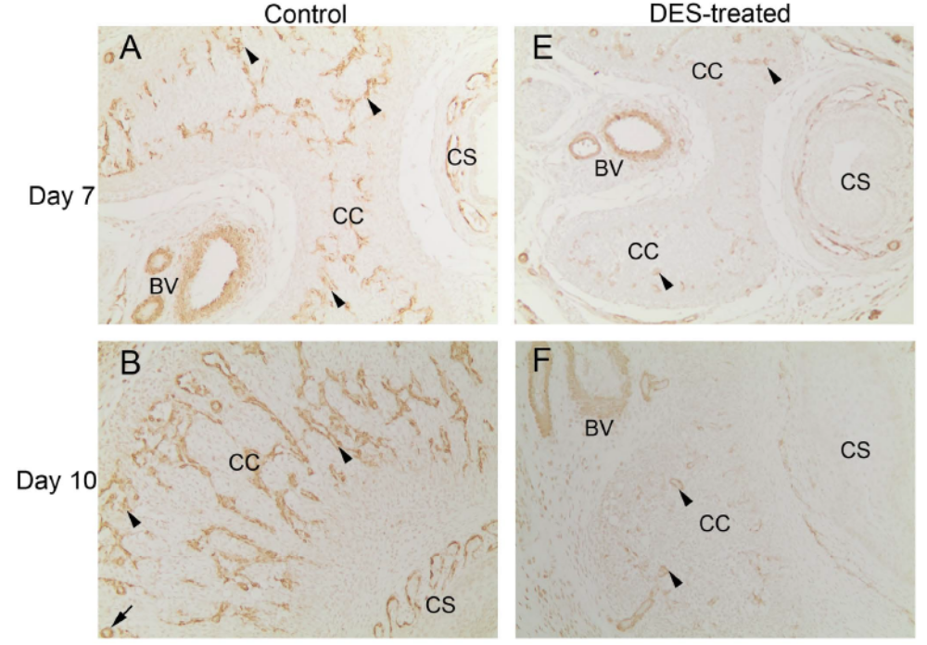
ACTA immunolocalization

Slide 24
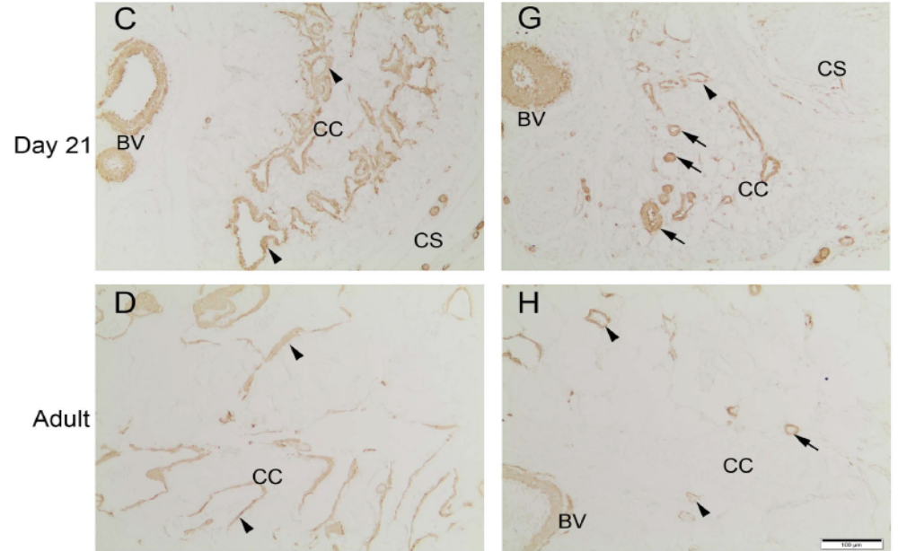
Results: ACTA IHC
Control
DES-treated

Slide 25
Down-regulation of the smooth muscle cell marker Myh11 was specific to the corpus cavernosum penis
*
***
Corpus cavernosum Corpus spongiosum Prostate

Slide 26
Similarly, estrogen and anti-androgen induced effects on Pde5a were limited to the corpus cavernosum penis
**
**
Corpus cavernosum Corpus spongiosum Prostate

Slide 27
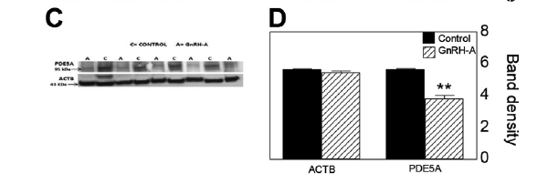
PDE5A protein is downregulated in GnRH-A treated penile tissues

Slide 28
Summary of results
Neonatal treatment with DES and antide…
Suppressed testicular testosterone surge at day 7
Decreased MYH11, ACTA2 and PDE5A expression
Increased PPARG & ESR1 expression
Both DHT and ICI mitigated DES-induced effects in the penis
However, ICI unable to mitigate antide effects

Slide 29
Conclusions
Anti-androgens cause permanent mal-development of the penis, similar to estrogenic exposure
Low androgen levels/action due to DES impedes differentiation of stromal cells into smooth muscle cells in the corpus cavernosum while enhancing adipogenesis.
ESR1 mediated pathway and low T involved in DES; low T in GnRH-A

Slide 30
Hypothesis for mechanism of estrogen-induced mal-development of the penis
E
PPARγ,
MYH11, ACTA2
Testosterone
ERα
Leydig Cell
Stromal Cell
Stromal Cell

Slide 31
Acknowledgements
Dr. Hari Goyal
Dr. Liz Simon
Dr. Tim Braden
Ms. Carol S. Williams
Mr. John W. Williams
Dr. Datiri & CMRC staff

Slide 32
THANK YOU

