Slide 1


Innovations in clinical pharmacy education and research
Lilian M. Azzopardi
President, European Association of Faculties of Pharmacy
Department of Pharmacy, Faculty of Medicine and Surgery
University of Malta

Slide 2
Department of Pharmacy
Clinical Pharmacy
Innovations

Slide 3
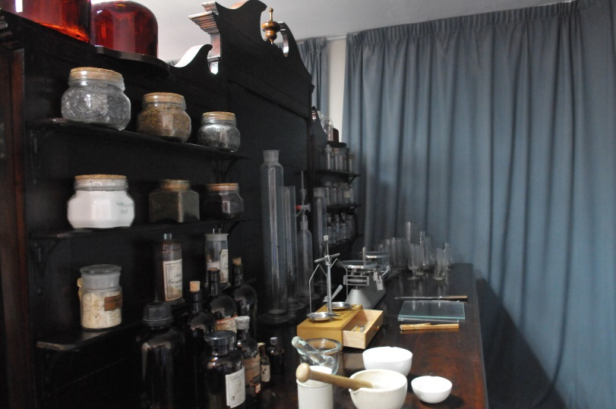
History
Faculty of Medicine and Surgery
Established in 1676 when the Council of the Order of the Knights of St John approved the Grandmaster’s decision for the foundation of the faculty at the Sacra Infermeria (Holy Infirmary) in Valletta.
Traditional Pharmacy Bench, Department of Pharmacy, University of Malta

Slide 4
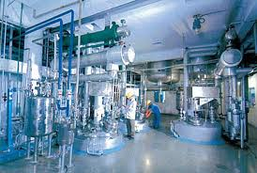
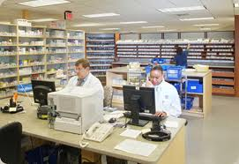
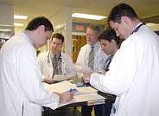
Courses offered
Degree in Pharmaceutical Technology
Bachelor of Science in Pharmaceutical Technology
Degree in Pharmacy

Slide 5
Bachelor of Science (Honours) in Pharmaceutical Technology
DURATION 3 Years
  Processes involved in the development, manufacture and handling of medicines and medical devices
  Development of a critical analysis approach towards pharmaceutical process technologies involved in the development, distribution and access to medicinal products.
  Quality control and Quality assurance in manufacture and compounding of medicines.
Interest in Pharmaceutical Processes

Slide 6
Degree in Pharmacy
a) four-year full-time course leading to the Bachelor of Science (Honours) in Pharmaceutical Science
b) a three-semester full-time course leading to the Master of Pharmacy
Persons in possession of these two degrees would be eligible for a warrant to practise pharmacy in Malta and in the EU.

Slide 7
Pharmacy Education in Malta
Two cycle programme: BSc (Hons) Pharmaceutical Science- Master of Pharmacy (M.Pharm)
Total 5.5 years Pharmacist
Master of Science in Pharmacy
Doctorate in Pharmacy
Doctor of Philosophy
Level 7 Degree
Level 8 Degree

Slide 8

Clinical Pharmacy
One of the most dramatic changes in
pharmacy education
pharmacy practice
Gloria N. Francke, 1969
Francke GN. Evolvement of “clinical pharmacy”. Drug Intell Clin Pharm 1969; 3 (12): 348-53.

Slide 9
Pharmacy Education in Europe in 1994
Subject area % curriculum
Chemistry 25-46
Biological sciences 12-32
Medical sciences 11-30
Pharmaceutical technology 6-22
Physics and Mathematics 3-13
Law and Social aspects 1-16
EAFP. Evaluation and comparison of education training in European Faculties of Pharmacy. 1994 http://enzu.pharmine.org/media/filebook/files/Bourlioux_full_report.pdf
Notes:
In the 1994 survey undertaken by EAFP, it was identified that there was a diversity in how pharmacy programmes were organised in the different countries

Slide 10
Pharmacy Education in Europe in 2006
Subject area % curriculum
Medical sciences 28.0%
Chemistry 24.0%
Pharmaceutical technology 15.0%
Biological sciences 11.0%
Physics and Mathematics 6.4%
Generic 6.4%
Law and Social aspects 6.2%
Atkinson J, Rombaut B. The PHARMINE study on the impact of the European Union directive on sectoral professions and of the Bologna declaration on pharmacy education in Europe. Pharmacy Practice 2011; 9(4): 188-194.
Notes:
The distribution of the subject area, we notice that compared to the 1994 study, there was an overall shift in emphasis towards medical sciences that incorporate pharmacotherapy, pharmaceutical care aspects, pharmacology. The Generic section is a new section included in this survey to cater for traineeships.

Slide 11
Curriculum mapping
Medical Sciences: Chemistry ratio
Ireland 2.61 84.1% community pharmacy
France 2.38 72.9% community pharmacy
Malta 2.0 45.0% community pharmacy
19.2% hospital pharmacy
Notes:
Still if you look at the individual data, you will find countries where the programme is more medical sciences oriented like Ireland, France and Malta which are the top three in this regard. A point to note is that in Malta the principal occupation is again community pharmacy but a very low figure whilst there are a large number of pharmacists in hospital pharmacy including clinical pharmacy services.

Slide 12
Pharmacy Education
Timeline in Europe
1985/432 EEC Council Directive on pharmacy education
Five years duration
1985
1999
Two cycle- Masters
Mobility
Quality Assurance
Bologna Declaration
2005
2005/36 EC Council Directive on the recognition of professional qualifications

Slide 13
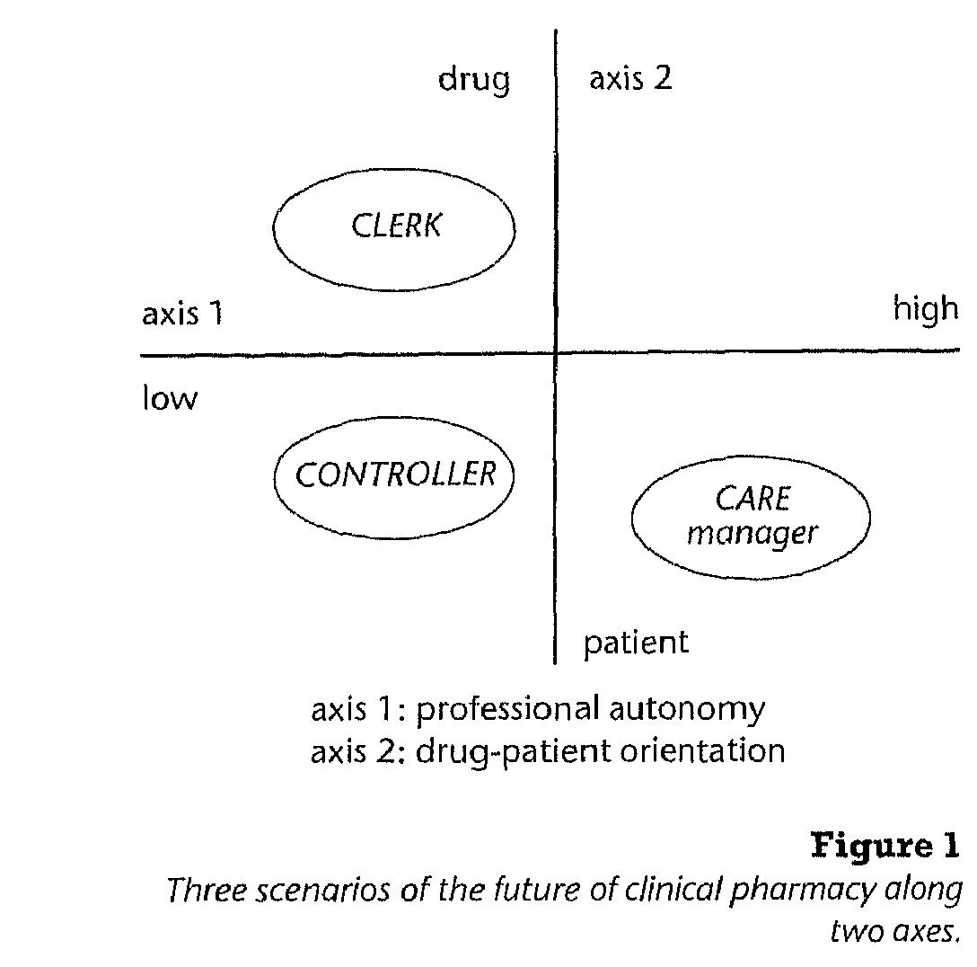
Clinical Pharmacy Education
Patient first
Proactive
Partnership
Leufkens H, Hekster Y, Hudson S. Scenario analysis of the future of clinical pharmacy. Pharm World Sci 1997; 19(4): 182-185.

Slide 14
innovations

Slide 15
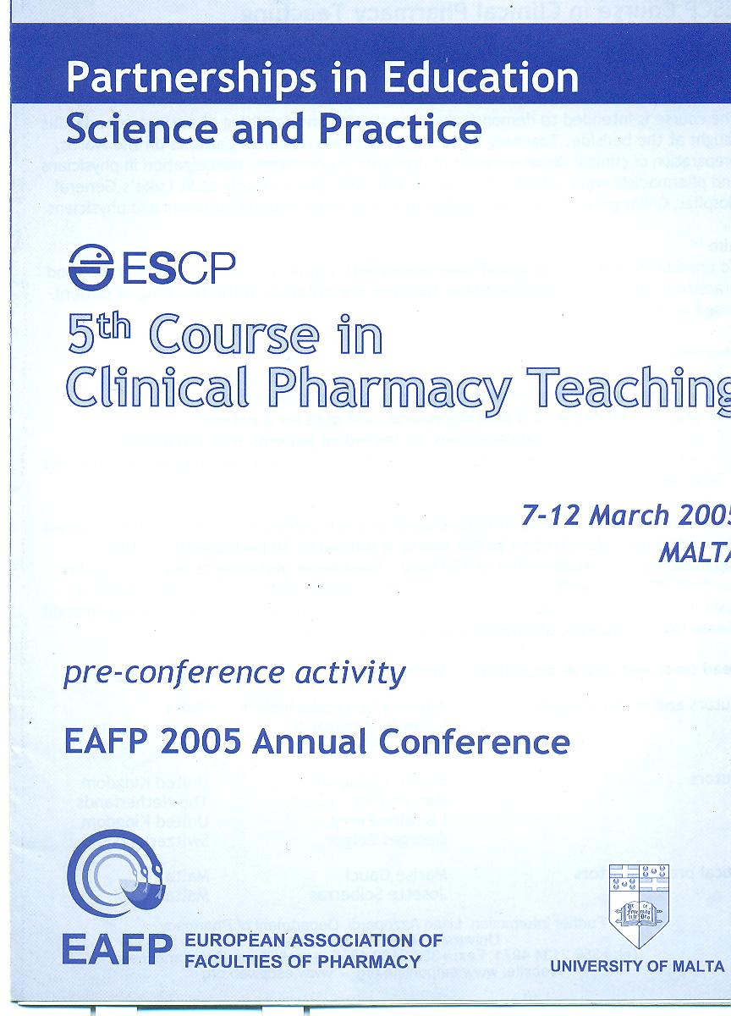
Innovations: Bedside teaching
Hudson SA, McAnaw JJ, Johnson BJ. The changing roles of pharmacists in society. IeJSME 2007; 1(1): 22-34.

Slide 16
Pharmacy Education: Target
Provide pharmacy education that prepares graduates who can function within a diverse and complex pharmaceutical setting
Notes:
From this perspective the target is to have graduates who can function within a diverse and complex pharmaceutical setting, also keeping in mind that the curriculum is preparing graduates for other settings required by other stakeholders eg. industry

Slide 17

Pharmacy Education: Focus
think
communicate
Mobilize knowledge
Merge science and practice
apply
Notes:
From this perspective the target is to have graduates who can function within a diverse and complex pharmaceutical setting, also keeping in mind that the curriculum is preparing graduates for other settings required by other stakeholders eg. industry

Slide 18
Pharmacy Education: Outcome
Development of critical thinking and problem-solving skills
Transition from dependent to active, self-directed lifelong learners
Notes:
The outcome is that we want to develop graduates who have critical thinking and problem solving skills and who are active, self-directed lifelong learners.

Slide 19
Example: Objectives of the Experiential Learning Module
Utilise the principles of experiential education and engagement of students in “real-life” activities.
Describe the importance of workplace skills
Instill the importance of competence through lifelong learning habits
Provide basic understanding and utility of continuous professional development
Provide appropriate leadership skills through example

Slide 20
Examples of Active learning
Reflecting on your strengths and what you want to learn and improve
Identify 3 SMART learning objectives:
specific
measurable
achievable
relevant
timed
Student Portfolio
Complete reflection form at the start and midpoint
Daily record sheet
Evaluation sheet at the start (t0), midpoint (t7) and the end

Slide 21
Models
Emphasise active engagement of students in the learning models
Foster scientific inquiry and innovation
Immerse students in practice early
Case-based learning
Flipped Classroom
Research Projects
Longitudinal approach
Experientials

Slide 22

Integration of Science and Practice
x
Practice
Science
Notes:
We should be looking away from this scenario of a tug of war between the science and practice but rather at a situation where the two aspects are supporting each other to keep our focus within the curriculum.

Slide 23

Integration of Science and Practice
Notes:
So we should be more looking at this scenario where we have the disciplines of pharmaceutical chemistry, pharmaceutical technology, pharmacology all contributing to the therapeutic aspects – very commonly captured in the module of pharmacy practice.

Slide 24
Research: Supporting innovative pharmaceutical services
Pharmacist-led point-of-care genotyping for individualised treatment in cardiology
Clopidogrel is a prodrug that requires biotransformation to the active metabolite by CYP2C19
Genetic variation for non functional CYP2C19 has been associated with increased risk of stent thrombosis and higher risk of myocardial infarction, stroke and death
Notes:
Having a knowledge of pharmacodynamics can be used in the genetic approach to select the drug therapy that improves patient adherence to treatment.

Slide 25
Clinical pharmacist
+ CYP2C19 genotype results
Personalised therapy
Limit occurrence of MACE and bleeding
Reduce drug interactions
Cost-effective
recommendations
Use of Clopidogrel
Slide credit: Wirth F, Azzopardi LM. Pharmacogenetic implications in clopidogrel therapy: A pharmacist-led management approach
Notes:
Pharmacists can interpret the genotype results and support physicians in the appropriate therapy for the individual patient.

Slide 26
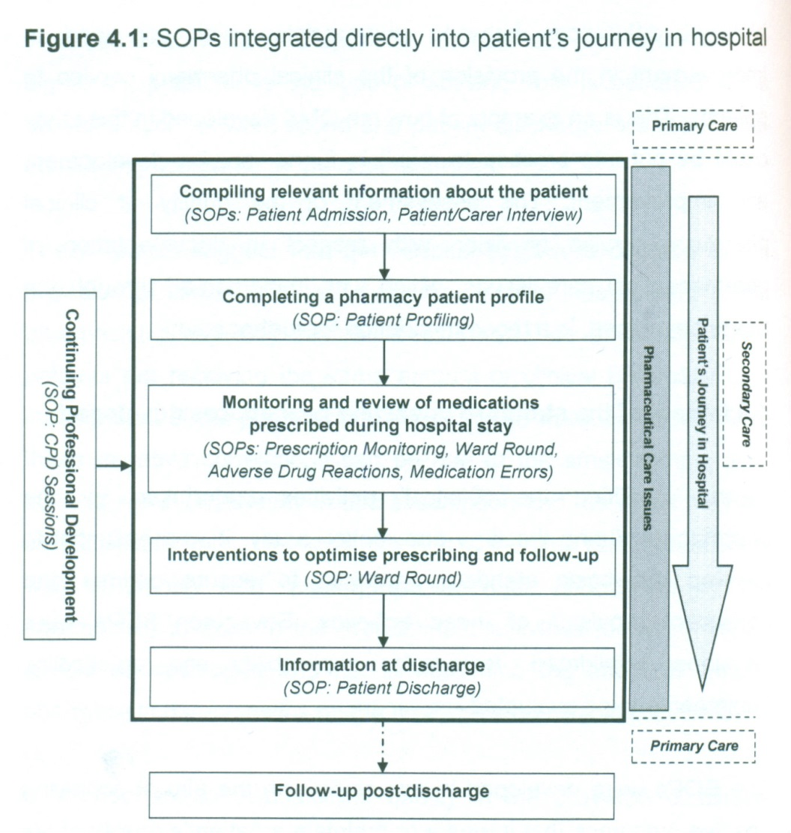
Quality System for Clinical Pharmacy Activities
Wirth F, Azzopardi LM, Serracino-Inglott A. Quality management system for clinical pharmacy services. Scholars’ Press: Germany. 2013.

Slide 27
Postgraduate education to support innovation
A post-graduate degree with insights into clinical pharmacy, patient safety and pharmaceutical regulatory sciences that is at the same qualification level of a PhD
Collaboration with College of Pharmacy, University of Illinois, Chicago
Notes:
The concept of offering programmes that allow the professional pharmacist to take up academic programmes that lead to a level 8 academic degree equivalent to a PhD whilst developing advanced professional skills in clinical pharmacy that are required for the delivery of services within healthcare delivery settings. The professional doctorate entails the practice and research aspects.

Slide 28
Postgraduate doctorate
Interprofessional learning at the professional sites with consultant physicians, nurses and other healthcare professionals
Take up applied pharmacy research
Journal clubs, case presentations, scenario analysis, reflective portfolios, presentations and discussions

Slide 29
Outcome
Empower pharmacists
to assume care manager positions
take up leadership roles
drive policies and developments in clinical pharmaceutical services that draw on scientific, evidence-based and innovative research

Slide 30
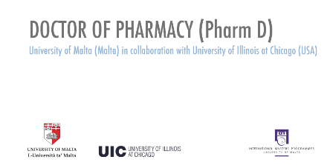
Postgraduate education to support innovation
Skills developed
Lead and manage medication knowledge, mitigate errors and support decision-making based on evidence-based sources
Notes:
Within my university we have the postgraduate programme leading to the level 8 Professional Doctorate being delivered in collaboration with the University of Illinois at Chicago. The targets of the programme are to develop skills in the management of medication knowledge,

Slide 31
Postgraduate education to support innovation
Skills developed
Collect and critically assess clinically relevant data to facilitate innovation in use of drugs, monitoring and management of drug therapy plans, pharmacovigilance aspects
Notes:
To collect and critically assess clinically relevant data
To identify opportunities for improvement of a medication-use system

Slide 32
Postgraduate education to support innovation
Skills developed
Identify opportunities for improvement of medication-use systems and development of novel direct patient pharmaceutical services
Notes:
To collect and critically assess clinically relevant data
To identify opportunities for improvement of a medication-use system

Slide 33
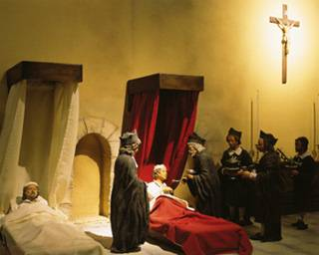

1500, Clinical Pharmacy Services in Europe. Sacra Infermeria Valletta

Slide 34
Thank you
lilian.m.azzopardi@um.edu.mt
http://www.um.edu.mt/ms/pharmacy

