Slide 1
Do Arbuscular mycrorhizal fungi stimulate or retard the decomposition of organic residue in soils?
Lili Wei
Institute of Urban Environment,
Chinese Academy of Science, Xiamen, China

Slide 2
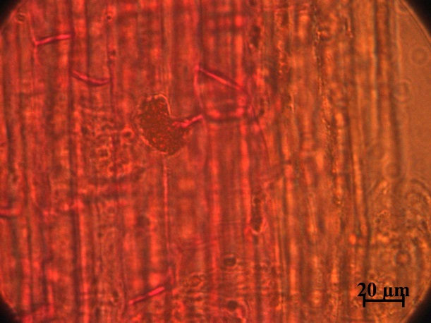
Outline
Why AMF important in carbon cycling
The role of AMF in SOM decomposition
Open questions
Conceptual hypothesis

Slide 3
I. Why AMF important in carbon cycling

Slide 4
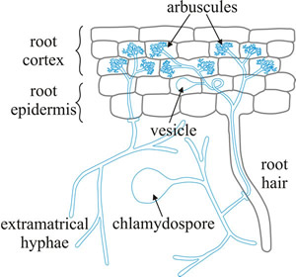
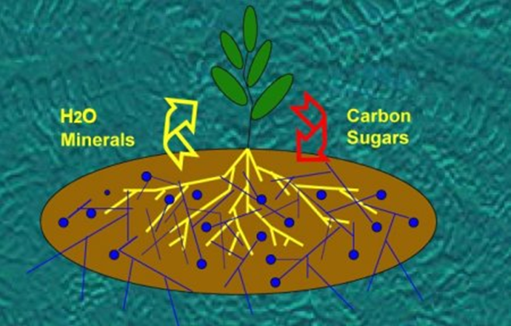
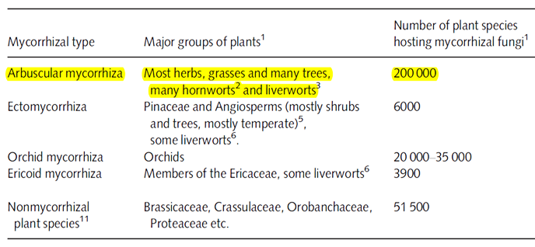
1. The most widespread plant symbionts
Arbuscular mycorrhizal fungi (AMF) are a group of obligate biotrophic plant symbionts .
> 80% land plant
van der Heijden et al. 2015

Slide 5
2. Many functions
Benefits to plant hosts
Ecosystem-scale functions
Plant community structure
Enhancing plant nutrient uptake
Soil microbial structure
AMF
Protection against root pathogens
Soil stability
Improving plant abiotic stress resistance
Carbon cycling
Based on Liu et al. 2015

Slide 6
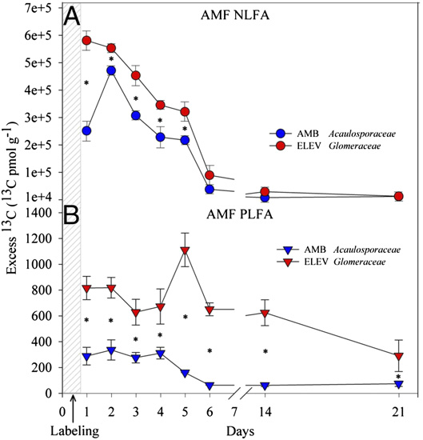
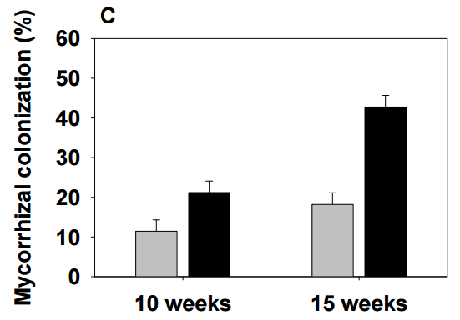
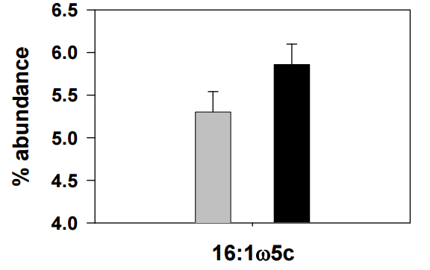
3. Growth and activities stimulated by elevated CO₂
elevated CO₂
ambient CO₂
¹³C enrichment in the AMF signatures 16:1ω5 determined in rhizosphere soil
(Drigo et al. 2010)
Cheng et al. 2012

Slide 7
II. The role of AMF in SOM decomposition
Acceleration of SOM decomposition
Protection of SOM by forming aggregates
？
Soil organic matter (SOM)

Slide 8
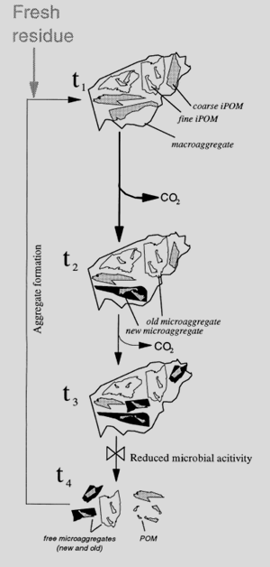
1. Contribution to soil aggregation
Based on Six et al. 2000
AMF
1.1 ‘Life cycle’
Macroaggregate forming (250-2500 µm in diameter):
decomposable OM,
small diameter roots,
AM hyphae detritus,
glomalin-related soil protein (GRSP).
Microaggregate forming (20–250 µm in diameter)
(Miller & Jastrow 2000).

Slide 9
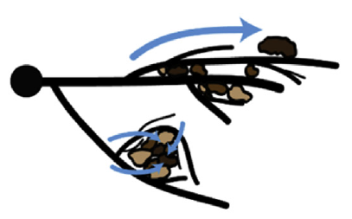
Production of glomalin-related soil protein (GRSP)
Physical enmeshment of soil particles by extensive networks
Rillig 2004; Lehmann & Rillig 2015

Slide 10
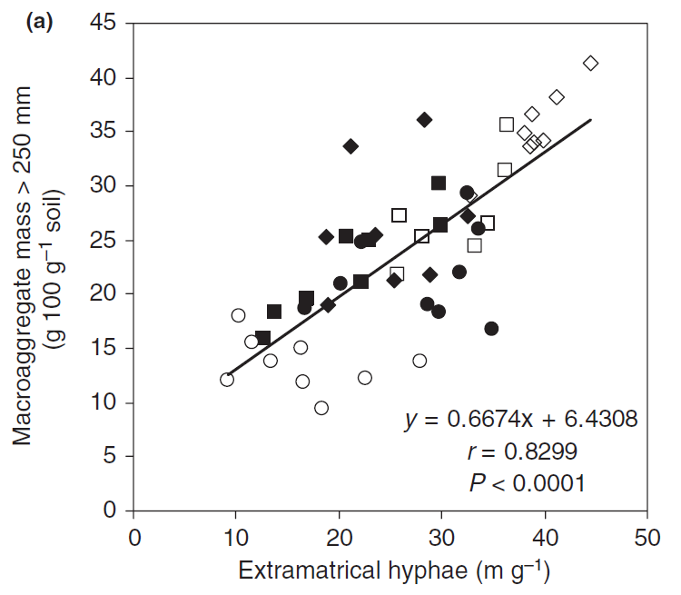
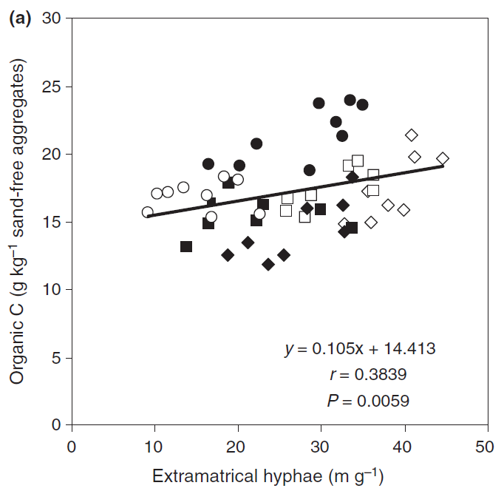
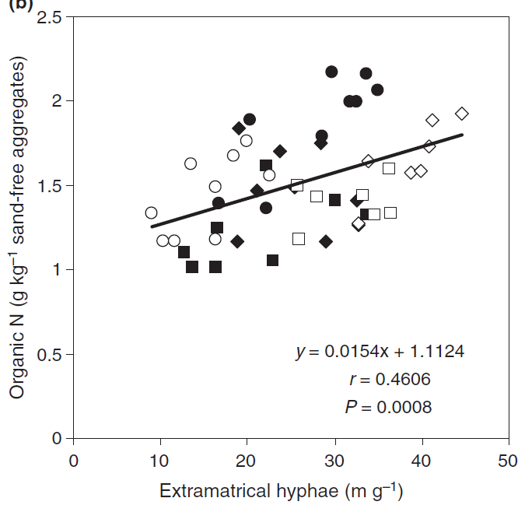
1.2 Ecosystem-scale observation
Diverse management practices (burning, N-fertilization and fungicide application)
Multispecies prairie communities
Wilson et al. 2009

Slide 11
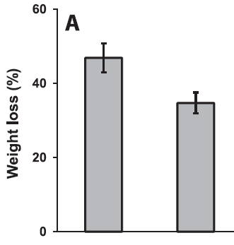
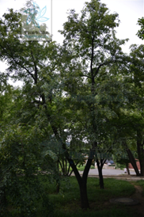
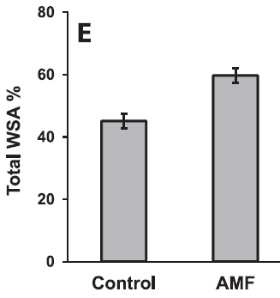
1.3 Microcosm observation
The wooden sticks (Tilia species)
Slowed the decomposition of woody plant litter
Increased soil aggregation
Leifheit et al. 2015

Slide 12
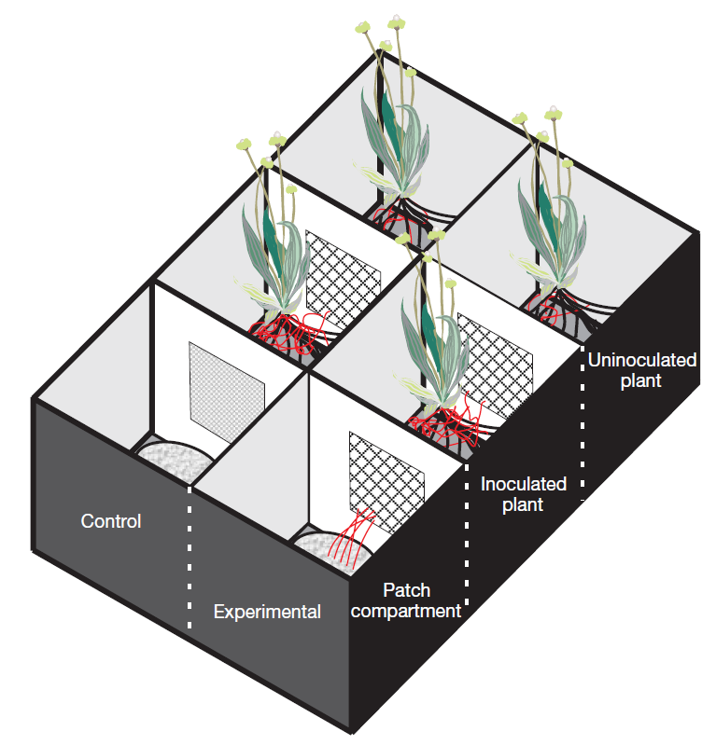
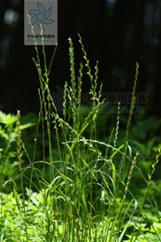
2. Acceleration of residue decomposition
A patch of dual-labelled (¹⁵N/¹³C) Lolium perenne leaves.
A lower retention of ¹³C in the OM patch
Hodge et al. 2001

Slide 13
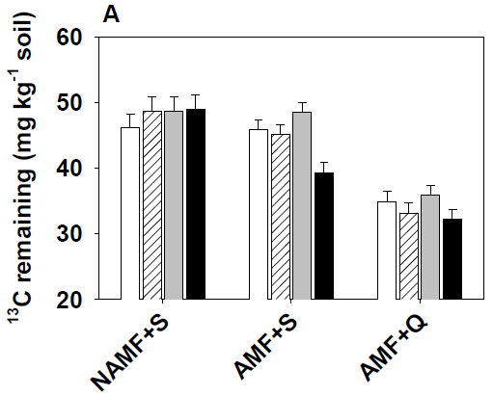
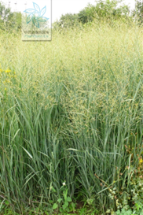
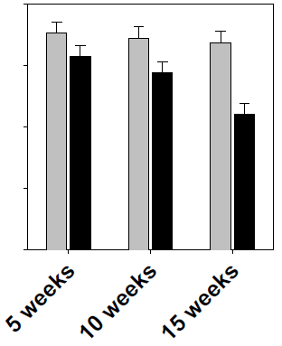
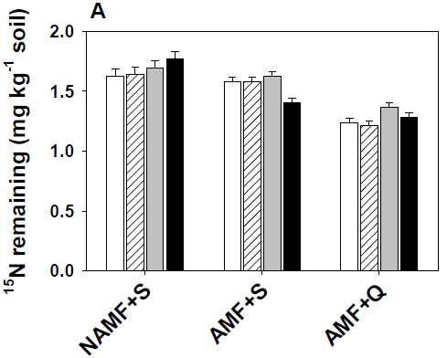
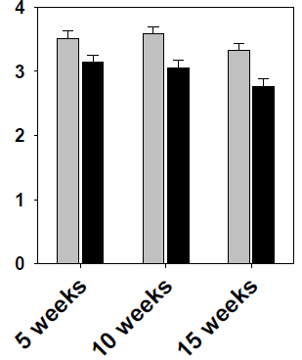
380ppmv
580ppmv
Dual ¹³C/¹⁵N labeled residues of Panicum virgatum
Increased the losses of ¹³C and ¹⁵N in OM patch (Cheng et al. 2012)

Slide 14
III. Open Questions
What if there is no fresh residues input?
What if the fresh residues apply in the rhizosphere?

Slide 15
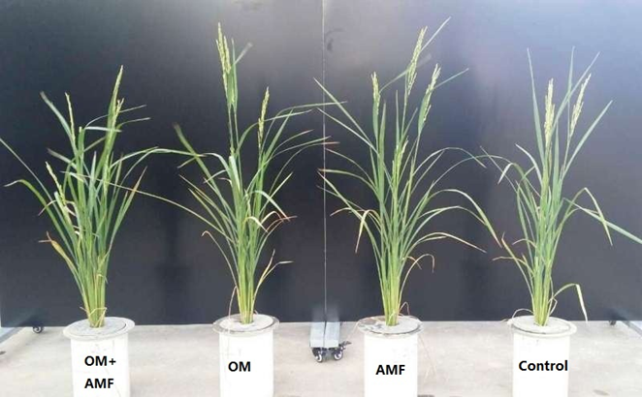
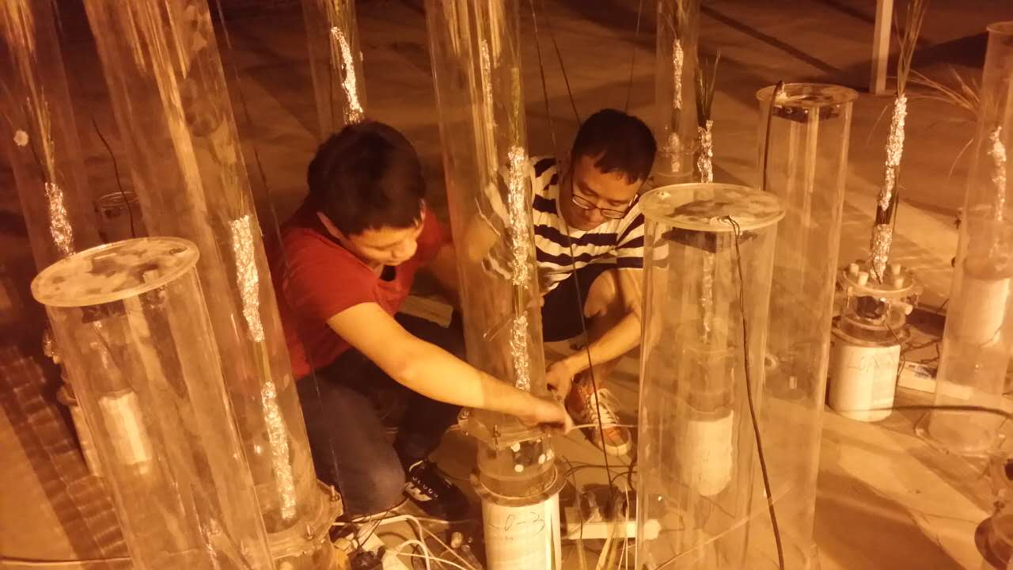
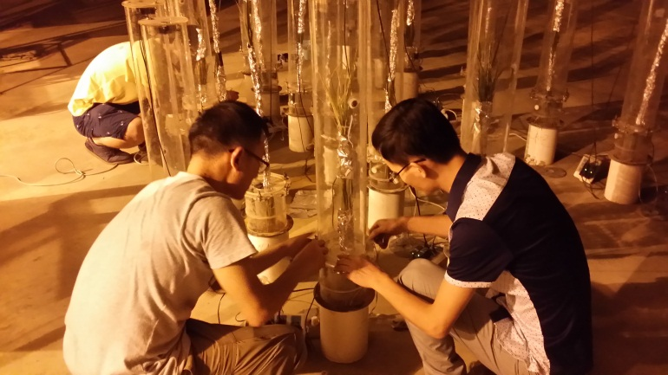
Our Experiment
Tillering
Hyphosphere
Leaf litter
Rhizosphere
Heading

Slide 16
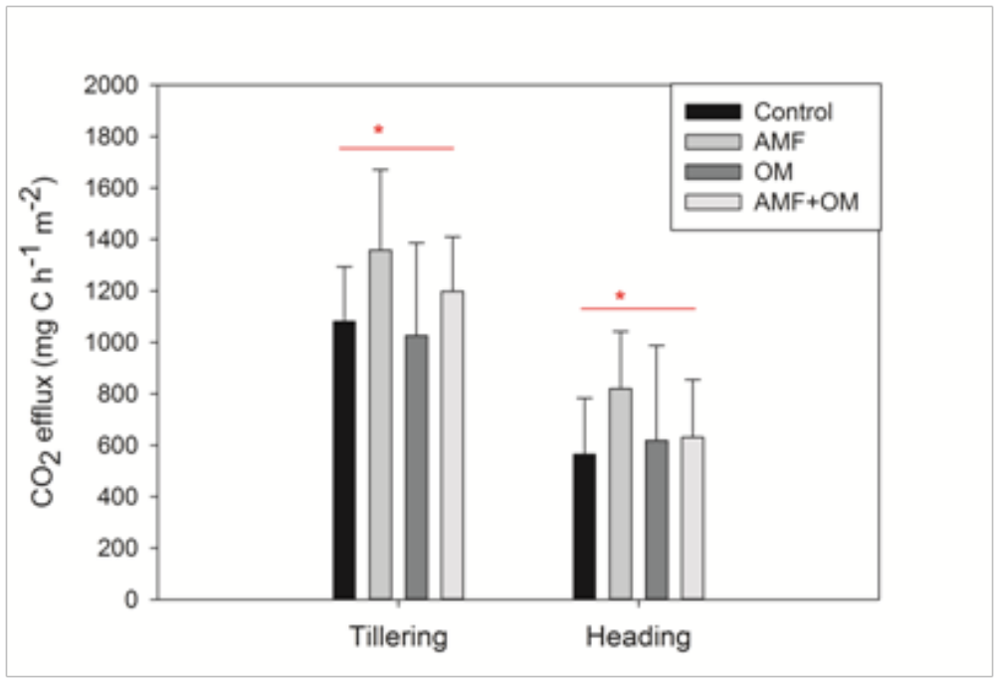
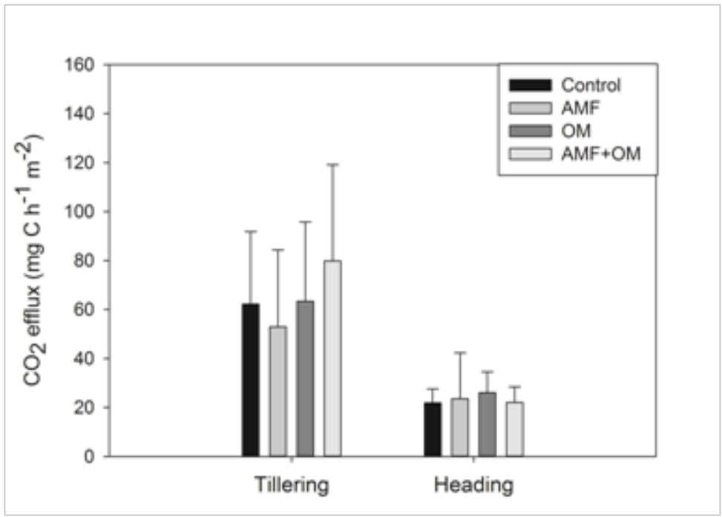
Inoculation with AMF increased CO₂ efflux in the rhizoshpere in the absence of fresh litter input.
Rhizoshpere
Hyphosphere
The hyphae did not accelerate CO₂ emission in the absence of fresh litter input.

Slide 17
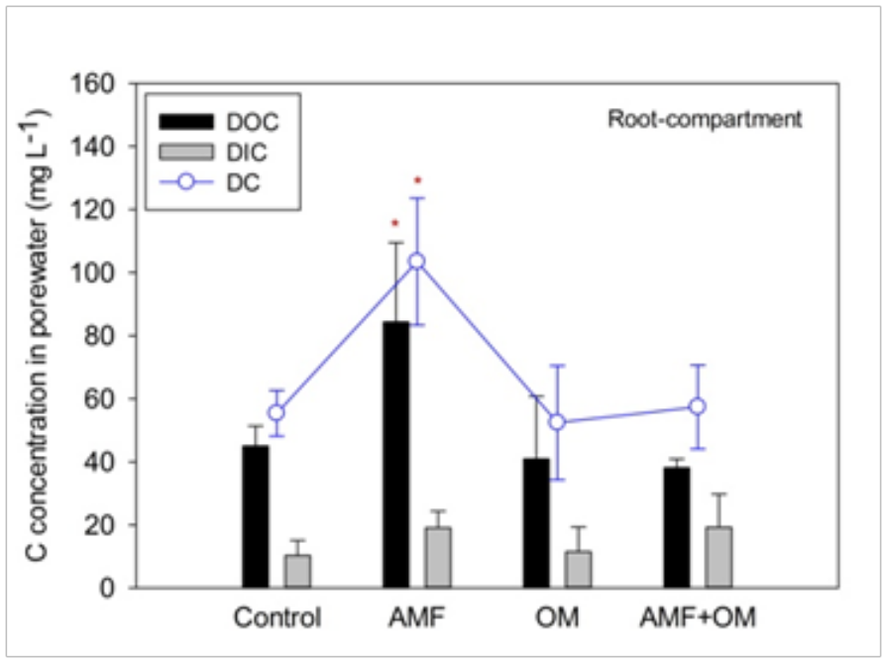
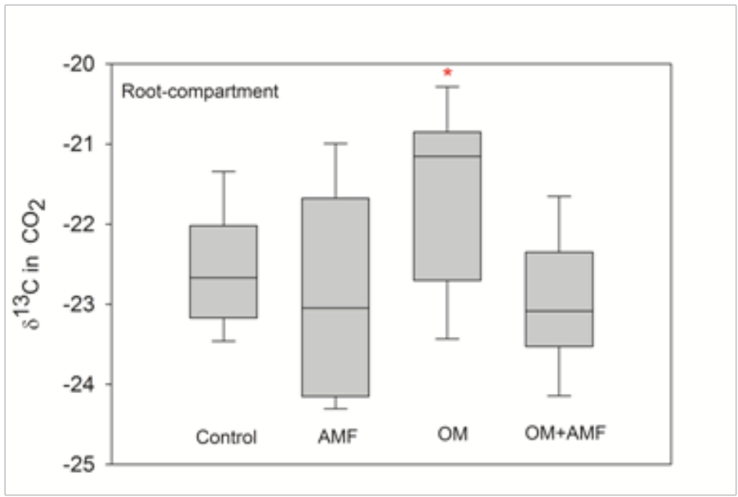
Where is the increased CO₂ derived from?
Root respiration
AMF respiration
Decomposition of labile C

Slide 18
3. Residue’s quality
Stimulating
Retarding
Labile/Recalcitrant
Recalcitrance is not necessary for soil organic matter formation (Derrien & Amelung 2011; Dungait et al., 2012)

Slide 19
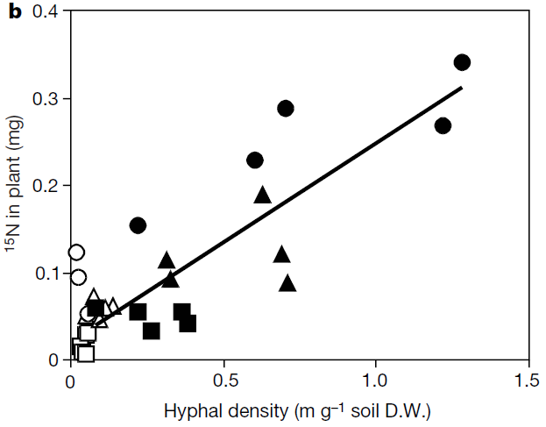
N capture
(Hodge et al. 2001; Leigh et al. 2009)
Independent from the amount of C source
(Hodge & Fitter 2010)
Ammonium transporter (Guether et al. 2009)
N rich residues

Slide 20
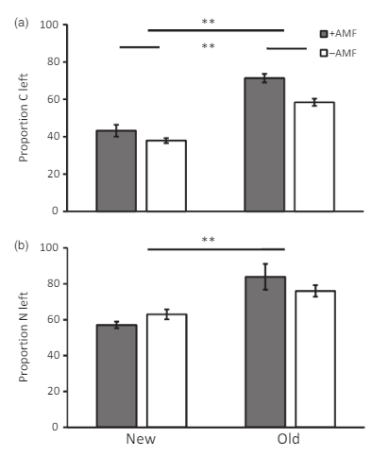
4. Time?
The application with such old residue led to more soil retention of litter-derived C and N compared with the addition with fresh residue
(The ‘old residue’ means that the residue has passed through an initial stage of decomposition after 3-month incubation).
Verbruggen et al., 2016

Slide 21
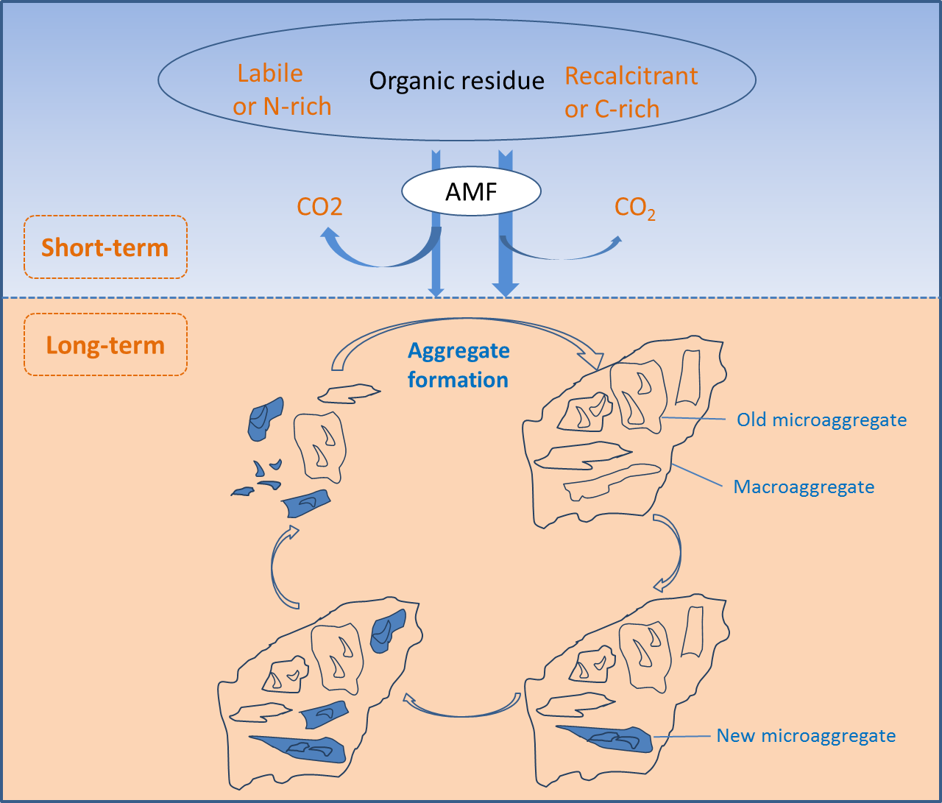
IV. Hypothesis

Slide 22

Thanks
l.l.wei@hotmail.com

