Slide 1
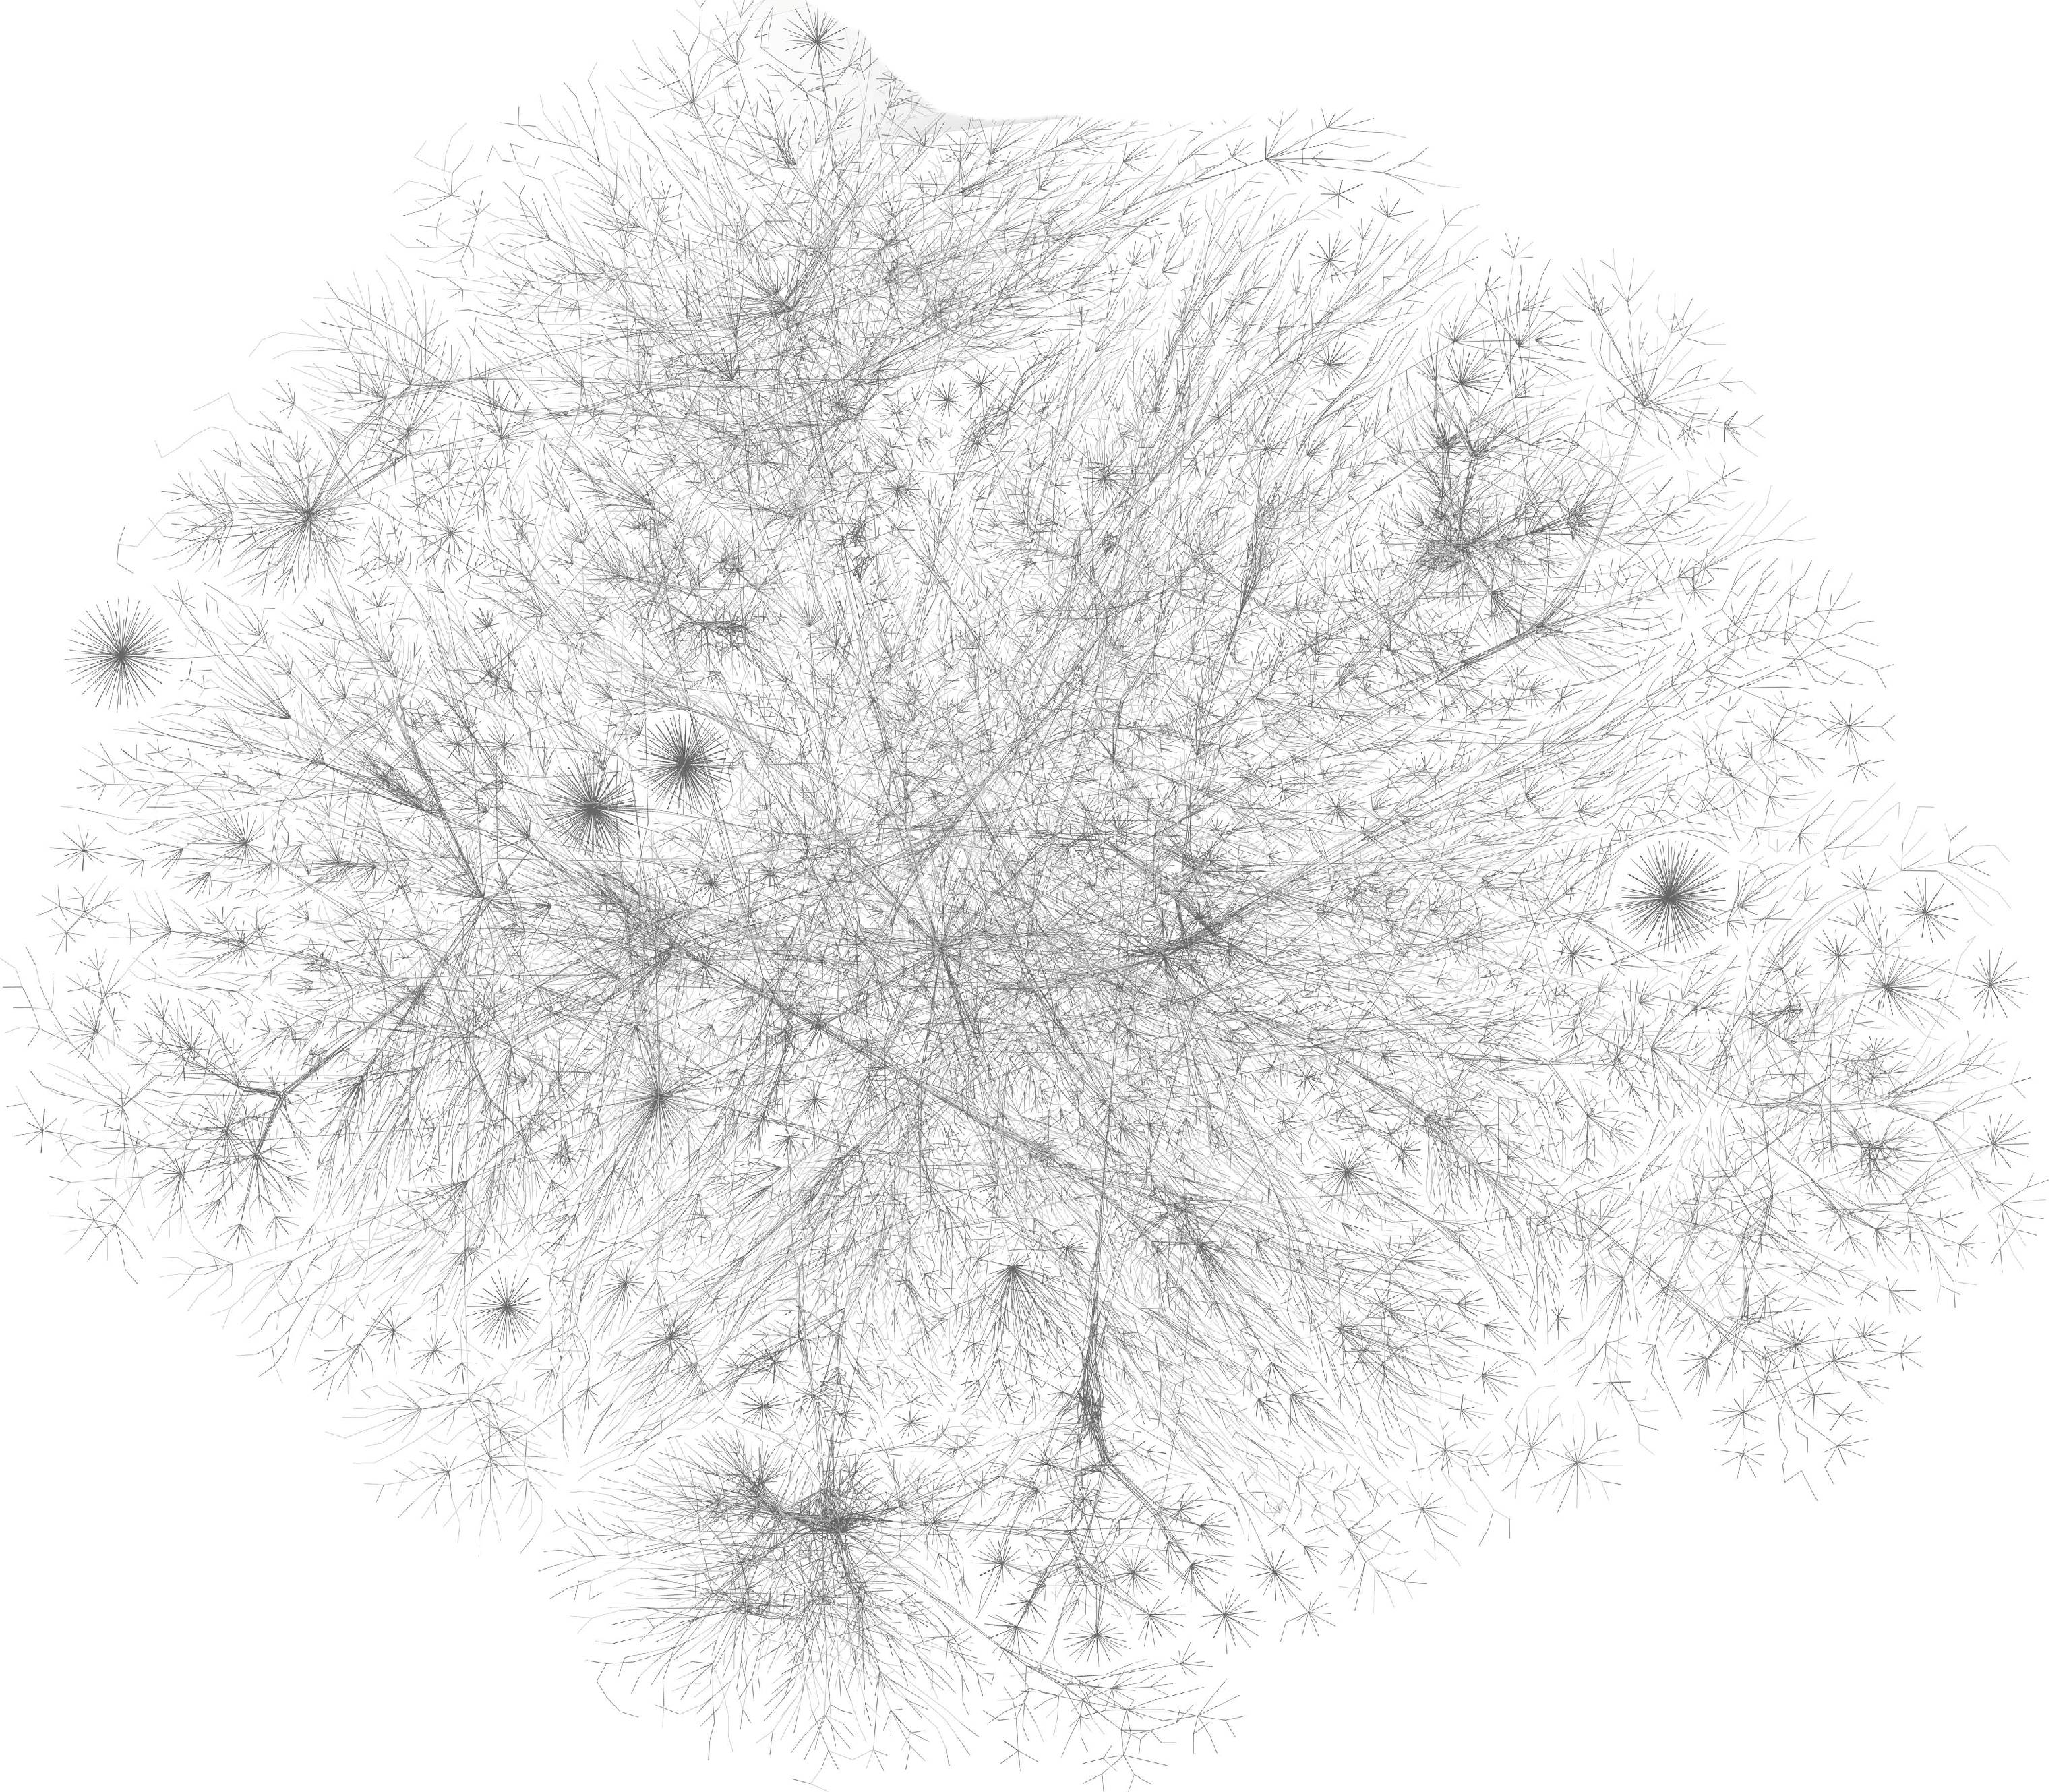

Evolution-informed Modeling discover biomarkers for precision oncology
College of Health Solutions
Department of biomedical informatics
Li Liu, M.D. (liliu@asu.edu)
August 22, 2016

Slide 2

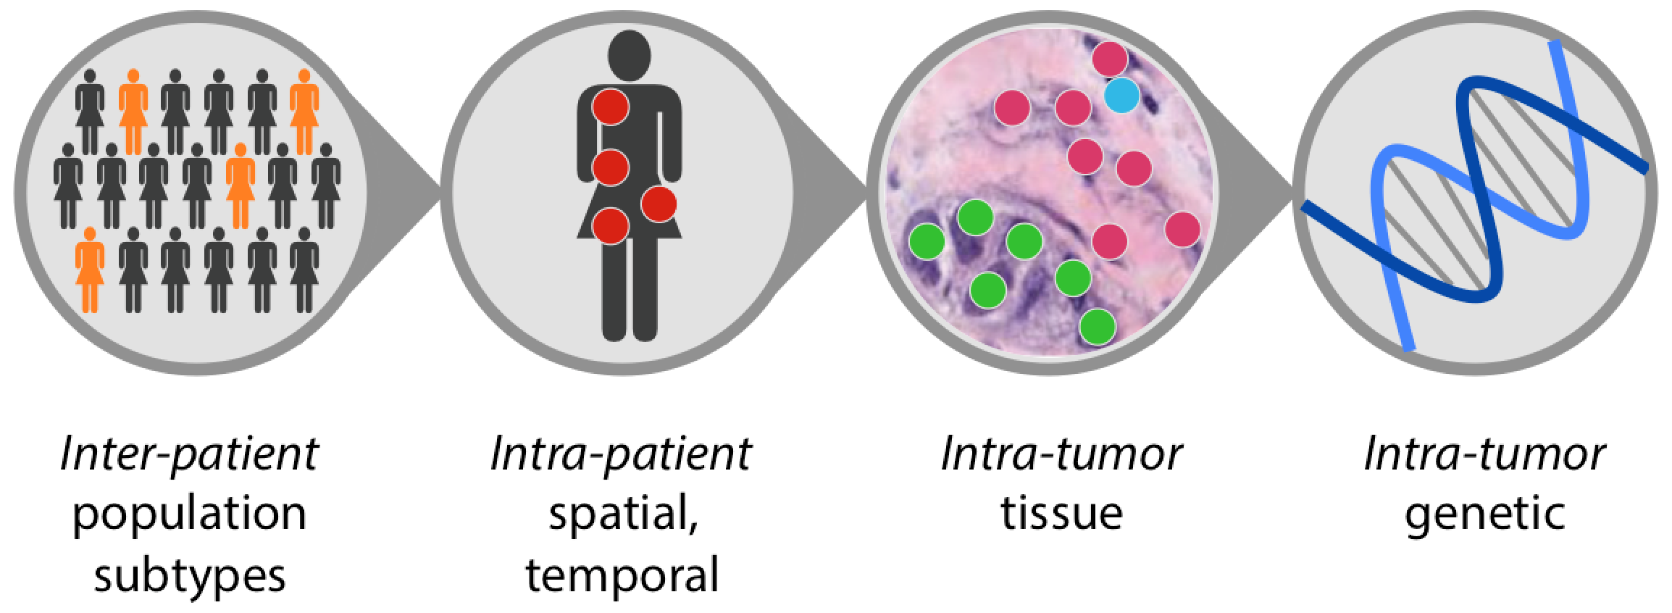




Precision Oncology
Biological heterogeneity of cancer
(courtesy image from Florian Markowetz)
Precision oncology
DD
x
Prevention
Screening
Diagnosis
Treatment
Monitoring
Department of biomedical informatics
Biodesign Institute

Slide 3
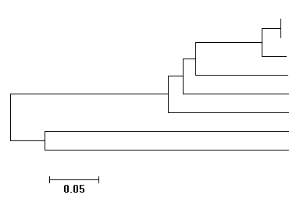

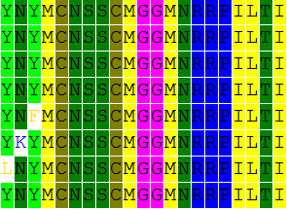
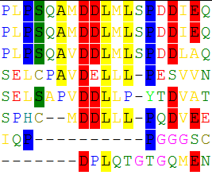







Molecular Evolution
Sequence Conservation Indicates Functional Importance
Conserved
Variable
Essential
Nonessential
long t, slow r, high p
short t, fast r, low p
Evolutionary time span (t)
Absolute substitution rate (r)
Evolutionary probability (p)
Kumar et. al. 2012; Liu, et. al. 2016
Department of biomedical informatics
Biodesign Institute

Slide 4
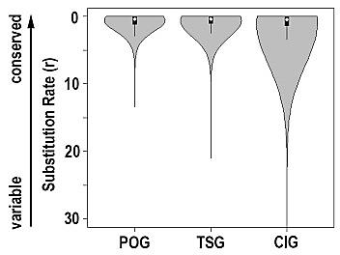

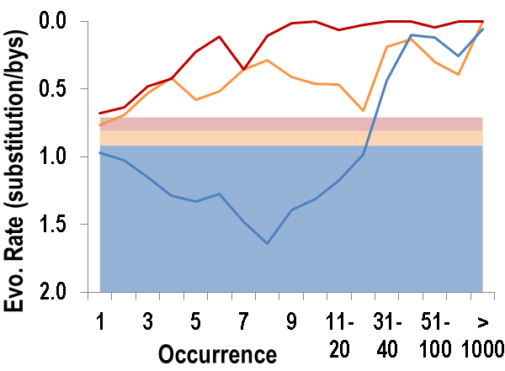
Evolutionary Patterns of Cancer Genes
Cancer driver genes are highly conserved.
Cancer driver mutations disrupt highly conserved sites.
POG: proto-oncogene TSG: tumor suppressor gene CIG: cancer insignificant gene
Changes in conserved genes have more severe functional impact than in variable genes in carcinogenesis and tumor progression.
Department of biomedical informatics
Biodesign Institute

Slide 5
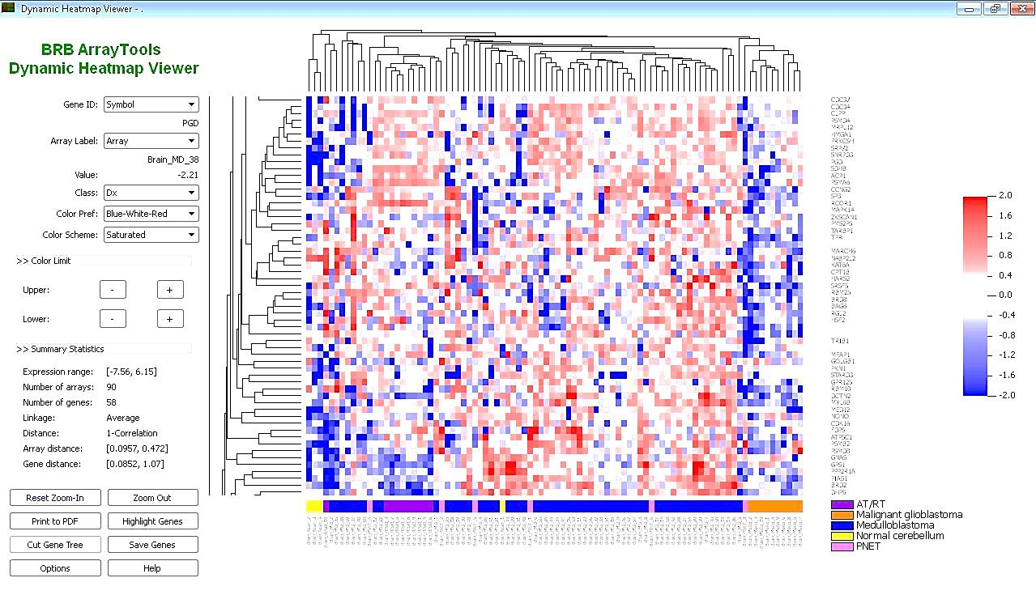
Cancer Biomarker Discovery
Prioritize evolutionarily conserved features in cancer biomarker discovery.
Omics data
High dimensionality
High noise-level
Biomarkers
Statistical significance
Functional importance
stat
evo
Department of biomedical informatics
Biodesign Institute

Slide 6

Prioritize Evolutionarily Conserved Features
Evolution-informed Modeling:
  Embed evolutionary conservation as priori knowledge in a machine-learning framework to select biomarkers.
standard sparse logistic regression
weighted sparse logistic regression
Sum(1/r, -log(stat_p))
Department of biomedical informatics
Biodesign Institute

Slide 7
Application on AML
Acute Myeloid Leukemia
Individual variability:
  cure rate: 5% - 40%
  resistance to chemotherapy: 30% - 90%
Standard-of-care:
  3 risk groups: favorable, intermediate, and adverse;
Early prediction of therapeutic responses
  a clinical actionable prediction
  conventional markers: 62% accuracy
  genomic markers: low reproducibility
Burnett, et. al., 2013; Dohner, et. al., 2015; Walter, et. al., 2015
Department of biomedical informatics
Biodesign Institute

Slide 8

Predict AML Chemo-resistance
2014 DREAM Challenge
  Treatment outcomes: complete remission vs. resistance
  Clinical parameters: age, drug, blood count, cytogenetic, etc.
  Proteomic parameters: expression level of 231 proteins.
training data
191 patients
testing data
100 patients
Aim: use clinical and proteomic parameters to predict treatment outcomes
Noren, et. al., 2016
Department of biomedical informatics
Biodesign Institute

Slide 9
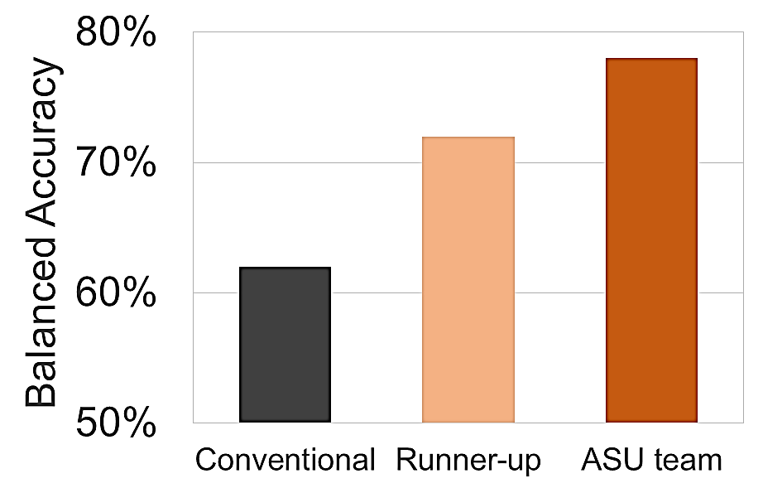
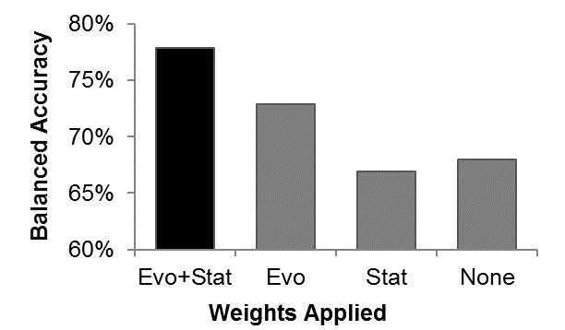

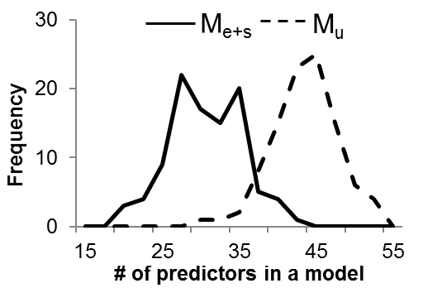
DREAM AML Challenge
Evolution Wins
The top two protein markers in our model
  PIK3CA: a well-known drug target
  GSK3: a newly proposed drug target
  We found them without using priori knowledge on drug targets!
Noren, et. al., 2016; Liu, et. al., 2016
Department of biomedical informatics
Biodesign Institute

Slide 10
Reproducibility
Inconsistent Genetic Biomarkers from Omics Data
Noise in
Omics Data
False Positives
False Negatives
Irreproducible
Results
Two gene expression studies of AML
GSE2191 |  | GSE425
25 patients with good prognosis |  | 75 patients with poor prognosis
28 patients poor prognosis |  | 41 patients with good prognosis
Affymetrix HG_U95v2 |  | cDNA Array
No marker
in common
Molloy, et. al., 2003; Walter, et. al., 2015
Department of biomedical informatics
Biodesign Institute

Slide 11
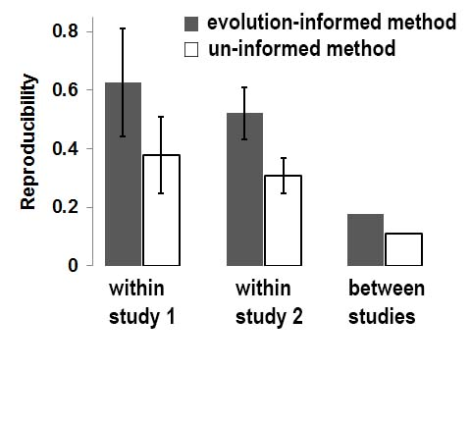
Reproducibility
Evolution-informed Modeling Increases Reproducibility
Standard sparse logistic regression (un-informed)
Evolution-weighted sparse logistic regression (evo-informed)
Reproducibility = % of markers in common
Department of biomedical informatics
Biodesign Institute

Slide 12
Reproducibility
Function of Common Biomarkers
Evolution-informed models (8 common genes in both studies)
GO Term | Gene Count | FDR
Signal transduction | 5 | 0.04
Cellular protein modification process | 4 | 0.02
Un-informed models (28 common genes in both studies)
GO Term | Gene Count | FDR
Unclassified | 11 | 0.01
Signal transduction | 8 | 0.07
Department of biomedical informatics
Biodesign Institute

Slide 13
Reproducibility
Outstanding Biomarkers
PPP2R5E gene and PPP3R1 gene
  Affect oncogenic potential of leukemic cells
  Prognostic roles in lung cancer, gastric cancer, etc.
RAP1B gene
  Member of RAS oncogene family
  Prognostic roles in gastric cancer, breast cancer, etc.
CUL1 gene & SKP1 gene
  Components of SCF complexes
  Involved in multiple signaling pathways and cell cycle regulation
  Prognostic roles in prostate cancer, colorectal cancer, etc.
UBE2D2 gene, COPS2 gene and CFAP20 gene
  No reported association with cancer clinical outcomes.
Department of biomedical informatics
Biodesign Institute

Slide 14
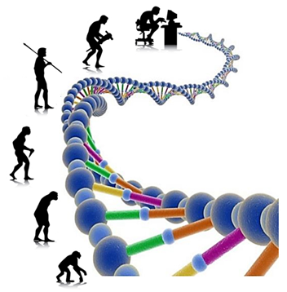
Acknowledgement
Arizona State University
Tao Yang
Yung Chang
Michigan University
Jieping Ye
Temple University
Sudhir Kumar
Maxwell Sanderford
THANK YOU
Department of biomedical informatics
Biodesign Institute

