Slide 1


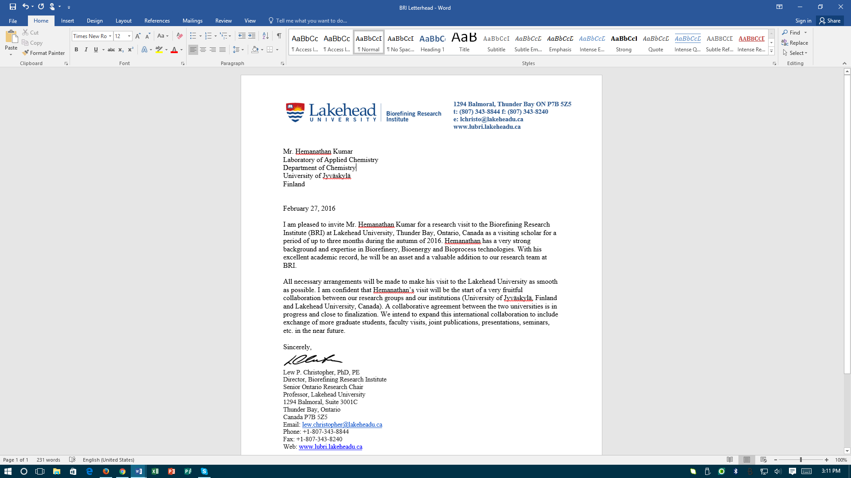
Consolidated Bioprocessing of Lignocellulosic Materials for Cost-Competitive Bioenergy Production
L.P. Christopher
Biorefining Research Institute
Lakehead University
Thunder Bay, ON, Canada

Slide 2
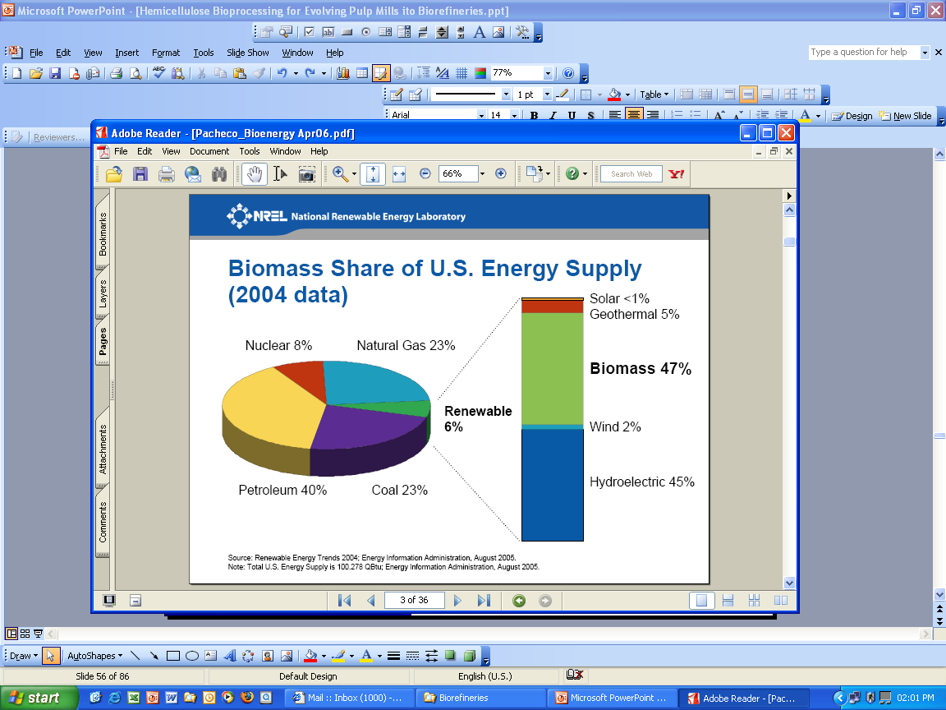
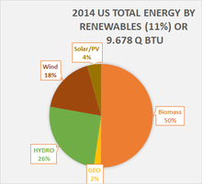
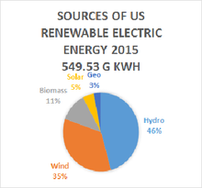
Biomass and Bioenergy
Demand for production of renewable energy currently driven by four major factors:
  increasing energy demands
  fluctuating oil prices & concerns about oil reserves
  growing food needs
  increasing GHG emissions
Biomass share of US energy supply: from 3% in 2004 to 5.5% in 2014.
US DOE: 1.3 billion dry tons of biomass available for bioprocessing to displace 30% of the nation's consumption of liquid transportation fuels
Billion Ton:: Forest residues (~30%); Dedicated Crops (~25%); Crops & Agri Residues (~40%);

Slide 3
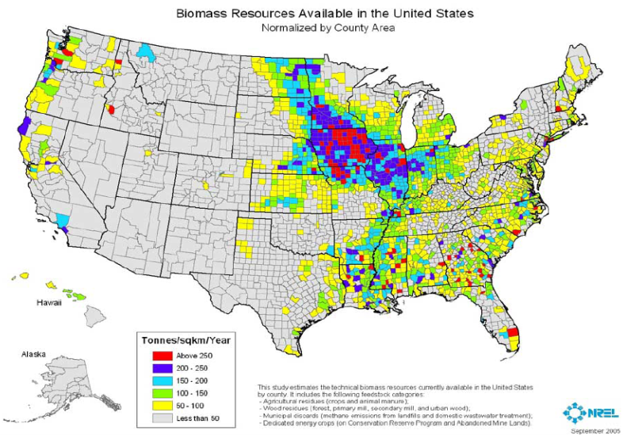
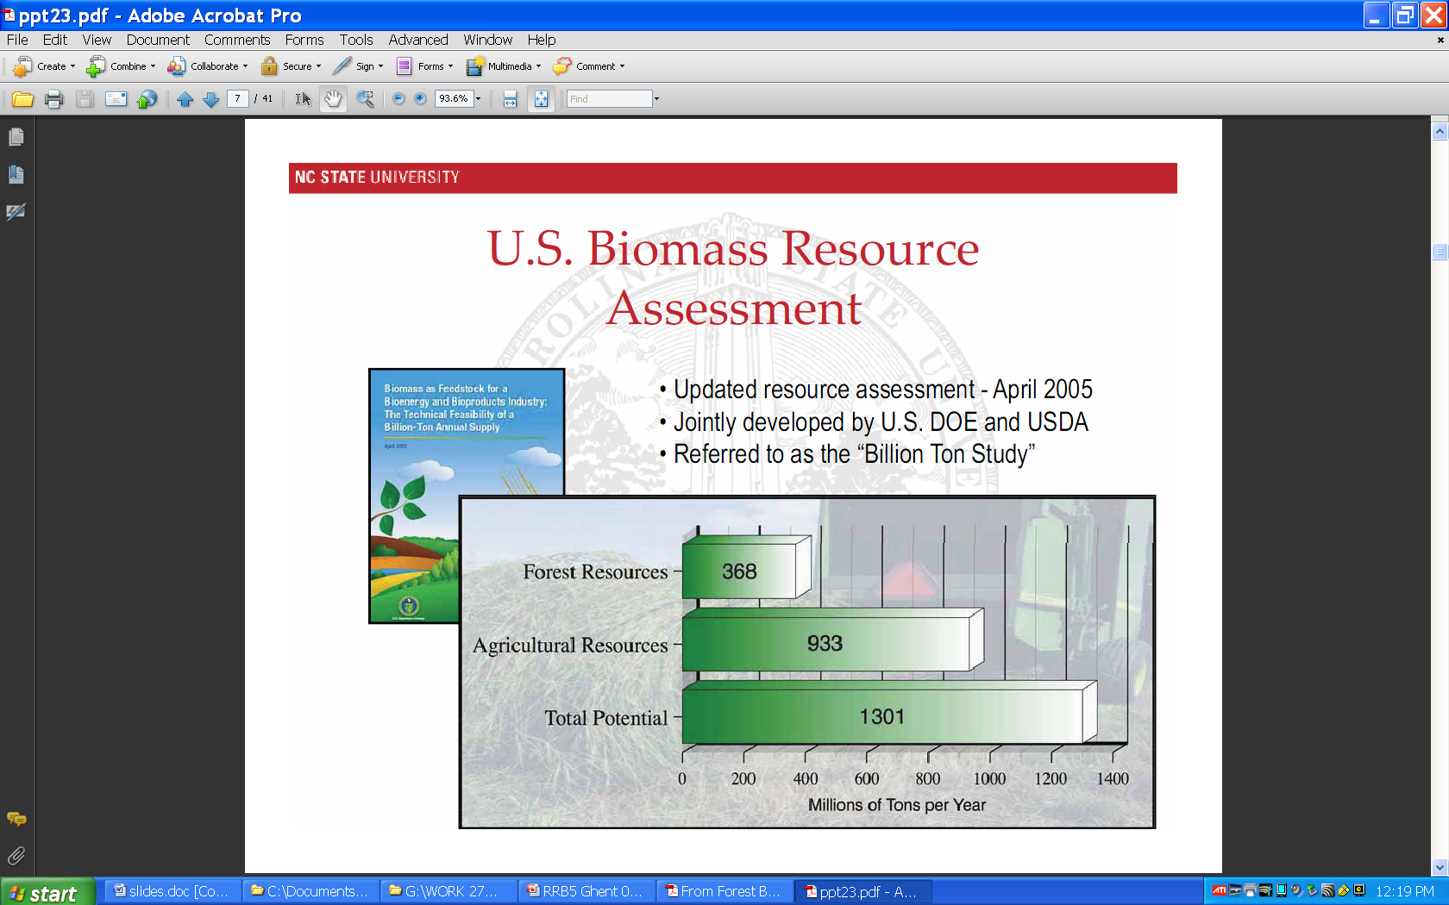
Billion Ton Vision
Economic benefits
  Reduced dependence on imported petroleum
Environmental benefits
  Reduced GHG emissions
  Reduced pollution by utilizing industrial & agricultural waste
  Biodegradable, reusable & recyclable products
Social benefits
  Social development of rural communities
  Improvements in human health and quality of life
DOE’s Billion Ton Biomass : 30% of US gasoline demand

Slide 4
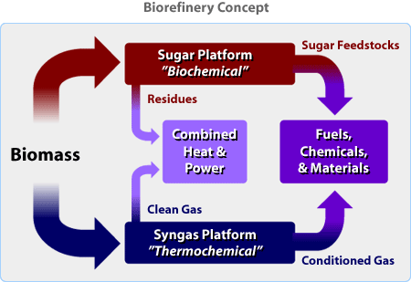
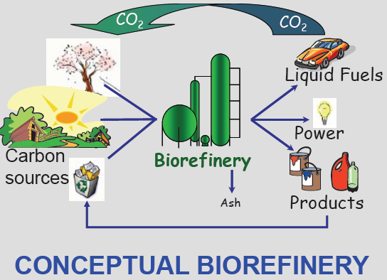
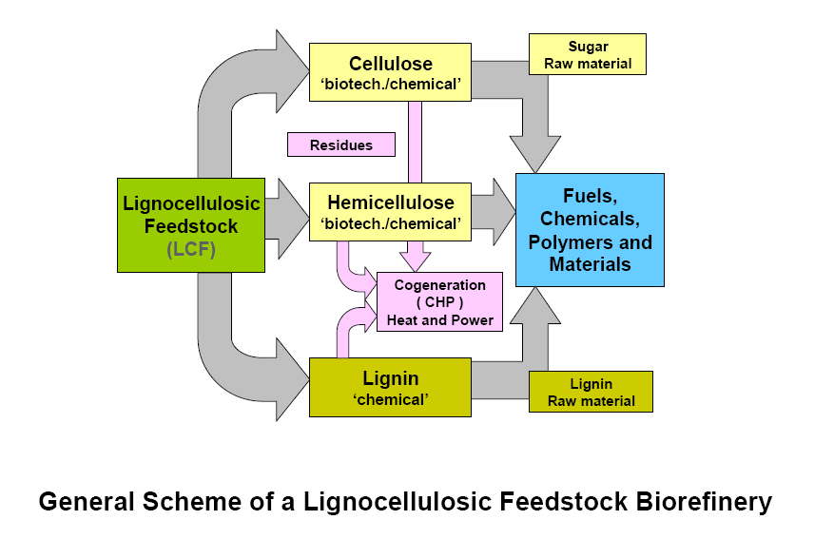
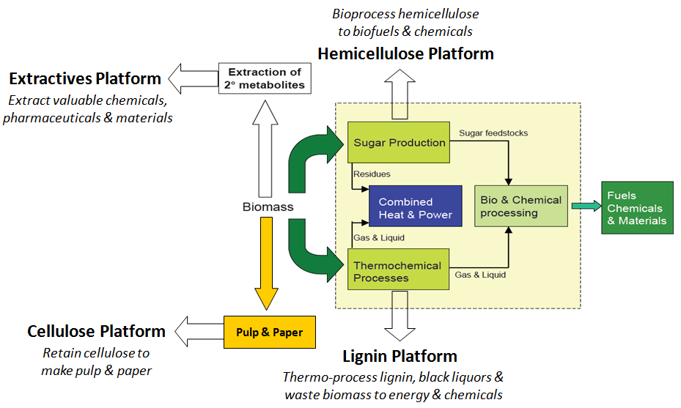
Biorefinery Concept :
C-neutral, Waste-free Bioprocessing

Slide 5
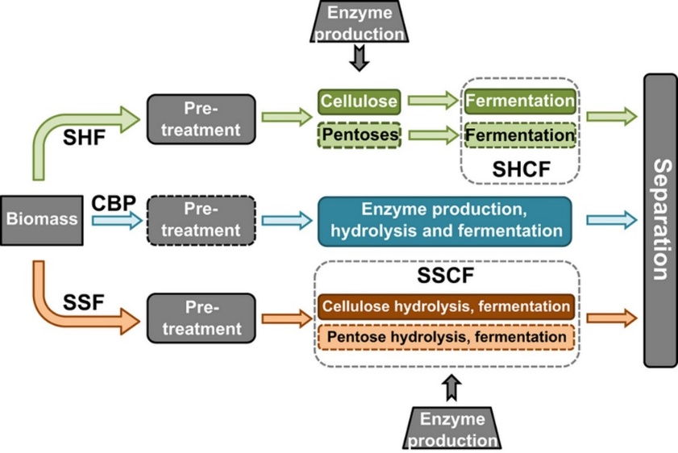
Consolidated Bioprocessing (CBP)
Four processing steps for biomass conversion carried out in one bioreactor by a single organism or microbial consortium:
Enzyme production
Enzymatic hydrolysis of biomass to fermentable sugars
Fermentation of hexose sugars
Fermentation of pentose sugars

Slide 6
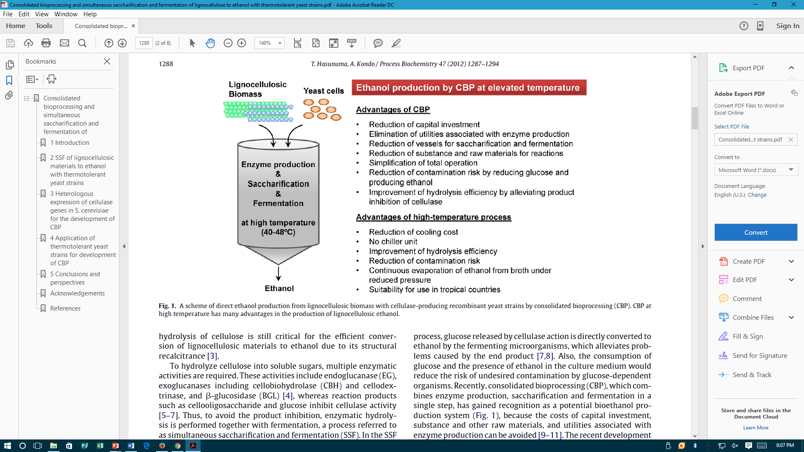
Advantages of CBP
Advantages of Thermophilic CBP
Hydrolysis and fermentation carried out at the same temperature – a drawback of SSF: reduced cooling costs; increased enzymatic hydrolysis efficiency
Continuous evaporation of ethanol from broth under vacuum: reduced ethanol intolerance; simplified distillation
Overall processing cost reduction over SSF – 4-fold

Slide 7
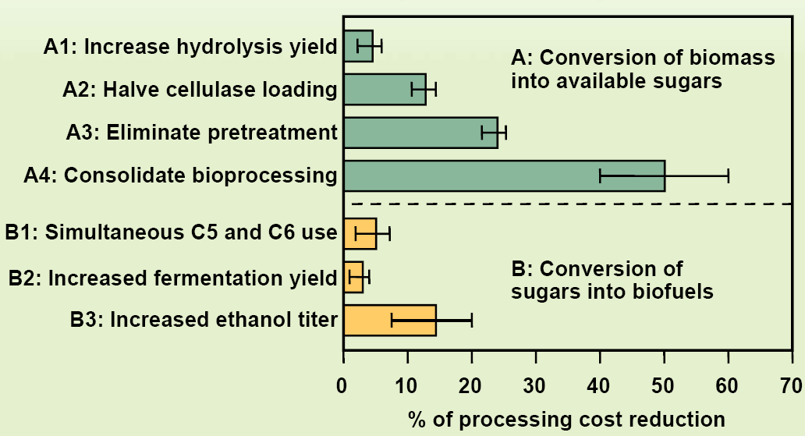
Impact of Processing Steps on Biofuel Production Cost
Consolidated bioprocessing to cellulosic ethanol
has the greatest potential for cost reductions (40-60%)

Slide 8
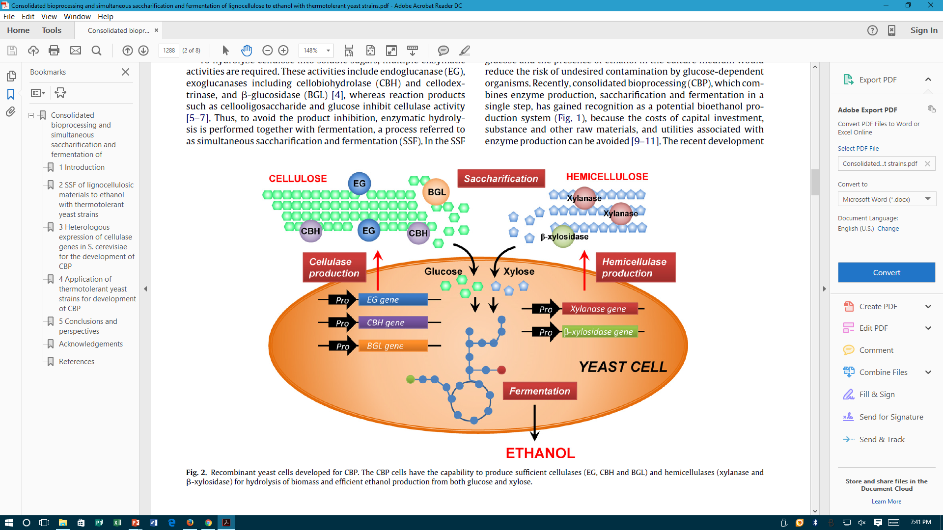
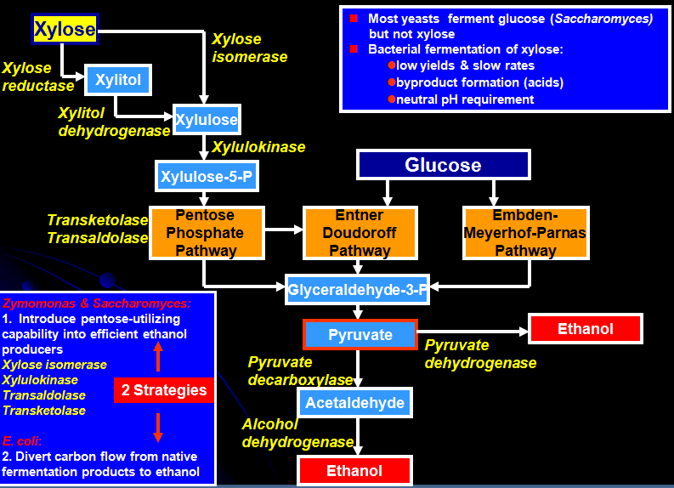
Engineering Ethanologens for CBP
Engineering enzyme production capabilities
Engineering pentose-fermenting capabilities

Slide 9

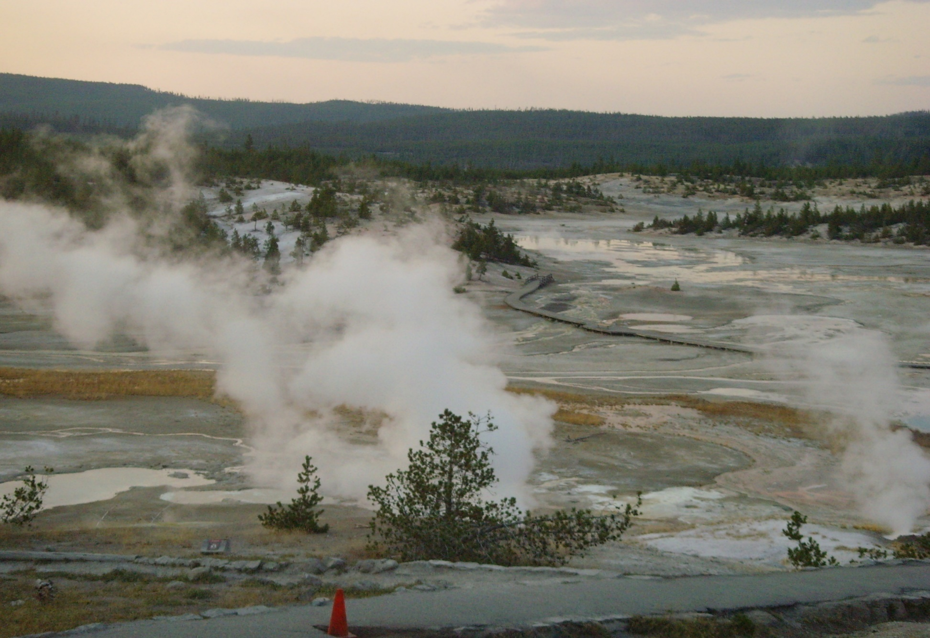
Bioprospecting for Extremophiles with CBP Capabilities
Yellowstone National Park
One of the world's largest petrified forests, located in WY, USA
2.2 million acres in area, larger than the states of Rhode Island or Delaware
About half (10,000) of the geothermal features and two-thirds (300) of the world's geysers are located in YNP
One of the greatest locations of thermophilic microbial diversity

Slide 10


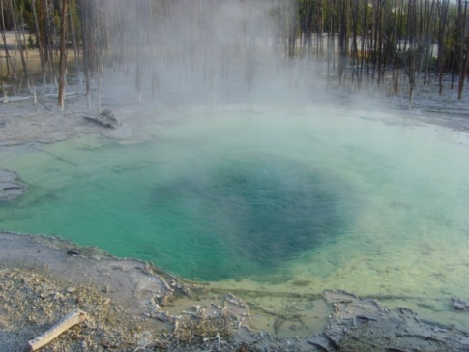
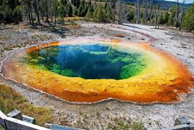
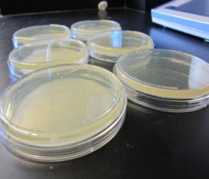
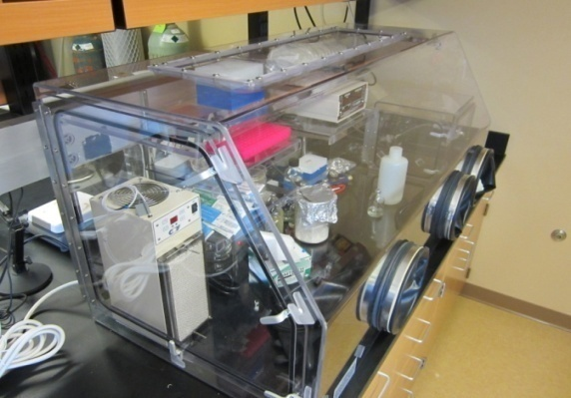
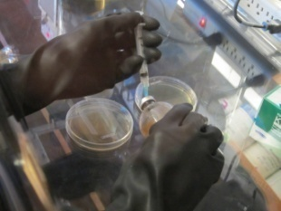
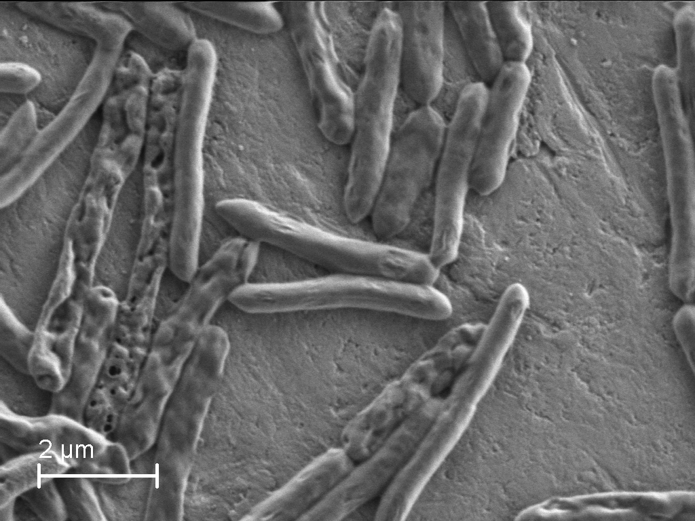
Extremophiles from
Yellowstone National Park - YNP, WY
Sampling
Discovery of new thermophilic bacteria
Sampling
Enrichment
Isolation
Identification
Characterization
Optimization

Slide 11
Bioethanol

Slide 12
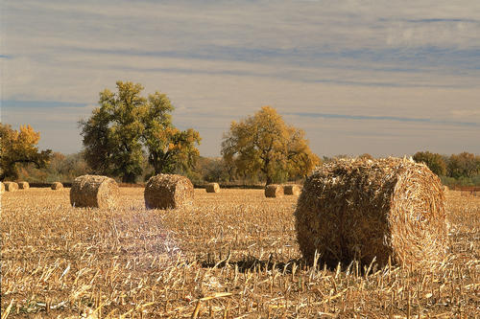
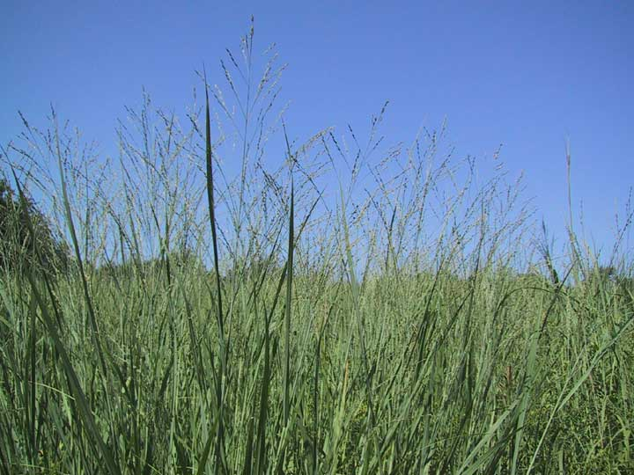
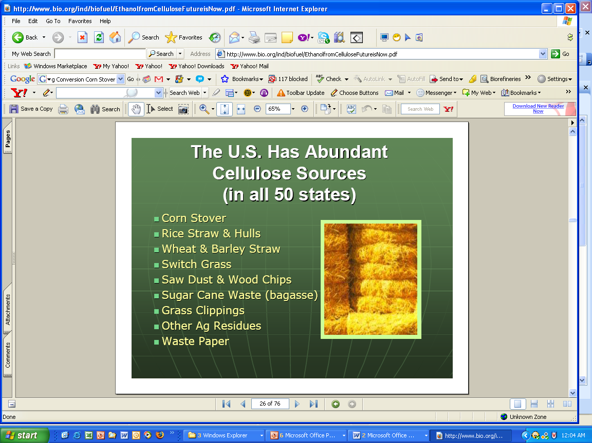
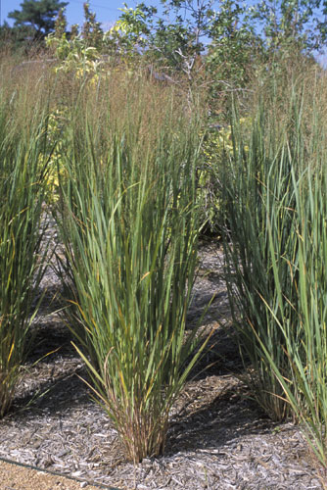

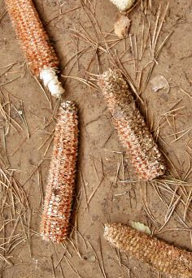
Bioethanol Feedstocks

Slide 13
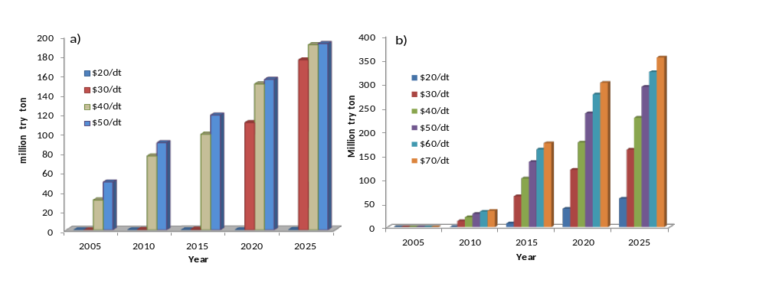
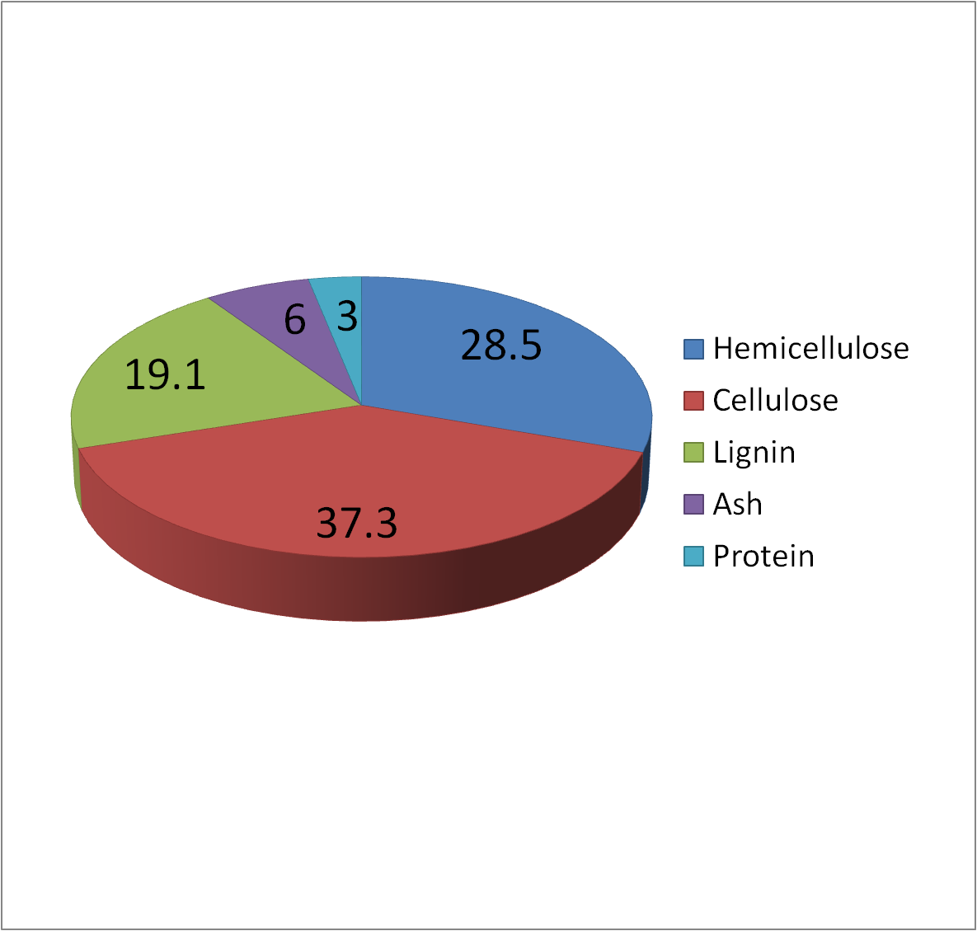
Switchgrass (SWG)
Energy crop (low nutrient/water requirements; high adaptability to any weather/soil/land conditions)
High yields (25 t/ha or 10 t/acre on average)
High carbohydrate (>65%) and low lignin (<20%) content (favors bioprocessing)
Low energy cost: $2.5/GJ ($3.5/GJ for natural gas; $17/GJ for crude oil)
Production predicted to increase up to 10-fold by 2020
(from current 30 million t/year in 2010 to 300 million t in 2020)
Availability of switchgrass biomass in the United States
(http://bioweb.sungrant.org/Technical/Biomass+Resources/Agricultural+Resources
/Crop+Residues/Corn+Stover/Default.htm)

Slide 14
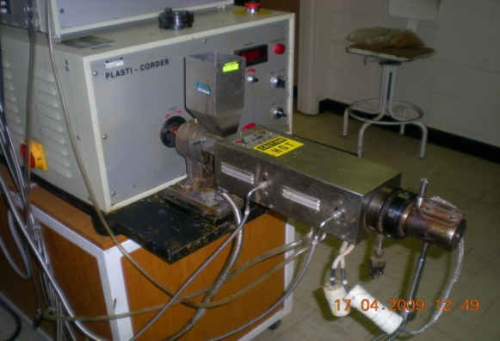
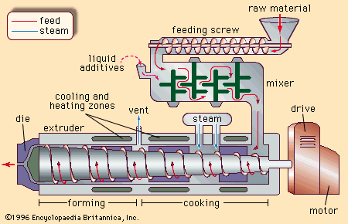
Feedstock Pretreatment
Single screw extruder
Screw speed : 100 rpm
Barrel temperature: 100°C
Switchgrass
Parameters | Untreated SWG (%) | Pretreated SWG (%)
Glucose | 25.5±5.8 | 25.2±3.5
Xylose | 17.4±2.1 | 17.6±2.0
Arabinose | 4.9±1.2 | 4.8±1.3
Mechanical extrusion mixes, grinds, sterilizes & disrupts plant cell walls
Can be combined with chemical & enzymatic pretreatments
Does not change biomass composition or create inhibitors

Slide 15
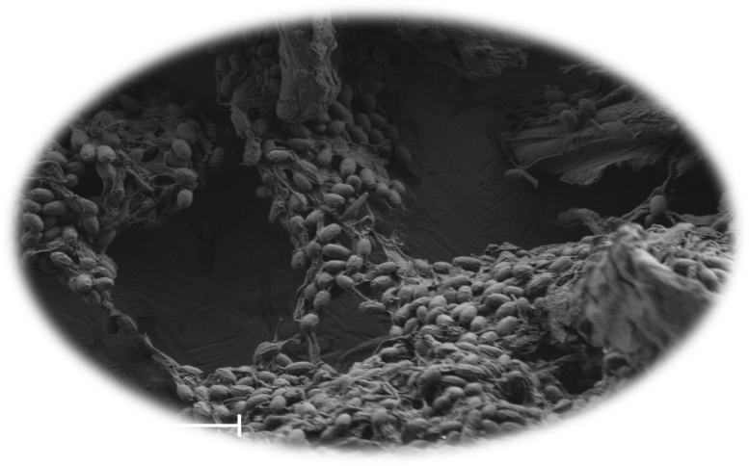
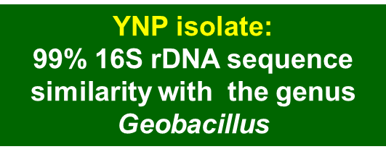
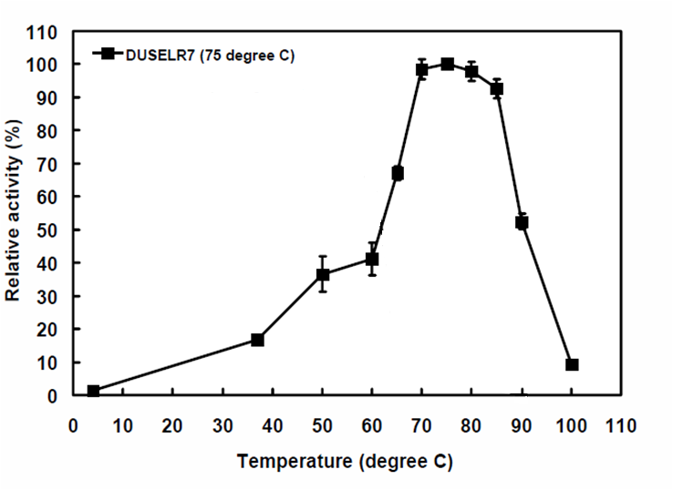
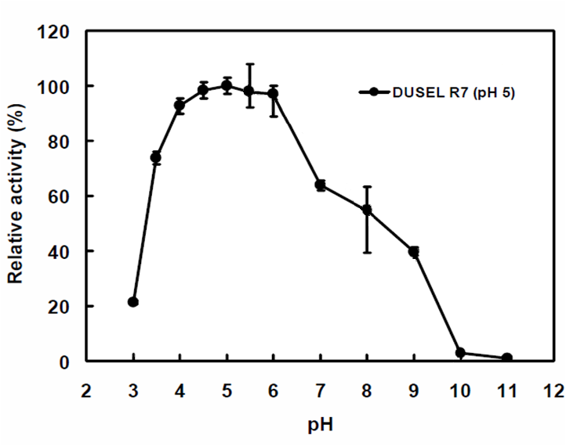
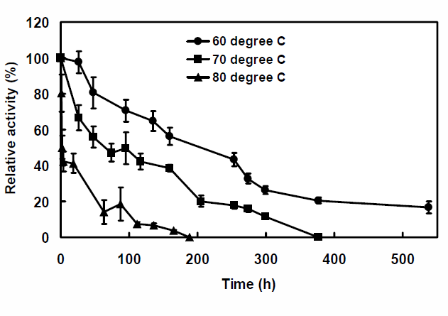
Cellulase Characterization
Broad temperature optima: 70-85ºC
Broad pH optima: 4-6
Remarkable thermostability: 50% residual activity after incubation at 70ºC for 7 days

Slide 16
Hydrolysis and Fermentation
Process Configurations
Pretreatment (100ºC)
PRETREATMENT
PRETREATMENT
PRETREATMENT
70
Liquefaction
60
Liquefaction (70ºC)
Total
Total
Total
Liquefaction
Bacterial SSF
Liquefaction
Liquefaction
Liquefaction
Liquefaction
Bacterial SSF
hydrolysis
Bacterial SSF
hydrolysis
hydrolysis
50
Temperature (ºC)
Total
Total
Total
Saccharification
Saccharification
hydrolysis
Saccharification
hydrolysis
hydrolysis
40
SSF
(30ºC)
Fungal
SSF
SSF
Fermentation
Fermentation
Fermentation
Fermentation
SSF
SSF
Fermentation
SSF
Fermentation
Fermentation
SSF
Fermentation
Fermentation
30
DOWN STREAM PROCESSING, ETHANOL DISTILLATION
DOWN STREAM PROCESSING, ETHANOL DISTILLATION
DOWN STREAM PROCESSING, ETHANOL DISTILLATIO
Distillation
(78ºC)
At 20% solids loadings - partial liquefaction of biomass observed after 36 h
Process continued as SSF

Slide 17
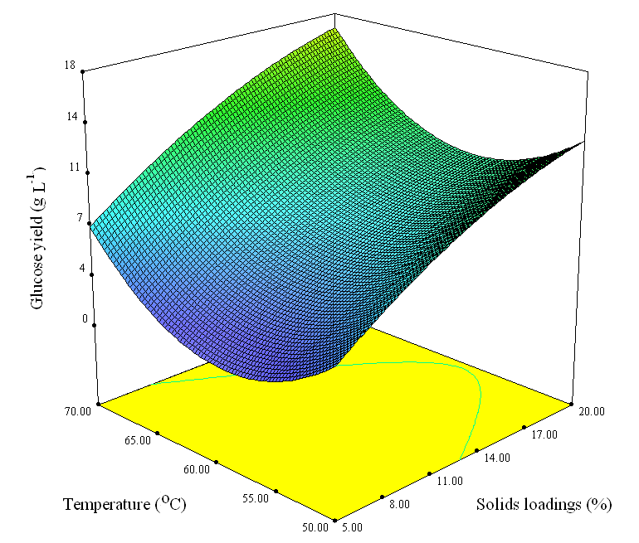
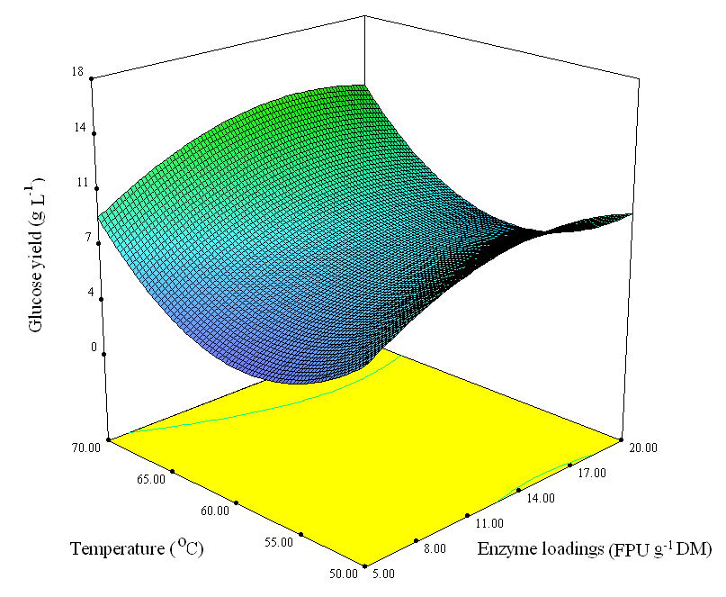
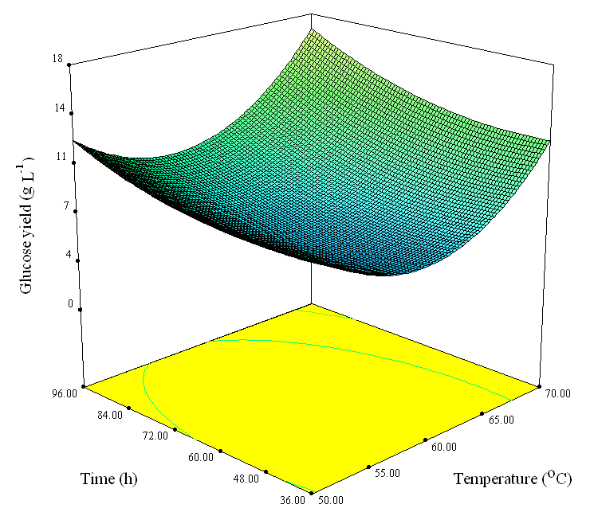
Enzymatic Hydrolysis: 50ºC vs 70ºC
Temperature vs Solids Loadings
Temperature vs Enzyme Loadings
Temperature vs Time
RSM Modeling of Enzymatic Hydrolysis: All 4 parameters had significant impact on cellulose conversion yields
Parameter | Advantages at 70ºC vs 50ºC
Enzyme loadings | At the same glucose yield, 4-times lower enzyme loadings required (5 FPU g⁻¹ DM vs 20 FPU g⁻¹ DM)
Solids loadings | At the same solids loadings, 30-60% higher glucose yields obtained
Hydrolysis time | At the same glucose yield, 2.7-times shorter hydrolysis times required (36 h vs 96 h)

Slide 18
CBP for Ethanol Production
Microorganism : Geobacillus sp. R7
Substrate(0.5 g/L) : corn stover, prairie grass
Temperature : 60⁰C
pH : 7
Agitation : 150 rpm
Time : 216 h (9 d)
Parameters | Geobacillus sp.
End products from cellulose (aerobic) | glucose, cellobiose
End products from cellulose (microaerophilic) | glucose, cellobiose, acetic acid, ethanol
Under limited oxygen (microaerophilic) conditions:
Enzyme production/hydrolysis/fermentation in 1 step
Clostridium sp. CBP biomass to ethanol capabilities
First report on Geobacillus sp.

Slide 19
Advantages of Thermostable Cellulases
Increased reaction/conversion rates due to improved mass transfer rates allowing the use of lower enzyme dosages resulting in higher yields of fermentable sugars;
Improved substrate solubility and reduced viscosity of feedstock allowing the use of higher solids loadings;
Reduced hydrolysis times resulting in significant cost savings

Slide 20
Biohydrogen

Slide 21
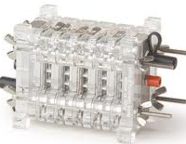


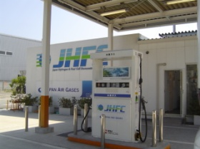

H₂ Importance
H₂ is considered the fuel of the future due to:
  high energy density of 143 MJ/Kg (H₂) - compared to 26.9 MJ/Kg for EtOH (> 5-fold) and 43.5 MJ/Kg for gasoline (> 3-fold)
  eco-friendly: non-polluting - water is the only product, no GHG
  renewable: can be produced from plant biomass and organic waste
Improves energy efficiency (when integrated with fuel cells)
Strengthens energy security
Global demand of 45 million t/year (9 million t/year in the U.S. = 20% of total)
Economy

Slide 22
H₂ Production Technologies
H₂
Chemical
Methane reforming
Biological
Biophotolysis
Electrolysis
Photo-
fermentation
Dark
fermentation
2H₂O → 2H₂ + O₂
C₆H₁₂O₆ + 12 H₂O → 12 H₂ + 6CO₂
C₆H₁₂O₆ + 2H₂O → 2CH₃COOH+ 4H₂ + 2CO₂
Non-renewable
GHG
96% of total prod.
High capital cost
4% of total prod.
O₂ inhibits H₂ase/
N₂ase
Low yields/rates
Low photochem.
efficiency
No GHG
(Renewable)
Higher rates/ yields
No light required
No GHG
Broad substrate
utilization

Slide 23
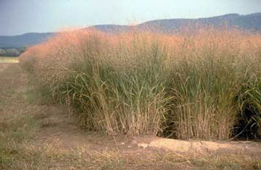
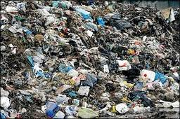
CBP for H₂ Production
H₂ energy production cost (biomass): $15-25/GJ
H₂ energy production cost (steam reforming): $11/GJ
Crude oil energy production cost: $17/GJ
SWG/MSW
COST
Pretreatment
Acid hydrolysis - fermentation inhibitors
Direct conversion
Saccharification
Enzymatic hydrolysis – expensive
Direct conversion of biomass (CBP) omitting pretreatment and saccharification would decrease H₂ energy costs (target: <$11/GJ) and increase cost competitiveness of production process.
Dark fermentation
Novel H₂ overproducing strain
H₂

Slide 24
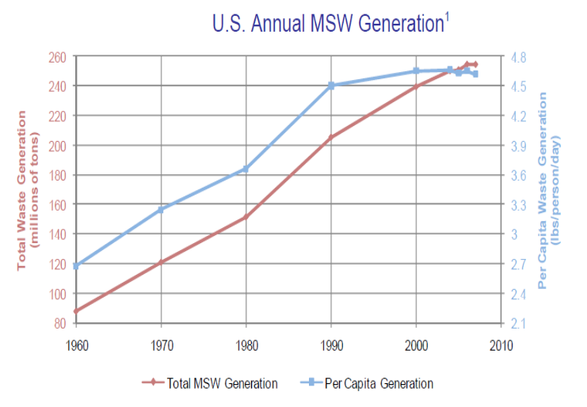
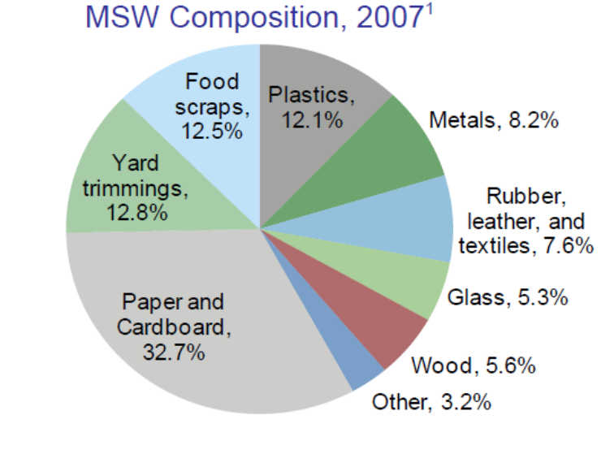
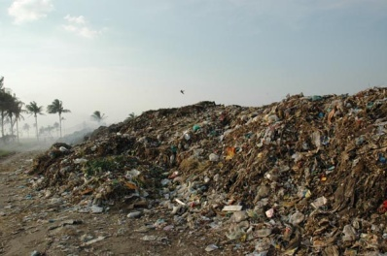
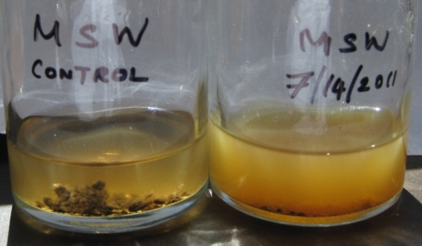
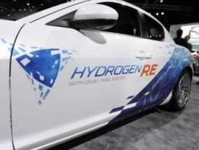
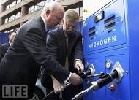
Municipal Solid Waste (MSW)
Source: Center for Sustainable System, University of Michigan (2009)
MSW – 250 million t in U.S. (2010)
Close to 5 lb/person/day waste generation
> 60% biodegradable material
Pollution burden with no significant cost value
Huge potential for environmental/ economic benefits
Microbial fermentation

Slide 25
H₂ Production Parameters & C-Balance of Isolate A
Parameter | Polymeric Substrates
 | Cellulose | SWG
Max H₂ concentration (mmol/L) | 23.18 | 14.29
Vol H₂ production rate (mmol/L/h) | 0.16 | 0.10
H₂ yield (ml/g substrate) | 260.49 | 310.33
Cellulose vs SWG
Higher H₂ concentration (23 g/l) and volumetric productivity (0.16 mmol/L/h)– on cellulose
20% higher H₂ yield (310 ml/g) on SWG over cellulose
Carbon material balance
48-54% of carbon - directed towards cell biomass formation
25–35% of carbon - released as CO₂
11-27% of carbon - converted to metabolites (acetate and lactate)

Slide 26
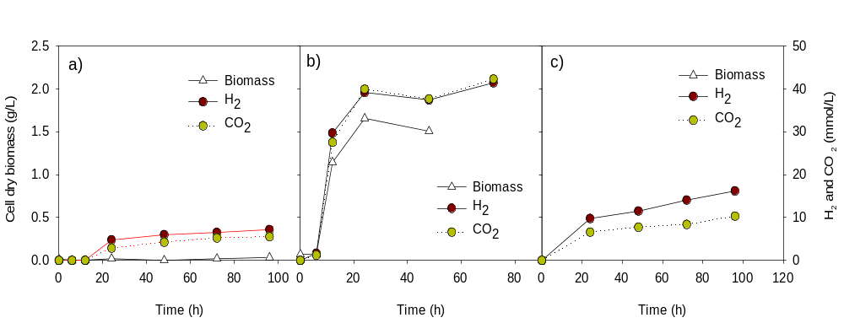
H₂ Production by Thermophilic Isolate A
No chemical or biological pretreatment of SWG required
The highest reported level of H₂ production rate – 0.16 mmol/L/h from untreated SWG
Isolate A under non-optimized conditions produced 0.32 mmol/L /h (2-fold increase)
Control
Glucose
Switchgrass
40 mmol H₂/L on 1% glucose after 96 h (or 4 mol/mol glucose)
18 mmol H₂/L on 3% SWG after 96 h

Slide 27
Impact of Processing Steps on Production Costs
H₂ from biomass:
$15-25/GJ
H₂ by steam reforming: $11/GJ
Crude oil: $17/GJ
Consolidated bioprocessing (CBP) has potential for 40-60% cost reductions
Pretreatment can reduce processing costs by 20-30%
Thermophilic CBP (TCBP) has the greatest potential for cost savings: 75% on average

Slide 28
Advantages of Thermophilic Bioprocessing
Broad range of complex polymeric substrates to produce H₂
Thermodynamically-favorable reaction of H₂ formation at higher T
Theoretical H₂ yield of 4 mol/mol glucose reached
No physico-chemical pretreatment of SWG required
Decreased risk of contamination by microorganisms that compete for the same substrates
Potential cost savings from thermophilic consolidated bioprocessing (TCBP) estimated at 75% on average

Slide 29



Thank you

