Slide 1

Vascular Insulin Resistance of a Rat Model of Polycystic Ovary Syndrome - Effects of Parallel Vitamin D3 Treatment
Levente Sára MD, PhD; Péter Antal MD; Gabriella Masszi MD, PhD; Róbert Tarszabó MD; Ágnes Novák MD; Anna Buday MD, PhD; Eszter M. Horváth MD, PhD; Péter Hamar MD, PhD; Rita Benkő PhD; Emil Monos MD, PhD, DSc; Zoltán Benyó MD, PhD, DSc; György L. Nádasy MD, PhD, DSc; Szabolcs Várbíró MD, PhD
2nd Department of Obstetrics and Gynecology,
Institute of Human Physiology and Clinical Experimental Research,
Department of Pathophysiology
Faculty of Medicine, Semmelweis University Budapest

Slide 2
Definitions, Symphtoms, Comorbidities
PCOS affects approximately 4-10% of fertile women around the world Rotterdam criteria(2003): 1. oligo- / anovulation, 2. androgen excess 3. policystic morphology of the ovaries ­
AEPS(2006): 1. hiperandrogenemia , 2. ovarial dysfunction, 3. exclusion of other syndromes, entities
    Major sympthomes: menstrual disorders (oligo-/ amenorrhoea; oligo-/ anovulation), infertility, obesity, hirsutism, acne.
The incidence of metabolic syndrome is 2-4 times higher in PCOS(33­-46%).
PCOS often associated with obesity, insulin resistance (20­-40%),
dislipidemy (30­-70%), hipertension.
Increased risk of vitamin D deficiency
PCOS alters cardiovascular function through these mechanisms

Slide 3
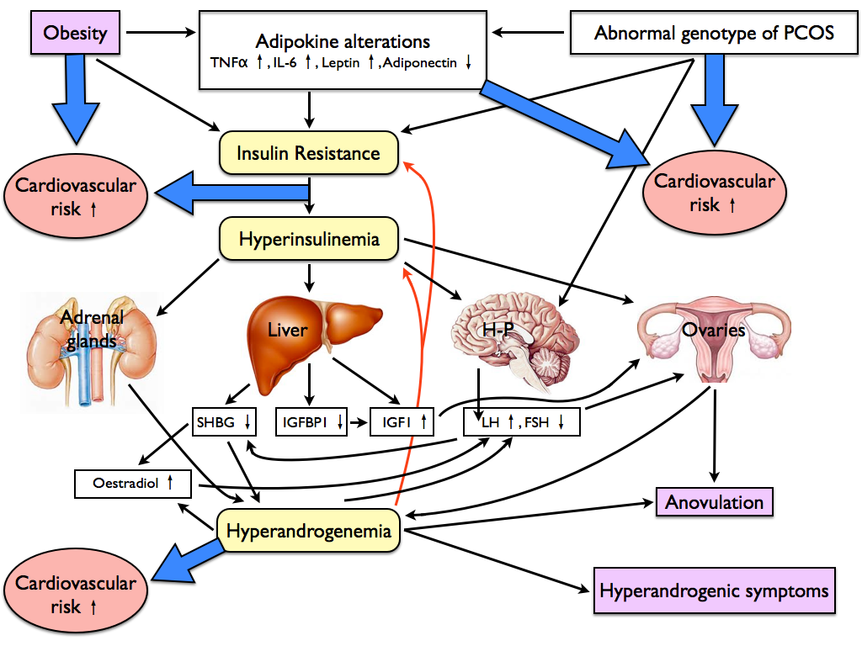


Slide 4
Role of Vitamin D
Vitamin D3 deficiency occured in 72% of PCOS patients. This percentage is higher in obesity.(Wehr et al. 2011)
Vitamin D deficiency may contribute to elevated blood pressure and has a crucial role in the development of hypertension.(Wong et al. 2010, Tare et al. 2011, Judd et al. 2011
Several studies have confirmed the relationship between IR and vitamin D deficiency(Ngo et al, 2011, Yiu et al. 2011)

Slide 5
Aims of the Study
To induce PCOS by a 70-day-DHT treatment in a modified animal model (described by Manneras and Yanes) for examining early metabolic and functional changes - the earliest detectable lesions
To determine the early effects of DHT treatment on carbohydrate metabolism before the onset of hypertension.
To identify early mechanical and pharmacological alterations in a morphologically stable skeletal muscle resistance vessel
To clarify the effects of DHT on insulin-dependent vasodilation on resistance arterioles
We also investigated the effect of low-dose vitamin D3 treatment on the vascular biomechanical adaptation and the pharmacological responsiveness of the gracilis resistance arterioles

Slide 6
Methods
Treatment protocol ­ metabolic parameters
Thirty adolescent (21- to 28-day-old) female Wistar rats that weighed 100-140 gram were used. Twenty of the animals received subcutaneous pellets (7,5 mg, 83 μg/day DHT-release). Ten animals underwent sham operations (control). (Manneras and Yanes).
Ten DHT-treated animals received weekly doses of 120 ng /100 g 1,25 (OH)2 D3 vitamin (DHT+D3 group) subcutaneously (Calcijex (2 μg/ml; 1,25[OH]2D3). A vehicle was given to the remaining 20 animals (Przybylski).
After eight weeks of treatment, an oral glucose tolerance test was performed. (0,3 g/100 g OGTT). Blood glucose and plasma insulin were measured following overnight fasting and 120 minutes after an oral glucose load.
After ten weeks of DHT treatment blood pressure was measured directly through the carotid artery.
The ovaries were formaldehyde fixed, stained with hematoxylin-eosine and histologically examined for controlling PCOS morphology.

Slide 7
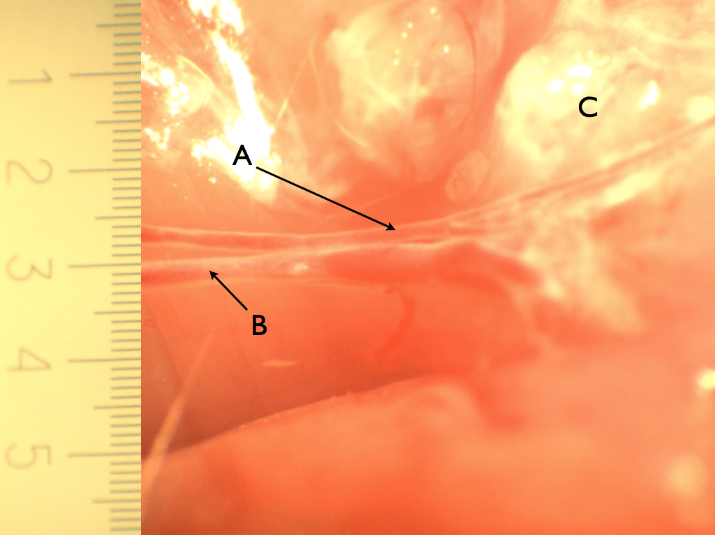
Methods pressure arteriography
In each group musculocutan arterioles (∅ kb. 150 μm) were cannulated and connected to pressure-servo pumps.
Arteriolar biomechanics, norepinephrine induced contractility, acetylcholine relaxation and insulin induced dilation were tested in gracilis arterioles by pressure arteriography in control as well as in DHT- and in DHT with vitamin D3-treated animals (C, n=10; DHT, n=10; DHT+D3, n=10).
Dose-diameter curves were recorded in the presence of 30, 60, 120, 240 and 600 mU/ml of insulin.

Slide 8
Results
Vital parameters ­ carbohydrate metabolism
 | Controls n=10 | DHT – treated n=10 | DHT + Vitamin D treated n=10
Blood sugar 0’ | 5.31±0.15 mM/L | 5.35±0.24 mM/L | 5.18±0.27 mM/L
Blood sugar 120’ | 6.11±0.11 mM/L | 6.36±0.2 mM/L | 7.09±0.13 mM/L
Insulin 0’ | 0.42±0.02 ng/ml | 0.42±0.03 ng/mL | 0.45±0.04 ng/mL
Insulin 120’ | 0.71±0.14 ng/mL | 1.42±0.33 ng/mL * | 0.48±0.07 ng/mL ‡
Glycated protein (Fructoseamine) | 157±3 mM/L | 151±4 mM/L | 156±4 mM/L
Mean blood pressure | 122 ± 3 mmHg | 123 ± 6 mmHg | 123 ± 4 mmHg
Body weight | 298 ± 8 g | 354 ± 16 g * | 353 ± 9 g †
p<0,05
p<0.01

Slide 9
Results
Biomechanics - ­morphology of arterioles
Outer radii in Ca²⁺-free solution
｝
*,‡
p<0,01
The outer radii from Ca²⁺-free relaxation at P=50 mmHg were not different in the controls and DHT+D3. Both radii were smaller than in the arterioles isolated from the DHT-treated animals (p<0.05). The values are expressed as the mean±SEM. *DHT was significantly different from the control. ‡ The DHT+D3 was significantly different from the DHT group.

Slide 10
Results
Pharmacology of the smooth muscle
Norepinephrine induced tone
Myogenic tone
}
(RiNkr-RiNe) / RiNkr %
}
(RiCa²⁺-free - RiNkr) / RiCa²⁺-free%
*,†,‡
*,†,‡
p<0,001
p<0,001
Values are expressed as the mean ± SEM. * DHT was significantly different from the control. † DHT+D3 was significantly different from the control. ‡ The DHT+D3 group was significantly different from the DHT group. (p<0.001)

Slide 11
Results
Pharmacology - endothel function
A
B
†
(RiACh - RiNe) / RiNe
(RiACh - RiLNAME) / RiACh
*
*
p<0,05
p<0,05
Values are expressed as the mean ± SEM. * DHT was significantly different from the control. † DHT+D3 was significantly different from the control. ‡ The DHT+D3 group was significantly different from the DHT group. (p<0.05)

Slide 12
Results
insulin-induced relaxation
*, ‡
*, ‡
*, ‡
*, ‡
*, ‡
*, ‡
*, ‡
*, ‡
*, ‡
(RiInsulin -RiNE) / RiNE
(RiInsulin -RiNE) / RiCa²⁺-free
*, ‡
p<0,01
p<0,01

Slide 13
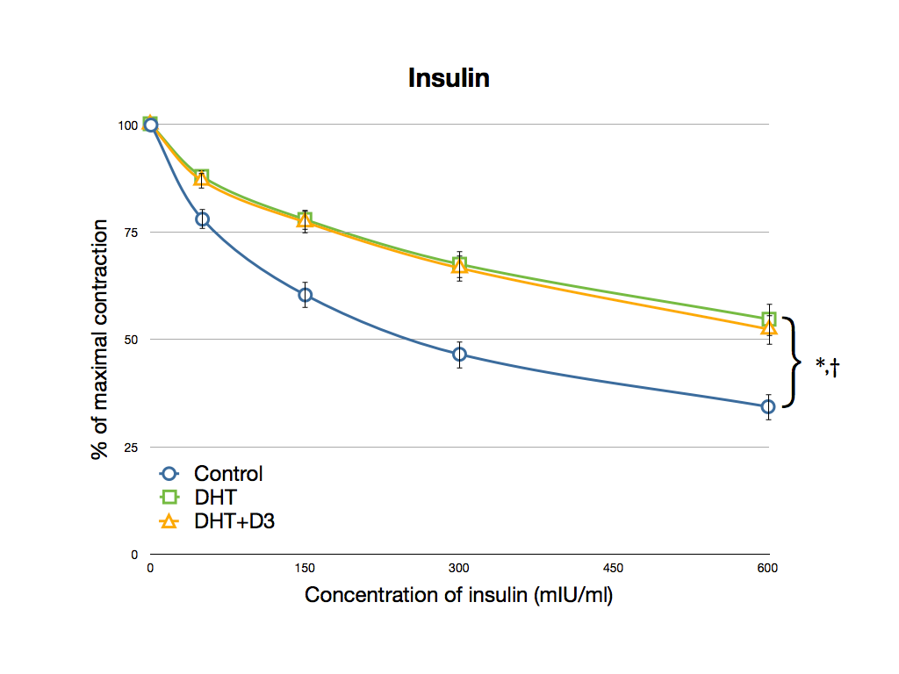

Slide 14
Conclusions
­ vital parameters - vessel reactivity
DHT-treatment was reported to contribute to hypertension after 90 days. After 70-day DHT-treatment the typical metabolic alterations of PCOS were developed without increased blood pressure (Manneras et al. 2006., Yanes et al. 2011.)
We observed an increase in arteriolar outer and inner diameter after DHT treatment. The relaxed lumen was dilated but was not accompanied by an elevation in wall mass (eutrophic remodelling). Chronic vitamin D3 treatment restored vascular diameter.
Reduced endothelium- and smooth muscle-dependent vasorelaxation and constriction with a complete loss of nitric oxide(NO)-dependent relaxation (Sara et al. Gynecol Endocrinol 2012;28(12):961-4.)

Slide 15
Conclusions
Inzulin-induced relaxation in arteries
Systemic IR without altered glucose metabolism was developed after 70-day DHT treatment. Vitamin D3 therapy was demonstrated to reverse systemic IR. (Sara et al. 2011; Fertil Steril. 97(2): 462-468.)
Metabolically proven IR of DHT treated female rats associates with reduced ability of the resistance arterioles to relax in response to insulin ( Vascular IR )
Vitamin D restored vascular IR in musculocutaneous arterioles but had no effects in the aorta.
The observed alterations of resistance arteries form an important prehypertensive pathway of vascular damage in PCOS and might explain the observed clinical effectiveness of vitamin D treatment.

