Slide 1


Student Nurses Learn Spiritual care in hospice and palliative care settings
Lesline Lewinson 2015

Slide 2
Spirituality in nursing
There is no question that spirituality is a relevant part of health care, but research has shown that this aspect of holistic care is given minimal attention in nurse education (Ross 2006)
Nurses say that, spirituality is an important part of their caring activity for patients, furthermore, they desire to be better equipped (Baldacchino 2008, McSherry and Jameson 2011)

Slide 3
My Doctoral Studies
I am engaged in a 2 part qualitative longitudinal study, using a constructivist grounded theory method (concentrates on meaning) and in-depth interviews. Data were collected over three years - 2012-2015.
My participants were a convenience sample of adult branch student nurses from 5 different cohorts over the three years, and from two different locations.
I present a small part of the preliminary findings from my investigation.

Slide 4


Learning spiritual care
“Caught or Taught”
In the classroom - theoretical content is insufficient
May be hidden in other topics e.g. ethics
Selective placements -
Hospice & Palliative Care

Slide 5
Students’ Verbatim Views
I don’t think we do enough, I don’t think there is enough on the syllabus …(P7)
… if it [spiritual care] had been addressed a lot sooner in my training, I would have recognised it a lot sooner … and not wait until halfway through my training … to look retrospectively at things to recognise that’s what I was doing (P12)

Slide 6
Contd.
I think with some guidance and preparation within our training I would have dealt with that [spirituality] better …
Having it as a lecture is all very well but you just sit there and listen and maybe you participate a little bit - but you come out of that lecture room and you forget it …
You might have handouts … but probably
never refer to them again (P2)

Slide 7
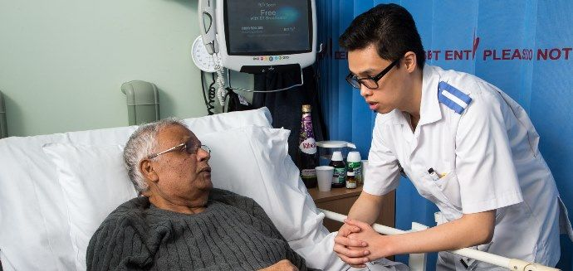
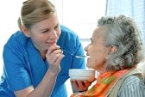
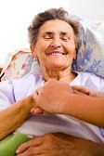
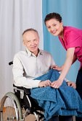
Contd.
I think everything to do with the course and all of the caring aspects that we’ve gained from … the classroom have helped me in practice (P3)
? spiritual care more caught rather than taught (Bradshaw 1997)

Slide 8
Learning in practice
my mentor … was a link nurse for spirituality … I think being able to work with her she kind of opened my eyes a little bit more to spirituality … I had kind of done it before but it hadn’t been highlighted as spirituality and spiritual care for a patient. … I think for me personally when I am learning … the practical side of being able to see it with a specific patient or in a specific area - that has helped me … (P12)

Slide 9
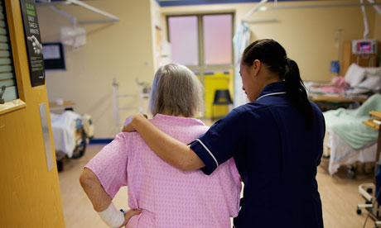
Hospice & palliative care settings
(Verbatim)
I did my spirituality course in a local hospice … I had no understanding as such, I had to sort of go and work on it and do the course (P5)
the only time I have ever seen it is around palliative care - that’s when nurses make more of an effort (P6)

Slide 10
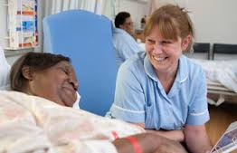
Contd.
I did a placement in a hospice … I found that they did it [spiritual care] really well … (P7)
Until I had that placement I didn’t really
address spirituality and spiritual
needs, and it wasn’t brought to
my forefront until I went to a
Hospice Palliative care setting …
I had a huge input in the
palliative care (P12)

Slide 11
Theory & Practice
… learning from clinical practice is an important aspect of it because that is where you really learn a lot of your practice, and yes that’s good. But I think backup of knowledge from lectures, you know, that academic side, there should be that bit more knowledge coming from that side, so that you can sort of incorporate your knowledge in the clinical practice, you know – sort of bridge that gap between the two (P6)

Slide 12
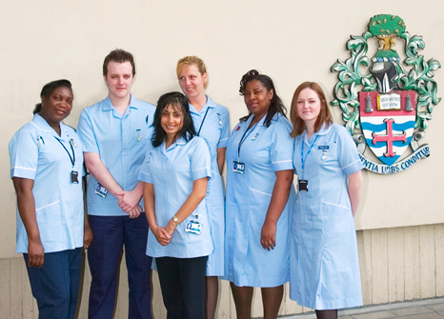
Student nurses learn that -
Palliative care improves physical, psychological and spiritual wellbeing of patients and their families
Student nurses do appreciate hospice & palliative experience for learning spiritual care

Slide 13
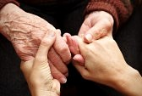
Conclusions
Spiritual care is part of the art of nursing and students need clinical experience to develop their reasoning and tacit knowledge (Greenstreet 1999),
And real-life situations are important (Giske 2012)
Spiritual care in nursing practice is reciprocal
(Pesut 2002, Giske & Cone 2012)
I suggest that spiritual care can
be both taught and caught.

Slide 14

Thank you for listening

Slide 15
Bibliography
Baldacchino,D. R., 2008. Teaching on the spiritual dimension in care: the perceived impact on undergraduate nursing students. Nurse Education Today 28, 501-512
Bradshaw, A., 1997. Teaching spiritual care to nurses: an alternative approach. Int. Journal of Palliative Nursing 3, 51-57
Giske, T., 2012. How undergraduate nursing students learn to care for patients spiritually in clinical studies – a review of literature. Journal of Nursing Management 20, 1049-1057
Giske, T., Cone, P. H., 2012. Opening up to learning spiritual care of patients: a grounded theory study of nursing students. Journal of Clinical Nursing 21, 2006-2015
Greenstreet, W. M., 1999. Teaching spirituality in nursing: a literature review. Nurse Education Today 19, 649-658
McSherry, W., Jameson, S., 2011. An online survey of nurses’ perceptions of spirituality and spiritual care. Journal of Clinical Nursing 20, 1757-1767
Pesut, B., 2002. The development of nursing students’ spirituality and spiritual care-giving. Nurse Education Today 22, 128-135

