Slide 1

What Does “Analytics” Mean in
Population Health Management &
Collaborative Care
October 2014

Slide 2


Fee For Service Model
Every time a service is performed, remuneration is given to the provider…
Patient Population
$
$
$
HIS
Acute Care

Slide 3
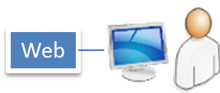
Payment Reform
With value-based care models, excessive encounters can penalize a provider…
Patient Population
Home / Family
Care Givers
?
PMS
?
Provider 2
$
$
…and it may be due to things out of the provider’s control.
-$
HIS
Acute Care

Slide 4
Collaborative Care Model
Collaborative providers, jointly treating their common patients, benefit all involved
Patient Population
$
$
PMS
Provider 2
HIS
Acute Care

Slide 5

Whole Person Care
Apps
Apps
Patient Population
CLAIMS
mHEALTH
Managed Care
Long-Term Care
Apps
Apps
EHR
ADMIN
Primary Care
Social / Human Services
Apps
Apps
HIE
PMS
Specialty Care
Behavioral Health
Apps
Home / Family
HIS
Apps
Acute Care

Slide 6



Which Patients To Manage?
80 / 20
High Cost, Bad Outcomes
Chronic Diseases; High Acuity; High Utilization; Comorbid Conditions; and Those Trending These Ways

Slide 7
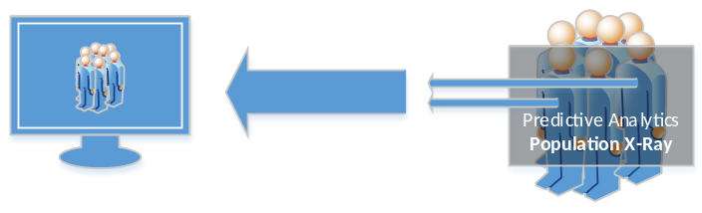
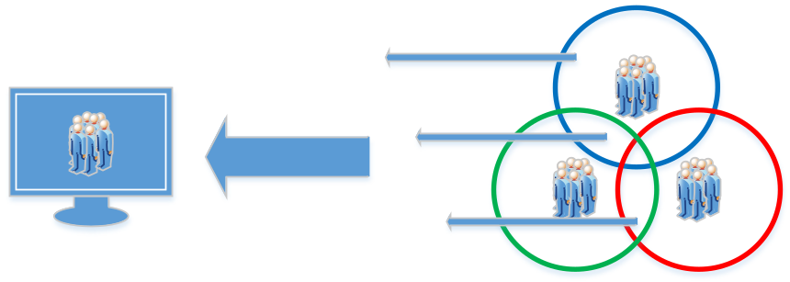


How To Build The Target Population?
Combination of Approaches
Predictive Analytics
Population Stratification
Program Lists
One-Up Patient Registration

Slide 8


Some programs focus on analytics…
Insight
Care
Coordination
Analytics &
Reporting
…but can’t infuse their insight into the care model

Slide 9
Some programs focus on care management…
Care Model
Care
Coordination
Analytics &
Reporting
…but can’t measure its efficacy or calibrate it based on insights

Slide 10
Good use of analytics bridges the chasm…
Care Model
Insight
Population Health Management
Care
Coordination
Analytics &
Reporting
…and enables cohesive population health management

Slide 11
What It’s All About…
Data
&
Methodology

Slide 12


Path to Data Utilization & Analytics
What We Collect
Clinical Data
Administrative Data
Care Coordination Data
What We Store
Raw Data
Derived Data
Meta Data
What We Report
Data By Source
Aggregated Data
Dynamic Computations
Structured Data Groups
Quality Measures
Outcome Measures
Combinations
How We Present
Static Reports
Ad-Hoc Reports
Dashboards
In-Application Utilization
Alerting
Logs
Exports / Transmissions
Meta Reporting
Care Delivery, Operations
Care Coordination

Slide 13
Considerations For Measure Reporting
Source of Truth
Normalization
Duplication
Data Relationships
Data Cleansing
Deletion / Replacement
Data Window & History
Archival and Retention
Source
Schedule
Encoding
Format
Collection Method
Completeness
Coverage (e.g. – transaction vs. warehouse)
What We Collect
What We Store
What We Report
How We Present
Data Access
Logical Naming
Report Refresh
Sharing (internal & external)
Drilling (across & down)
Format
Contractual Requirements
Clinical Improvement
Coordination Improvement
Report Definition
Data Inclusion / Exclusion
Data Grouping Definition (e.g. – diagnosis grouping)

Slide 14
What Is The Task?
What We Collect
Clinical Data
Administrative Data
Care Coordination Data
What We Store
Raw Data
Derived Data
Meta Data
What We Report
Data by Source
Aggregated Data
Dynamic Computations
Structured Data Groups
Quality Measures
Outcome Measures
Combinations
How We Present
Static Reports
Ad-Hoc Reports
Dashboards
In-Application Utilization
Alerting
Logs
Exports / Transmissions
Meta Reporting
Care Delivery, Operations, Receipt
Care Coordination

Slide 15
Where Do We Start?
1
4
2
5
What We Collect
Clinical Data
Administrative Data
Care Coordination Data
What We Store
Raw Data
Derived Data
Meta Data
What We Report
Data by Source
Aggregated Data
Dynamic Computations
Structured Data Groups
Quality Measures
Outcome Measures
Combinations
How We Present
Static Reports
Ad-Hoc Reports
Dashboards
In-Application Utilization
Alerting
Logs
Exports / Transmissions
Meta Reporting
Constraints
3
Conflict
Constraints
Requirements
Care Delivery, Operations, Receipt
Requirements
Care Coordination

Slide 16
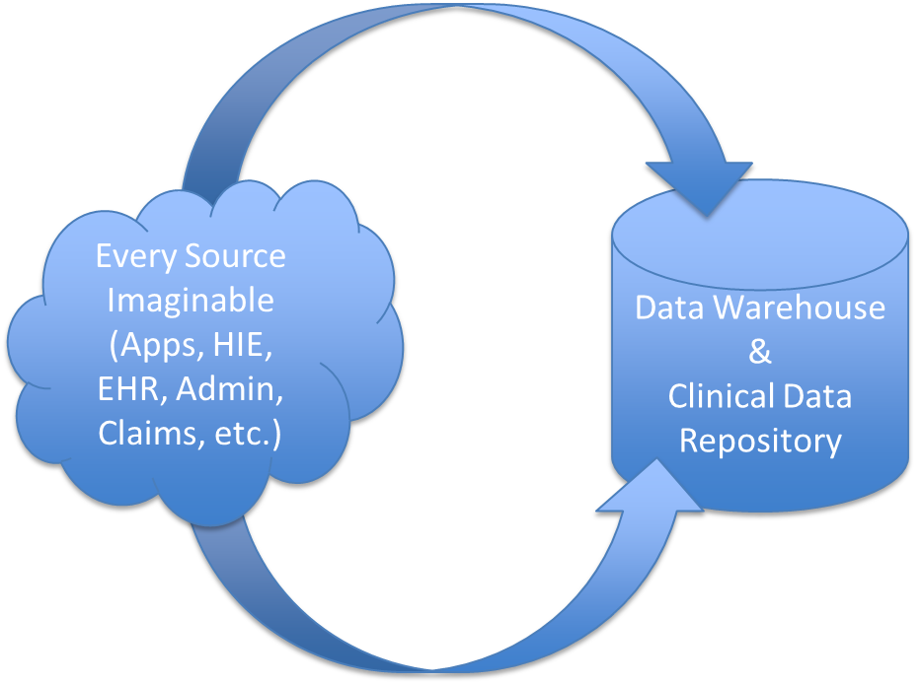
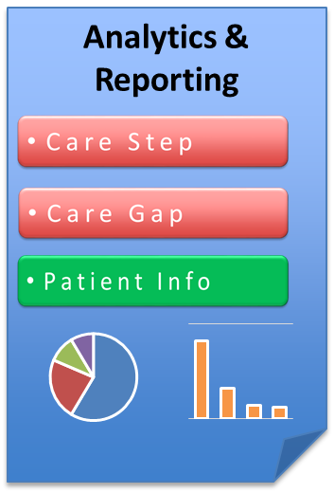
Key Concept: Meta-Data as Coordination Data
Timing
Sources
Completeness
Consistency
Etc.
Meta Data

Slide 17
Traditional Sources of Data
Clinical & Administration
  Typically from EHRs, HISs, and HIEs
  HL7 2.x, HL7 CCD, & HL7 CDA more generally largely define the data content and representation
  Labs, meds, diagnoses, procedures, vitals, etc. usually comprise the core
  Cost information from provider administration systems
Claims
  Largely file-based extracts
  Typically restrictions from data custodians (i.e. – Payers) on use
  Comprehensive for encounters, labs, meds, etc., spanning providers

Slide 18
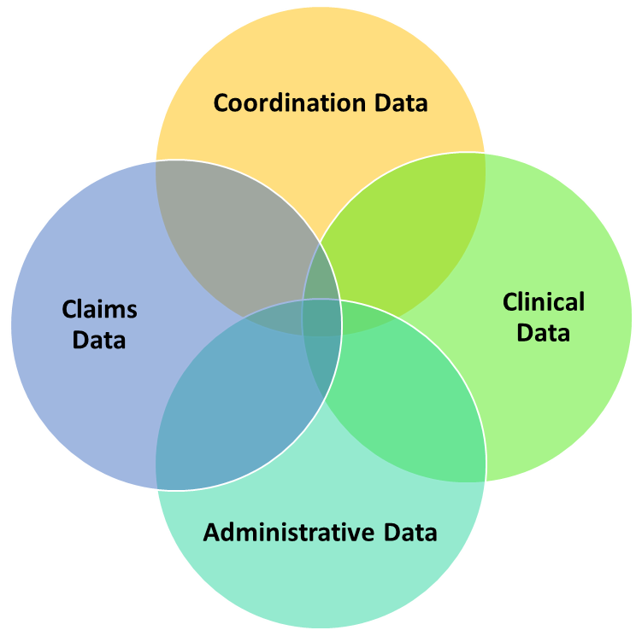
Data Harmony & Coordination Data
Enjoin Coordination data as a recognized category akin to clinical & claims data
  Logistical Interventions
  Outreach
  Operations
All data sources must be appropriately melded
Data
Harmony

Slide 19
Over Simplified Predictive Analytics
β₁(var₁)+β₂(var₂)+...+β_{n}(var₃)
Relative
contribution
of each
variable
Variables
(e.g., diags,
demographics,
etc.)

Slide 20
Over Simplified - Example
Risk Score =
(.35)(ICD-9)+(.4)(zipcode)+...+(.25)(age)
Represents contribution of various values for the variable. Continuous variables broken into bands.
Relative Contribution may be determined by degree of correlation, published guidelines, etc.
Could be hundreds of variables

Slide 21
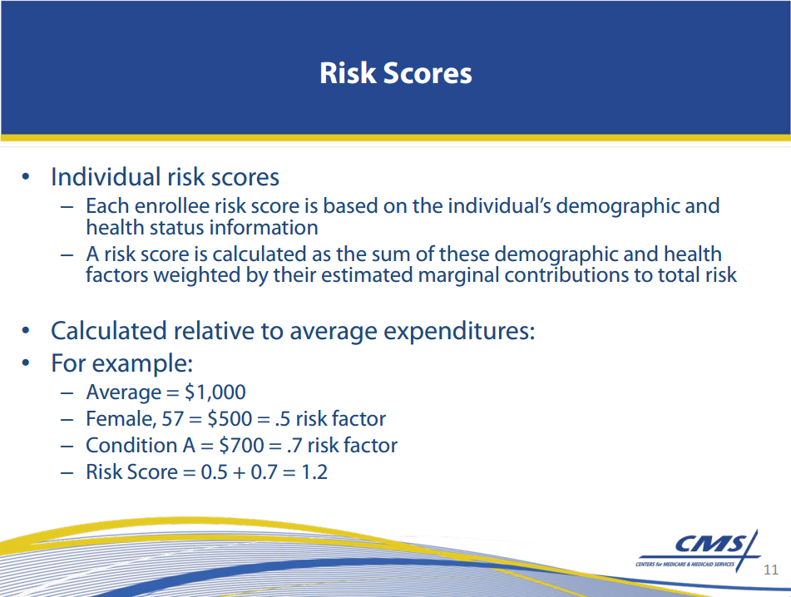
Example Proposed Risk Score Method (CMS)

Slide 22
Red Flags with Predictive Analytics in a Far-Flung Collaborative-Care Model
β₁(var₁)+β₂(var₂)+...+β_{n}(var₃)
= RISK SCORE
The independent variables you really want are care coordination variables and meta data about the process you are using to improve care
The more sources and differences in data capture, consistency, timing, coverage, etc., the more unstable the data and the more error-prone is the relative contribution (requiring recalibration)
Need to identify all outcomes up front rather than allow them to emerge as program matures and analysts experiment
A “score” conveys a level of precision that belies the volatility of the underlying data, especially in the early period of the program

Slide 23
Corollary to Coordinated-Care Variables Used in Predictive Model
We want all levels of analytic results to help calibrate the operational model for programs on a go-forward basis
Therefore, analytics should be tightly coupled with the operational activities to allow for closed-loop improvement of care – CLIC -- (i.e., symbiosis between care delivery and measurement)
  The expression of analytics and operational activities should leverage the same concepts so their relationships can be determined and exploited

Slide 24
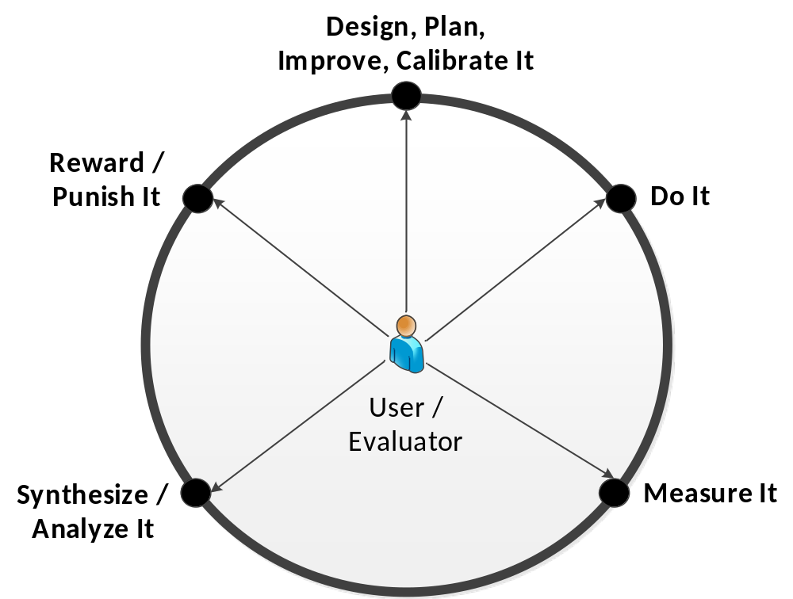
CLIC Makes Analytics Useful
CLIC
Closed-Loop Improvement of Care
Insight is Actionable

Slide 25
Some Working Definitions
What are analytics? – methods to perform data analysis, typically in a quantitative way
  Characterization: Segmenting by attributes (e.g. – using a query) – a.k.a. “descriptive” analytics
  Association: Determining the contributing variables that are correlated to the dependent (e.g., outcome) variable – a.k.a. “prescriptive” analytics
  Predictive: a classification system that allows estimation of future values of patient care variables based on patterns seen in the population
    Learn by Example: developing an analytic model based on previous data examples used to “train” the model (e.g., regression analysis)
    Learn by Observation: developing an analytic model based on data on hand, using the emergent patterns to shape it

Slide 26
Some Working Definitions (cont’d)
What is population stratification? – dividing up the population by some set of criteria that categorizes the members of the population
What is risk stratification? – population stratification where the criteria used to segment is indicative of the population members’ risk of having a given outcome

Slide 27
Predictive Analytics Characteristics
We want four things in predictive analytics
  Want to know what variables are positively correlated with outcome, and to what degree, which gets to the risk the outcome will happen given the attributes (independent variables) of the patient
  Want to predict (extrapolate) dependent variable value (e.g. – costs) given the anticipated dependent variables (and likelihood)
  Want to know how much of the predicted value is excess or deficit compared to the typical or desired state (risk adjusted)
  Want to know which of the opportunities are actually actionable (ie, which of the high risk things can I discard, and which should I pursue based upon the impact I can have?)
By comparison and/or assigning of thresholds, the population may be partitioned by the results of the above analyses

Slide 28
Considerations on Type of “Risk”
Risk-Factor Stratification
Risk Stratification
Risk factors can come from organic sources (e.g., a program’s internal assessment of risk factors for an outcome), or authoritative sources (e.g., medical evidence)
There may be a “score” or “scale” associated with risk factors that allow for classification
May afford more flexibility in dynamic analysis (e.g., when outcomes-of-interest are not fixed, or there are various intermediate outcomes to consider)
When authoritative sources used, the math has already been done for you (e.g., PAM, LACE)
Typically arrived at through some computational method such as regression analysis or clustering
Dependent variable (e.g., outcome) can be designed to be a rate, such a likelihood percentage
In order to stratify by a risk of an outcome, the outcome must be defined; however, it can be dynamic or pre-determined, depending on the requirements of the analytic method chosen
Typically, the math needs to be done, but resulting model is more specific to your exact population

Slide 29
Outcomes, Methodology, & Data
Start
Outcomes – Assess if there are fixed outcomes of interest
  E.g., 25% reduction in admissions making # admissions an outcome
Methodology – Choose analytic methods suited to appropriately mine the population and represent the chosen outcomes
  Regression analysis is typically used for healthcare population data sets, as well as other techniques such as cluster analysis
Data – Ensure data available both supports measurement of outcomes, and has characteristics that optimize applicability of chosen methods

Slide 30




Processing The Data That Matters
1
Level of Contribution of Determinant Variable
Outcome of Interest for patient j
(e.g., risk, # admissions, etc.)
Relevant Determinant Variable
(e.g., key test result value)
Σ_{i}^{n}
Medical / Behavioral Determinants
β_{1,j}X_{1,j}
β_{2,j}X_{2,j}
…
β_{n,j}X_{n,j}
Y_{j} =
Outcome
Claims, EHR/HIE/HIS Data
(e.g., SHIN-NY)
Process Measures
Regression analysis can be used to “learn by example” so model predicts future from past examples
Traditionally, outcomes measurement would be a function of medical data alone.

Slide 31
Processing The Data That Matters
1
Medical / Behavioral Determinants
β_{1,j}X_{1,j}
β_{2,j}X_{2,j}
…
β_{n,j}X_{n,j}
Σ_{i}^{n}
Y_{j} =
Claims, EHR/HIE/HIS Data
(e.g., SHIN-NY)
Outcome
Process Measures
With the use of care coordination tools that allow for diversity of care-team composition, more variables on process and non-medical determinants can be explicitly analyzed
Social Determinants
Community-wide Coordination Tools:
Assessments, Care Plan, Consensus Patient Summary, etc.
Coordination Determinants

Slide 32

Apply Model & Segment
2
Low Risk
(<= 50%)
Medium Risk
(> 50%)
High Risk
(> 75%)
Y_{j} =
32

Slide 33
Auto-Classify New Patients & Update Patient Progress
3
Low Risk
(<= 50%)
Medium Risk
(> 50%)
High Risk
(> 75%)
Technology tools should perform this ongoing automated classification to facilitate workflow
Y_{j} =

Slide 34
Periodically Reset Analytic Model
4
Recalibrate
Recalibrate
Recalibrate
Recalibrate
Sample present-day population to update model characteristics regarding determinant relevance and contribution level
Σ_{i}^{n}
Can replace previous patient classifications, or maintain longitudinal risk history for population analysis (intervention contributions should grow as time goes on)
β_{1,j}X_{1,j}
β_{2,j}X_{2,j}
…
β_{n,j}X_{n,j}
Y_{j} =
Y_{j} =

Slide 35
Analyze for Meaningful Impact
5
Low Risk
(<= 50%)
Medium Risk
(> 50%)
High Risk
(> 75%)
Sensitivity Analysis can be performed to determine if planned interventions will likely result in meaningful change in patient condition (i.e., move to a lower risk category). Where potential impact is projected to be minimal, care management activities can be re-prioritized.

Slide 36

Further Stratify for Workflow
6
High Risk
(> 75%)
Recent Encounters
Care Manager 1
Member of Health Home
Alignment with On-Duty Staff
Competencies / Experience
Care Manager 2
Beyond the top level stratifications which are more global in nature, there should be temporal derivative stratifications allowed to optimize work assignments and care management efficacy.

Slide 37
Meld Analytics for Nuanced Targeting
7
High Risk for Compound Outcomes
Highest Risk Across Outcomes
Union
Intersection
High Risk Factors for Admission (e.g., PAM)
High Risk of Admission
(> 75%)
By combining the resultant sets from stratification, more refined or inclusive sets can be constructed in order to

Slide 38
Dynamic-Outcome Predictions
Sidebar
Time
Cluster Analysis to see:
How similar the histories are of present-day High Risk group
How many present-day patients are similar to High-Risk’s histories
Retrospective look at cluster member histories
Cluster Analysis or Risk-Factor Stratification
Care Dimension
Using this form of predictive analysis (via “evolution analysis”), we are freed from fixing the outcomes of interest at the onset, and can dynamically change outcomes to suit our dynamic analysis (learning by observation).

Slide 39
What is The Takeaway…
Analytics are
part & parcel with
care delivery

Slide 40
Thank You for Your Time and Attention!
Presented By:
LeRoy Jones, CEO – GSI Health www.gsihealth.com

