Slide 1


Challenges and Advances
in Environment-Based
Voice Interaction
Automation and Robotics
June 14, 2016
Leor Grebler, CEO
UCIC
leor@ucic.io

Slide 2
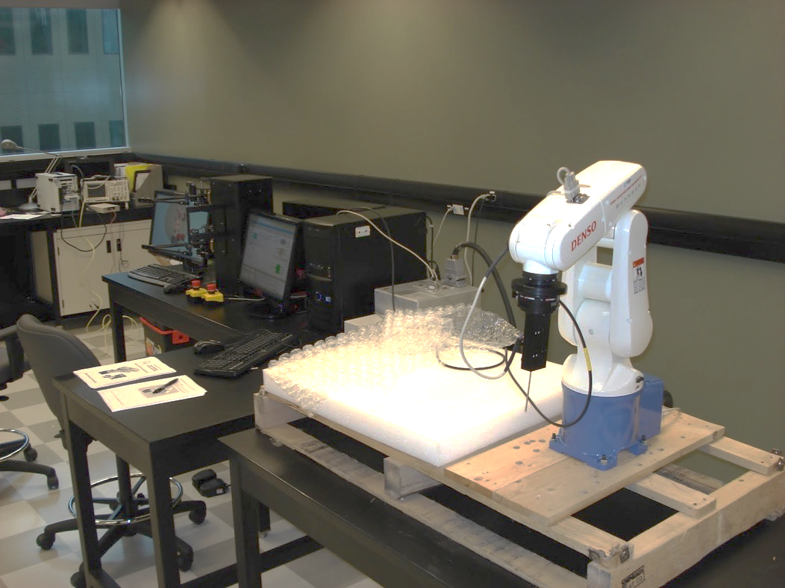

Slide 3


Slide 4


Slide 5
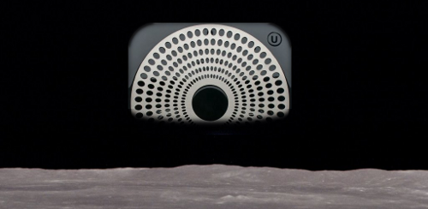
Ubi
UCIC

Slide 6
Ambient Voice

Slide 7
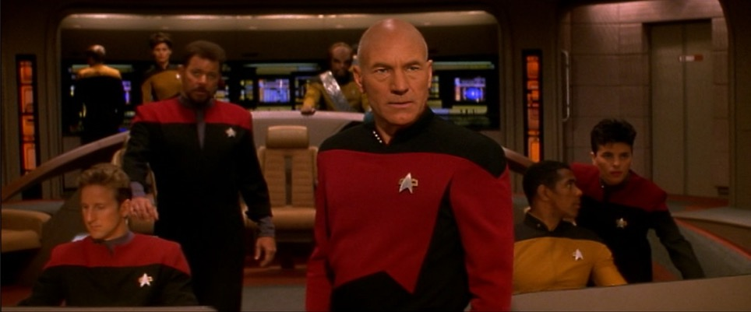

Slide 8


Slide 9
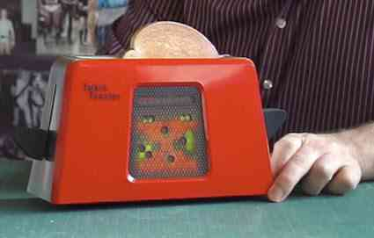

Slide 10


Slide 11
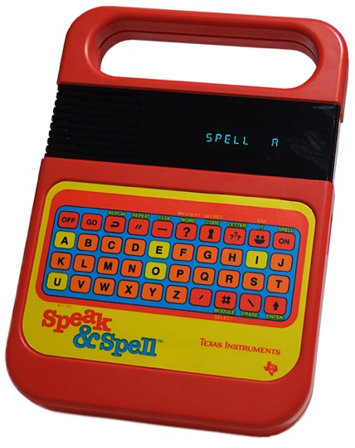

Slide 12
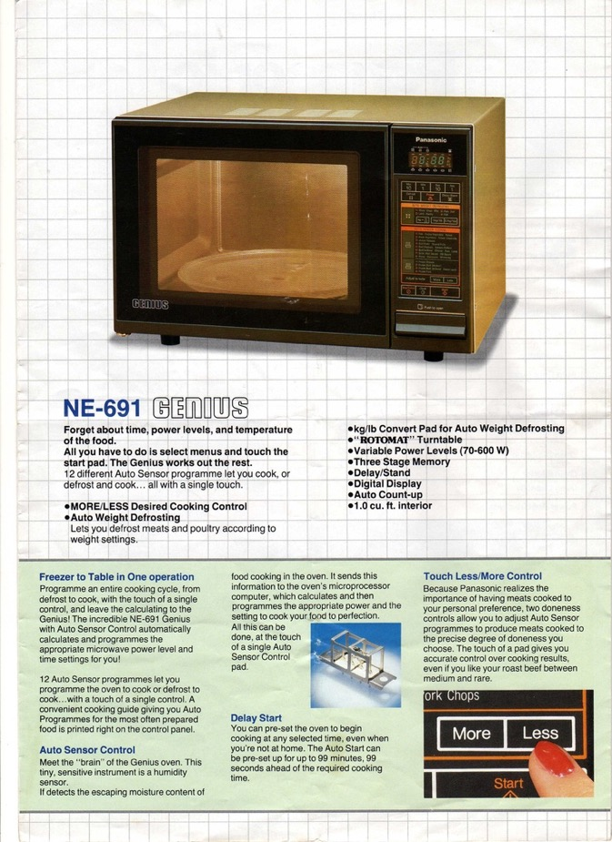

Slide 13
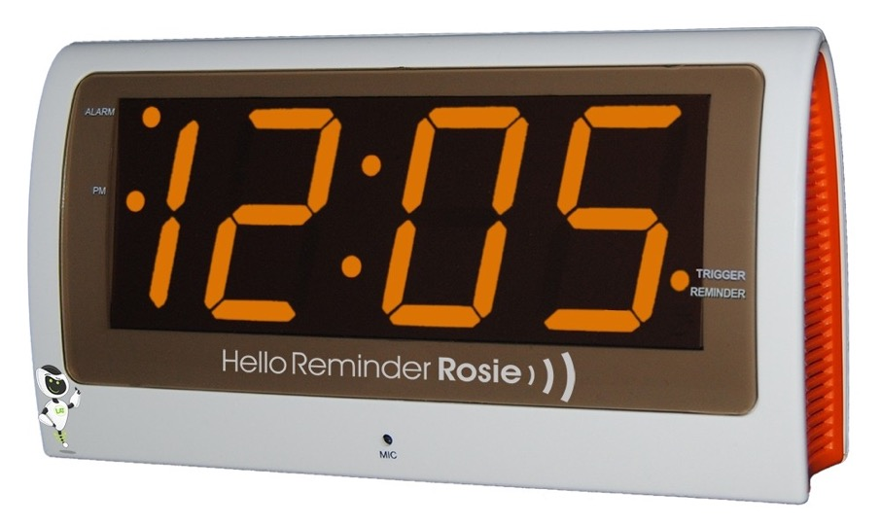

Slide 14
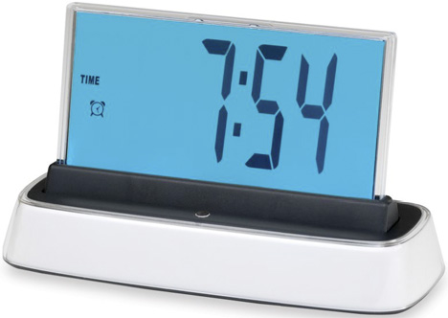

Slide 15
Imminent Future

Slide 16
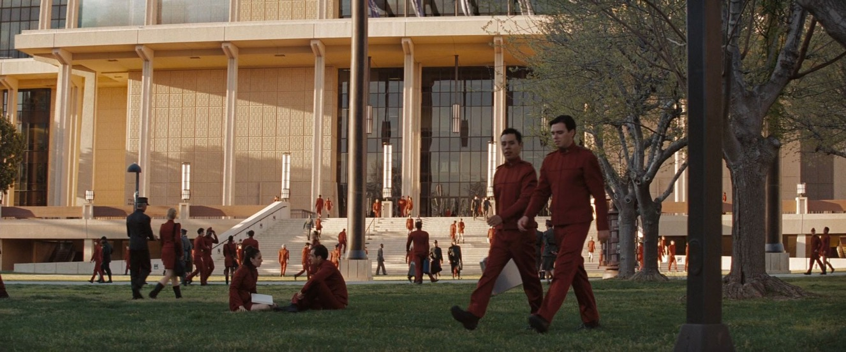
Ubi
UCIC

Slide 17
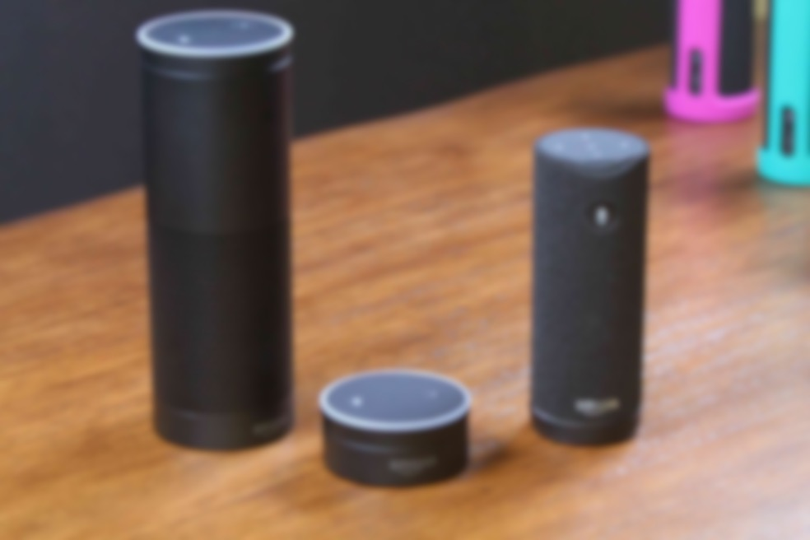


Slide 18
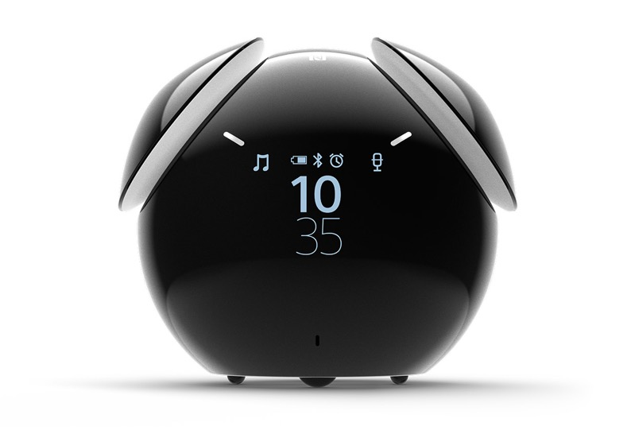

Slide 19
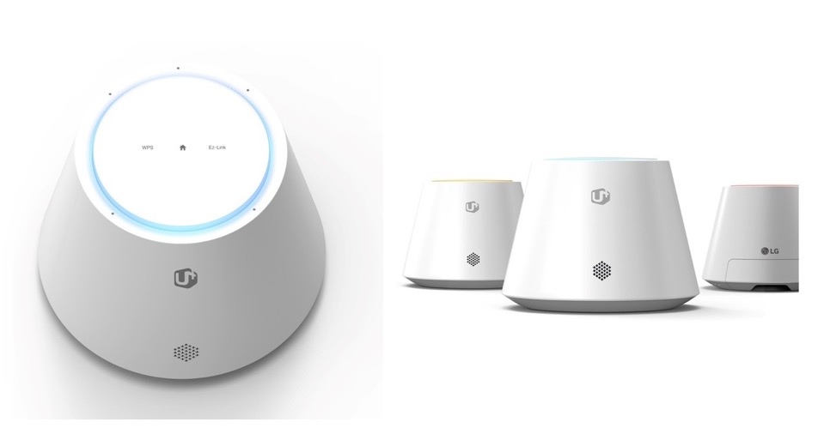

Slide 20
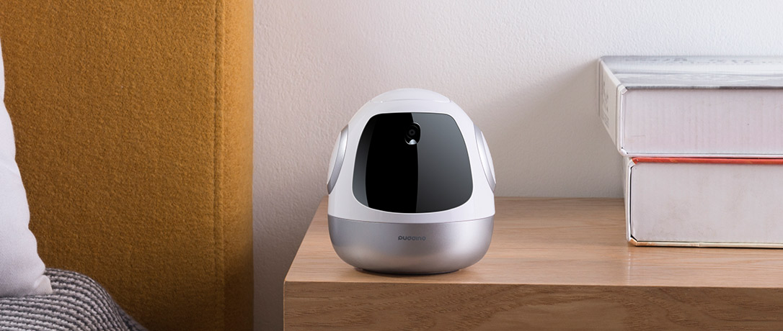

Slide 21
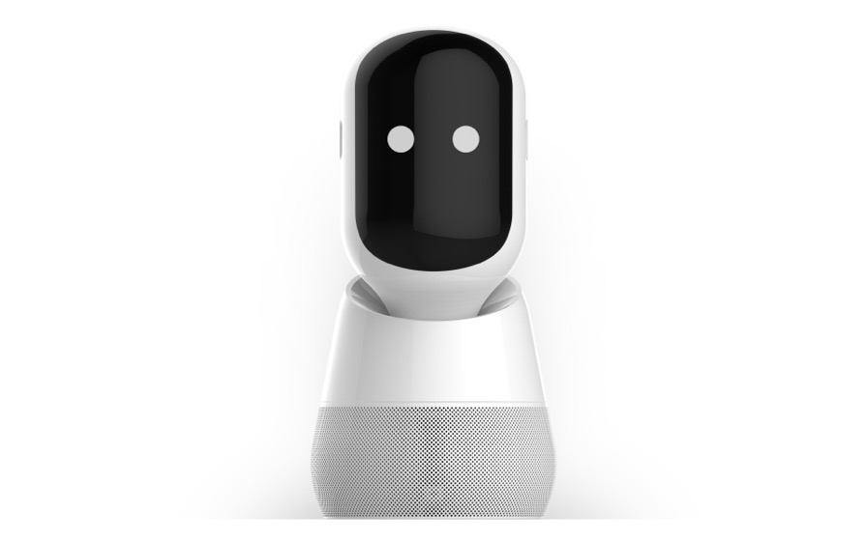

Slide 22
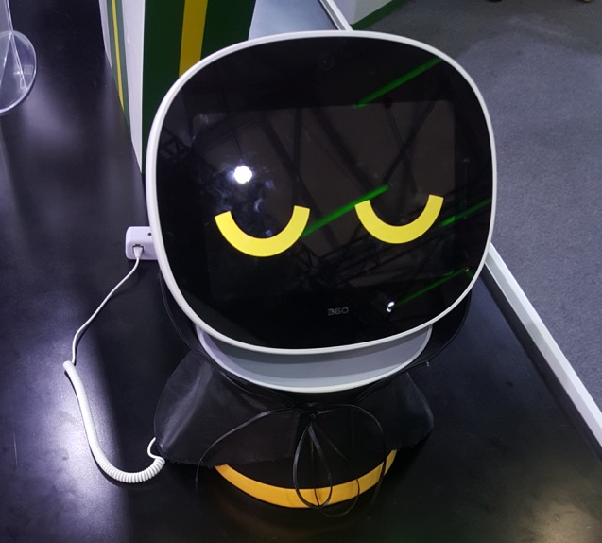

Slide 23
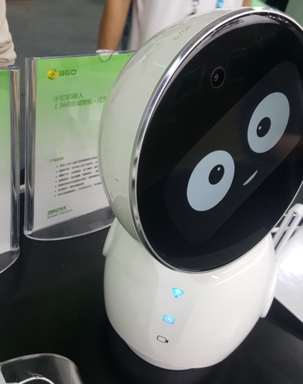

Slide 24
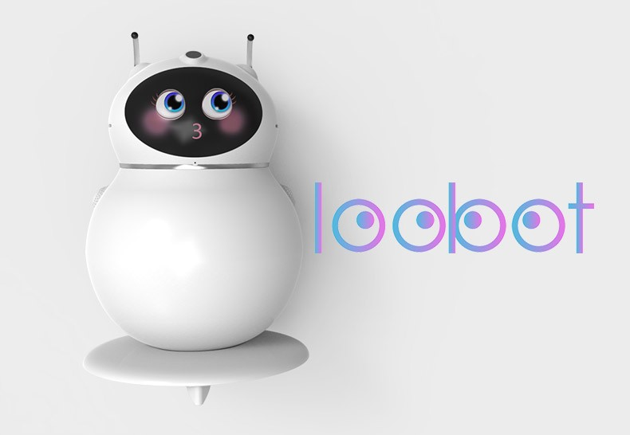

Slide 25
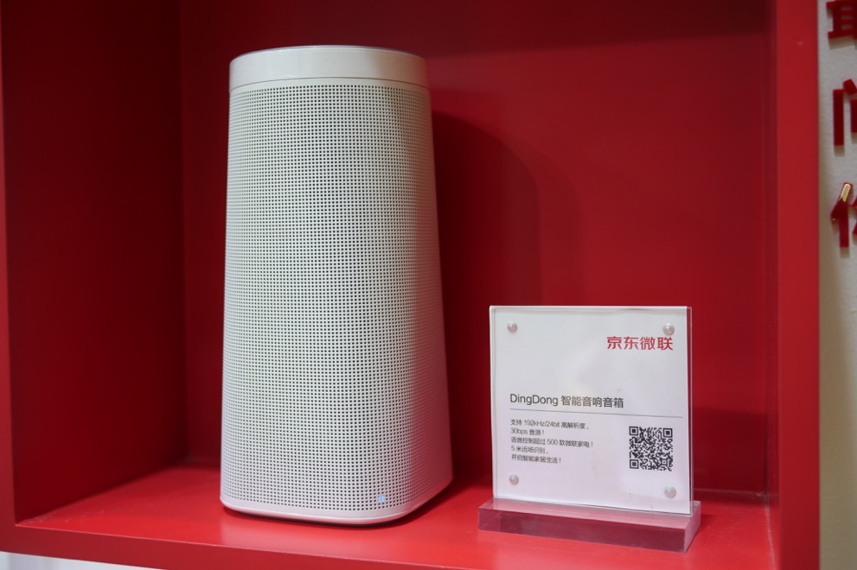

Slide 26
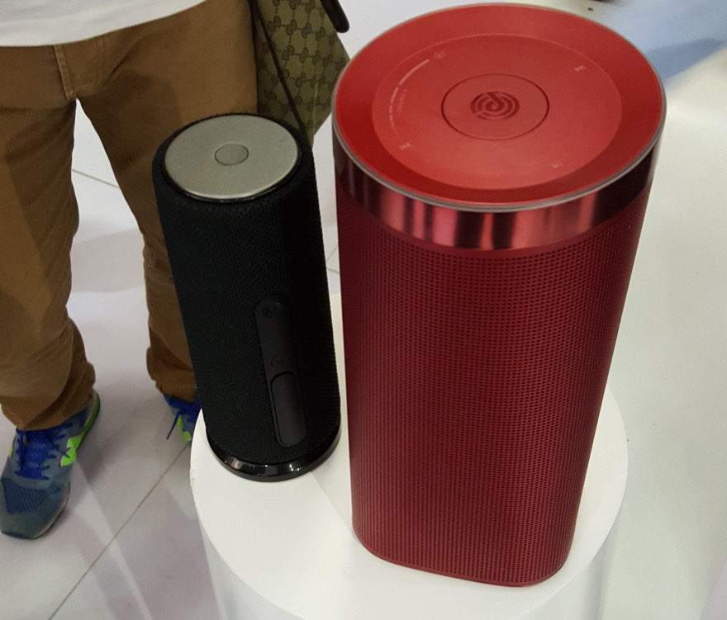

Slide 27
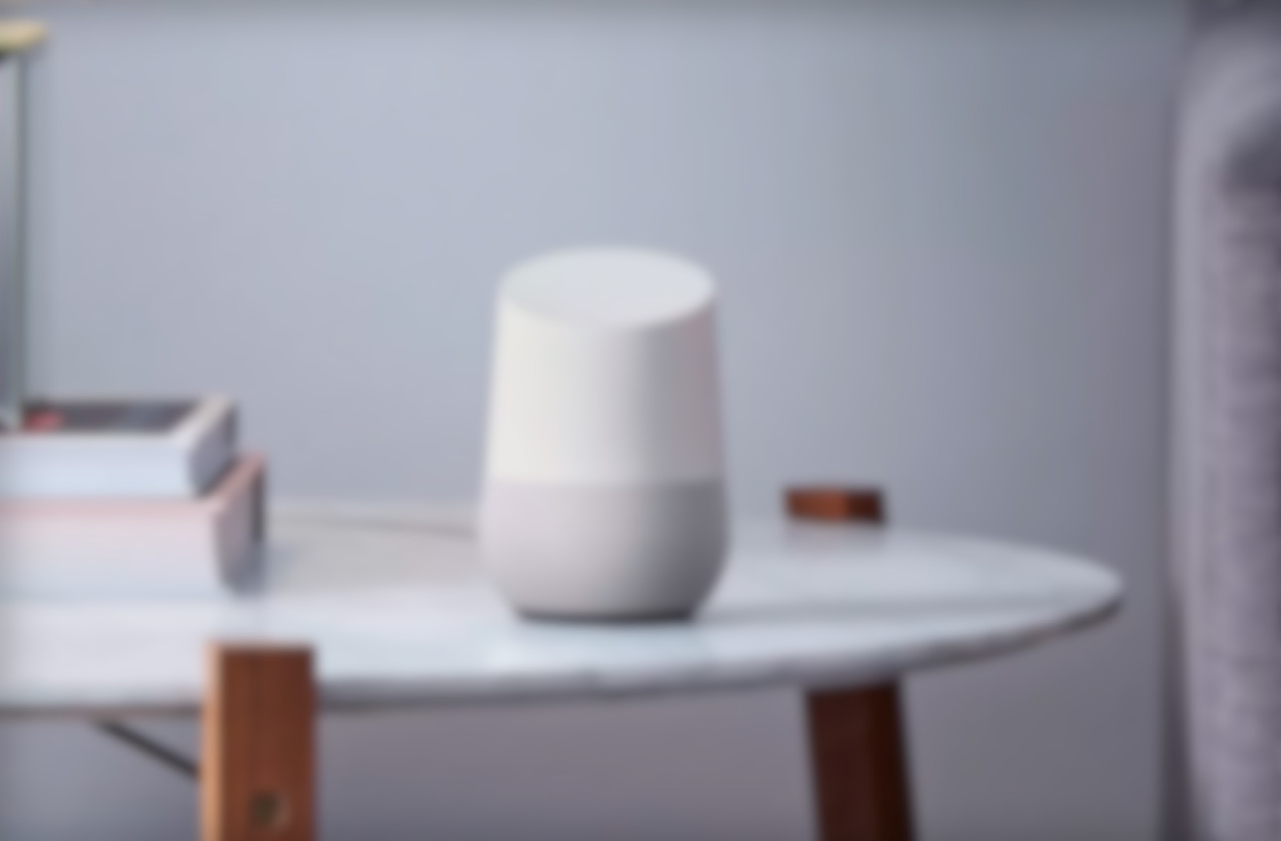
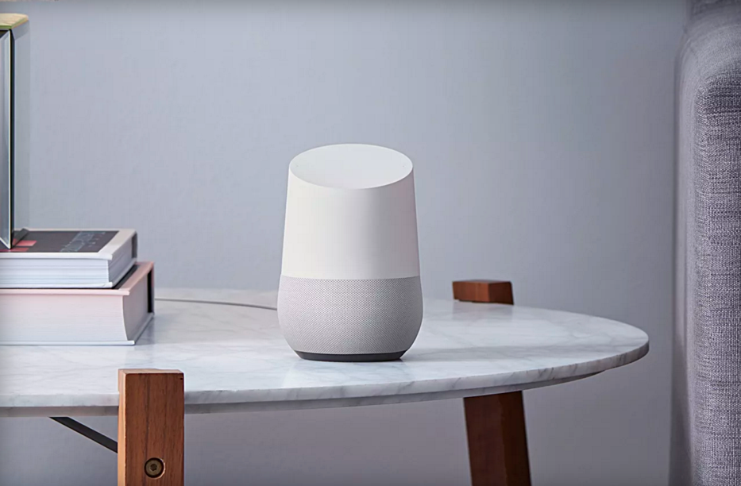

Slide 28
Trends

Slide 29




Slide 30





Slide 31





Slide 32
Advancing Tech

Slide 33
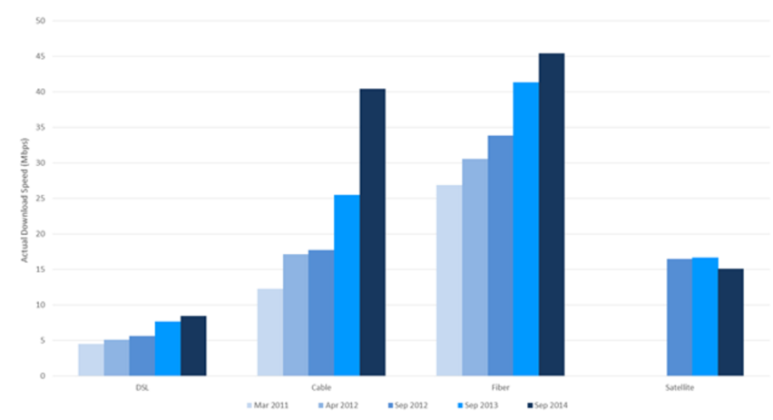


Slide 34
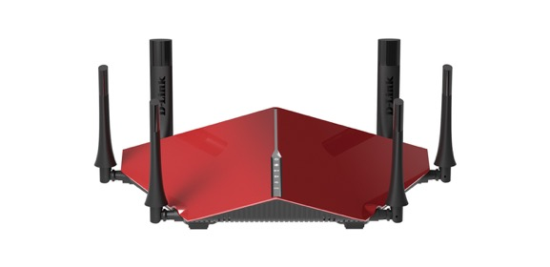
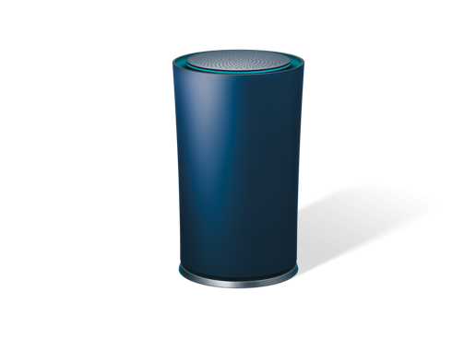

Slide 35
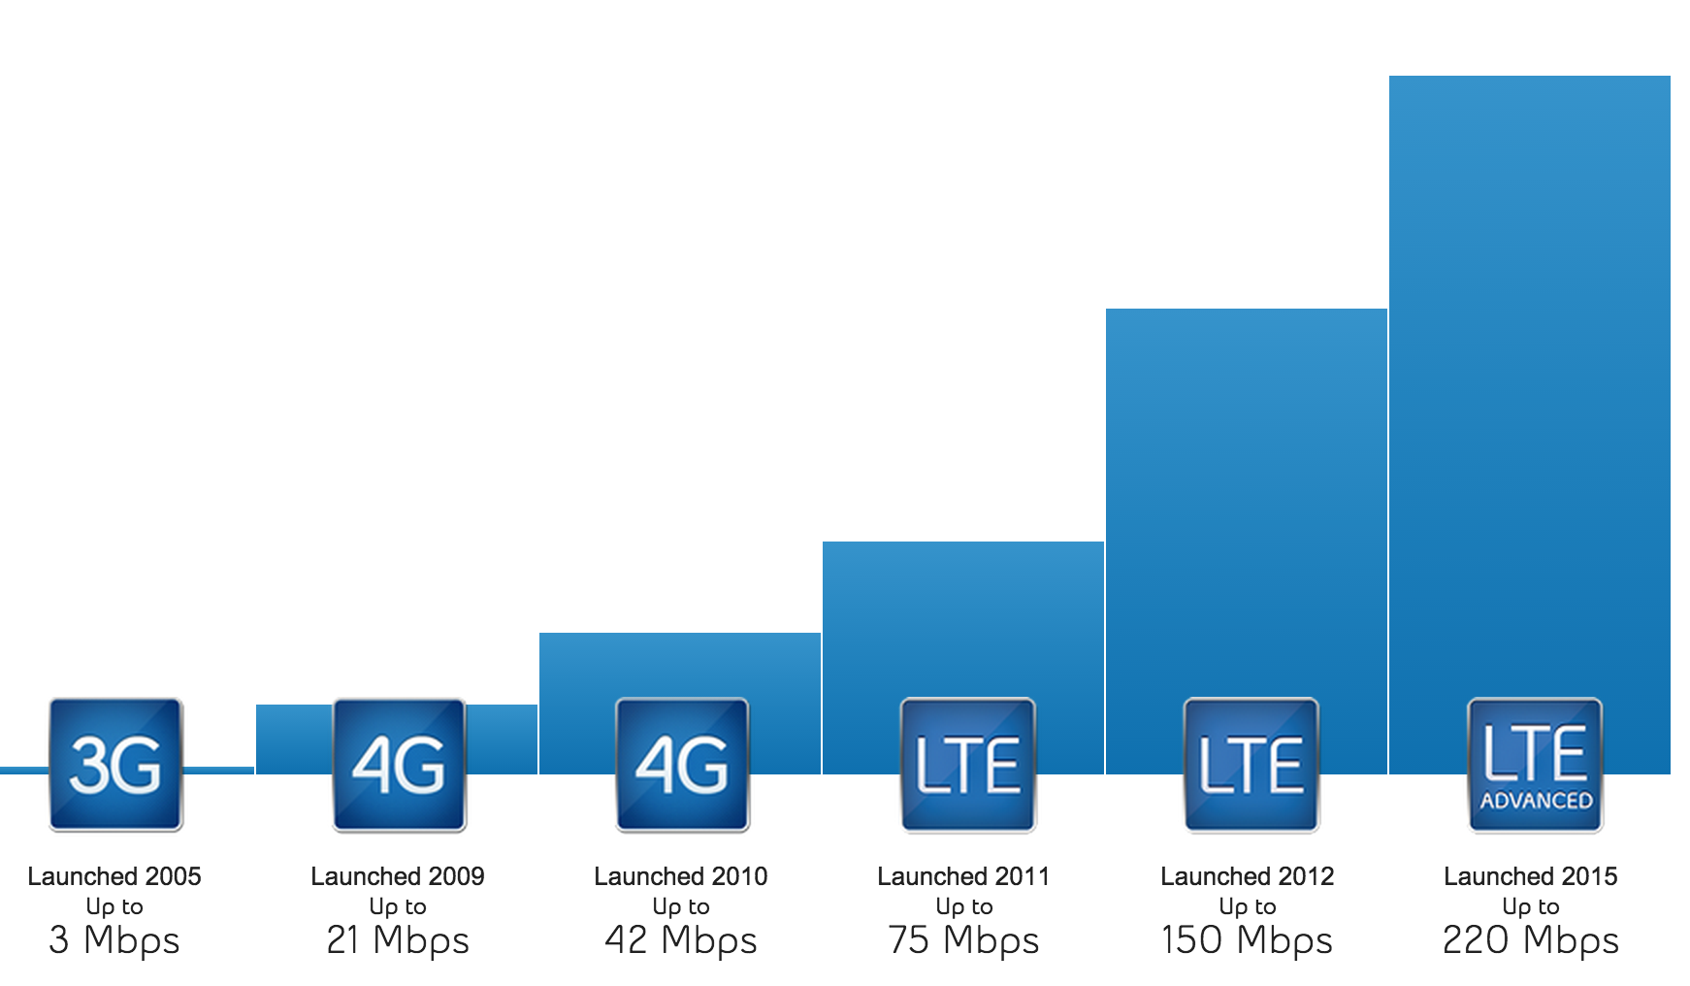

Source: Mobile Syrup

Slide 36
Speech → Intent

Slide 37
Classifiers

Slide 38
Next 5 Years

Slide 39
Far Field ASR

Slide 40
Miniaturization

Slide 41
New Models

Slide 42
New App Store

Slide 43
Next 10 Years

Slide 44
Biometrics

Slide 45
Device-Free

Slide 46

TTS:
Leaving Uncanny Valley

Slide 47
Challenges &
Opportunities

Slide 48
leor@ucic.io

