Slide 1
4th Asia Pacific Congress & Expo on Dental and Oral Health July 27-29, 2015 Brisbane, Australia
Associate Professor Leonie M. Short
Innovative Educational Approach for Oral Health Therapy Education in Australia

Slide 2
Content
Oral health therapy
Introduction
Australia
Philosophy
Curriculum
Clinical placements
Lessons learnt
Plan for the future
Conclusion
Questions
Contact details

Slide 3
Oral health therapist
A dual-skilled oral health professional that combines the disciplines of dental therapy and dental hygiene in a contemporary and innovative manner.
Dental therapy – copied from Great Britain and New Zealand and spread across Commonwealth countries (Singapore, Malaysia and Hong Kong).
Dental hygiene – originated and strong in Europe and North America (Canada and USA).
Oral health therapy – the Netherlands.

Slide 4
Introduction
This paper outlines the development of the Bachelor of Oral Health degree at the CQUniversity in Rockhampton from 2010 to the present.
This three-year degree trains and educates graduates to perform preventive and operative dentistry on patients of all ages within a defined scope of practice.
Maximum of 30 students each years (HSC and STEPS with a telephone interview).

Slide 5
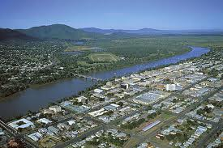
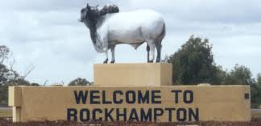
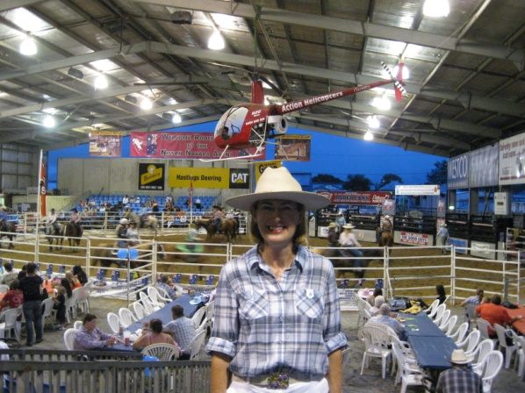
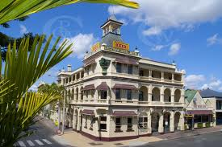
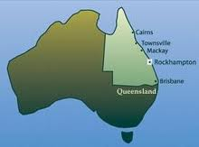
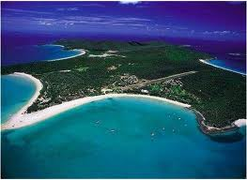
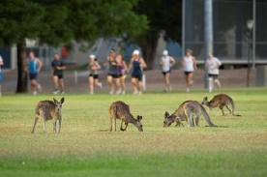
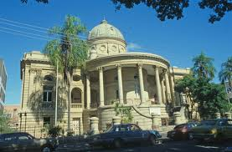

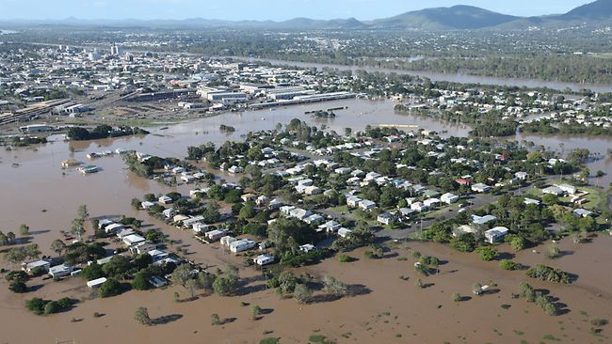
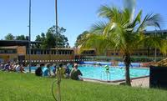

Slide 6
Australia
It is only one of three oral health degrees in Australia and New Zealand to be accredited for adult scope of practice:
  La Trobe University, Victoria
  CQUniversity, Queensland
  University of Newcastle, NSW
Post-graduate qualifications:
  University of Melbourne
  University of Adelaide

Slide 7
Philosophy
The program does not sit alongside dental programs; it sits alongside programs in medical science, sonography, medical imaging, chiropractic and paramedic science as well as nursing, speech pathology, podiatry, physiotherapy and occupational therapy.
What we don’t have in terms of being part of a dental school, we make up for with a focus on interprofessional education and practice with allied health and nursing.

Slide 8
Curriculum
The curriculum aims to foster a collaborative approach to clinical practice with oral health students studying and learning with, about and from students from other disciplines.
Interprofessional education (IPE) and practice (IPP).
In this way, links between oral health and general or systemic health are made in terms of patient-centred care.

Slide 9
Clinical Placements
We can organise placements in our small oral health program that would be difficult to implement in a larger program in the city.
An innovative education approach for oral health therapy students at CQUniversity can be illustrated by clinical placements in residential care facilities and in the CQUniversity Health Clinics.

Slide 10
Lessons Learnt
Telling me that I can’t do it was not helpful; but having so many people helping me was a huge benefit. I had the experience, networks and drive to make it happen.
Being patient and waiting for non-supporters to move on was crucial to our success. Only work with nice people....
Planning the curriculum for the future, not the present was a key factor.
The University allowed for, and provided, the best facilities, equipment and instruments for the students.
Understanding that is takes a village to develop and deliver an oral health therapy program.

Slide 11
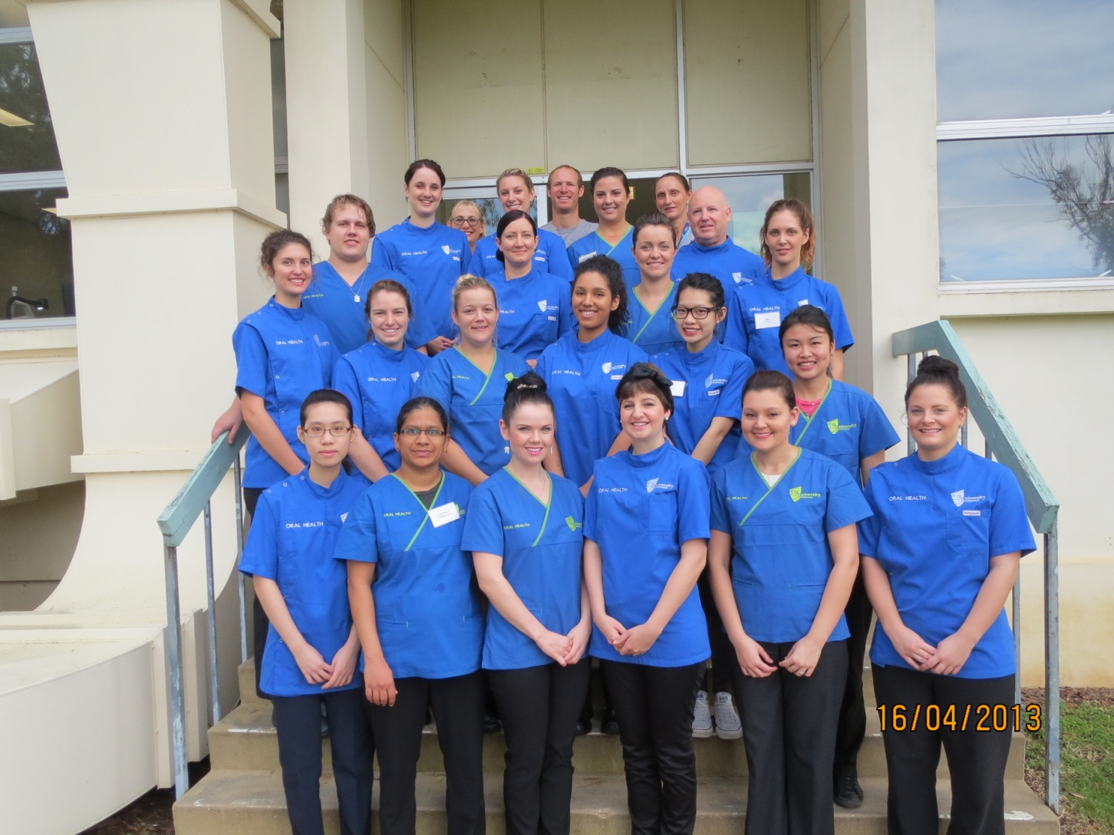
Cohort of First Year Students

Slide 12
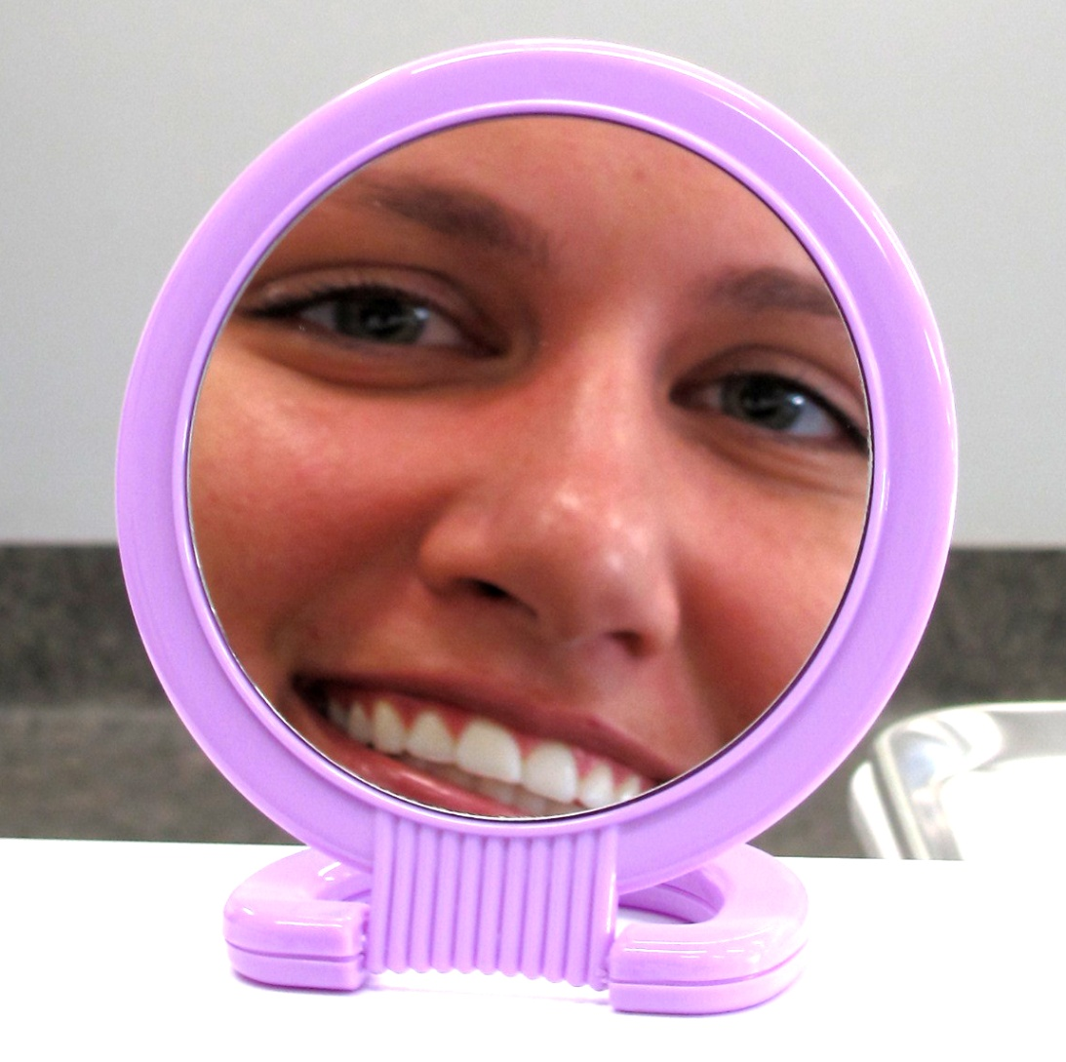
Indigenous Graduates and Students

Slide 13
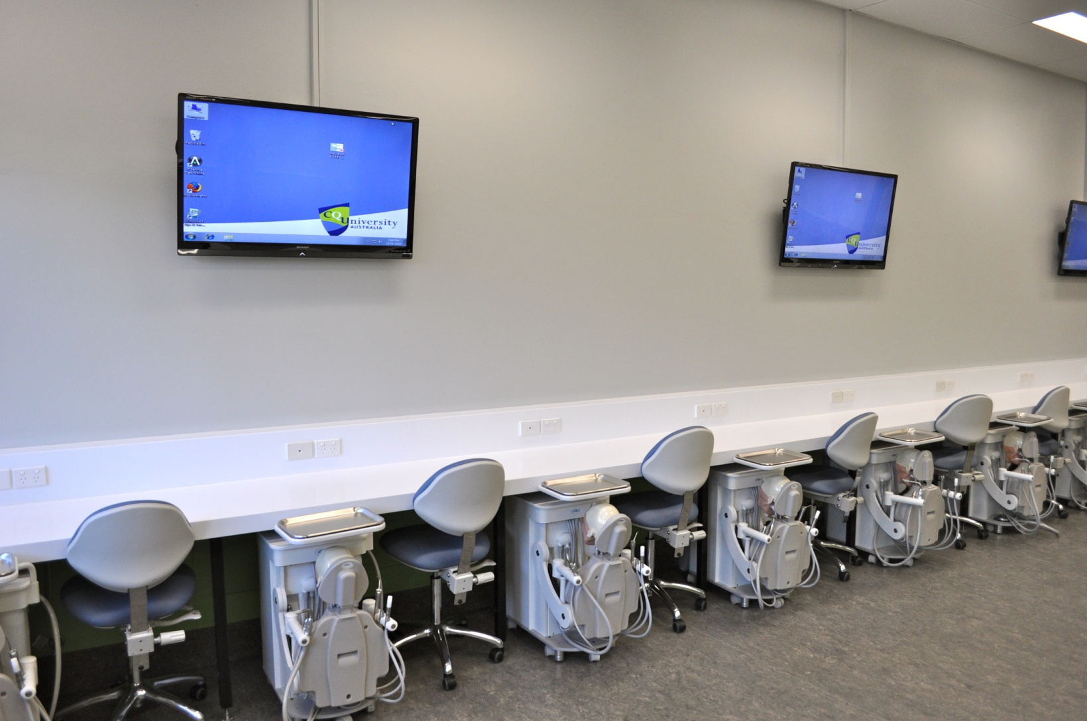
Oral Health Simulation Laboratory

Slide 14
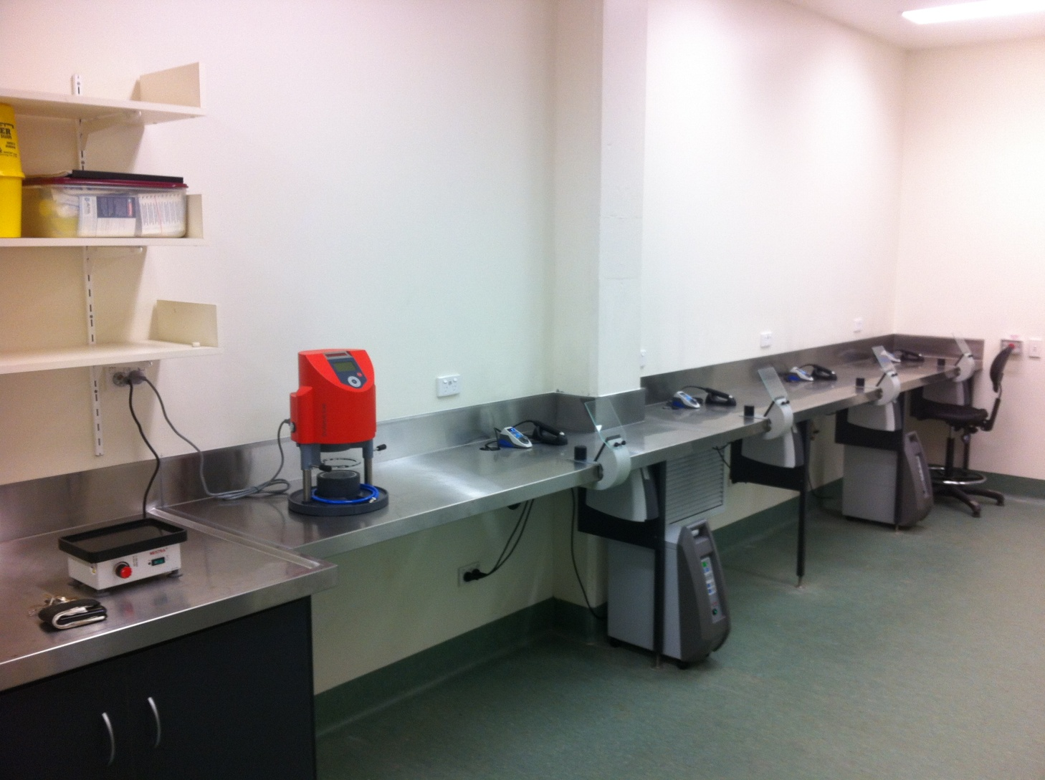
Oral Health Prosthetic Laboratory

Slide 15
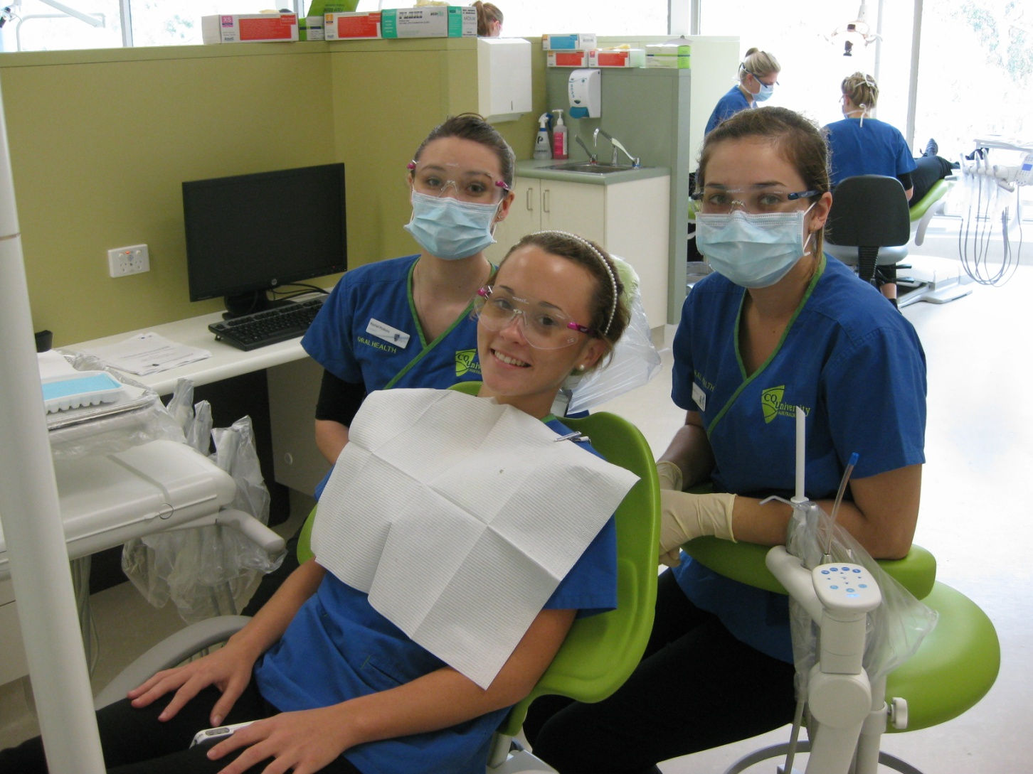
CQH&HS Chronic Disease Clinic at CQUniversity

Slide 16
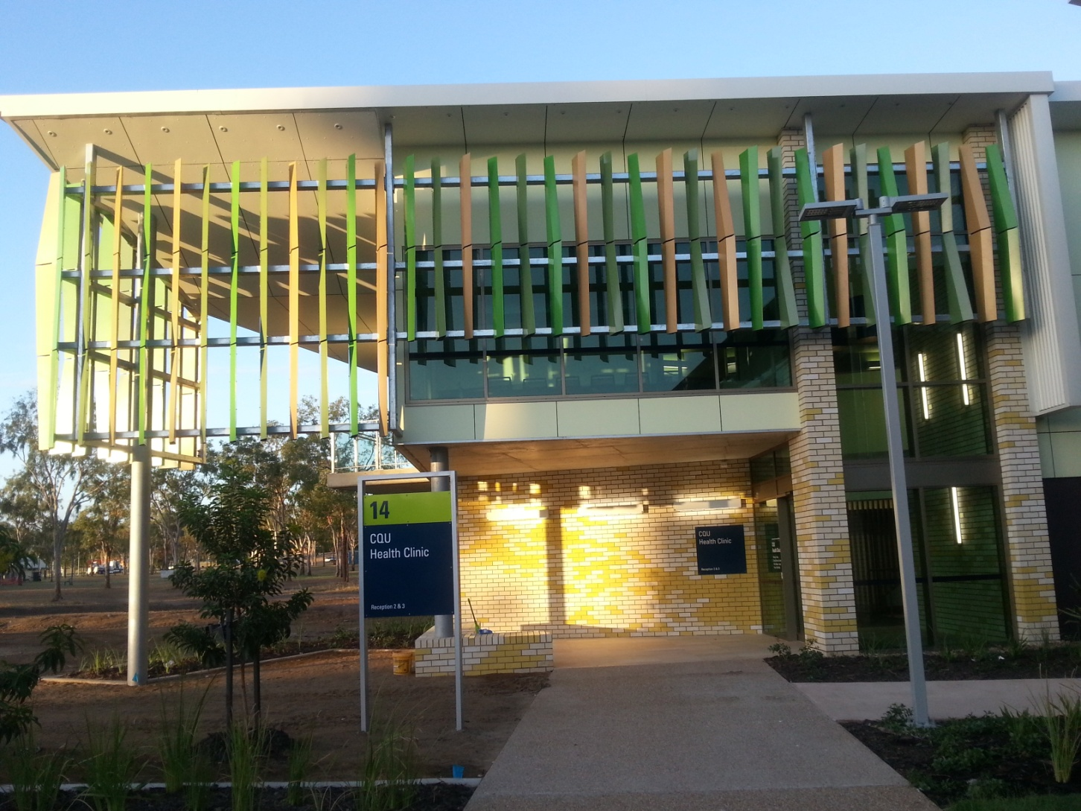
Private Health Clinic at CQUniversity

Slide 17
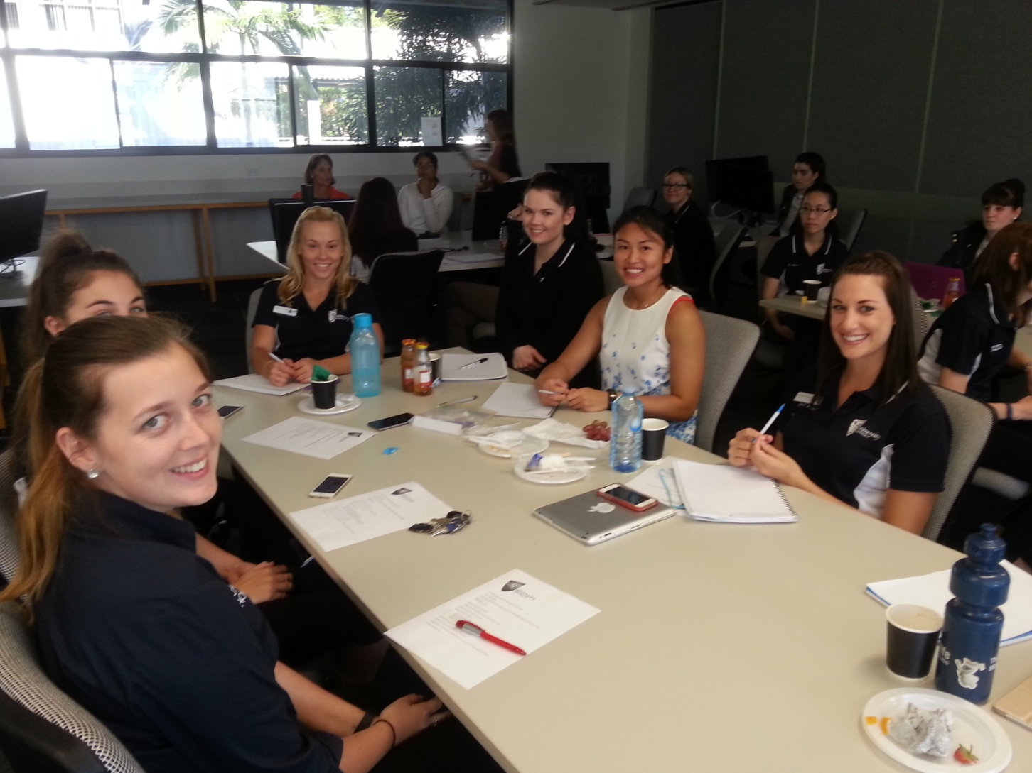
Interprofessional Education with Speech Pathology

Slide 18
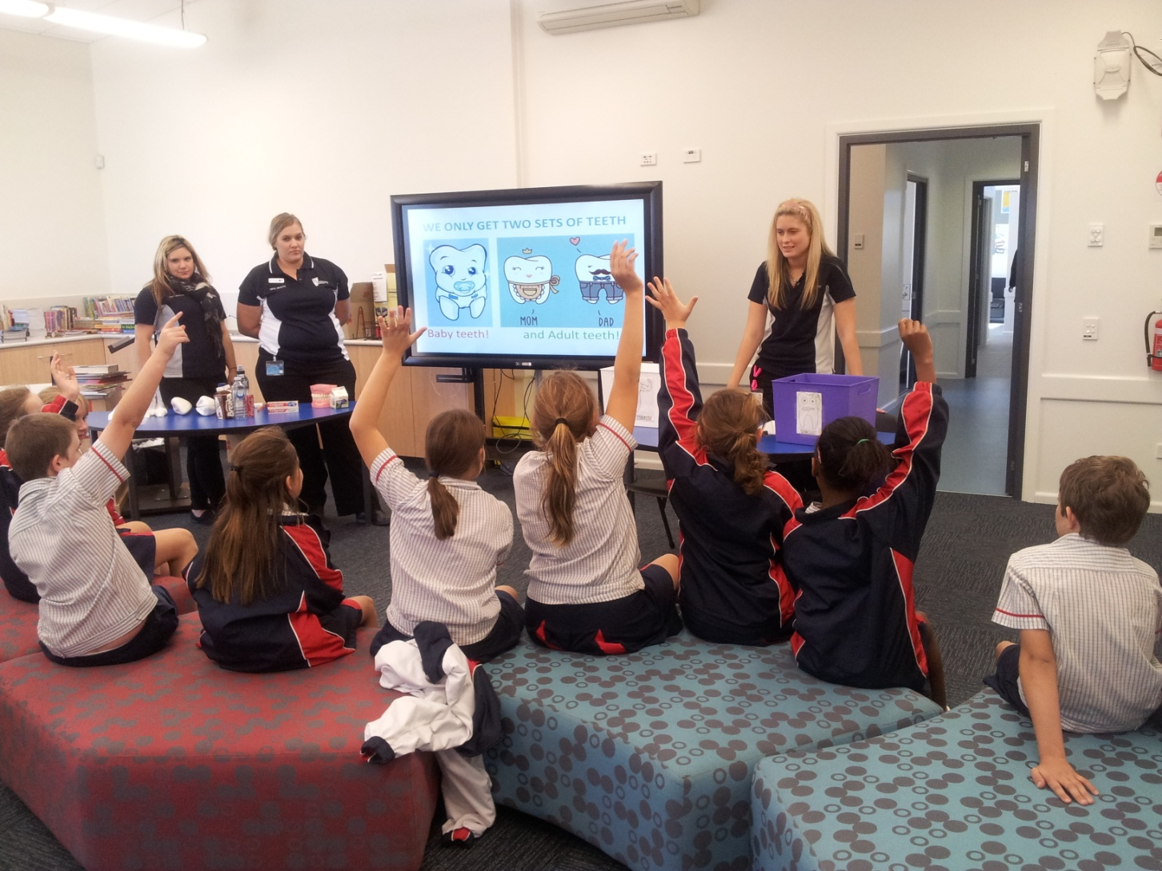
Rural Clinical Placement to Emerald, Springsure and Clermont

Slide 19
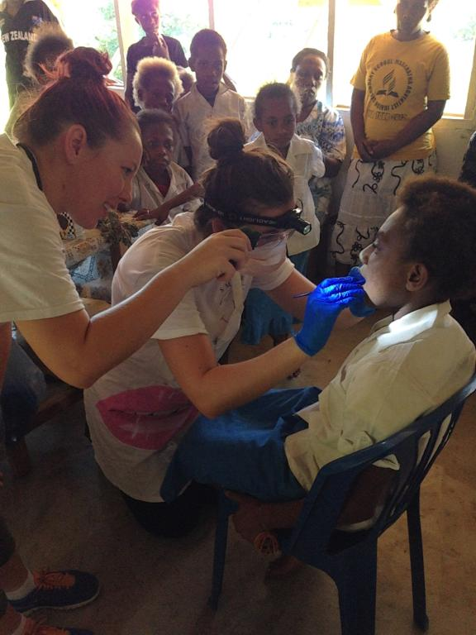
Clinical Placement to Vanuatu

Slide 20
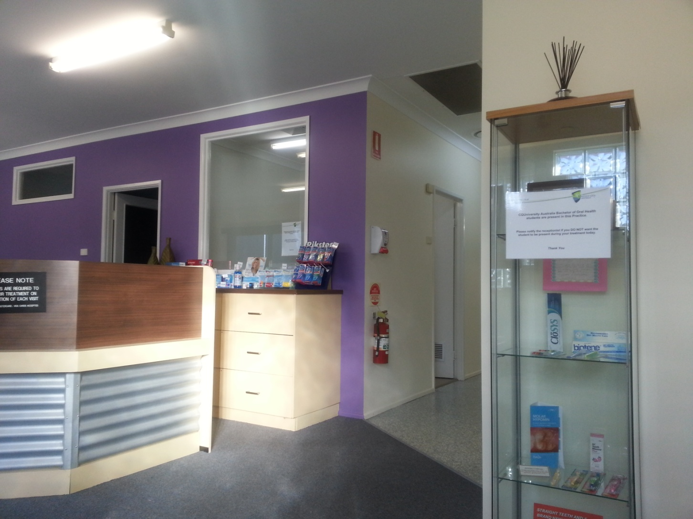
Private Dental Practices

Slide 21
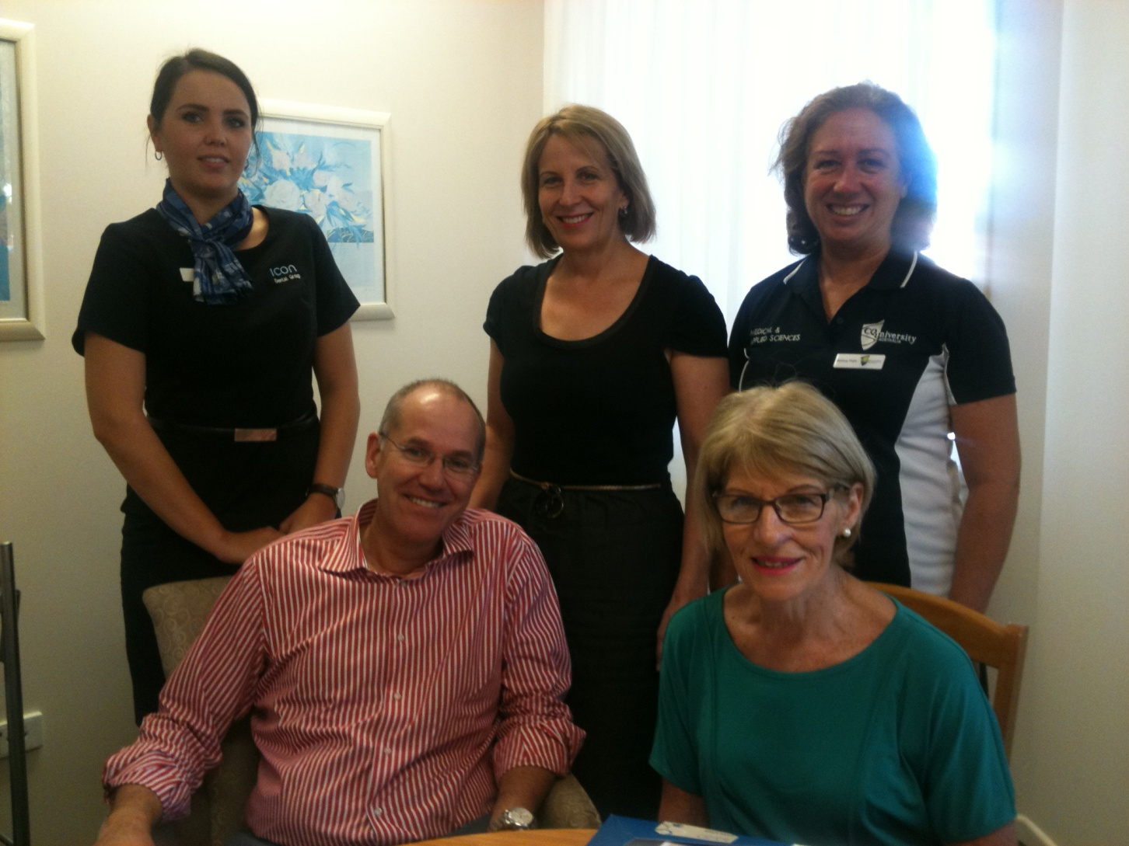
Residential Care Facilities (Nursing Homes) with Icon Dental Group

Slide 22
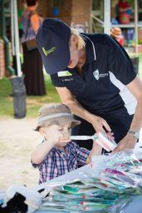
Child Care Centre

Slide 23
Plans for the Future
Refining and improving the BOralHlth program.
Continuing Professional Development (CPD) courses (online and face-to-face).
TAFE courses (RTO).
International students (max. of 2 each year).
International partnerships.

Slide 24
Conclusion
New oral health programs can be established in regional areas of Australia with a lot of help from a lot of people.
There is a real opportunity to adopt an innovative educational approach in a setting which could otherwise be viewed as ‘traditional’ and ‘conservative’.
I’d encourage others to provide teaching and learning experiences which better equip graduates for contemporary clinical practice.

Slide 25
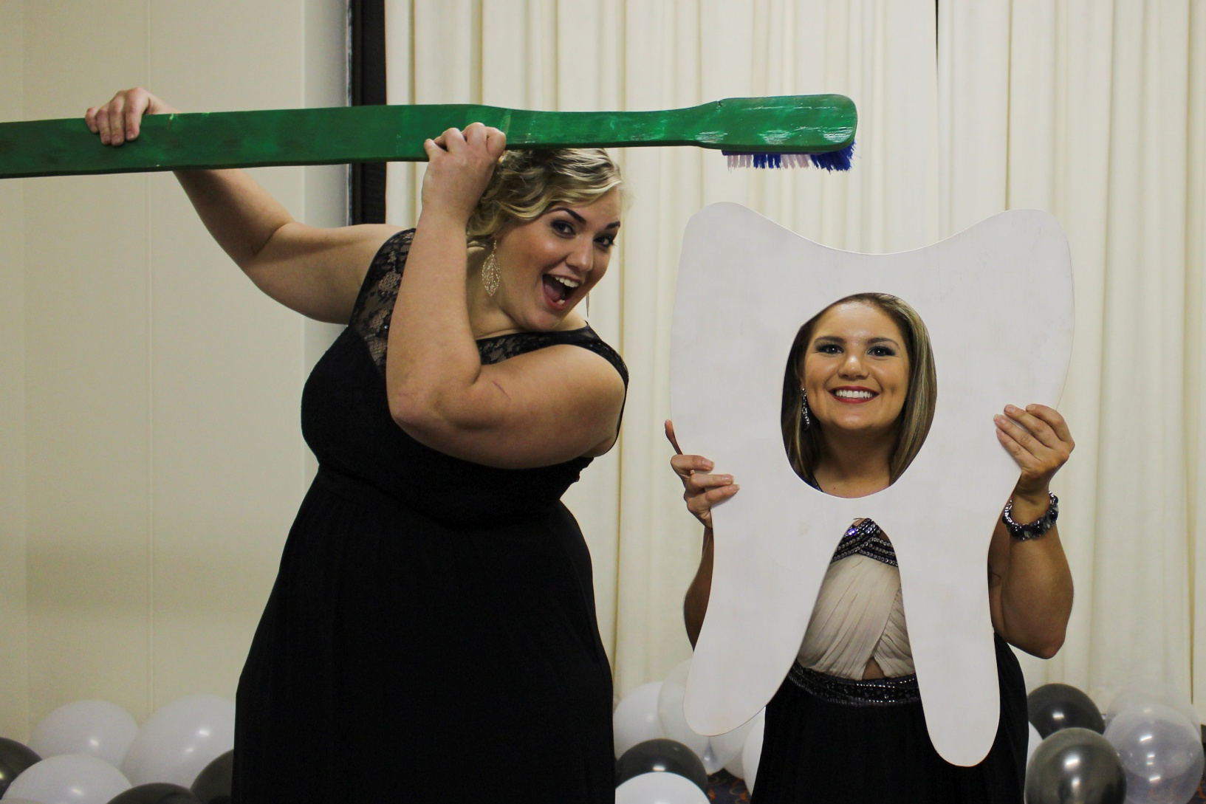
Graduation Ball August 2014

Slide 26
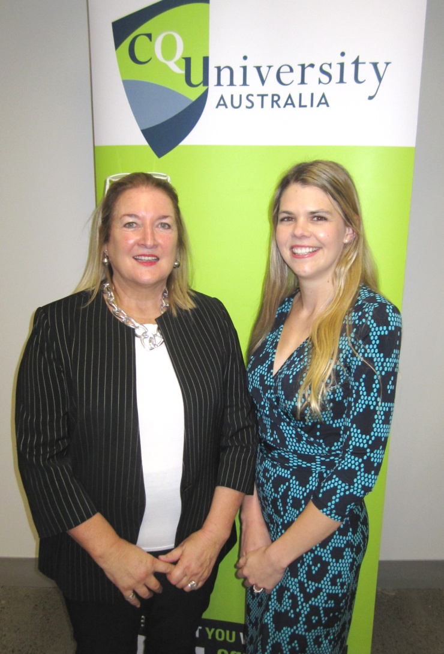
Scholarships and Awards with Corporate Partners July 2015

Slide 27
Questions

Slide 28
Contact Details
    Associate Professor Leonie M. Short
    Discipline Lead for Oral Health
    School of Medical and Applied Sciences
    Building 6, Room 1.21
    CQUniversity
    Bruce Highway
    ROCKHAMPTON QLD 4702
    l.m.short@cqu.edu.au
    +61 (0)7 4923 2831 (tel)
    +61 (0)7 4930 9209 (fax)

